Slide 1
Graphs without Ontologies
Clifford Anderson
Suellen Stringer-Hye
Ed Warga
Vanderbilt University Library
@suellenshye
@mrwargames @andersoncliffb

Slide 2
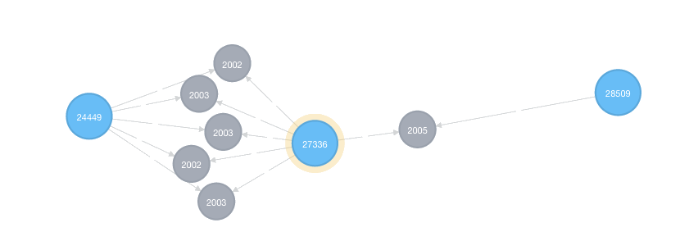
What is a Graph?
A graph is a representation of a set of objects where some pairs of objects are connected by links.*
*at least according to Wikipedia

Slide 3
Directed Property Graph
Properties
Node
(Vertex)
Node
(Vertex)
Relationship (Edge)
Properties
Properties

Slide 4
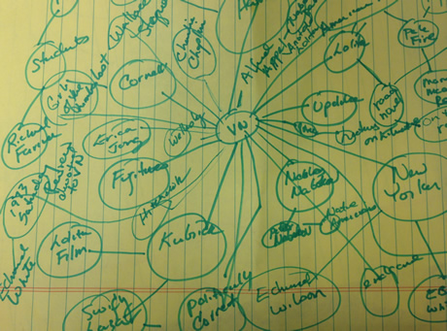
Modeling the Graph

Slide 5
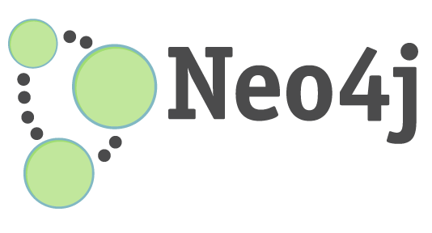
Neo4J
Native Graph Database
ACID-Compliant*
Primarily Written in Java/Scala
Open Source:
Community Edition: GPLv3
Enterprise Edition: AGPLv3
Two Versions
Neo4j Embedded
Neo4j Server
*Atomicity, Consistency, Isolation, Durability

Slide 6
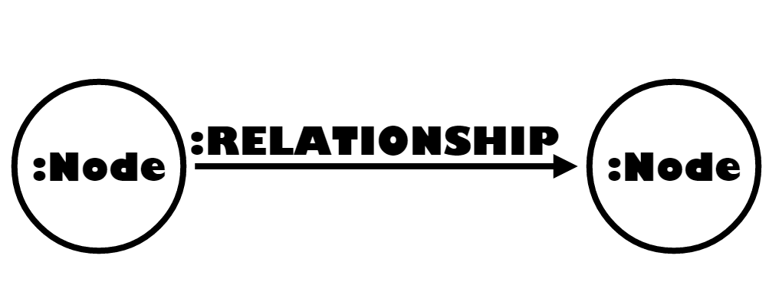
Pattern Matching
match (a:Node)-[r:RELATIONSHIP]->(b:Node) return a,r,b

Slide 7
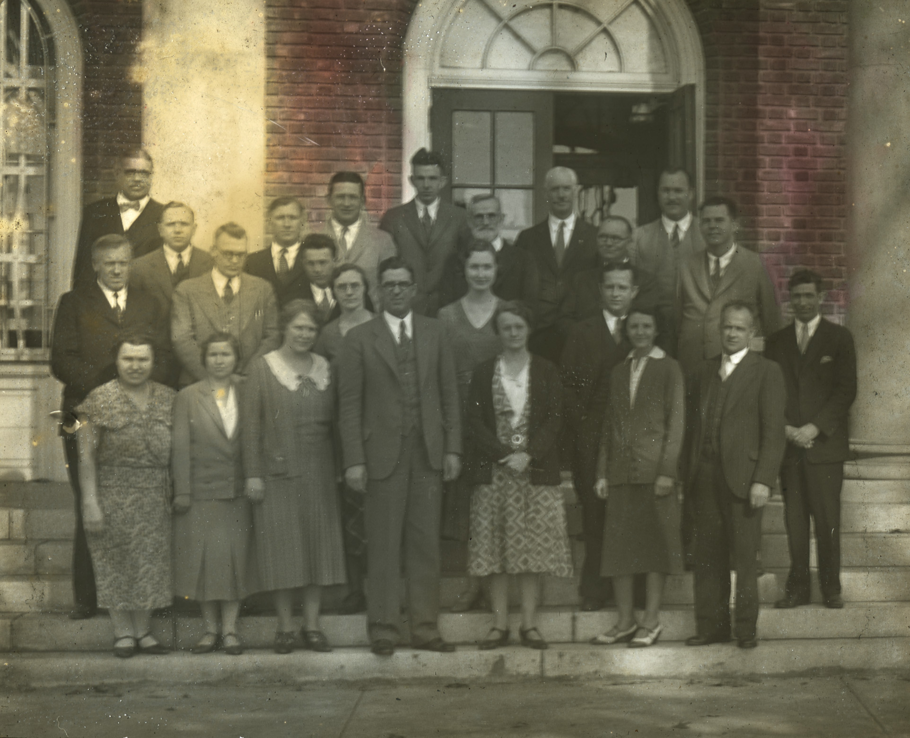
Scholarly Patterns
Notes:
“Picture of a group of Elon College faculty in 1931-1932” by Belk Archives and Special Collections. https://www.flickr.com/photos/belkarchives/7365996856. License: https://creativecommons.org/licenses/by-nc/2.0/

Slide 8
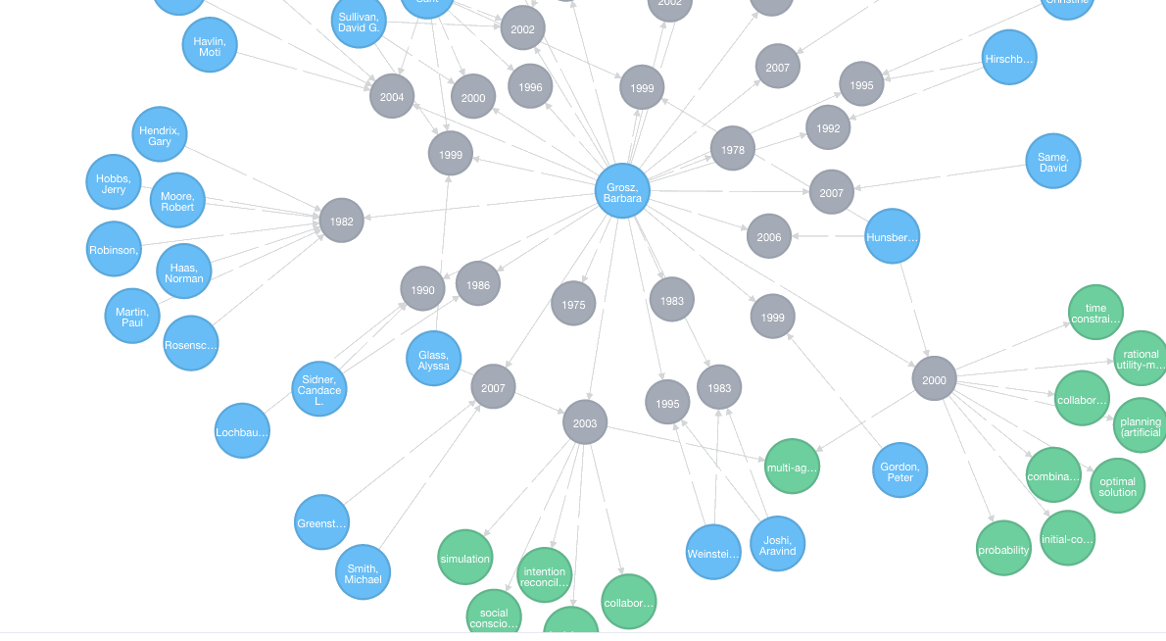
Graphing Faculty Interests

Slide 9




Analyzing IR Data

Slide 10
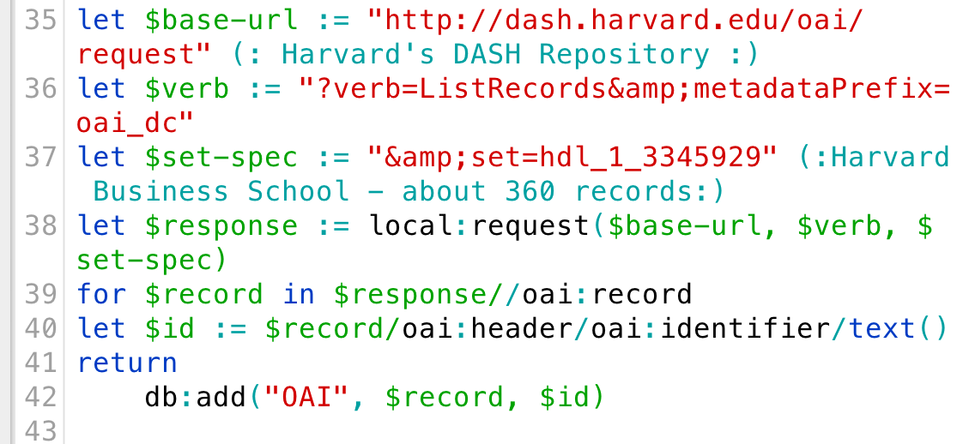
get-oai-data.xqy

Slide 11
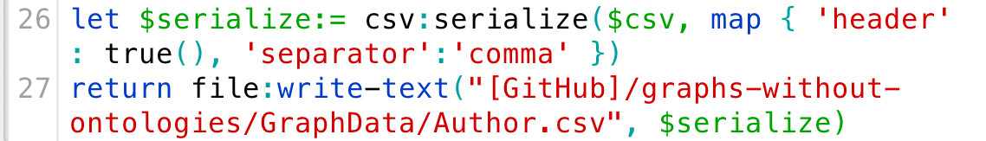
OAI => CSV

Slide 12
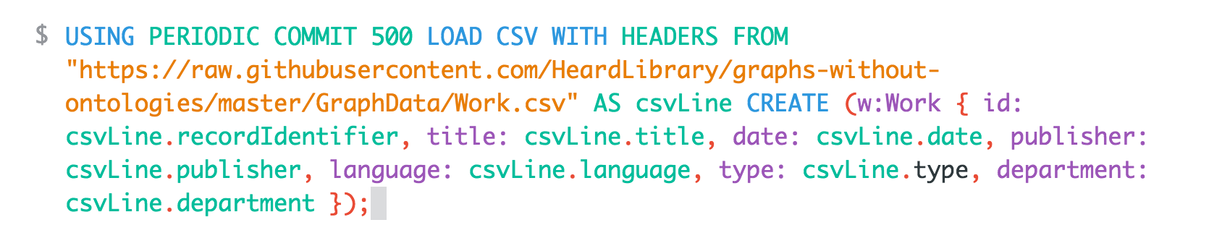
Load Data in Neo4j

Slide 13

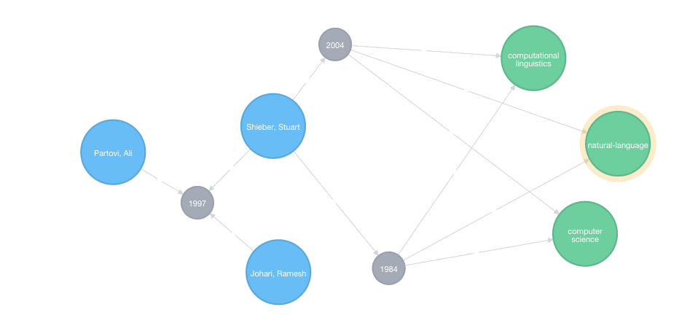
Data Model

Slide 14
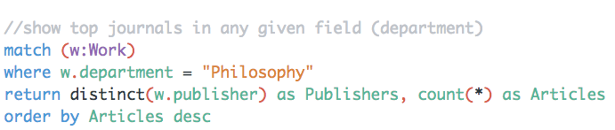
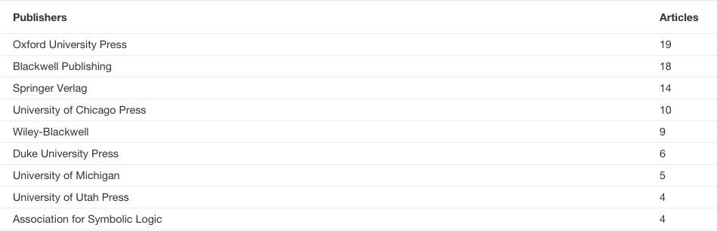
Top Journals in Philosophy

Slide 15
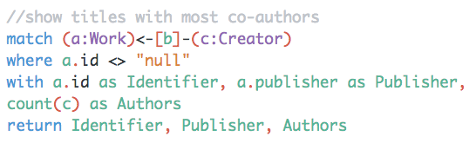
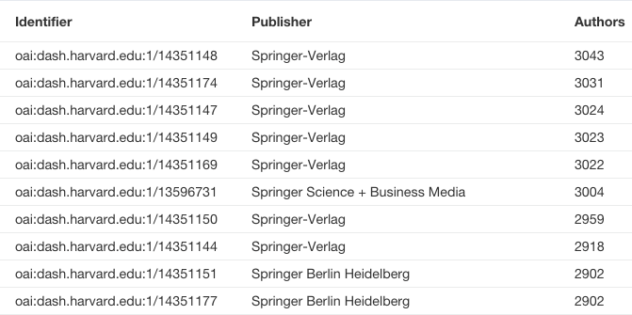
Show Papers with Most Co-Authors

Slide 16
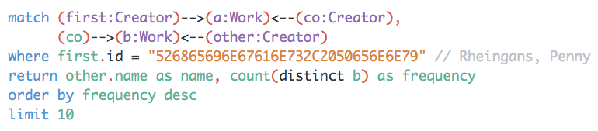
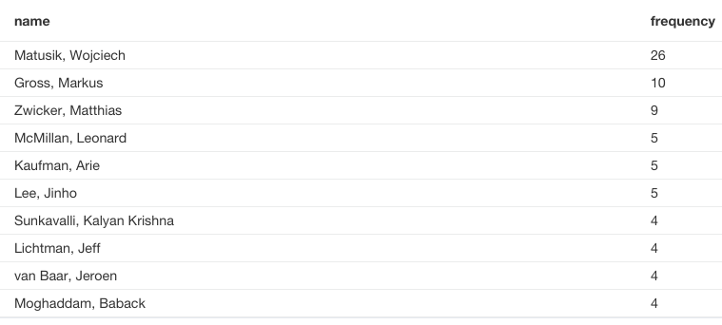
Recommendation Engine
Notes:
This query is adapted from Building a Recommendation Engine with Cypher in Two Minutes (http://neo4j.com/developer/guide-build-a-recommendation-engine/)

Slide 17
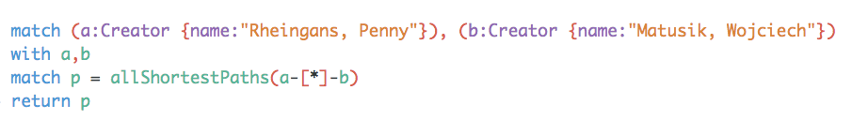
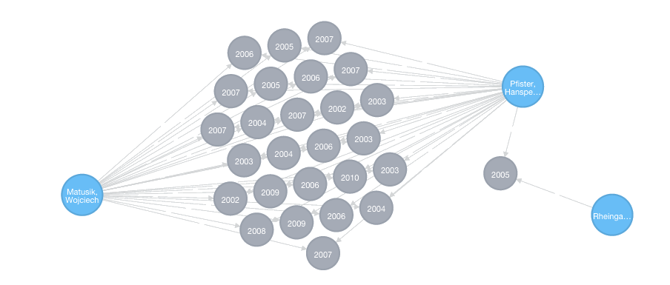
Recommendation Engine
Notes:
This query is adapted from Building a Recommendation Engine with Cypher in Two Minutes (http://neo4j.com/developer/guide-build-a-recommendation-engine/)

Slide 18
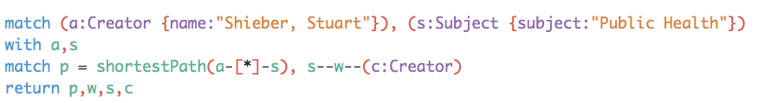
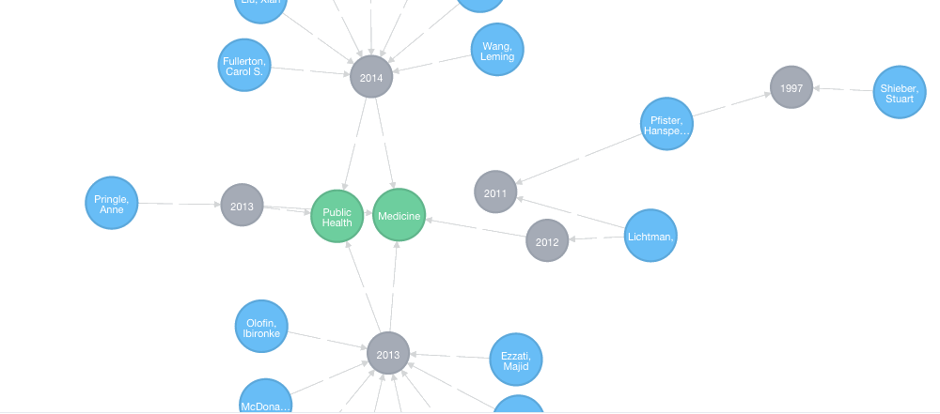
Shortest Path Analysis

Slide 19
Challenges & Prospects
Challenges
Authority control in repositories is inconsistent
Limited subject snalysis
How much metadata cleanup to perform?
Prospects
Gather data from all institutional repositories
Associate creators with ORCIDs
Develop more powerful recommendation tool

