Slide 1
Geoserver installation

Slide 2
Download Java SE Runtime Environment 7
Must be version 7; Geoserver not compatible with version 8
Install Java before installing Geoserver

Slide 3
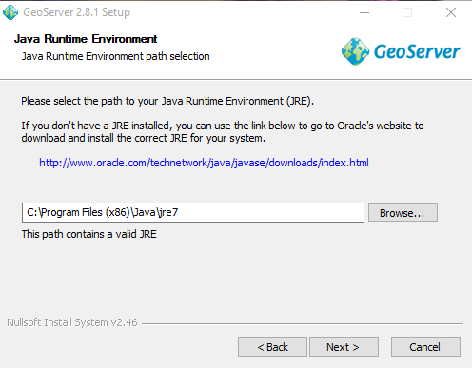

Slide 4
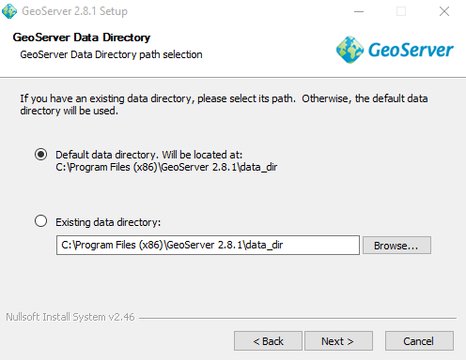

Slide 5
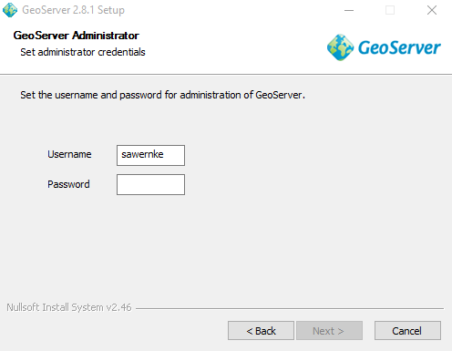
Username/pw Don’t do this—keep the defaults
admin
geoserver
Installation process appears to revert to default values (see below)

Slide 6
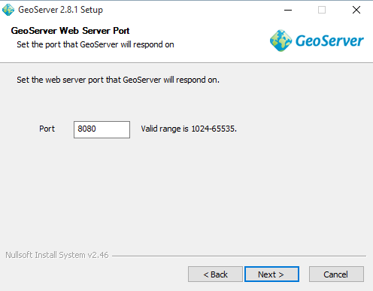

Slide 7
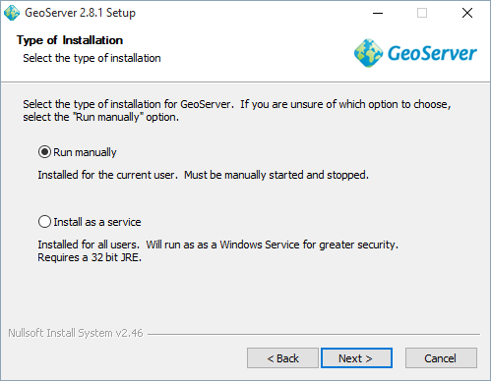

Slide 8
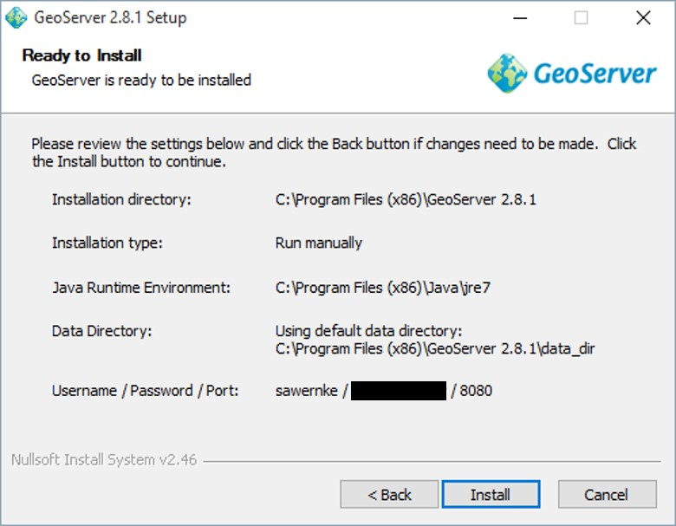
Final confirmation before install

Slide 9
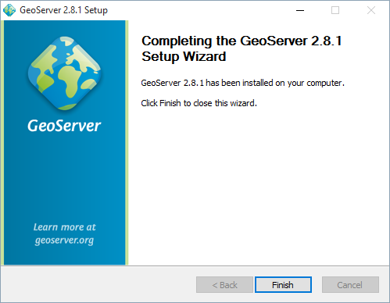
That’s it.

Slide 10
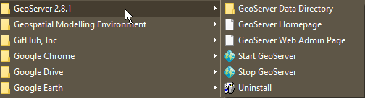
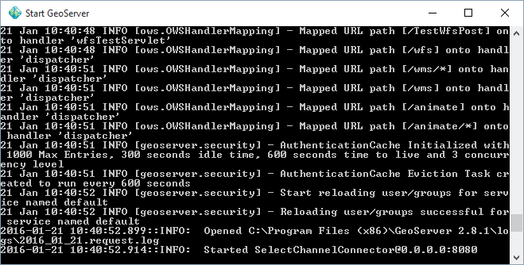
Start Geoserver

Slide 11
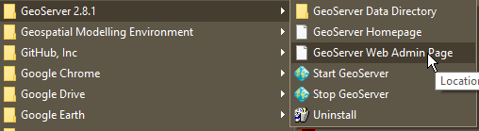
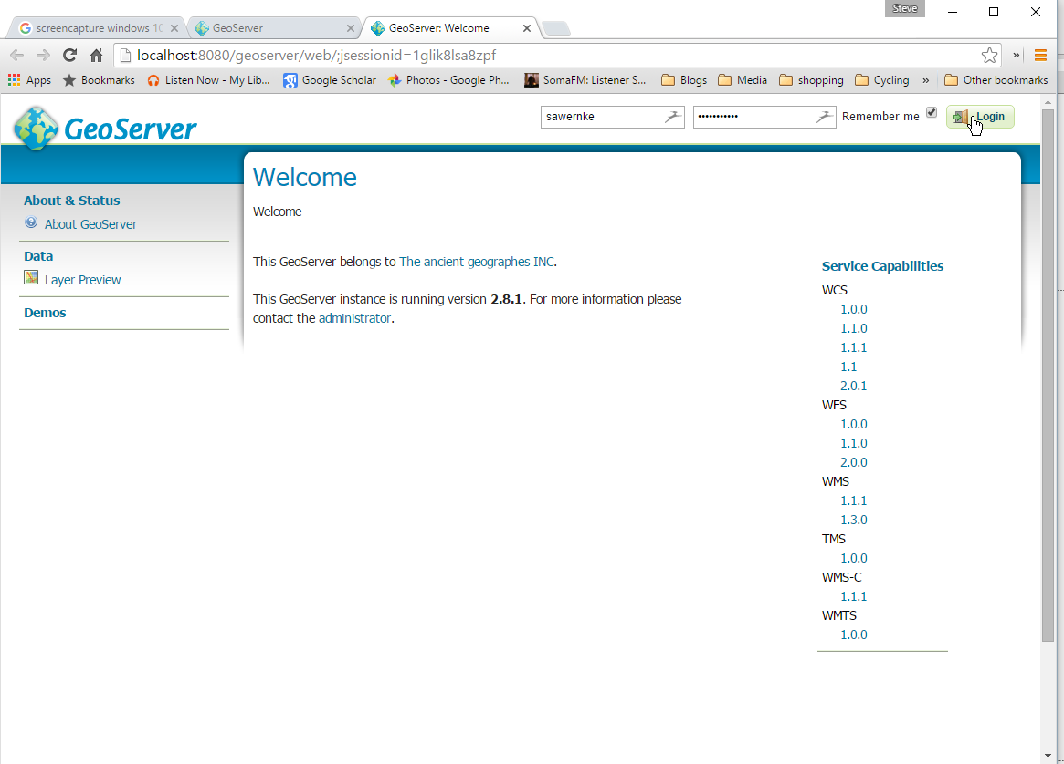
Open Geoserver Web Admin page & login
Throws username/pw error for non-default values
Enter
User: admin
Pw: geoserver

Slide 12
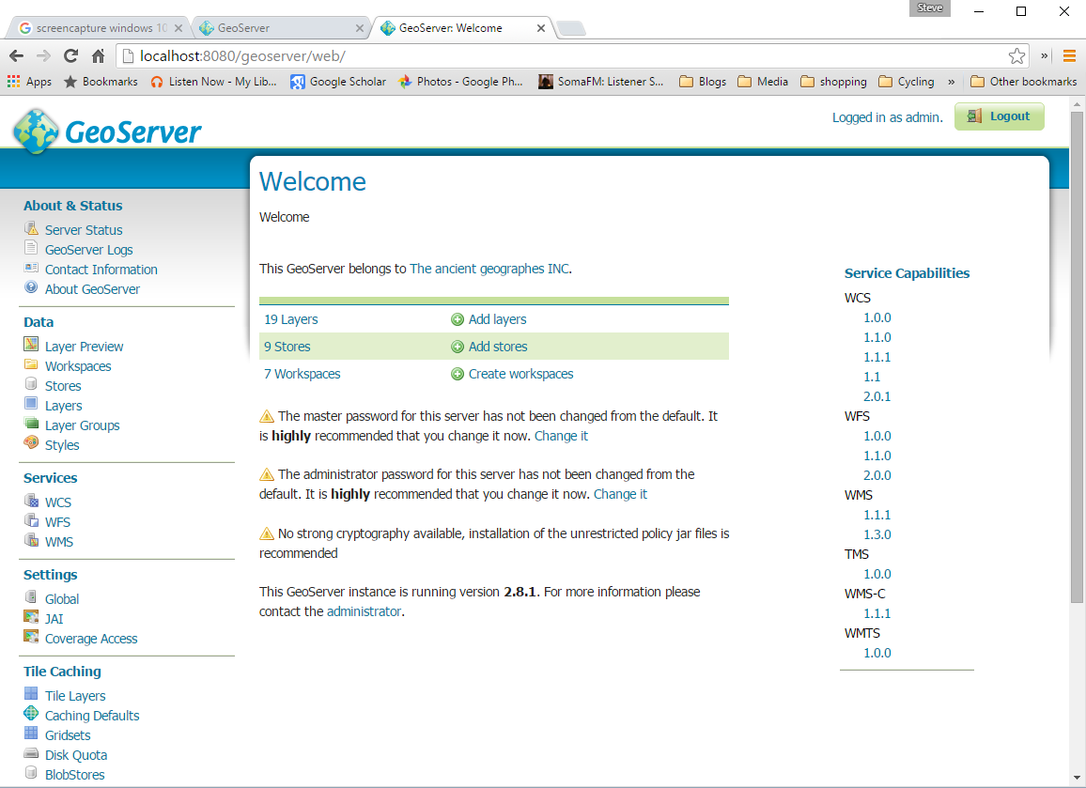
In!

Slide 13
Adding some data
EG I would like to link over to my PostGIS data
We can add a link to this data as a data “store” within the default “workspace”
So this requires a bit of understanding about data storage concepts within Geoserver. Hierarchically, they are Workspaces > Stores > Layers

Slide 14
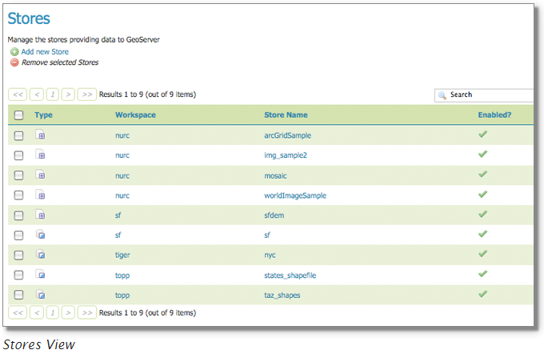
Stores
A store connects to a data source that contains raster or vector data. A data source can be a file or group of files, a table in a database, a single raster file, or a directory (for example, a Vector Product Format library). The store construct allows connection parameters to be defined once, rather than for each dataset in a source. As such, it is necessary to register a store before configuring datasets within it. (http://docs.geoserver.org/latest/en/user/webadmin/data/stores.html)

Slide 15
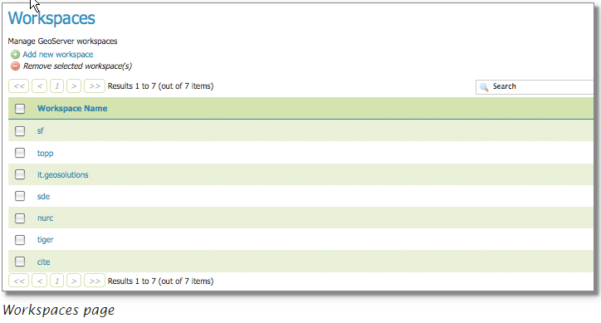
Workspace
Analogous to a namespace, a workspace is a container which organizes other items. In GeoServer, a workspace is often used to group similar layers together. Layers may be referred to by their workspace name, colon, layer name. Two different layers can have the same name as long as they belong to different workspaces.
http://docs.geoserver.org/latest/en/user/webadmin/data/workspaces.html

Slide 16
Layers
In GeoServer, the term “layer” refers to a raster or vector dataset that represents a collection of geographic features. Vector layers are analogous to “featureTypes” and raster layers are analogous to “coverages”. All layers have a source of data, known as a Store. The layer is associated with the Workspace in which the Store is defined.
In the Layers section of the web interface, you can view and edit existing layers, add (register) a new layer, or remove (unregister) a layer. The Layers View page displays the list of layers, and the Store and Workspace in which each layer is contained. The View page also displays the layer’s status and native SRS.

Slide 17
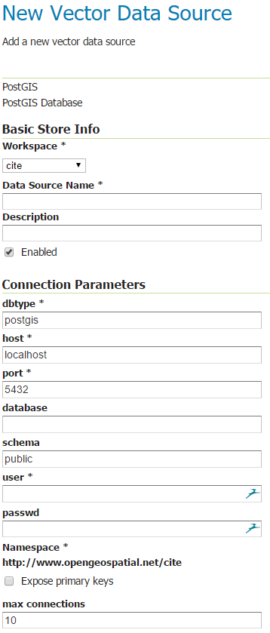
Add PostGIS layer
Stores > Add new store > Vector Data Sources > PostGIS

Slide 18
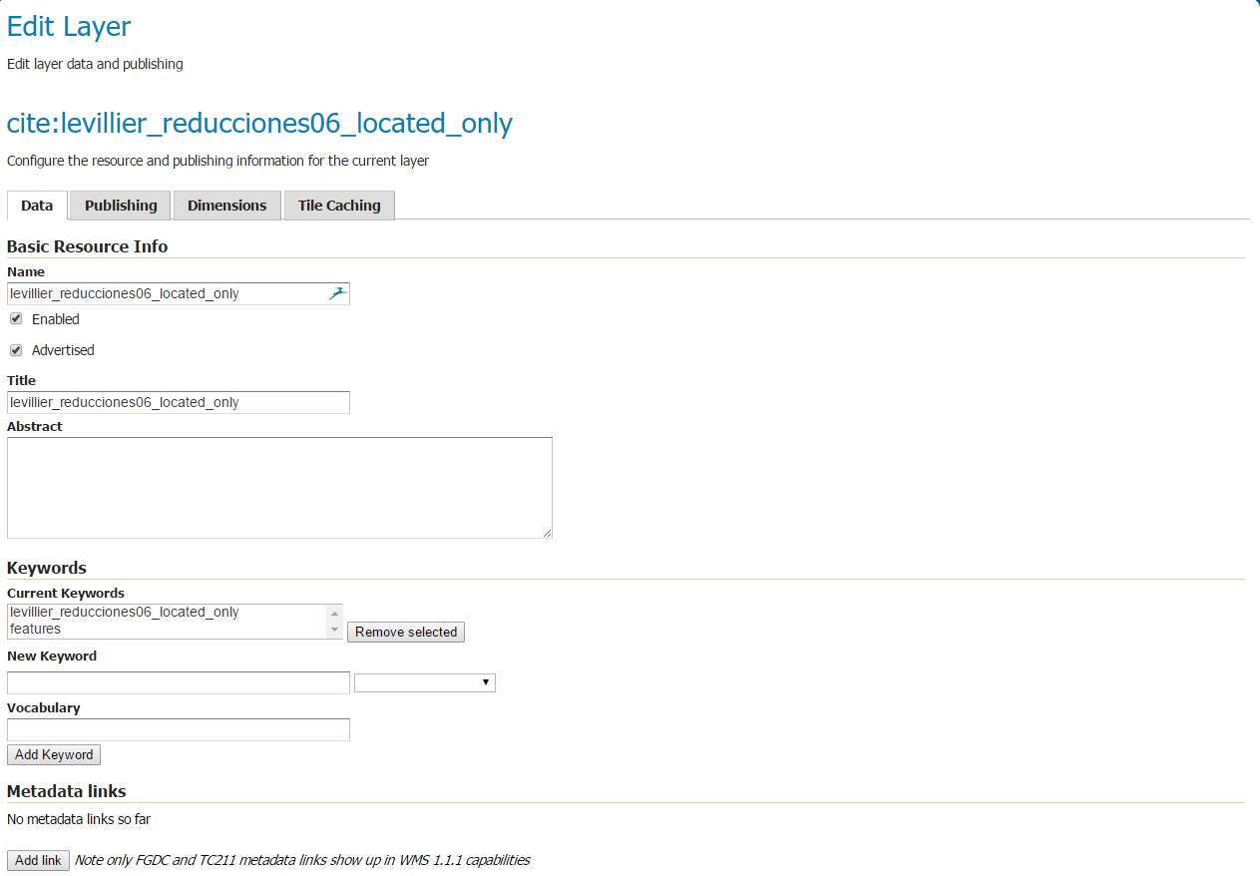
Select table (which in postgis includes geometry) and publish

Slide 19
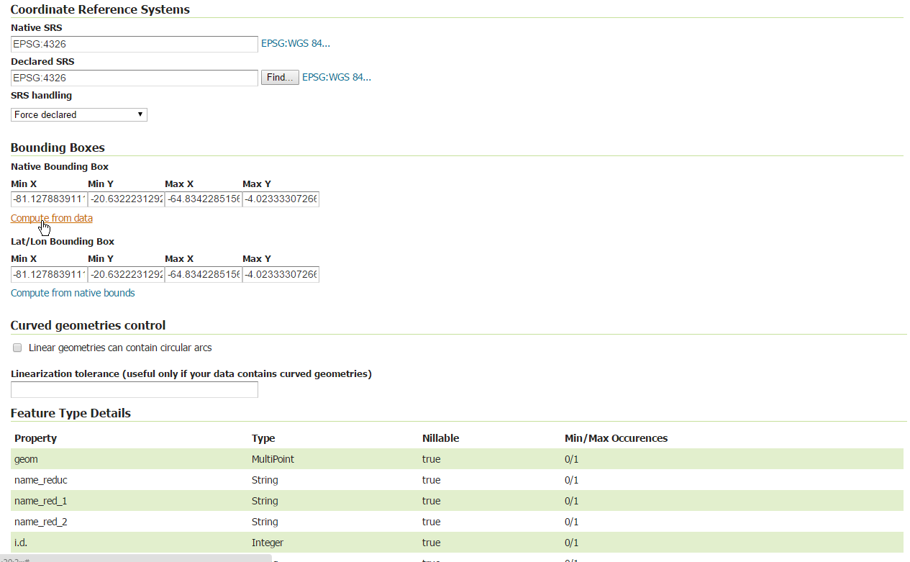
In publish window, compute Lat/Long bounding box from data extent (required). Save.

Slide 20
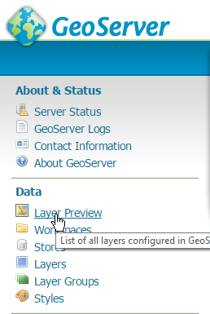
Go to layer preview and preview it.

