Slide 1
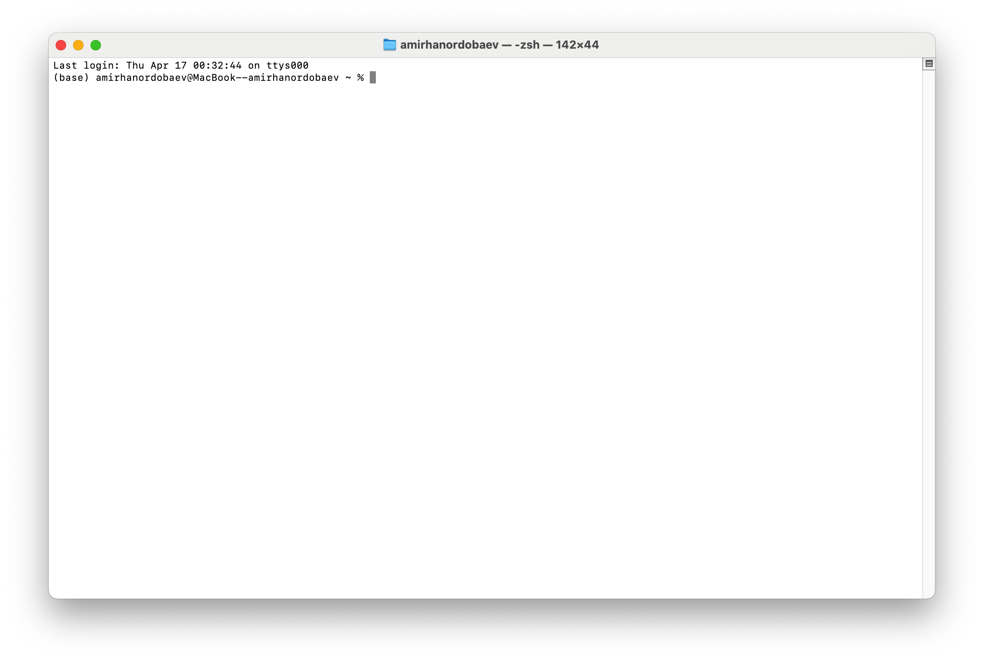
Enhancing Datasets and Introduction to Reinforcement Learning
This presentation explores techniques to enhance machine learning datasets. We will cover Data Augmentation and SMOTE. We'll also provide an introduction to Reinforcement Learning.
Our goal is to highlight the importance of data quality and quantity for machine learning improvements.

Slide 2
The Problem: Insufficient Data
Enhancing Datasets and Introduction to Data Augmentation
Machine learning models thrive on data. However, real-world datasets are often limited, imbalanced, or both. This scarcity can lead to overfitting, where models memorize the training data but perform poorly on new, unseen data. Overfitting occurs because the model doesn't generalize well.
Medical Imaging: Obtaining labeled medical images requires expert radiologists and can be costly.
This presentation explores techniques to enhance machine learning datasets. We will cover Data Augmentation and SMOTE. We'll also provide an introduction to Augmented Learning.
Fraud Detection: Fraudulent transactions are rare, leading to highly imbalanced datasets.
Acquiring more real-world data can be prohibitively expensive, especially in domains like medical imaging or fraud detection, where data collection is difficult, time-consuming, or sensitive.
Rare Events: Predicting equipment failure or natural disasters often suffers from limited event data.
Our goal is to highlight the importance of data quality for machine learning improvements.
Augmentation - the action or process of making or becoming greater in size or amount.
Data Augmentation: Expanding Your Dataset

Slide 3
Enhancing Datasets and Introduction to Data Augmentation
The Problem: Insufficient Data
Machine learning models thrive on data. However, real-world datasets are often limited, imbalanced, or both. This scarcity can lead to overfitting, where models memorize the training data but perform poorly on new, unseen data. Overfitting occurs because the model doesn't generalize well.
Medical Imaging: Obtaining labeled medical images requires expert radiologists and can be costly.
Fraud Detection: Fraudulent transactions are rare, leading to highly imbalanced datasets.
This presentation explores techniques to enhance machine learning datasets. We will cover Data Augmentation and SMOTE. We'll also provide an introduction to Augmented Learning.
Rare Events: Predicting equipment failure or natural disasters often suffers from limited event data.
Acquiring more real-world data can be prohibitively expensive, especially in domains like medical imaging or fraud detection, where data collection is difficult, time-consuming, or sensitive.
Our goal is to highlight the importance of data quality for machine learning improvements.
Augmentation - the action or process of making or becoming greater in size or amount.
Data Augmentation: Expanding Your Dataset

Slide 4

Data Augmentation involves creating new data from existing data.
Our goal is to highlight the importance of data quality and quantity for machine learning improvements.
Data Augmentation: Expanding Your Dataset
This presentation explores techniques to enhance machine learning datasets. We will cover Data Augmentation and SMOTE. We'll also provide an introduction to Reinforcement Learning.
Augmentation - the action or process of making or becoming greater in size or amount.
This improves model generalization and reduces overfitting. Common techniques include rotations, flips, crops, and zooms. For example, rotating handwritten digit images by +/- 15 degrees can increase the dataset size.
Increases data
Reduces overfitting
More data improves model training.
Avoids memorization.
Enhancing Datasets and Introduction to Reinforcement Learning
Better generalization
Performs well on new data.

Slide 5
Image Augmentation Techniques
Color Space Augmentations
Brightness
Contrast
Saturation
Mixing Images
CutMix
MixUp
Geometric Transformations
Data Augmentation: Expanding Your Dataset
Rotation
Scaling
Translation
Data Augmentation involves creating new data from existing data.
This presentation explores techniques to enhance machine learning datasets. We will cover Data Augmentation and SMOTE. We'll also provide an introduction to Reinforcement Learning.
Flips
This improves model generalization and reduces overfitting. Common techniques include rotations, flips, crops, and zooms. For example, rotating handwritten digit images by +/- 15 degrees can increase the dataset size.
Our goal is to highlight the importance of data quality and quantity for machine learning improvements.
Increases data
Reduces overfitting
More data improves model training.
Avoids memorization.
Better generalization
Performs well on new data.
Augmentation - the action or process of making or becoming greater in size or amount.
Enhancing Datasets and Introduction to Reinforcement Learning
Kernel Filters
Blurring
Applying random crops and color jittering to a dataset of cats and dogs can result in a 3x increase in data.
Sharpening

Slide 6
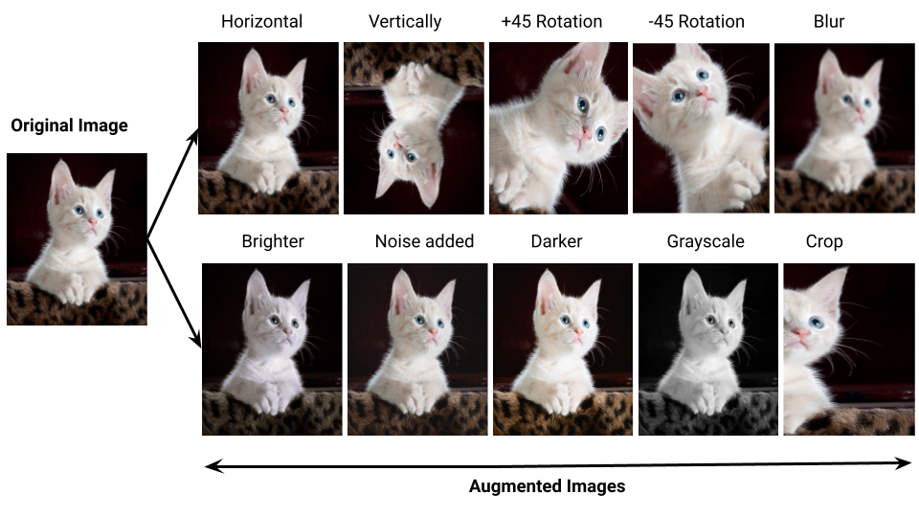
Example:
Image Augmentation Techniques
Geometric Transformations
Color Space Augmentations
Kernel Filters
Mixing Images
Blurring
CutMix
Rotation
Brightness
Sharpening
MixUp
Scaling
Contrast
Translation
Saturation
Flips
Applying random crops and color jittering to a dataset of cats and dogs can result in a 3x increase in data.

Slide 7
Example with code:
Example:

Slide 8
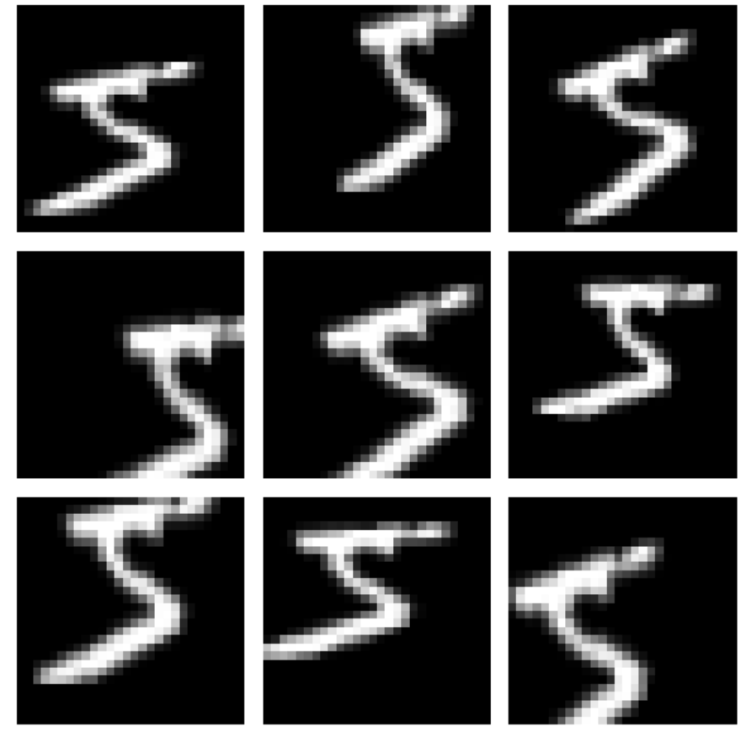
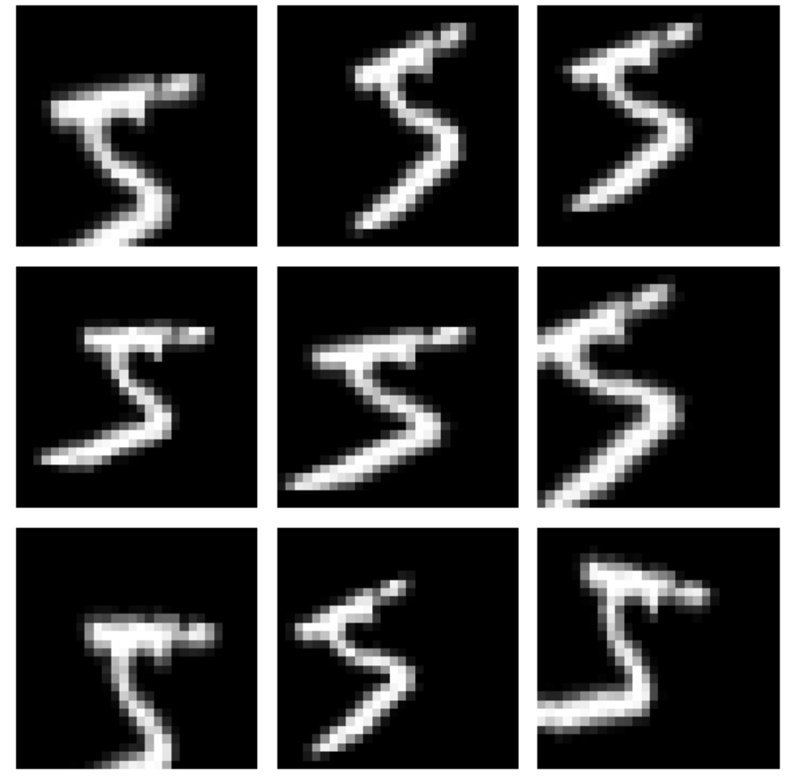
Synonym Replacement
Back Translation
Synonym replacement involves substituting words with synonyms, maintaining the semantic meaning of the text while introducing variations. For example, replacing "good" with "excellent" or "great" in a text corpus.
Back translation involves translating text to another language and back, creating paraphrased versions of the original text. This technique can generate diverse training samples while preserving the semantic meaning.
Text Data Augmentation Techniques
Example:
Example with code:
1st iteration
import numpy as np
import matplotlib.pyplot as plt
from tensorflow.keras.datasets import mnist
from tensorflow.keras.preprocessing.image import ImageDataGenerator
# Load MNIST dataset
(x_train, y_train), (_, _) = mnist.load_data()
# Expand dimensions to match expected input shape: (samples, height, width, channels)
x_train = np.expand_dims(x_train, -1)
# Normalize pixel values to [0, 1]
x_train = x_train.astype("float32") / 255.0
# Create an image data generator with augmentation settings
datagen = ImageDataGenerator(
rotation_range=20, # Random rotation between -20 and 20 degrees
width_shift_range=0.2, # Horizontal shift
height_shift_range=0.2, # Vertical shift
zoom_range=0.2 # Random zoom
)
# Take one sample image and create a batch of size 1
sample_image = x_train[0]
sample_image = np.expand_dims(sample_image, 0) # Shape: (1, 28, 28, 1)
# Generate augmented images using the generator
augmented_images = datagen.flow(sample_image, batch_size=1)
# Display the first 9 augmented images
plt.figure(figsize=(6, 6))
for i in range(9):
batch = next(augmented_images)
image = batch[0].squeeze()
plt.subplot(3, 3, i + 1)
plt.imshow(image, cmap='gray')
plt.axis('off')
plt.tight_layout()
plt.show()
2st iteration
Author comment A simple MNIST augmentation demo using ImageDataGenerator: loads one image, applies rotation, shifts, and zoom, then displays 9 augmented versions.
Random Insertion/Deletion
Random insertion and deletion techniques involve adding or removing words from the text, introducing noise and variability. These techniques can improve the model's robustness to variations in sentence structure.

Slide 9
Output:
Text Data Augmentation Techniques
Synonym Replacement
Random Insertion/Deletion
Back Translation
Synonym replacement involves substituting words with synonyms, maintaining the semantic meaning of the text while introducing variations. For example, replacing "good" with "excellent" or "great" in a text corpus.
Random insertion and deletion techniques involve adding or removing words from the text, introducing noise and variability. These techniques can improve the model's robustness to variations in sentence structure.
Back translation involves translating text to another language and back, creating paraphrased versions of the original text. This technique can generate diverse training samples while preserving the semantic meaning.
Example with code:

Slide 10



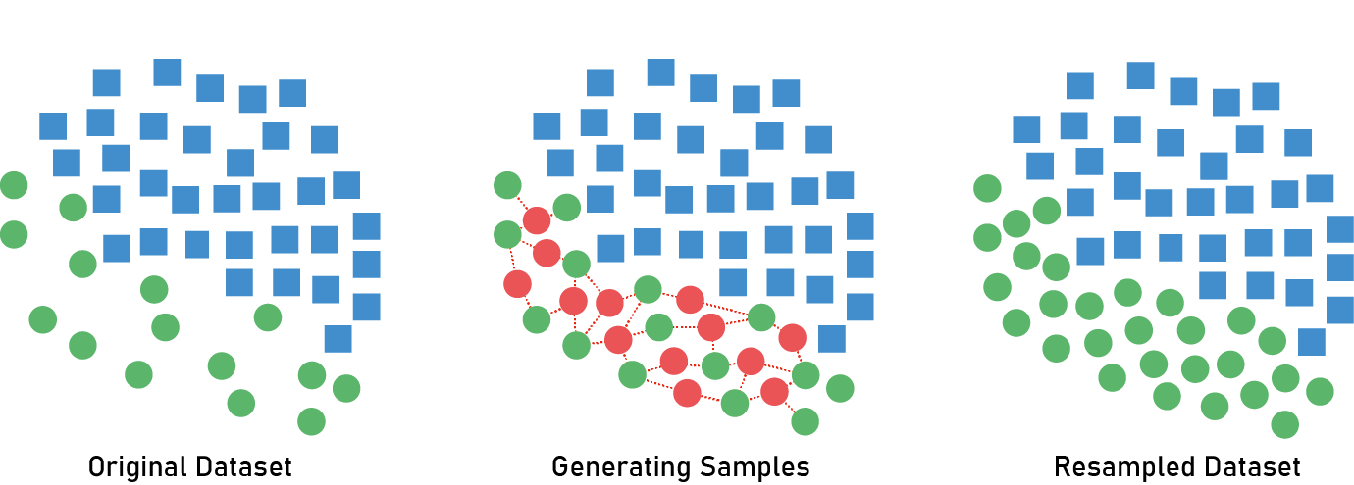
Data Imbalance and the Need for
Synthetic
Minoirity
Oversampling
TechniquE
Example with code:
import random
import nltk
from nltk.corpus import wordnet
from deep_translator import GoogleTranslator
nltk.download('wordnet')
nltk.download('omw-1.4')
# Original sentence
sentence = "This movie was good and the acting was fantastic."
# 1. Synonym Replacement
def synonym_replacement(sentence, n=2):
words = sentence.split()
new_words = words.copy()
random.shuffle(words)
replaced = 0
for word in words:
synonyms = wordnet.synsets(word)
if synonyms:
synonym_words = [lemma.name() for lemma in synonyms[0].lemmas() if lemma.name() != word]
if synonym_words:
new_words = [synonym_words[0] if w == word else w for w in new_words]
replaced += 1
if replaced >= n:
break
return ' '.join(new_words)
# 2. Random Insertion/Deletion
def random_insertion_deletion(sentence, insert_prob=0.3, delete_prob=0.3):
words = sentence.split()
new_words = []
for word in words:
if random.random() > delete_prob:
new_words.append(word)
if random.random() < insert_prob:
new_words.append("very") # simple insert
return ' '.join(new_words)
# 3. Back Translation (via English → German → English)
def back_translation(sentence):
translated = GoogleTranslator(source='auto', target='de').translate(sentence)
back_translated = GoogleTranslator(source='de', target='en').translate(translated)
return back_translated
# Demonstration
print("Original:", sentence)
print("Synonym Replacement:", synonym_replacement(sentence))
print("Random Insertion/Deletion:", random_insertion_deletion(sentence))
print("Back Translation:", back_translation(sentence))
Imbalanced datasets can bias machine learning models. The problem involves minority and majority classes.
Output:
SMOTE (Synthetic Minority Oversampling Technique) helps address this. For example, in fraud detection, 99% might be non-fraudulent, and 1% fraudulent.
Visual Example
Synonym Replacement
Back Translation
Synonym replacement involves substituting words with synonyms, maintaining the semantic meaning of the text while introducing variations. For example, replacing "good" with "excellent" or "great" in a text corpus.
Back translation involves translating text to another language and back, creating paraphrased versions of the original text. This technique can generate diverse training samples while preserving the semantic meaning.
Balances data
Improves accuracy
Reduces bias
Random Insertion/Deletion
Random insertion and deletion techniques involve adding or removing words from the text, introducing noise and variability. These techniques can improve the model's robustness to variations in sentence structure.

Slide 11
Data Imbalance and the Need for
Synthetic
Minoirity
Oversampling
TechniquE
Imbalanced datasets can bias machine learning models. The problem involves minority and majority classes.
Output:
SMOTE (Synthetic Minority Oversampling Technique) helps address this. For example, in fraud detection, 99% might be non-fraudulent, and 1% fraudulent.
Visual Example
Balances data
Improves accuracy
Reduces bias
import random
import nltk
from nltk.corpus import wordnet
from deep_translator import GoogleTranslator
nltk.download('wordnet')
nltk.download('omw-1.4')
# Original sentence
sentence = "This movie was good and the acting was fantastic."
# 1. Synonym Replacement
def synonym_replacement(sentence, n=2):
words = sentence.split()
new_words = words.copy()
random.shuffle(words)
replaced = 0
for word in words:
synonyms = wordnet.synsets(word)
if synonyms:
synonym_words = [lemma.name() for lemma in synonyms[0].lemmas() if lemma.name() != word]
if synonym_words:
new_words = [synonym_words[0] if w == word else w for w in new_words]
replaced += 1
if replaced >= n:
break
return ' '.join(new_words)
# 2. Random Insertion/Deletion
def random_insertion_deletion(sentence, insert_prob=0.3, delete_prob=0.3):
words = sentence.split()
new_words = []
for word in words:
if random.random() > delete_prob:
new_words.append(word)
if random.random() < insert_prob:
new_words.append("very") # simple insert
return ' '.join(new_words)
# 3. Back Translation (via English → German → English)
def back_translation(sentence):
translated = GoogleTranslator(source='auto', target='de').translate(sentence)
back_translated = GoogleTranslator(source='de', target='en').translate(translated)
return back_translated
# Demonstration
print("Original:", sentence)
print("Synonym Replacement:", synonym_replacement(sentence))
print("Random Insertion/Deletion:", random_insertion_deletion(sentence))
print("Back Translation:", back_translation(sentence))

Slide 12

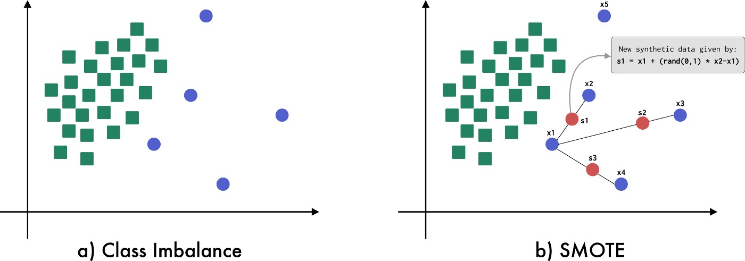
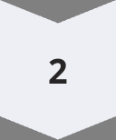

Example with code:
Output:
SMOTE: Creating Synthetic Samples
SMOTE identifies k-nearest neighbors for minority class samples. It generates new samples along the lines connecting the sample to its neighbors.
Advantages include addressing class imbalance and avoiding overfitting. Caveats include the introduction of noise if not applied carefully.
Find neighbors
Identify k-nearest neighbors.
Create samples
Generate new samples.
Balance data
Address imbalance.
SMOTE in Detail: How It Works
Consider a fraud detection dataset where only 1% of the transactions are fraudulent. A model trained on this imbalanced dataset may achieve high accuracy but fail to identify fraudulent transactions. SMOTE can be used to generate synthetic fraud cases, helping the model learn to detect fraud more effectively.
For each minority class sample, find k-nearest neighbors (e.g., k=5).
Select one neighbor at random.
Create a new sample along the line connecting the two samples. This is done by interpolating the feature values.
Repeat until the minority class is balanced.
The imblearn library in Python provides an easy-to-use implementation of SMOTE.

Slide 13
SMOTE in Detail: How It Works
For each minority class sample, find k-nearest neighbors (e.g., k=5).
Consider a fraud detection dataset where only 1% of the transactions are fraudulent. A model trained on this imbalanced dataset may achieve high accuracy but fail to identify fraudulent transactions. SMOTE can be used to generate synthetic fraud cases, helping the model learn to detect fraud more effectively.
Select one neighbor at random.
Create a new sample along the line connecting the two samples. This is done by interpolating the feature values.
Repeat until the minority class is balanced.
The imblearn library in Python provides an easy-to-use implementation of SMOTE.

Slide 14
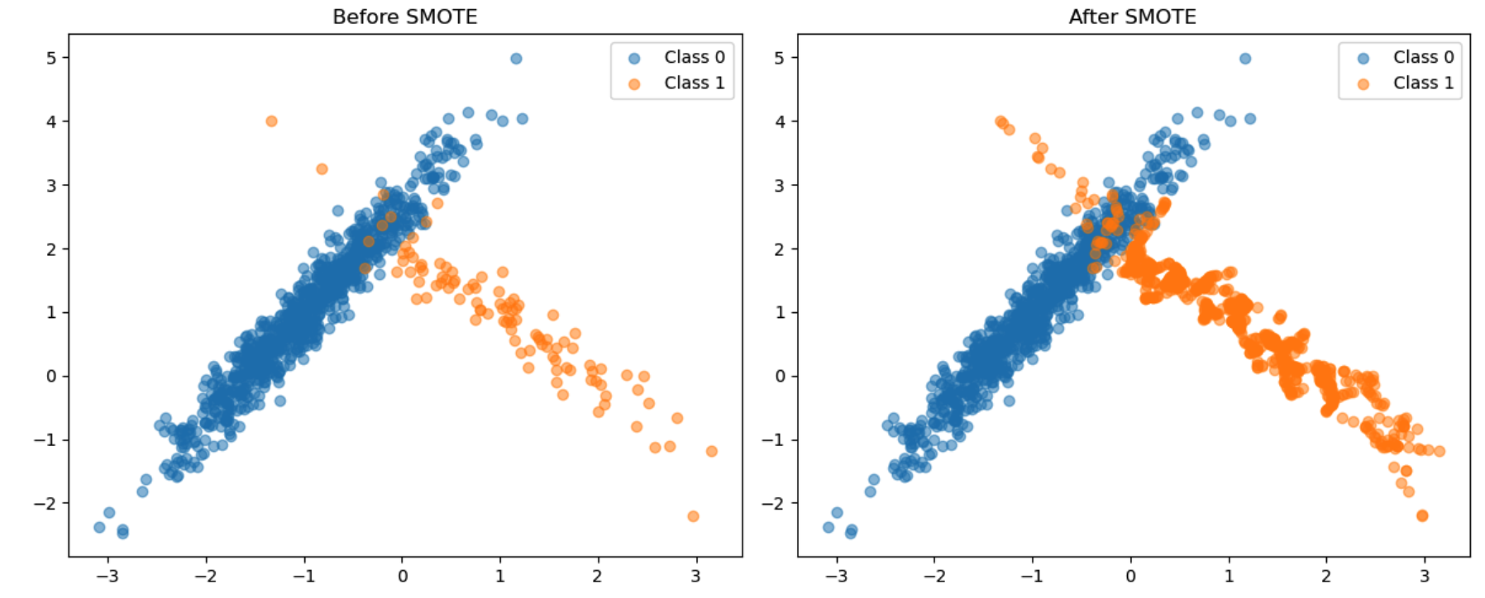
Easy
Data Augmentation vs SMOTE
Diffuculty
Conclusion: Unleashing the Power of Data Augmentation
Data Augmentation
SMOTE
Example with code:
from sklearn.datasets import make_classification
from imblearn.over_sampling import SMOTE
from collections import Counter
import matplotlib.pyplot as plt
from sklearn.decomposition import PCA
# Create an imbalanced dataset
X, y = make_classification(n_samples=1000, n_features=2, n_informative=2,
n_redundant=0, n_clusters_per_class=1,
weights=[0.9, 0.1], flip_y=0, random_state=42)
print("Before SMOTE:", Counter(y))
# Apply SMOTE
smote = SMOTE(random_state=42)
X_res, y_res = smote.fit_resample(X, y)
print("After SMOTE:", Counter(y_res))
# Plotting
plt.figure(figsize=(12, 5))
plt.subplot(1, 2, 1)
plt.title("Before SMOTE")
plt.scatter(X[y == 0][:, 0], X[y == 0][:, 1], label="Class 0", alpha=0.5)
plt.scatter(X[y == 1][:, 0], X[y == 1][:, 1], label="Class 1", alpha=0.5)
plt.legend()
plt.subplot(1, 2, 2)
plt.title("After SMOTE")
plt.scatter(X_res[y_res == 0][:, 0], X_res[y_res == 0][:, 1], label="Class 0", alpha=0.5)
plt.scatter(X_res[y_res == 1][:, 0], X_res[y_res == 1][:, 1], label="Class 1", alpha=0.5)
plt.legend()
plt.tight_layout()
plt.show()
Output:
Generates synthetic data to balance classes; specifically for minority classes.
Generates new data through transformation of existing data; applicable to all classes.
Image classification, object detection, and natural language processing.
Fraud detection, medical diagnosis, and rare event prediction.
While both techniques aim to improve model performance, they address different problems and are suited for different use cases. Data augmentation is more general-purpose, while SMOTE is specifically designed to handle class imbalance.
Potential improvement in model accuracy
Data augmentation is free to implement
Code is available on my GitHub
Data augmentation stands as a powerful tool for enhancing model performance, offering a cost-effective and readily accessible means to improve accuracy and generalization. By experimenting with diverse techniques and carefully validating augmentation strategies, practitioners can unlock the full potential of data augmentation and achieve superior results in their machine learning endeavors.
GitHub
90%
Access
Improvement

Slide 15
Easy
Diffuculty
Conclusion: Unleashing the Power of Data Augmentation
Data Augmentation vs SMOTE
Data Augmentation
SMOTE
Generates new data through transformation of existing data; applicable to all classes.
Generates synthetic data to balance classes; specifically for minority classes.
Image classification, object detection, and natural language processing.
Fraud detection, medical diagnosis, and rare event prediction.
While both techniques aim to improve model performance, they address different problems and are suited for different use cases. Data augmentation is more general-purpose, while SMOTE is specifically designed to handle class imbalance.
Potential improvement in model accuracy
Data augmentation is free to implement
Code is available on my GitHub
Data augmentation stands as a powerful tool for enhancing model performance, offering a cost-effective and readily accessible means to improve accuracy and generalization. By experimenting with diverse techniques and carefully validating augmentation strategies, practitioners can unlock the full potential of data augmentation and achieve superior results in their machine learning endeavors.
GitHub
90%
Access
Improvement

Slide 16

Thank you for watching!
Conclusion: Unleashing the Power of Data Augmentation
Wishing you smooth code, clean datasets, and models that converge — until next time! 👋🚀
90%
Easy
GitHub
Amirhan Ordobaev
Improvement
Diffuculty
Access
Potential improvement in model accuracy
Data augmentation is easy to implement
Code is available on my GitHub
I’d really appreciate it if you followed me on GitHub :)
Data augmentation stands as a powerful tool for enhancing model performance, offering a cost-effective and readily accessible means to improve accuracy and generalization. By experimenting with diverse techniques and carefully validating augmentation strategies, practitioners can unlock the full potential of data augmentation and achieve superior results in their machine learning endeavors.

Slide 17
Data Augmentation vs. SMOTE
Thank you for watching!
Data Augmentation
SMOTE
Wishing you smooth code, clean datasets, and models that converge — until next time! 👋🚀
Generates synthetic data to balance classes; specifically for minority classes.
Generates new data through transformation of existing data; applicable to all classes.
Amirhan Ordobaev
Image classification, object detection, and natural language processing.
Fraud detection, medical diagnosis, and rare event prediction.
I’d really appreciate it if you followed me on GitHub :)
While both techniques aim to improve model performance, they address different problems and are suited for different use cases. Data augmentation is more general-purpose, while SMOTE is specifically designed to handle class imbalance.

