Slide 1
Institut für Grundlagen der Elektrotechnik und Elektronik (IEE)
Professur für Hochparallele VLSI-Systeme und Neuromikroelektronik
Spiking Neural Networks
Wu,Binyi
Dresden, 20 Januar 2017

Slide 2
Content
Architecture of Spiking Neural Networks (SNNs)
Leaky Integrate and Fire (LIF) Neuron
Adaptive Synapse
Address-Event Representation (AER)

Slide 3
Content
Architecture of Spiking Neural Networks (SNNs)
Leaky Integrate and Fire (LIF) Neuron
Adaptive Synapse
Address-Event Representation (AER)

Slide 4
Architecture of Spiking Neural Networks (SNNs)
Synaptic adaptor array
Neuron array
Synaptic adaptor
Synapese
Synaptic adaptor
Synapese
soma
axon
Synaptic adaptor
Synapese
AER Bus
AER Bus
Adaptors[1]
Neuron[1]
Address-Event Representation (AER) Bus
Adaptors[N]
Neuron[N]
[1] Runchun M.Wang, Tara J. Hamilton, Jonathan C. Tapsonand André van Schaik. 2015. “A neuromorphic implementation of multiple spike-timing synaptic plasticity rules for large-scale neural networks”. Frontiers in Neuroscience. doi: 10.3389/fnins.2015.00180

Slide 5
Content
Architecture of Spiking Neural Networks (SNNs)
Leaky Integrate and Fire (LIF) Neuron
Adaptive Synapse
Address-Event Representation (AER)

Slide 6
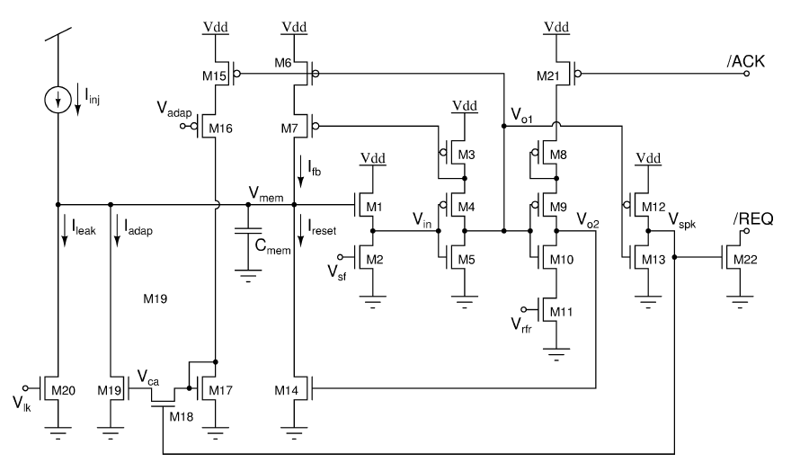
Leaky Integrate and Fire (LIF) Neuron
[1] Indiveri, G., Chicca, E., and Douglas, R. (2006). A VLSI array of low-power spiking neurons and bistable synapses with spike-timing dependent plasticity. IEEE Trans. Neural Netw. 17, 211–221.

Slide 7
Content
Architecture of Spiking Neural Networks (SNNs)
Leaky Integrate and Fire (LIF) Neuron
Adaptive Synapse
Address-Event Representation (AER)

Slide 8
Adaptive Synapse
biological synapses
not simple interfacing elements
an important computational role in NNs
short– and long–term plasticity(memory)

Slide 9
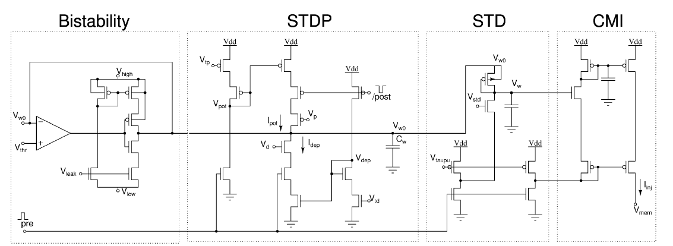
short–term plasticity
Adaptive Synapse
Short–Term Depression
Current-Mirror-Integrator
long–term plasticity
Spike-Timing Dependent Plasticity
[1] Indiveri, G., Chicca, E., and Douglas, R. (2006). A VLSI array of low-power spiking neurons and bistable synapses with spike-timing dependent plasticity. IEEE Trans. Neural Netw. 17, 211–221.

Slide 10
Adaptive Synapse
long–term plasticity
short–term plasticity
[1] Indiveri, G., Chicca, E., and Douglas, R. (2006). A VLSI array of low-power spiking neurons and bistable synapses with spike-timing dependent plasticity. IEEE Trans. Neural Netw. 17, 211–221.

Slide 11
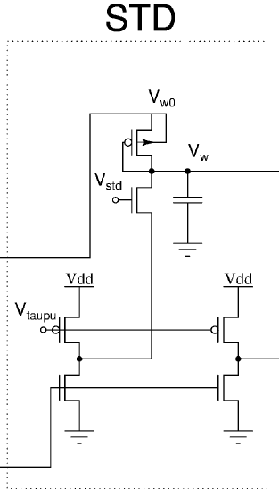
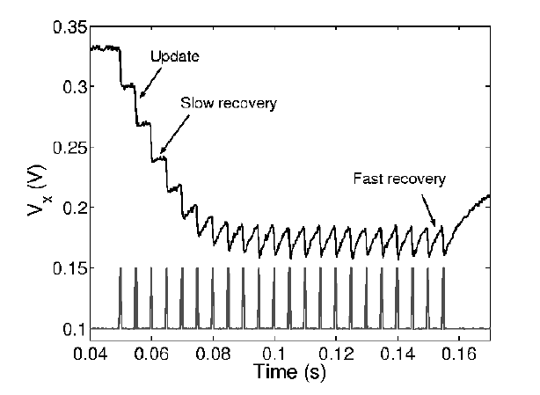



short–term plasticity
$$V_{w}$$
$$V_{w}$$
$$V_{pre}$$
[1] M. Boegerhausen, P. Suter, and S.-C. Liu, “Modeling short-term synaptic depression in silicon,” Neural Comput., vol. 15, no. 2, pp. 331–348, Feb. 2003.

Slide 12
long–term plasticity
[1] Indiveri, G., Chicca, E., and Douglas, R. (2006). A VLSI array of low-power spiking neurons and bistable synapses with spike-timing dependent plasticity. IEEE Trans. Neural Netw. 17, 211–221.

Slide 13
Content
Architecture of Spiking Neural Networks (SNNs)
Leaky Integrate and Fire (LIF) Neuron
Adaptive Synapse
Address-Event Representation (AER)

Slide 14
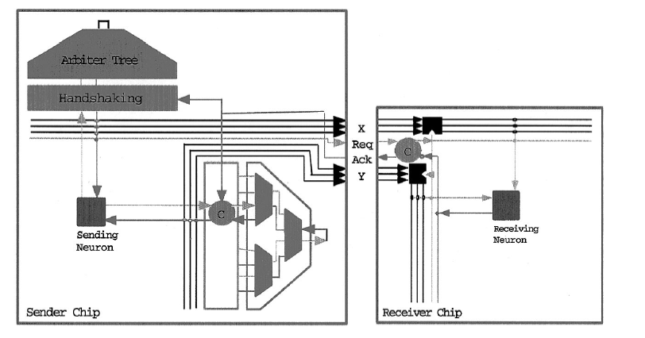
Address-Event Representation (AER)
[1] Boahen, K. (2000). Point-to-point connectivity between neuromorphic chips using address events. IEEE Trans. Circuits Syst. 47, 416–434.

Slide 15
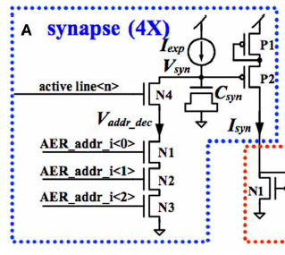

Address-Event Representation (AER)
instead of handshaking use “active line”
instead of arbiter, a full encoder and decoder,
use a 3/8 bit address(56)
[1] Runchun M.Wang, Tara J. Hamilton, Jonathan C. Tapsonand André van Schaik. 2014. “A mixed-signal implementation of a polychronous spiking neural network with delay adaptation”. Frontiers in Neuroscience. doi: 10.3389/fnins.2014.00051

Slide 16
References
Runchun M.Wang, Tara J. Hamilton, Jonathan C. Tapsonand André van Schaik. 2015. “A neuromorphic implementation of multiple spike-timing synaptic plasticity rules for large-scale neural networks”. Frontiers in Neuroscience. doi: 10.3389/fnins.2015.00180
Indiveri, G., Chicca, E., and Douglas, R. (2006). A VLSI array of low-power spiking neurons and bistable synapses with spike-timing dependent plasticity. IEEE Trans. Neural Netw. 17, 211–221.
Boahen, K. (2000). Point-to-point connectivity between neuromorphic chips using address events. IEEE Trans. Circuits Syst. 47, 416–434.
Wang, R., Cohen, G., Stiefel, K. M., Hamilton, T. J., Tapson, J., and van Schaik, A. (2013b). An FPGA implementation of a polychronous spiking neural network with delay adaptation. Front. Neurosci. 7:14. doi: 10.3389/fnins.2013.00014
Arthur, J. V., and Boahen, K. (2004). “Recurrently connected silicon neurons with active dendrites for one-shot learning,” in 2004 IEEE International Joint Conference on Neural Networks
Wang, R., Cohen, G., Stiefel, K. M., Hamilton, T. J., Tapson, J., and van Schaik, A. (2014 ). A mixed-signal implementation of a polychronous spiking neural network with delay adaptation. Front. Neurosci.

Slide 17
Thank you for your attention!

Slide 18
Thank you for your attention!

Slide 19
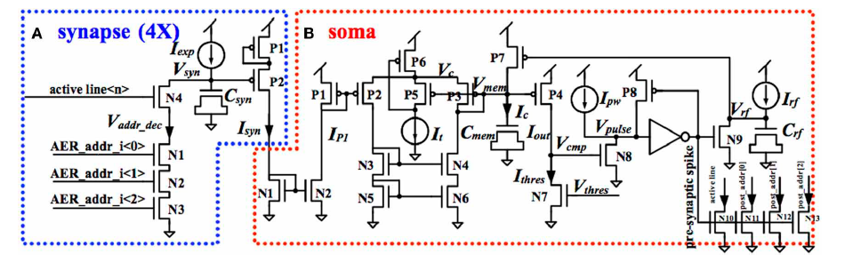


Leaky Integrate and Fire (LIF) Neuron
[1] Runchun M.Wang, Tara J. Hamilton, Jonathan C. Tapsonand André van Schaik. 2014. “A mixed-signal implementation of a polychronous spiking neural network with delay adaptation”. Frontiers in Neuroscience. doi: 10.3389/fnins.2014.00051

