Slide 1
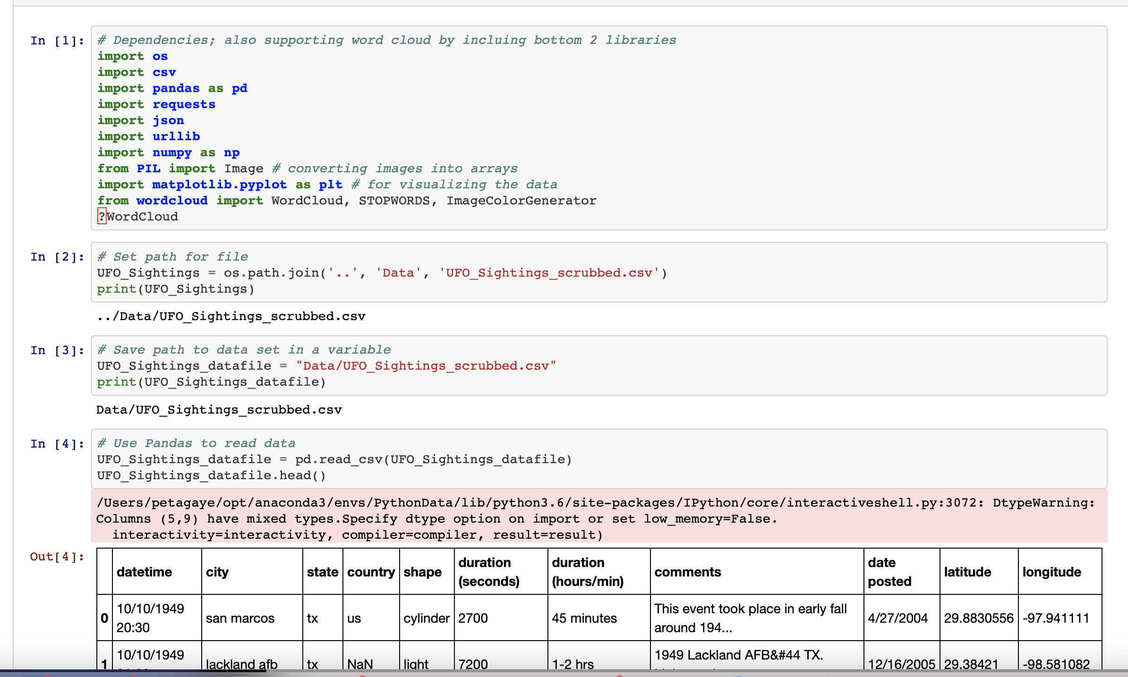
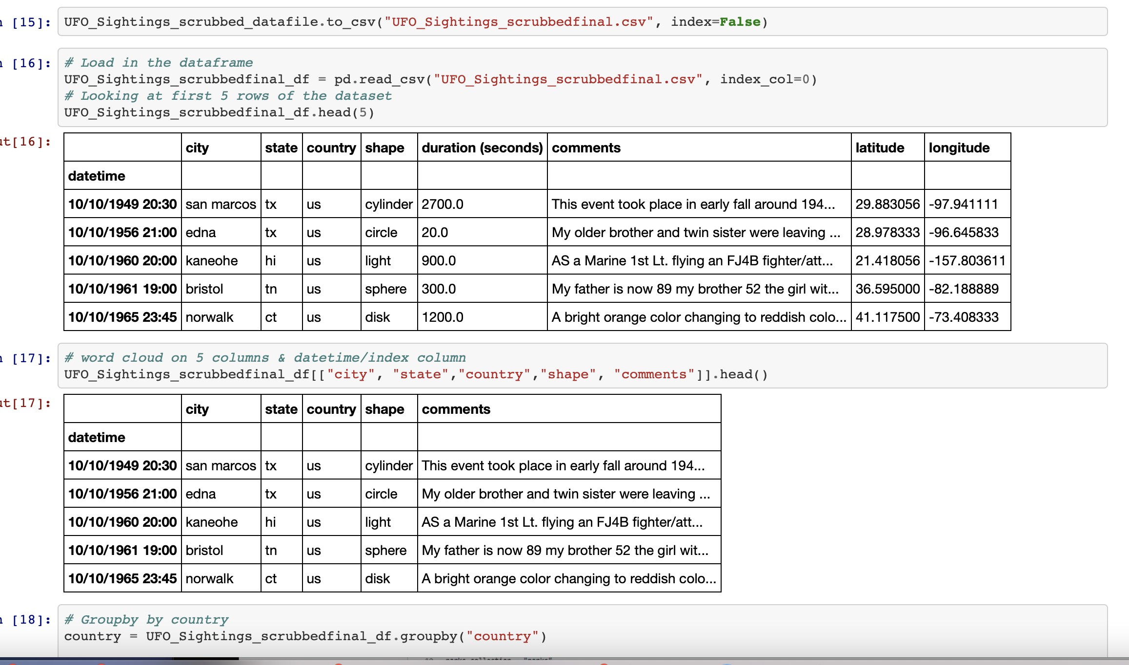
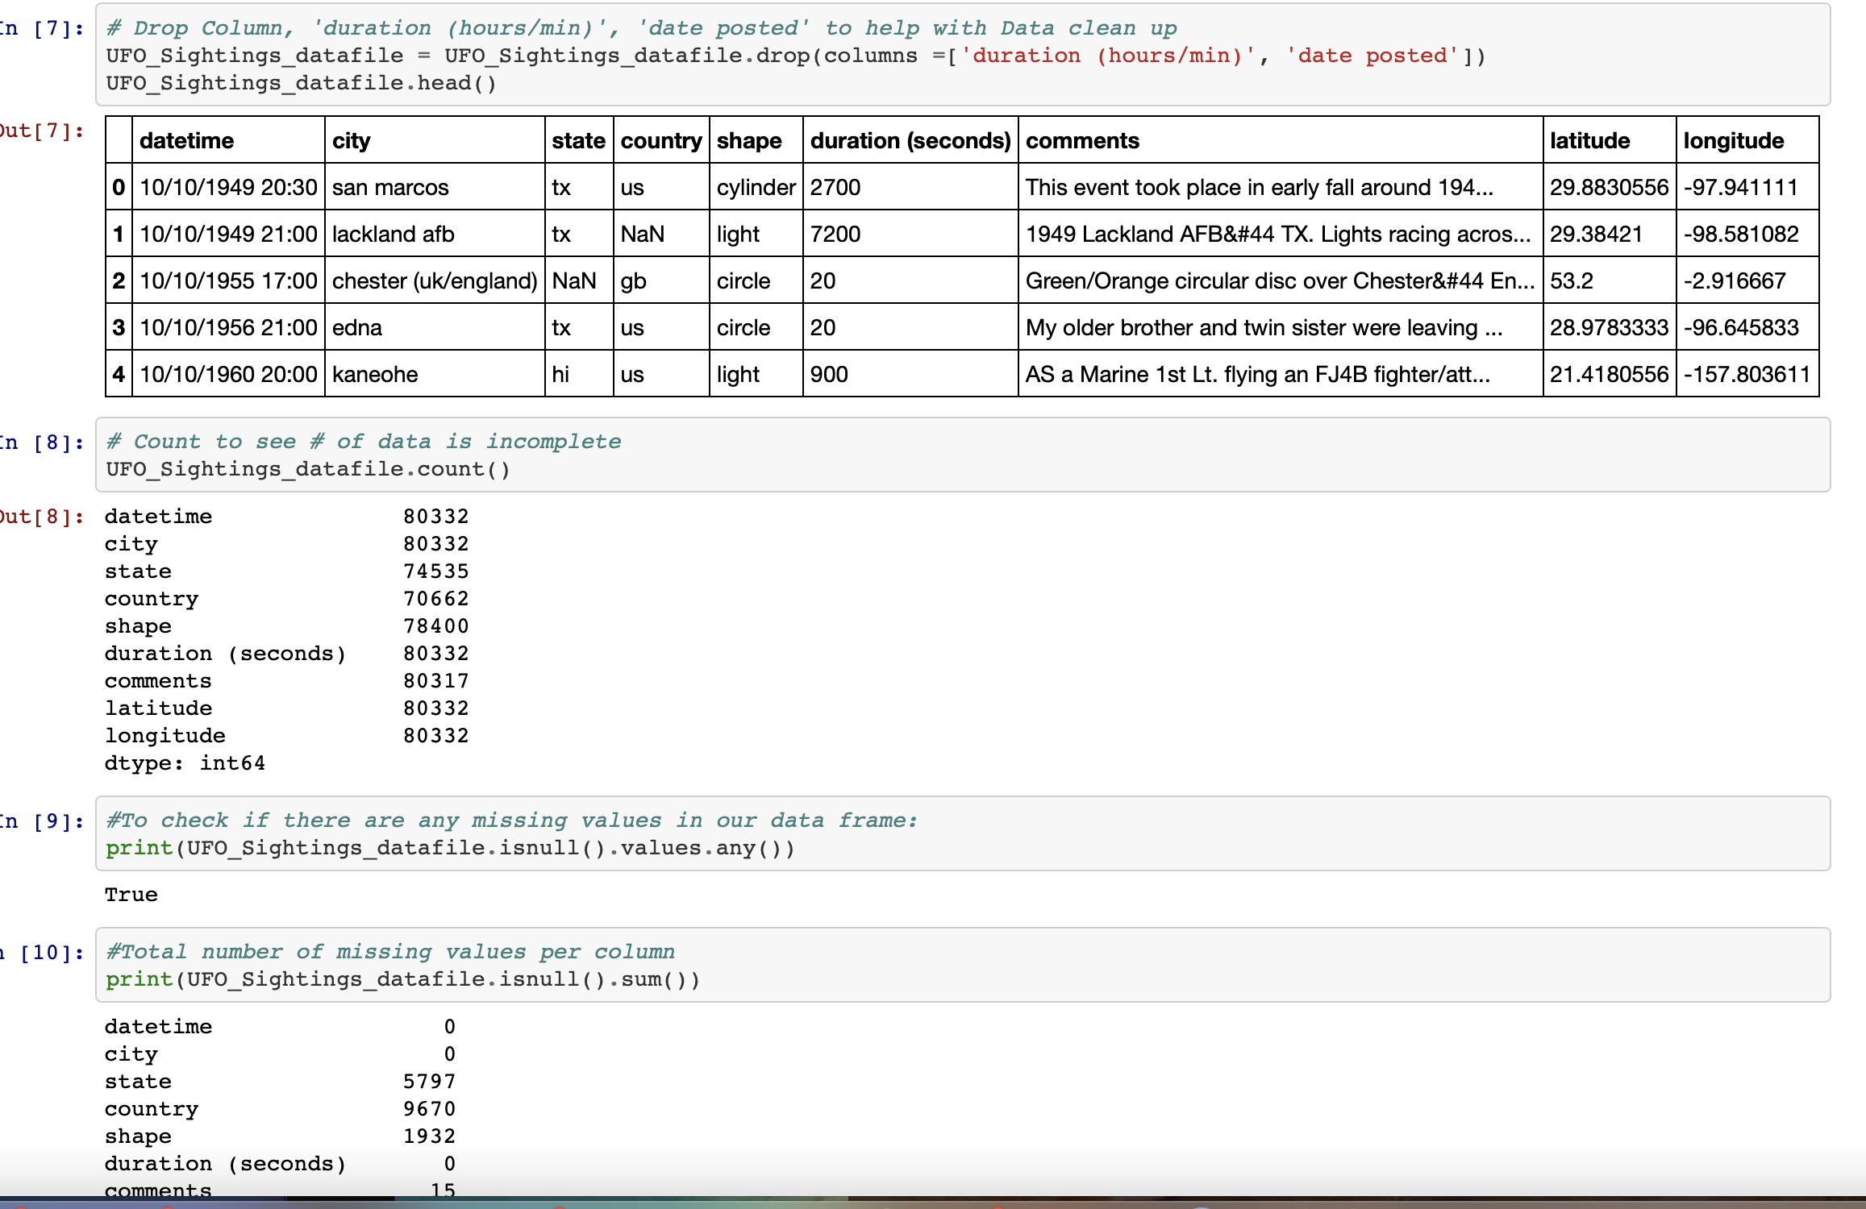
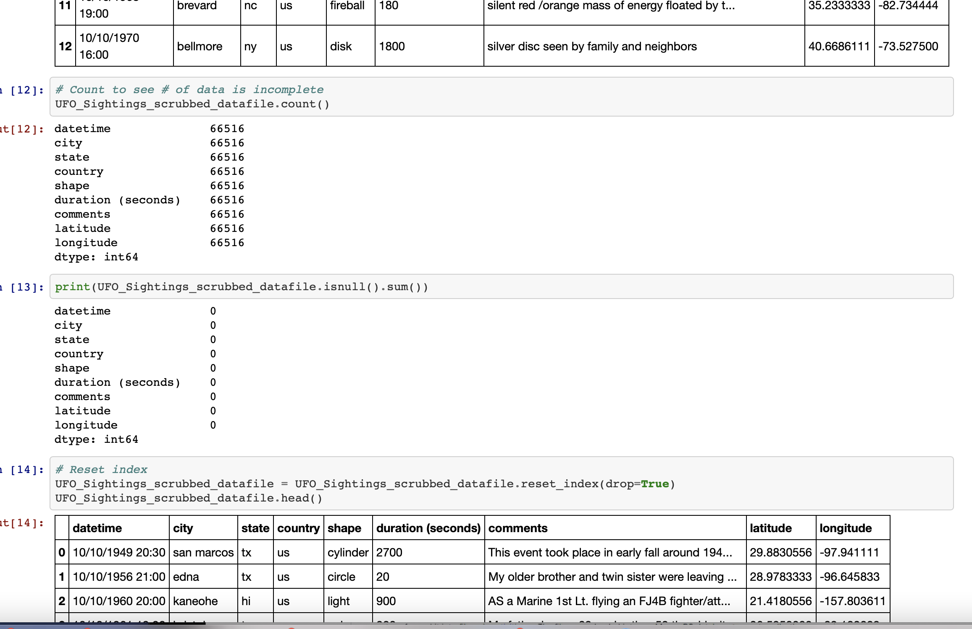
LISTING ALL DEPENDENCIES
LOADING SCRUBBED DATA IN DF
Dropping columns
Cleaned files

Slide 2
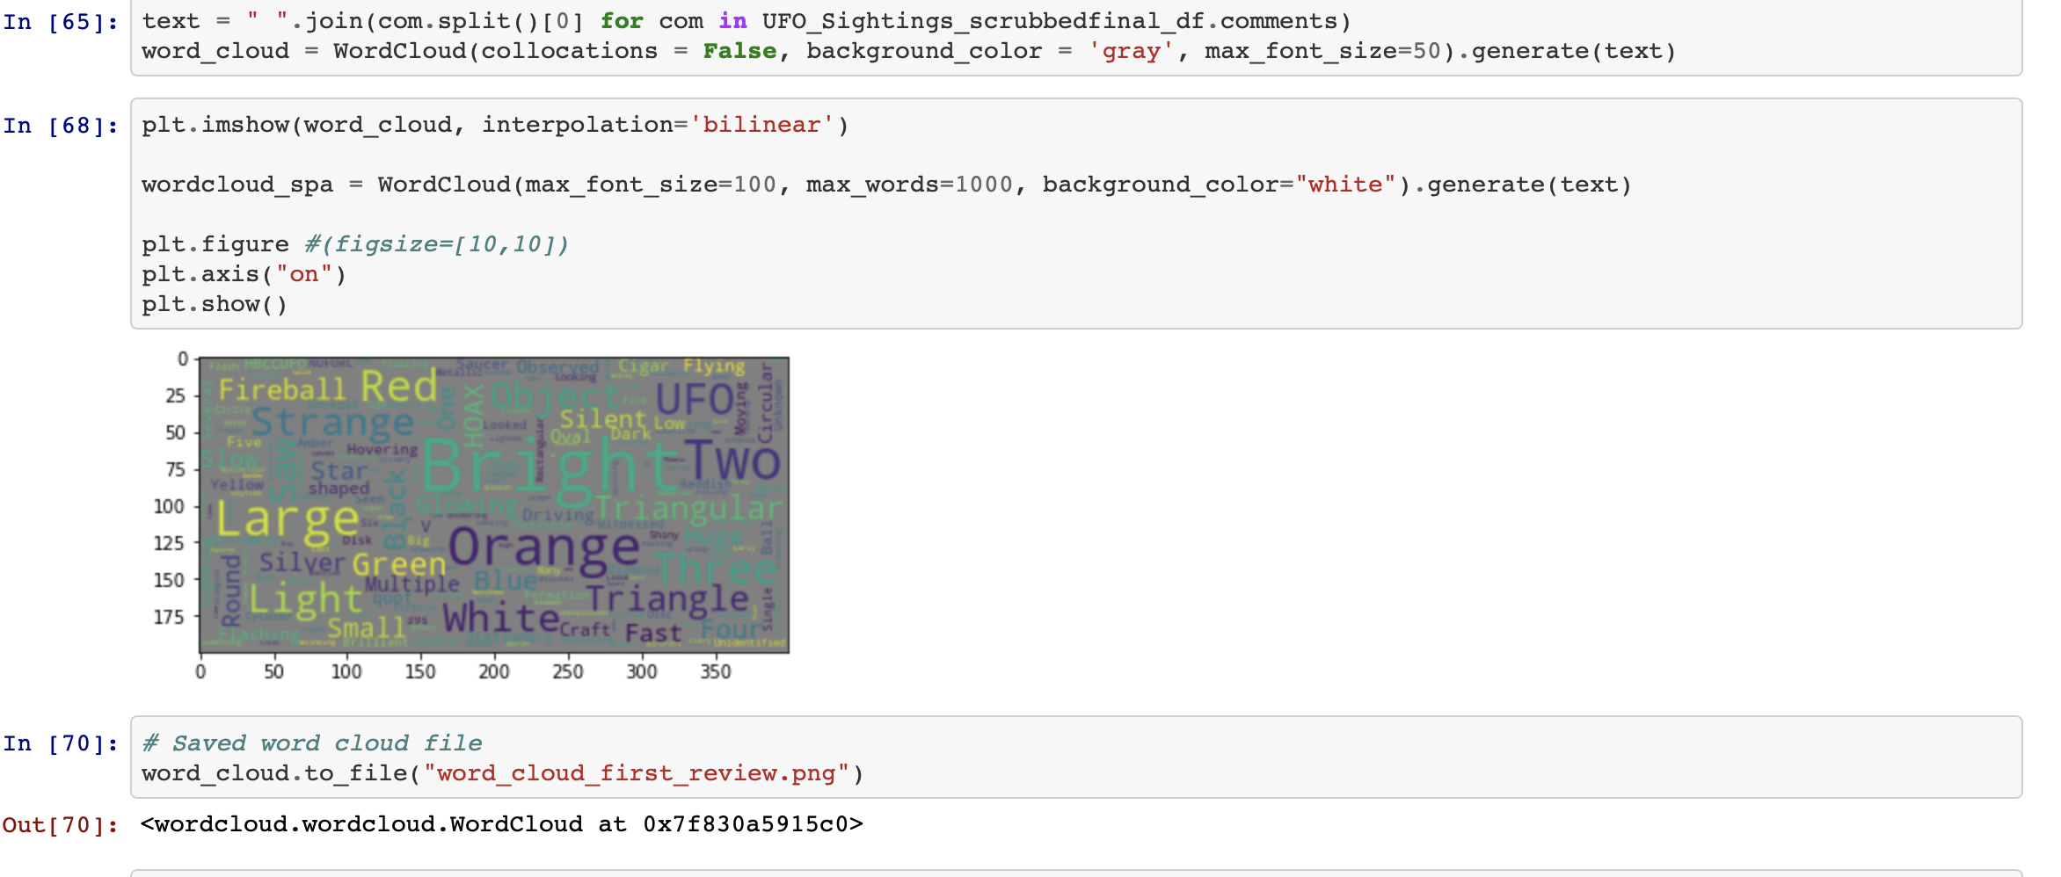
LOADING SCRUBBED DATA IN DF
Word Cloud

