Slide 1
Citi Bike Analysis
File created on: 10/09/2021 9:17:47 PM
Data Analysis of Citi Bike Activity in July Prior to COVID and During the COVID Quarantine
Analyst: Heather Mott

Slide 2
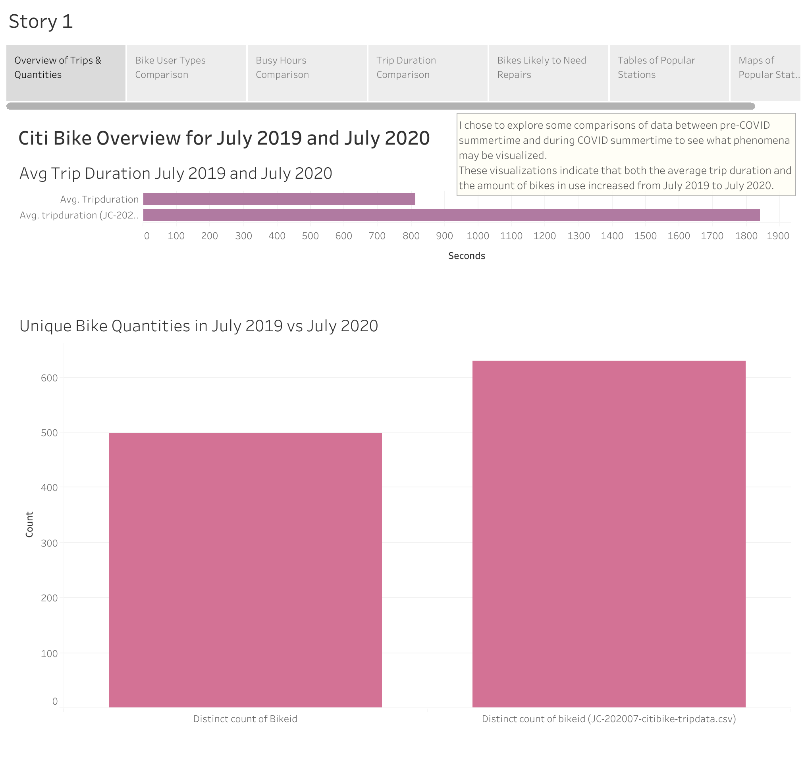

Slide 3
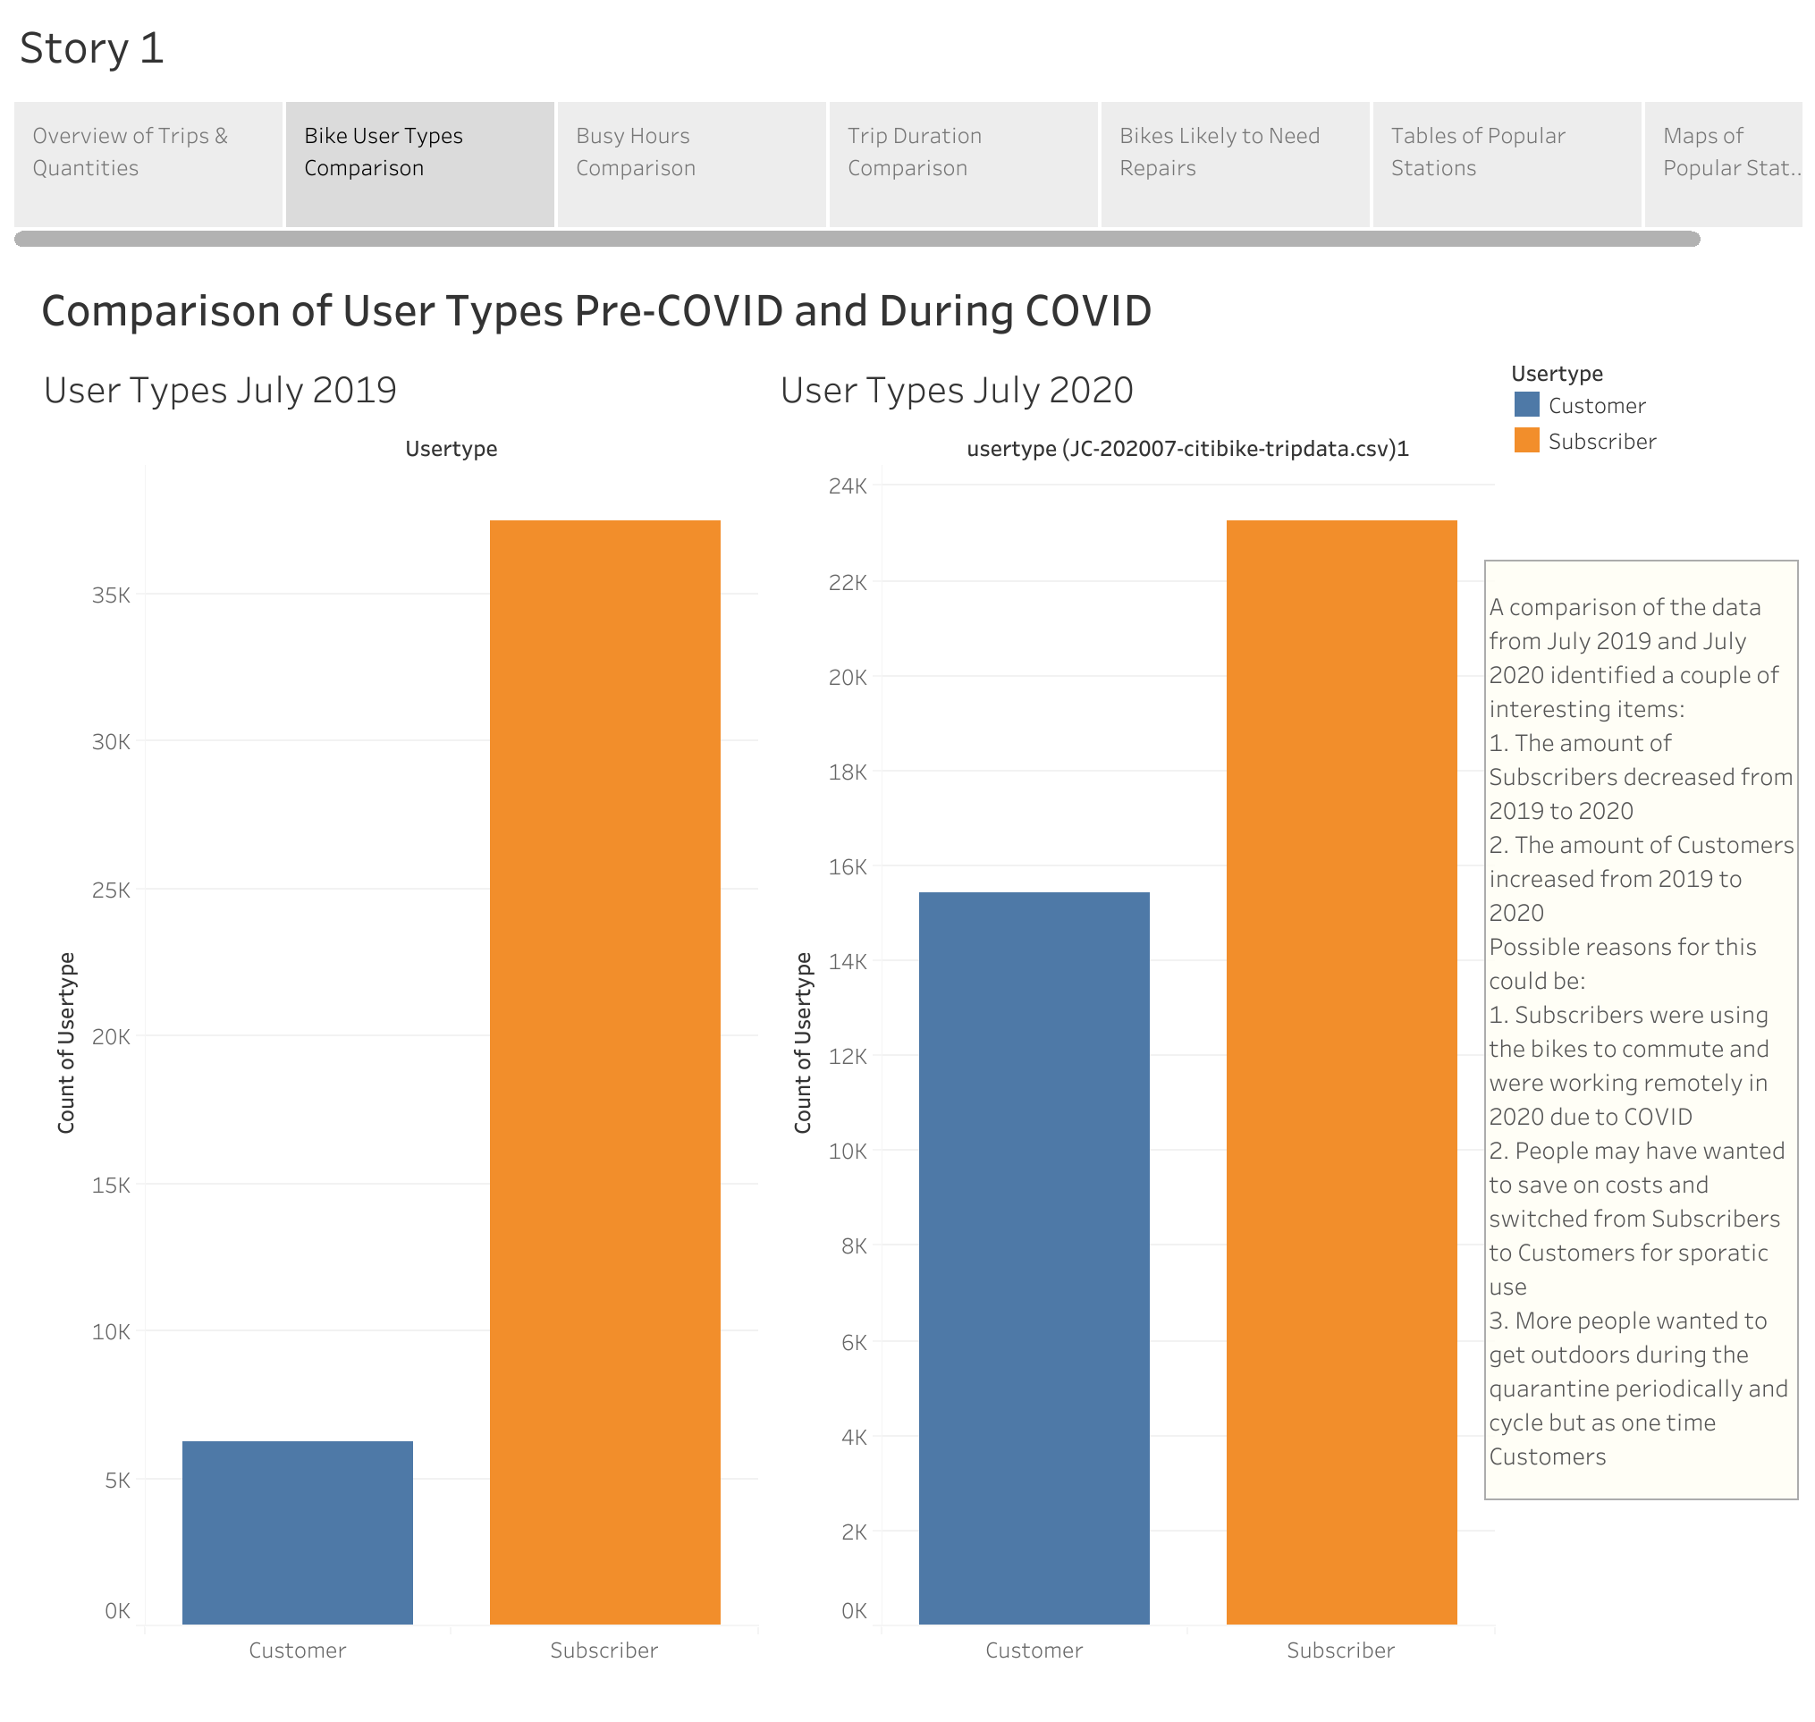

Slide 4
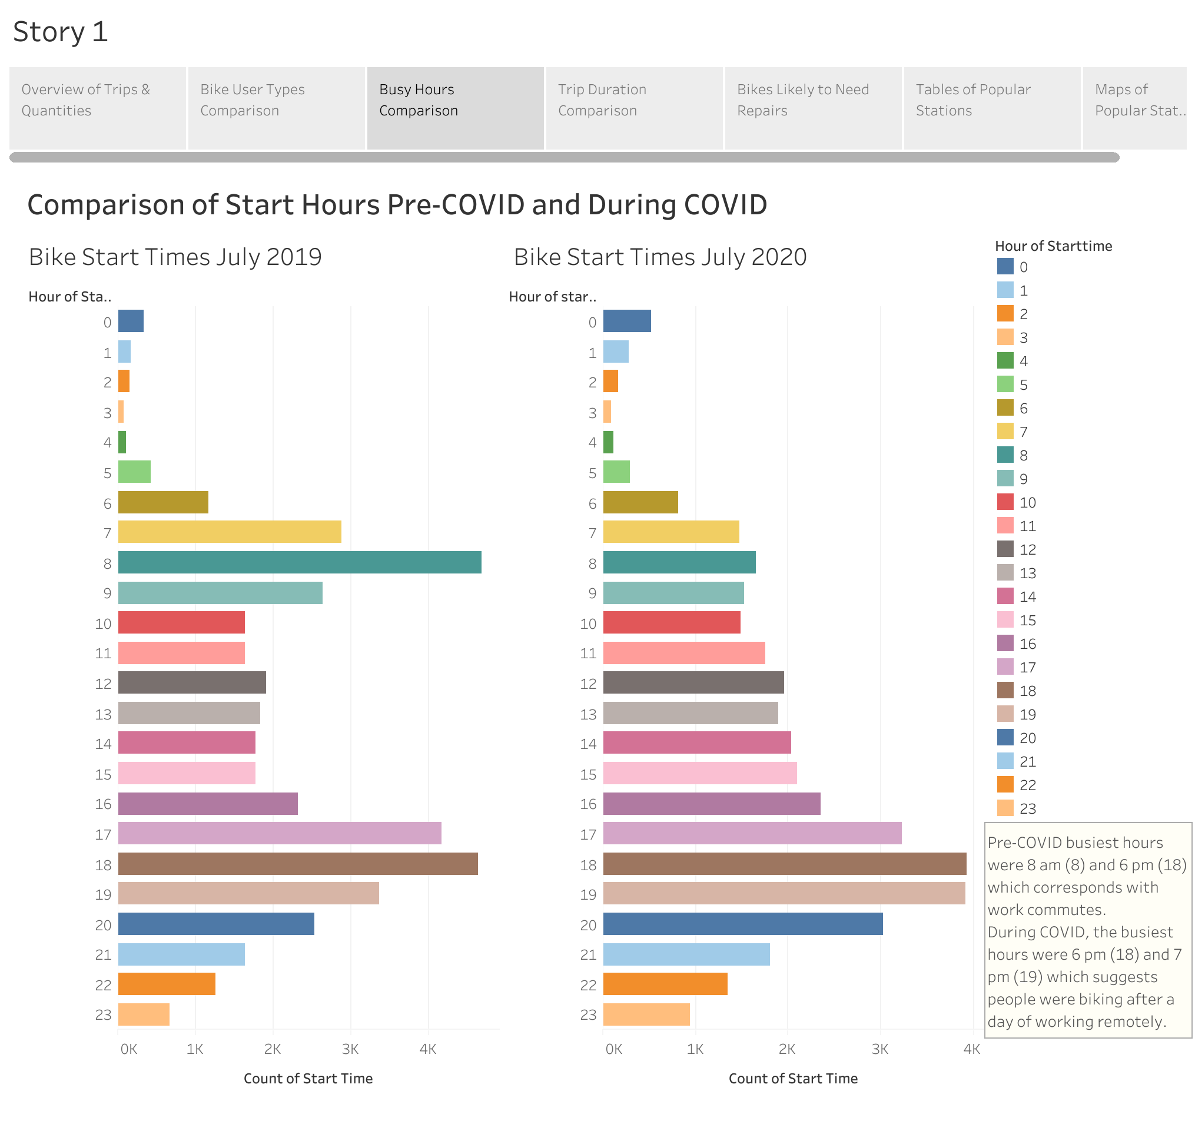

Slide 5
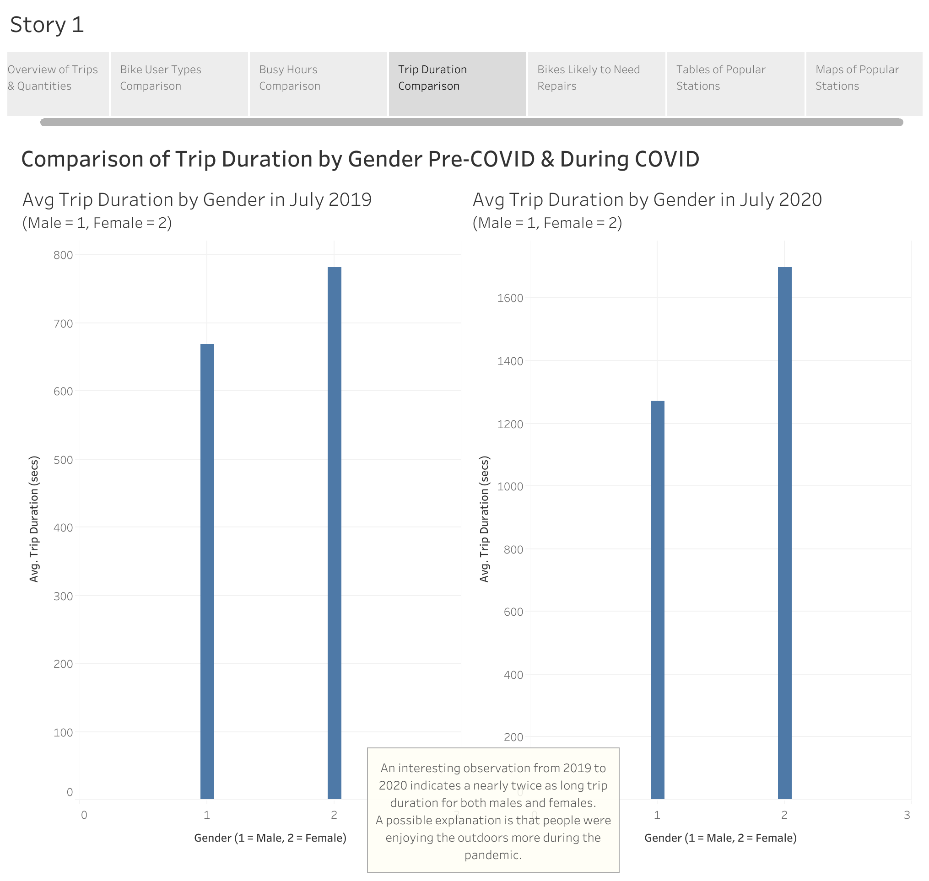

Slide 6
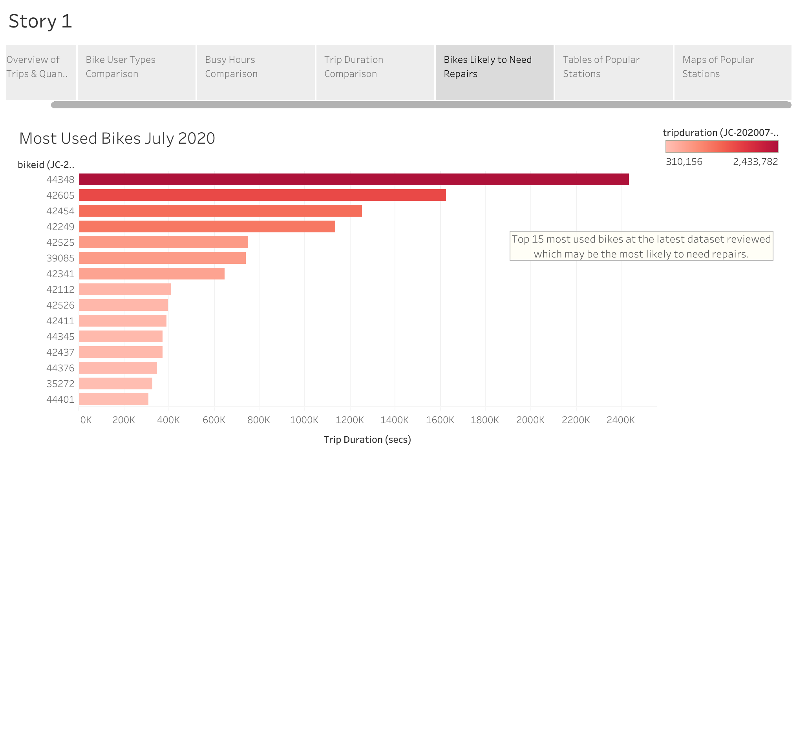

Slide 7
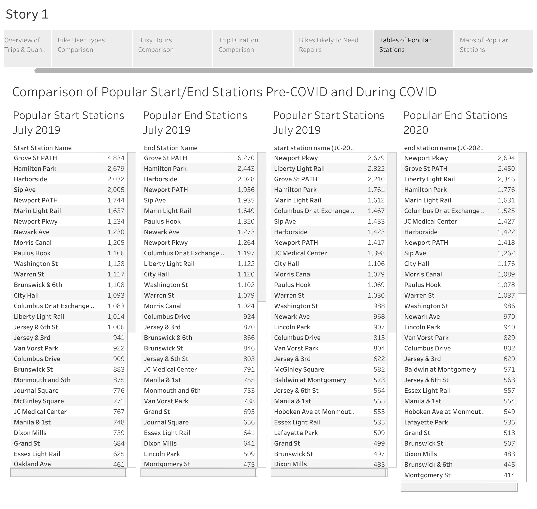

Slide 8
