Slide 1
October 2022
Update

Slide 2
Activity Report
Saving vehicle data after the simulation runs.
The data is pulled from the XML output files SUMO generates.
Including vehicle:
Position
Velocity
Acceleration
Using the Flake8 linter to check code style, syntax, and complexity.

Slide 3
SUMO – Collecting Data
Collect vehicle data at the end of each simulation.
Planning to use this data as input into the platooning controller.

Slide 4
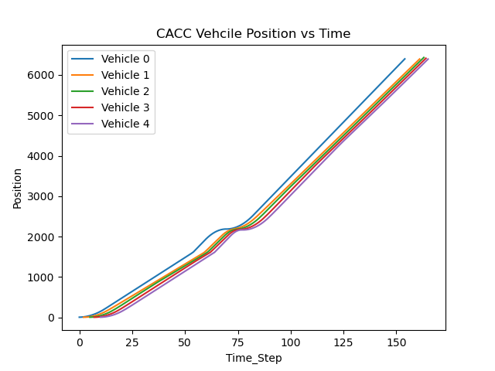
SUMO Position Data (meters)

Slide 5
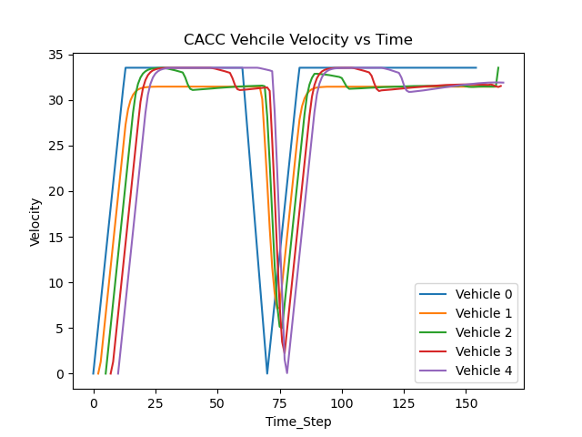
SUMO Velocity Data (m/s)

Slide 6
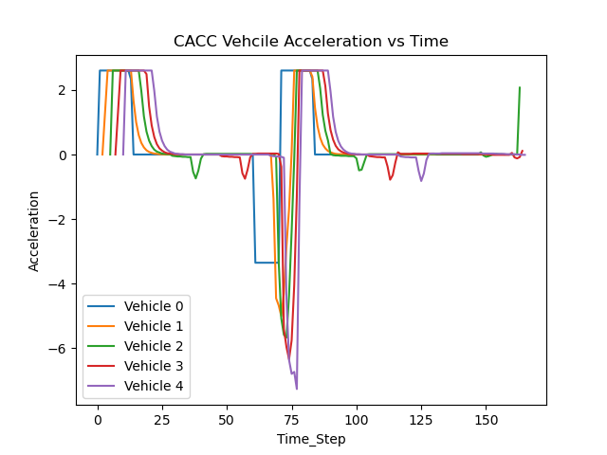
SUMO Acceleration Data (m/s²)

Slide 7
Flake8
Flake8 is a Python library that wraps PyFlakes, pycodestyle and Ned Batchelder's McCabe script.
It is a great toolkit for checking your code base against coding style (PEP8), programming errors.
https://flake8.pycqa.org/en/latest/

Slide 8
Gantt Chart

