Slide 1
Battle of the Neighbourhoods
Comparing New York City, USA and London, UK with two factors: Crime rate and Median House Price.
By Heather Tymms

Slide 2
Problem and Data Collection
Problem
This analysis will see where would be best to start up a business in the two ccities comparing crime rate and house orices.
These factors are good to include because a businessperson who wants to start a business, they would like to keep their enployees safe and also it not be to exprensive to rent/buy land.
The data collected was from reputable sources from local aurthorities of the respective locations.
The New York PoliceDepartment (NYPD) and the Bepartment of Finance (DOF) were used for New York’s data.
For London, the London Borough profiles were used, the data of which were collected by the London local authorities.

Slide 3
Methodology
The data was cleaned to make a data frame for each city,. The columns were: Borough, Crime rate per thousand and median house price of the area.
Each row is a different borough in the City. NYC had 5 goroughs whereas LDN had over 30 boroughs.
These dataframes were used to visualise the information found in python.
Analysis was done in the report that is on GitHub.

Slide 4
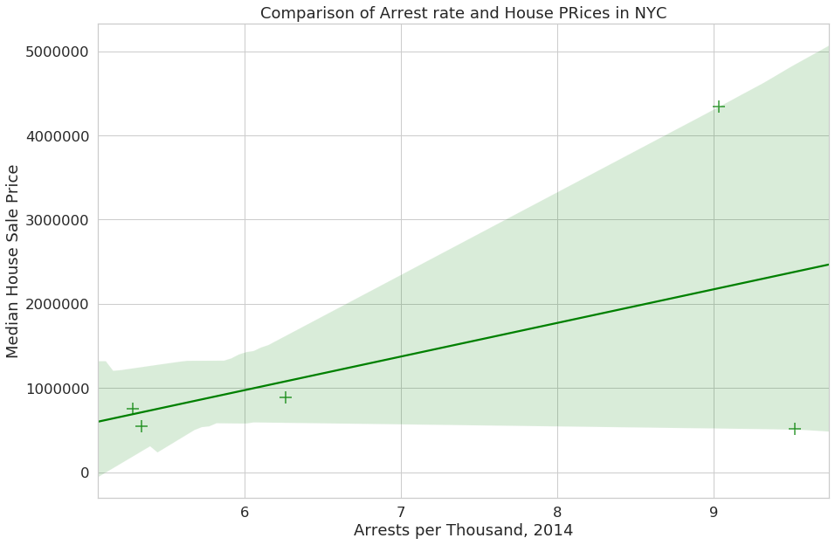
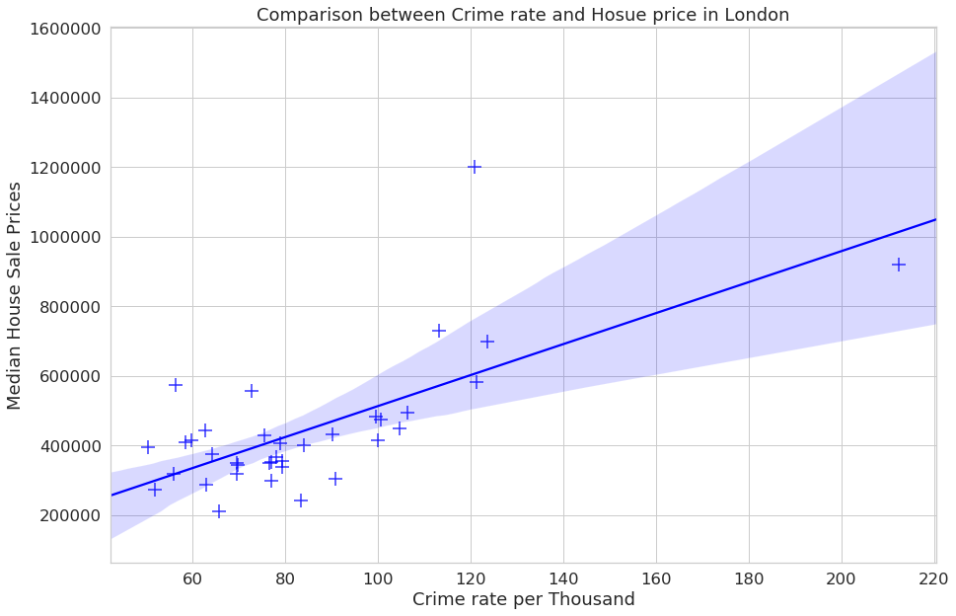
Regression
These graphs show regression between crime rate and houding price in each borough of each city. This is very interesting finding, where as crime rate increases, the house prcies increase too. This correlation does not mean causation.

Slide 5
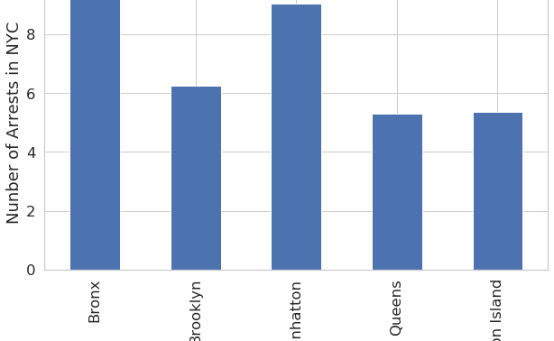
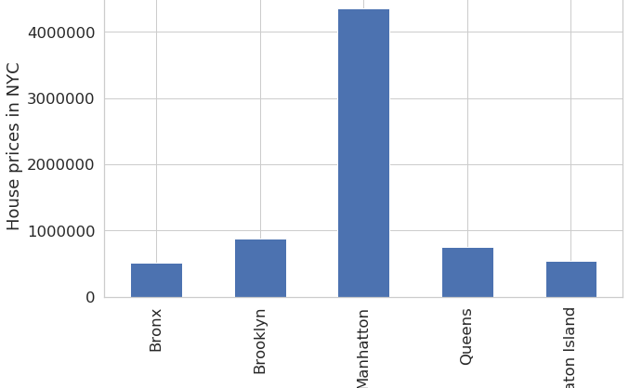
Bar Graph - New York
These bar graphs show the comparison of each factor to the boroughs in New York City.
As you can see, Manhattan has the most expensive houses but they are also the second highes arrest rate in the city.

Slide 6
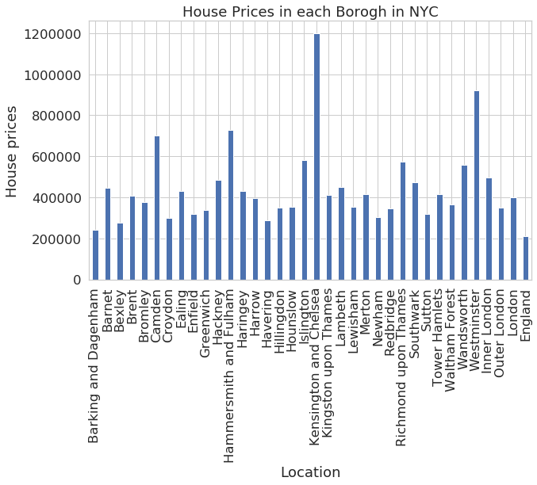
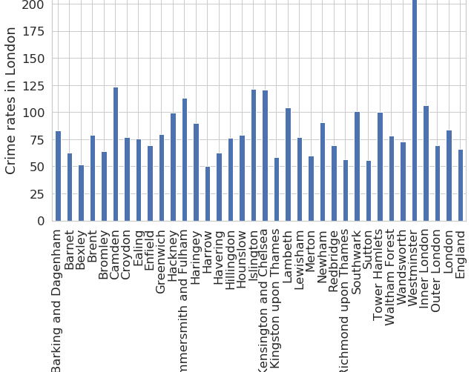
Bar Graphs - London
These bar gtaphs show that comparison of each factor against the Boroughs of the City of London.
It is easy to see that there are more boroughs in London than there are in New York.

Slide 7
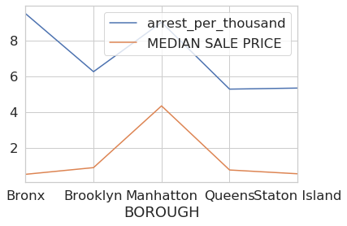
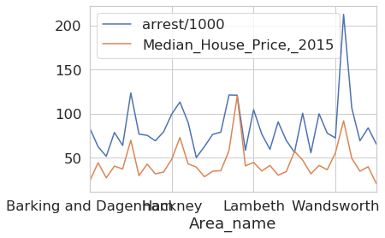
Line Graphs
These line graph show both factors:crime rate and house prices, in each borough.
It shows a very similar correlation between the house price and the crime rate.

Slide 8
Comparing
New York City
The City of London
Using the data we found alone, the two best Boroughs to start a business in are:
Queens
Statton Island’
We will use these to try and find where is best to start.
The two best boroughs in London to start up a business is either:
Bexley
Harrow
These will be compared to with New York City in the next section.

Slide 9
Foursquare – Coffee Shops
Foursquare?
The four boroughs:
Queens, NYC
Statton Island, NYC
Harrow, LDN
Bexley, LDN
Using the coffee shop information both Harrow and Statton Island don’t have many coffee shops so wont be the best place to set up the business.
Queens have more coffee shops and is in a better location than Bexley, so this would be the best place.
It is beneficial to start up a business around a coffee shop so you won’t have to buy a coffee maker.
Foursquare is a website that uses their users to find and review places around major cities. It is a very useful tool.

Slide 10
Overall
Using the information from reputable sources, we have made informative graphs and also compared the differences between New York and London.
Further analysis
Next time, it would be best to compare more factors to house prices as more factors would afftect where to set up a new business.

Slide 11
Thank you for watching
By Heather Tymms

