Slide 1
Effect of predictor variables on CGRP.Coverage

Slide 2
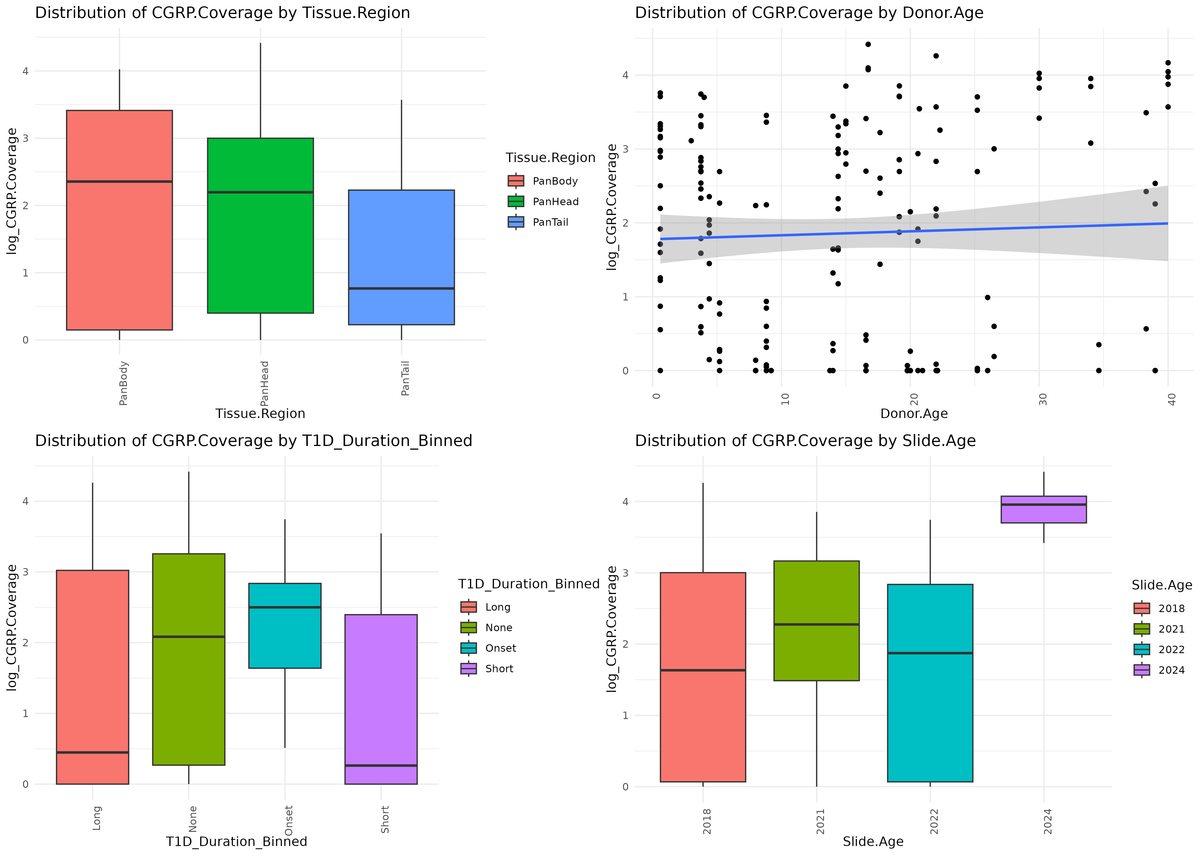

Slide 3
