Slide 1
Effect of predictor variables on SNAP25.high.threshold.coverage

Slide 2
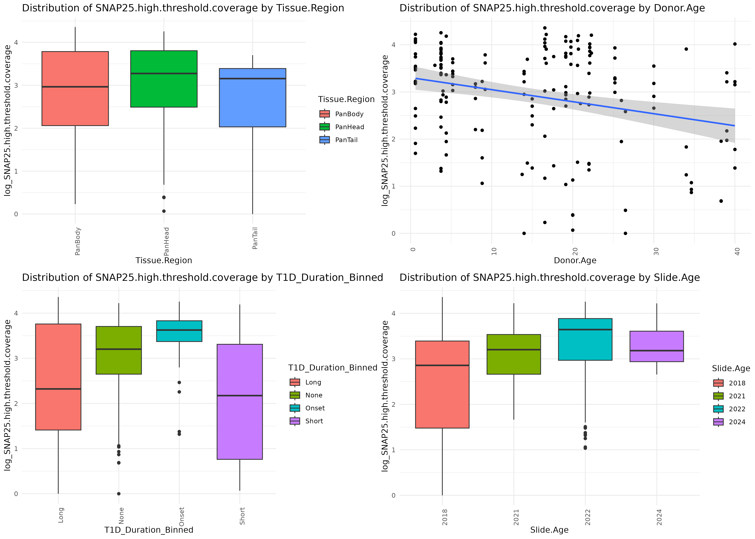

Slide 3
