Slide 1
Effect of predictor variables on SNAP25.low.threshold.coverage

Slide 2
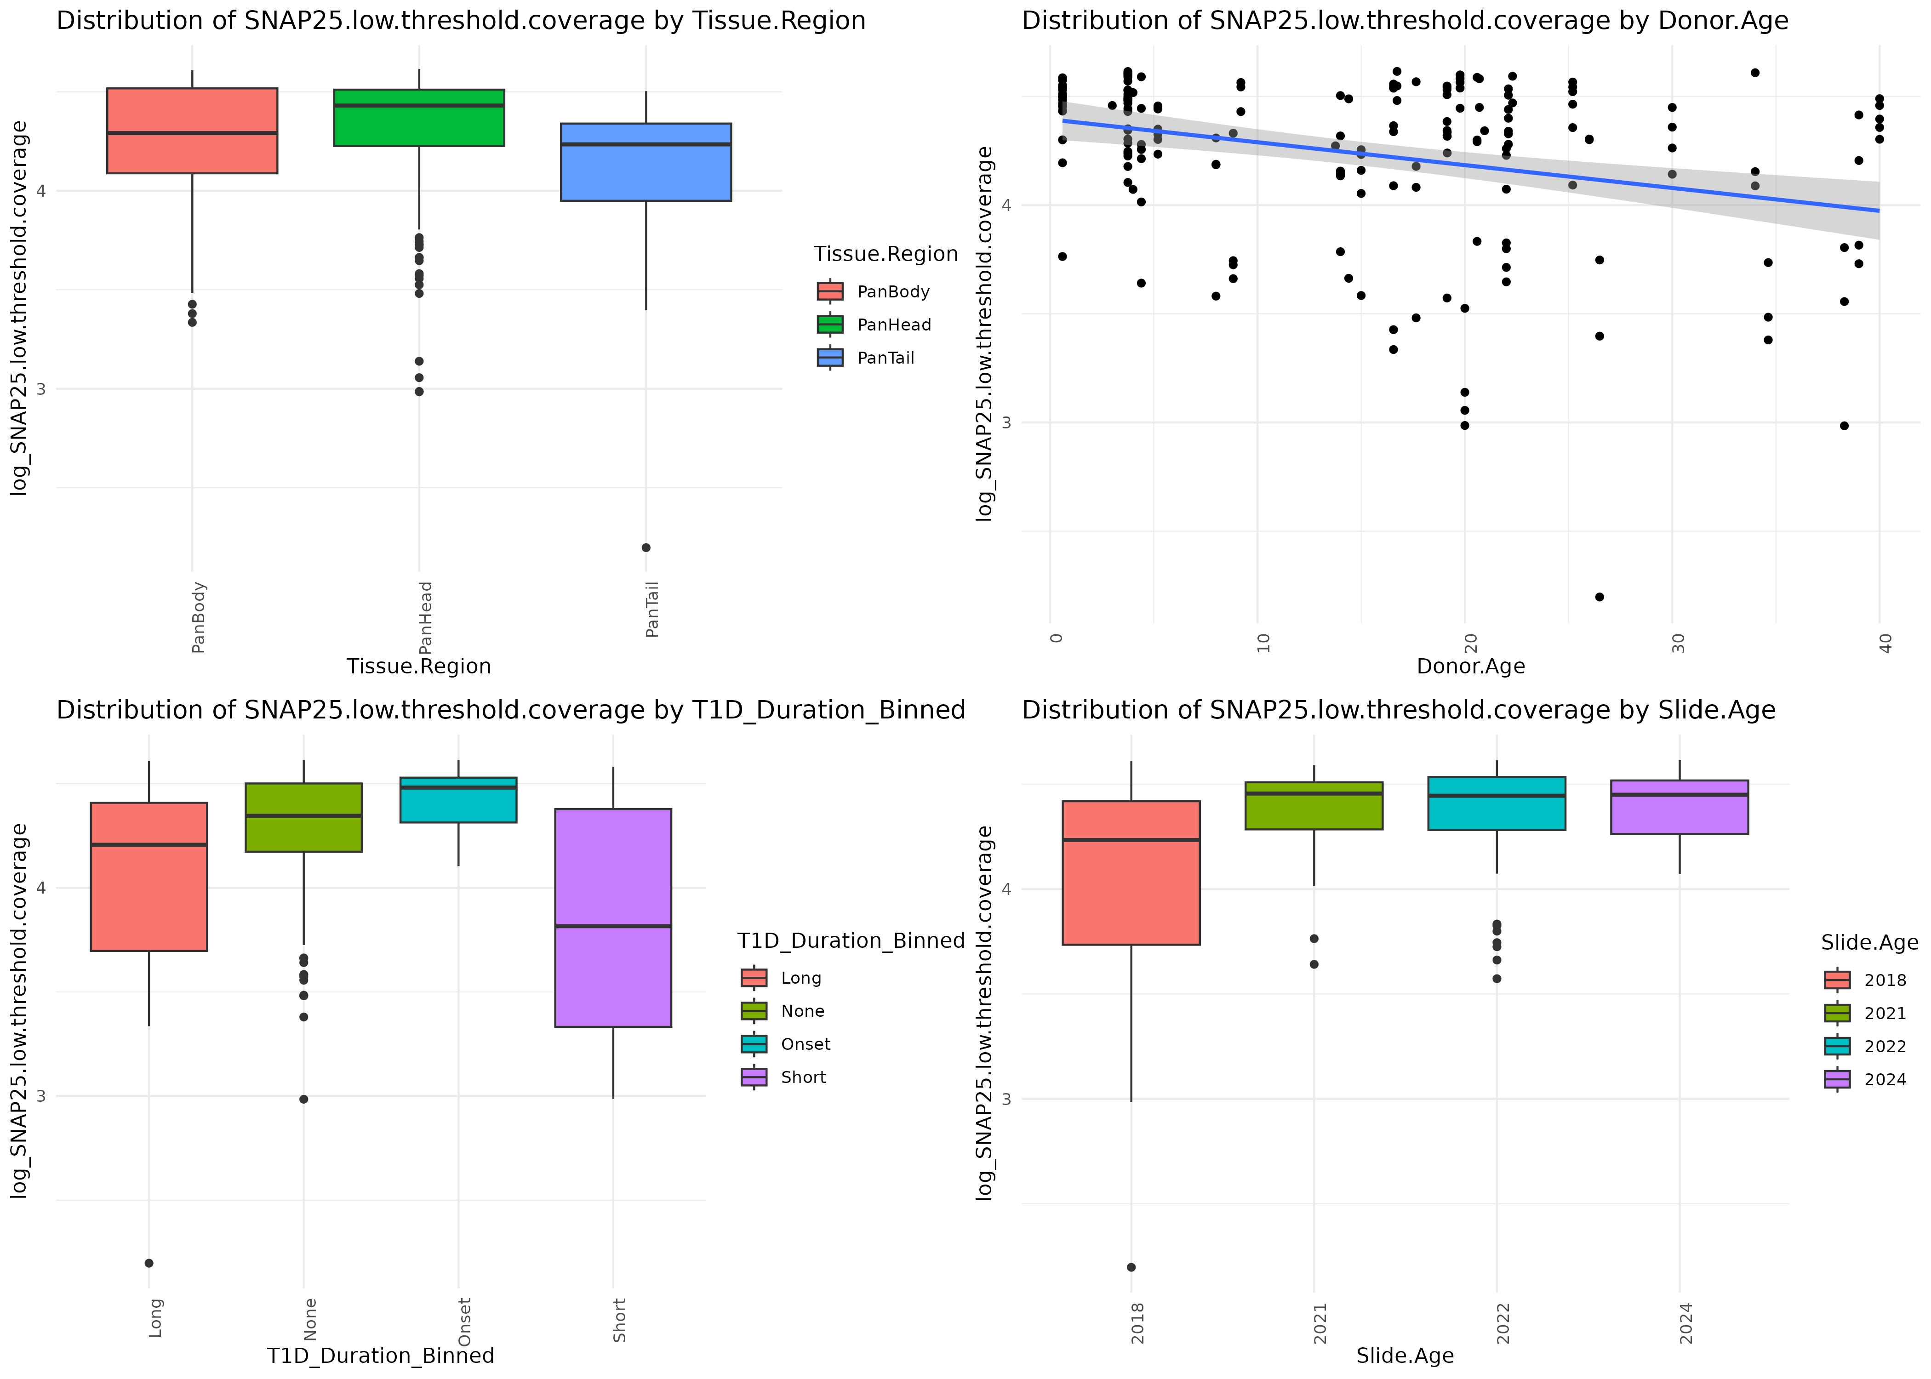

Slide 3
