Slide 1
Week 10

Slide 2
Warm-up (10 minutes)
Take the following list [0,1,2,3,4,5,6,7,8,9] and reverse it. Try to come up with the simplest way of doing this without using the reverse method.
Write a list comprehension to take the reversed list and divide each value by two.

Slide 3
Today's Activities
Warmup (15 mins)
Review Homework (20 mins)
Linear Algebra in Python (45 mins)
Break (15 mins)
More Complex Error Handling (10 mins)
Recursion (15 mins)
Group Exercise (60 mins)

Slide 4
Review homework (20 mins)
Please make sure you are discussing the homework in your rooms. If I come into them and no one is talking, we’re just going to stop giving you time to review homework in class.
Be brave!
Someone should share their screen
If someone has a different approach to one of the questions, that person should share their screen so you can discuss that approach
It is important to discuss your code so you can grow

Slide 5
Linear Algebra
Vector math
What is a vector?
Has magnitude and direction
Matrix Math
Practically we use this for PCA and One-Hot encoding

Slide 6
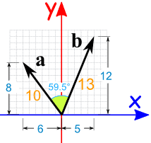
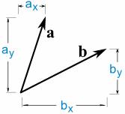
Dot product
BUT, if all we have is the vector itself:

Slide 7
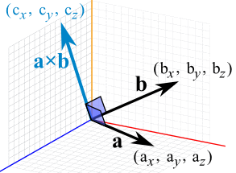
Cross product

Slide 8
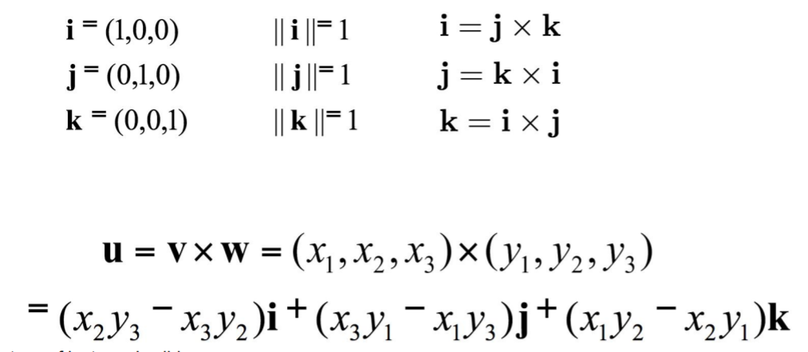
Cross Product

Slide 9
One Hot Encoding
A vector representation of a categorical value
This is a type of preprocessing used in machine learning
We will talk more about this in a few weeks!
So, you are converting categories to numbers so they can be processed better and more efficiently!
You are creating dummy variables… BUT This can lead to the Dummy Variable Trap
Notes:
https://www.educative.io/edpresso/one-hot-encoding-in-python

Slide 10
Dummy Variable Trap
Independent variables are multicollinear
Simply: variables are highly correlated, and one can be predicted from one or more others
Example: creating a dummy variable for male and a dummy variable for female is redundant

Slide 11
I cannot possibly teach you everything there is to know about linear algebra in an hour. STLCC has affordable linear algebra classes if you have taken calculus. Some are even remote.

Slide 12
Break (15 Minutes)
Attendance word: OutstandingOpsEngineer

Slide 13
Why is error handling important?

Slide 14
Recursion
Recursion = when a function calls itself
Recursion is regularly asked about in entry-level data scientist and data engineer interviews.
It is possible to write a function that never terminates, so be careful!
You will get memory issues (stack overflows) if you mess it up, which you will. It uses a ton of memory to do recursion in general in imperative languages.

Slide 15
Week 10 Group Exercise
Once you finish and have submitted your exercise in Canvas via a github link, use the remaining time to work on your homework.

