Slide 1
Week 23

Slide 2
Warm-up (10 minutes)
What is object-oriented programming? How have we used objects in this class?
What’s the difference between a REST API and CRUD API?

Slide 3
Today's Activities
Warmup (15 mins)
Review Homework (15 mins)
NoSQL DBs Reading (15 mins)
Mongo DB (30 mins)
Break (15 mins)
Final Project Breakout (30 mins)
Group Exercise (60 mins)

Slide 4

Next week is our last class! Please come prepared to present your final project. Also, think about something you learned that you found interesting AND be prepared to share what the next topic is you plan to learn about.

Slide 5
Review Homework

Slide 6
Questions from Reading
Why is MongoDB considered to be a non-relational database? What does it mean for a database to be “non-relational”? How does that differ from “relational” databases?
What are the four types of NoSQL databases? What type is MongoDB? How does that type work?
Notes:
https://www.mongodb.com/nosql-explained

Slide 7
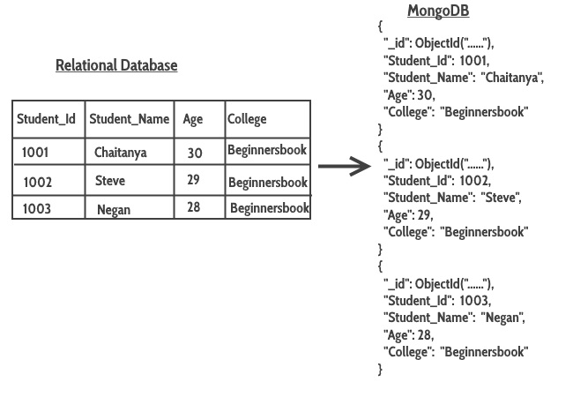
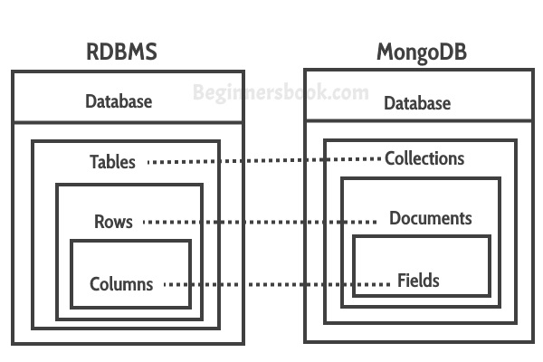
Notes:
https://beginnersbook.com/2017/09/mapping-relational-databases-to-mongodb/

Slide 8
ACID vs CAP
ACID
CAP
Guiding principles for SQL DBs
Atomicity, Consistency, Isolation, and Durability
Focused on reliability and consistency of data
Guiding principles for NoSQL DBs
Consistency, Availability and Partition
Focused on high availability of data

Slide 9
Break (15 Minutes)
Attendance word:CSSConjurer

Slide 10

Group Project Work (30 mins)

Slide 11
Week 23 Group Exercise
Once you finish and have submitted your exercise in Canvas via a github link, use the remaining time to work on your homework.

