Slide 1
Week 14

Slide 2
Warm-up (10 minutes)
What is linear regression? What kind of problems can you solve with it?
What is K-nearest neighbor? What kind of problems can you solve with it?

Slide 3
Today's Activities
Warmup (15 mins)
Review Homework ( 20 mins)
Multiple Linear Regression (25 mins)
Break (10 mins)
Logistic Regression (25 mins)
Other Ways to Evaluate Models Besides Using Accuracy (10 mins)
Group Exercise (45 mins)
Project 2 group work (30 mins)

Slide 4
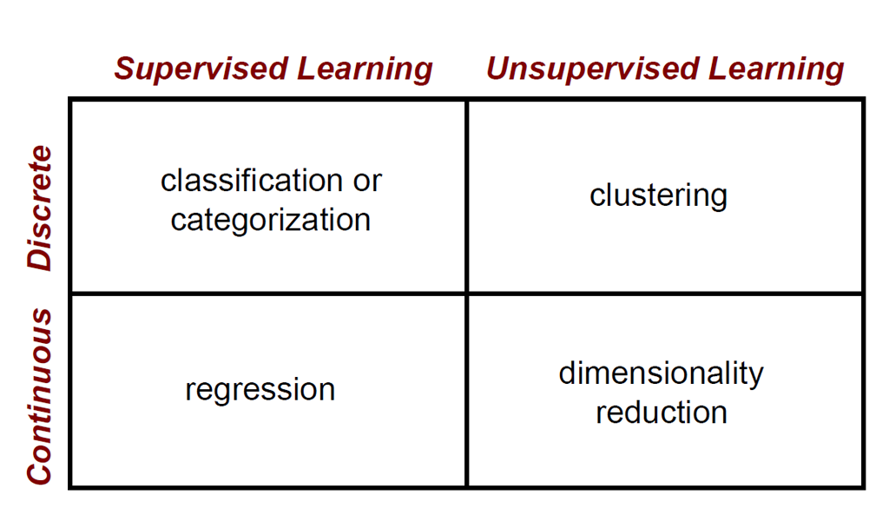

Slide 5
Multiple Linear Regression
Multiple linear regression predicts a dependent variable from MULTIPLE independent variables. “Multivariate” means the result is a vector.
How do we know which columns to choose? We look at correlations, we compare the R² values before and after a feature is added, and sklearn.feature_selection has many functions to assist with feature selection. *
y = m1x1 + m2x2 + m3x3 + … + b
Use mean squared error and R² (R-squared) to validate model performance.
*really, this depends on the shape of the data. There are other statistical models and tests like ANOVA that we won't discuss here

Slide 6
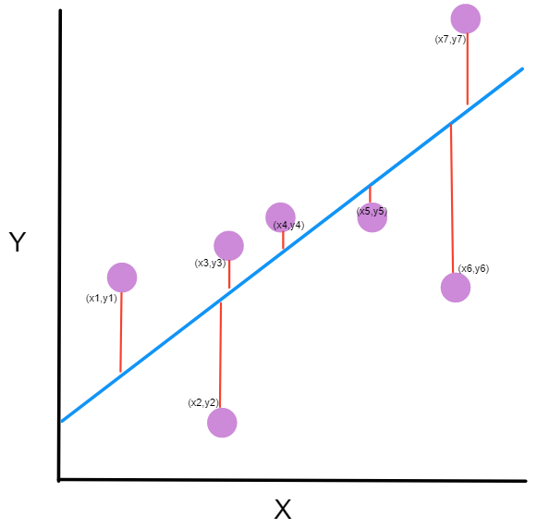
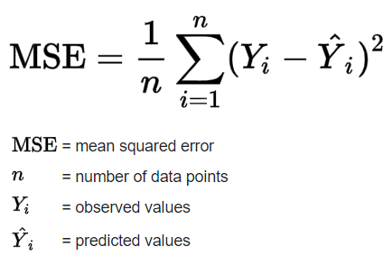
Mean Squared Error
Notes:
https://www.freecodecamp.org/news/machine-learning-mean-squared-error-regression-line-c7dde9a26b93/

Slide 7
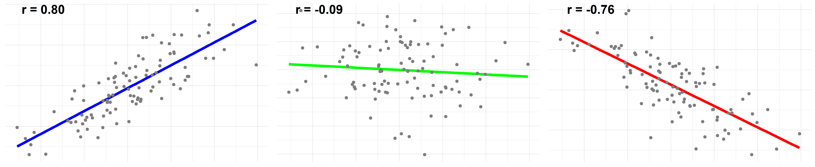
R and R-Squared
R is the correlation between two variables
R² is the square of the correlation
R² represents how close the data is to the regression line OR how well the model fits the raw data
R² is between 0 and 1, and the closer this value is to 1 the more variability is explained by the model

Slide 8
Break (10 Minutes)
Attendance word:CSSConjurer

Slide 9
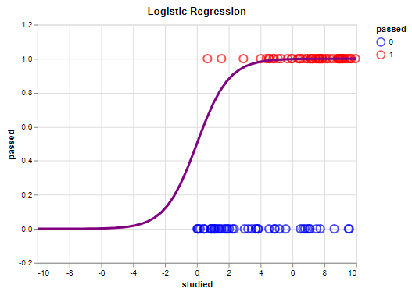
Logistic Regression
Used when trying to predict the answer to a yes/no question or any binary question
Response follows an S-shaped curve

Slide 10
Questions from the Reading
Why can’t linear regression work for the types of problems we use logistic regression for?
What is complete separation? Why is it a problem?
Notes:
https://christophm.github.io/interpretable-ml-book/logistic.html

Slide 11
Ways to Evaluate Models
Accuracy = true positives + true negatives
tp+ tn+fp+fn
Precision = tp_____
tp + fp
Recall = tp_____
tp + fn
F1score = 2* precision*recall
precision + recall

Slide 12
Week 14 Group Exercise
Once you finish and have submitted your exercise in Canvas via a github link, use the remaining time to work on your homework.

