Slide 1
Week 09

Slide 2
Warm-up (10 minutes)
Use the agg function to find the mean, median, and standard deviation of the price for the belize Airbnb data (in week 4). Describe what you’re seeing in as simple of terms as possible.
Use the documentation:
https://pandas.pydata.org/docs/reference/api/pandas.DataFrame.agg.html

Slide 3
Today's Activities
Warmup (10 mins)
Presentations (75 mins)
Break (15 mins)
Basic Probability in Python (30 mins)
Group Exercise (50 mins)

Slide 4
Presentations (75 mins)

Slide 5
Break (10 Minutes)
Attendance word: OutstandingOpsEngineer

Slide 6
What is probability?
Notes:
How frequently we expect an outcome to occur if we repeat an experiment over repeatedly.

Slide 7
Random Variables
A random variable, x, is a variable where the possible outcomes are a function of a random phenomena.
The probability for any event is between 0 and 1, inclusive
The summation of the probabilities of each outcome equals 1
We use a random seed to make sure our results are repeatable.

Slide 8
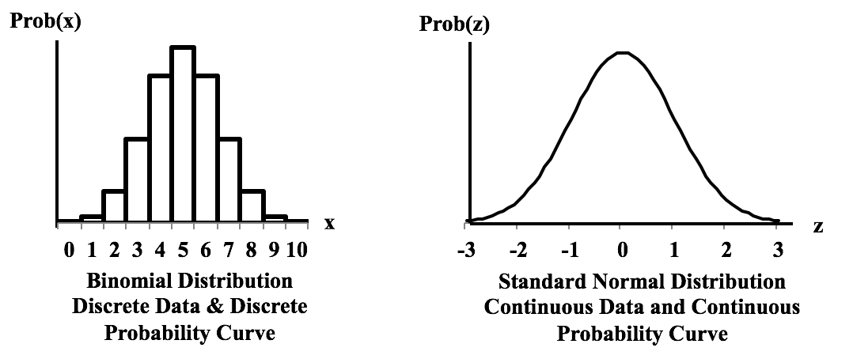
Discrete and Continuous
What is an example of something continuous? Discrete?
Notes:
statisticsfromatoz.com/blog/statistics-tip-of-the-week-different-distributions-can-have-discrete-or-continuous-probability-graphs-for-discrete-or-continuous-data

Slide 9
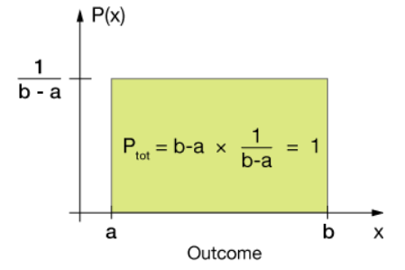
Uniform Distribution
Notes:
https://xaktly.com/UniformProbDistr.html

Slide 10
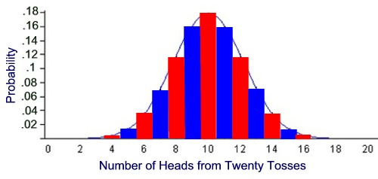
Binomial Distribution
Notes:
https://mathbitsnotebook.com/Algebra2/Probability/PBBinomialProbNormalCurve.html

Slide 11
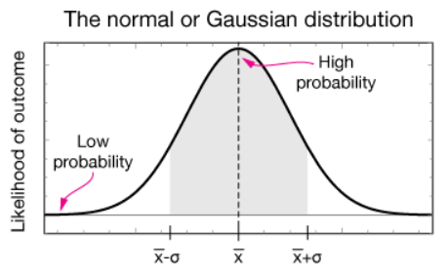
Normal Distribution

Slide 12
Expected Value
Law of large numbers – as the sample size increases the sample mean gets closer to the population mean
Uniform distribution – for a random variable, expected value is (a+b)/2, where a is the maximum possible value and b is the minimum
Binomial distribution – mean is the expected value, which is equal to n trials * p probability
Standard normal distribution – mean

Slide 13
Practice (5 mins)
What is the point of creating a random seed in probability?
What is the expected value for the number of heads in 50 trials of coin tosses?

Slide 14
Week 9 Group Exercise
Once you finish and have submitted your exercise in Canvas via a github link, use the remaining time to work on your homework.

