Slide 1
Week 18

Slide 2
Warm-up (10 minutes)
How do you evaluate the performance of your model when you’re trying to predict a continuous variable? Why?
Take a numpy array [1,2,3,4,5,6] and multiply each value in that array by 3 as simply as possible.

Slide 3
Today's Activities
Warmup (15 mins)
Review Homework (15 mins)
Intro to Neural Networks (40 mins)
Break (15 mins)
Neural Networks (35 mins)
Group Exercise (60 mins)

Slide 4
Class Memo
To continue in this course, you must have completed 16 of the 17 assignments by today!
Remember, for the whole course, you can miss one assignment, but you must complete all your group projects.

Slide 5
Review Homework

Slide 6
AI is sometimes heralded as the new industrial revolution. If deep learning is the steam engine of this revolution, then data is its coal: the raw material that powers our intelligent machines, without which nothing would be possible – Francois Chollet, AI Researcher and Author

Slide 7
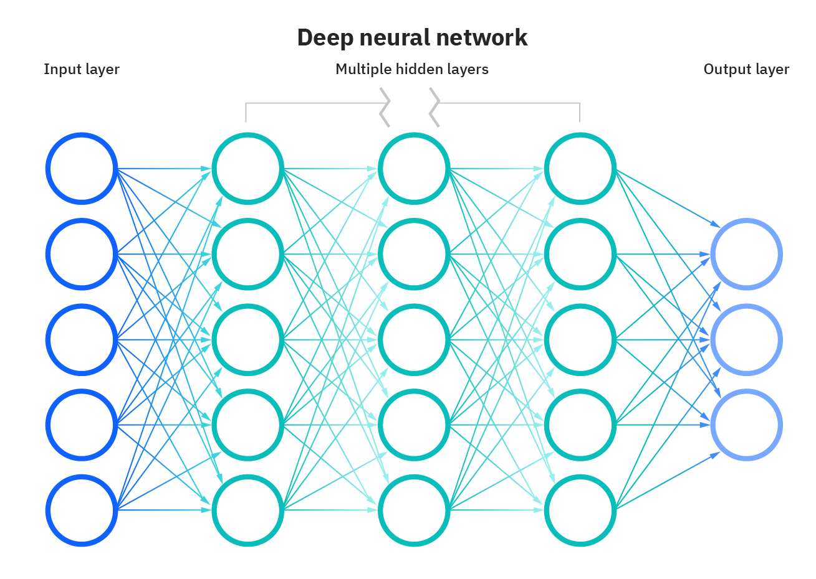
What is a Neural Network?
Process that mimics the human brain to understand patterns in data
Each node is a “perceptron”, which is similar to multiple linear regression
The result of the perceptron feeds an activation function
Hidden layers fine-tune the results until the error is minimized
Deep learning algorithm - A neural network with more than three layers
Notes:
https://www.ibm.com/cloud/learn/neural-networks

Slide 8
Thought exercise (5 mins)
What are the steps your brain goes through when a deer runs out in front of your car?
Eyes take in movement and resolves into realization and categorizes – flight response
Panic – gasp, swear, yell
Check rear-view mirrors to see if you will get rear ended
Breathing fast
Step on brakes, swerve, slow down, drive onto shoulder

Slide 9
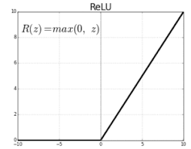
ReLU and Activation Functions
Activation functions allow our algorithm to learn more complex patterns in the data
Simplest non-linear equation is ReLU:
if input > 0:
return input
else:
return 0
Can use more complicated activation functions like tanh, but ReLU is sufficient and super performant for a wide variety of problems
Notes:
https://ailephant.com/glossary/relu-function/

Slide 10
Forward and Backward Propagation
Forward – takes input values and propagates forward through the hidden layers to the output. Used to calculate predictions and errors.
Backward – go back one layer at a time from output to input to see how small changes impact the difference between the predicted and actual values. Working to minimize the loss function.

Slide 11
Questions from Reading
In your own words, what is a loss function? Why do we need them?
What type of loss functions are there? Which one makes the most sense for our diabetes dataset?

Slide 12
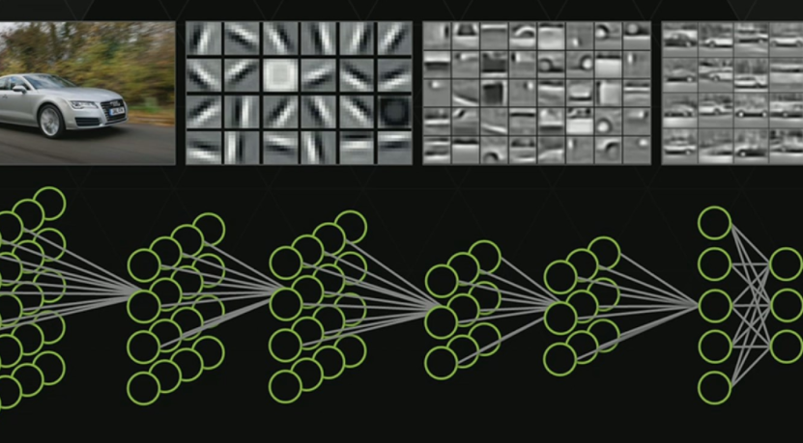
How do Neural Networks Learn?
They are usually used for supervised learning, so there is an answer they can tune to.
Backpropagation is critical to the learning process
Notes:
https://itnext.io/machine-learning-neural-networks-and-algorithms-4cd27a105b89

Slide 13
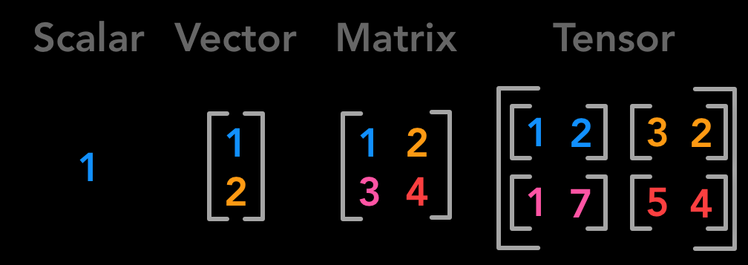
What is a tensor?

Slide 14
Break (15 Minutes)
Attendance word:CSSConjurer

Slide 15
Questions from Reading
What is a multilayer perceptron?
Which approach to improving model stability was the most successful for the example in the reading? Why do you think that was?
Notes:
https://machinelearningmastery.com/how-to-improve-neural-network-stability-and-modeling-performance-with-data-scaling/

Slide 16
Week 18 Group Exercise
Once you finish and have submitted your exercise in Canvas via a github link, use the remaining time to work on your homework.

