Slide 1
Week 20

Slide 2
Warm-up (10 minutes)
How do you avoid overfitting your model?
What is the difference between univariate, bivariate, and multivariate analysis?

Slide 3
Today's Activities
Warmup (15 mins)
Review Homework (15 mins)
Natural Language Processing (30 mins)
Tokenization (15 mins)
Break (15 mins)
More NLP (30 mins)
Group Exercise (60 mins)

Slide 4
Review Homework

Slide 5
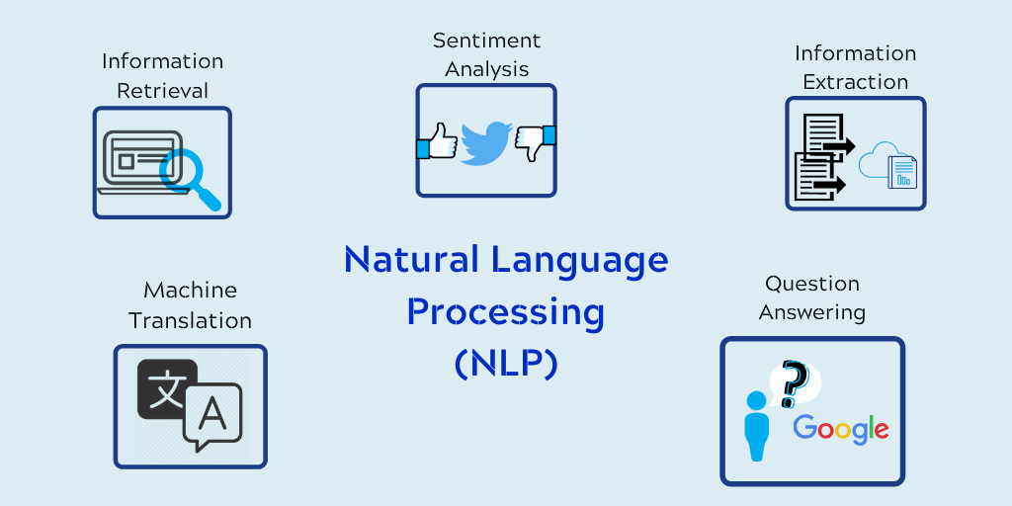
Natural Language Processing
Taking information in natural language text and processing it with code to learn more. AKA Computational Linguistics
This discipline takes programming concepts and applies them to linguistics
Process of teaching computers our language
Notes:
https://www.cybiant.com/resources/natural-language-processing/

Slide 6
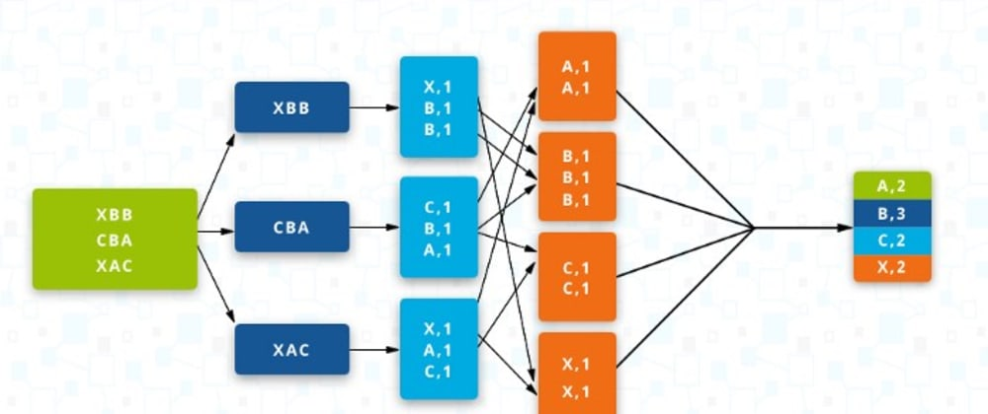
Map Reduce
Data processing paradigm for taking large volumes of data and condensing it into aggregate results
One way we can find out the total number of times a value exists in a block of text
We can then infer the focus of the text
Notes:
https://dev.to/grozail/my-first-map-reduce-without-hadoop-in-pure-python-40hg

Slide 7
Steps in Comprehensive NLP System
Tokenization – separating text into smaller tokens that can be analyzed.
Morphological Analysis – word formation
Syntactic Analysis – sentence structure
Semantic Analysis – meaning
Pragmatic Analysis – understanding
Natural language generation – perhaps surprisingly, this is not as hard as understanding language

Slide 8
Questions from Reading
What is tokenization? What are some issues that arise with it?
What is hyphenation?
Notes:
https://nlp.stanford.edu/IR-book/html/htmledition/tokenization-1.html

Slide 9
Break (15 Minutes)
Attendance word:CSSConjurer

Slide 10
Week 20 Group Exercise
Once you finish and have submitted your exercise in Canvas via a github link, use the remaining time to work on your homework.

