Slide 1
Week 16

Slide 2
Warm-up (10 minutes)
What is KNN? How does it work? How is it evaluated? Be concise. These are the kind of questions that are asked in data science interviews.
Write a lambda that takes the following list and returns only the odd values in it. [1, 2, 3, 4, 5, 6, 7, 8, 9, 10] .

Slide 3
Today's Activities
Warmup (15 mins)
ETL Code Reviews (75 mins)
Break (10 mins)
Decision Trees (35 mins)
Group Exercise (45 mins)

Slide 4
Class Memo
To continue in this course, you must have completed 16 of the 17 assignments by January 26th!
Remember, for the whole course, you can miss one assignment, and your in-class activity AVERAGE needs to be greater than or equal to 70%.

Slide 5

ETL Code Reviews

Slide 6
Break (10 Minutes)
Attendance word:TerrificTSQL

Slide 7
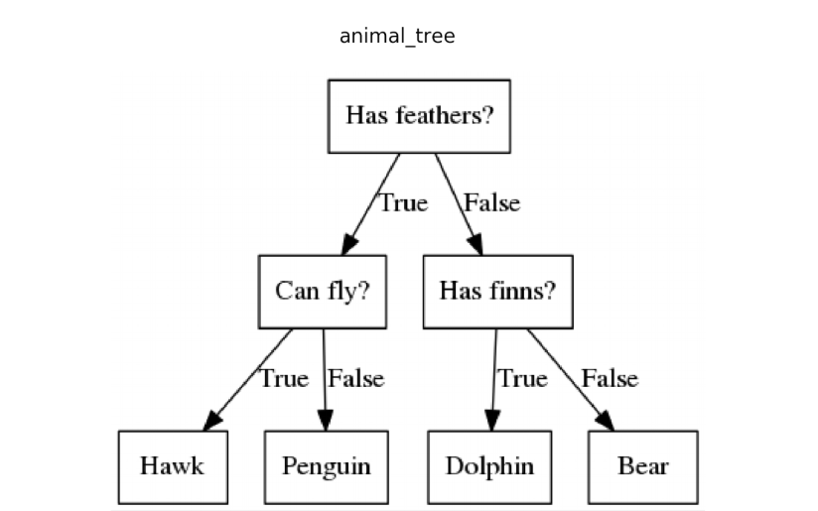
Decision Tree
Notes:
https://towardsai.net/p/programming/decision-trees-explained-with-a-practical-example-fe47872d3b53

Slide 8
Decision Trees
Decision tree – a type of supervised learning algorithm where each node represents a choice between different alternatives. This process involves splitting the data up into multiple parts with a list of rules to guide predictions.
Inductive reasoning – go from specific observations to general conclusions. Decision trees are inductive.
Deductive reasoning – specific conclusion that follows general theory
1) All men are mortal
2) Socrates is a man
Therefore: Socrates is mortal

Slide 9
Questions from the Reading
What are the main splitting criteria for decision trees? How would you choose between them?
What are some ways to tune decision trees to improve accuracy?
Notes:
https://datascience.foundation/sciencewhitepaper/understanding-decision-trees-with-python

Slide 10

Information Gain
Information theory – information value of a message depends on how surprising the content of a message is
Information is measured in bits
Entropy – the average level of uncertainty in the variable’s possible outcomes… converted to bits
With a coin, the maximum surprise is 1-p or ½
The minimum surprise is 0, if your prediction is correct
A low probability event has high information (since it is surprising)

Slide 11
Week 16 Group Exercise
Once you finish and have submitted your exercise in Canvas via a github link, use the remaining time to work on your project

