Slide 1
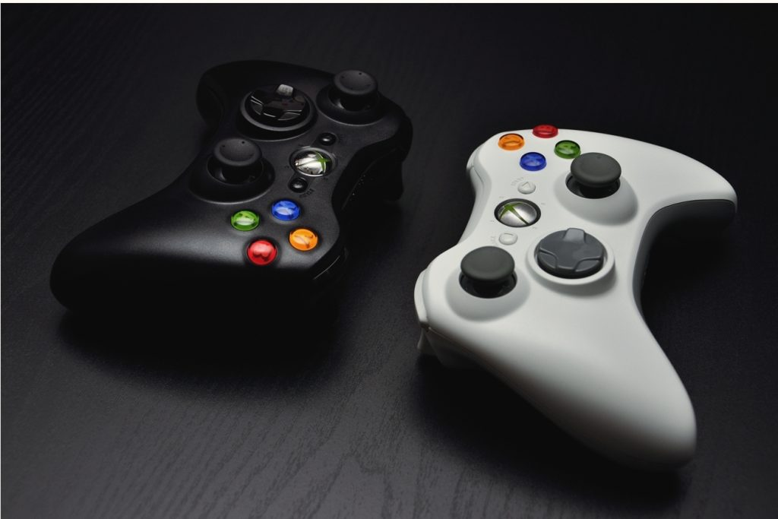

GameCo
Budgeting Strategy 2017
for GameCo
by Heather Stewart
This Photo by Unknown Author is licensed under CC BY-SA-NC

Slide 2
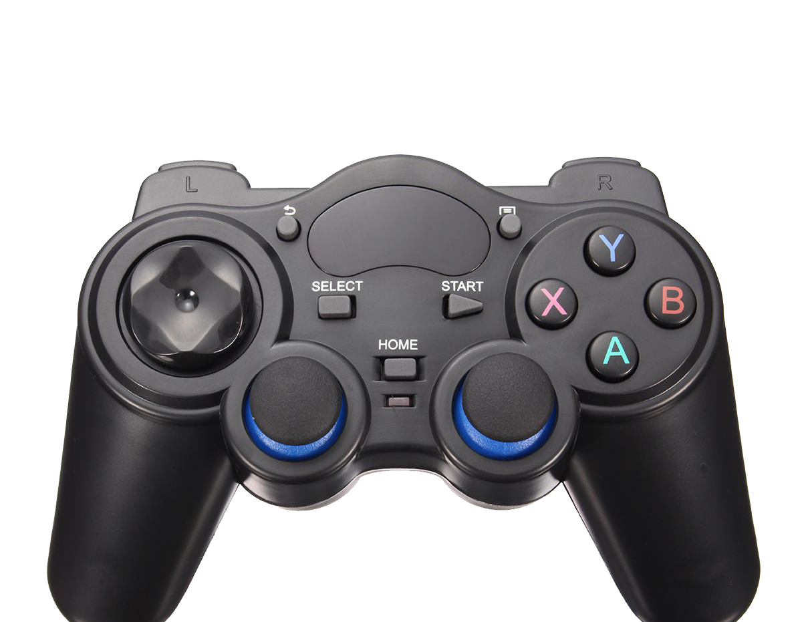
AGENDA
INTRODUCTION
REGIONAL SALES OVERTIME
PROPORTION OF REGIONAL SALES
Global Sales by Genre
Genre by Regions (NA,EU and JP)
Global Platform Sale
Platform Sales by regions
Review
RECOMMENDATION
CONCLUSION
This Photo by Unknown Author is licensed under CC BY-NC

Slide 3

Introduction
Using sales data of top sales regions from 1980-2016 to make educated marketing budget decision for 2017
Analyzing the top selling regions (North America, Europe, Japan) in proportion to Global sales.
Looking at the sales trends of games by genre and platform to also drive the final budgeting decision
This Photo by Unknown Author is licensed under CC BY

Slide 4
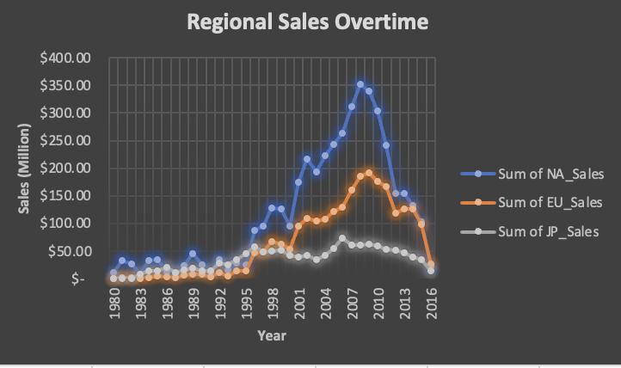
Hypotheses rejected: It shows that sales in all regions have not been the same

Slide 5
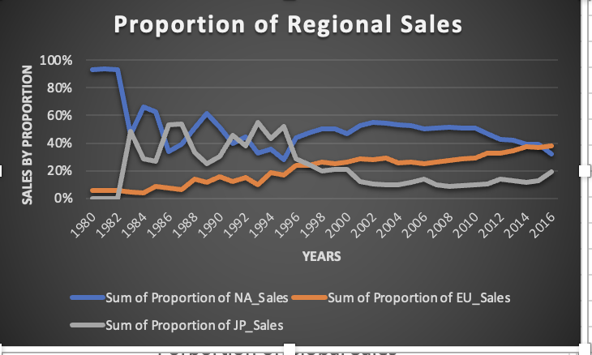
1982-1996 NA and JP sales have dominated the market and declined since. EU Sales has progressively rise throughout the years and have recently surpass NA sales.

Slide 6
Global Sales
by Genre

Slide 7
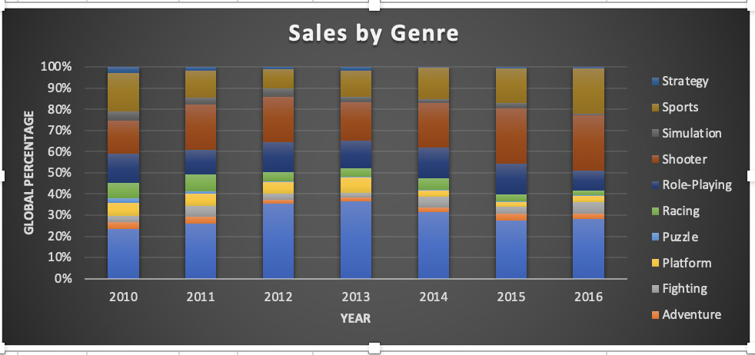
Top 3 Sellers by genre: Puzzle, Shooter & Sports

Slide 8
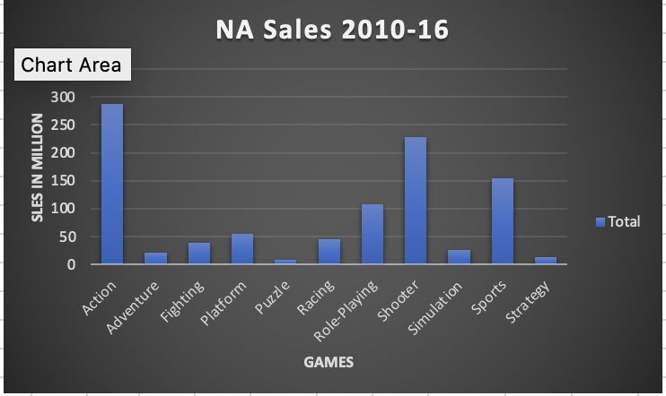
NA Top Genre: Action, Shooter & Sports

Slide 9
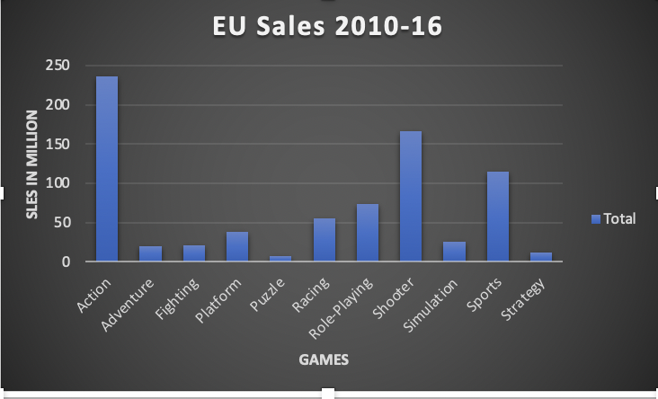
EU Top Genre: Action, Shooter & Sports

Slide 10
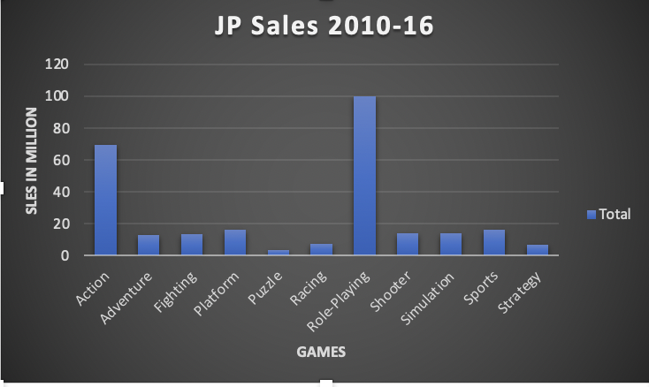
JP Top Genre: Action & Role Playing

Slide 11
Sales by
Platform

Slide 12
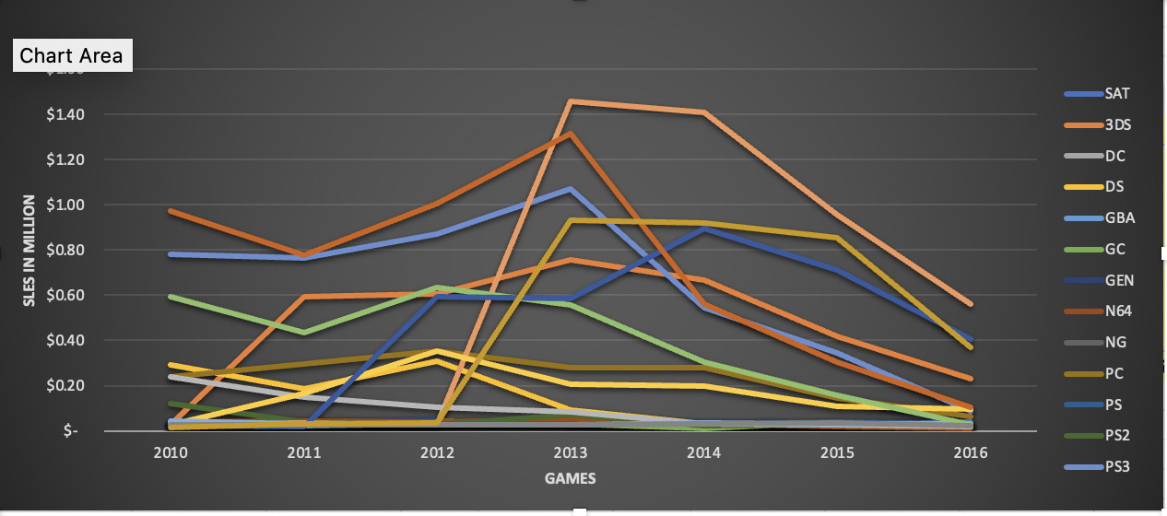
Global Sale by Platform
2013: PS4, X360, PS3 and Xone are best sellers
2013-15: Xone sold more than X360 and PS4

Slide 13
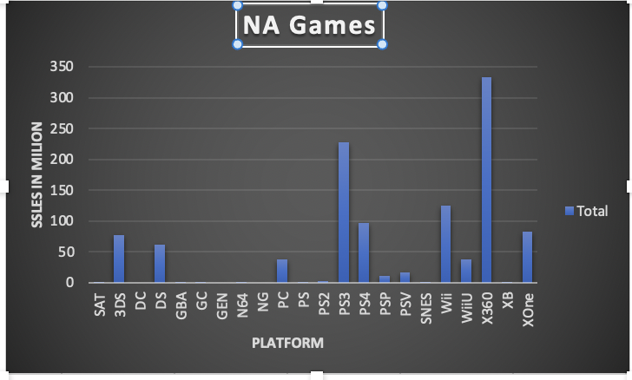
NA Top Platforms; PS3 and X360 and WII

Slide 14
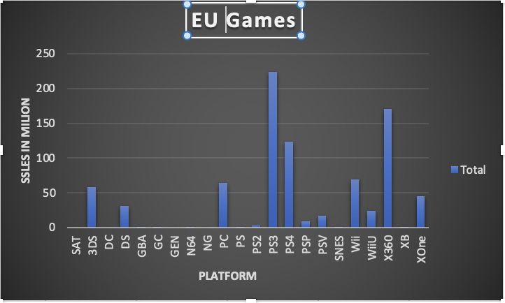
EU top Platforms: PS3, X360 and PS4

Slide 15
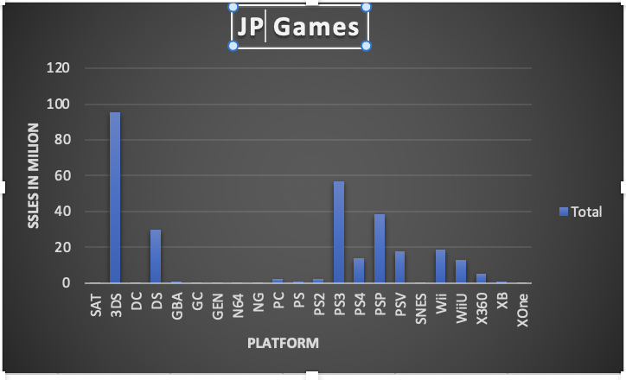
JP Top Platforms
3DS and PS3

Slide 16
REVIEW
We have observed that sales across all regions varies overtime, which rejects the first hypotheses
The proportion of Regional Sales relative to Global Sales shows that EU Sales is on a steady upward trend whereas both NA and JP sales shows mirroring reflections, JP is trending upward while NA is trending downward.
NA sales has dominated the market between 1996-2013, and shown a declined since 2013 relative to Global market
Sales by Genre in this region are Action, Shooter and Sports
Sales by Platform are PS4, X360 and WII
EU sales has also slowly progress overtime and has done better than JP market. Currently doing better than both NA and JP markets relative to Global sales
Sales by Genre in this market are Action, Shooter and Sport
Sales by Platform are PS3, X360 and PS4
JP sales had the least amount of traction and has slowly declined relative to Global market
Sales by Genre are Action and Role Playing
Sales by Platform are 3DS and PS3

Slide 17
RECOMMENDATION
Considering that Sales of Genre and Platform in both NA and EU are similar, marketing budget should be allocated to those games in both those regions.
JP market has the least sales volume and shows preference for different genres and platforms. Given this fact, the least marketing budget should be allocated there. However, it should be noted that cultural difference could be a major player in the receptiveness of marketing style and therefore should be researched and reassess.
Overall, most of the marketing budget should be targeted to the European market due to it slow continuous upward trend.
With sales in NA declining, marketing should target some its budget to research and development.

Slide 18
Thank YOU
Heather Stewart
This Photo by Unknown Author is licensed under CC BY-SA-NC

