Slide 1
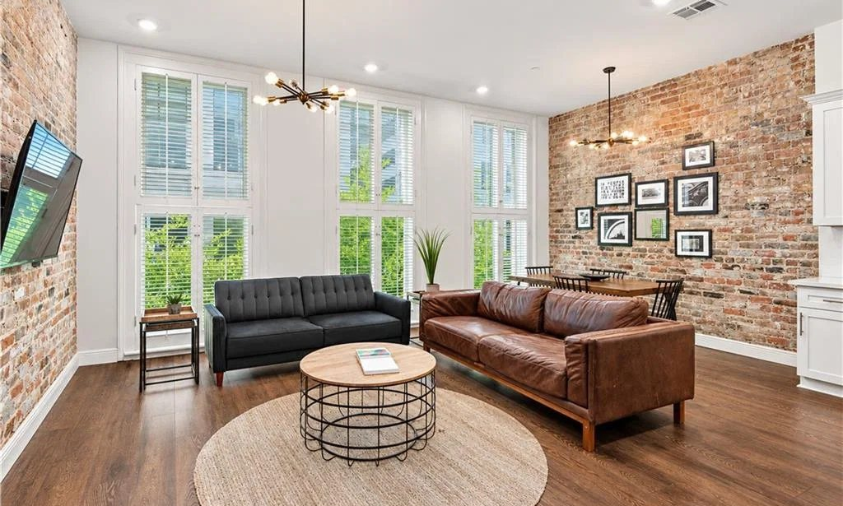
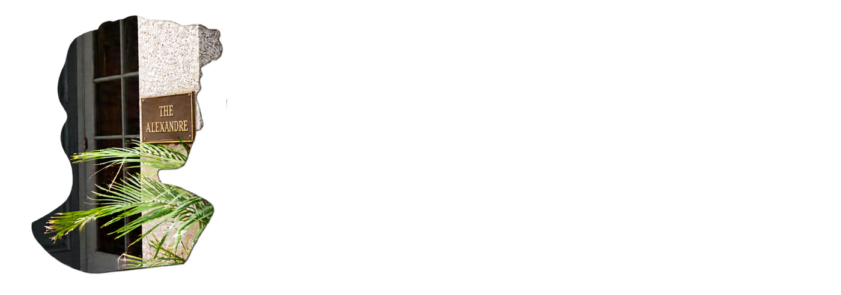
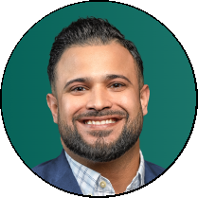
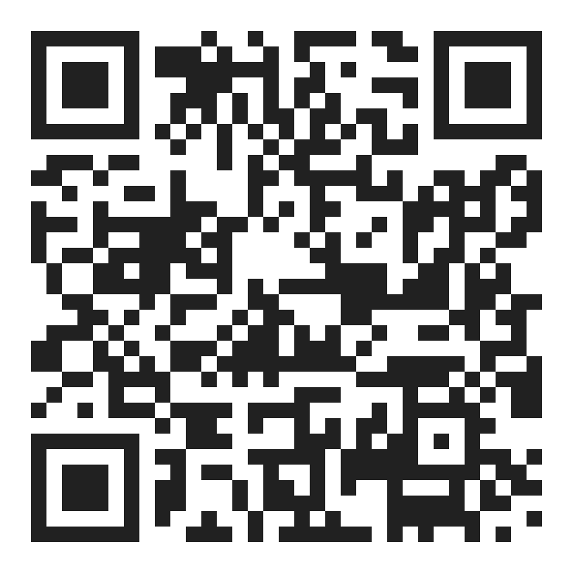

CONDO FINANCING AT THE ALEXANDRE
AS LITTLE AS
5%
Conventional condo financing for eligible primary‑residence buyers.
DOWN
YOUR LENDER
FINANCING BY
Nate DiGiovanni
Loan Officer | NMLS #1934694 | Eustis Mortgage
504.418.3416
| nate@eustismortgage.com
APPLY WITH NATE
Conventional financing offered by Eustis Mortgage Corporation.

