Slide 1
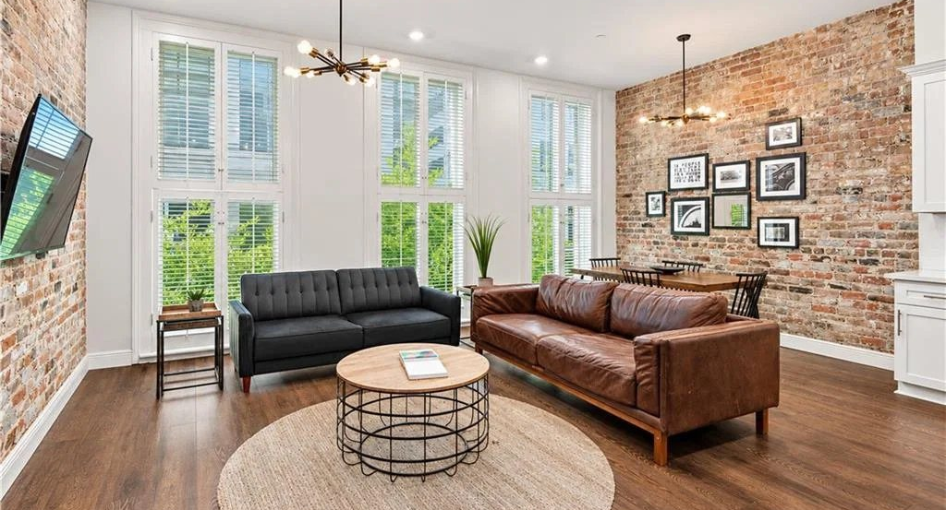
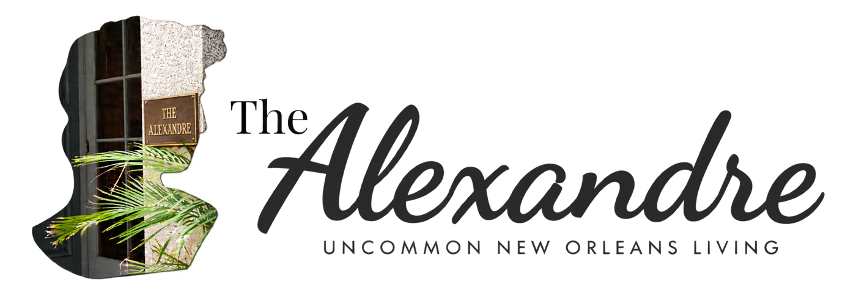
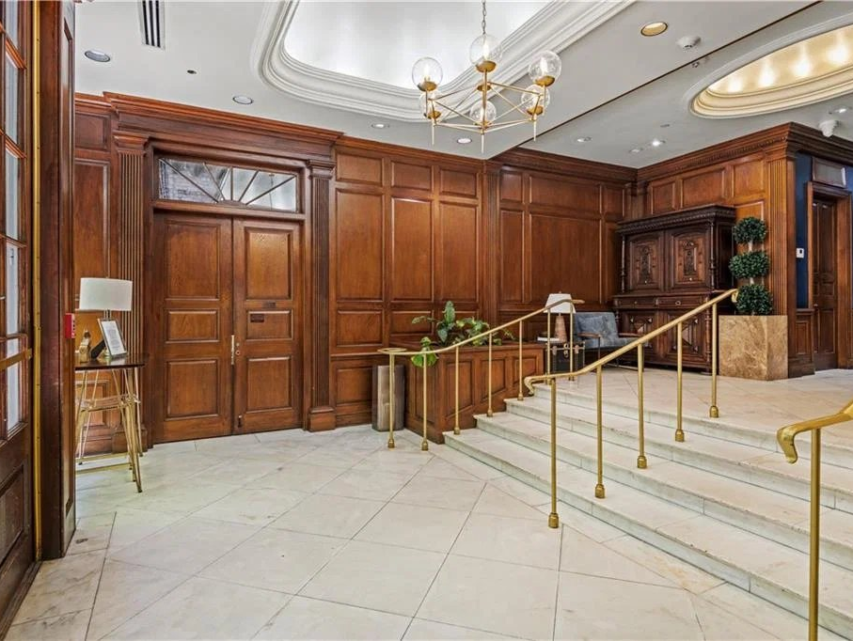
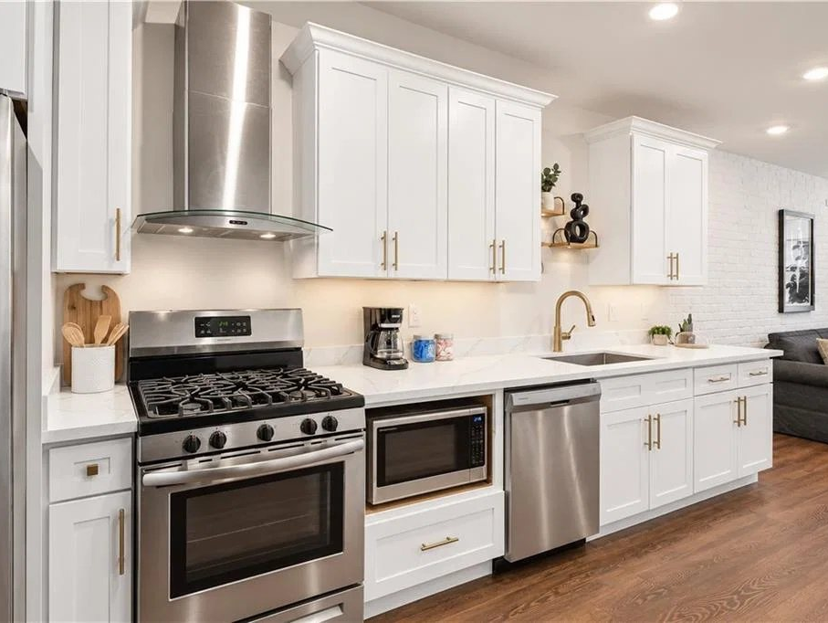
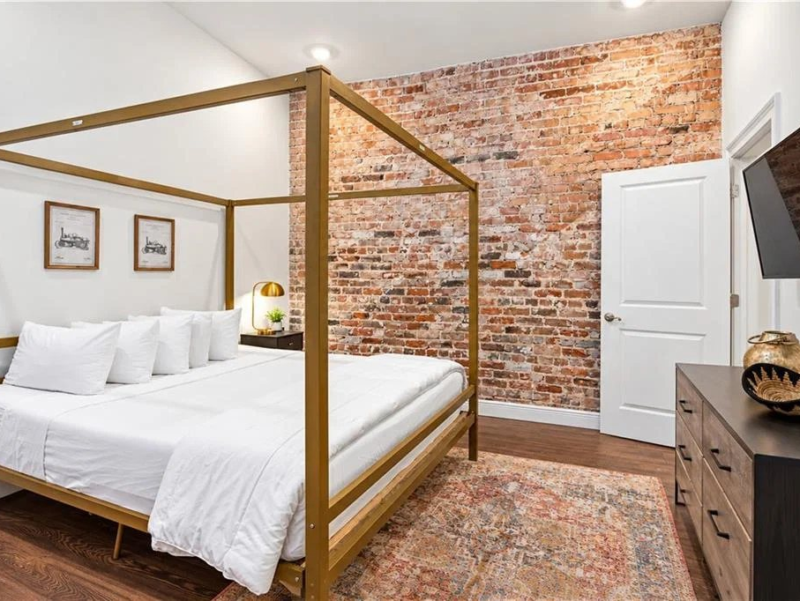
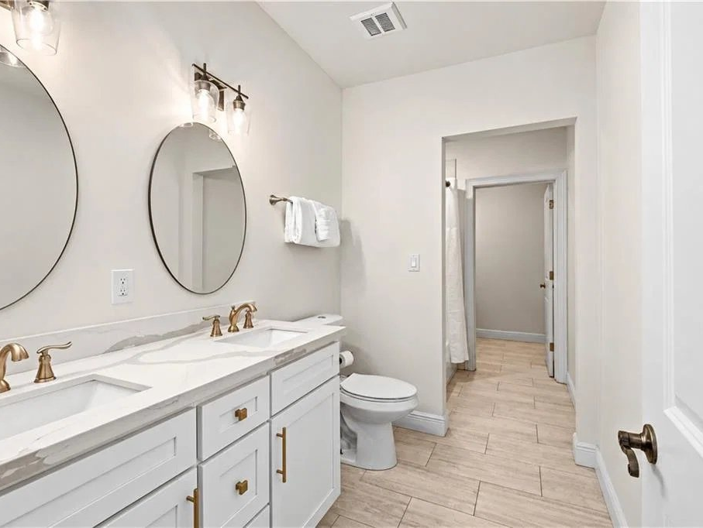

UNCOMMON NEW ORLEANS LIVING
Designed to be effortless.
Fully furnished condos with full-size appliances and elevator access, inside a historic building on New Orleans' original Newspaper Row.
AS LITTLE AS
Conventional condo financing for eligible primary‑residence buyers. Second home and investment condo financing also available.
5%
FINANCING BY
Nate DiGiovanni, Loan Officer
NMLS #1934694 | 504.418.3416
DOWN
EQUAL HOUSING
OPPORTUNITY
CONVENTIONAL FINANCING OFFERED BY EUSTIS MORTGAGE CORPORATION. NOT A COMMITMENT TO LEND. ALL BORROWERS ARE SUBJECT TO CREDIT APPROVAL. RATES AND TERMS MAY CHANGE AT ANYTIME WITHOUT NOTICE. NMLS #70345. SEE REVERSE FOR PAYMENT EXAMPLE.

Slide 2

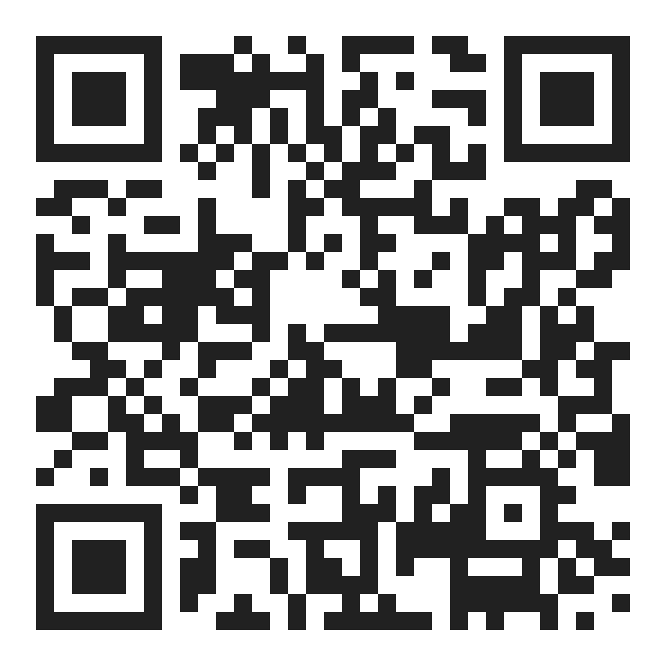



CONDO FINANCING AT THE ALEXANDRE
We can finance your condo at The Alexandre.
Eustis Mortgage has conventional financing available for condos in this building. A New Orleans lender since 1956.
FINANCING OPTIONS
AS LITTLE AS
Second home
5%
Primary residence
Contact for details.
Conventional condo financing for eligible buyers.
Investment property
DOWN
Contact for details.
HOW TO GET STARTED
01
02
03
Get prequalified
Tour the condos
Know your numbers
Talk with Nate about your budget and the financing options for your plans.
See available units at The Alexandre with Desiree McSwain.
Review your down payment, monthly payment, and cash to close before you buy.
YOUR LENDER
Nate DiGiovanni
TOURS AND UNITS
Loan Officer | NMLS #1934694
Desiree McSwain
Eustis Mortgage
504-232-8199
504.418.3416
coolmurphy.com/thealexandre
nate@eustismortgage.com
APPLY WITH NATE
FINANCING BY EUSTIS MORTGAGE
EQUAL HOUSING
OPPORTUNITY
CONVENTIONAL FINANCING OFFERED BY EUSTIS MORTGAGE CORPORATION. NOT A COMMITMENT TO LEND. ALL BORROWERS ARE SUBJECT TO CREDIT APPROVAL. RATES AND TERMS MAY CHANGE AT ANYTIME WITHOUT NOTICE. NMLS #70345
Payment example: For a sales price of $365,000 with 5% down, a loan amount of $346,750 on a 30-year fixed conventional loan at a 7.500% interest rate (8.000% APR) would have 360 monthly principal and interest payments of approximately $2,424.53. Payment shown is principal and interest only and excludes taxes, insurance, PMI, and HOA dues; the actual payment will be higher. Rates are for example only, are not a quote, and are subject to change.

