Slide 1
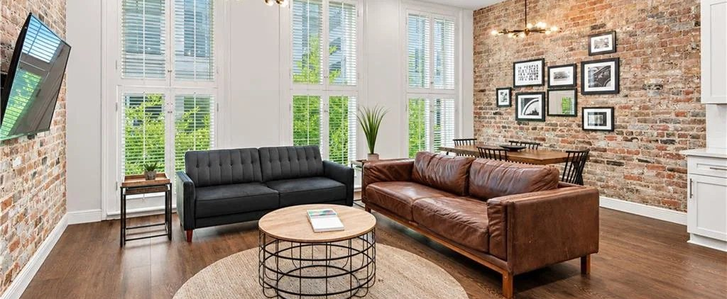
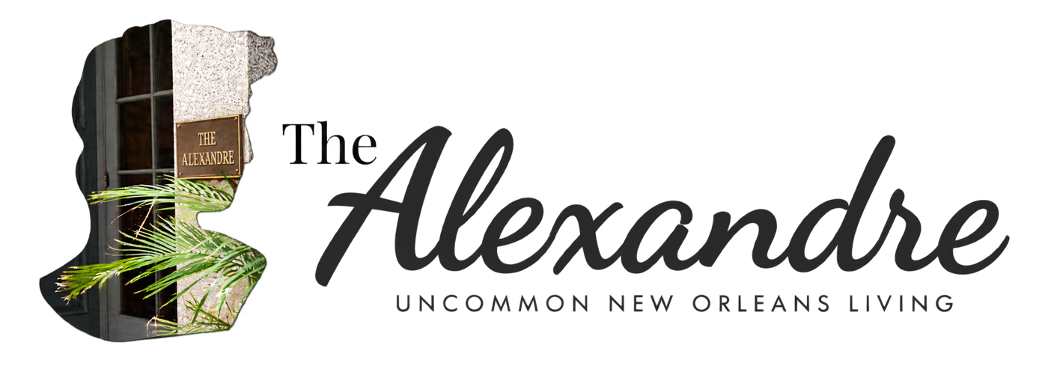


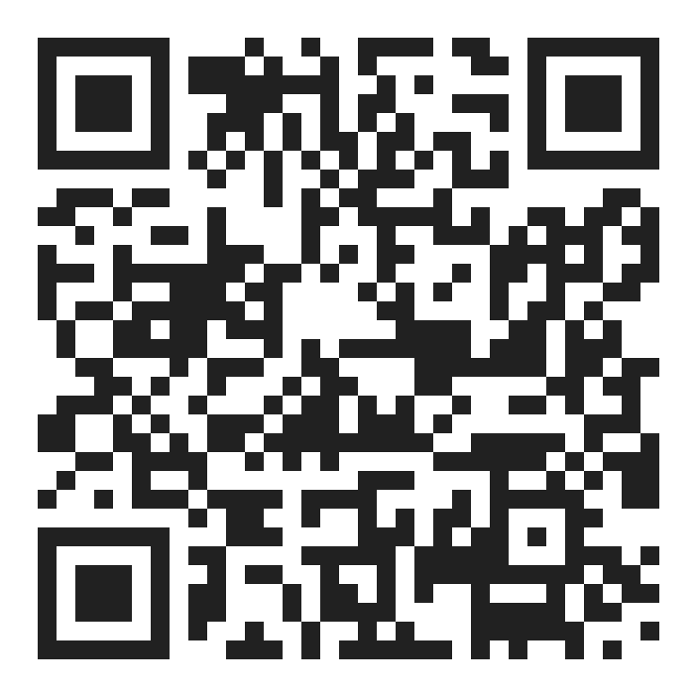

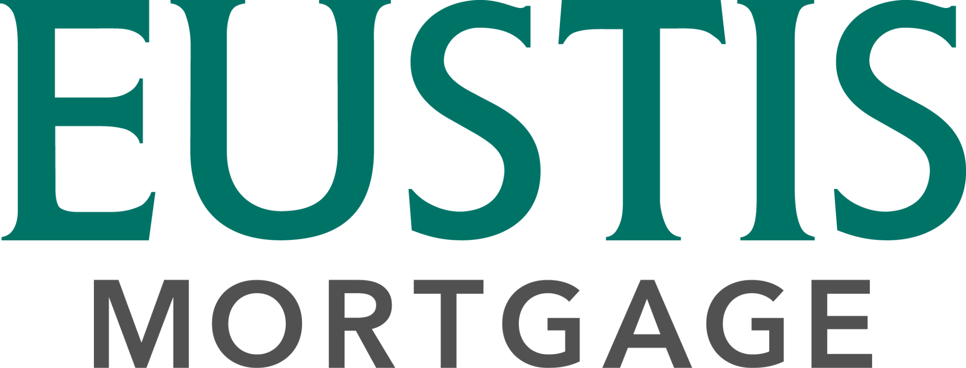
CONDO FINANCING AT THE ALEXANDRE
Own a piece of New Orleans history.
AS LITTLE AS
5%
PRIMARY RESIDENCE
Conventional condo financing with as little as 5% down for eligible primary‑residence buyers and units.
DOWN
ALSO AVAILABLE
Second home and investment condos
Contact for details
YOUR LENDER
TOURS AND UNITS
Nate DiGiovanni
Desiree McSwain
Loan Officer | NMLS #1934694
504-232-8199
Eustis Mortgage
coolmurphy.com/thealexandre
504.418.3416
nate@eustismortgage.com
APPLY WITH NATE
FINANCING BY EUSTIS MORTGAGE
EQUAL HOUSING
OPPORTUNITY
CONVENTIONAL FINANCING OFFERED BY EUSTIS MORTGAGE CORPORATION. NOT A COMMITMENT TO LEND. ALL BORROWERS ARE SUBJECT TO CREDIT APPROVAL. RATES AND TERMS MAY CHANGE AT ANYTIME WITHOUT NOTICE. NMLS #70345
Payment example: For a sales price of $365,000 with 5% down, a loan amount of $346,750 on a 30-year fixed conventional loan at a 7.500% interest rate (8.000% APR) would have 360 monthly principal and interest payments of approximately $2,424.53. Payment shown is principal and interest only and excludes taxes, insurance, PMI, and HOA dues; the actual payment will be higher. Rates are for example only, are not a quote, and are subject to change.

