Slide 1
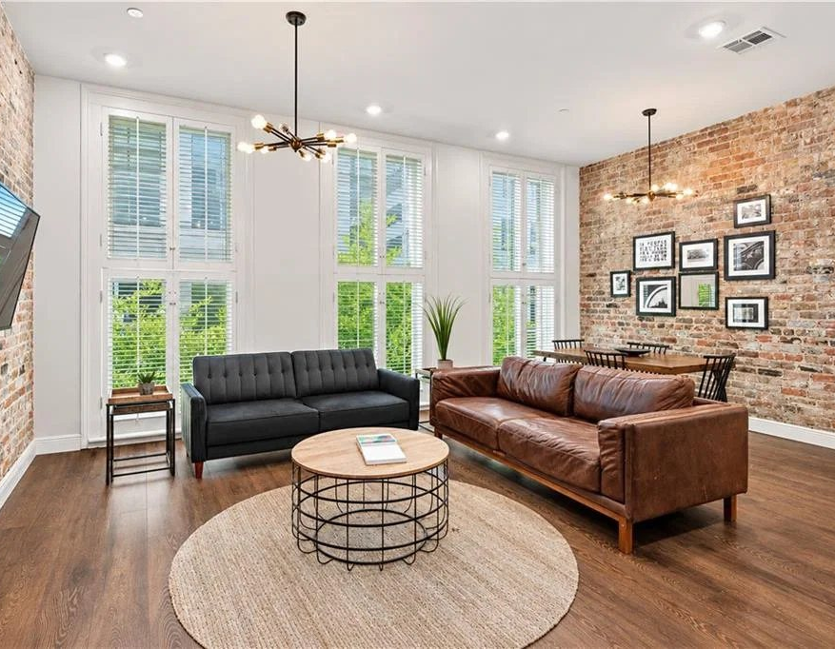


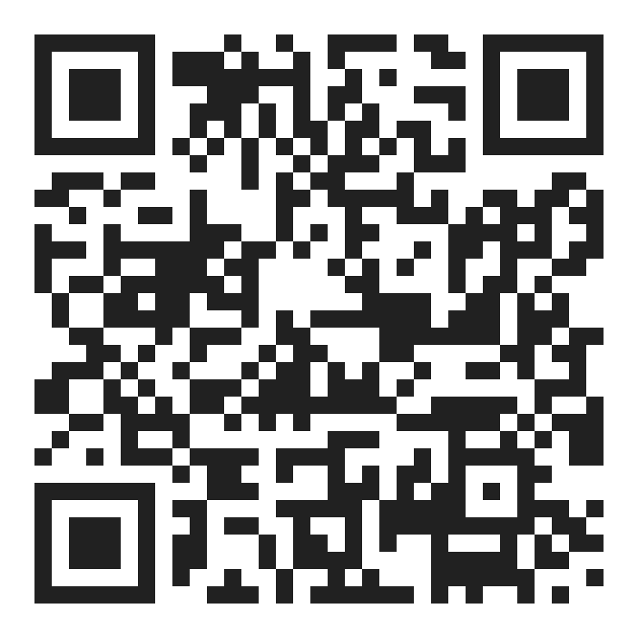


CONDO FINANCING AT THE ALEXANDRE
As little as 5% down.
Conventional condo financing for eligible primary-residence buyers. Second home and investment property options also available.
YOUR LENDER
Nate DiGiovanni
Loan Officer | NMLS #1934694 | Eustis Mortgage
504.418.3416 | nate@eustismortgage.com
APPLY WITH NATE
FINANCING BY
EQUAL HOUSING
OPPORTUNITY
CONVENTIONAL FINANCING OFFERED BY EUSTIS MORTGAGE CORPORATION. NOT A COMMITMENT TO LEND. ALL BORROWERS ARE SUBJECT TO CREDIT APPROVAL. RATES AND TERMS MAY CHANGE AT ANYTIME WITHOUT NOTICE. NMLS #70345

Slide 2
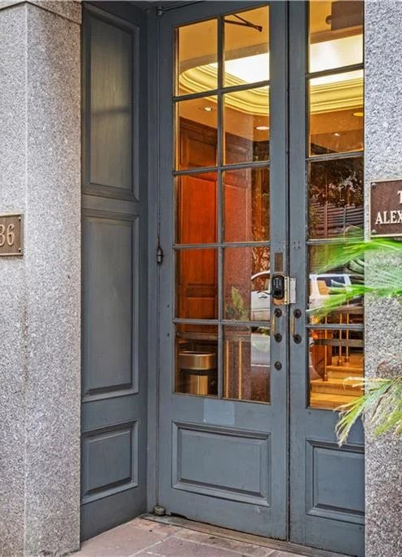
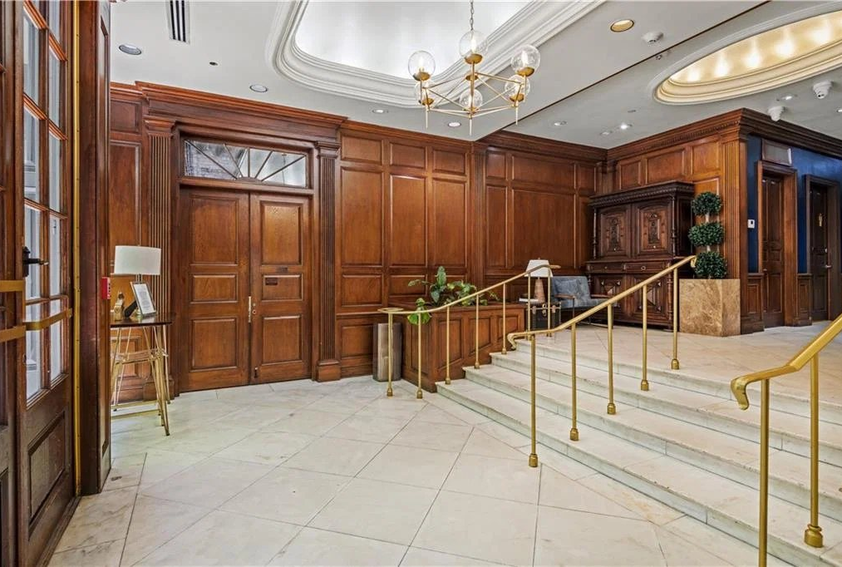
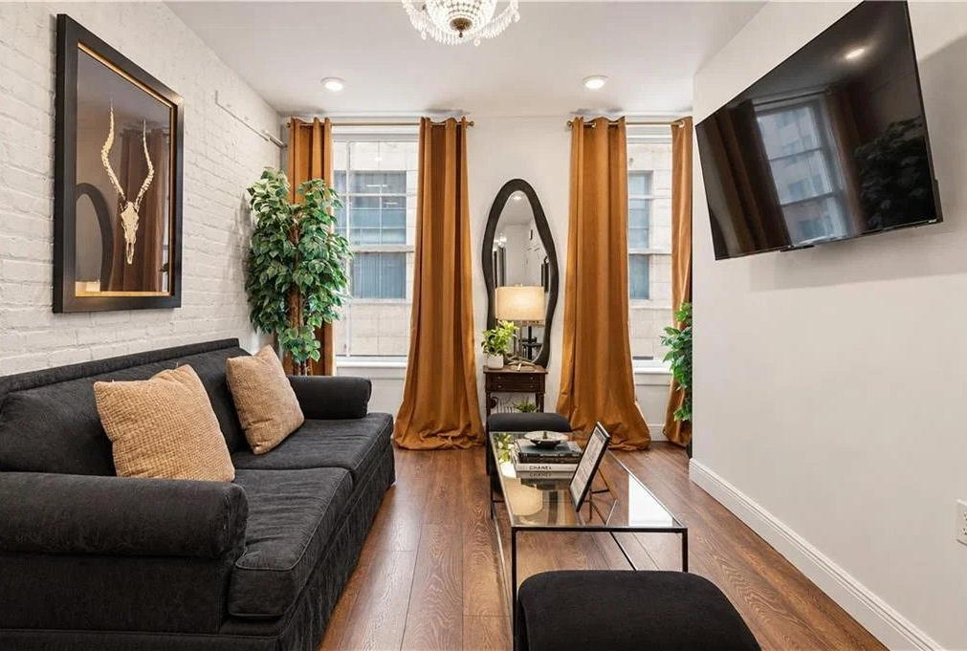


IF WALLS COULD TALK
Uncommon New Orleans living.
coolmurphy.com/thealexandre
YOUR LENDER
Nate DiGiovanni
Loan Officer | NMLS #1934694 | Eustis Mortgage
504.418.3416 | nate@eustismortgage.com
APPLY WITH NATE
FINANCING BY
EQUAL HOUSING
OPPORTUNITY
CONVENTIONAL FINANCING OFFERED BY EUSTIS MORTGAGE CORPORATION. NOT A COMMITMENT TO LEND. ALL BORROWERS ARE SUBJECT TO CREDIT APPROVAL. RATES AND TERMS MAY CHANGE AT ANYTIME WITHOUT NOTICE. NMLS #70345

Slide 3
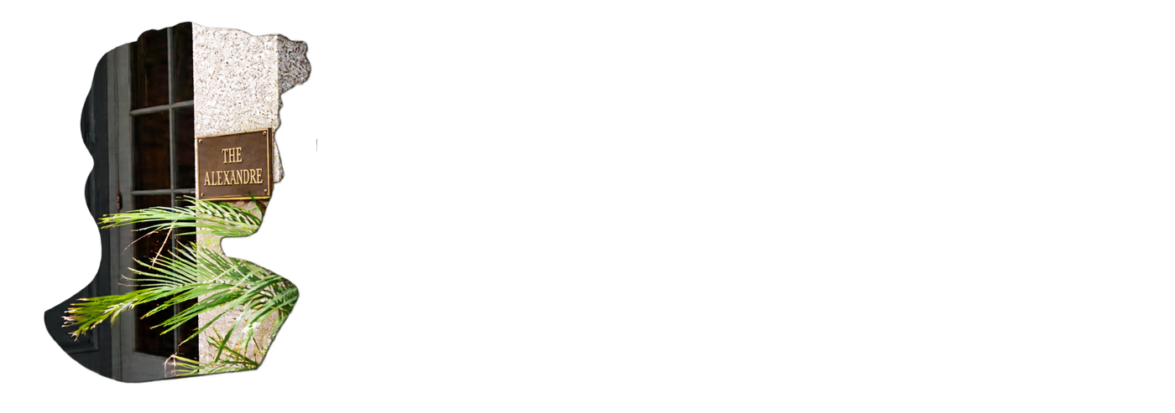

NEXT STEPS
Ready to own at The Alexandre?
YOUR LENDER
Nate DiGiovanni
Loan Officer | NMLS #1934694
Eustis Mortgage
504.418.3416
APPLY WITH NATE
nate@eustismortgage.com
TOURS AND UNITS
Desiree McSwain
504-232-8199
FINANCING BY
EQUAL HOUSING
OPPORTUNITY
CONVENTIONAL FINANCING OFFERED BY EUSTIS MORTGAGE CORPORATION. NOT A COMMITMENT TO LEND. ALL BORROWERS ARE SUBJECT TO CREDIT APPROVAL. RATES AND TERMS MAY CHANGE AT ANYTIME WITHOUT NOTICE. NMLS #70345

