Slide 1
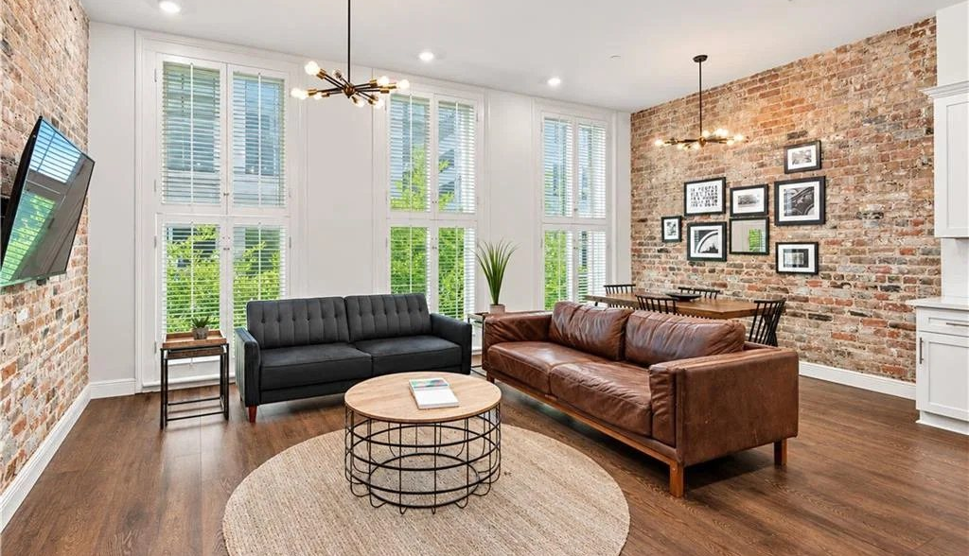


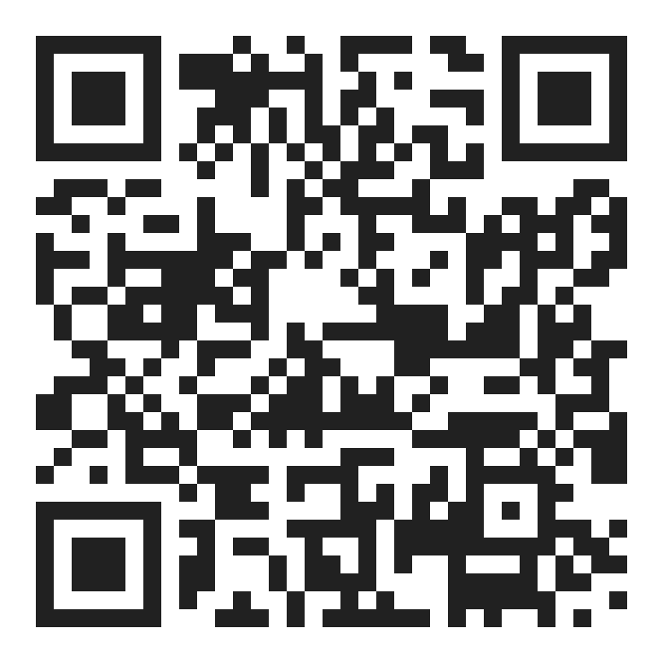


CONDO FINANCING AT THE ALEXANDRE
As little as 5% down at The Alexandre.
Conventional condo financing for eligible primary-residence buyers.
YOUR LENDER
Nate DiGiovanni
Loan Officer | NMLS #1934694 | Eustis Mortgage
504.418.3416 | nate@eustismortgage.com
APPLY WITH NATE
FINANCING BY
EQUAL HOUSING
OPPORTUNITY
CONVENTIONAL FINANCING OFFERED BY EUSTIS MORTGAGE CORPORATION. NOT A COMMITMENT TO LEND. ALL BORROWERS ARE SUBJECT TO CREDIT APPROVAL. RATES AND TERMS MAY CHANGE AT ANYTIME WITHOUT NOTICE. NMLS #70345
SWIPE →

Slide 2


CONDO FINANCING AT THE ALEXANDRE
Primary residence
5%
AS LITTLE AS
DOWN
Conventional condo financing for eligible primary‑residence buyers and units.
ALSO AVAILABLE
Second home and investment property
Contact for details
YOUR LENDER
Nate DiGiovanni
Loan Officer | NMLS #1934694 | Eustis Mortgage
504.418.3416 | nate@eustismortgage.com
APPLY WITH NATE
FINANCING BY
EQUAL HOUSING
OPPORTUNITY
CONVENTIONAL FINANCING OFFERED BY EUSTIS MORTGAGE CORPORATION. NOT A COMMITMENT TO LEND. ALL BORROWERS ARE SUBJECT TO CREDIT APPROVAL. RATES AND TERMS MAY CHANGE AT ANYTIME WITHOUT NOTICE. NMLS #70345

Slide 3
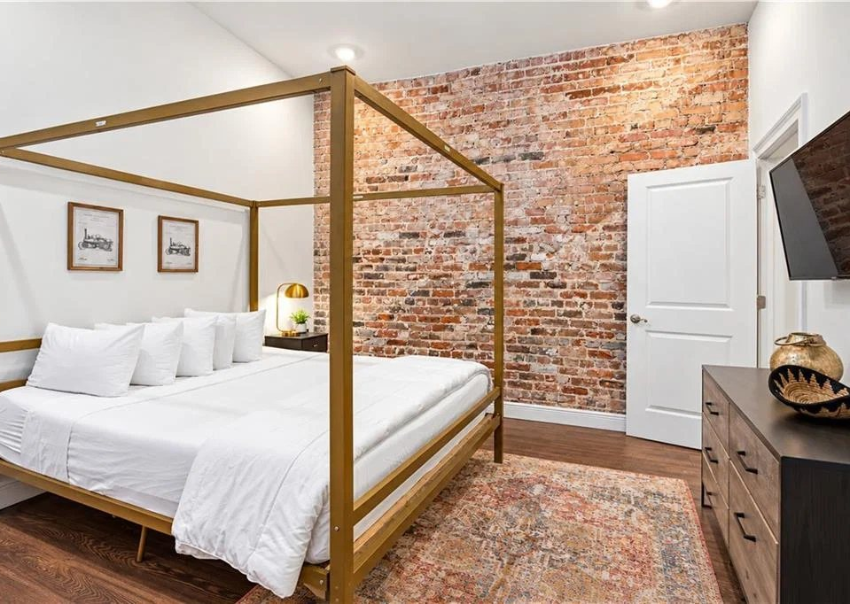
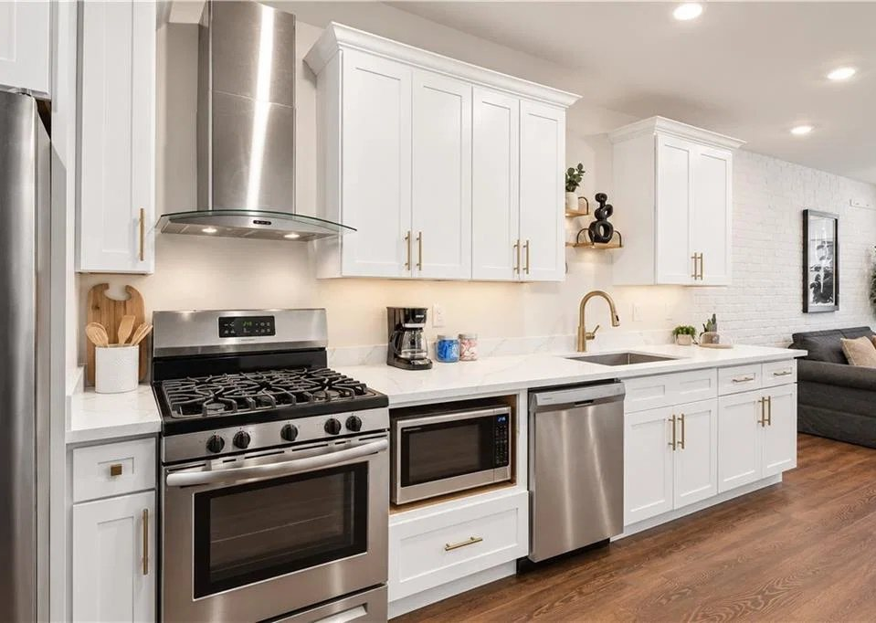
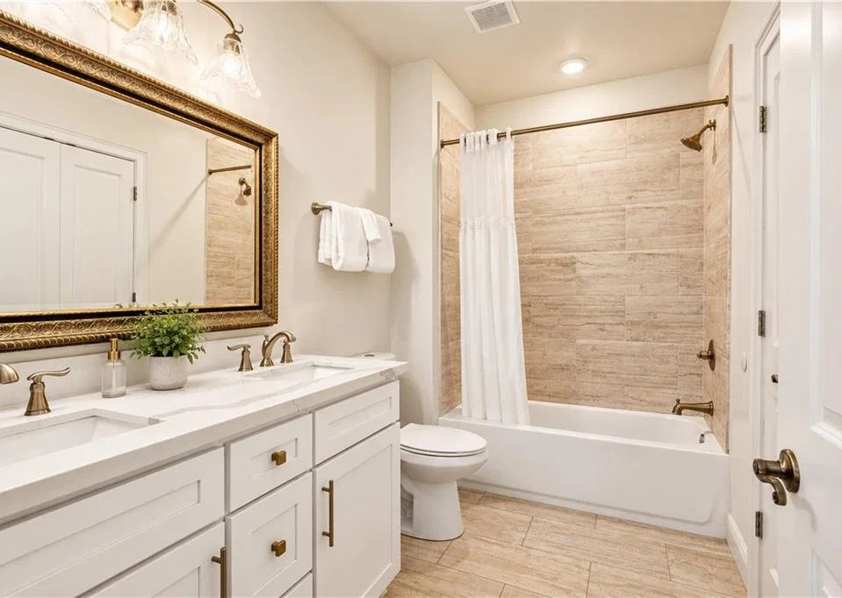
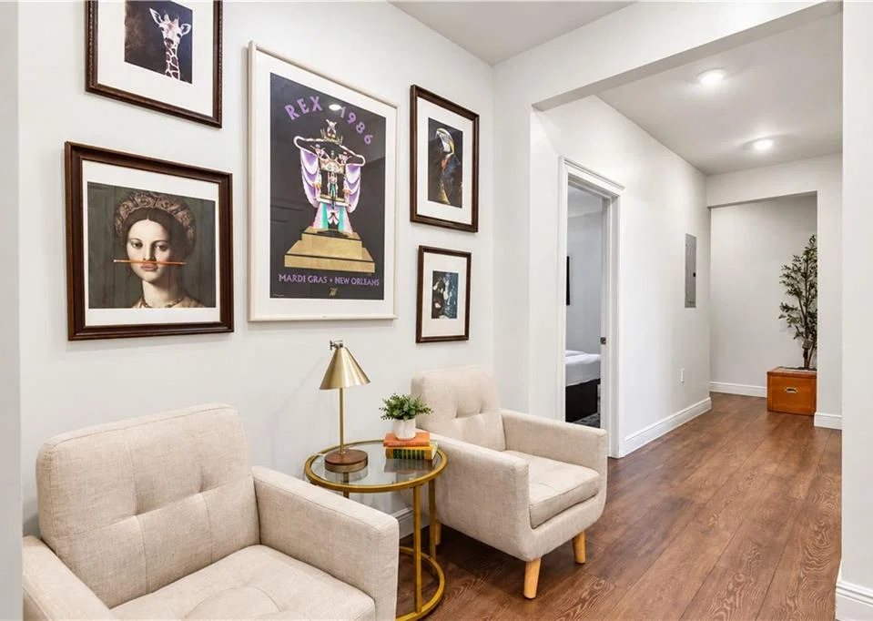
DESIGNED TO BE EFFORTLESS
Inside the condos.
336 Camp Street, New Orleans
SWIPE →
YOUR LENDER
Nate DiGiovanni
Loan Officer | NMLS #1934694 | Eustis Mortgage
504.418.3416 | nate@eustismortgage.com
APPLY WITH NATE
FINANCING BY
EQUAL HOUSING
OPPORTUNITY
CONVENTIONAL FINANCING OFFERED BY EUSTIS MORTGAGE CORPORATION. NOT A COMMITMENT TO LEND. ALL BORROWERS ARE SUBJECT TO CREDIT APPROVAL. RATES AND TERMS MAY CHANGE AT ANYTIME WITHOUT NOTICE. NMLS #70345

Slide 4


NEXT STEPS
Ready to own at The Alexandre?
YOUR LENDER
Nate DiGiovanni
Loan Officer | NMLS #1934694
Eustis Mortgage
504.418.3416
APPLY WITH NATE
nate@eustismortgage.com
TOURS AND UNITS
Desiree McSwain
504-232-8199
coolmurphy.com/thealexandre
FINANCING BY
EQUAL HOUSING
OPPORTUNITY
CONVENTIONAL FINANCING OFFERED BY EUSTIS MORTGAGE CORPORATION. NOT A COMMITMENT TO LEND. ALL BORROWERS ARE SUBJECT TO CREDIT APPROVAL. RATES AND TERMS MAY CHANGE AT ANYTIME WITHOUT NOTICE. NMLS #70345

