Slide 1
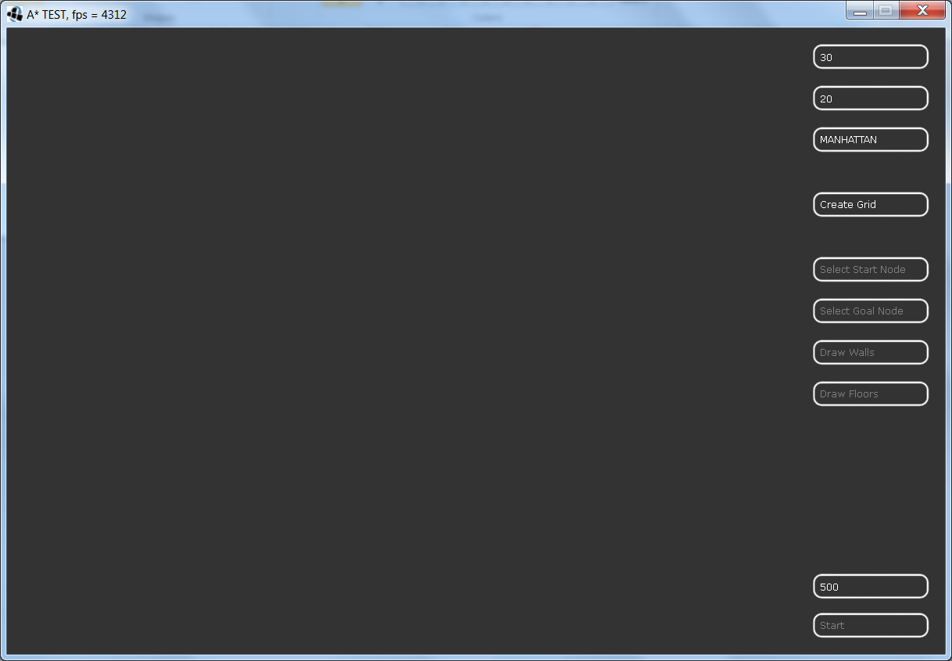
Run the application by:
- Double clicking the ”tiralabra.jar”
- Type in terminal: java -jar tiralabra.jar
Grid Width ->
Grid Height ->
Heuristic Method ->
- Select the Grid Width and Grid Height you wan to use.
- Select the Heuristic method.
- Create the Grid
Now you can draw more walls or floors using the correct buttons on the right.
You have to select start and goal nodes to enable the start button.
To restart the simulation, you’ll have to create a new grid.
Stress test:
- Type in terminal:
java -jar tiralabra -s [width] [height] [iterations] [optional yes/no]
Iterations just tells the code how many times you want to do the same test.
yes/no is for running with OWN COLLECTIONS/UTILS COLLECTION
Evaluation time (ms) ->

