Slide 1
Sampling and Aliasing
Notes:
Sampling refers to turning a continuous signal into a discrete signal

Slide 2
Filtering
Filtering Properties
Correlation & Convolution
Non-linear Filters
Notes:
Reminder: 3R’s of computer vision are Reconstruction, Recognition, and (Re-)organization.

Slide 3


Why does a lower resolution image still make sense to us?
What information do we lose?
Slide: Derek Hoiem, Image: http://www.flickr.com/photos/igorms/136916757/
Notes:
Downsampling is useful when we need to reduce storage space

Slide 4
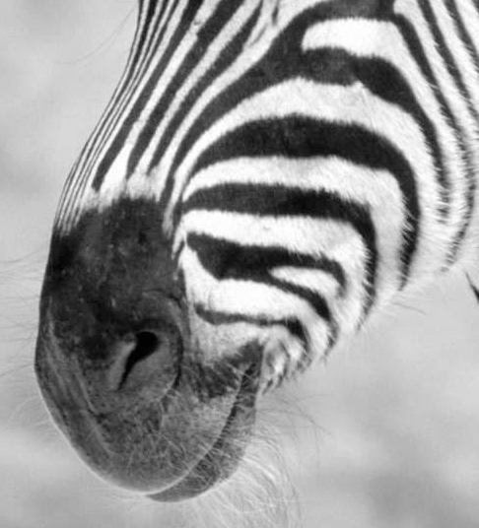
Making lower resolution images:
Subsampling by a factor of 2
Throw away every other row and column to create a 1/2 size image
Notes:
The higher the subsampling factor, the more pixels are skipped, resulting in smaller images

Slide 5
Making lower resolution images:
Subsampling by a factor of 2
Throw away every other row and column to create a 1/2 size image
Notes:
The higher the subsampling factor, the more pixels are skipped, resulting in smaller images

Slide 6
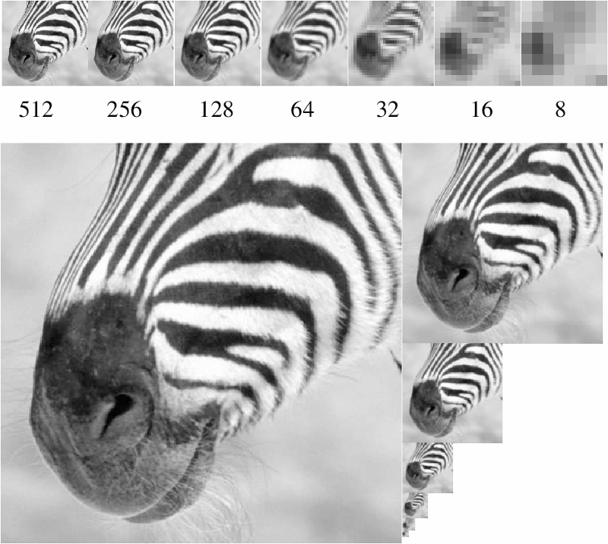
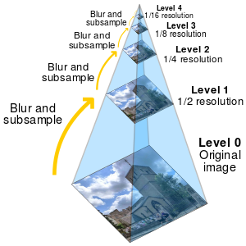
Image Pyramid
David Forsyth
Notes:
Downsampling repeatedly results in an ‘image pyramid’

Slide 7
Downsampling
Start with image of w x h
Sample every other pixel
im_small = image[ ::w, ::w ]
To build a pyramid,
repeat Steps 1 & 2
until im_small is 1 pixel large.
James Hays

Slide 8
Downsampling
Start with image of w x h
Sample every other pixel
im_small = image[ ::w, ::w ]
To build a pyramid,
repeat Steps 1 & 2
until im_small is 1 pixel large.
NumPy Syntax
w = 2
::2 -> start at 0,
end at ‘end’,
increase every 2, until the end.
e.g.,
0,2,4,6,…,w
(if w is not even, then this goes to w-1)
James Hays

Slide 9
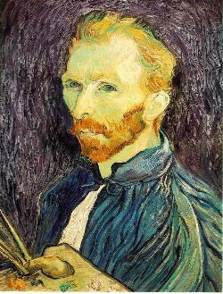
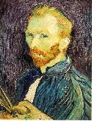

Image Subsampling
1/8
1/4
Throw away every other row and column to create a 1/2 size image.
Steve Seitz

Slide 10

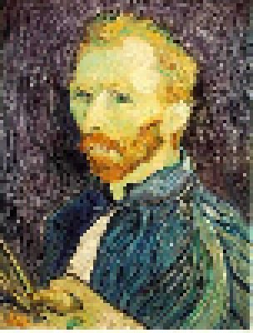
Subsampling without Filtering
1/2
1/4 (2x subsample)
1/8 (4x subsample)
Steve Seitz
Notes:
Issue with naïve downsampling: we start to see artifacts (e.g. white pixels not present in original image, jagged edges)

Slide 11
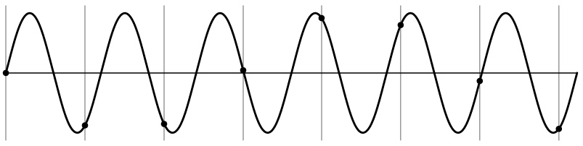
Aliasing
S. Marschner
Notes:
Aliasing occurs when we sample a signal at a frequency that is too low such that we can’t properly reconstruct the original signal (more in a few slides).
If we reconstructed the signal using just the sampled points (black dots above), we’d get a completely different-looking reconstruction than the original signal (see next slide).
Intuitively, we don’t have enough information about the signal because we sampled it too infrequently.

Slide 12
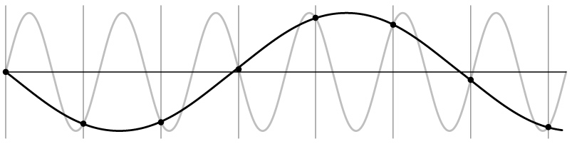
Aliasing
S. Marschner

Slide 13
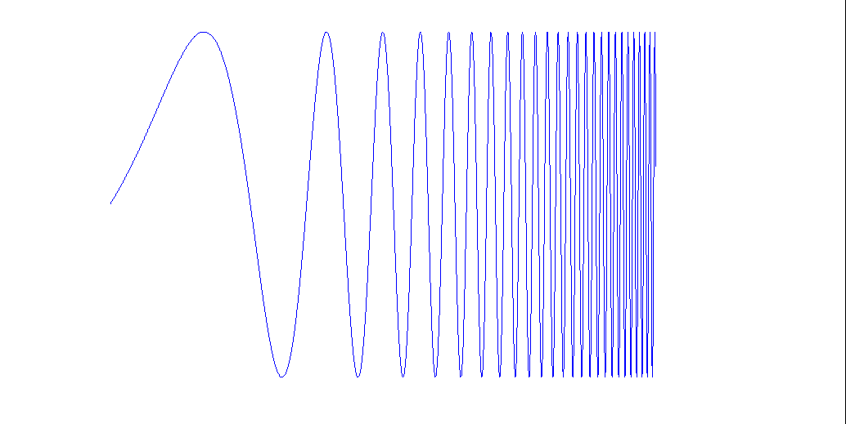
What’s happening?
Input signal:

Slide 14
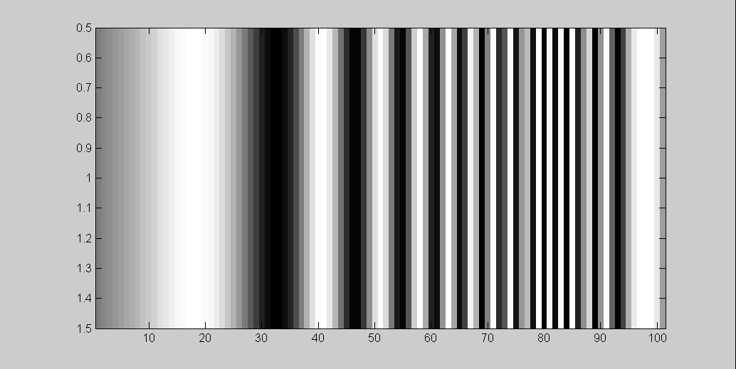
What’s happening?
Input signal:
Plot as image:
x = 0:.05:5; plt.imshow(sin((2.^x).*x))

Slide 15
What’s happening?
Aliasing!
Not enough samples
Input signal:
Plot as image:
x = 0:.05:5; plt.imshow(sin((2.^x).*x))

Slide 16
What’s happening?
Aliasing!
Not enough samples
Input signal:
Plot as image:
x = 0:.05:5; plt.imshow(sin((2.^x).*x))
Aliasing:
When two signals become indistinguishable from one another due to sampling.
They are ‘aliases’ of one another.

Slide 17
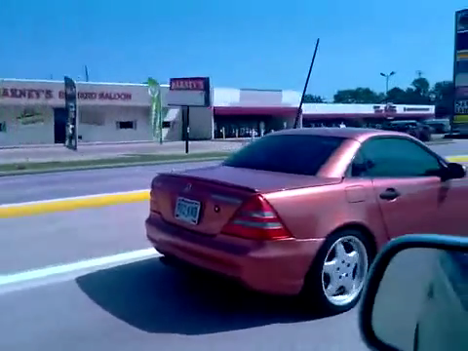
Temporal Aliasing in Videos
[YouTube; JoinBuzzirk; phrancque]
Notes:
https://www.youtube.com/watch?v=Y1yHMy0-4TM
https://www.youtube.com/watch?v=jQDjJRYmeWg

Slide 18

Temporal Aliasing in Videos
[YouTube; JoinBuzzirk; phrancque]
Notes:
https://www.youtube.com/watch?v=Y1yHMy0-4TM
https://www.youtube.com/watch?v=jQDjJRYmeWg

Slide 19
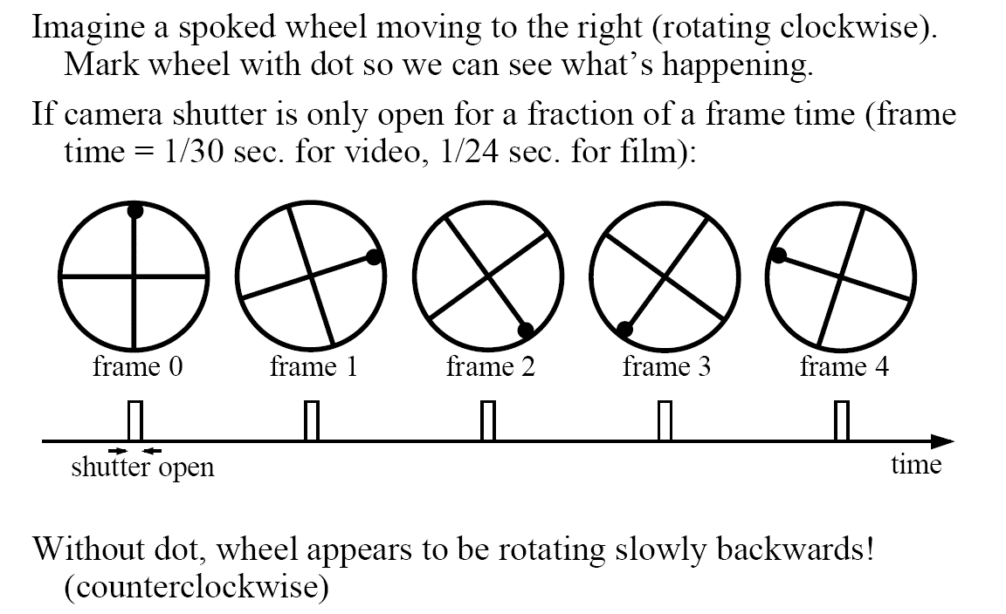
Aliasing in video
Steve Seitz

Slide 20
Nyquist-Shannon Sampling Theorem
When sampling a signal at discrete intervals,
the sampling frequency must be ≥ 2 × f_{max} max frequency of signal
Signal is completely determined if so.
v
v
v
good
bad
Notes:
The Nyquist-Shannon sampling theorem tells us how frequently we need to sample the continuous signal so that we are guaranteed a perfect reconstruction

Slide 21
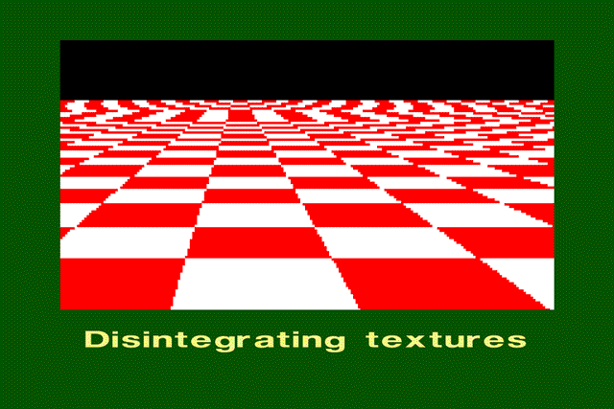
Aliasing in Graphics
A. Efros

Slide 22
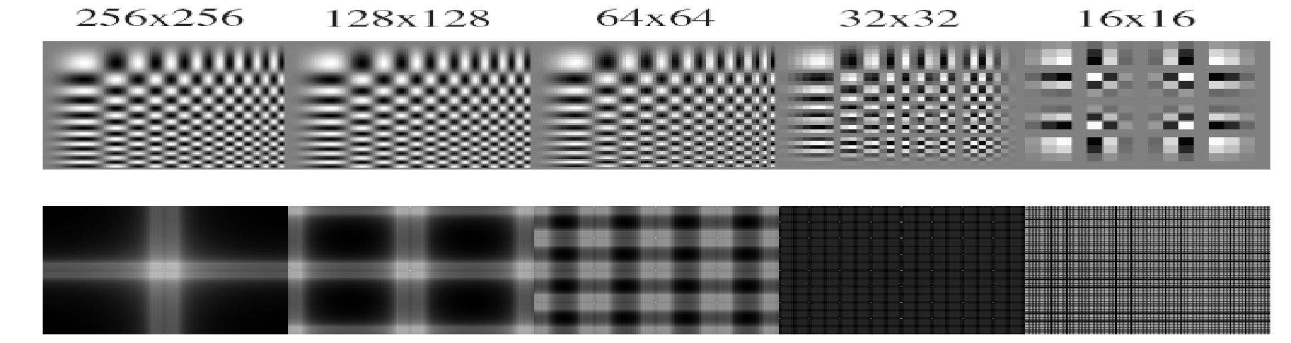
Sampling and aliasing

Slide 23
Anti-aliasing
Solutions:
Sample more often
Remove all frequencies that are greater than half the new sampling frequency
  Will lose information
  But it’s better than aliasing
  How?
Hays

Slide 24
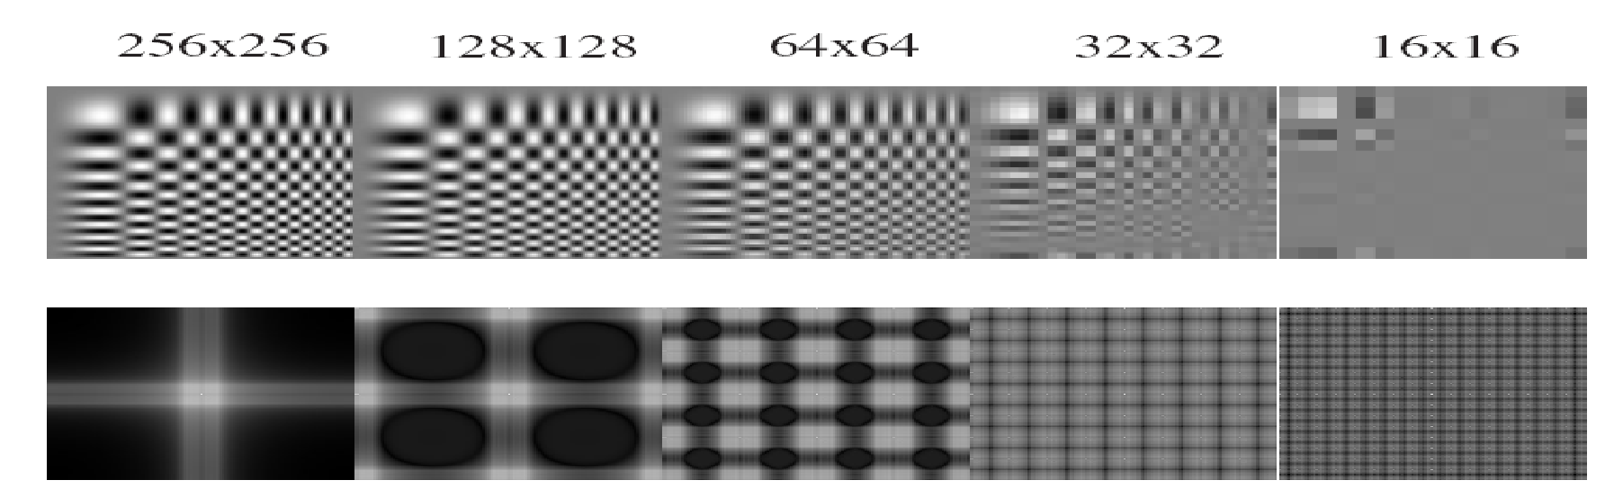
Anti-aliasing
Forsyth and Ponce 2002

Slide 25
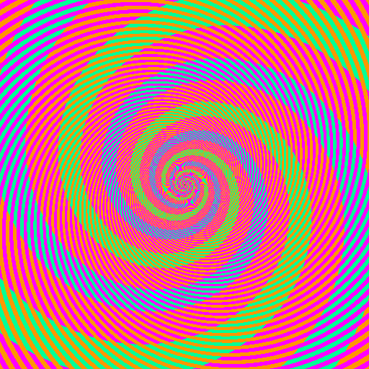
Aliasing and Moiré patterns

Slide 26
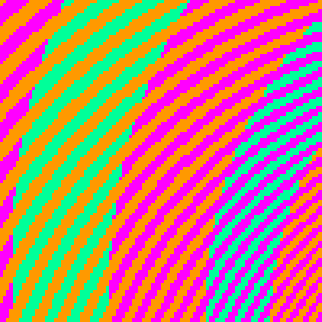
Aliasing and Moiré patterns
The blue and green colors are the same
http://blogs.discovermagazine.com/badastronomy/2009/06/24/the-blue-and-the-green/

Slide 27
Low-pass and high-pass filtering
Remove high frequencies with a low pass filter
  A blur filter!
  Could also be called a ‘high cut’ filter (but few do)
Counterpart: high pass filter
  Only keeps the high frequencies
  Edge detection (Sobel) is an example high pass filter
Related: band pass / band stop (or notch) filter
  Only affect specific frequencies
  How could we construct one with linear filters?

Slide 28
Algorithm for downsampling by factor of 2
Start with image(h, w)
Apply low-pass filter
im_blur = imfilter( image, fspecial(‘gaussian’, 7, 1) )
Sample every other pixel
im_small = im_blur( 1:2:end, 1:2:end );
Hays

Slide 29
Subsampling without Filtering
1/2
1/4 (2x subsample)
1/8 (4x subsample)
Steve Seitz

Slide 30



Subsampling with Gaussian Pre-filtering
Gaussian 1/2
G 1/4
G 1/8
Gaussian Pyramid. Burt and Adelson, 1983

Slide 31
Subsampling with Gaussian Pre-filtering
Gaussian 1/2
G 1/4
G 1/8
Gaussian Pyramid. Burt and Adelson, 1983

Slide 32
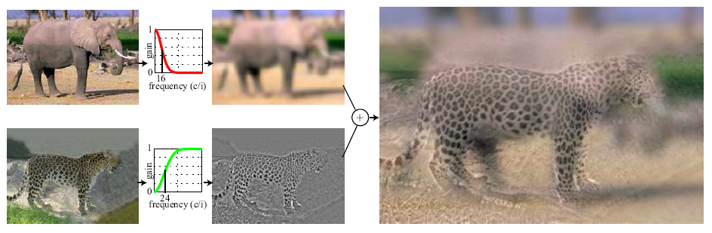
Hybrid Images
Hybrid Images. A. Oliva, A. Torralba, P.G. Schyns

Slide 33
Frequency Domain
Hybrid Images
Fourier Transforms
FT as filtering

