Slide 1
Encoders, Decoders,
Unsupervised
Self-supervised
COMP 322: Computer Vision and Image Processing
Hong Xu · Rhodes College
Adapted from Brown University CSCI 1430 Computer Vision (Spring 2026).
Original file: 2026_Spring_L18_EncodersDecoders_UnSelfSupervised.pptx.

Slide 2
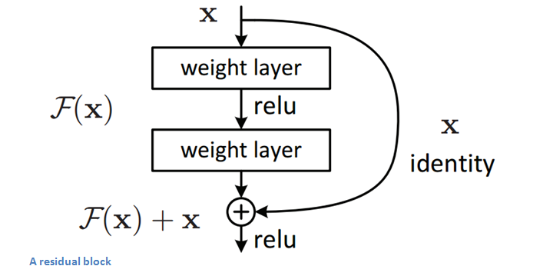
Residual Unit
The inputs of a lower layer is added to a node in a higher layer.
Notes:
If identity were the optimal mapping, then we would set all the weight layers to 0 and be done.
If the optimal mapping were close to the identity, then this formulation makes it easier to find small fluctuations.
So, why does it help with the vanishing gradient problem?
Helps to preserve gradient ‘flow’ locally through each ResBlock because the scale of the gradient is approximately maintained by adding back x.
Described as ‘norm preserving’ - https://arxiv.org/pdf/1805.07477.pdf

Slide 3
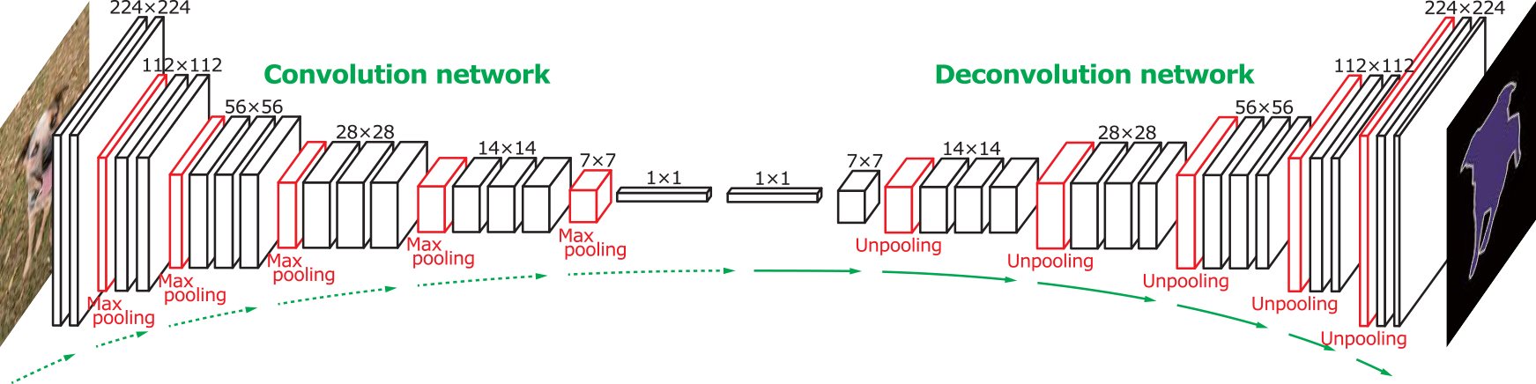
Decoder networks learn to upsample
Encoder network
Decoder network
Often called “deconvolution”, but misnomer.
Not the deconvolution that we saw in deblurring -> that is division in the Fourier domain.
‘Transposed convolution’ is better.
Zeiler et al., Deconvolutional Networks, CVPR 2010
Noh et al., Learning Deconvolution Network for Semantic Segmentation, ICCV 2015
Notes:
The network architecture here is VGG
Six days to train on an NVIDIA Titan X GPU

Slide 4
What is ‘in’ an encoder?
Notes:
http://yosinski.com/deepvis

Slide 5
What is model inspection?
I want to know how my model is performing.
What could I do?
Compute statistics, precision/recall plots
Look at confusion matrices / misclassified images
But which neurons are important?
What within the images themselves is important?

Slide 6
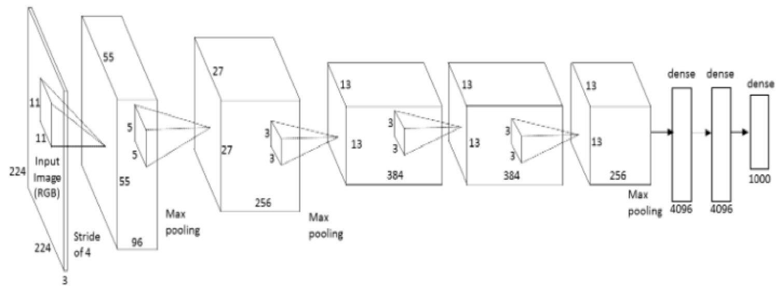

What input to a neuron maximizes a class score?
To visualize the function of a specific unit in a neural network, we synthesize an input to that unit which causes high activation.
Neuron of choice i
An image of random noise x.
Repeat:
Forward propagate: compute activation a_{i}(x)
Back propagate: compute gradient at neuron ∂a_{i}(x) / ∂x
Add small amount of gradient back to noisy image.
Andrej Karpathy
Notes:
Activation = result of the convolution
Next, we do a forward pass using this image xx as input to the network to compute the activation ai(x)ai(x) caused by xx at some neuron ii somewhere in the middle of the network. Then we do a backward pass (performing backprop) to compute the gradient of ai(x)ai(x) with respect to earlier activations in the network. At the end of the backward pass we are left with the gradient ∂ai(x)/∂x∂ai(x)/∂x , or how to change the color of each pixel to increase the activation of neuron ii . We do exactly that by adding a little fraction αα of that gradient to the image:
x←x+α⋅∂ai(x)/∂x
We keep doing that repeatedly until we have an image x∗x∗ that causes high activation of the neuron in question.

Slide 7
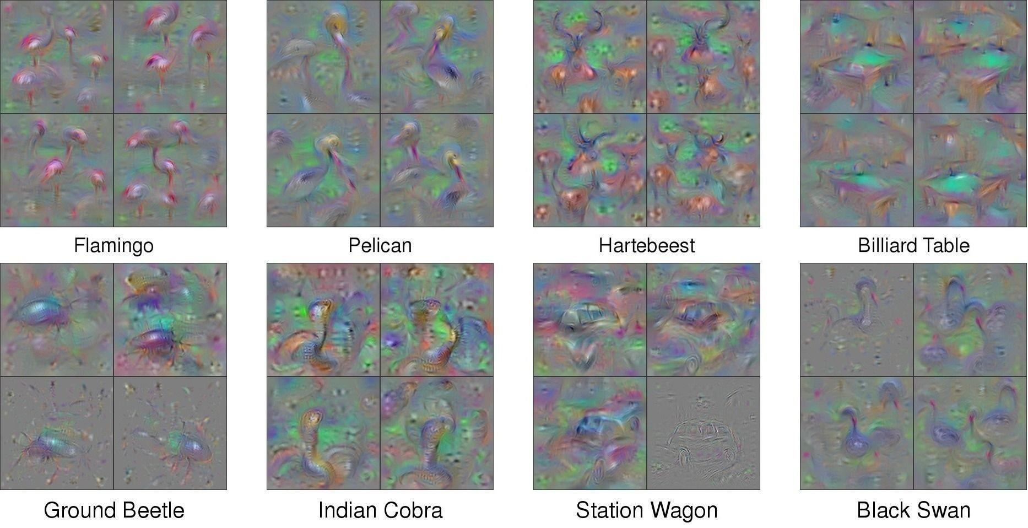
What image maximizes a class score?
[Understanding Neural Networks Through Deep Visualization, Yosinski et al. , 2015] http://yosinski.com/deepvis

Slide 8
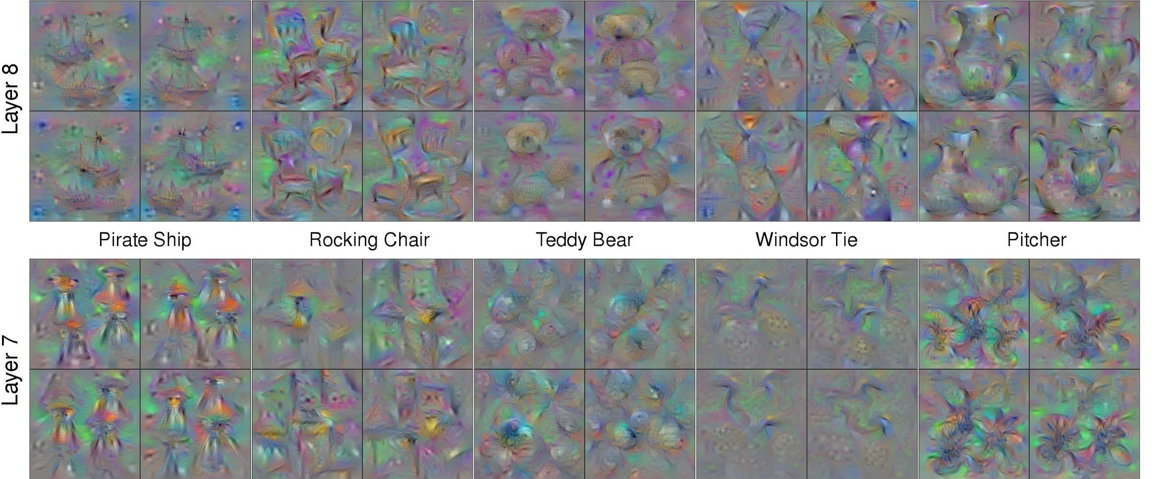
What image maximizes a class score?
Andrej Karpathy

Slide 9
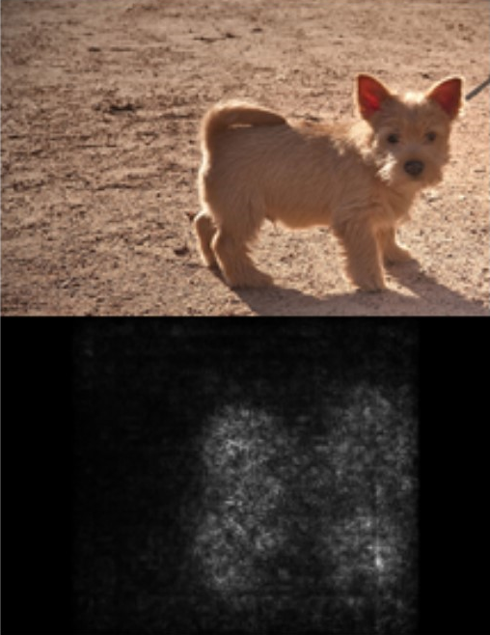
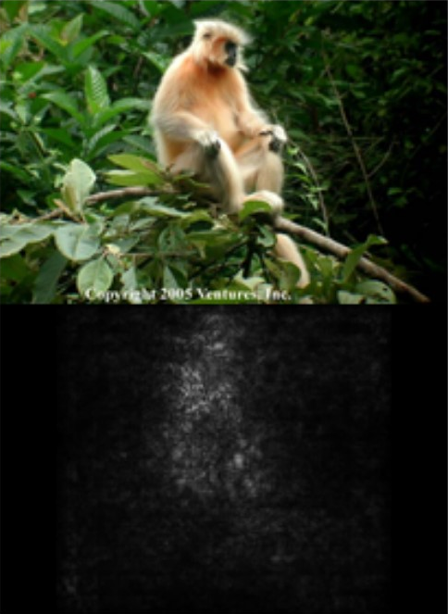
Saliency Maps
Use backpropagation to compute derivative of classification wrt. each pixel.
Useful to find areas where changes would affect result.
…but outputs can be hard to interpret, especially with multiple scene or object parts.
ImageNet classes of dog, gibbon
[Simonyan et al., 2013]
Notes:
Deep Inside Convolutional Networks: Visualising
Image Classification Models and Saliency Maps
https://arxiv.org/pdf/1312.6034.pdf

Slide 10
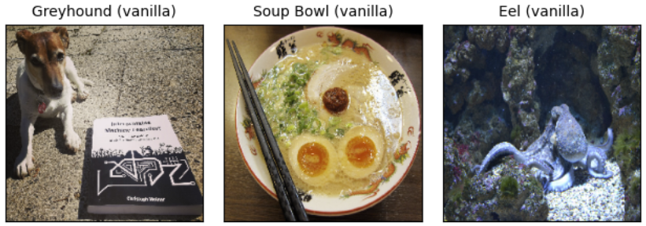
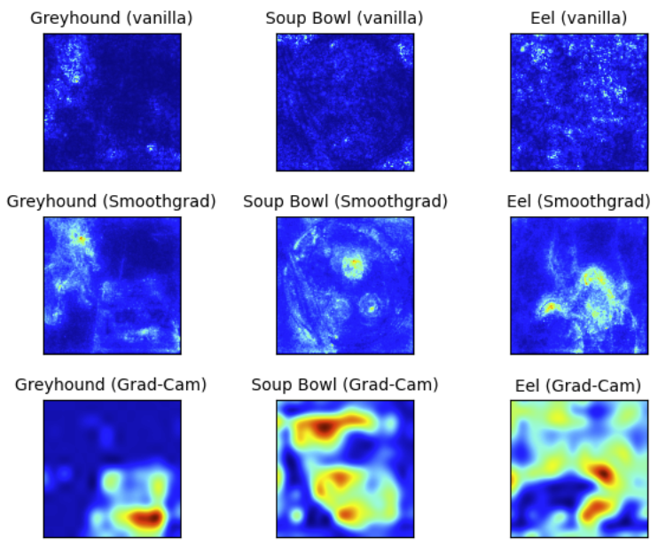
Output can be hard to interpret.
Varies significantly depending on which method we use.
[Christoph Molnar]
Notes:
https://christophm.github.io/interpretable-ml-book/pixel-attribution.html
Vanilla – basic saliency; loss wrt pixel values

Slide 11
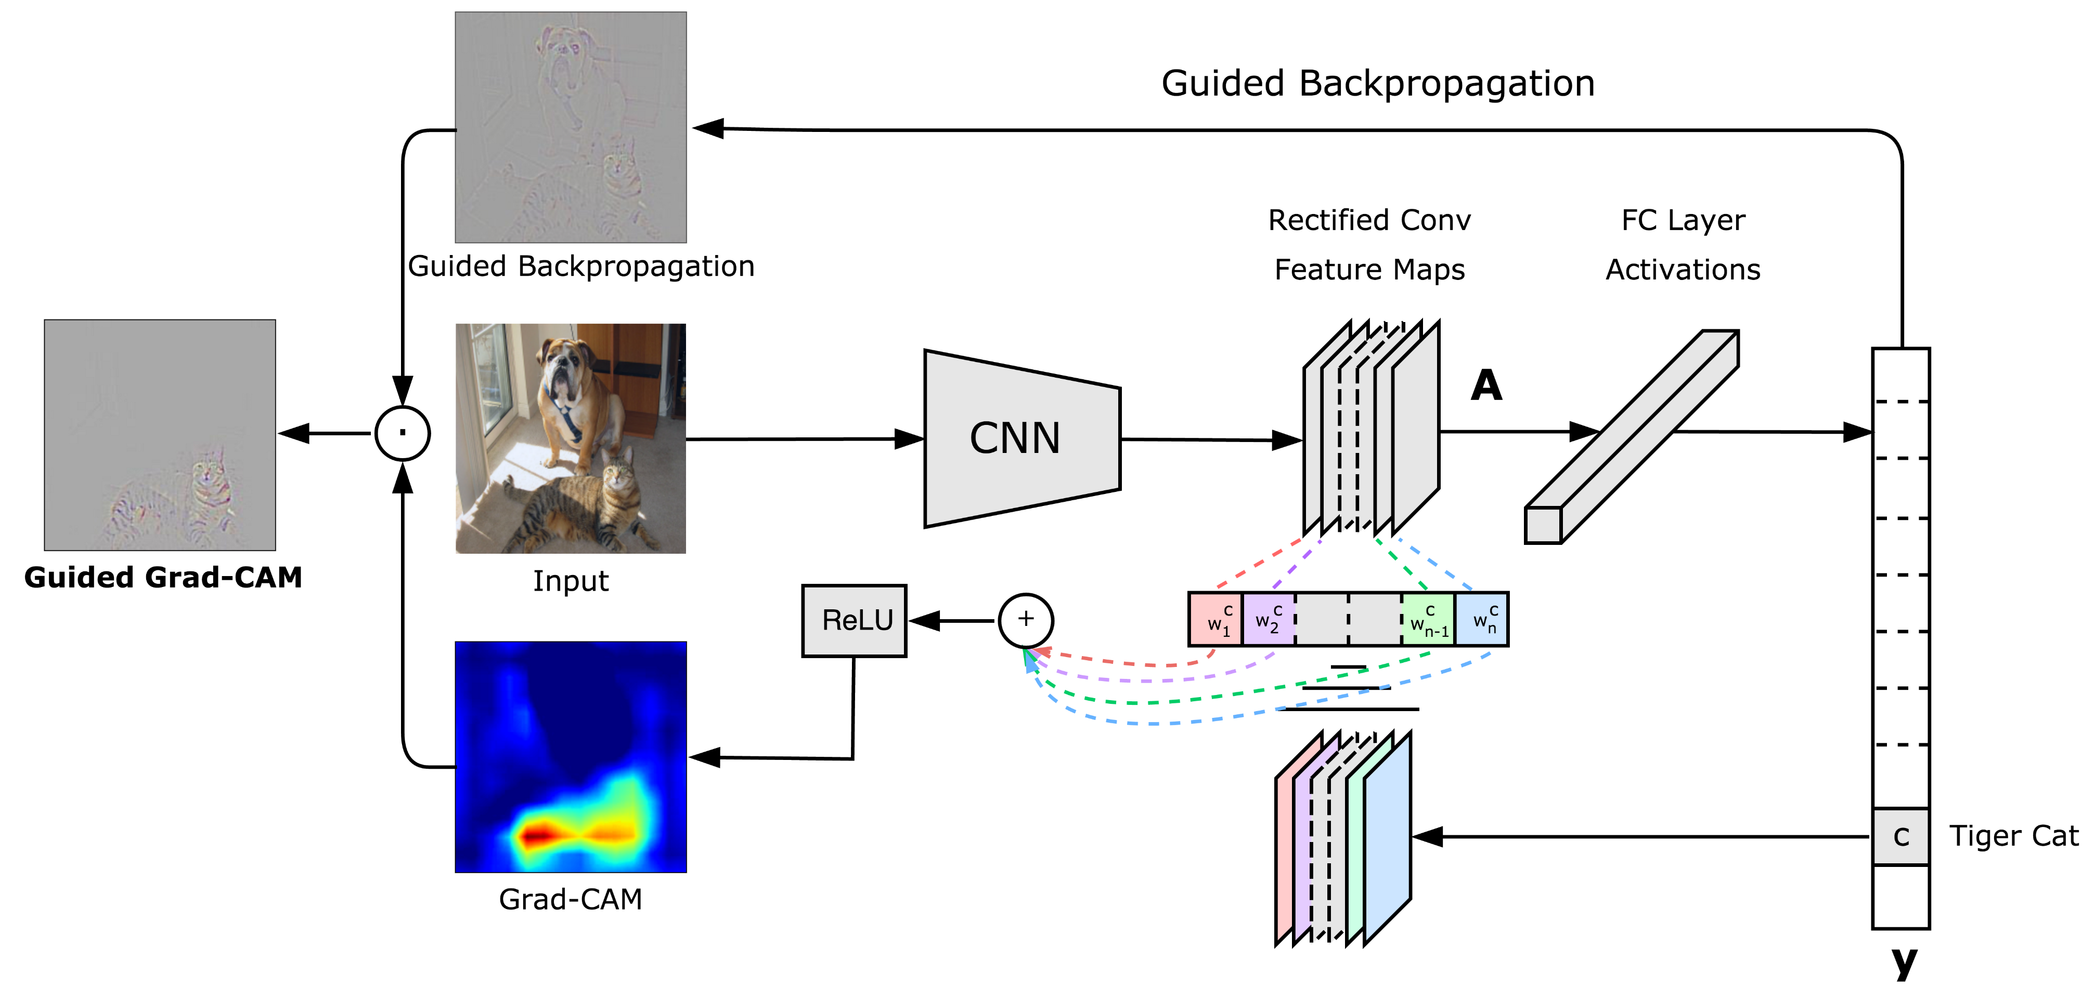
Better Saliency Maps
e.g., Grad-CAM
Notes:
http://gradcam.cloudcv.org/

Slide 12
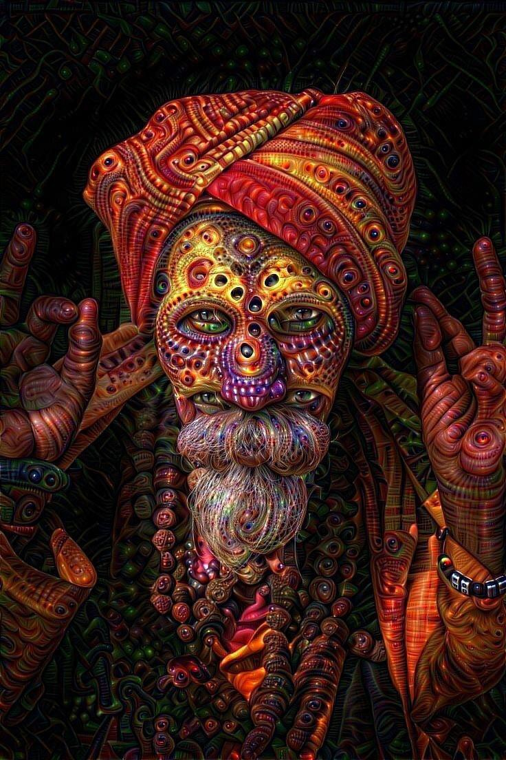
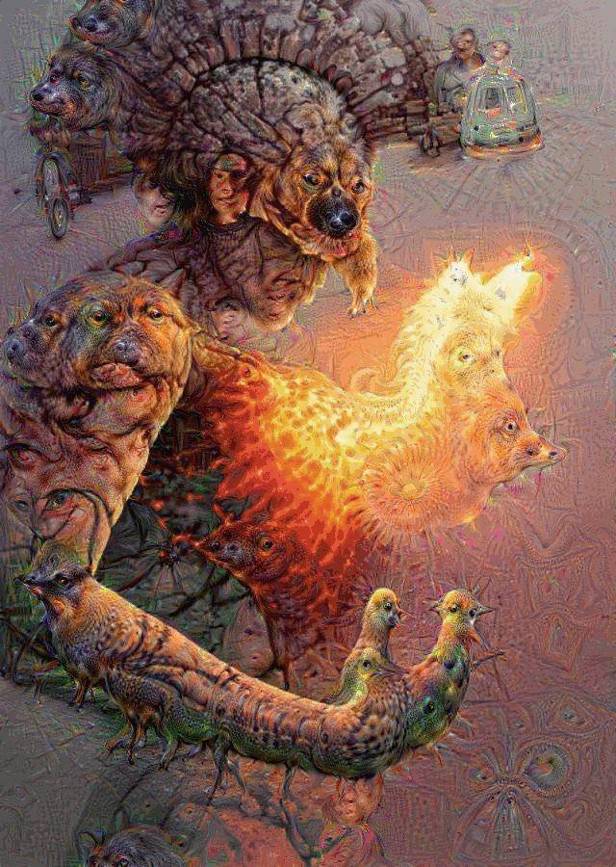
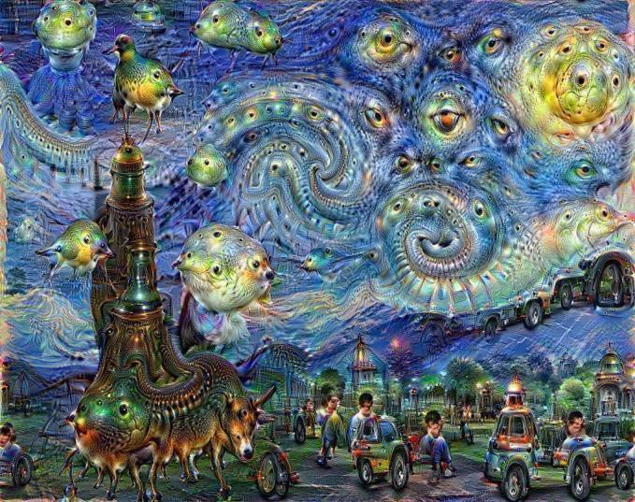
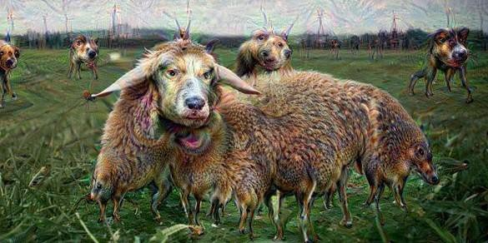
DeepDream
DeepDream https://github.com/google/deepdream
Andrej Karpathy

Slide 13
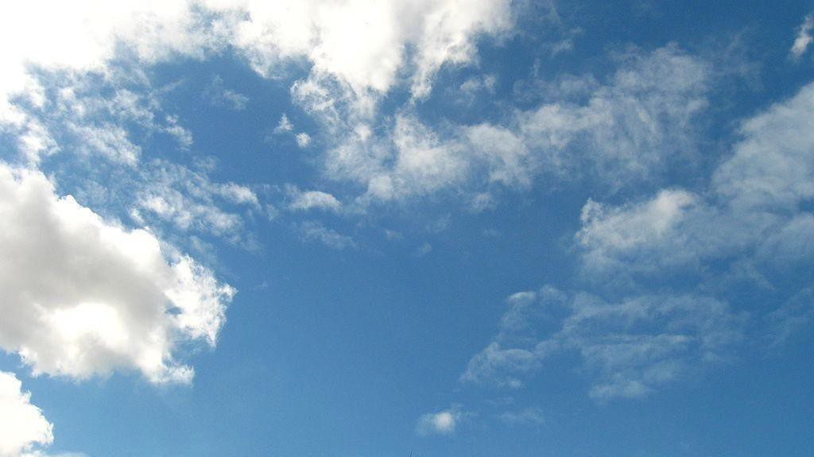
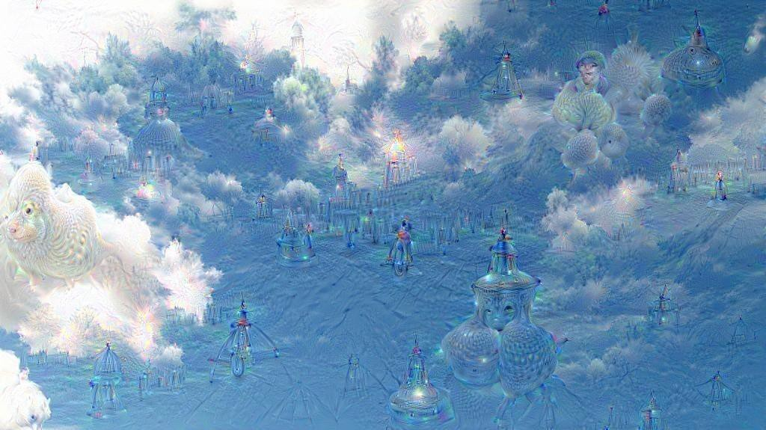
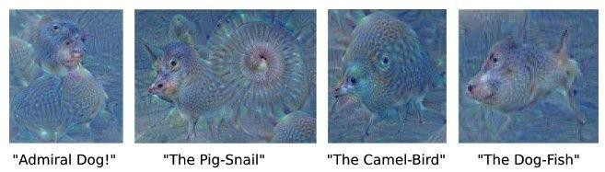
DeepDream – add gradient back to image
Creates a feedback loop: any slightly detected dog face will be made more and more dog-like over time.
Andrej Karpathy

Slide 14
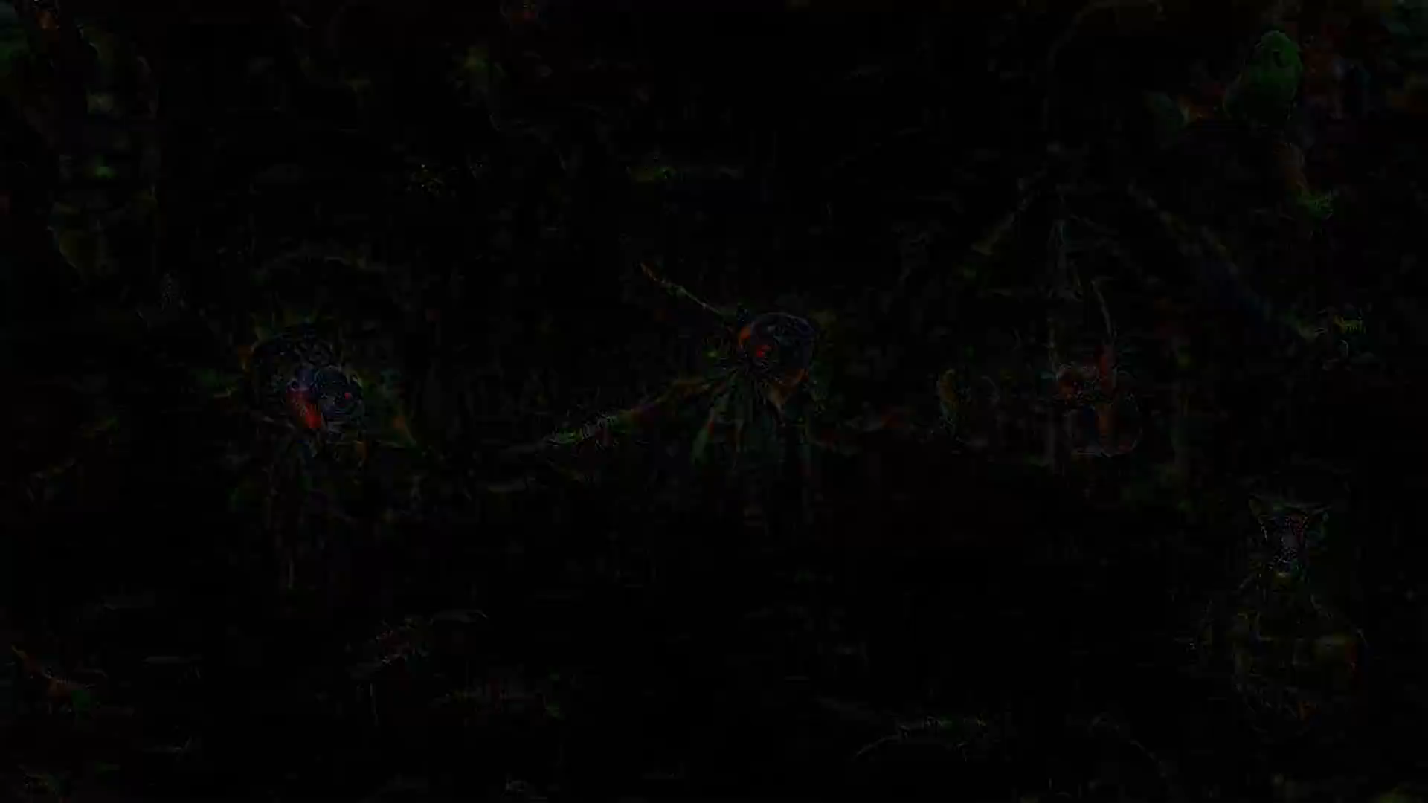
DeepDream
Deep Dream Grocery Trip - https://www.youtube.com/watch?v=DgPaCWJL7XI
Notes:
Deep Dream Grocery Trip
https://www.youtube.com/watch?v=DgPaCWJL7XI
Deep Dreaming Fear & Loathing in Las Vegas: the Great San Francisco Acid Wave https://www.youtube.com/watch?v=oyxSerkkP4o

Slide 15
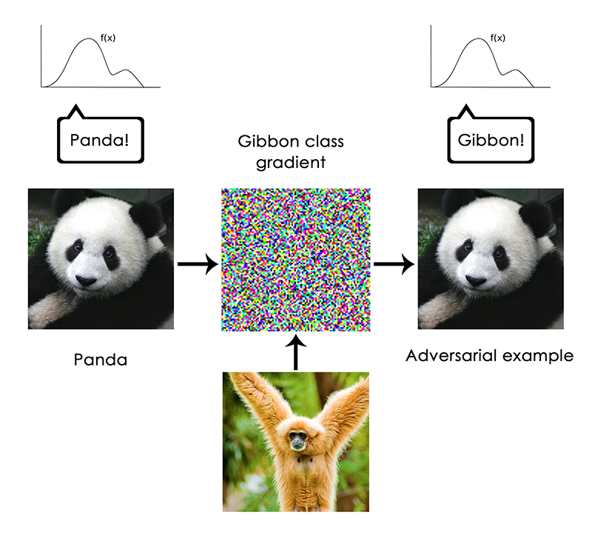
Francois Chollet - https://blog.keras.io/the-limitations-of-deep-learning.html
Notes:
But no

Slide 16
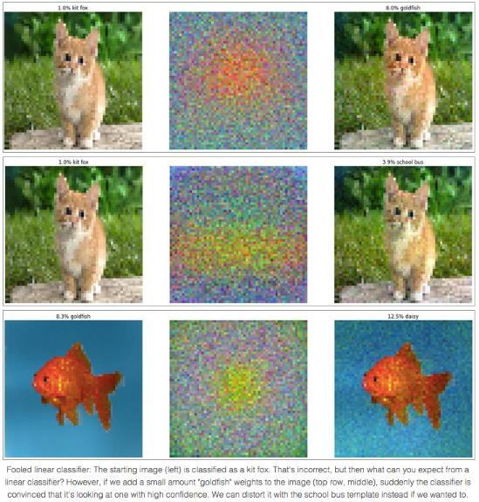
Fooling a linear classifier
To fool a linear classifier, add a small multiple of the weight vector to the training example:
x ← x + αw
http://karpathy.github.io/2015/03/30/breaking-convnets/
Jia-bin Huang

Slide 17
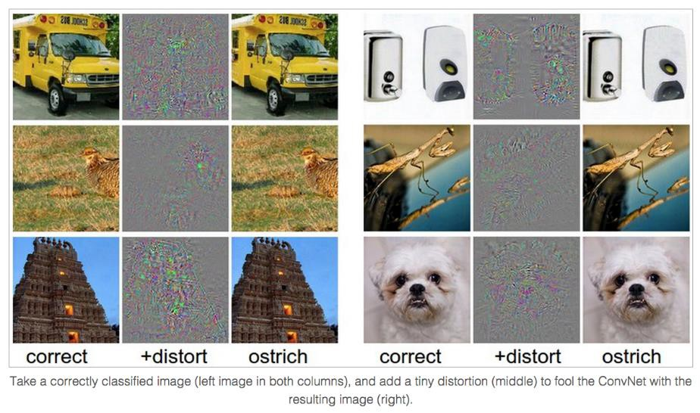
Breaking CNNs
Intriguing properties of neural networks [Szegedy ICLR 2014]

Slide 18
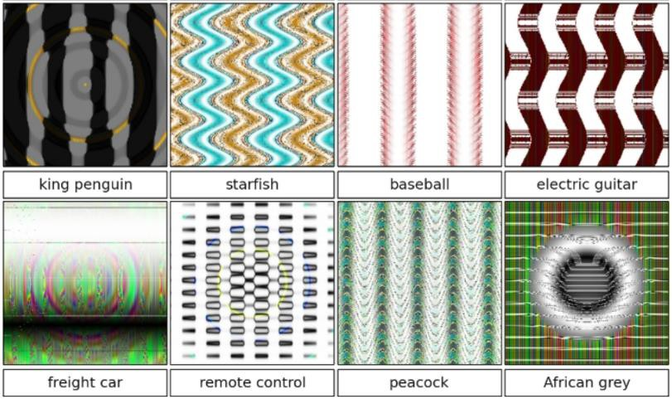
Breaking CNNs
Deep Neural Networks are Easily Fooled: High Confidence Predictions for Unrecognizable Images [Nguyen et al. CVPR 2015]
Notes:
But what types of images does this process produce? As we showed in a previous paper titled Deep networks are easily fooled: high confidence predictions for unrecognizable images, the results when this process is carried out on final-layer output neurons are images that the DNN thinks with near certainty are everyday objects, but that are completely unrecognizable as such.
Synthesizing images without regularization leads to “fooling images”: The DNN is near-certain all of these images are examples of the listed classes (over 99.6% certainty for the class listed under the image), but they are clearly not
http://www.cv-foundation.org/openaccess/content_cvpr_2015/papers/Nguyen_Deep_Neural_Networks_2015_CVPR_paper.pdf

Slide 19
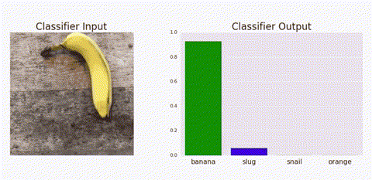
Adversarial Patches
[Brown et al., Adversarial Patch, 2018 - https://arxiv.org/pdf/1712.09665.pdf]
Notes:
https://www.theverge.com/2018/1/3/16844842/ai-computer-vision-trick-adversarial-patches-google

Slide 20
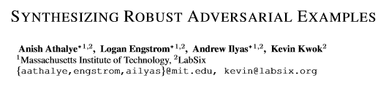
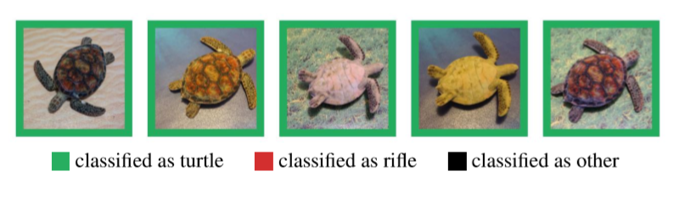
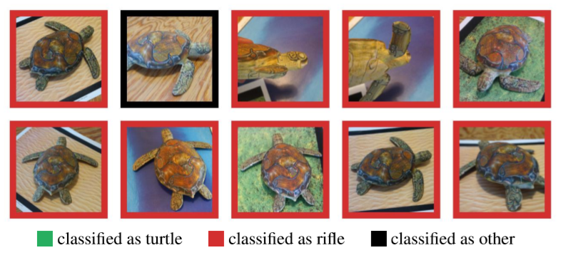
https://arxiv.org/pdf/1707.07397.pdf

Slide 21
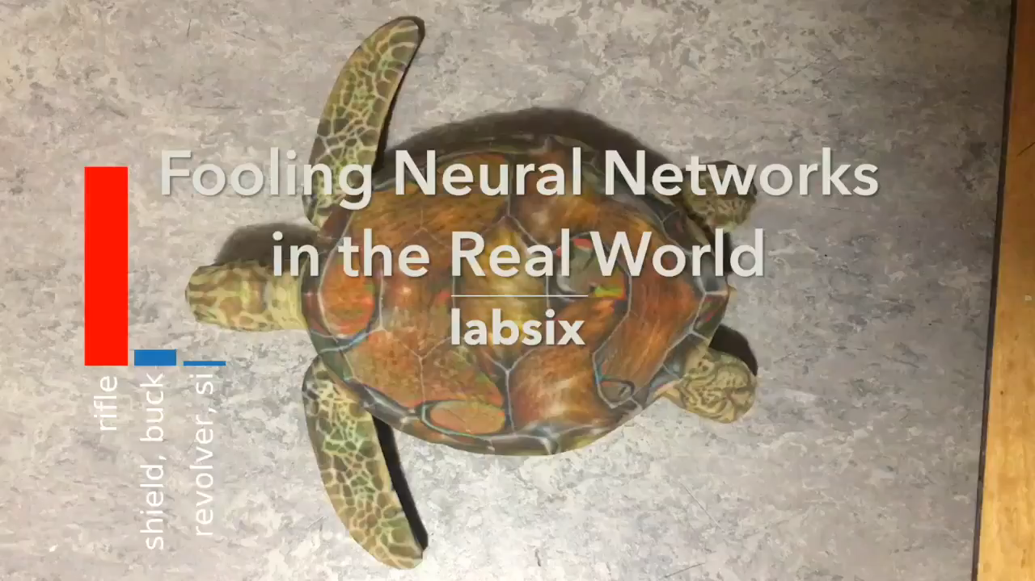

Slide 22
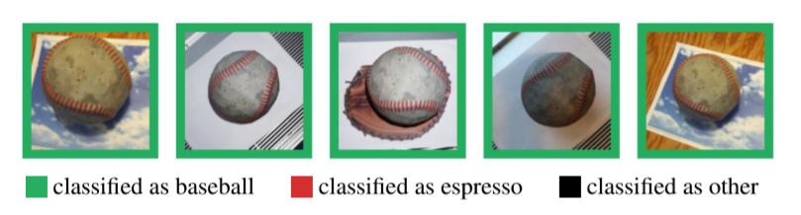
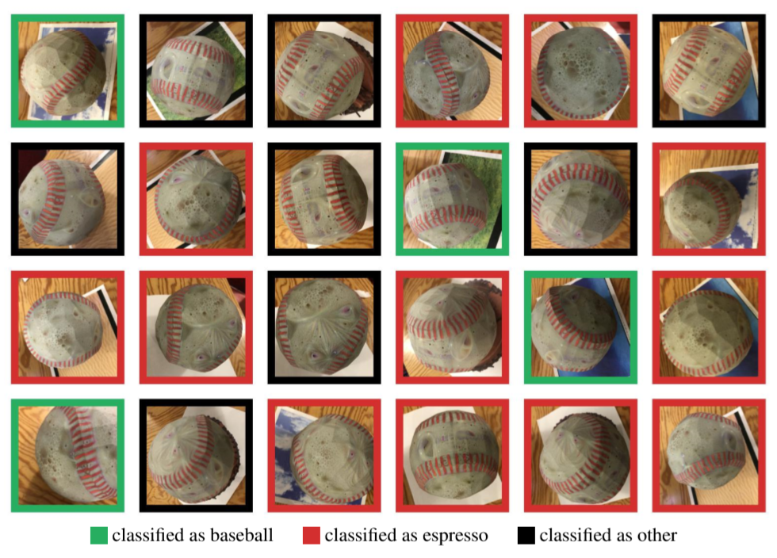

Slide 23
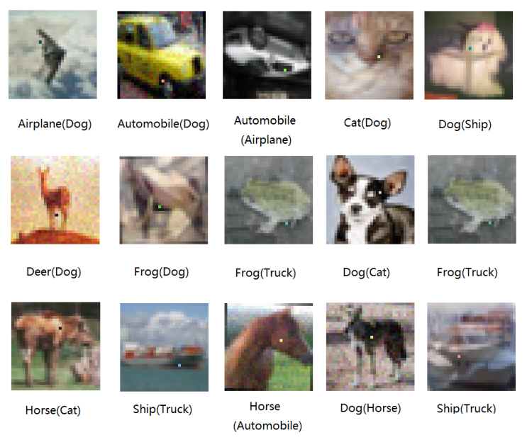
Su et al., One pixel attack for fooling deep neural networks https://arxiv.org/abs/1710.08864

Slide 24
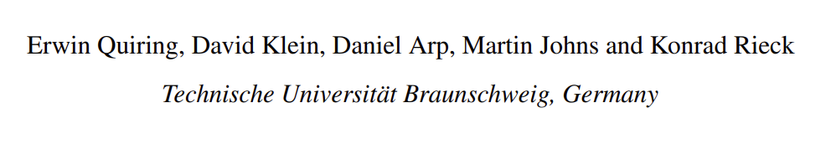
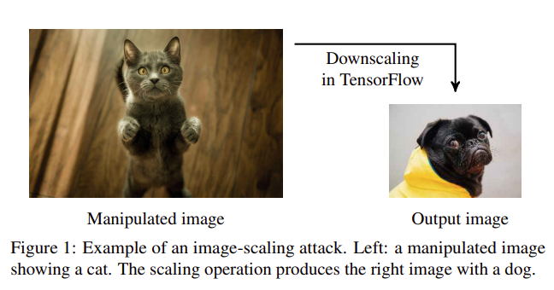
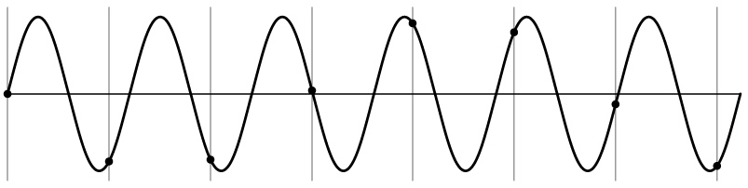
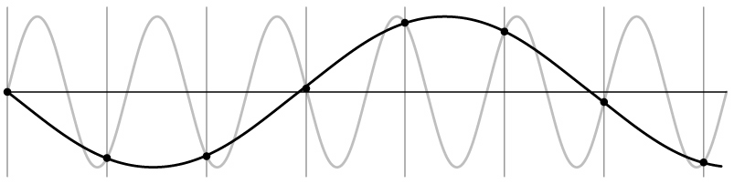
Adversarial Preprocessing
Aliasing attack! Downsampling
operation does not anti-alias properly.
[https://www.usenix.org/system/files/sec20fall_quiring_prepub.pdf]

Slide 25
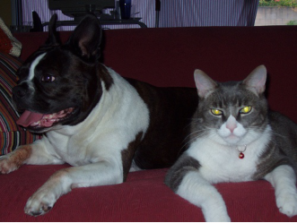
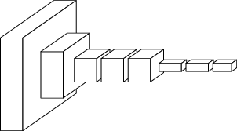
ConvNets perform classification
< 1 millisecond
“tabby cat”
1000-dim vector
end-to-end learning
[Slides from Long, Shelhamer, and Darrell; CVPR 2015]

Slide 26
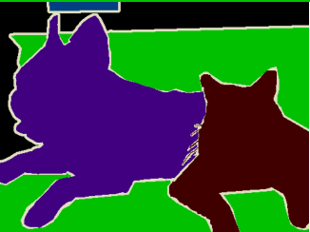
What if we want pixels out?
~1/10 second
???
end-to-end learning
[Slides from Long, Shelhamer, and Darrell; CVPR 2015]

Slide 27
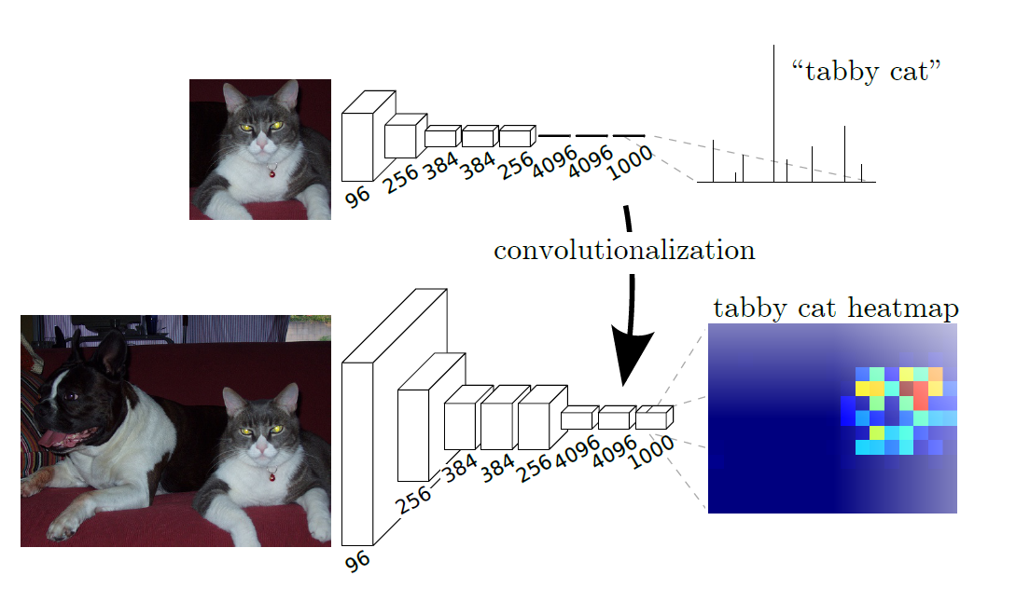
Notes:
Fig 2 from paper: Transforming fully connected layers into convolutional layers enables a classification network to output a heat map.
Adding layers and a spatial loss produce an efficient machine for end-to-end dense learning.

Slide 28
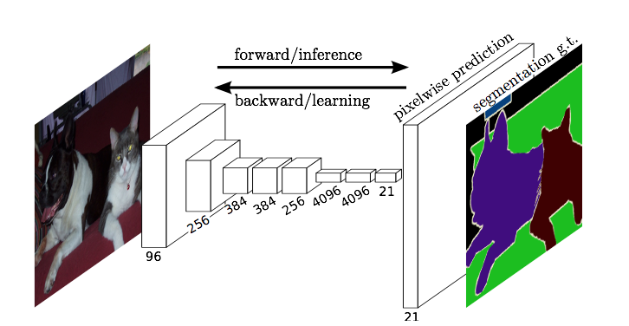
What if we want high-res output?
This one.
Hint: sometimes we use an upsampling network

Slide 29
Decoder networks learn to upsample
Encoder network
Decoder network
Often called “deconvolution”, but misnomer.
Not the deconvolution that we saw in deblurring -> that is division in the Fourier domain.
‘Transposed convolution’ is better.
Zeiler et al., Deconvolutional Networks, CVPR 2010
Noh et al., Learning Deconvolution Network for Semantic Segmentation, ICCV 2015
Notes:
The network architecture here is VGG
Six days to train on an NVIDIA Titan X GPU

Slide 30
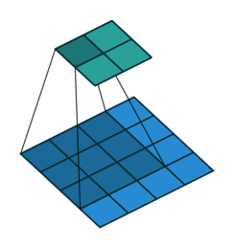
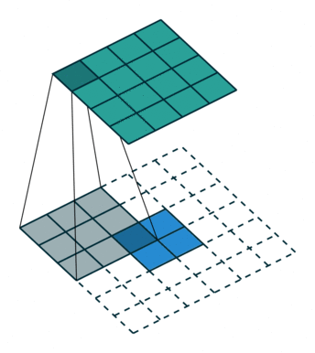
Upsampling with transposed convolution
Convolution
Transpose convolution
Padding = 0
Stride = 1
Padding = 0
Stride = 1

Slide 31


Convolution (sliding window)
Image
Kernel
Result
1 | 2 | 3 | 4
5 | 6 | 7 | 8
9 | 10 | 11 | 12
13 | 14 | 15 | 16
1 | 1 | 1
1 | 1 | 1
1 | 1 | 1
54 | 61
90 | 99
$$∗$$
$$=$$
No 1/9 term; not a blur.
Notes:
What is transpose convolution?
Let’s start with an alternative representation – the unrolling of convolution into a matrix.
Note – the kernel is _just some kernel_ here to make the math easy.

Slide 32


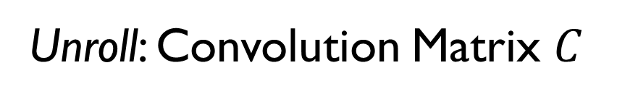
Unroll: Convolution Matrix $C^{ }$
Convolution (sliding window)
Image
Kernel
Result
Vectorized Image
1 | 2 | 3 | 4
5 | 6 | 7 | 8
9 | 10 | 11 | 12
13 | 14 | 15 | 16
1 | 1 | 1
1 | 1 | 1
1 | 1 | 1
54 | 61
90 | 99
1
2
3
4
5
6
7
8
9
10
11
12
13
14
15
16
$$∗$$
$$=$$
Result
(row vector)
T
1 | 1 | 1 | 0 | 1 | 1 | 1 | 0 | 1 | 1 | 1 | 0 | 0 | 0 | 0 | 0
54
$$×$$
$$=$$

Slide 33
Convolution (sliding window)
Image
Kernel
Result
Vectorized Image
1 | 2 | 3 | 4
5 | 6 | 7 | 8
9 | 10 | 11 | 12
13 | 14 | 15 | 16
1 | 1 | 1
1 | 1 | 1
1 | 1 | 1
54 | 61
90 | 99
1
2
3
4
5
6
7
8
9
10
11
12
13
14
15
16
$$∗$$
$$=$$
Result
(row vector)
Unroll: Convolution Matrix $C^{ }$
T
1 | 1 | 1 | 0 | 1 | 1 | 1 | 0 | 1 | 1 | 1 | 0 | 0 | 0 | 0 | 0
0 | 1 | 1 | 1 | 0 | 1 | 1 | 1 | 0 | 1 | 1 | 1 | 0 | 0 | 0 | 0
54
61
$$×$$
$$=$$

Slide 34
Convolution (sliding window)
Image
Kernel
Result
Vectorized Image
1 | 2 | 3 | 4
5 | 6 | 7 | 8
9 | 10 | 11 | 12
13 | 14 | 15 | 16
1 | 1 | 1
1 | 1 | 1
1 | 1 | 1
54 | 61
90 | 99
1
2
3
4
5
6
7
8
9
10
11
12
13
14
15
16
$$∗$$
$$=$$
Result
(row vector)
Unroll: Convolution Matrix $C^{ }$
T
1 | 1 | 1 | 0 | 1 | 1 | 1 | 0 | 1 | 1 | 1 | 0 | 0 | 0 | 0 | 0
0 | 1 | 1 | 1 | 0 | 1 | 1 | 1 | 0 | 1 | 1 | 1 | 0 | 0 | 0 | 0
0 | 0 | 0 | 0 | 1 | 1 | 1 | 0 | 1 | 1 | 1 | 0 | 1 | 1 | 1 | 0
54
61
90
$$×$$
$$=$$

Slide 35
Convolution (sliding window)
Image
Kernel
Result
Vectorized Image
1 | 2 | 3 | 4
5 | 6 | 7 | 8
9 | 10 | 11 | 12
13 | 14 | 15 | 16
1 | 1 | 1
1 | 1 | 1
1 | 1 | 1
54 | 61
90 | 99
1
2
3
4
5
6
7
8
9
10
11
12
13
14
15
16
$$∗$$
$$=$$
Result
(row vector)
Unroll: Convolution Matrix $C^{ }$
T
1 | 1 | 1 | 0 | 1 | 1 | 1 | 0 | 1 | 1 | 1 | 0 | 0 | 0 | 0 | 0
0 | 1 | 1 | 1 | 0 | 1 | 1 | 1 | 0 | 1 | 1 | 1 | 0 | 0 | 0 | 0
0 | 0 | 0 | 0 | 1 | 1 | 1 | 0 | 1 | 1 | 1 | 0 | 1 | 1 | 1 | 0
0 | 0 | 0 | 0 | 0 | 1 | 1 | 1 | 0 | 1 | 1 | 1 | 0 | 1 | 1 | 1
54
61
90
99
$$×$$
$$=$$

Slide 36



Transposed Convolution Matrix
$$C^{⊤}$$
"Image”
Result
Result (re-formed)
1 | 0 | 0 | 0
1 | 1 | 0 | 0
1 | 1 | 0 | 0
0 | 1 | 0 | 0
1 | 0 | 1 | 0
1 | 1 | 1 | 1
1 | 1 | 1 | 1
0 | 1 | 0 | 1
1 | 0 | 1 | 0
1 | 1 | 1 | 1
1 | 1 | 1 | 1
0 | 1 | 0 | 1
0 | 0 | 1 | 0
0 | 0 | 1 | 1
0 | 0 | 1 | 1
0 | 0 | 0 | 1
1
2
3
4
$$=$$
1
3
3
2
4
10
10
6
4
10
10
6
3
7
7
4
1 | 3 | 3 | 2
4 | 10 | 10 | 6
4 | 10 | 10 | 6
3 | 7 | 7 | 4
$$×$$
2 x 2
4 x 4
Note: this is no longer a convolution operation.

Slide 37
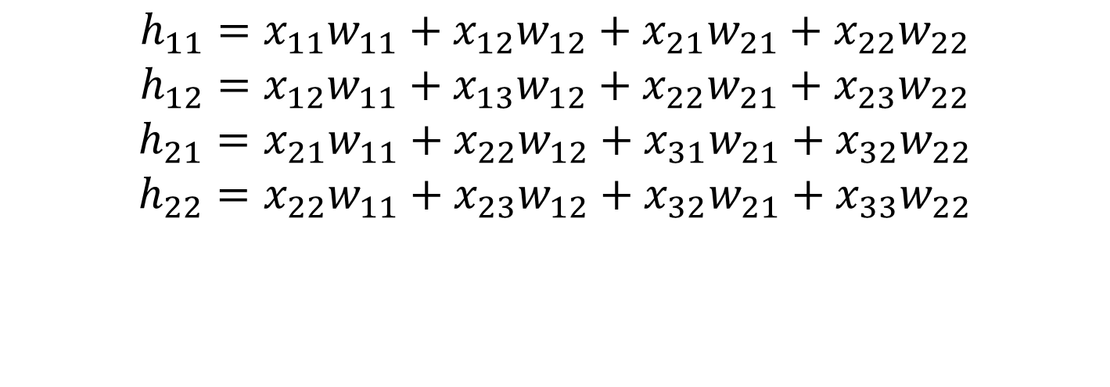
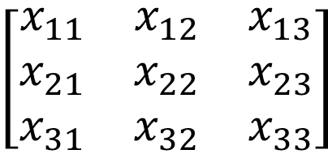

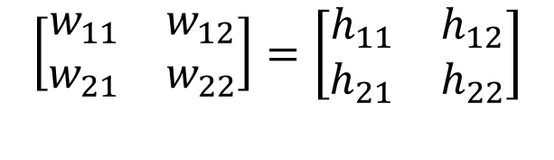
Transpose conv. = backward pass of conv.
Convolution
$$\left[\begin{matrix}x_{11} & x_{12} & x_{13} \\ x_{21} & x_{22} & x_{23} \\ x_{31} & x_{32} & x_{33}\end{matrix}\right]$$
$$∗$$
$$\left[\begin{matrix}w_{11} & w_{12} \\ w_{21} & w_{22}\end{matrix}\right]=\left[\begin{matrix}h_{11} & h_{12} \\ h_{21} & h_{22}\end{matrix}\right]$$
$$h_{11}=x_{11}w_{11}+x_{12}w_{12}+x_{21}w_{21}+x_{22}w_{22}$$
$$h_{12}=x_{12}w_{11}+x_{13}w_{12}+x_{22}w_{21}+x_{23}w_{22}$$
$$h_{21}=x_{21}w_{11}+x_{22}w_{12}+x_{31}w_{21}+x_{32}w_{22}$$
$$h_{22}=x_{22}w_{11}+x_{23}w_{12}+x_{32}w_{21}+x_{33}w_{22}$$
Notes:
With thanks to Konrad Kording
lec6.pdf (upenn.edu)

Slide 38
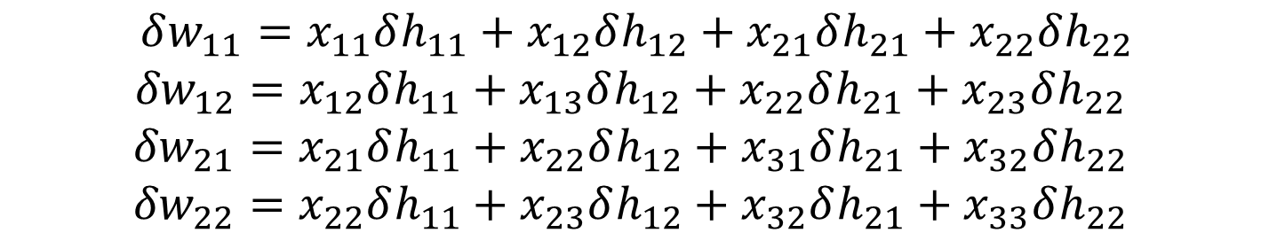
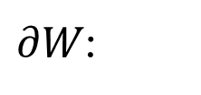
Transpose conv. = backward pass of conv.
Convolution
$$\left[\begin{matrix}x_{11} & x_{12} & x_{13} \\ x_{21} & x_{22} & x_{23} \\ x_{31} & x_{32} & x_{33}\end{matrix}\right]$$
$$∗$$
$$\left[\begin{matrix}w_{11} & w_{12} \\ w_{21} & w_{22}\end{matrix}\right]=\left[\begin{matrix}h_{11} & h_{12} \\ h_{21} & h_{22}\end{matrix}\right]$$
Derivative of convolution in weight update step
$∂W$:
$δw_{11}=x_{11}δh_{11}+x_{12}δh_{12}+x_{21}δh_{21}+x_{22}δh_{22}$
$${δw}_{12}=x_{12}δh_{11}+x_{13}δh_{12}+x_{22}δh_{21}+x_{23}δh_{22}$$
$${δw}_{21}=x_{21}δh_{11}+x_{22}δh_{12}+x_{31}δh_{21}+x_{32}δh_{22}$$
$${δw}_{22}=x_{22}δh_{11}+x_{23}δh_{12}+x_{32}δh_{21}+x_{33}δh_{22}$$

Slide 39
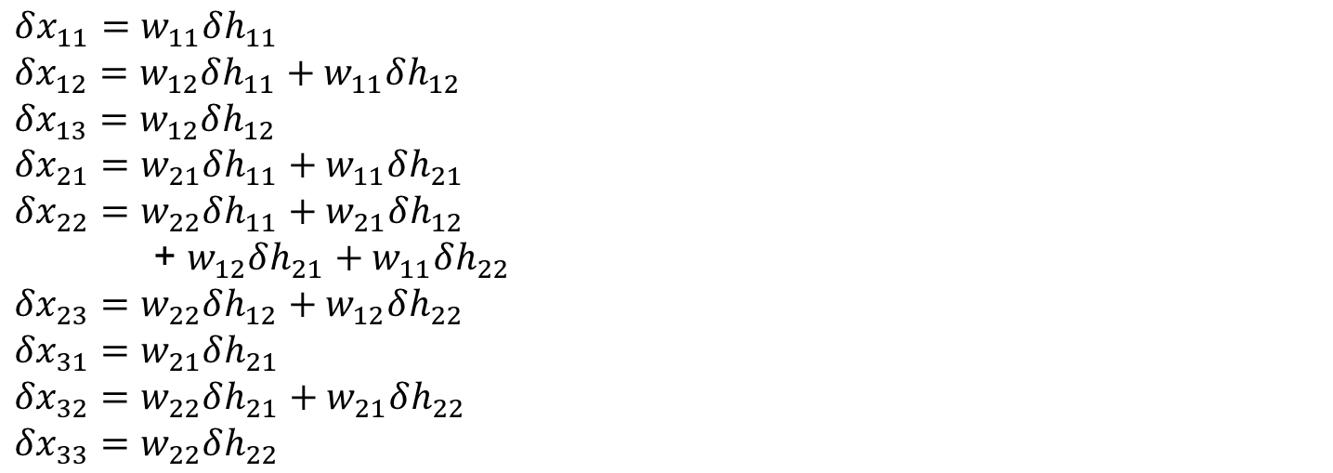
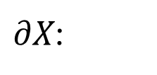
Transpose conv. = backward pass of conv.
Convolution
$$\left[\begin{matrix}x_{11} & x_{12} & x_{13} \\ x_{21} & x_{22} & x_{23} \\ x_{31} & x_{32} & x_{33}\end{matrix}\right]$$
$$∗$$
$$\left[\begin{matrix}w_{11} & w_{12} \\ w_{21} & w_{22}\end{matrix}\right]=\left[\begin{matrix}h_{11} & h_{12} \\ h_{21} & h_{22}\end{matrix}\right]$$
$∂X$:
$$δx_{11}=w_{11}δh_{11} \\ {δx}_{12}=w_{12}δh_{11}+w_{11}δh_{12} \\ {δx}_{13}=w_{12}δh_{12} \\ {δx}_{21}=w_{21}δh_{11}+w_{11}δh_{21}$$
$${δx}_{22}=w_{22}δh_{11}+w_{21}δh_{12}$$
+ $w_{12}δh_{21}+w_{11}δh_{22}$
$${δx}_{23}=w_{22}δh_{12}+w_{12}δh_{22}$$
$${δx}_{31}=w_{21}δh_{21}$$
$${δx}_{32}=w_{22}δh_{21}+w_{21}δh_{22}$$
$${δx}_{33}=w_{22}δh_{22}$$

Slide 40
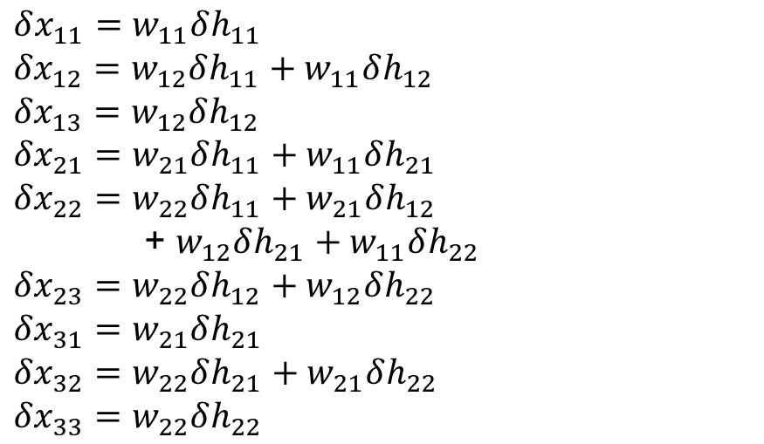




Transpose conv. = backward pass of conv.
Convolution
$$\left[\begin{matrix}x_{11} & x_{12} & x_{13} \\ x_{21} & x_{22} & x_{23} \\ x_{31} & x_{32} & x_{33}\end{matrix}\right]$$
$$∗$$
$$\left[\begin{matrix}w_{11} & w_{12} \\ w_{21} & w_{22}\end{matrix}\right]=\left[\begin{matrix}h_{11} & h_{12} \\ h_{21} & h_{22}\end{matrix}\right]$$
$∂X$:
$$C^{⊤}$$
$$δx_{11}=w_{11}δh_{11} \\ {δx}_{12}=w_{12}δh_{11}+w_{11}δh_{12} \\ {δx}_{13}=w_{12}δh_{12} \\ {δx}_{21}=w_{21}δh_{11}+w_{11}δh_{21}$$
$${δx}_{22}=w_{22}δh_{11}+w_{21}δh_{12}$$
+ $w_{12}δh_{21}+w_{11}δh_{22}$
$${δx}_{23}=w_{22}δh_{12}+w_{12}δh_{22}$$
$${δx}_{31}=w_{21}δh_{21}$$
$${δx}_{32}=w_{22}δh_{21}+w_{21}δh_{22}$$
$${δx}_{33}=w_{22}δh_{22}$$
$$w_{11}$$ | 0 | 0 | 0
$$w_{12}$$ | $$w_{11}$$ | 0 | 0
0 | $$w_{12}$$ | 0 | 0
$$w_{21}$$ | 0 | $$w_{11}$$ | 0
$$w_{22}$$ | $$w_{21}$$ | $$w_{12}$$ | $$w_{11}$$
0 | $$w_{22}$$ | 0 | $$w_{12}$$
0 | 0 | $$w_{21}$$ | 0
0 | 0 | $$w_{22}$$ | $$w_{21}$$
0 | 0 | 0 | $$w_{22}$$
$${δh}_{11}$$
$$δh_{12}$$
$${δh}_{21}$$
$${δh}_{22}$$
$$×$$
Operations are the same!
Notes:
How transpose convolution implemented in practice:
Swap forward and backward pass operations for the convolutional layer.

Slide 41




Analog to upsampling/downsampling
Downsampling (no aliasing):
Blur image (convolve)
Throw away every second sample along x,y
Upsampling:
Add zeros between every sample along x,y
Bilinearly interpolate by convolving with tent kernel
Convolve with bilinear (tent) kernel
Notes:
https://www.quora.com/How-do-fully-convolutional-networks-upsample-their-coarse-output ?
1603.07285.pdf (arxiv.org) + https://github.com/vdumoulin/conv_arithmetic
1609.07009.pdf (arxiv.org) “Is the deconvolution layer the same as a convolutional layer?”
Also called ‘fractionally-strided convolution’
Where the convolutions overlap, we ADD the output.
How do we apply the weights when the kernel crosses multiple input pixels from the previous layer?

Slide 42

Analog to upsampling/downsampling
Transposed convolution as fractionally-strided convolution
Convolution
2x2, stride 2, 3x3 kernel,
upsample to 5x5.
Notes:
https://www.quora.com/How-do-fully-convolutional-networks-upsample-their-coarse-output ?
1603.07285.pdf (arxiv.org) + https://github.com/vdumoulin/conv_arithmetic
1609.07009.pdf (arxiv.org) “Is the deconvolution layer the same as a convolutional layer?”
https://en.wikipedia.org/wiki/Deconvolution
Also called ‘backwards strided convolution’ or ‘fractionally-strided convolution’
Where the convolutions overlap, we ADD the output.
How do we apply the weights when the kernel crosses multiple input pixels from the previous layer?

Slide 43
Analog to upsampling/downsampling
Downsampling (no aliasing):
Blur image to remove high frequencies (convolve)
Throw away every second sample along x,y
Upsampling:
Add zeros between every sample along x,y
Bilinearly interpolate by convolving with tent kernel
Upsampling analogy implies that strided convolution can be used to implement transpose convolution.
Called ‘fractionally-strided convolution’ as we insert empty space (new zero-valued pixels) ‘halfway’ between pixels.
Notes:
https://www.quora.com/How-do-fully-convolutional-networks-upsample-their-coarse-output ?
1603.07285.pdf (arxiv.org) + https://github.com/vdumoulin/conv_arithmetic
1609.07009.pdf (arxiv.org) “Is the deconvolution layer the same as a convolutional layer?”
Also called ‘fractionally-strided convolution’
Where the convolutions overlap, we ADD the output.
How do we apply the weights when the kernel crosses multiple input pixels from the previous layer?

Slide 44


Kernel size/stride is important.
Is uneven overlap a problem?
Uneven overlap across output
Yes = causes grid artifacts
Could fix it by picking stride/kernel numbers which have no overlap…
Notes:
https://datascience.stackexchange.com/questions/6107/what-are-deconvolutional-layers
https://distill.pub/2016/deconv-checkerboard/

Slide 45
Is uneven overlap a problem?
Uneven overlap across output
Yes = causes grid artifacts
Could fix it by picking stride/kernel numbers which have no overlap…
Or…think in frequency!
Introduce explicit bilinear upsampling before transpose convolution; let kernels of transpose convolution learn to fill in
only high-frequency detail.
https://distill.pub/2016/deconv-checkerboard/
Notes:
https://datascience.stackexchange.com/questions/6107/what-are-deconvolutional-layers
https://distill.pub/2016/deconv-checkerboard/

Slide 46
Decoder networks learn to upsample
Encoder network
Decoder network
Often called “deconvolution”, but misnomer.
Not the deconvolution that we saw in deblurring -> that is division in the Fourier domain.
‘Transposed convolution’ is better.
Zeiler et al., Deconvolutional Networks, CVPR 2010
Noh et al., Learning Deconvolution Network for Semantic Segmentation, ICCV 2015
Notes:
The network architecture here is VGG
Six days to train on an NVIDIA Titan X GPU

Slide 47

Semantic segmentation results
Notes:
Thanks to Simon Prince

Slide 48

Results
FCN
SDS*
Truth
Input
SDS = *Simultaneous Detection and Segmentation Hariharan et al. ECCV14
Not Score Distillation Sampling…
[Long et al.]
Notes:
+ NYUD net for multi-modal input and SIFT Flow net for multi-task output

Slide 49

Scale-space of deep features (concatenated)
Combine where (local, shallow) with what (global, deep)
Fuse features into deep jet
(cf. Hariharan et al. CVPR15 “hypercolumn”)

Slide 50

Upsampling kernels with skip layer refinement
[Long et al.]

Slide 51
Upsampling kernels with skip layer refinement
interp + sum
interp + sum
dense output
[Long et al.]

Slide 52
Upsampling kernels with skip layer refinement
interp + sum
Skip to fuse layers!
interp + sum
dense output
[Long et al.]

Slide 53
Upsampling kernels with skip layer refinement
interp + sum
Skip to fuse layers!
interp + sum
End-to-end, joint learning
of semantics and location
dense output
[Long et al.]

Slide 54

UNet [Ronneberger et al., 2015]

Slide 55


Skip layer refinement
input image
stride 32
stride 16
stride 8
ground truth
no skips
1 skip
2 skips

Slide 56

U-Nets for everything!
Need a general encoder for images?
Need to map from one domain to another?

Slide 57

UNets for everything!
Need a general encoder for images?
Need to map from one domain to another?
[Isola Zhu, Zhou, Efros – Pix2Pix 2017] – a UNet with a GAN
Notes:
https://github.com/phillipi/pix2pix

Slide 58


UNets for everything!
Need a general encoder for images?
Need a compressed image representation?
Stable Diffusion image generator
Has a UNet inside it as a
general image latent space.
[Rombach, Blattmann, Lorenz, Esser, Ommer 2022]

Slide 59
Auto-encoders
Unsupervsed / self-supervised with a reconstruction loss

Slide 60

MNIST

Slide 61

Autoencoders
Lilian Weng
Notes:
http://www.cs.toronto.edu/~larocheh/publications/icml-2008-denoising-autoencoders.pdf

Slide 62

Notes:
https://introduction-to-autoencoders.vercel.app/

Slide 63

Denoising Autoencoders (Vincent et al. 2008)
Lilian Weng

Slide 64
What is ‘in’ an decoder?
Untrained Networks as Image Priors, Heckel & Hand, ICLR 2019
Deep Image Prior, Ulyanov et al. CVPR 2018

Slide 65
What is an image model?
Describes a class of signals it can represent.
Classical approach: DCT (discrete cosine transform) -> frequency space!
Represent natural images with fewer frequency coefficients than Nyquist limit.
Basis for JPEG compression!
Question: What kind of an image model is a CNN?
…when trained on many images?
...when trained on a single image?

Slide 66
The network structure itself is a ‘prior’!
1. Pick a simple decoder network G with parameters C
2. Give it a fixed random input B₀ (never changes)
3. Optimize C so that G(C) matches the target image
The network structure constrains what images can be produced.
If the network has FEWER parameters than pixels (N ≪ n):
→ It can represent natural images (smooth, structured)
→ It CANNOT represent random noise (unstructured)
→ Built-in regularization, no early stopping needed!

Slide 67

Image Pyramid
David Forsyth
Notes:
Downsampling repeatedly results in an ‘image pyramid’

Slide 68



Peak Signal to Noise Ratio
If we had a noise free $m×n$ image $I$ and its noisy variant $K$:
Mean squared error
Work in log domain because scales of dynamic range are large.
Where MAX is peak of possible signal.
E.G., 8bit, MAX =255.
[Wikipedia]
Notes:
Wikipedia:
Jump to navigationJump to searchPeak signal-to-noise ratio, often abbreviated PSNR, is an engineering term for the ratio between the maximum possible power of a signal and the power of corrupting noise that affects the fidelity of its representation. Because many signals have a very wide dynamic range, PSNR is usually expressed in terms of the logarithmic decibel scale.
Sensitivity to perceptual stimuli is logarithmic.

Slide 69


Peak Signal to Noise Ratio
Uncompressed image
JPEG compressed image
Q=90, PSNR 45.53dB
[Wikipedia]
Notes:
https://en.wikipedia.org/wiki/Peak_signal-to-noise_ratio

Slide 70

Peak Signal to Noise Ratio
Uncompressed image
JPEG compressed image
Q=30, PSNR 36.81dB
[Wikipedia]
Notes:
https://en.wikipedia.org/wiki/Peak_signal-to-noise_ratio

Slide 71

Peak Signal to Noise Ratio
Uncompressed image
JPEG compressed image
Q=10, PSNR 31.45dB
[Wikipedia]
Notes:
https://en.wikipedia.org/wiki/Peak_signal-to-noise_ratio

Slide 72

Example Decoder Architecture
Start with a small fixed random tensor B₀ (e.g. 16×16 × k channels).
Each layer: 3×3 convolution (channel mixing) → bilinear upsample 2× → ReLU → channel normalization.
Final layer: 1×1 convolution → sigmoid → output RGB image (512×512×3).
Notes:
Classic convolutional decoder.

Slide 73

Noise is learned last! (3x3 conv, bilinear, ReLU)
Note: Uses cosine annealing learning rate decay.
Notes:
This is related to why they are called ‘denoising decoders’ or ‘denoising autoencoders’.
Noise is a kind of regularization that can add robustness.
In classification setting, may also provide weak robustness to adversarial examples.
Image: Eileen Collins – first woman to command a space shuttle mission.

Slide 74

Example Decoder Architecture
Start with a small fixed random tensor B₀ (e.g. 16×16 × k channels).
Each layer: 1×1 convolution (channel mixing) → bilinear upsample 2× → ReLU → channel normalization.
Final layer: 1×1 convolution → sigmoid → output RGB image (512×512×3).
No spatial convolutions! Only 1×1 (pixel-wise) + upsampling.
Notes:
This is the architecture from the Deep Decoder paper. Deep Image Prior uses a Unet.

Slide 75

Noise is learned last! (1x1 conv, bilinear, ReLU)
1 x 1 convolutions have fewer free parameters, more constrained.
Fits less noise than 3x3; achieves higher PSNR to clean target.
Note: Uses cosine annealing learning rate decay.
Notes:
The underparameterized network physically cannot represent the noise.
Paper reports 29.6 dB on 512×512 astronaut (σ=25); we use 256×256 here for speed.

Slide 76

Denoising
Noisy input: 20.8 dB → Deep Decoder output: 22.7 dB
No training data, no early stopping — just optimize and read off the result.
The underparameterized network physically cannot represent the noise.
Paper reports 29.6 dB on 512×512 astronaut (σ=25); we use 256×256 here for speed.

Slide 77

Also inpaints!
50% of pixels removed → reconstruction: 22.0 dB
Same network, same code — only the loss changes: L = || mask · (G(C) − y) ||²
The network fills in missing pixels by leveraging its structural bias.

Slide 78
Key Takeaways
1. Neural networks can be image models WITHOUT any training.
The network structure itself encodes useful priors about natural images.
2. Upsampling = coarse-to-fine generation = image pyramid in reverse.
This is why the decoder naturally represents smooth, structured images.
3. Underparameterization provides automatic regularization.
Fewer parameters than pixels → can't fit noise → denoises for free.
4. Sometimes simpler is better.
Strip an autoencoder to just its decoder. Remove convolutions.
What's left still works — and is easier to understand and analyze.

Slide 79
Other model inspection approaches
Additional slides

Slide 80

Is there a model agnostic way?
Local Interpretable
Model-agnostic Explanations (LIME)
Which image regions were important for classifying this as “tree frog”?
Which for “pool table”?
[Riberio et al., 2016 KDD]
Notes:
Paper: https://arxiv.org/pdf/1602.04938v1.pdf
Blog post: https://www.oreilly.com/content/introduction-to-local-interpretable-model-agnostic-explanations-lime/

Slide 81

What is LIME doing?
Explaining complex decision boundary of black box model by a linear model trained around local perturbations of an instance.
Instance of class 2
Instance in question
of class 1
Perturbed instances
Size of cross/dot = weight in linear model
Learned non-linear decision boundary
[Riberio et al., 2016 KDD]
Notes:
https://www.oreilly.com/content/introduction-to-local-interpretable-model-agnostic-explanations-lime/

Slide 82
Local Interpretable Model-agnostic Explanations (LIME)
Step 1: Split the image up into superpixels
[Riberio et al., 2016 KDD]

Slide 83






Superpixels: Mid-level clustering
50x50 Patch
50x50 Patch
[Felzenszwalb and Huttenlocher 2004]
Superpixels!
[Shi and Malik 2001]
[Hoiem et al. 2005, Mori 2005]
Notes:
Remember: from unsupervised machine learning crash course.
For feature support or efficiency

Slide 84
Superpixel algorithm (SLIC)
Approach: k-means clustering
Setup:
Features: l,a,b (color) and x,y (position)
Metric: Euclidean distance with spatial normalization for x,y
Algorithm:
Distribute ‘seed’ points (initial k-clusters) across image in a regular grid
Run k-means until convergence
Split clusters that are disconnected spatially
Assign superpixels by clusters
[Simplified version of ‘SLIC’ superpixels – Achanta et al. 2010]
Notes:
Remember: L,a,b is a perceptual color space as a transform of RGB space.
This is slightly simplified as an implementation of SLIC:
SLIC has a 2a) step that moves the seeds to the lowest image gradient point within a nearby neighborhood, so that they don’t lie on edges.
SLIC’s spatial normalization term is m / S, where m is a ‘compactness’ free variable and S is set relative to the initial regular grid sampling.
SLIC superpixels – Achanta et al. 2010
https://infoscience.epfl.ch/record/149300

Slide 85



SLIC Superpixel Results (varying k)

Slide 86
Local Interpretable Model-agnostic Explanations (LIME)
Step 1: Split the image up into superpixels
[Riberio et al., 2016 KDD]

Slide 87

Local Interpretable Model-agnostic Explanations (LIME)
Step 2: Perturb instances – randomly set superpixels to gray and generate new dataset

Slide 88
Local Interpretable Model-agnostic Explanations (LIME)
Step 3: Classify the perturbed instances

Slide 89
Local Interpretable Model-agnostic Explanations (LIME)
Step 4: Learn a linear classification model (K-LASSO) on this new dataset that weights outputs.
Each data point:
Feature: superpixel on/off
x = { 1, 0, 0, 0, 1, 1, 1, 0, 0, 1 }
Label:
y = {0.85}
Notes:
LASSO = linear regression with weight regularization
K-LASSO = k-factor linear regression with weight regularization

Slide 90
Local Interpretable Model-agnostic Explanations (LIME)
Step 5: Keep only intersection of high-weight examples for final explanation output.

Slide 91

LIME: Which areas caused the classifications?
3rd confident: “Balloon”
Most confident: “Tree frog”
2nd confident: “Pool table”

Slide 92
Why useful?
Linear model on superpixels might be easier to interpret.
Perturbation + local approximation trick works for any classifier – classifier is treated as a black box.
Output explanations do not require underlying network representation to be interpretable itself.
Explanations do not require any knowledge of the inner workings of the network – only the output classifications
Operates on true black boxes
[Riberio et al., 2016 KDD]
Notes:
https://www.oreilly.com/content/introduction-to-local-interpretable-model-agnostic-explanations-lime/

