Slide 1
Transformers
COMP 322: Computer Vision and Image Processing
Hong Xu · Rhodes College
Original text Transformers → decoder-only LMs → multimodal models.
ViT is assigned reading (not re-derived in this lecture).
Adapted in part from Brown CSCI 1430 Spring 2026 materials
and diagrams from Simon Prince, Understanding Deep Learning.

Slide 2
Many slides from:
Prof. Simon Prince @ UBath
Understanding Deep Learning (course book!)
Some diagrams are subject to a Creative Commons CC-BY-NC-ND license. (C) MIT Press.

Slide 3
Transformers
Motivation
Dot-product self-attention
Matrix form
The transformer
Vision transformers
Properties of transformers

Slide 4
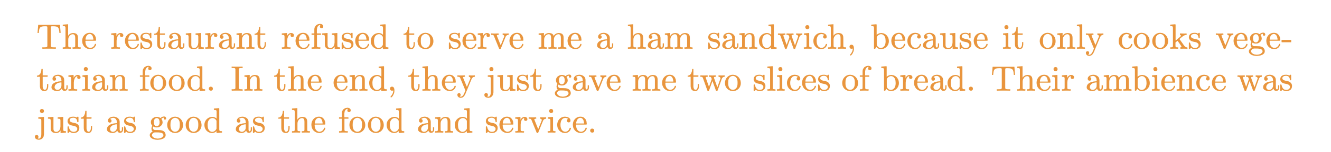
Motivation originally in text
Design neural network to encode and process sequences:

Slide 5

Motivation
Design neural network to encode and process sequences:

Slide 6

Motivation
Design neural network to encode and process sequences:
x N

Slide 7
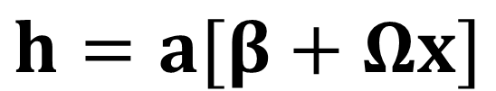
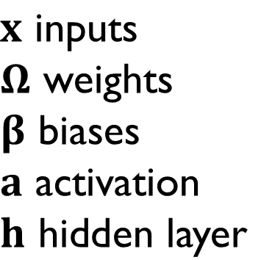
Standard fully-connected layer

Slide 8
Standard fully-connected layer

Slide 9
Standard fully-connected layer
Problem:
A very large number of parameters
Can’t cope with sequences of different lengths
Conclusion:
We need a model where parameters don’t increase with input length

Slide 10
Motivation
Design neural network to encode and process sequences:
The word their must “attend to” the word restaurant.

Slide 11
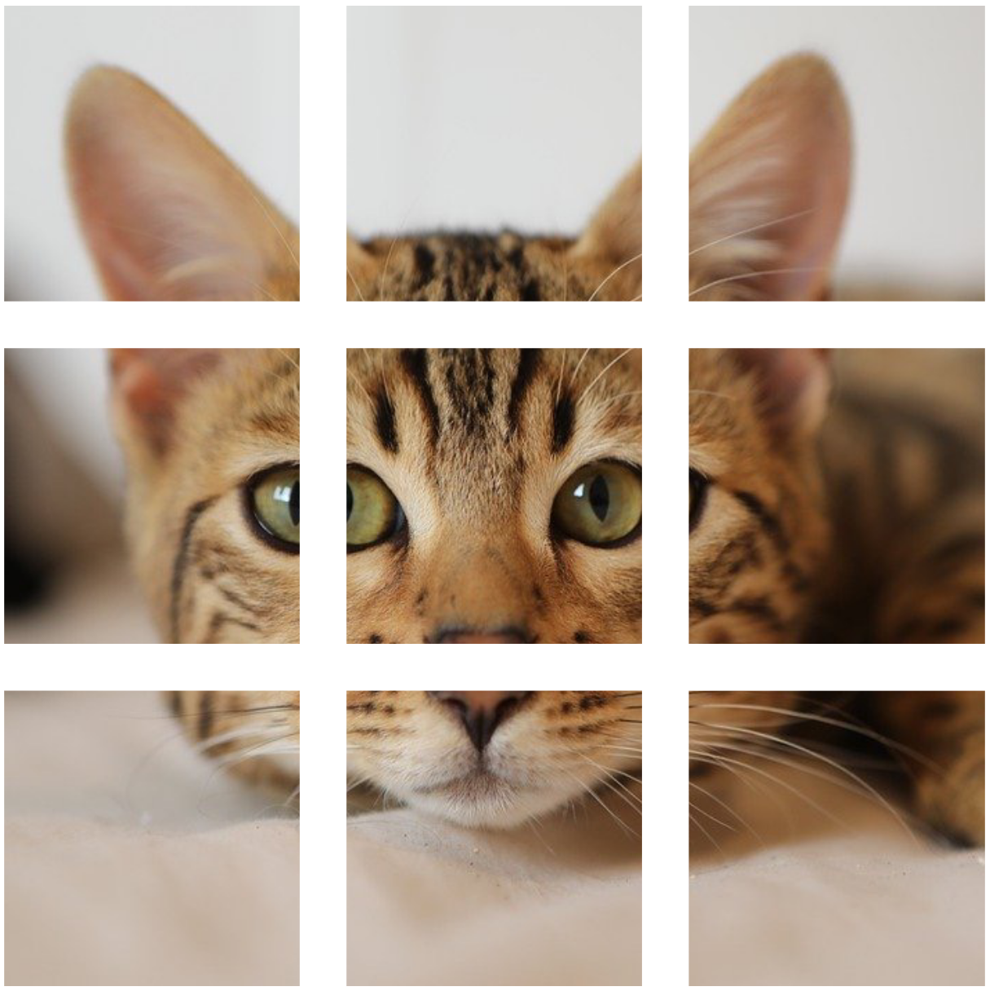
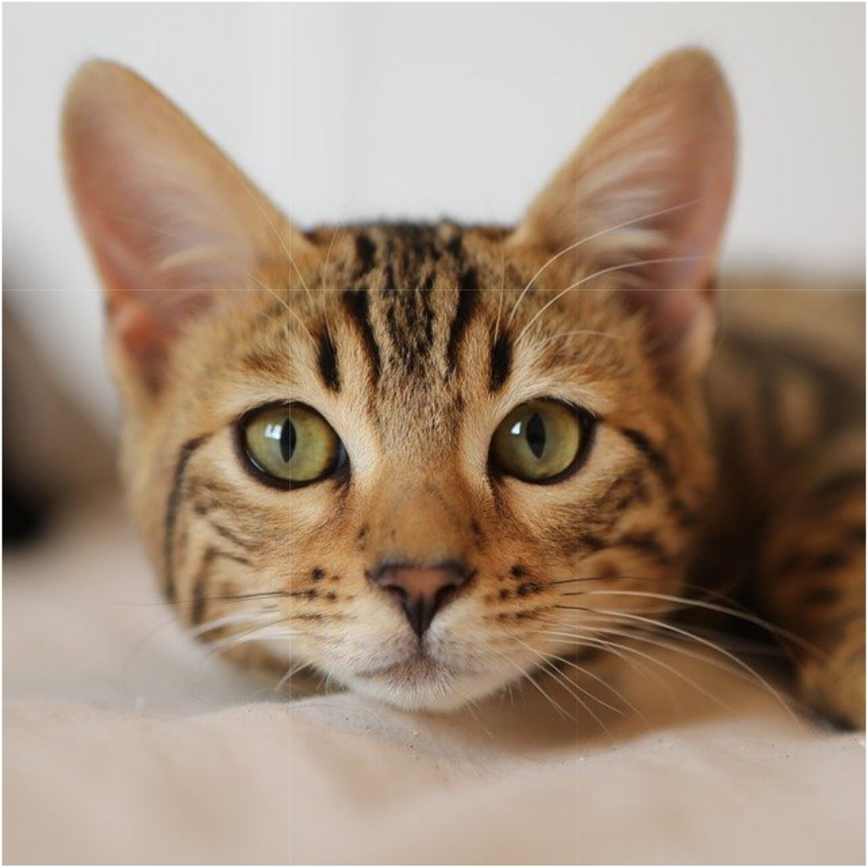
Motivation
Design neural network to encode and process sequences:
Notes:
Cat – via Justin Johnson - https://pixabay.com/photos/cat-kitten-pet-feline-whiskers-4262034/

Slide 12
Motivation
Design neural network to encode and process sequences:
The ear must “attend to” the other ear, eyes, and nose to know it is a cat.
There must be connections between the elements.
The strength of these connections will depend on the elements themselves.
Notes:
Cat – Justin Johnson

Slide 13
Transformers
Motivation
Dot-product self-attention
Matrix form
The transformer
Vision transformers
Properties of transformers

Slide 14
Dot-product self attention
Takes N inputs of size Dx1 and returns N inputs of size Dx1
Computes N values (no ReLU)
N outputs are weighted sums of these values
Weights depend on the inputs themselves

Slide 15
Dot-product self attention
Takes N inputs of size Dx1 and returns N inputs of size Dx1
Computes N values (no ReLU)
N outputs are weighted sums of these values
Weights depend on the inputs themselves

Slide 16
Dot-product self attention
Takes N inputs of size Dx1 and returns N inputs of size Dx1
Computes N values (no ReLU)
N outputs are weighted sums of these values
Weights depend on the inputs themselves

Slide 17
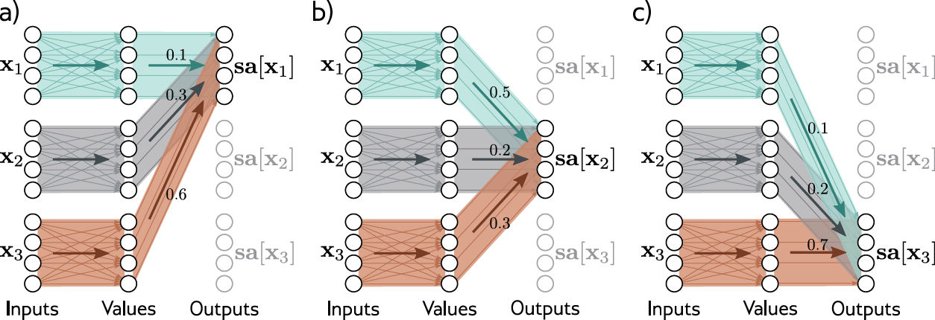
Attention as routing
Notes:
Self-attention as routing. The self-attention mechanism takes N inputs x₁, …, x_N ∈ ℝ^D (here N = 3 and D = 4) and processes each separately to compute N value vectors. The n^th output sa_n[x₁, … x_N] (written as sa_n[x•] for short) is then computed as a weighted sum of the N value vectors, where the weights are positive and sum to one.
a) Output sa₁[x•] is computed as a[x₁, x₁] = 0.1 times the first value vector, a[x₂, x₁] = 0.3 times the second value vector, and a[x₃, x₁] = 0.6 times the third value vector.
b) Output sa₂[x•] is computed in the same way, but this time with weights of 0.5, 0.2, and 0.3.
c) The weighting for output sa₃[x•] is different again. Each output can hence be thought of as a different routing of the N values.

Slide 18
Attention as routing
Notes:
Self-attention as routing. The self-attention mechanism takes N inputs x₁, …, x_N ∈ ℝ^D (here N = 3 and D = 4) and processes each separately to compute N value vectors. The n^th output sa_n[x₁, … x_N] (written as sa_n[x•] for short) is then computed as a weighted sum of the N value vectors, where the weights are positive and sum to one.
a) Output sa₁[x•] is computed as a[x₁, x₁] = 0.1 times the first value vector, a[x₂, x₁] = 0.3 times the second value vector, and a[x₃, x₁] = 0.6 times the third value vector.
b) Output sa₂[x•] is computed in the same way, but this time with weights of 0.5, 0.2, and 0.3.
c) The weighting for output sa₃[x•] is different again. Each output can hence be thought of as a different routing of the N values.

Slide 19
Attention as routing
Notes:
Self-attention as routing. The self-attention mechanism takes N inputs x₁, …, x_N ∈ ℝ^D (here N = 3 and D = 4) and processes each separately to compute N value vectors. The n^th output sa_n[x₁, … x_N] (written as sa_n[x•] for short) is then computed as a weighted sum of the N value vectors, where the weights are positive and sum to one.
a) Output sa₁[x•] is computed as a[x₁, x₁] = 0.1 times the first value vector, a[x₂, x₁] = 0.3 times the second value vector, and a[x₃, x₁] = 0.6 times the third value vector.
b) Output sa₂[x•] is computed in the same way, but this time with weights of 0.5, 0.2, and 0.3.
c) The weighting for output sa₃[x•] is different again. Each output can hence be thought of as a different routing of the N values.

Slide 20
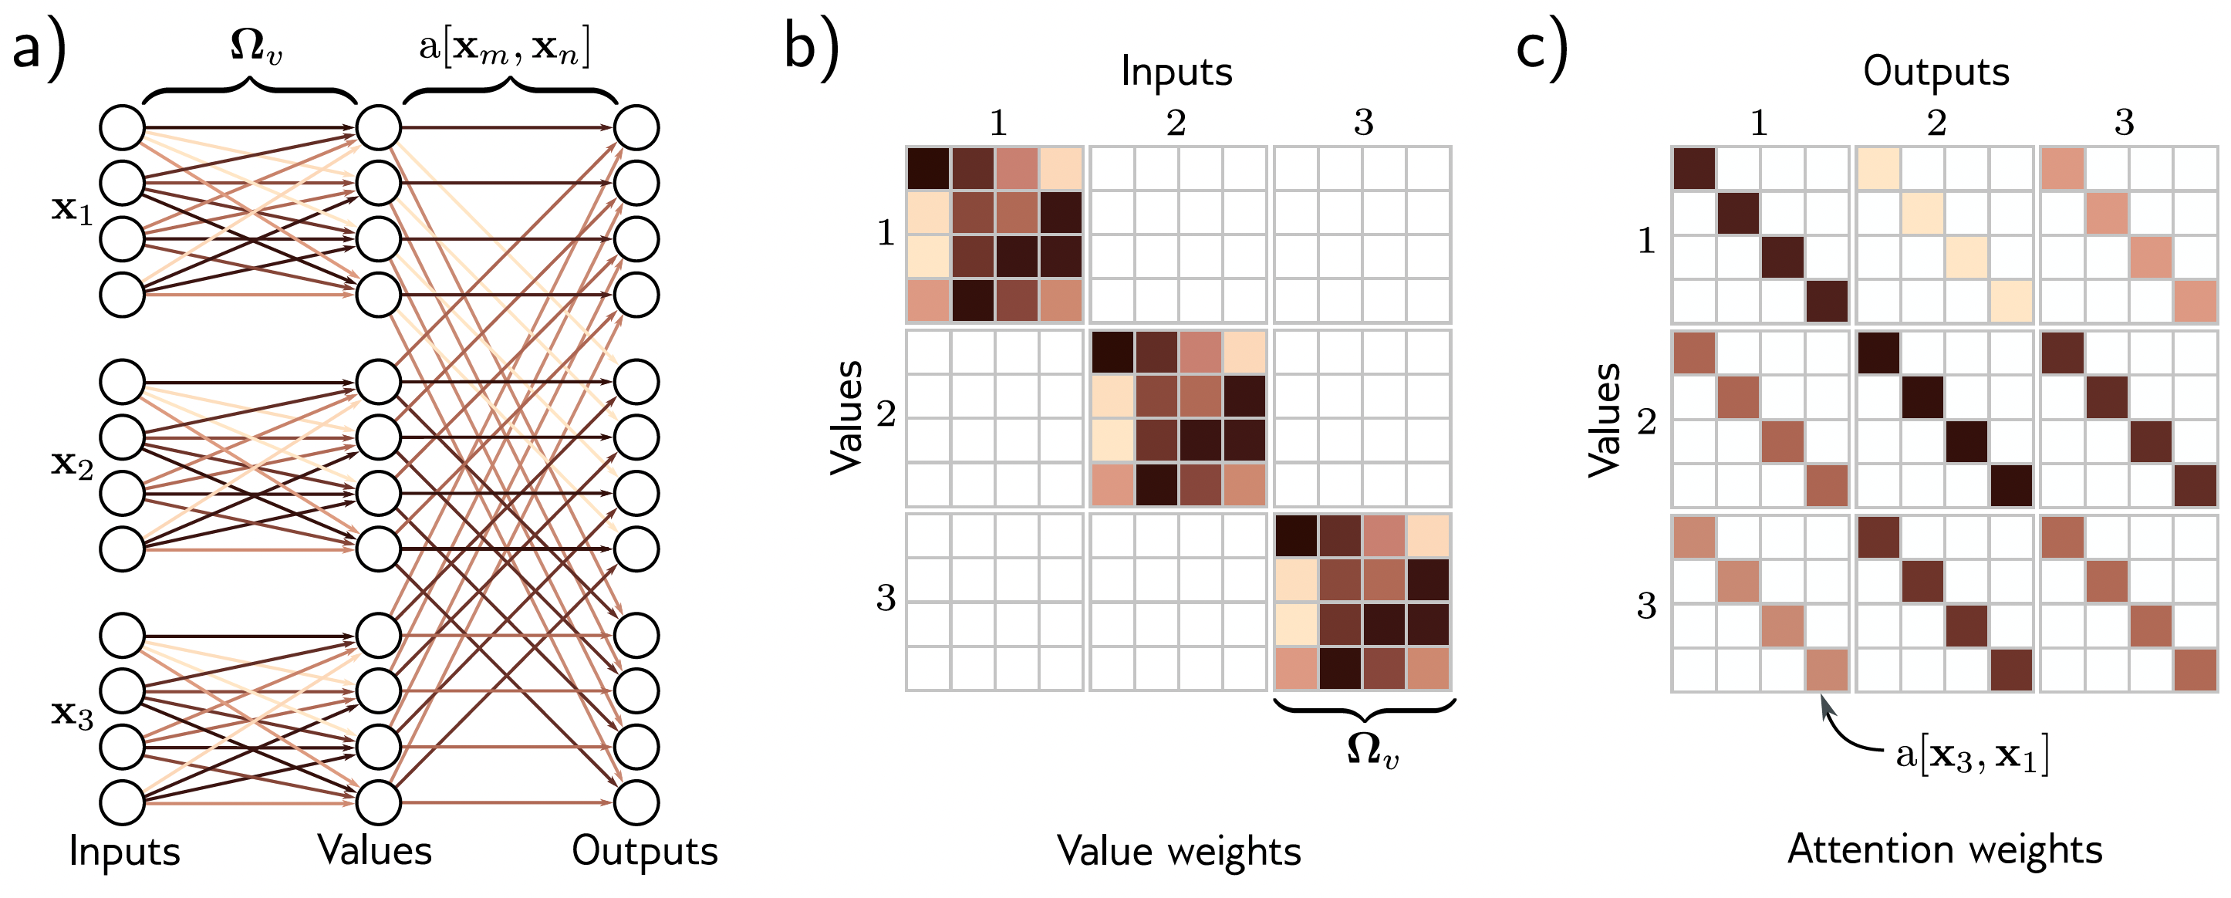
Attention as matrix view
Same color = same weight
Notes:
Self-attention for N = 3 inputs x_n, each with dimension D = 4.
Each input x_n is operated on independently by the same weights Ω_v (same color equals same weight) and biases β_v (not shown) to form the values β_v + Ω_v x_n. Each output is a linear combination of the values, with a shared attention weight a[x_m, x_n] defining the contribution of the m^th value to the n^th output.
Matrix showing block sparsity of linear transformation Ω_v between inputs and values.
Matrix showing sparsity of attention weights relating values and outputs.

Slide 21
Attention weights
Compute N “queries” and N “keys” from input
Calculate similarity and pass through softmax:

Slide 22
Attention weights
Compute N “queries” and N “keys” from input
Take dot products and pass through softmax:
Weights depend on the inputs themselves
Notes:
Softmax adds the non-linearity

Slide 23
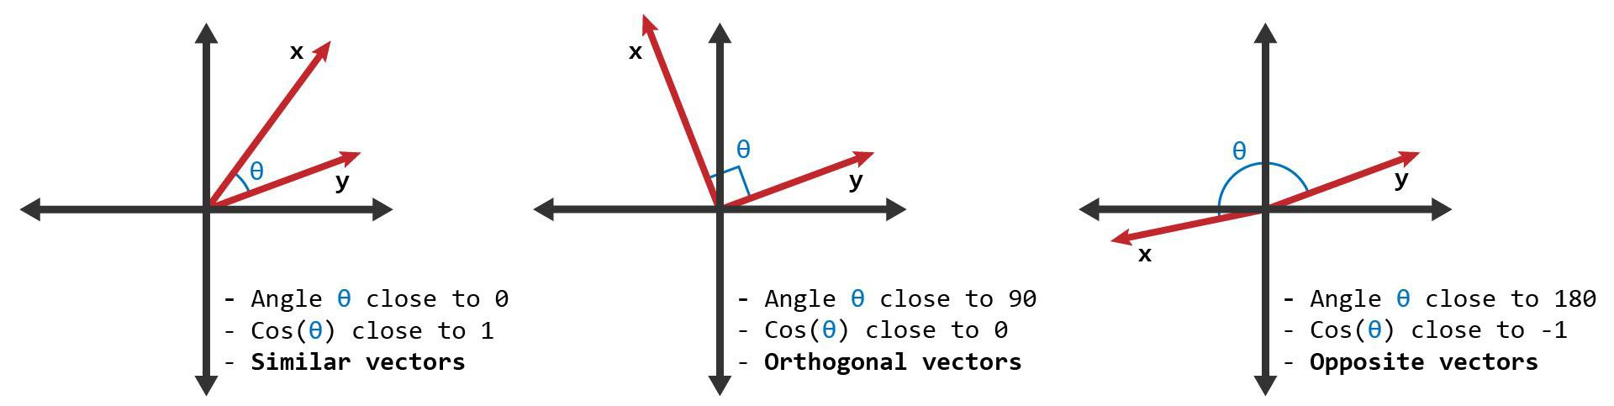
Recap: Dot product = measure of similarity

Slide 24
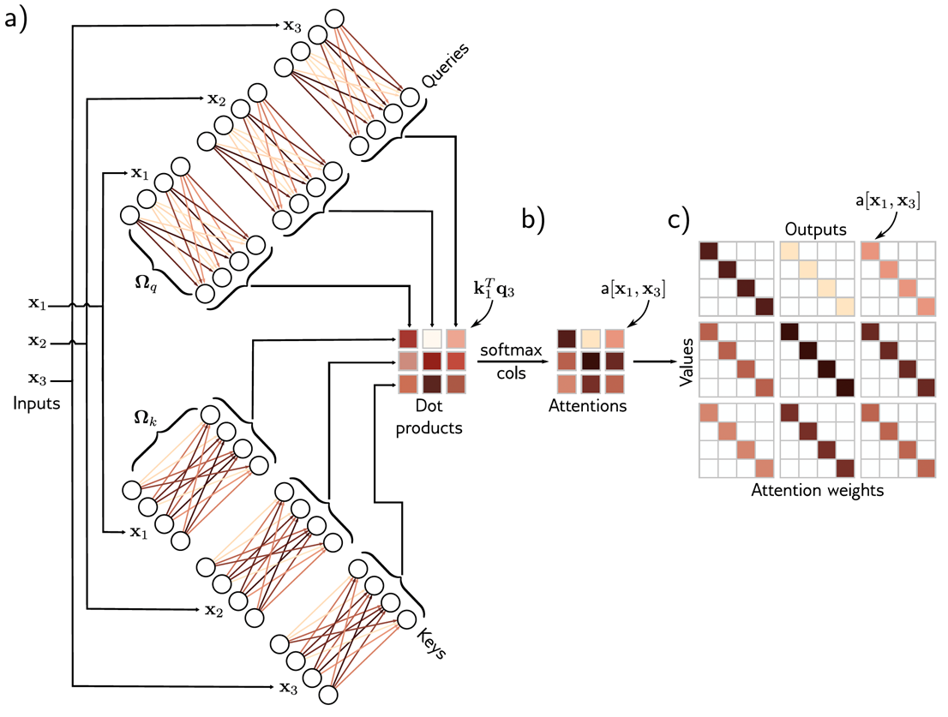
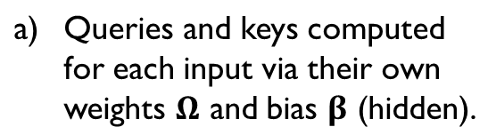
Computing attention weights
Same color = same weight
Notes:
Figure 12.3 Computing attention weights.
Query vectors q_n = β_q + Ω_q x_n and key vectors k_n = β_k + Ω_k x_n are computed for each input x_n.
The dot products between each query and the three keys are passed through a softmax function to form non-negative attentions that sum to one.
These route the value vectors (figure 12.1) via the sparse matrix from figure on previous slide

Slide 25
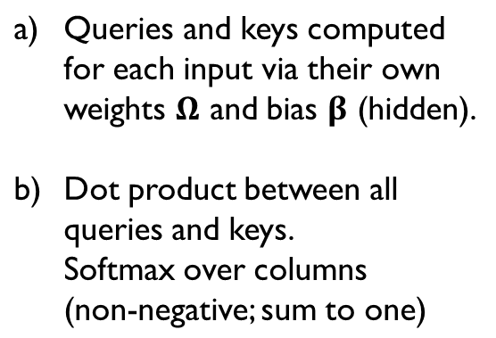
Computing attention weights
Same color = same weight
Notes:
Figure 12.3 Computing attention weights.
Query vectors q_n = β_q + Ω_q x_n and key vectors k_n = β_k + Ω_k x_n are computed for each input x_n.
The dot products between each query and the three keys are passed through a softmax function to form non-negative attentions that sum to one.
These route the value vectors (figure 12.1) via the sparse matrix from figure on previous slide

Slide 26
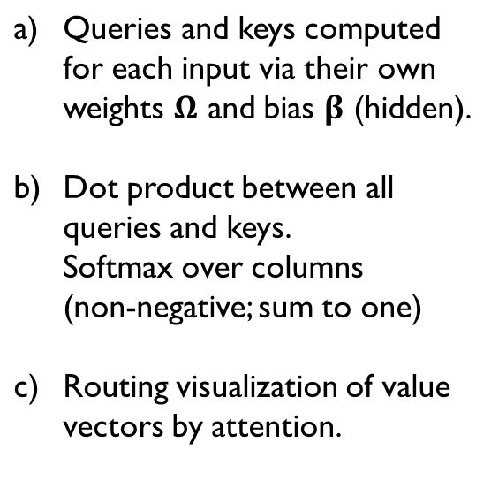
Computing attention weights
Same color = same weight
Notes:
Figure 12.3 Computing attention weights.
Query vectors q_n = β_q + Ω_q x_n and key vectors k_n = β_k + Ω_k x_n are computed for each input x_n.
The dot products between each query and the three keys are passed through a softmax function to form non-negative attentions that sum to one.
These route the value vectors (figure 12.1) via the sparse matrix from figure on previous slide

Slide 27
Computing attention weights
Same color = same weight
Notes:
Figure 12.3 Computing attention weights.
Query vectors q_n = β_q + Ω_q x_n and key vectors k_n = β_k + Ω_k x_n are computed for each input x_n.
The dot products between each query and the three keys are passed through a softmax function to form non-negative attentions that sum to one.
These route the value vectors (figure 12.1) via the sparse matrix from figure on previous slide

Slide 28
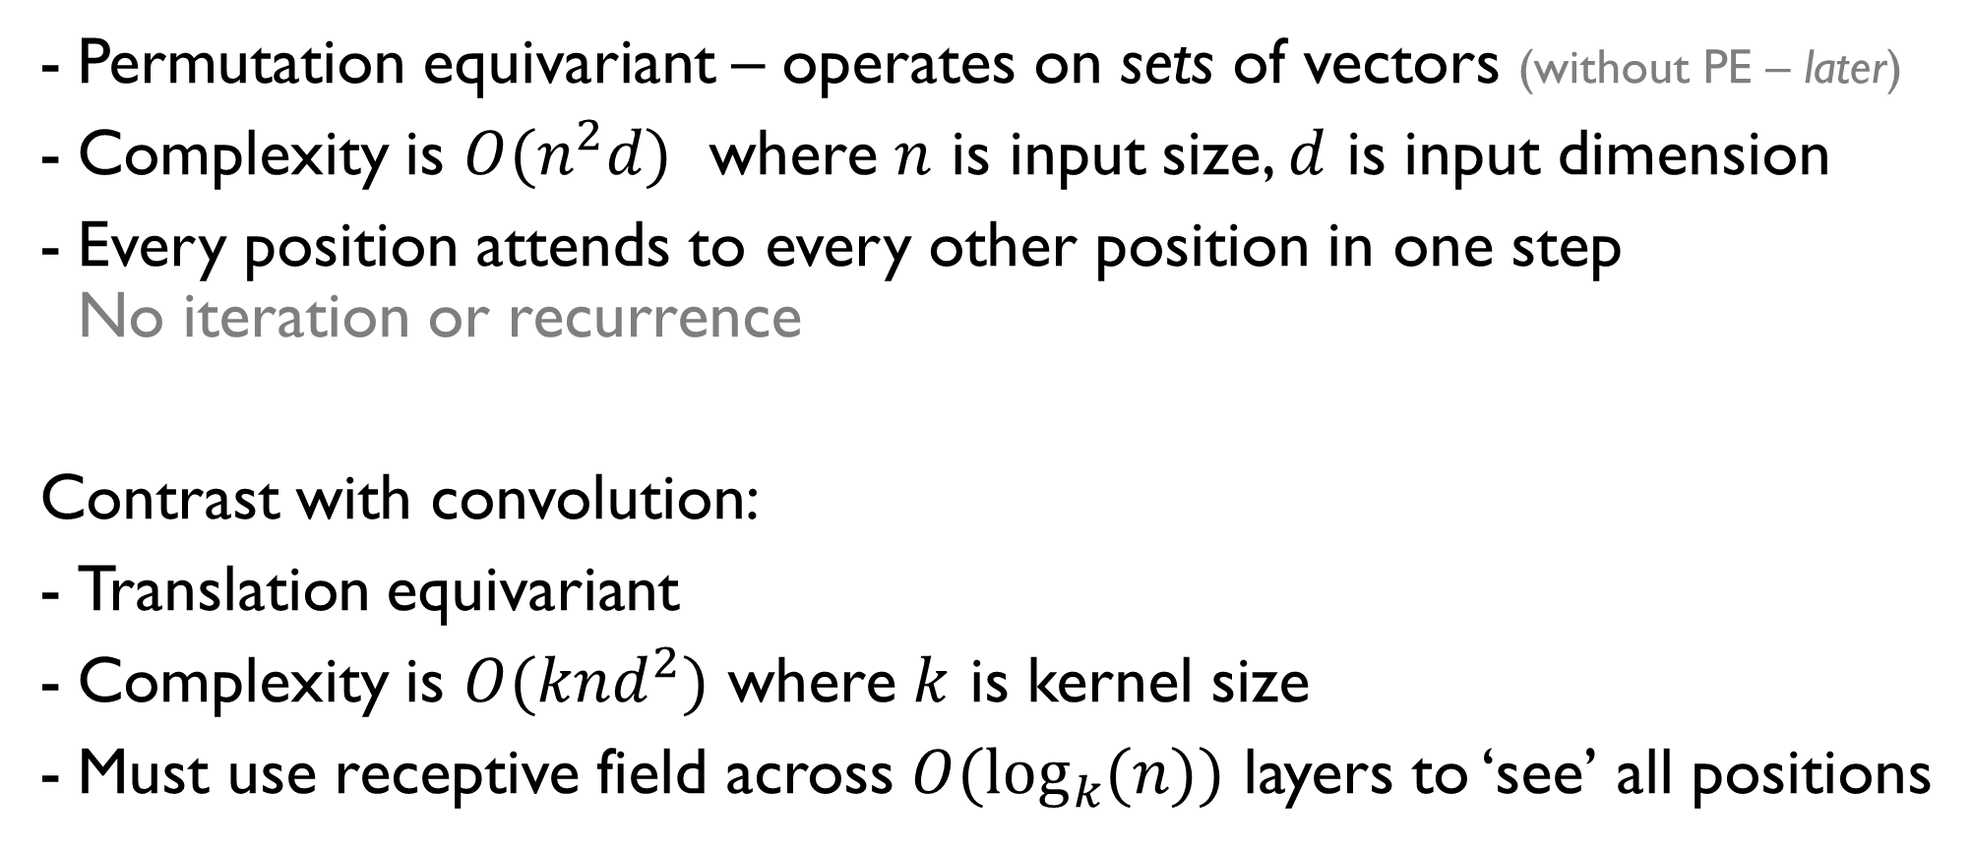
Properties of self-attention

Slide 29
Motivation – did we achieve it?
Design neural network to encode and process sequences:
We have a model where parameters don’t increase with input length
We have connections between the elements.
The strength of these connections will depend on the elements themselves.

Slide 30
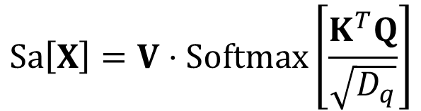

Self Attention Details
Scaled dot product self attention:
Prevents large magnitudes in dot products dominating softmax (causing slow training).
Masked self attention for training
Set all attention values ‘ahead of’ query to –inf.
Stops method ‘cheating’ and looking ahead in sequence.
Regular self attention
Scaled self attention
Dimension
(queries)
Notes:
Does it matter which dimension we use?

Slide 31
Transformers
Motivation
Dot-product self-attention
Matrix form
The transformer
Vision transformers
Properties of transformers

Slide 32
Matrix form
Store N input vectors in matrix X
Compute values, queries and keys:
Combine self-attentions

Slide 33
Self-attention in matrix form can be efficient
Notes:
Self-attention can be implemented efficiently if we store the N input vectors x_n in the columns of the D×N matrix X.
The input X is operated on separately by the query matrix Q, key matrix K, and value matrix V.
The dot products are then computed using matrix multiplication, and a softmax operation is applied independently to each column of the resulting matrix to calculate the attentions.
Finally, the values are post-multiplied by the attentions to create an output of the same size as the input.
Matrix multiplies => thanks Justin Johnson.

Slide 34
Is a single attention head enough?
Single softmax forces all ‘considerations’ to be weighted against each other.
Consider:
The bank near the river closed its doors early.
To understand sentence, must attend to:
meaning of river (not a financial bank),
subject of verb closed,
its – where bank is the antecedent.
Notes:
Multi-head self-attention.
Self-attention occurs in parallel across multiple “heads”.
Each has its own queries keys, and values. Here, two heads are depicted in the cyan and orange boxes, respectively.
The outputs are vertically concatenated, and another linear transformation \Omega_c is used to recombine them.
Why? Consider:
"The bank near the river closed its doors early."
To understand "bank", a model needs to simultaneously attend to:
"river" → disambiguates meaning (riverbank, not financial bank)
"closed" → this is the subject of that verb
"its" → bank is the antecedent
One softmax can't peak sharply on all three. Three heads can each own one relationship.

Slide 35
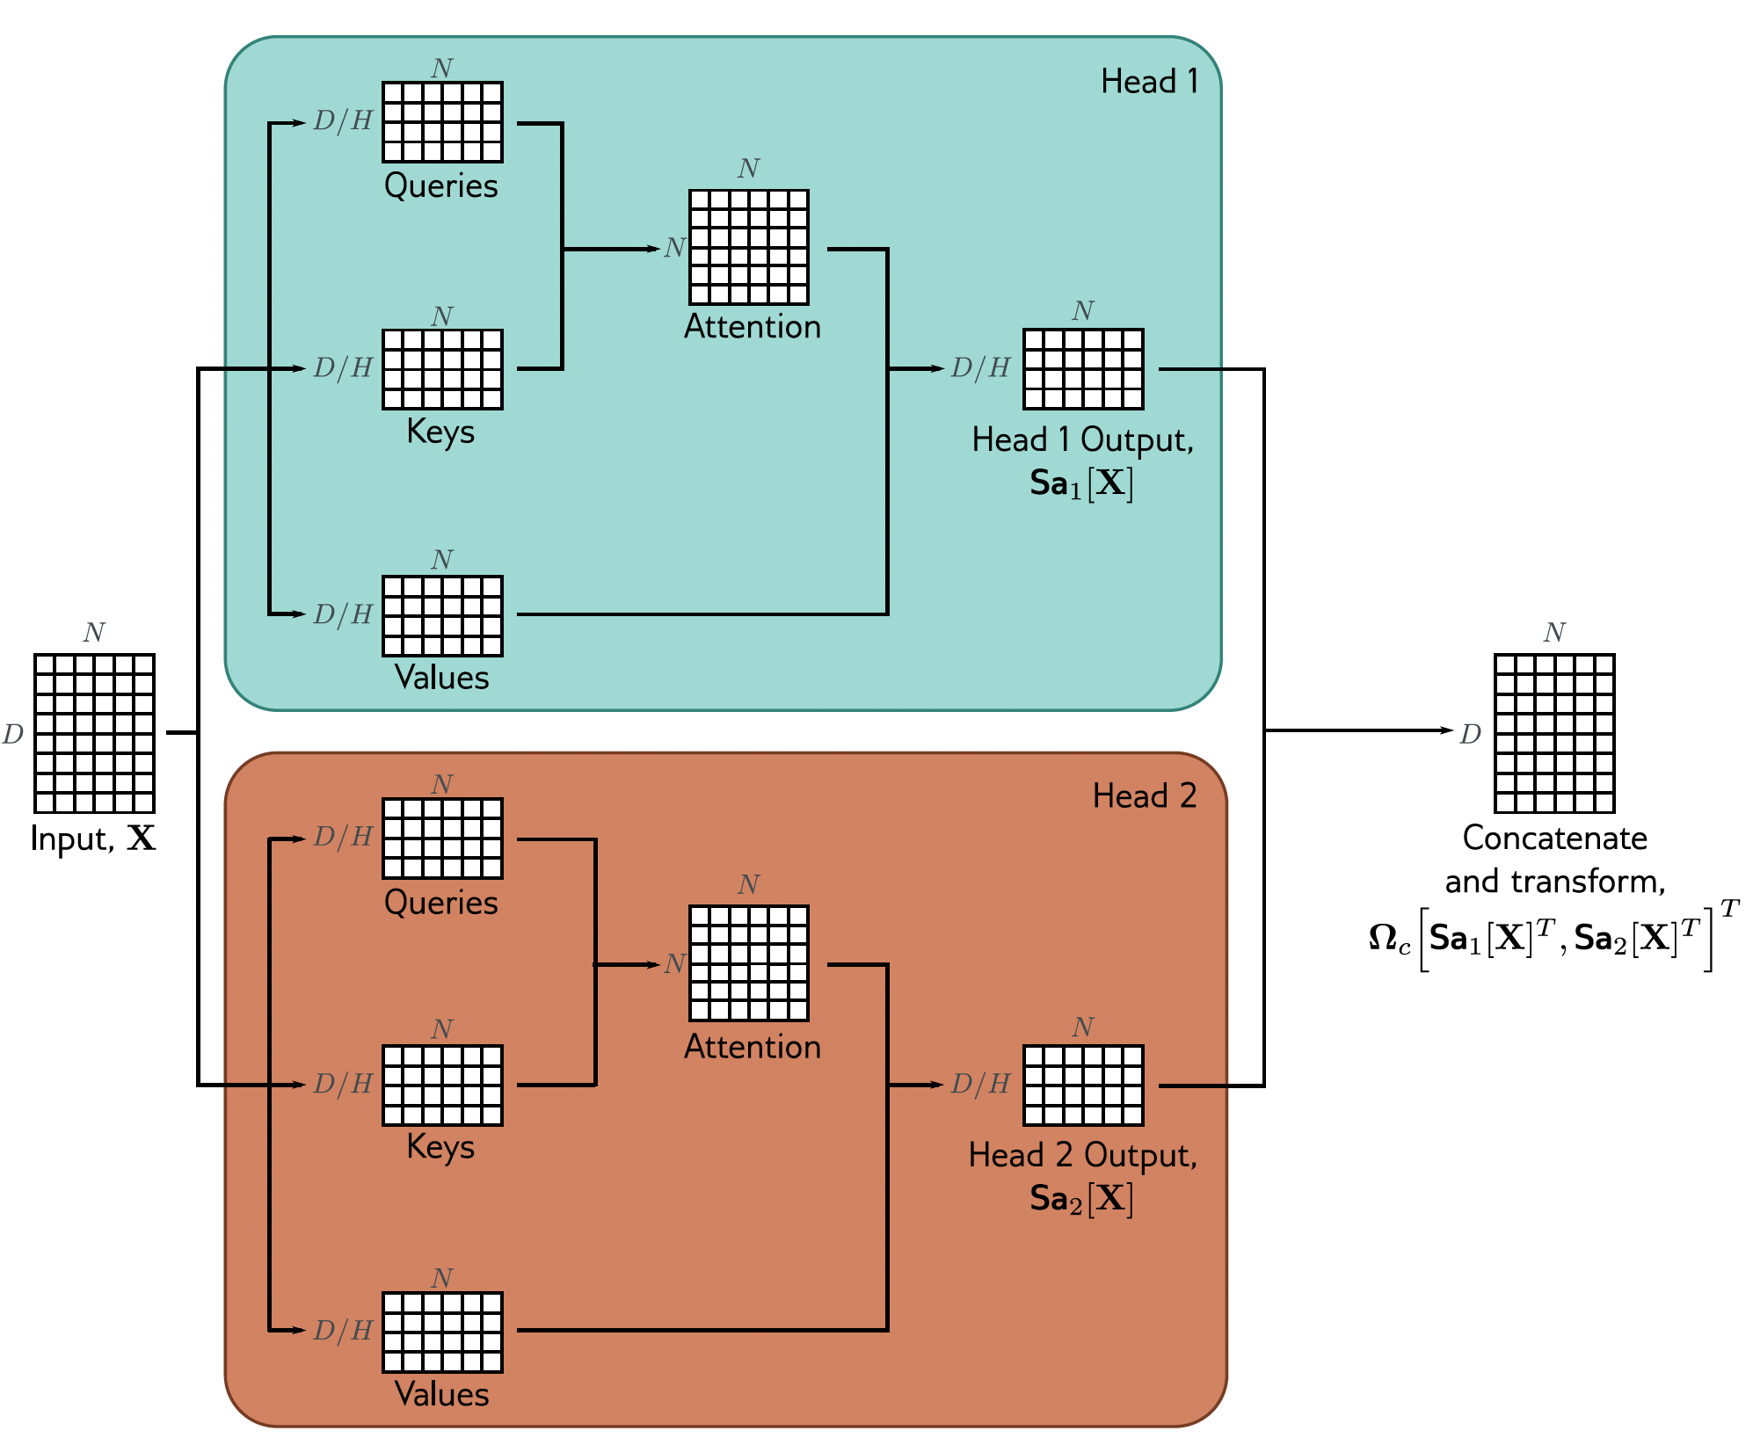
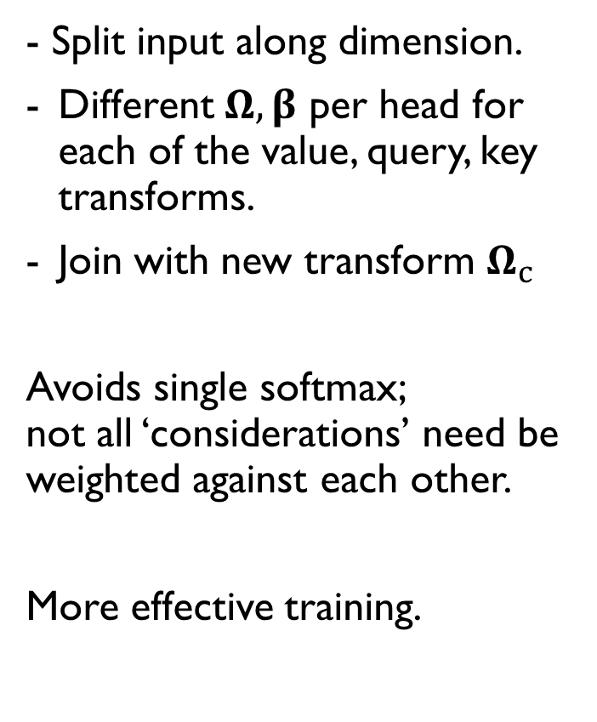
Multi-head self attention
Notes:
Multi-head self-attention.
Self-attention occurs in parallel across multiple “heads”.
Each has its own queries keys, and values. Here, two heads are depicted in the cyan and orange boxes, respectively.
The outputs are vertically concatenated, and another linear transformation \Omega_c is used to recombine them.
Why? Consider:
"The bank near the river closed its doors early."
To understand "bank", a model needs to simultaneously attend to:
"river" → disambiguates meaning (riverbank, not financial bank)
"closed" → this is the subject of that verb
"its" → bank is the antecedent
One softmax can't peak sharply on all three. Three heads can each own one relationship.

Slide 36
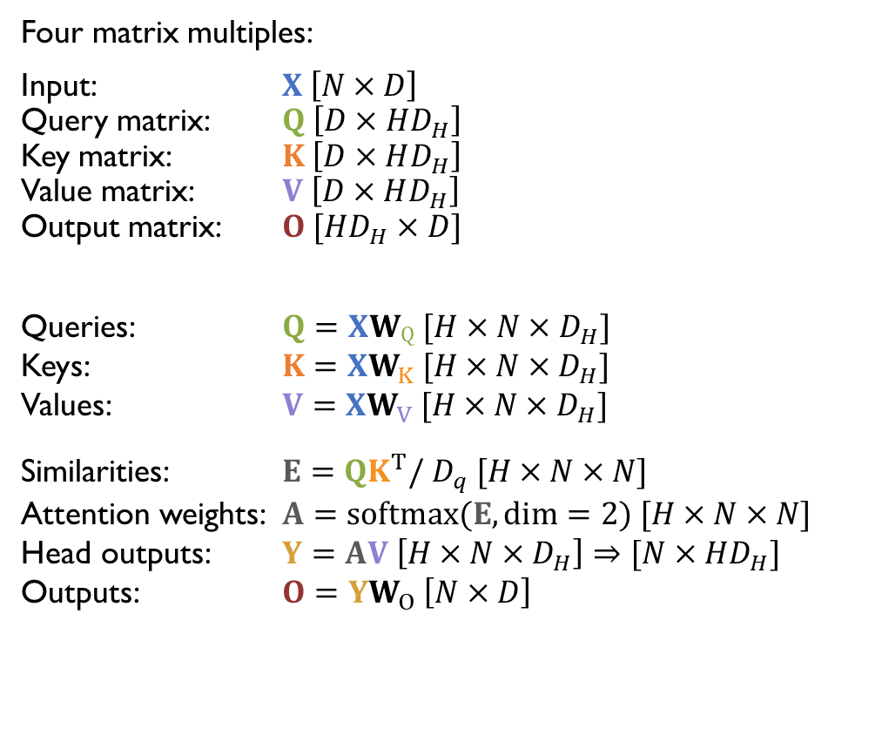
How many multiplies?
[Justin Johnson]

Slide 37
Cross-attention
Suppose I have multiple data modalities, e.g., images, text,
as my input data vectors. Can I ‘fuse’ them?
Make each query produce one output which mixes
information in the data vectors.

Slide 38
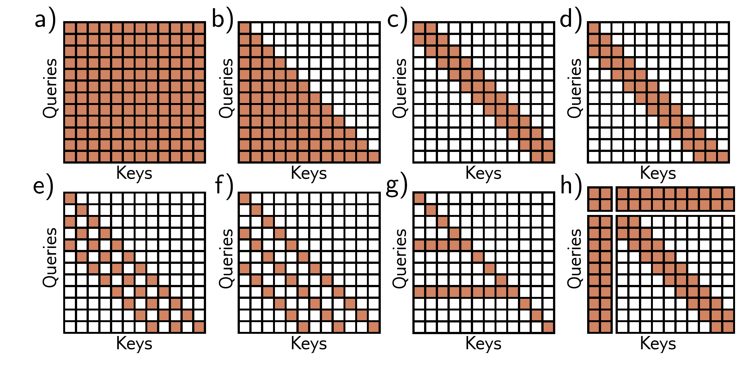
Self-attention interaction matrices
Full (encoder)
Decoder
(only looks back)
Convolutional
Convolutional
(decoder)
Convolutional
with dilation
Conv w. dilation (decoder)
Important tokens look back
Global tokens
(like [cls])
Notes:
Interaction matrices for self-attention.
In an encoder, every token interacts with every other token, and computation expands quadratically with the number of tokens.
In a decoder, each token only interacts with the previous tokens, but complexity is still quadratic.
Complexity can be reduced by using a convolutional structure (encoder case).
Convolutional structure for decoder case.
(+f) Convolutional structure with dilation rate of two and three (decoder case).
g) Another strategy is to allow selected tokens to interact with all the other tokens (encoder case) or all the previous tokens (decoder case pictured).
h) Alternatively, global tokens can be introduced (left two columns and top two rows). These interact with all the tokens as well as with each other.

Slide 39
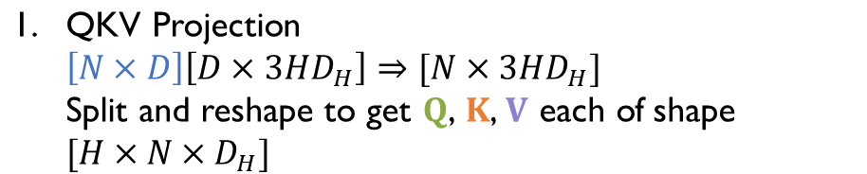
How many multiplies?
[Justin Johnson]
Notes:
3 because we do this for each of queries, keys, and values

Slide 40
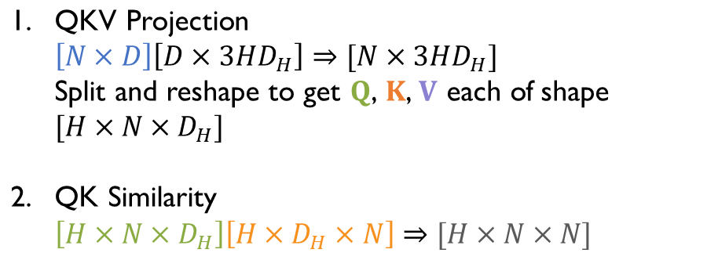
How many multiplies?
[Justin Johnson]

Slide 41
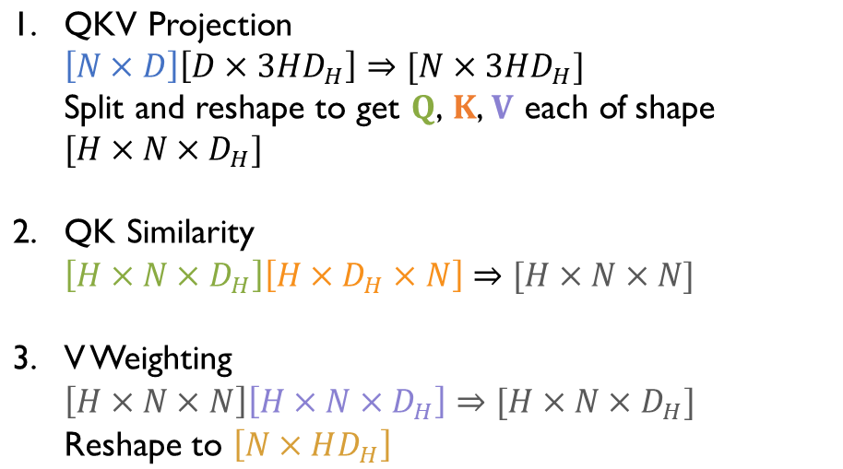
How many multiplies?
[Justin Johnson]

Slide 42
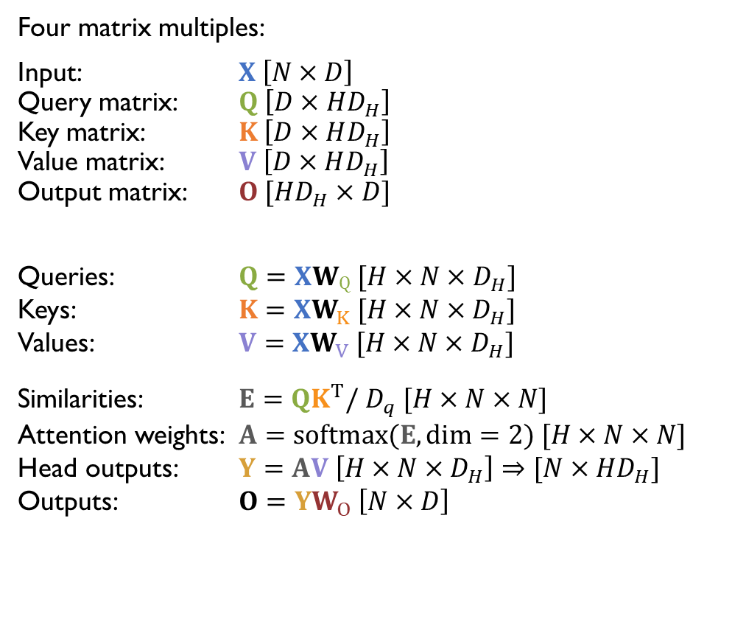
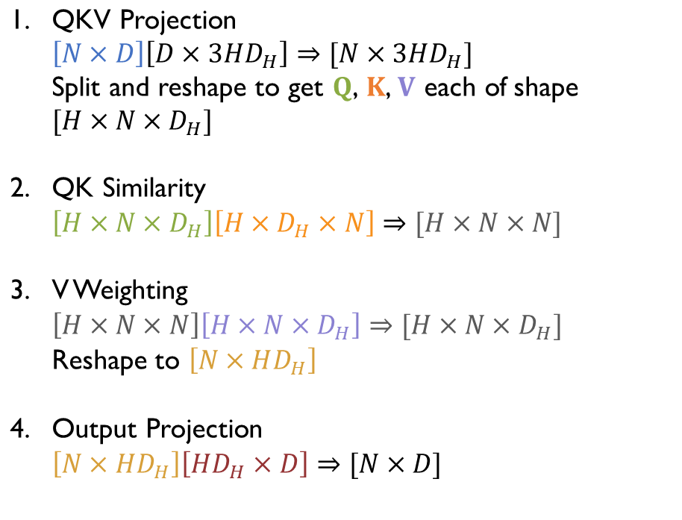
How many multiplies?
[Justin Johnson]

Slide 43
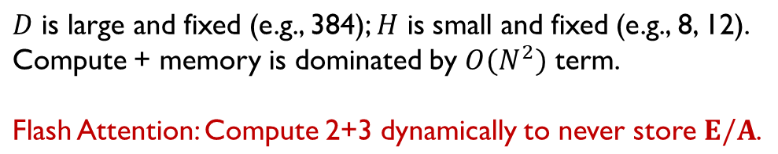
How many multiplies?
[Justin Johnson]

Slide 44
Self-attention is equivariant to permuting sequence order.
But order is sometimes important in sequences:
The man ate the fish
vs.
The fish ate the man

Slide 45
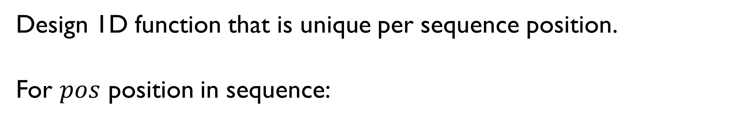
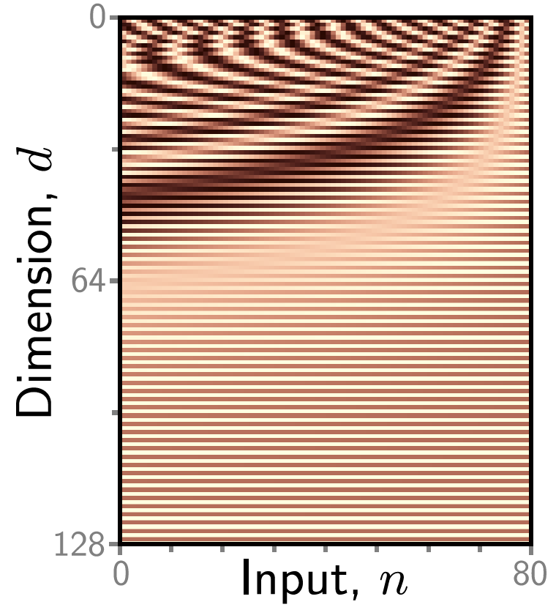
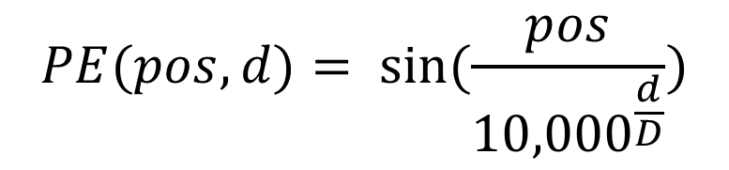
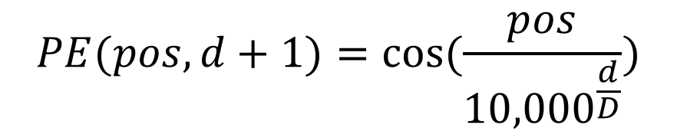
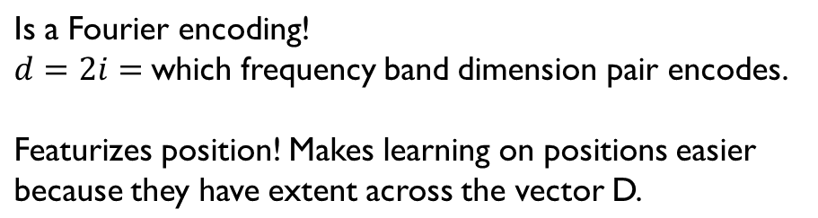
Notes:
Positional encodings.
The self-attention architecture is equivariant to permutations of the inputs. To ensure that inputs at different positions are treated differently, a positional encoding matrix Π can be added to the data matrix. Each column is different, so the positions can be distinguished. Here, the position encodings use a predefined procedural sinusoidal pattern (which can be extended to larger values of N if necessary). However, in other cases, they are learned.

Slide 46
Design function that is unique per sequence position.
Then add (or concat) to values, keys, queries:

Slide 47
- Learn the PE encoding.
May learn to emphasize layout info in data, e.g., more encoding precision needed at edges of images.
Unlike fixed PE, depends upon image resolution;
must interpolate to new size
Notes:
Positional encodings.
The self-attention architecture is equivariant to permutations of the inputs. To ensure that inputs at different positions are treated differently, a positional encoding matrix Π can be added to the data matrix. Each column is different, so the positions can be distinguished. Here, the position encodings use a predefined procedural sinusoidal pattern (which can be extended to larger values of N if necessary). However, in other cases, they are learned.

Slide 48
Transformers
Motivation
Dot-product self-attention
Matrix form
The transformer
Vision transformers
Properties of transformers

Slide 49
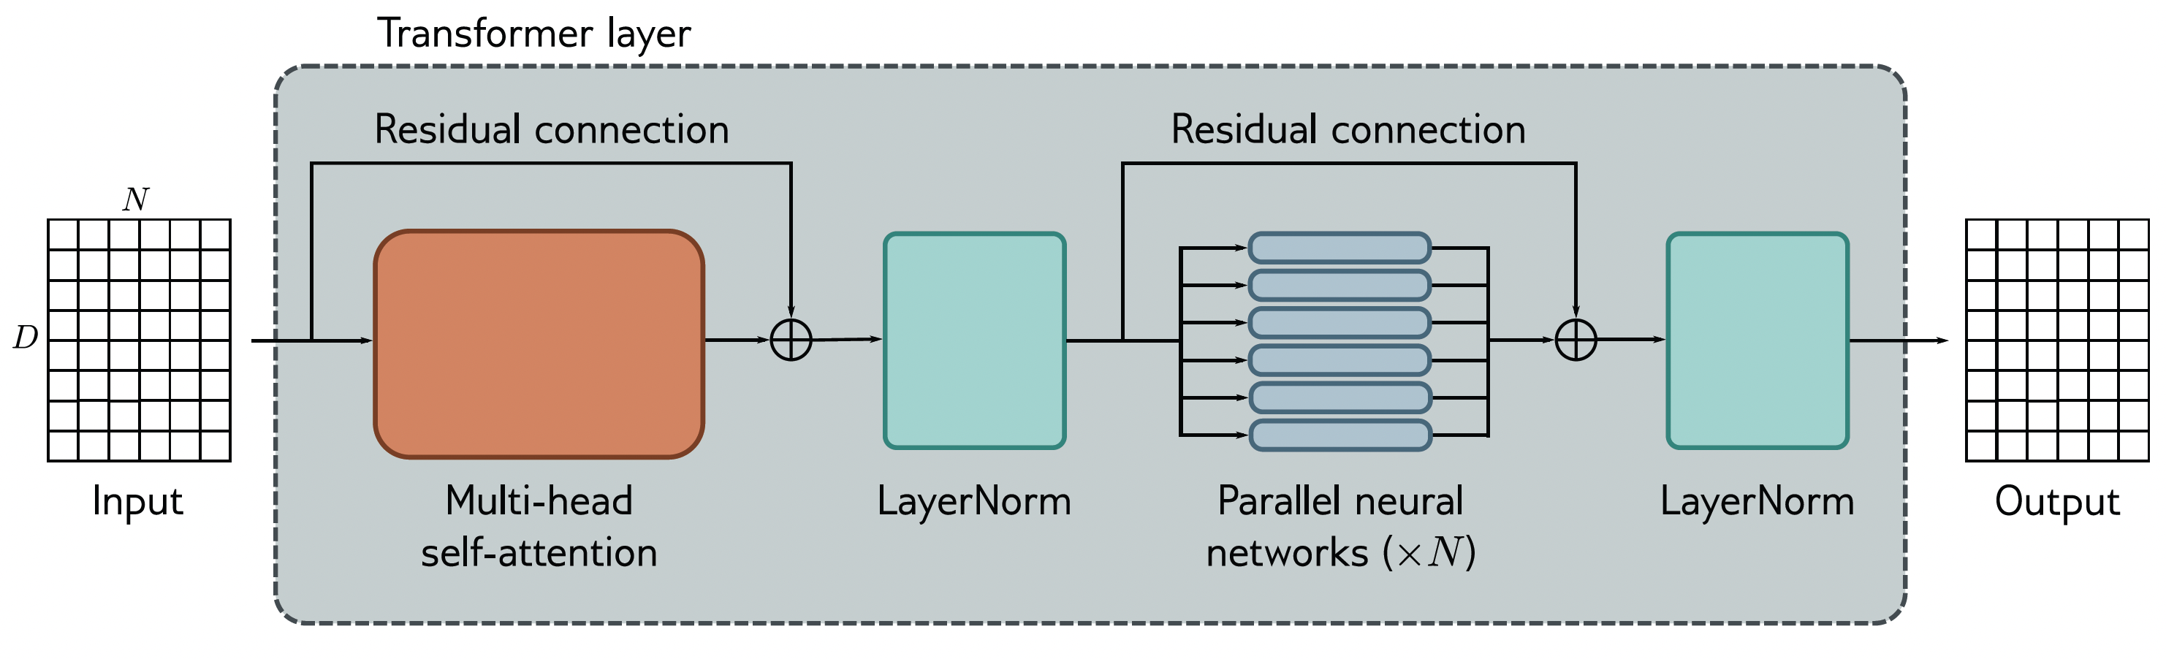
The transformer layer
[Vaswani et al., Attention is All You Need 2017]
Notes:
The transformer. The input consists of a D × N matrix containing the D-dimensional word embeddings for each of the N input tokens. The output is a matrix of the same size. The transformer consists of a series of operations. First, there is a multi-head attention block, allowing the word embeddings to interact with one another. This forms the processing of a residual block, so the inputs are added back to the output. Second, a LayerNorm operation is applied. Third, there is a second residual layer where the same fully connected neural network is applied separately to each of the N word representations (columns). Finally, LayerNorm is applied again.

Slide 50
Transformers
Motivation
Dot-product self-attention
Matrix form
The transformer
Vision transformers
Properties of transformers

Slide 51
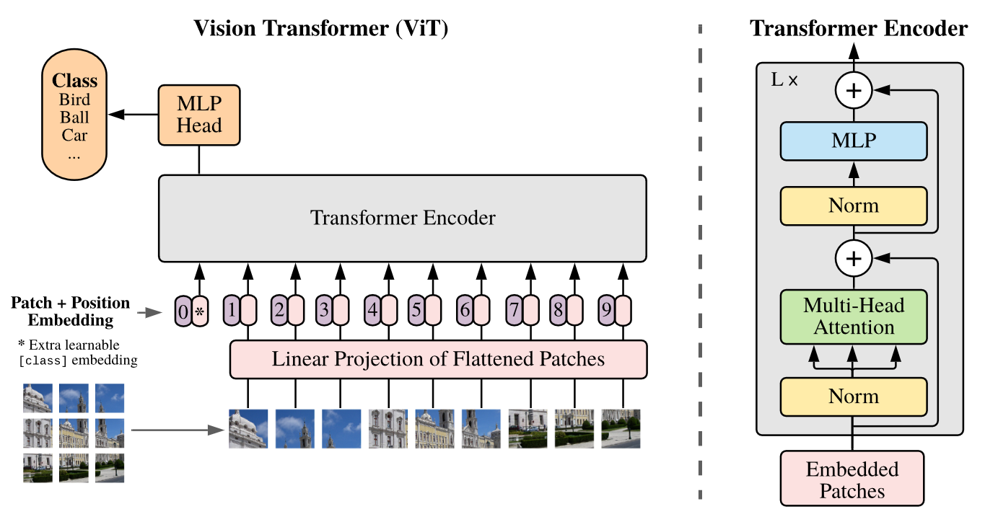
Layer norm now before
MLP and attention:
Allows residual to learn identity.
[Baevski & Auli, “Adaptive Input Representations for Neural Language Modeling”, arXiv 2018]
Notes:
Other improvements:
RMSNorm instead of Layer Norm - Zhang and Sennrich, “Root Mean Square Layer Normalization”, NeurIPS 2019
SwiGLU MLP instead of MLP - Shazeer, “GLU Variants Improve Transformers”, 2020

Slide 52
Layer norm now before
MLP and attention:
Allows residual to learn identity.
[Baevski & Auli, “Adaptive Input Representations for Neural Language Modeling”, arXiv 2018]
Notes:
Other improvements:
RMSNorm instead of Layer Norm - Zhang and Sennrich, “Root Mean Square Layer Normalization”, NeurIPS 2019
SwiGLU MLP instead of MLP - Shazeer, “GLU Variants Improve Transformers”, 2020

Slide 53
The original Transformer:
encoder–decoder

Slide 54
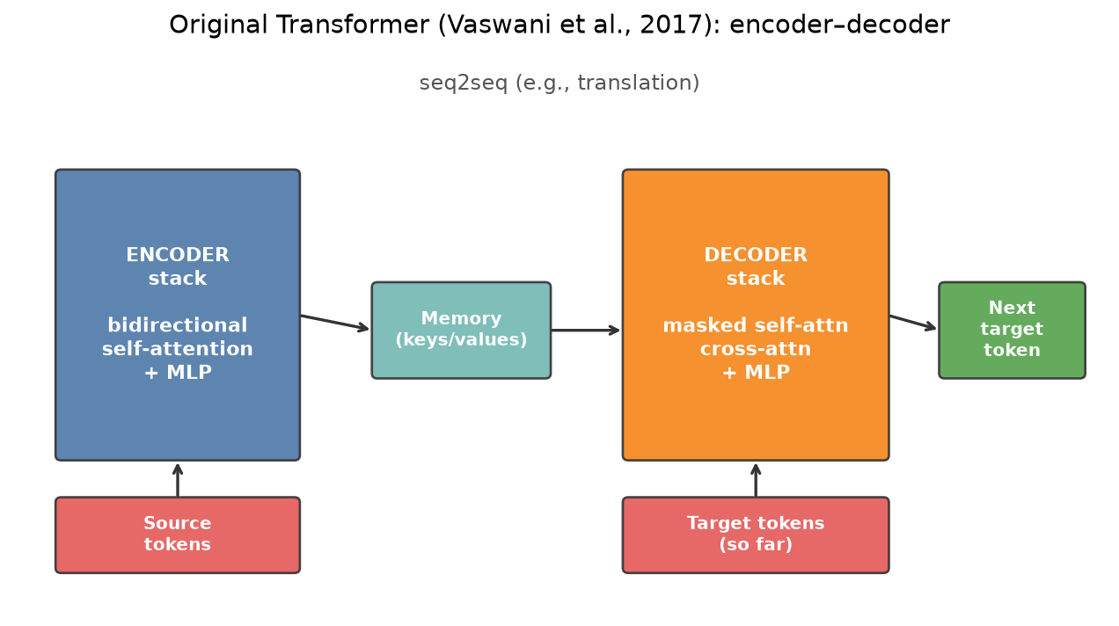
Attention Is All You Need (Vaswani et al., 2017)
Original setting: machine translation (sequence → sequence).
Two stacks: encoder over the source, decoder generating the target.
Building blocks you already have: multi-head attention, positions, residual + MLP.
New wiring: how encoder and decoder use those blocks differently.

Slide 55
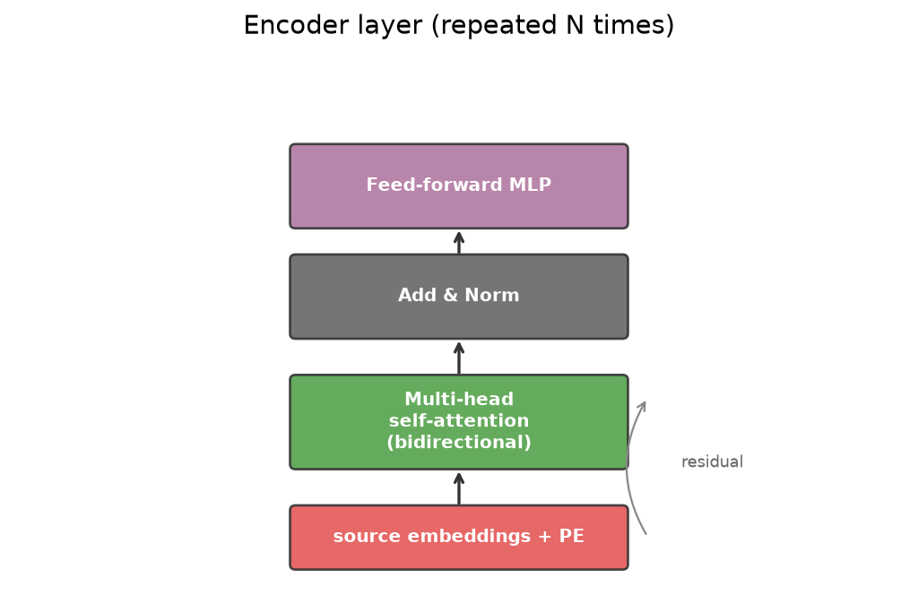
Encoder stack (original paper)
Input: source tokens + positional encodings.
Each layer: bidirectional self-attention over the source, then a position-wise MLP.
No causal mask: every source token may look at every other source token.
Output: contextual source memory for the decoder to read.

Slide 56
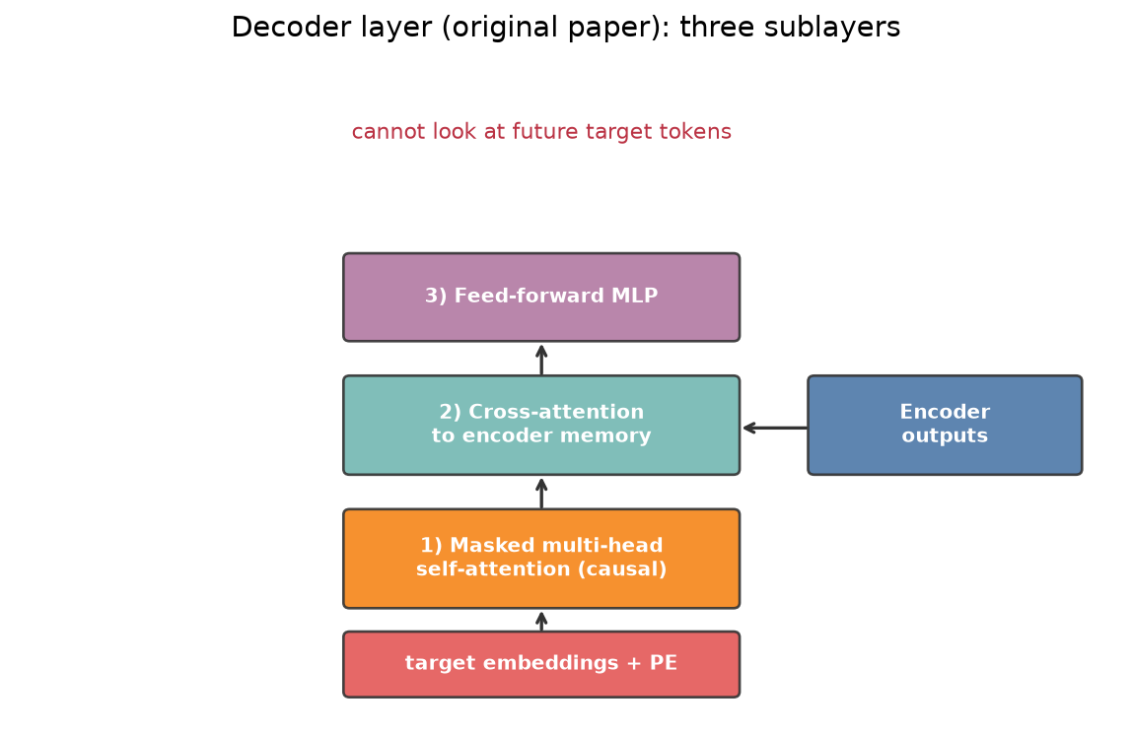
Decoder stack (original paper)
Input: target tokens so far + positions (teacher forcing in training).
Each layer has three sublayers:
1) masked (causal) self-attention over the target
2) cross-attention into the encoder memory
3) position-wise MLP
Causal mask: position i cannot attend to future positions > i.

Slide 57
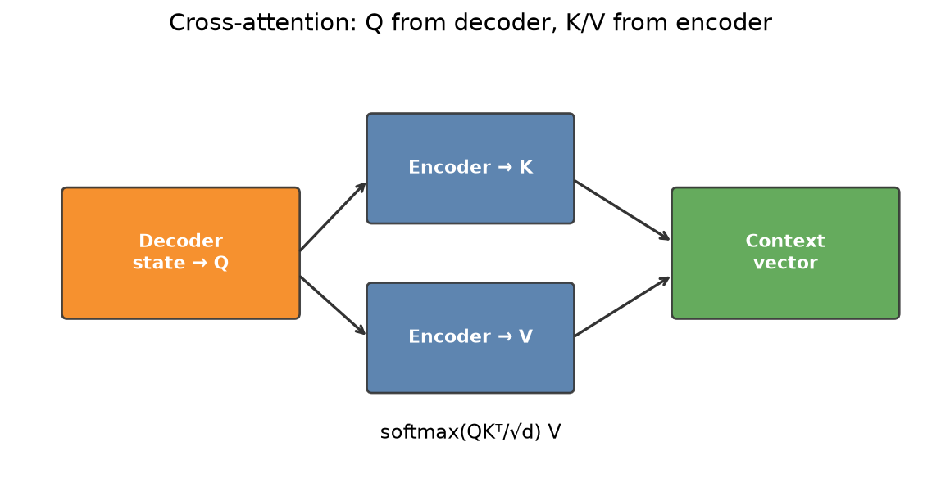
Cross-attention in the decoder
Queries come from the decoder state.
Keys and values come from the encoder outputs.
This is how the generator looks at the source while writing the target.
Same math as self-attention; different sources for Q vs K/V.

Slide 58
Today, “Transformer” usually
means decoder-only

Slide 59
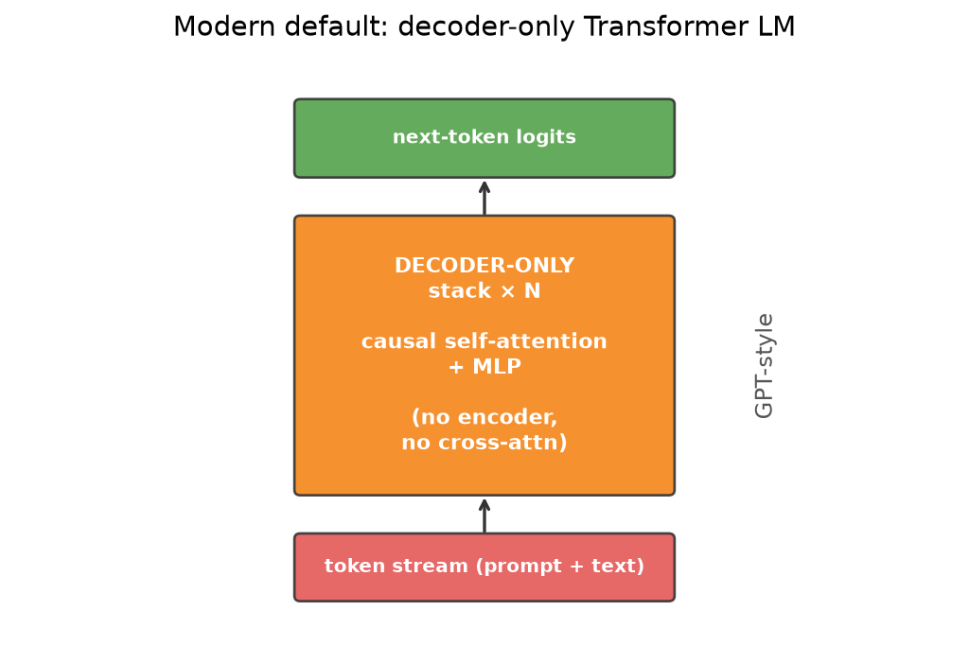
Decoder-only language models
GPT-style models drop the encoder stack.
One stack of decoder layers with causal self-attention (and an MLP).
No separate source encoder; no cross-attention to another stack.
In modern LLM talk, “a Transformer” almost always means this decoder-only setup.

Slide 60
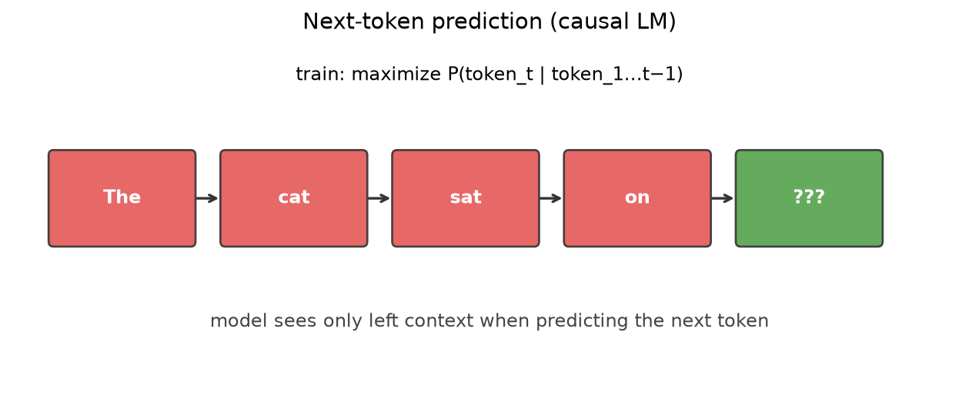
What a decoder-only model does
Task: next-token prediction. Given x1…xt, predict xt+1.
Causal mask enforces left-to-right generation.
Training: maximize likelihood of each next token on large corpora.
Sampling: feed the new token back in and continue (text generation).

Slide 61
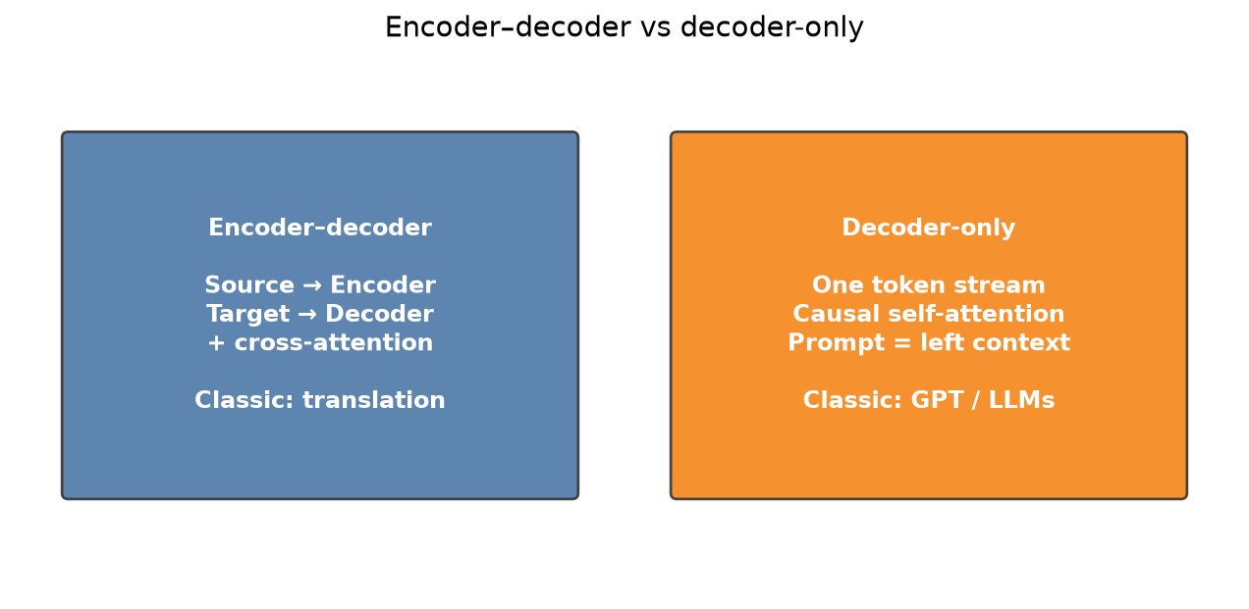
Encoder–decoder vs decoder-only
Encoder–decoder (OG paper): clear source and target (e.g., translation).
Decoder-only: one token stream; conditioning is earlier tokens (the prompt).
Same attention primitives underneath.
Default mental model from here: decoder-only Transformer LM.

Slide 62
From text Transformers
to multimodal LLMs

Slide 63
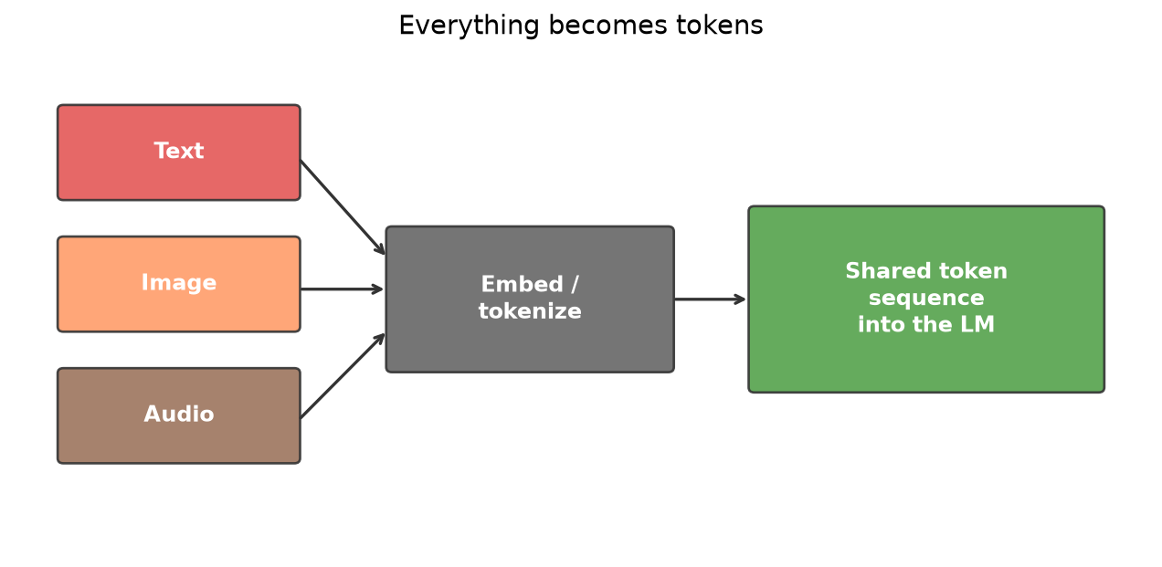
The key abstraction: everything is tokens
Text: subword / byte-pair tokens.
Images: patches or codes from an image tokenizer — still a sequence.
Audio and other sensors: likewise embedded as token sequences.
Once embedded, the same decoder-only Transformer can model the stream.

Slide 64
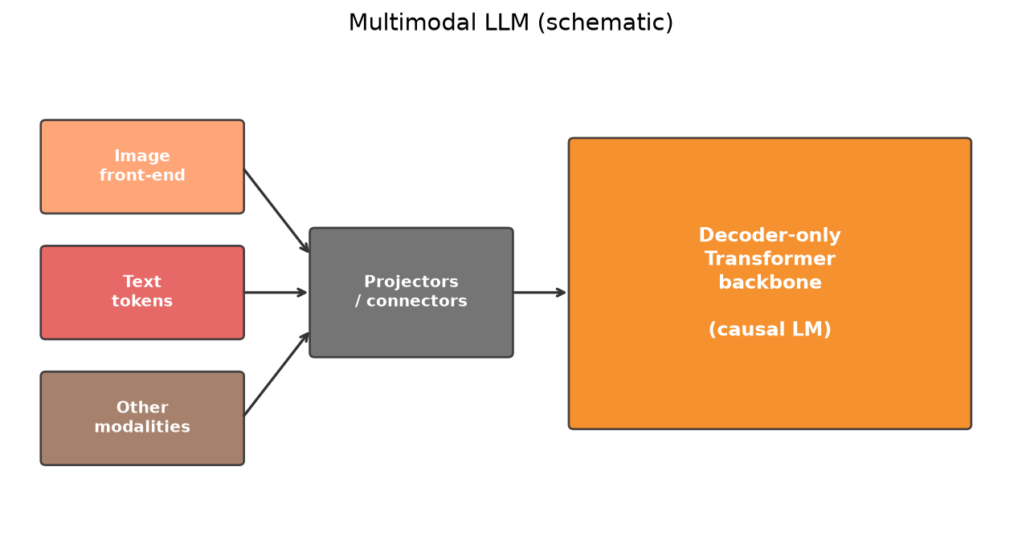
Multimodal LLMs (rough picture)
A large causal Transformer backbone (decoder-only).
Modality-specific front ends map images/audio → embedding sequences.
Optional projection / connector layers align those embeddings to the LM space.
Training mixtures: captioning, VQA, interleaved image–text, instruction tuning, …

Slide 65
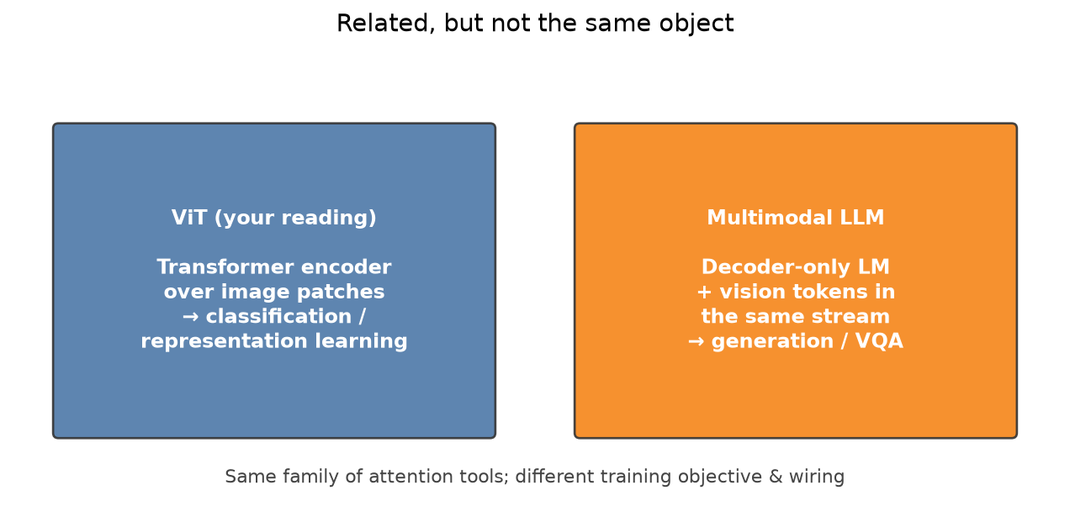
Where ViT fits (your reading)
ViT: Transformer encoder over image patches for recognition.
Related idea (attention on visual tokens), different product than a decoder-only multimodal LLM.
You will read the ViT paper for patches, [CLS]/pooling, and pretraining.
This lecture will not re-derive ViT.

Slide 66
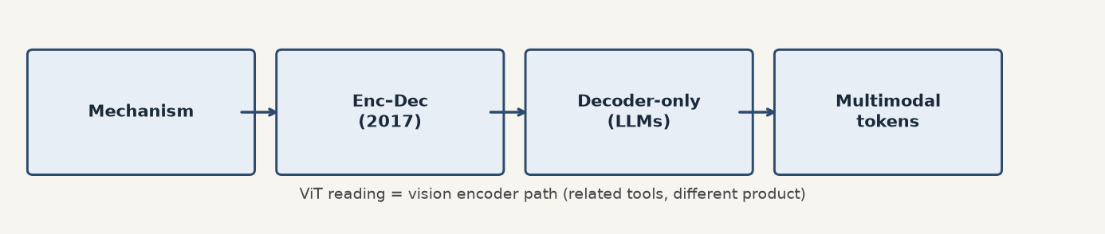
Takeaways
Self-attention + multi-head + positions = core mechanism.
Original Transformer = encoder–decoder seq2seq (e.g., translation).
Modern default in LLM land = decoder-only causal LM.
Multimodal LLMs: tokenize other modalities into the same kind of stream.
Next: read ViT to see attention as a vision backbone.

