Slide 1
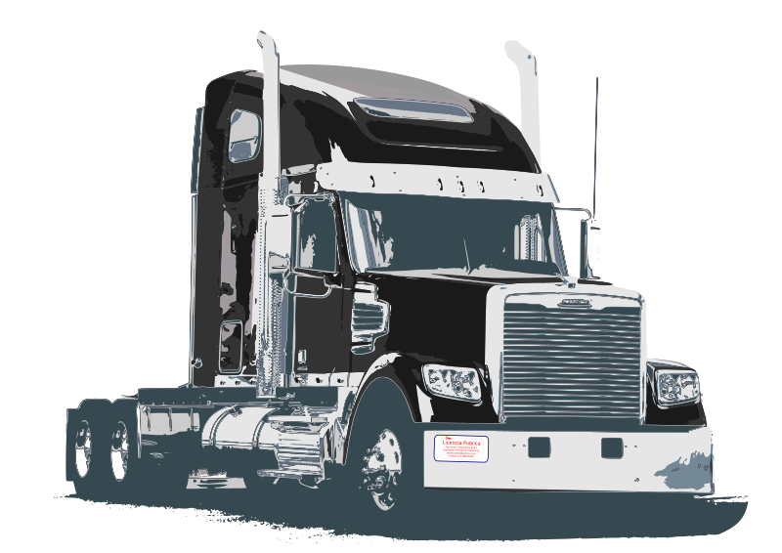
Proposed Heavy Vehicle Testbed Updates
A Presentation by Blake Fusick

Slide 2
Contributions
Efficiency
Data Transfer Improvements (only logging on front interface)
Less Overhead (Quicker Data Transfer)
Leads to Simplicity
Parsing Data on Front Interface for Plots
Rather than Parsing and Sending from BeagleBone
Testing
Check if Frames are Dropped
Determine Latency
Log Format
https://github.com/Heavy-Vehicle-Networking-At-U-Tulsa/NMFTA-CAN-Logger
Perform Diagnostics Tests
Solve Timestamp Problem
Power Loss Resets BeagleBones Causing Scheduling Issues
Connect BeagleBones to Server with Timestamp

Slide 3
More Contributions
Additional Features
Viewing/Filtering CAN Messages on Front Interface
Loop all Simulation Commands (Loop Drive)
Create Default Drives
Simplicity
Rather than Start 5 Different Scripts, Start Testbed with One
Eliminate unused Files/Code Leftover
Live Data/Commands (Ambitious Goal)

Slide 4
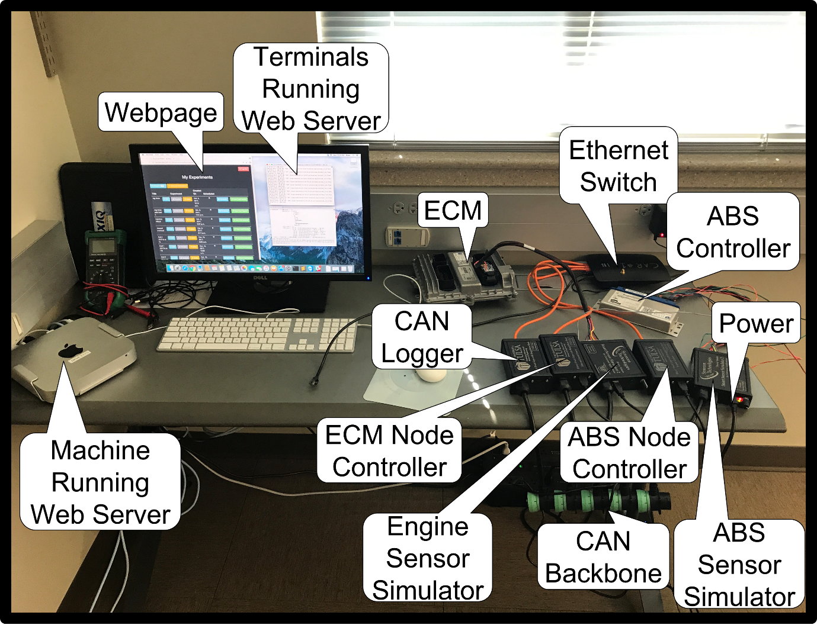
Testbed

Slide 5
ECUs and Simulators

Slide 6
Network Control Nodes

Slide 7
Data Transfer Improvements

Slide 8
Can Bus Traffic Logger

Slide 9
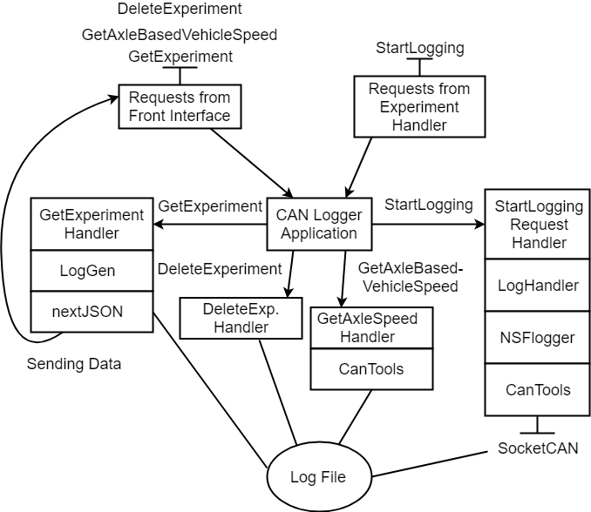
Current CAN Bus Traffic Logger
Request Handling
Wait for Requests from Experiment Handler
Start Logging Data Locally
Wait for Requests from Front Interface
Send Experiment Data
Send Plottable Data
Delete Experiments
Types of Requests
DeleteExperiment
GetExperiment
GetAxleBasedVehicleSpeed
StartLogging

Slide 10
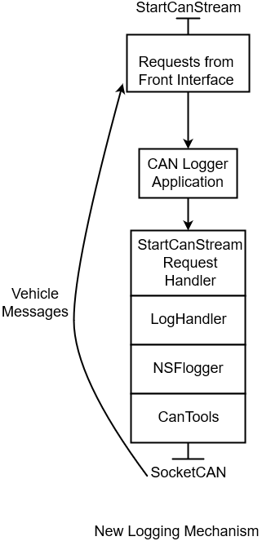
Proposed CAN Bus Traffic Logger
Request Handling
Wait for Requests from Front Interface
StartCanStream
Types of Requests
StartCanStream HTTP POST
JSON
“function”: “on” or “off”

Slide 11
Experiment Handler

Slide 12
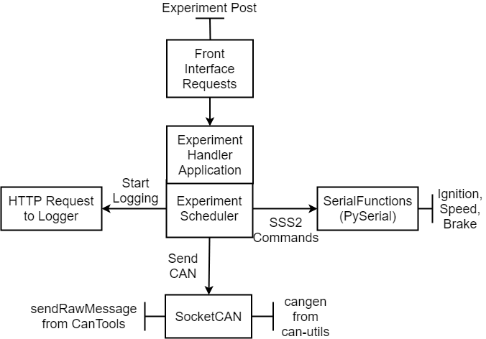
Current Experiment Handler
Tasks
Send CAN Frames
Send SSS2 Commands
Send HTTP Request to Logger
Use Commands at Specified Delays
Wait for HTTP POST Experiment Request
Starts the Experiment

Slide 13
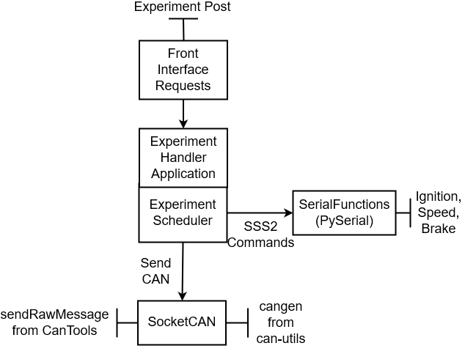
Proposed Experiment Handler
Tasks
Send CAN Frames at Specified Delays
Send SSS2 Commands at Specified Delays
Wait for HTTP POST Experiment Request
Functionality
No Experiment Objects on Handler
Just JSON with Commands at Specified Delays
Time = 0 => Perform Command Immediately

Slide 14
User Interface

Slide 15
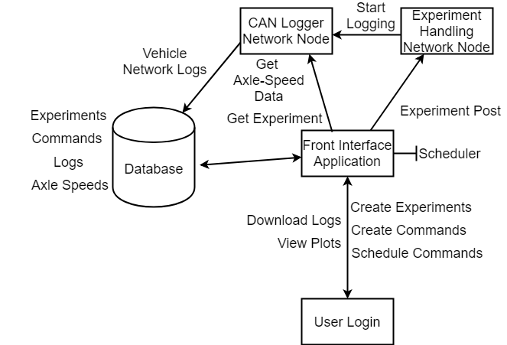
Old User Interface
Browser-Based Interface
User-Friendly
Take Input from Users
Login/Users
Associated with Experiments
Scheduling Tasks
Communication
Start Experiment
Retrieve Logs
Retrieve Plot Data
Database
Store Experiments/Data/Plot Data
Remote Access

Slide 16
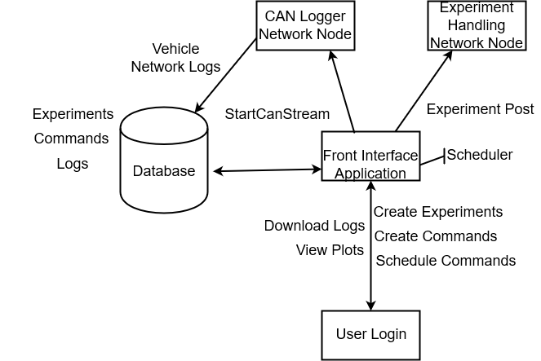
New User Interface
Browser-Based Interface
User-Friendly
Take Input from Users
Login/Users
Associated with Experiments
Scheduling Tasks
Communication
Start Experiment
Retrieve Logs
Retrieve Plot Data
Database
Store Experiments/Data/Plot Data
Remote Access

Slide 17
User Interface
Selecting a Plot and Parsing on User Interface

Slide 18
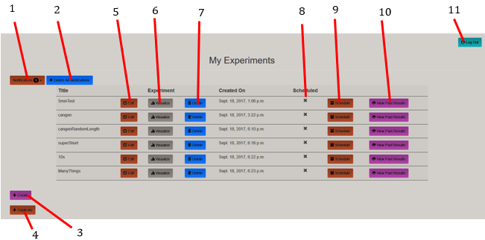
My Experiments Page

Slide 19
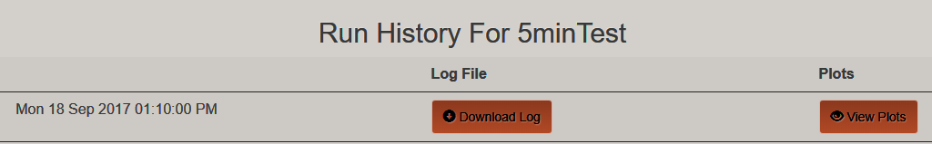
Run Results of an Experiment

Slide 20
View Plots Page Proposal
Interface
Parameter
Units

Slide 21
Testing and Timestamp Issues
Testing
Check if Frames are Dropped (full bus load)
4 Bytes of Tx Counter
Determine Latency
4 Bytes of Timestamp
Log Format
https://github.com/Heavy-Vehicle-Networking-At-U-Tulsa/NMFTA-CAN-Logger
Perform Diagnostics Tests
Solve Timestamp Problem
Power Loss Resets BeagleBones Causing Scheduling Issues
Connect BeagleBones to Server with Timestamp

Slide 22
Additional Features
Additional Features
Viewing/Filtering CAN Messages on Front Interface
Loop all Simulation Commands (Loop Drive)
Create Default Drives

Slide 23
Run Results of an Experiment
View Log

Slide 24
View Logs Page
Interface
Priority
PGN
DA
SA
Full ID
can1 6 FEF1 FF (Broadcast) 00 (Engine) 18FEF100 11 22 33 44 55 66 77 88
can0 3 F004 FF (Broadcast) 00 (Engine) 18F00400 00 11 22 33 44 55 66 77

Slide 25
User Interface
Live Data

Slide 26
My Experiments Page
View Live Data

Slide 27
View Live Data Page
Data
Plots
Interface
Priority
PGN
DA
SA
Full ID
can1 6 FEF1 FF (Broadcast) 00 (Engine) 18FEF100 11 22 33 44 55 66 77 88
can0 3 F004 FF (Broadcast) 00 (Engine) 18F00400 00 11 22 33 44 55 66 77

Slide 28
View Live Plots Page
Data
Plots
Interface
Parameter
Units

Slide 29
View Live Data Command Inputs (Scrolled Down)
Send Single CAN Message
Interface
ID:
Data:
Send CAN Message
Send Looped CAN Messages
Interface
Extended Bit
RTR Bit
Gap:
ID:
Data:
Loop CAN Message
Send Simulation Command
Type
Parameters:
Send Simulation Command
Parameter Updates
VIN:
Update VIN
Governor Speed:
Update Gov Speed
View Active Looped Messages

Slide 30
View Active Cangens Page
can1 –eI 18FEF100 –D 1122334455667788 –g 350
STOP
STOP
can1 –eI 18F00400 –g 100
STOP
STOP

Slide 31
Stop Cangen Page
Are you sure you want to stop this cangen?
can1 –eI 18F00400 –g 100
YES
NO
STOP
STOP

Slide 32
Summary of Contributions
Efficiency
Testing
Extra Features
Simplicity
Live Data

Slide 33

Questions?
https://www.duskyillusions.com/niche-niche-question/man-with-question-04/

