Slide 2
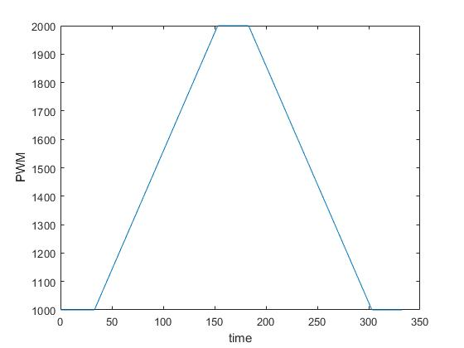
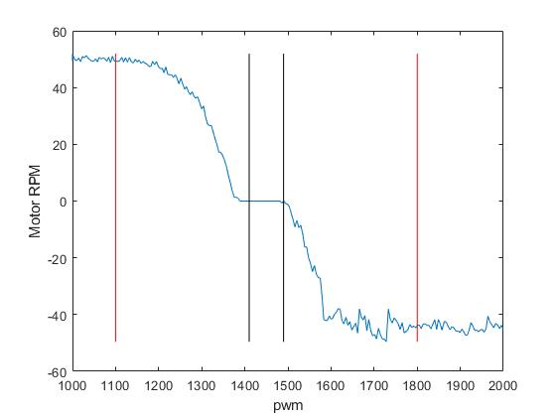
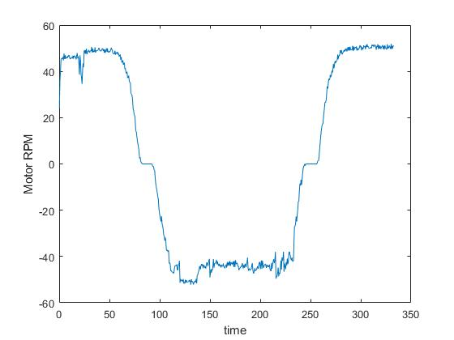
ESTIMATION DATASET
PWM Signal:
Ramp Input from 1000us to 2000us
DEAD BAND
PWM(1410 -1490)
Saturation
Rpm variation (51-53)
PWM ([1000, 1100], [1800, 2000])
Motor RPM:
Ramp Input from 1000us to 2000us -> 2 Cycles
Region of Interest
PWM([1100 , 1400], [1500, 1800])

Slide 3
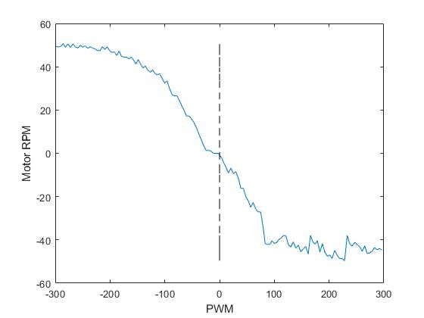
DATA FILTERING
As the region of interest lies in [1100us, 1400us] for clockwise motion and [1500us, 1800us] for anticlockwise motion, thus here we only filter the data points from the above region and rescale the input signal so as to make the above region a continuous function.
Region 1 : - [1100us, 1400us] (clockwise)
New Scale: [-300, 0]
Subtract the PWM signal by 1400
Region 2 : - [1500us, 1800us](anti-clockwise)
New Scale: [0, 300]
Subtract the PWM signal by 1500
The Input to the plant will be sent with respect to the new scale.
REGION 1
REGION 2

Slide 4
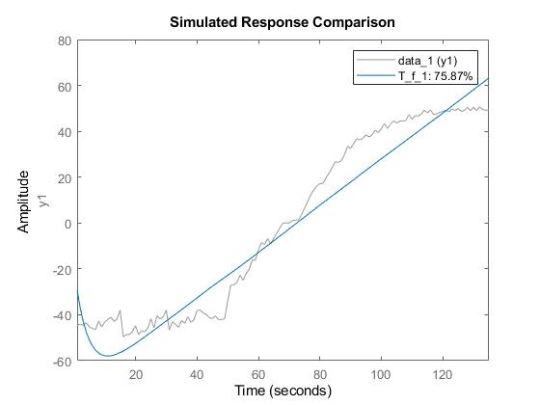
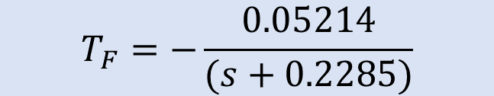
SYSTEM IDENTIFICATION
TOOLBOX
Poles: 1 Zeros: 0
$$T_{F}=−\frac{0.05214}{(s+0.2285)}$$
Number of poles: 1 Number of zeros: 0
Status:
Fit to estimation data: 75.87%
FPE: 90.42, MSE: 86.49

Slide 5
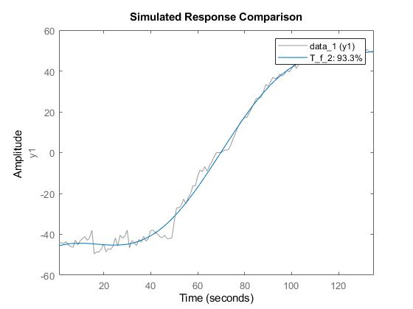
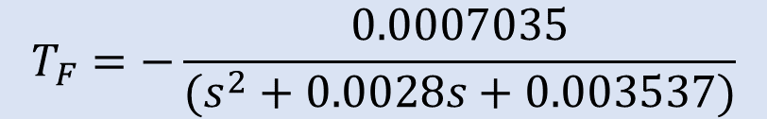
SYSTEM IDENTIFICATION
TOOLBOX
Poles: 2 Zeros: 0
$$T_{F}=−\frac{0.0007035}{(s^{2}+0.0028s+0.003537)}$$
Number of poles: 2 Number of zeros: 0
Status:
Fit to estimation data: 93.3%
FPE: 7.172, MSE: 6.66

Slide 6
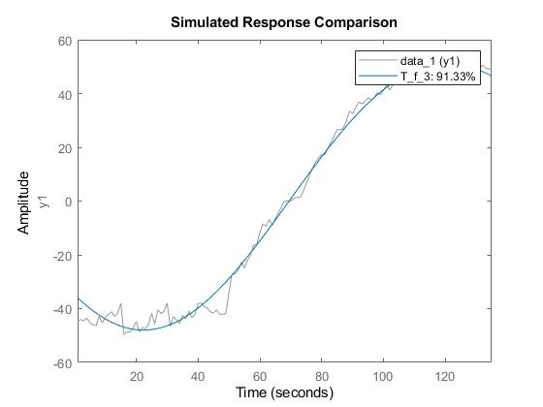
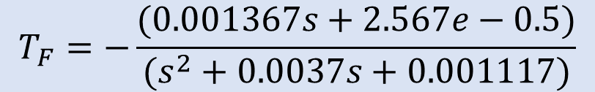
SYSTEM IDENTIFICATION
TOOLBOX
Poles: 2 Zeros: 1
$$T_{F}=−\frac{(0.001367s+2.567e−0.5)}{(s^{2}+0.0037s+0.001117)}$$
Number of poles: 2 Number of zeros: 1
Status:
Fit to estimation data: 91.33%
FPE: 12.2, MSE: 11.16

Slide 7

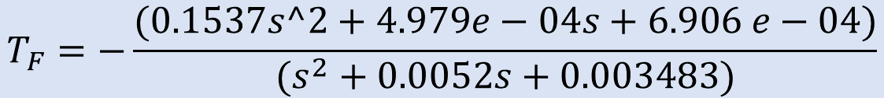
SYSTEM IDENTIFICATION
TOOLBOX
Poles: 2 Zeros: 2
$$T_{F}=−\frac{(0.1537s^2+4.979e−04s+6.906 e−04)}{(s^{2}+0.0052s+0.003483)}$$
Number of poles: 2 Number of zeros: 2
Status:
Fit to estimation data: 93.35%
FPE: 7.284, MSE: 6.566

Slide 8
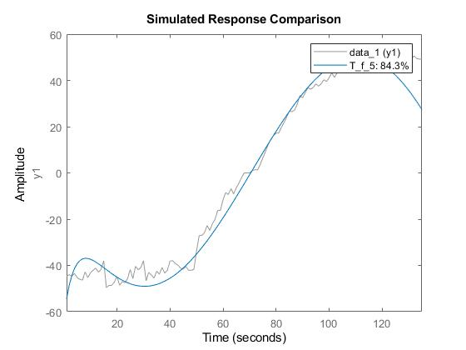
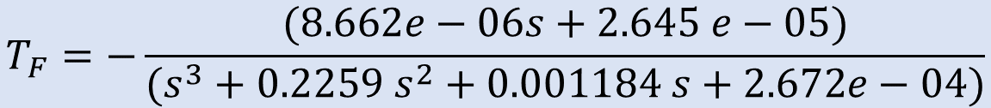
SYSTEM IDENTIFICATION
TOOLBOX
Poles: 3 Zeros: 1
$$T_{F}=−\frac{(8.662e−06s+2.645 e−05)}{(s^{3}+0.2259 s^{2}+0.001184 s+2.672e−04)}$$
Number of poles: 3 Number of zeros: 1
Status:
Fit to estimation data: 84.3%
FPE: 41.22, MSE: 36.61

Slide 9

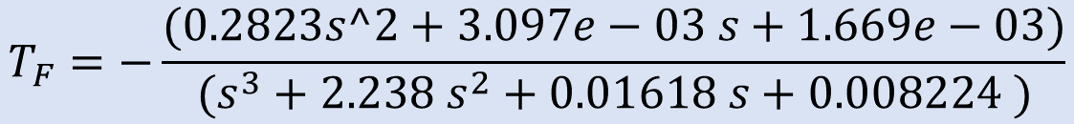
SYSTEM IDENTIFICATION
TOOLBOX
Poles: 3 Zeros: 2
$$T_{F}=−\frac{(0.2823s^2+3.097e−03 s+1.669e−03)}{(s^{3}+2.238 s^{2}+0.01618 s+0.008224 )}$$
Number of poles: 3 Number of zeros: 2
Status:
Fit to estimation data: 93.3%
FPE: 7.62, MSE: 6.668

Slide 10
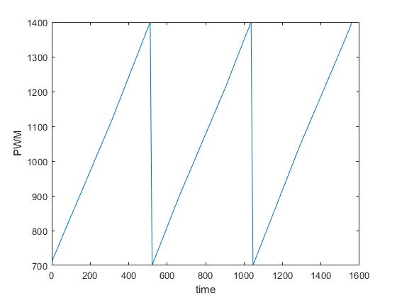
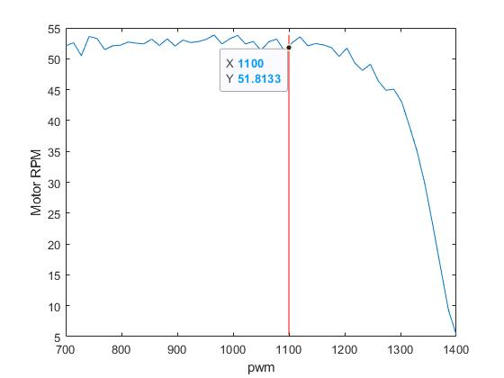
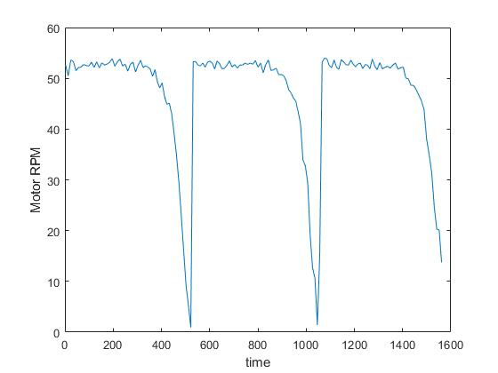
VALIDATION DATASET - 1
PWM Signal:
Ramp Input from 700us to 1400us
CLOCKWISE RUN
Saturation
Rpm variation (51-53)
PWM (700 - 1100)
Motor RPM:
Ramp Input from 700us to 1400us
-> Clockwise rotation (RPM +ve)
Region of Interest
PWM(1100 - 1400)

Slide 11
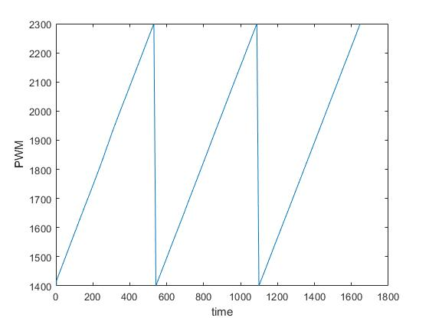
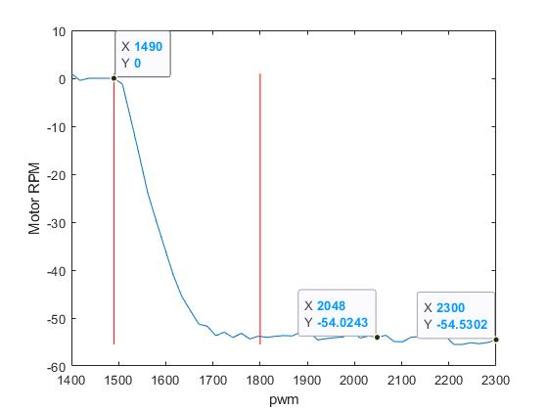
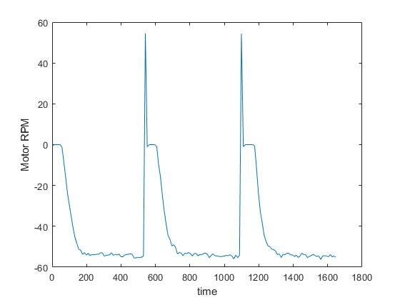
VALIDATION DATASET - 2
PWM Signal:
Ramp Input from 1400us to 2300us
ANTICLOCKWISE RUN
DEAD BAND
PWM(1410 -1490)
Region of Interest
PWM(1100 - 1400)
Motor RPM:
Ramp Input from 1400us to 2300us
-> Anticlockwise rotation (RPM -ve)
Saturation
Rpm variation (51-54)
PWM (1800 - 2300)

Slide 12
VALIDATION DATASET - 3
PWM Signal:
Ramp Input from 1400us to 2300us
ANTICLOCKWISE RUN
DEAD BAND
PWM(1410 -1490)
Region of Interest
PWM(1500 - 1800)
Motor RPM:
Ramp Input from 1400us to 2300us
-> Anticlockwise rotation (RPM -ve)
Saturation
Rpm variation (51-54)
PWM (1800 - 2300)

