Slide 1
Mobile robot concept
By Piotr Balion
And Borys Dudariev

Slide 2
Introduction
In this project we decided to create a remote-controlled tracked robot
It will also possess a live camera feed
Possible uses include investigation of hard to access places, search for survivors in collapsed buildings, tunnel/cave exploring and general recreational use.

Slide 3
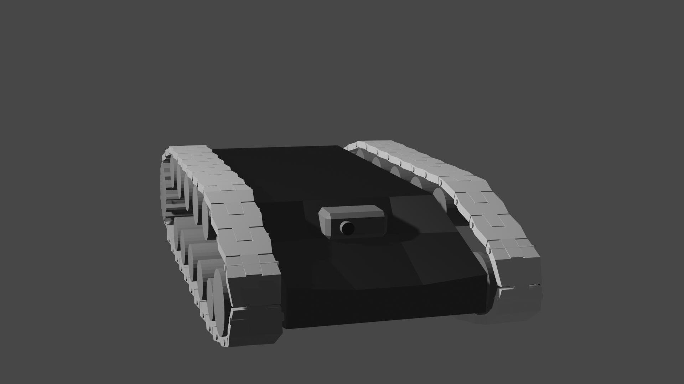
Features
Tracks for better mobility on rough terrain
A camera for distant navigation
Flashlight for low visibility environments
Wireless control
Possible control via cables

Slide 4
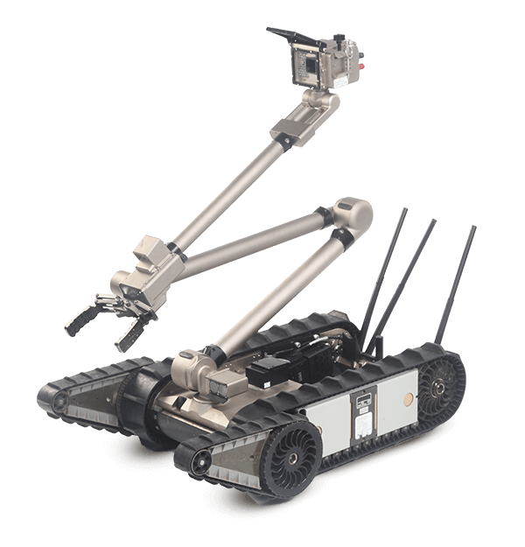
Real life examples of similar concepts
1) Packbot: A robot used during the aftermath of the 9/11 attacks, which includes additional features such as a robot arm and portable camera movement, as well as extendable frontal track system.

Slide 5
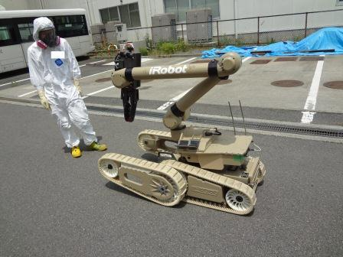
2).Warrior 710: A further development on the Packbot, this robot was used as a mine disarming robot and during the Fukushima nuclear disaster.

Slide 6
Target Customers
The robot will be created for reconnaissance tasks. Therefore it may arouse interests of:
Military
Police
Fire Brigade

Slide 7
Adventages and Disadventages
Can do dangarous for human being reconnaissance tasks
Small size
Good mobility in various types of enviroment
Simple and solid construction that is hard to break
Two ways of communicating with the robot
Might occure delay in camera stream
Created for one specific type of tasks

