Slide 1
🎮
GameFi Protocol
Option B — ERC-1155 In-Game Item Economy · Arbitrum Sepolia
Blockchain Technologies 2 — Final Project
Team
Project Stats
Gizatov Diar
Group:
SE-2421
Smart Contracts · GameAMM · GameVault
Rymbaev Eskendir
Network:
Arbitrum Sepolia
Frontend · Subgraph · Deployment
Contracts:
10 deployed & verified
Kalieva Nazerke
Governance · GameToken · Security Audit
Tests:
133 total · all pass
GitHub: github.com/Heb1ks/BlockFINAL2- · Chain ID: 421614

Slide 2
Project Overview
Full-stack decentralized GameFi economy on Arbitrum Sepolia
🏗
What We Built
⛓
Why L2 (Arbitrum Sepolia)
10 production-grade Solidity smart contracts forming a complete blockchain gaming economy: token, items, DEX, vault, rental, loot, governance, and factory.
Same EVM security as Ethereum Mainnet but ~10x lower transaction costs. Ideal for frequent in-game interactions like swaps, mints, and rentals.
🔒
Security-First Design
🧪
Comprehensive Testing
ReentrancyGuard, SafeERC20, CEI pattern, AccessControl roles, 2-day Timelock. Zero High and Zero Medium findings in internal security audit.
133 tests: 110+ unit, 16 fuzz (256 runs each), 5 invariant (64 runs, depth 15), 3 mainnet fork tests. All pass. ≥90% line coverage.
🗂
Architecture
🔗
External Integrations
Governance layer (GameToken+GameDAO+Timelock) · Economy layer (GameAMM+GameVault+NFTRentalVault) · Asset layer (GameItems+LootDrop+GameFactory).
Chainlink VRF v2 for provably fair loot · Chainlink Price Feed with staleness check · The Graph subgraph (9 entities, 100% synced) · Arbiscan verified.

Slide 3
Technology Stack
Languages, frameworks, and infrastructure
Smart Contracts
Development & Testing
Oracle & Randomness
Solidity 0.8.20
Foundry (Forge + Cast)
Chainlink VRF v2
OpenZeppelin Contracts
Fuzz Testing (256 runs)
Chainlink Price Feed
Inline Yul Assembly
Invariant Testing (64 runs)
AggregatorV3Interface
ERC-20 / ERC-1155 / ERC-4626
Fork Tests (Mainnet)
Staleness validation
Indexing & Analytics
Deployment & Ops
Security
The Graph (Studio)
Arbitrum Sepolia (L2)
Slither static analysis
9 indexed entities
Foundry Deploy Scripts
ReentrancyGuard
GraphQL queries
Arbiscan verification
SafeERC20
Arbitrum Sepolia subgraph
PowerShell helpers
CEI pattern + Timelock

Slide 4
Protocol Architecture
Three-layer smart contract design on Arbitrum Sepolia
GOVERNANCE LAYER
GameToken
ERC20Votes + ERC20Permit
MAX 1,000,000 GAME
GameDAO
OZ Governor · 1d delay
1w period · 4% quorum
TimelockController
2-day delay
All admin functions
ECONOMY LAYER
GameAMM
x·y=k · 0.3% fee
Yul assembly
GameVault (ERC-4626)
Yield for stakers
Chainlink price feed
NFTRentalVault
ERC-1155 rentals
5% platform fee
ASSET + INFRA LAYER
GameItems (ERC-1155)
UUPS Proxy V1→V2
MINTER + UPGRADER roles
LootDrop
Chainlink VRF v2
50% drop rate
GameFactory
CREATE + CREATE2
Deterministic deploy
External: Chainlink VRF · Chainlink Price Feed · The Graph subgraph · Arbiscan (verified)

Slide 5
Governance: GameToken + GameDAO
On-chain decentralized governance with 2-day Timelock
🪙 GameToken (ERC-20)
🗳 GameDAO (Governor)
Governance + voting token for the entire protocol
Full OpenZeppelin Governor stack + TimelockController
Standard
ERC-20 + ERC20Votes + ERC20Permit
Voting Delay
1 day
MAX Supply
1,000,000 GAME (hard cap)
Voting Period
1 week
Initial Mint
100,000 GAME → deployer
Quorum
4% of total supply
Mint Access
onlyOwner (Timelock after deploy)
Proposal Threshold
1% of total supply
Voting
Checkpoint-based snapshots (EIP-6372)
Timelock Delay
2 days (all admin actions)
Permit
Gasless approvals via EIP-2612
Flash-loan Guard
Snapshot-based voting power
Delegate
Propose
1d Delay
Vote 1w
Queue
2d Timelock
Execute

Slide 6
GameItems: ERC-1155 + UUPS Upgradeability
Five item types · V1→V2 upgrade with on-chain crafting
🗡 GameItems (ERC-1155)
UUPS Upgrade Flow
ID 0
ID 3
Proxy Contract
(stable address)
stores all state
Sword
Armor
ID 1
ID 4
Shield
Magic Orb
▼
Implementation V1
(GameItems)
ID 2
Potion
▼
Implementation V2
(GameItemsV2 + craft)
Roles:
MINTER_ROLE → LootDrop + Timelock | UPGRADER_ROLE → Timelock
Proxy:
UUPS ERC-1967 · _authorizeUpgrade: onlyRole(UPGRADER_ROLE)
V2 adds:
On-chain crafting (burn inputs → mint output item)
upgradeTo(V2)
onlyRole(UPGRADER_ROLE)

Slide 7
GameAMM: Constant-Product DEX
x·y=k formula · 0.3% fee · LP tokens · Inline Yul optimization
⚗ AMM Design
Swap Flow
Formula:
x · y = k (constant-product invariant)
1. approve TOKEN_A
Swap Fee:
0.3% retained in pool (no external treasury)
2. swapAtoB(amountIn, min)
3. validate amountIn > 0
LP Tokens:
ERC-20 (GameLP / GLP) — proportional shares
4. pull TOKEN_A (SafeERC20)
Protection:
minAmountOut slippage · nonReentrant guard
5. compute amountOut (Yul)
Functions:
swapAtoB · swapBtoA · addLiquidity · removeLiquidity
6. check slippage
7. transfer TOKEN_B
🔧 Yul Assembly Optimization
_sqrt (Solidity): ~230 gas → _sqrt (Yul): ~170 gas
−26% ✓
8. emit Swap event
_getAmountOut (Solidity): ~115 gas → _getAmountOut (Yul): ~95 gas
−18% ✓

Slide 8
GameVault (ERC-4626) + NFTRentalVault
Yield protocol + ERC-1155 item rental marketplace
💎 GameVault (ERC-4626)
🏰 NFTRentalVault
Standard:
ERC-4626 tokenized yield vault
Items:
ERC-1155 GameItems (any token ID)
Token:
GAME staked → vault shares
Currency:
GAME tokens per day
Yield source:
Protocol fees from NFTRentalVault
Fee:
5% platform fee (max 10%)
Oracle:
Chainlink price feed (ETH/USD)
Max Duration:
7 days per rental
Staleness:
Reverts if price > 1 hour old
Pattern:
Pull-over-push for fee withdrawal
Rounding:
Full compliance (rounding invariant)
Escrow:
Items held in vault during listing
Guard:
ReentrancyGuard on all state changes
Guard:
ReentrancyGuard · SafeERC20
listItem()
rentItem()
[rental period]
endRental()
delistItem()

Slide 9
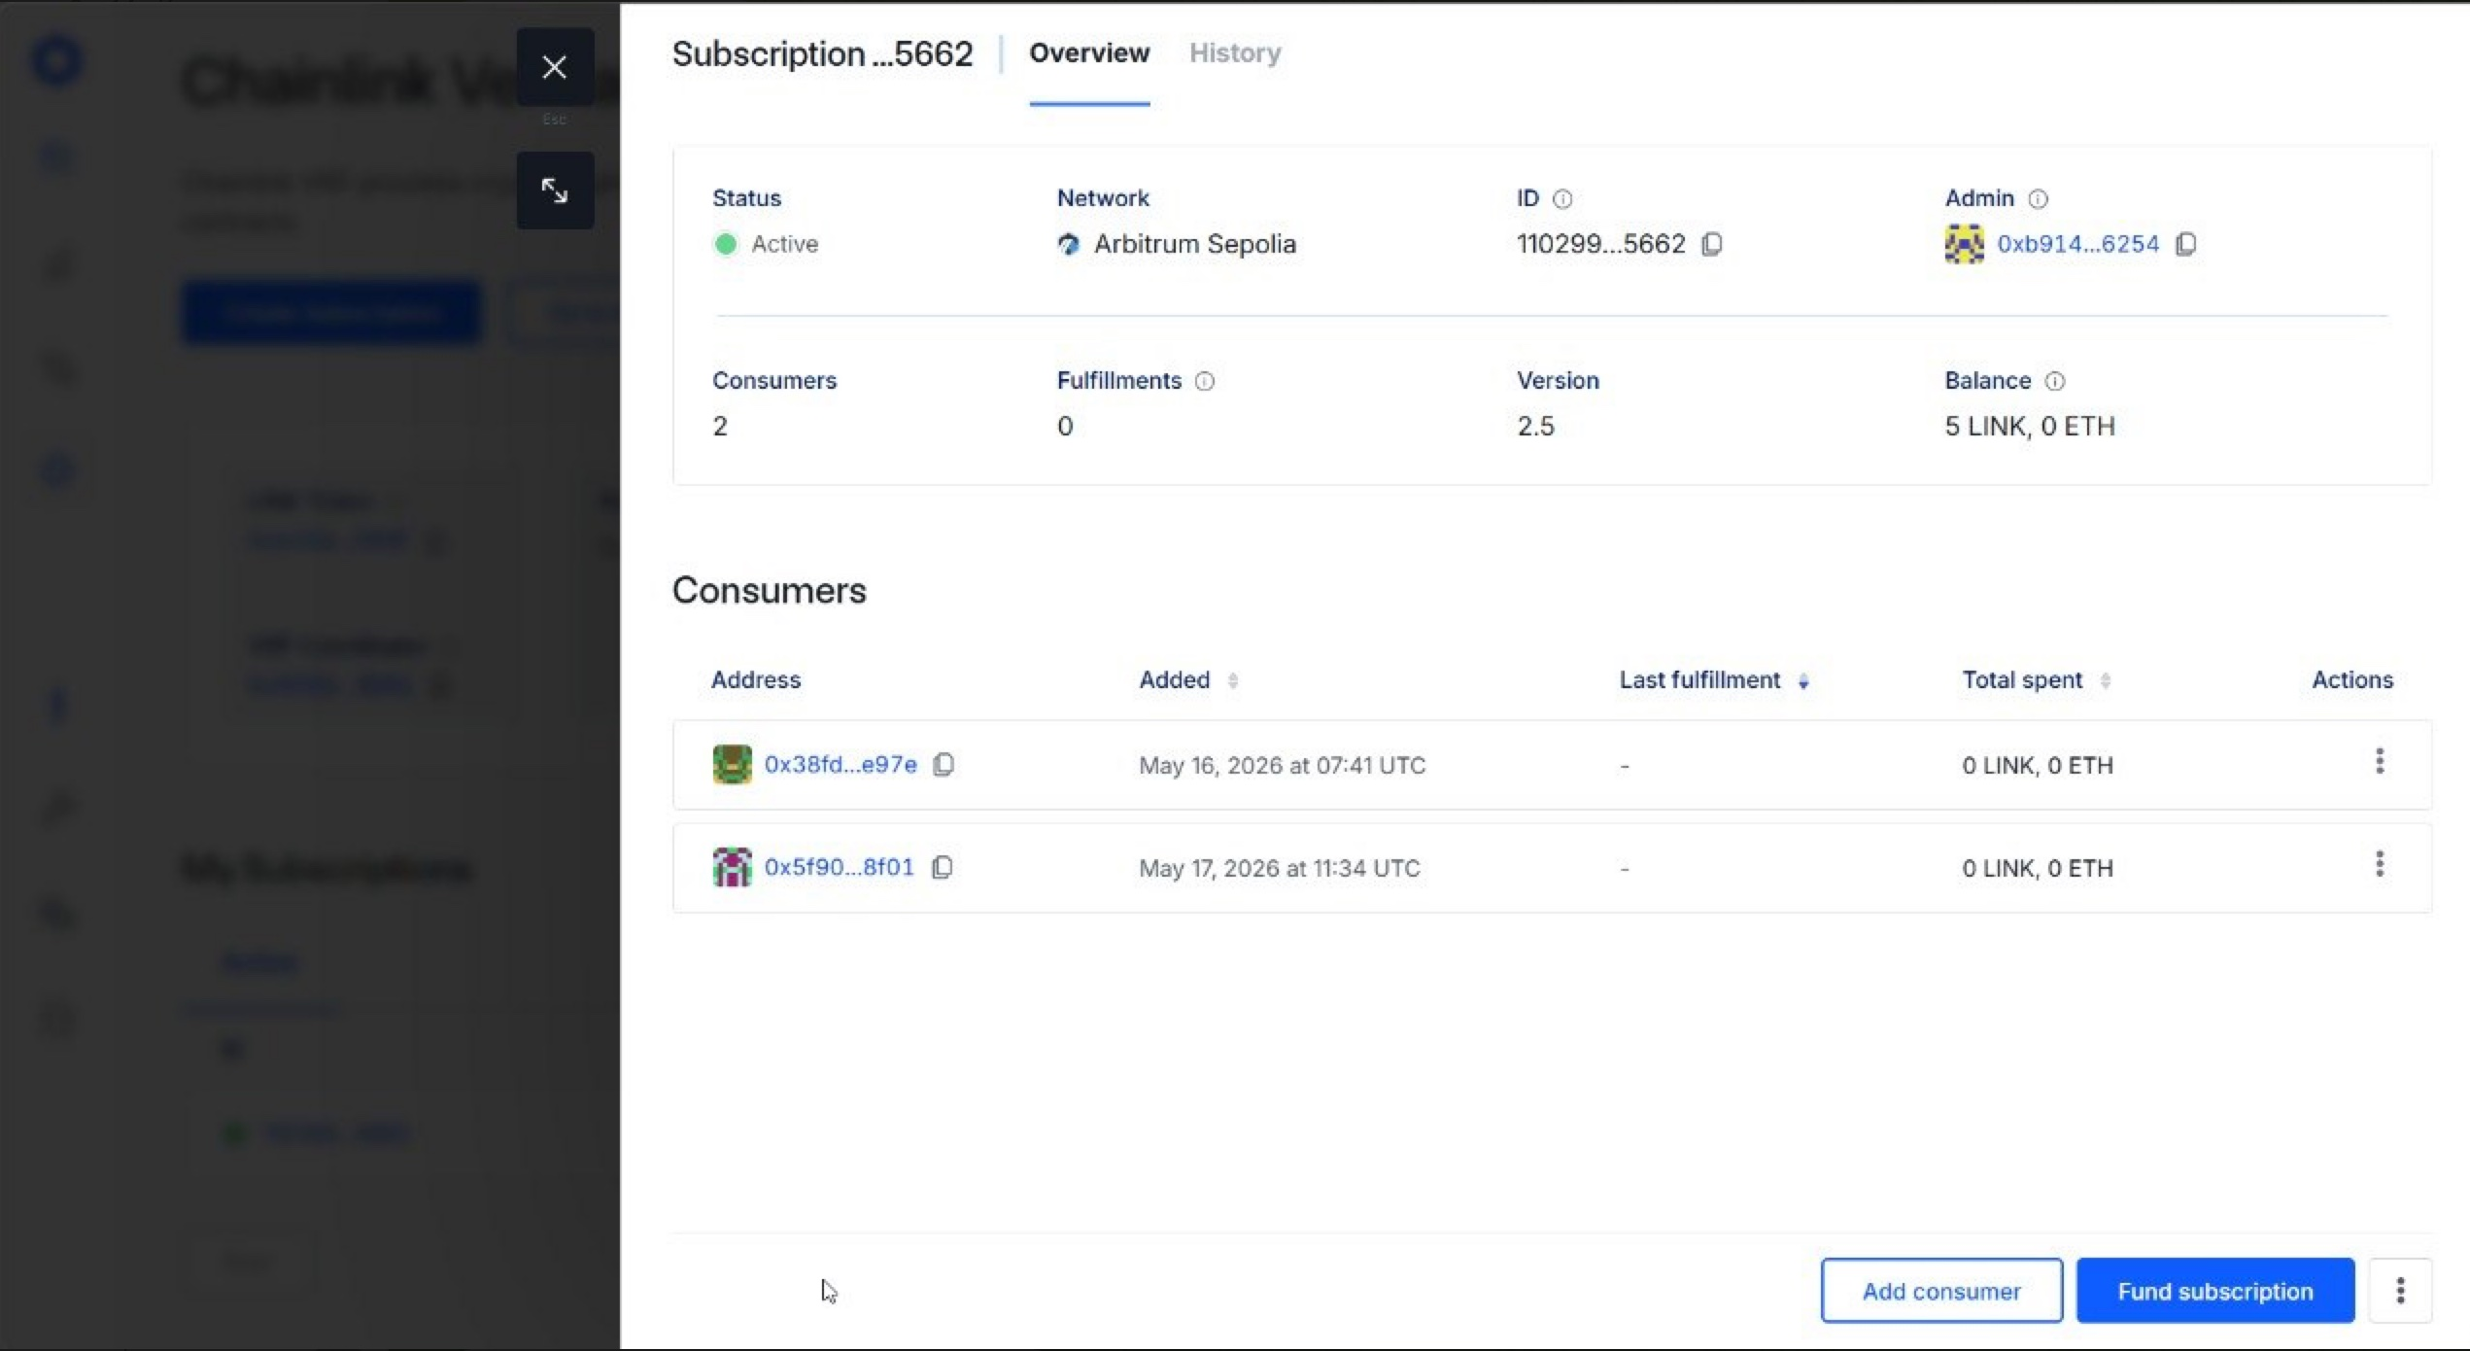
LootDrop: Chainlink VRF v2
Provably fair random item distribution · DAO-governed drop rates
🎲 LootDrop Contract
Chainlink VRF Subscription
VRF Version:
Chainlink VRF v2
Drop Rate:
500/1000 = 50% (DAO-governed)
Confirmations:
3 block confirmations
Callback Gas:
200,000 (CALLBACK_GAS_LIMIT)
Item Selection:
rand % 5 → itemId 0-4
Subscription:
Active · 5 LINK · 2 consumers
Minting:
MINTER_ROLE on GameItems

Slide 10
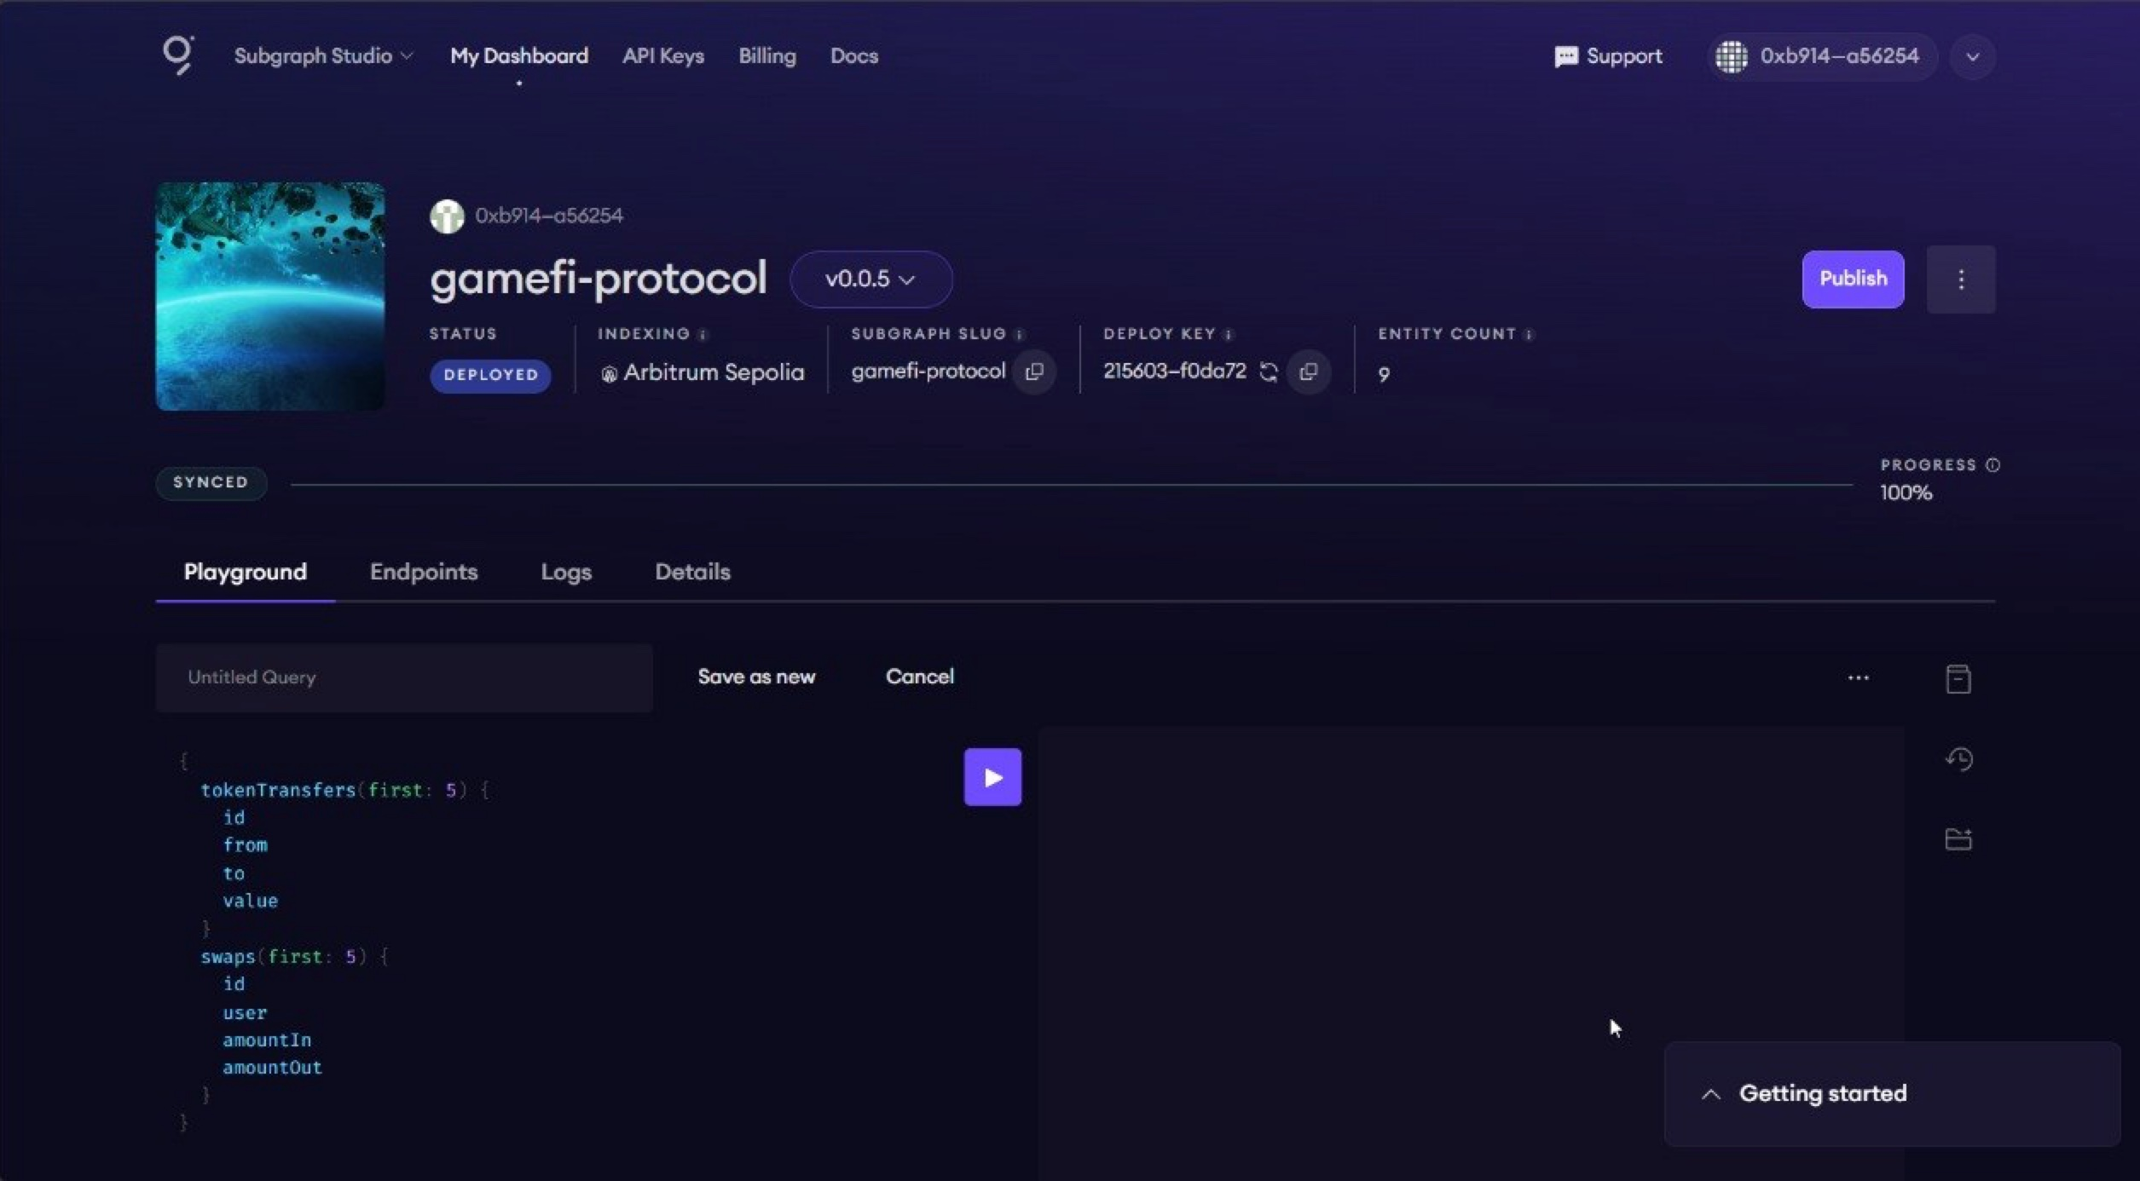
GameFactory + The Graph Subgraph
Deterministic deployment · On-chain event indexing
🏭 GameFactory
The Graph — gamefi-protocol v0.0.5
CREATE → deploys GameItems(admin)
DEPLOYED · Arbitrum Sepolia · SYNCED 100% · 9 entities
CREATE2 → deploys GameItems with salt
CREATE → deploys GameAMM(tokenA,tokenB)
predictGameItemsAddress(salt) → off-chain prediction
onlyOwner for all deploy functions
📊 Deployed & Verified
Network: Arbitrum Sepolia · Chain ID: 421614
All 10 contracts deployed and source-verified on Arbiscan
Deployment script: script/Deploy.s.sol (idempotent)
Verification: Arbiscan API + forge verify-contract

Slide 11
Deployed & Verified — Arbitrum Sepolia
All 10 contracts live on Chain ID 421614 · All verified on Arbiscan
Contract
Address
✓
GameToken (ERC-20 governance)
0x407a5Da64E3fc9FF202b76355d0FC0F34390c41A
✓
GameItems proxy (ERC-1155 UUPS)
0xd38cA79ADFc7300A95adaAc16A5F543c205eBf64
✓
GameFactory
0x545901c94Ce4bCB7960CeCB69C8b3C505Fcdd836
✓
TimelockController (2-day delay)
0x1ABA8B2a61196EDDd50C4456733D63Ff5f6139e0
✓
GameDAO (Governor)
0xCb0aD118Fc15313305d138097A2E6AE21706A59C
✓
GameAMM (x·y=k, 0.3% fee)
0xFf494842f23dbad3b478CDe35486e101cD880AF9
✓
GameVault (ERC-4626)
0xCB082d44E32f27D30C54c28F947A8C54fDFb6de8
✓
NFTRentalVault
0x476016df3bE27D697aB1494922Ac5352B936BcbF
✓
LootDrop (Chainlink VRF)
0xD1d24f55107c7ee9FDE319502d8Bca9fe1bB288c
✓
sepolia.arbiscan.io · All contracts source-verified

Slide 12
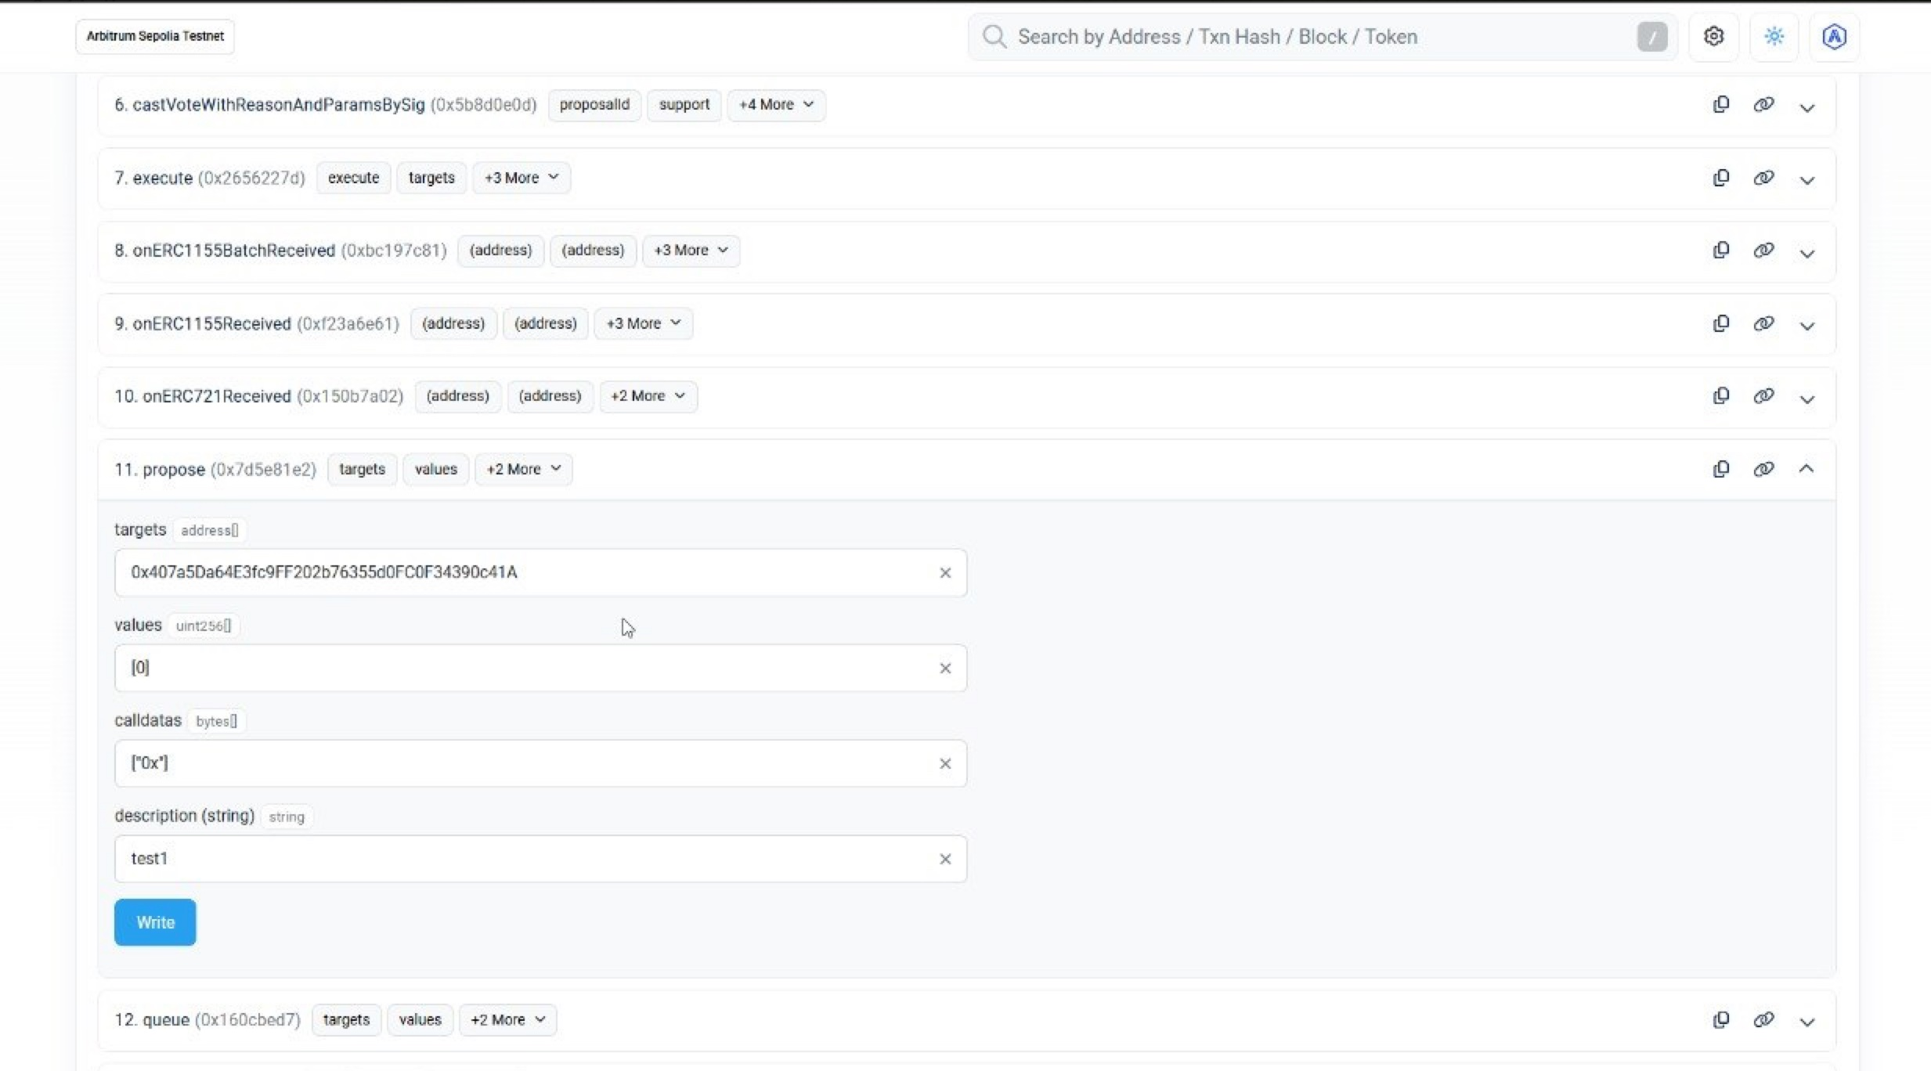
On-Chain Verification — Arbiscan
GameDAO contract · propose() function · live on Arbitrum Sepolia Testnet
Arbiscan — GameDAO Contract Interface
Address: 0xCb0aD118Fc15313305d138097A2E6AE21706A59C · Arbitrum Sepolia Testnet

Slide 13
Testing Suite — 133 Tests · All Pass
Foundry · Unit + Fuzz + Invariant + Fork tests
110+
16
5
3
Unit Tests
Fuzz Tests
Invariant
Fork Tests
Individual function testing, access control, edge cases
Property-based testing with 256 random runs each
Stateful testing: 64 runs, depth 15 per invariant
Mainnet fork with real Chainlink oracles
Key Test Cases:
invariant
invariant_k_never_decreases
k constant never drops after any swap sequence (GameAMM)
invariant
invariant_totalAssets_gte_deposits
vault assets always >= total deposited (GameVault)
fuzz
testFuzz_swapAtoB(uint256)
any amountIn value preserves the k invariant
fuzz
testFuzz_addLiquidity(uint64,uint64)
LP shares always proportional to deposit
unit
test_reentrancy_blocked
ReentrancyAttacker contract reverts on re-entry
fork
test_fork_chainlink_priceFeed
real Chainlink feed returns non-stale fresh price

Slide 14
Security Audit — Findings Overview
Internal audit · Slither + manual review · Zero High/Medium findings
0
0
0
4
Critical
High
Medium
Low/Info
LOW
LOW-01 · Centralized Mint Authority
Owner holds unrestricted mint capability until Timelock transfer. Risk: pre-transfer single-point-of-failure. Mitigation: transfer ownership to Timelock immediately after deployment.
Location: GameToken.sol
LOW
LOW-02 · Proposal Threshold Impact
1% proposal threshold (10,000 GAME) restricts smaller holders from creating proposals. In testnet with limited supply this reduces participation. Recommendation: configurable via Timelock.
Location: GameDAO.sol
LOW
LOW-03 · Hardcoded VRF Gas Limit
CALLBACK_GAS_LIMIT = 200,000 is hardcoded constant. Future GameItems upgrades may require more gas for mint logic. Risk: VRF fulfillment reverts silently. Make configurable.
Location: LootDrop.sol
INFO
GAS-01 · Repeated Storage Reads
platformFee is read from storage multiple times in rentItem(). Cache to local variable to save gas. Minor optimization opportunity.
Location: NFTRentalVault.sol

Slide 15
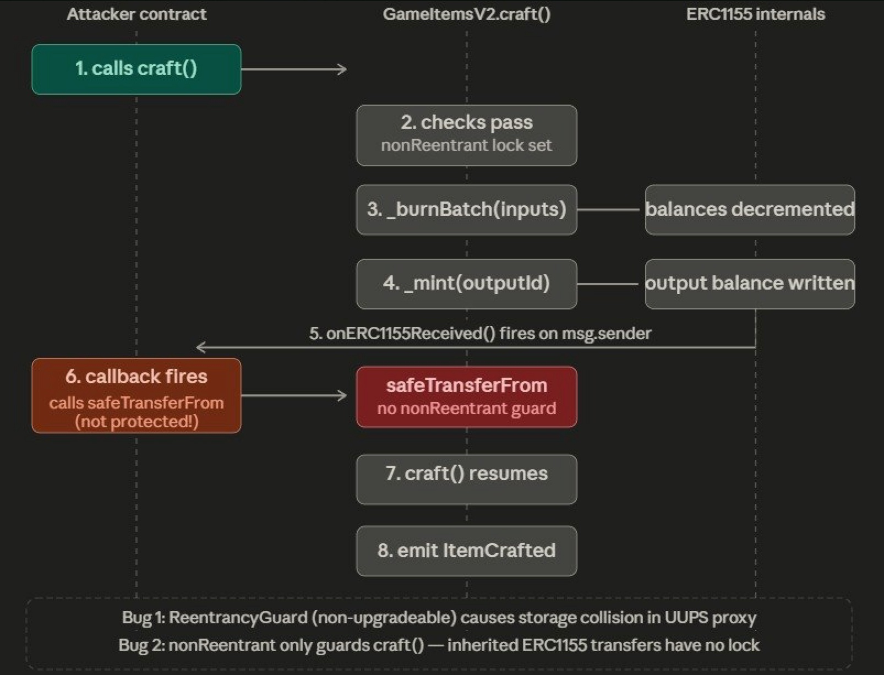
Security Case Study: Reentrancy Attack Analysis
Attack flow diagram from Security Audit Report
Attack Flow: GameItemsV2.craft()
Finding Analysis
Bug 1:
ReentrancyGuard (non-upgradeable version) causes storage collision in UUPS proxy context
Bug 2:
nonReentrant only guards craft() — inherited ERC-1155 transfers have no lock, enabling callback exploitation
Fix Applied:
Use ReentrancyGuardUpgradeable + extend guard to cover safeTransferFrom path
CEI Pattern:
Balances decremented before mint, mint before external call — state changes committed before interactions
Test Coverage:
test_reentrancy_blocked: ReentrancyAttacker contract confirms re-entry is rejected

Slide 16
Security Architecture — Defense in Depth
Multiple independent layers of protection applied throughout
🔄 Checks-Effects-Interactions
🔒 ReentrancyGuard
All state mutations committed before external calls. Prevents reentrancy at the logic level independent of guards.
OpenZeppelin nonReentrant modifier on all external state-changing functions. Hard lock preventing callback exploitation.
Applied: GameAMM, GameVault, NFTRentalVault
Applied: GameAMM, GameVault, NFTRentalVault
🔑 AccessControl / Ownable
🛡 SafeERC20
MINTER_ROLE and UPGRADER_ROLE gating on GameItems. Ownable on GameToken, GameVault, NFTRentalVault.
Wraps all ERC-20 transfers using safe versions that revert on failure, preventing silent transfer failures.
Applied: All contracts
Applied: GameAMM, GameVault, NFTRentalVault
⏱ TimelockController
📡 Oracle Staleness Check
2-day mandatory delay on all governance-executed actions. Community can monitor and react before execution.
GameVault reverts if Chainlink price feed updatedAt is older than 1 hour. Prevents stale price exploitation.
Applied: GameDAO
Applied: GameVault

Slide 17
Governance Security Analysis
Flash-loan resilience · Whale analysis · Timelock bypass analysis
⚡ Flash-Loan Attack Resilience
🐋 Whale Concentration Risk
GameDAO uses ERC20Votes with historical voting checkpoints. Voting power is read from the proposal SNAPSHOT BLOCK — not current balance. An attacker borrowing GAME tokens after proposal creation has ZERO voting power on that proposal. The 1-day voting delay further prevents instant manipulation.
Large GAME holders can influence outcomes. Mitigated by: 4% quorum requirement, 1-week public voting period (community can react), 2-day Timelock (time to exit), and public proposal visibility. Economic risk, not a contract bug.
⏱ Timelock Bypass Analysis
📡 Oracle Manipulation Resistance
All privileged actions route through TimelockController with a 2-day delay. TimelockController address is the DEFAULT_ADMIN_ROLE holder on GameItems and the owner() on all other contracts. No direct admin access pathway exists post-deployment.
GameAMM uses pool reserves (not oracle) for pricing — immune to oracle price manipulation. GameVault uses Chainlink only for informational USD valuation. Staleness check (>1 hour) prevents stale price abuse. AMM slippage protection (minAmountOut) protects users from sandwich attacks.

Slide 18
Gas Optimization & L2 Deployment
Yul assembly benchmarks · L1 vs Arbitrum Sepolia cost analysis
Yul Assembly vs Solidity (GameAMM)
L1 Ethereum vs Arbitrum Sepolia L2
Function
Solidity
Yul
Saving
Operation
ETH L1
Arb L2
_sqrt
~230 gas
~170 gas
−26% ✓
GameToken deploy
~1,200,000 gas
~10x cheaper
_getAmountOut
~115 gas
~95 gas
−18% ✓
addLiquidity
~180,000 gas
~10x cheaper
swapAtoB
~85,000 gas
~10x cheaper
deposit ERC-4626
~95,000 gas
~10x cheaper
listItem (rental)
~110,000 gas
~10x cheaper
propose (DAO)
~200,000 gas
~10x cheaper
~10x cheaper on Arbitrum Sepolia vs Ethereum Mainnet
Design Patterns:
Factory
UUPS Proxy
CEI
Pull-over-Push
Oracle Adapter
Reentrancy Guard
Timelock

Slide 19
External Infrastructure: Slither + The Graph
Static analysis results · Subgraph indexing
🔍 Slither Static Analysis
📊 The Graph Subgraph
Run: slither . --foundry-compile-all
Name:
gamefi-protocol
HIGH:
0
Version:
v0.0.5
MEDIUM:
0
Status:
DEPLOYED · SYNCED 100%
LOW:
0 (src)
Network:
Arbitrum Sepolia
INFO:
library only
Entities:
9 indexed
Progress:
100% synced
All findings in production source contracts (src/) resolved to zero High and zero Medium. Remaining flags are in OpenZeppelin + Chainlink library code — triaged and accepted.
Indexed Events:
tokenTransfers · swaps · liquidityEvents · listings · rentals · proposals · votes

Slide 20
All Deliverables Submitted ✅
GameFi Protocol — SE-2421 · Gizatov · Rymbaev · Kalieva
✅ 10 Contracts
✅ 133 Tests
Deployed & verified on Arbitrum Sepolia (Chain ID 421614)
110+ unit · 16 fuzz · 5 invariant · 3 fork · all pass
✅ 0 High/Medium
✅ Yul Optimizations
Security audit clean · Slither static analysis passed
−26% sqrt · −18% getAmountOut vs Solidity
✅ 7 Design Patterns
✅ The Graph
Factory · UUPS · CEI · Pull-Push · Oracle · Guard · Timelock
Subgraph deployed · 9 entities · 100% synced on Arbitrum
✅ Chainlink VRF
✅ Documentation
Active subscription · 2 consumers · 5 LINK funded
Architecture doc · Security audit · Gas report · README
GitHub: github.com/Heb1ks/BlockFINAL2- · sepolia.arbiscan.io · Chain ID: 421614

