Slide 1
Welcome
Computer Organization 2
Project
Team (27)

Slide 2
The signals used:
PCI Target Device
Frame
IRDY
CBE
AddressDataLine
Oe
CLK
RST
TRDY
DEVSEL

Slide 3
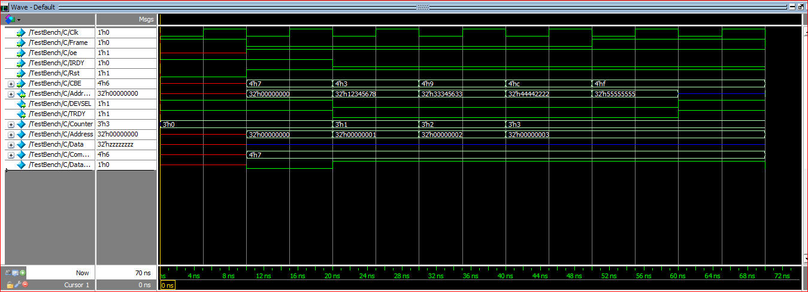
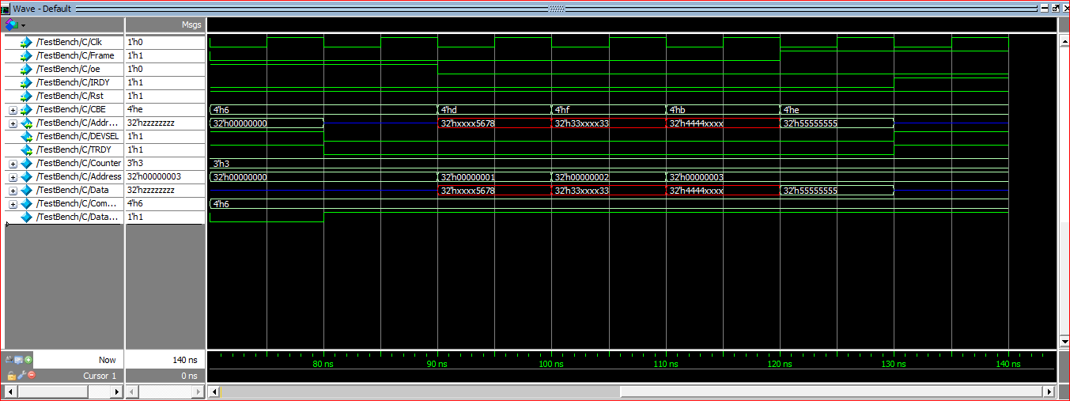
First Scenario: (Write &read 4 data starting from address zero)
Write
Transaction
Read
Transaction

Slide 4
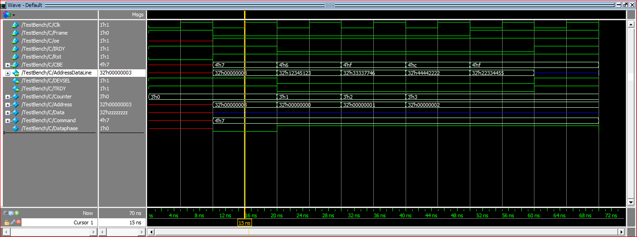
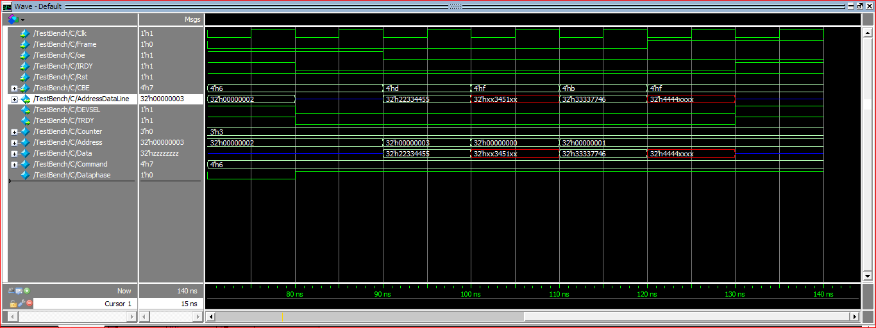
Second scenario: (Write 4 data starting from address 3 & reading 4 words from address 2)
Write Transaction
Read Transaction

Slide 5
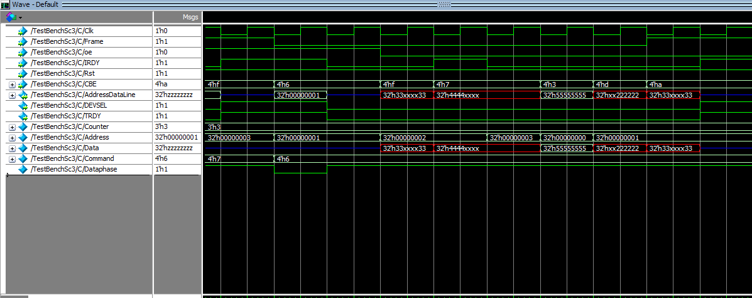
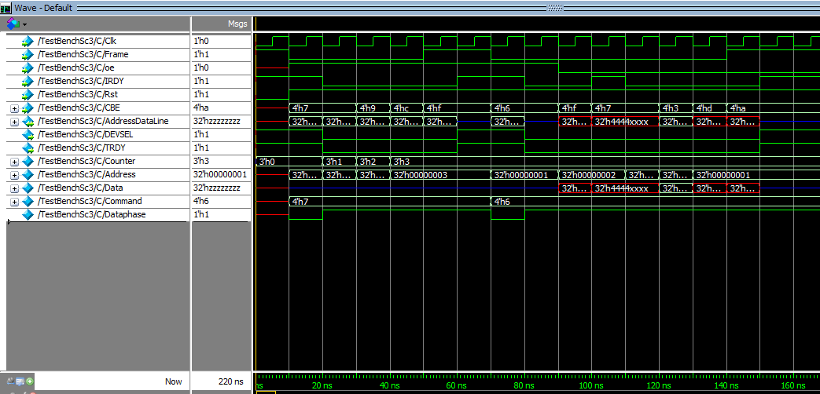
Third Scenario : ((IRDY=1):The IRDY is de-activated in the middle of the read transaction)
Read
Transaction
Write then
read

Slide 6
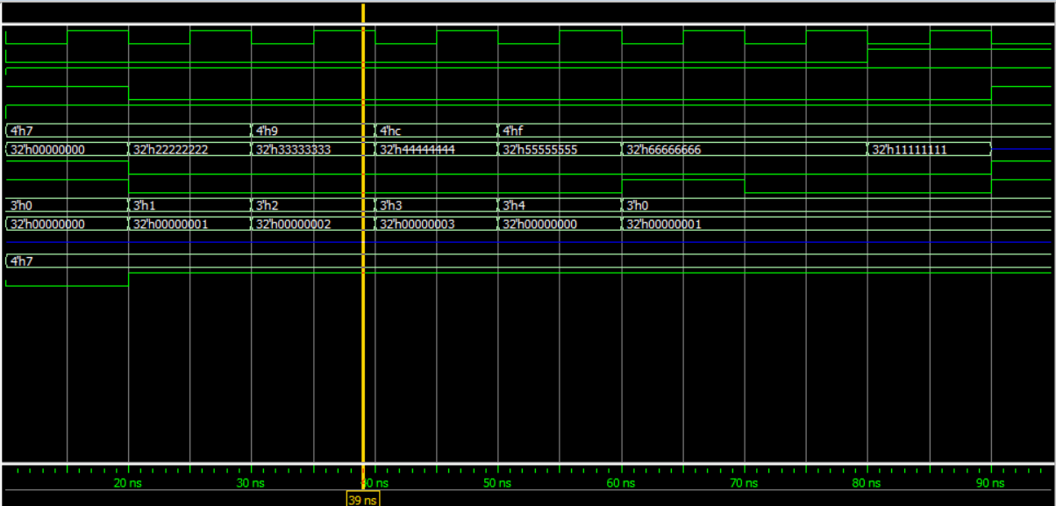
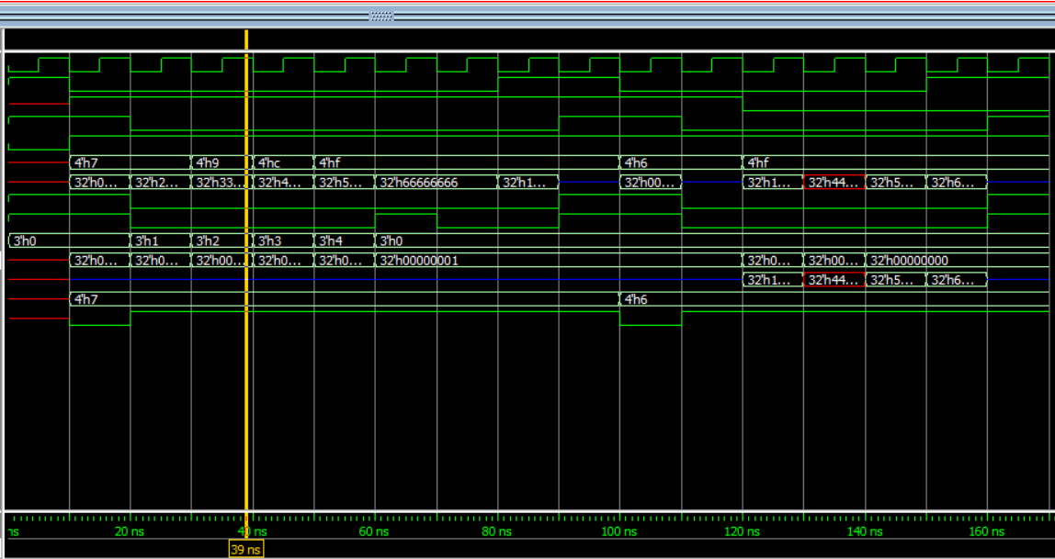
Fourth scenario: (Writing more than 4 words which is the total memory of the buffer which leads to make the TRDY=1 in the middle of the write transection )
Write
Transaction
Write then
read

Slide 7
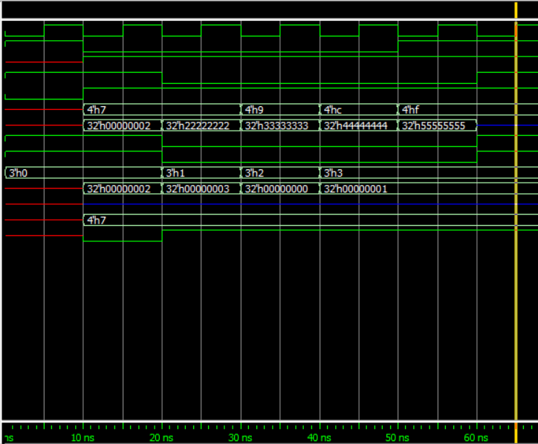
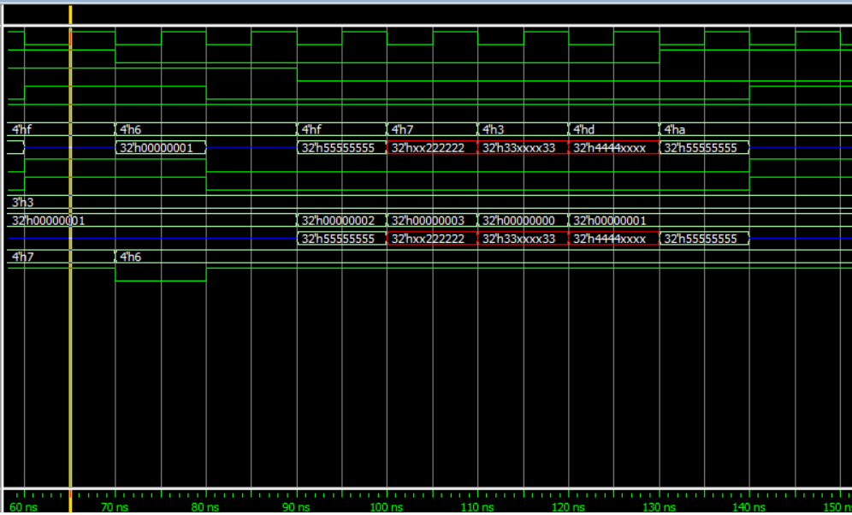
Fifth Scenario: (Write 4 data starting from address 2& reading 5 words from address location 1)
Write Transaction
Read Transaction

Slide 8
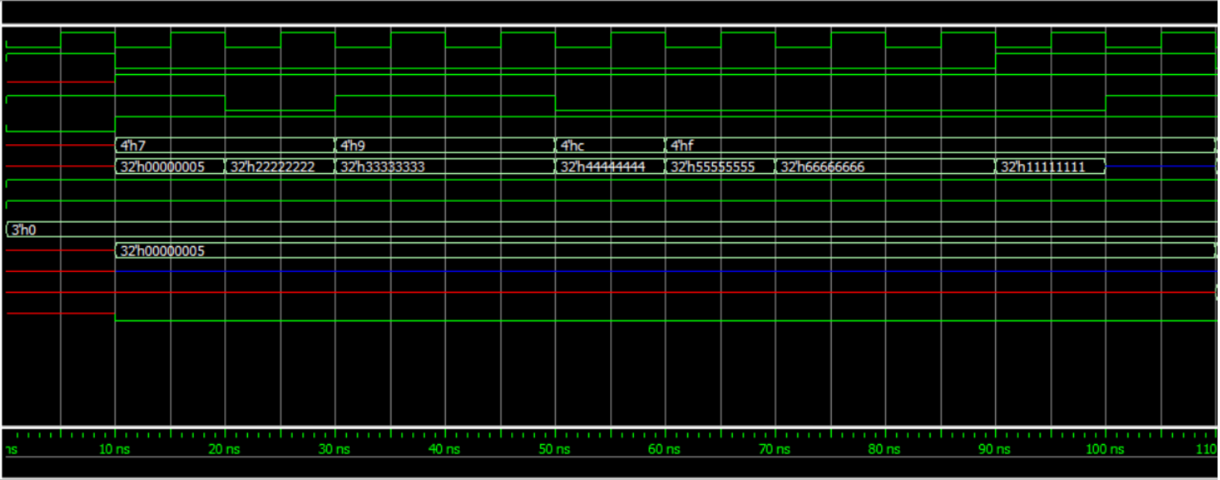
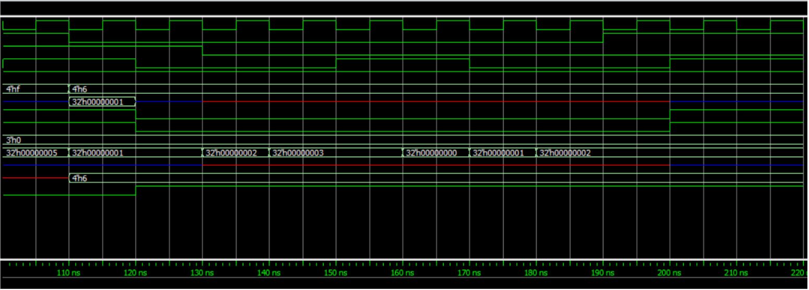
6th Scenario: (Sending address greater than 3. So this data is not to our target)
Write
Transaction
Read
Transaction

Slide 9
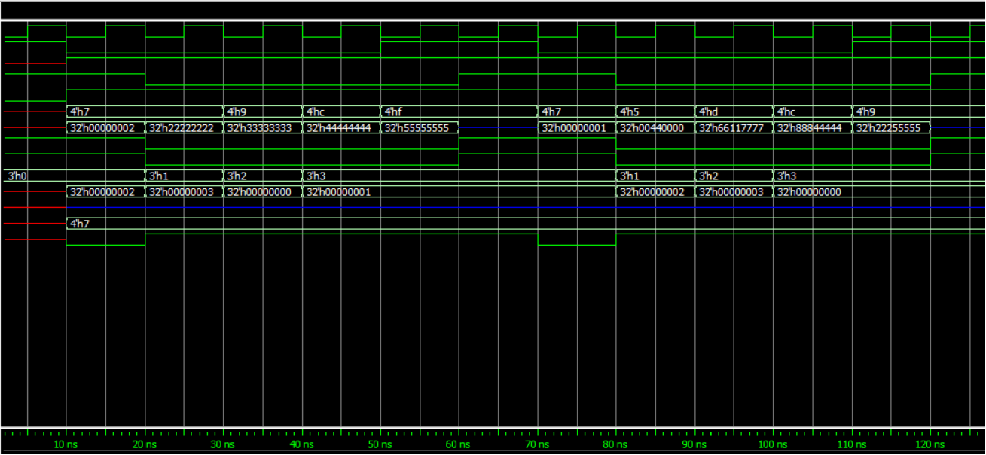
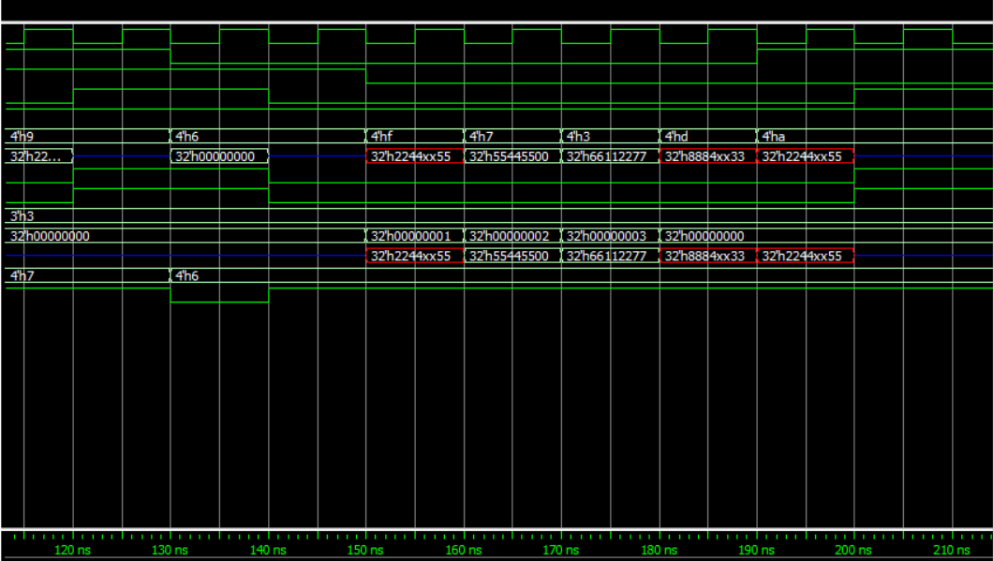
7th Scenario : (Making 3 Transitions (1st write 4 data from address 2, 2nd write 4 words Starting in address 1 , Read 5 words from the buffer starting from address 1)
1st Write
and
2nd Write
Transaction
Read
Transaction

Slide 10
Extra Features
Reset Signal
Special scenario: Two successive write Transactions then read Transaction (7th Scenario )
Special scenario: Writing more than 4 words of data (TRDY=1)
( Fourth scenario)
Special scenario: when IRDY gets deactivated in the middle of the read process (IRDY =1). (Third Scenario )
Special scenario: IRDY gets deactivated in the middle of the read process (IRDY =1)& Writing more than 4 words of data (TRDY=1)
( 8th scenario)

Slide 11
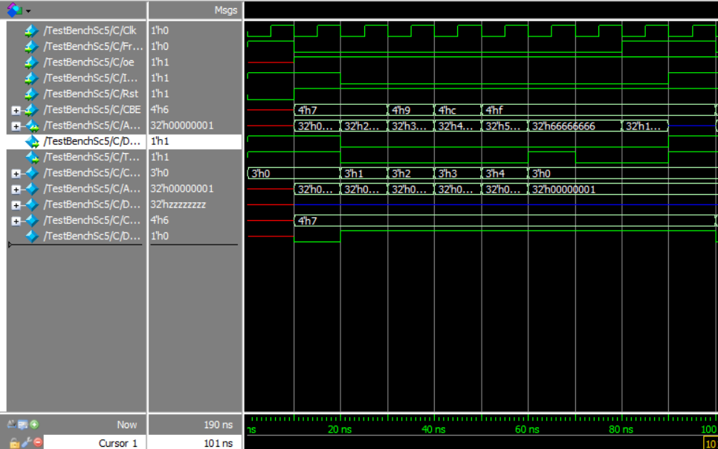
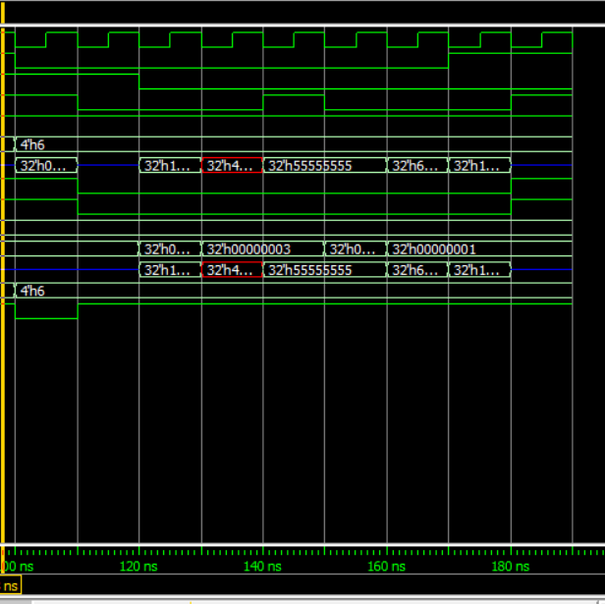
8th Scenario: (Writing more than 4 words which is the total memory of the buffer which leads to make the TRDY=1 in the middle of the write transection &in the middle of the read transaction the IRDY is de-activated
Write
Transaction
Read
Transaction

Slide 12
Thank You
Presented by :
Nora Nabil Ali
Heba Atef
Nehal Yasser
Nermeen Atif

