Slide 1

PSDIGITAL
Website
Direction
Structure, experience and creative direction for the new PS Digital website

Slide 2
01 — SITE MAP
A forward-thinking creative partner, online.
The core structure of the website, from first impression to first contact.
01
About
02
Services
Social Media · Branding · Website & App Design · Creative Production · Digital Consultation · Performance Marketing
03
Work
04
Team
05
Careers
Categories · Clients
06
Contact
PSDIGITAL · WEBSITE DIRECTION
02

Slide 3
02 — STRATEGIC OBJECTIVE
A forward-thinking creative partner, online.
Build a modern, high-impact digital platform that positions PSdigital as a forward-thinking creative partner, showcasing our ability to bring together strategy, creativity, and innovation to create digital solutions that drive growth. The website will combine a bold, futuristic visual identity with an effortless user experience, making it simple to explore our work, understand our capabilities, and connect with us.
01
02
03
Portfolio & Client Engagement
User Experience
Careers Submission
Prominent, easy-to-reach portfolio / work section
Clear, visually rich project showcases that invite deeper browsing
Simple navigation
Minimal clicks to find any page
Consistent layout across devices
An easy way to fill in the forms
Candidates can submit their work in minimal steps
PSDIGITAL · WEBSITE DIRECTION
03

Slide 4
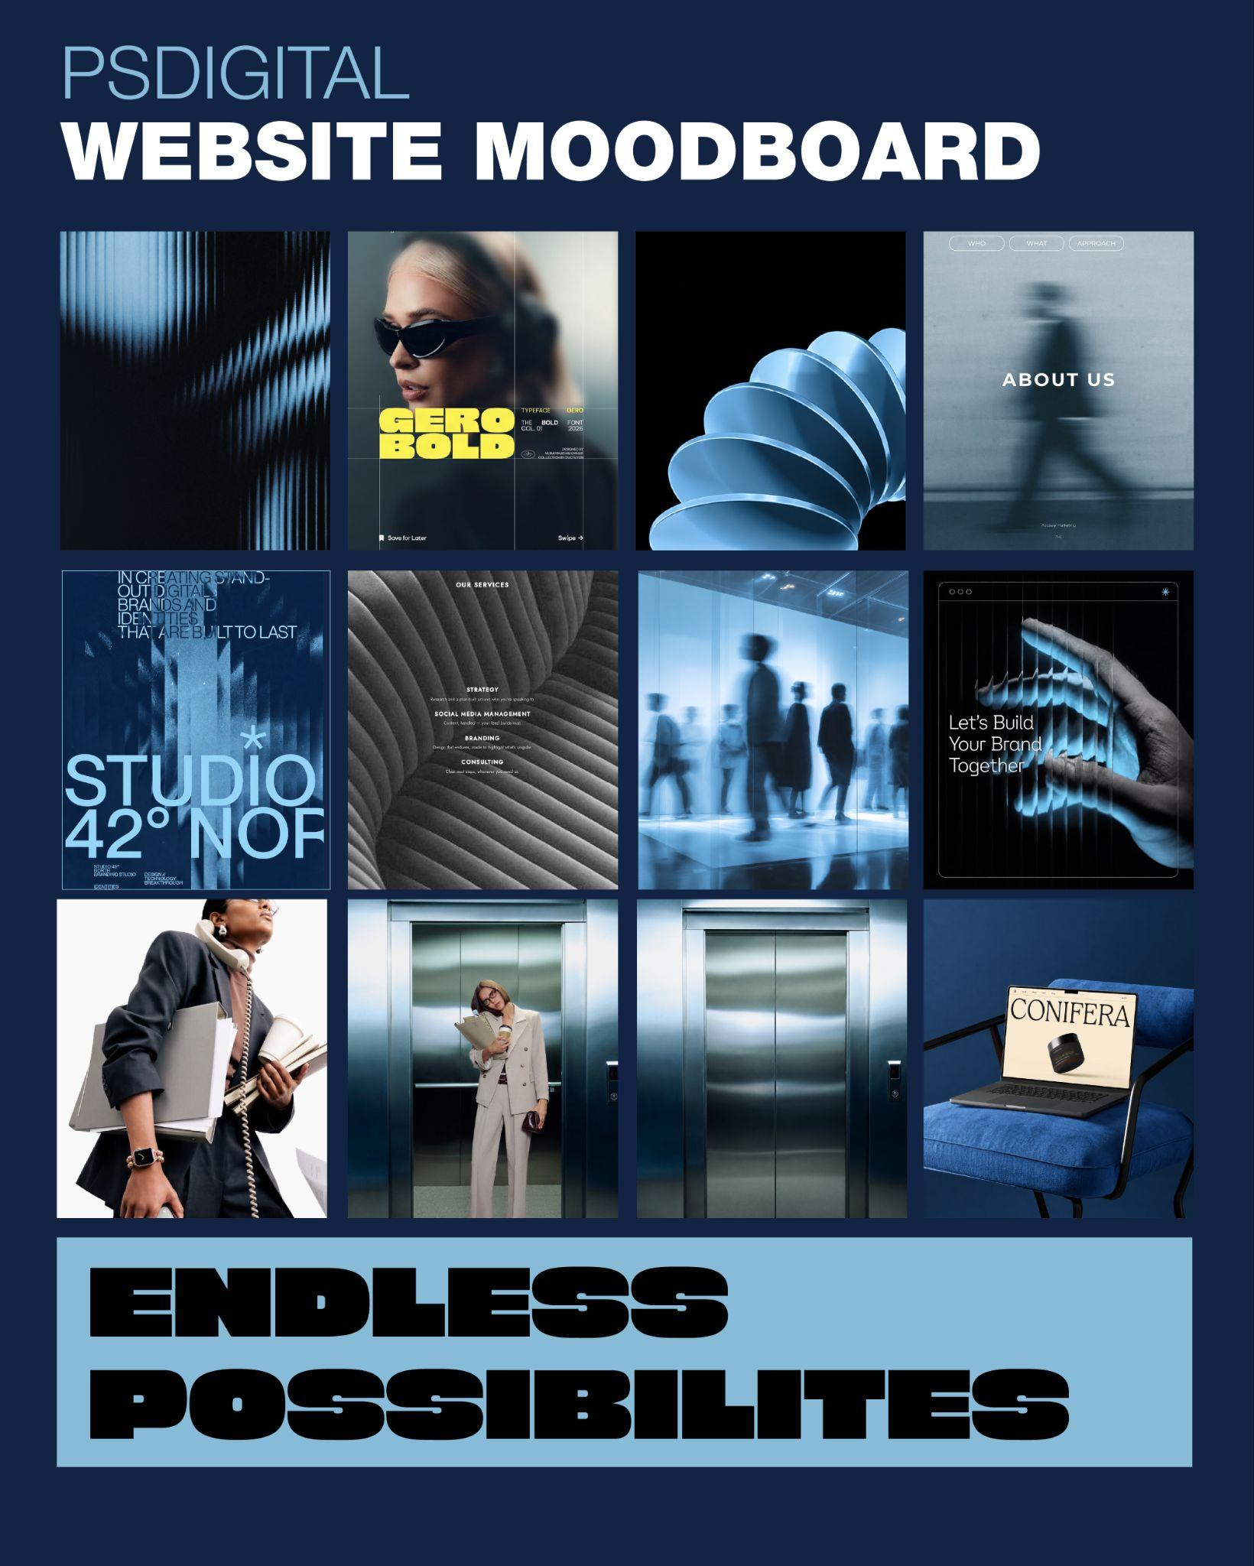
03 — CREATIVE DIRECTION
Futuristic. Minimal. Premium.
A futuristic, minimal and premium digital experience.
PALETTE
Dark navy to black, with bold accents.
SURFACES & MOTION
Motion blur, 3D forms, metallic surfaces and frosted glass effects create a sense of movement and depth.
TYPOGRAPHY
Bold, stretched typography brings personality to headlines, while clean sans-serif fonts keep the content clear and easy to read.
IMAGERY
Black and white imagery adds a human and stylish touch, balancing the futuristic aesthetic with a premium feel.
PSDIGITAL · WEBSITE DIRECTION
04

Slide 5

04 — TYPOGRAPHY
A loud headline, a clear read.
HEADER
STRETCH FONT REFERENCES
Gero Bold
Click to open
Reference 01
https://www.pinterest.com/pin/525162006563631751/
SUBHEADER
BODY TEXT
Reference 02
https://www.pinterest.com/pin/111182684546993611/
Helvetica Neue
Helvetica Neue
PSDIGITAL · WEBSITE DIRECTION
05

Slide 6
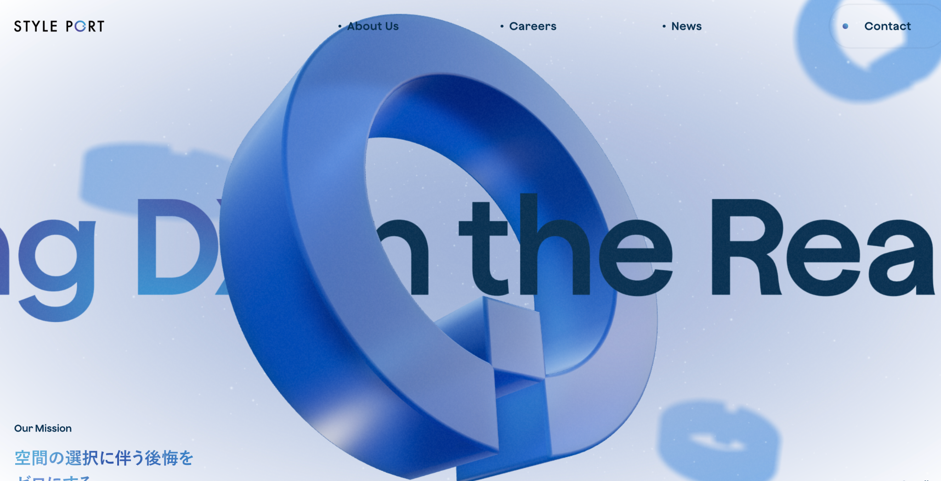
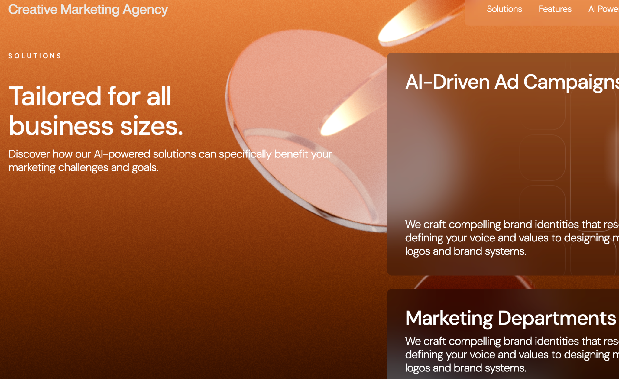
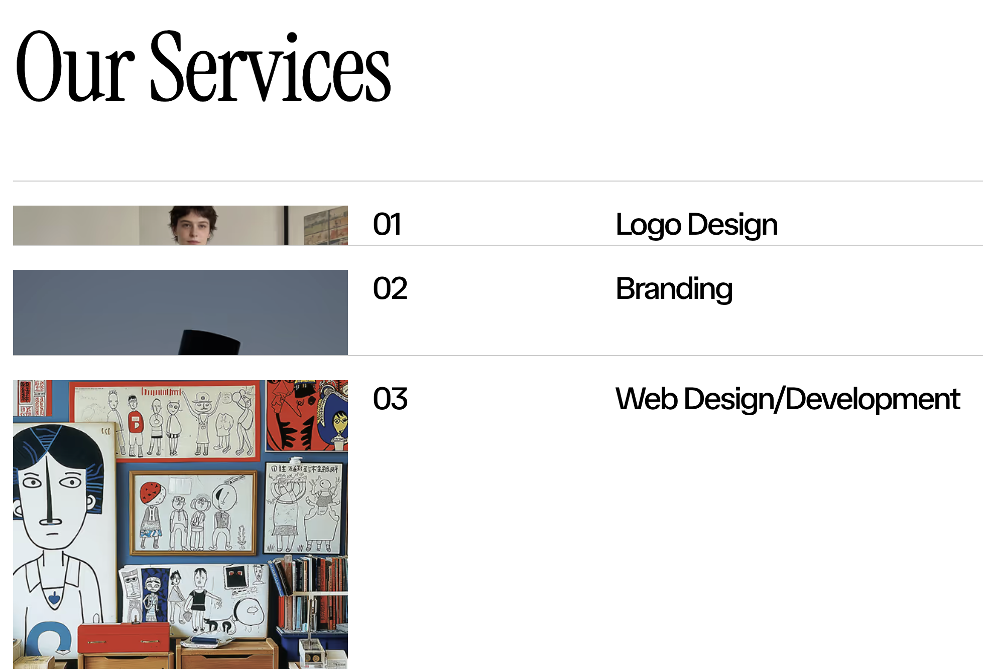
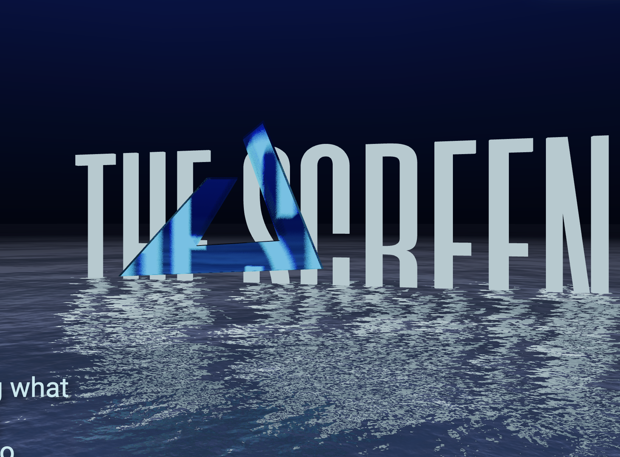
05 — REFERENCES · OVERALL STRUCTURE
The whole-site feel. Click any image or link.
01
02
03
04
Immersive 3D hero
Service cards with bold imagery
Numbered services index
Cinematic stretched type
styleport.co.jp
creativemarketing.peachweb.io
oddlymade.webflow.io/#services
techredux.co
PSDIGITAL · WEBSITE DIRECTION
06

Slide 7
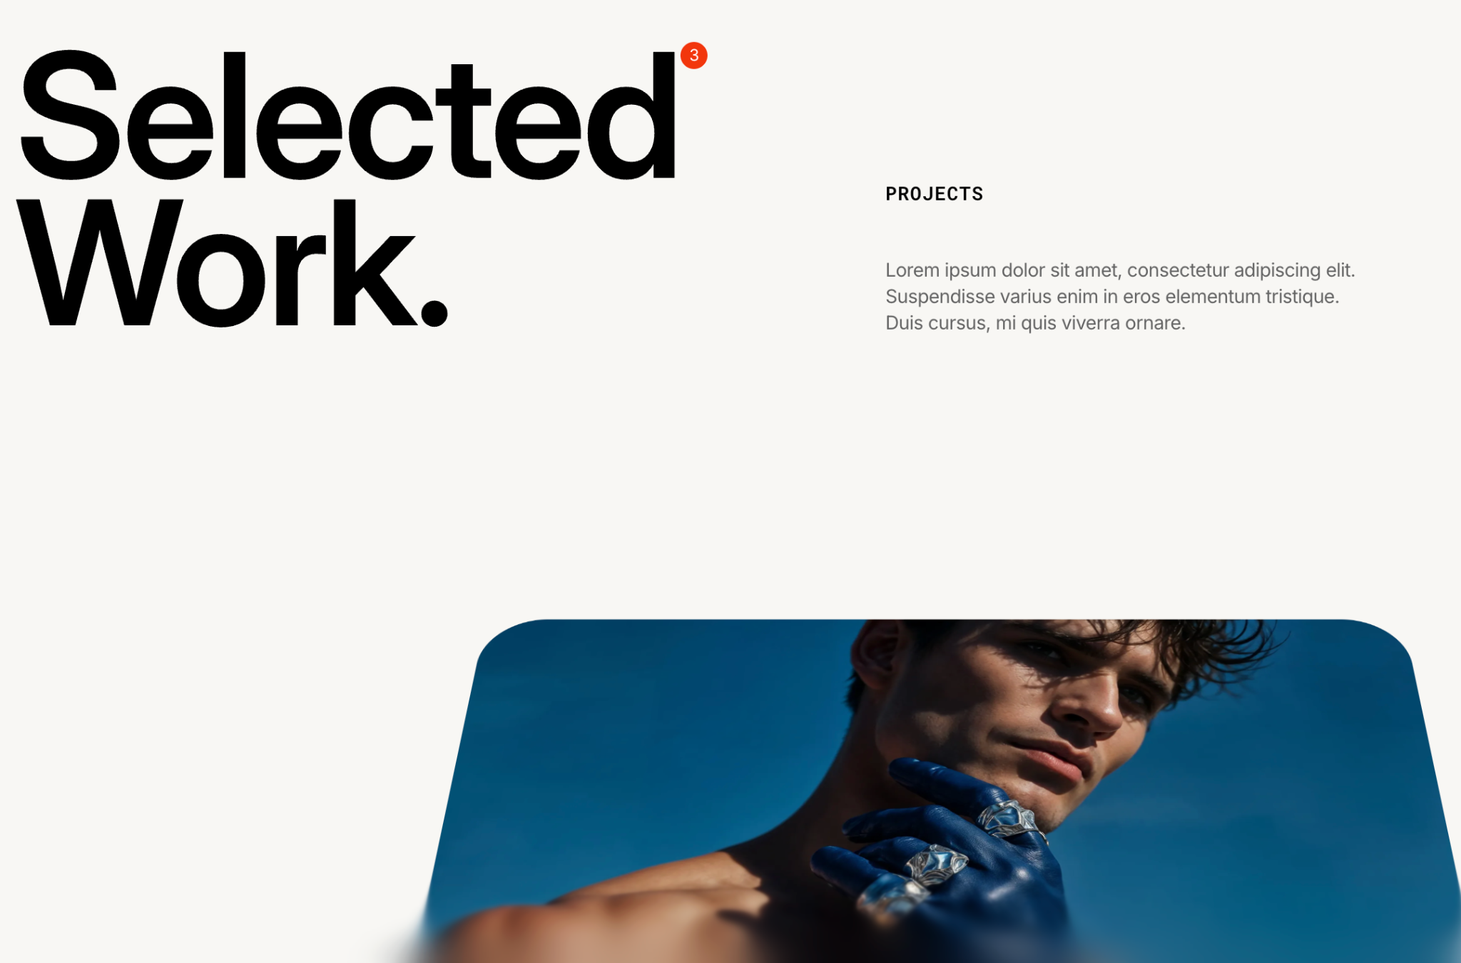
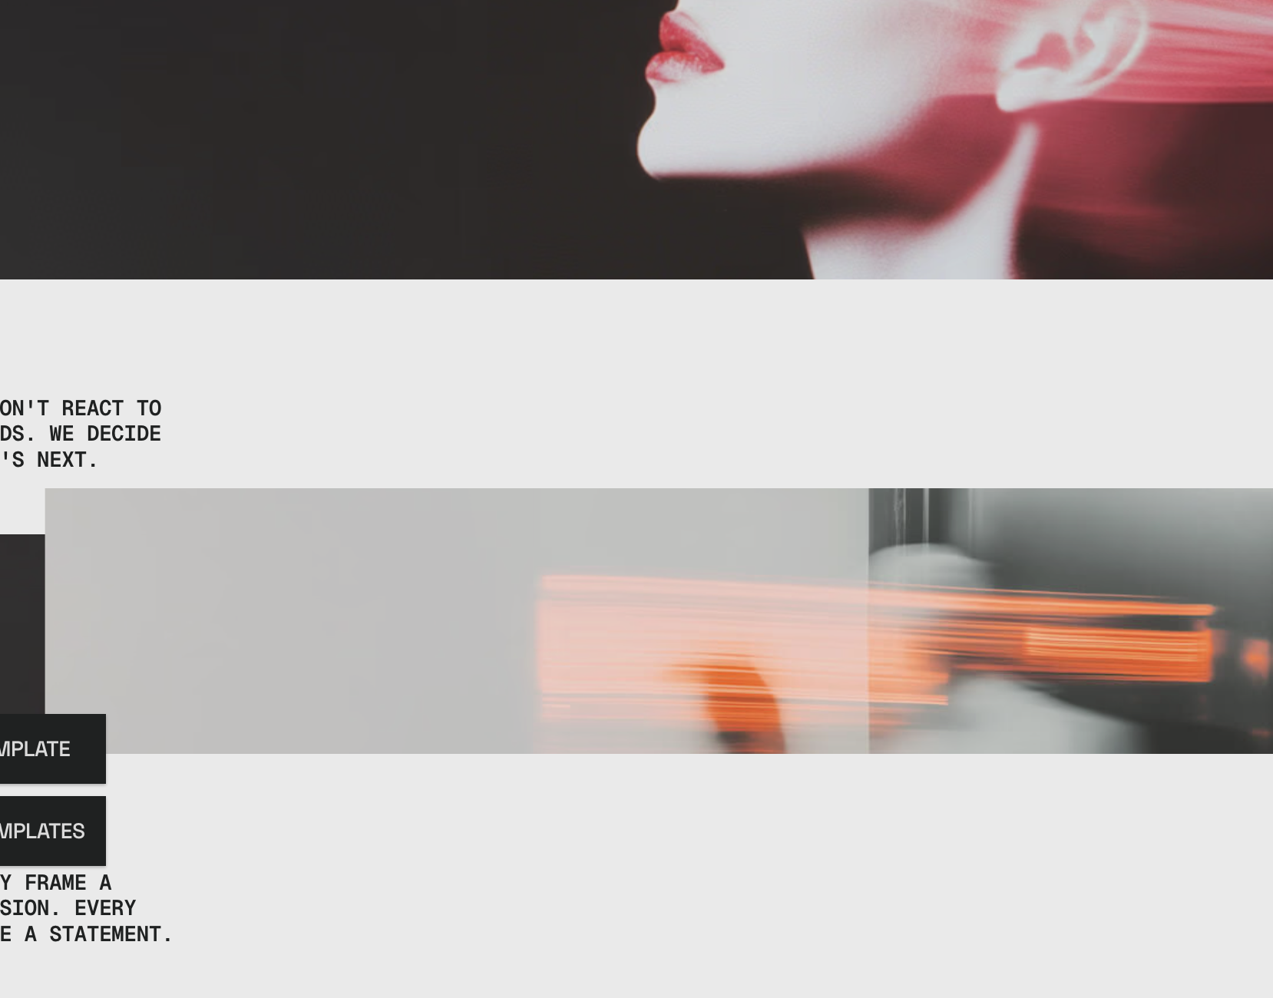
06 — REFERENCES · HOME & SERVICES
Motion that brings the work to life.
05
06
Home & services motion. Check the Studio inner page for the Team.
Services or clients representation
alture-template.webflow.io
agentura.framer.website
PSDIGITAL · WEBSITE DIRECTION
07

Slide 8
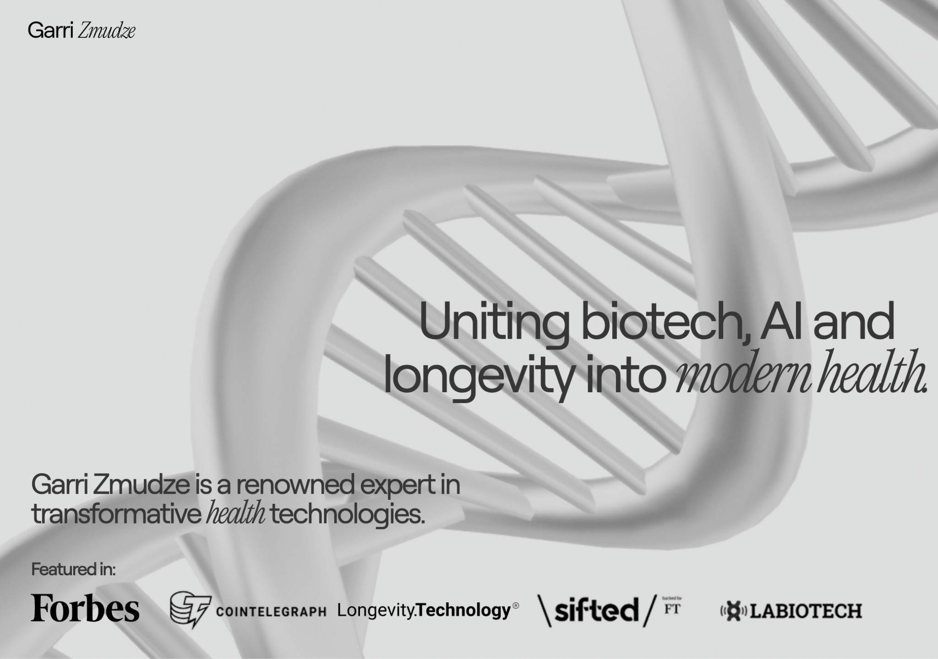

07 — REFERENCES · HEADER & NAVIGATION
First scroll, first impression.
08
Navigation bar motion idea
07
moonsworth.com/companies
Header wave
garrizmudze.com
PSDIGITAL · WEBSITE DIRECTION
08

Slide 9
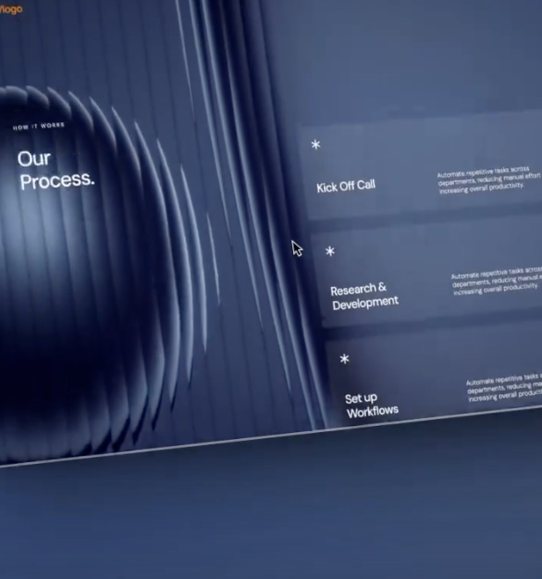
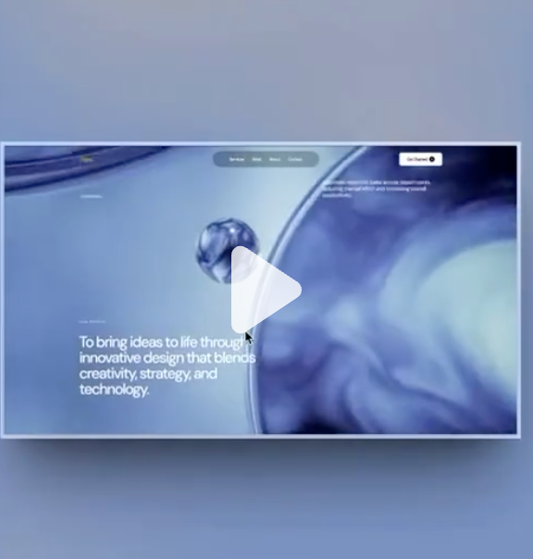
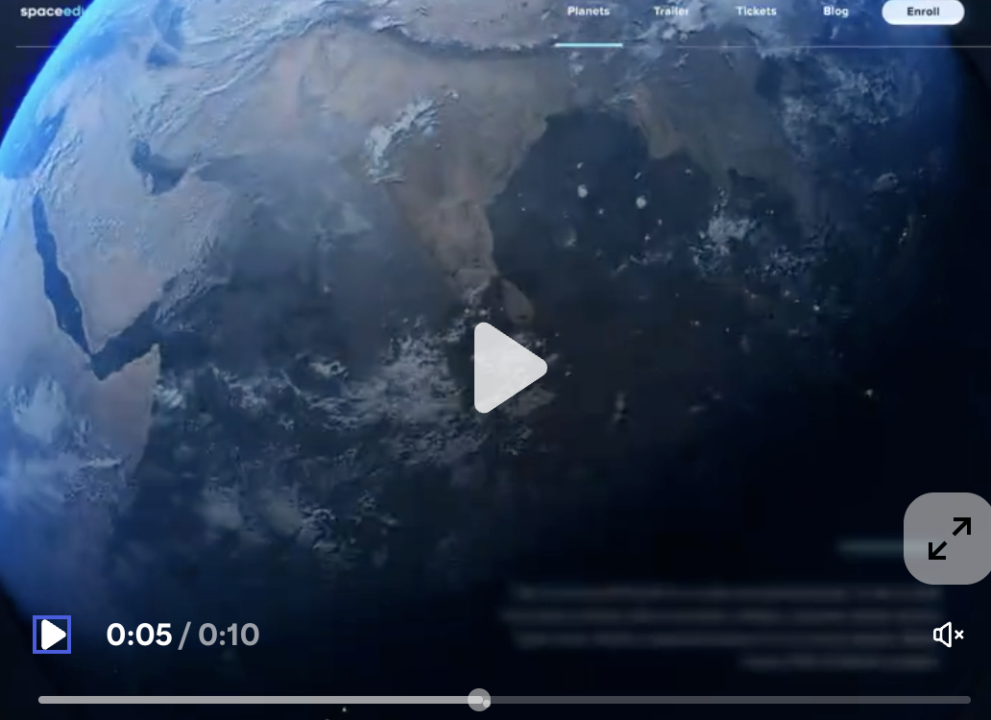
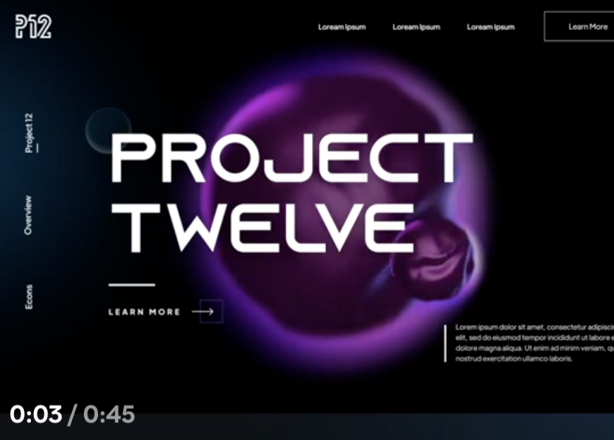
08 — EXTRA PINTEREST REFERENCES
Glass, depth and video-led storytelling.
09
10
11
12
pinterest.com/pin/946881890438431744
pinterest.com/pin/946881890438431876
pinterest.com/pin/579205202062763700
pinterest.com/pin/422281210389749
AGENCY REFERENCE https://www.creativeans.com/
PSDIGITAL · WEBSITE DIRECTION
09

Slide 10
PSDIGITAL
THANK YOU

