Slide 1
Compressor Performance Map Prediction using Machine Learning Algorithms: A multi-map training approach
Heba Youssef, Amanda Pieyre, and Ahmed Jhinaoui
Propulsion and Space Research Center, Technology Innovation Institute, Abu Dhabi, UAE
ISABE 2026 | Youssef, Pieyre & Jhinaoui | Technology Innovation Institute
Notes:
• Welcome, name + TII
• co-authors: Amanda Pieyre, Ahmed Jhinaoui
• topic: reconstructing missing compressor map regions with ML

Slide 2







About us
Heba Youssef
Advanced Technology Research Council
Researcher
Jet Engine Digital Twins
Amanda Pieyre
Business development
Research & development
Commercialization
Lead Researcher
Engine Performance
TII: 9 research centers, +1100 employees
Advanced Materials
AI and Digital Science
Autonomous Robotics
Ahmed Jhinaoui
Cryptography
Directed Energy
Propulsion and Space
Lead Data Scientist
Digital Engineering
Quantum
Renewable and Sustainable Energy
Secure Systems
Notes:
• TII = research pillar of ATRC (ASPIRE / TII / VentureOne)
• 9 research centres; we are Propulsion & Space
• introduce co-authors + roles

Slide 3
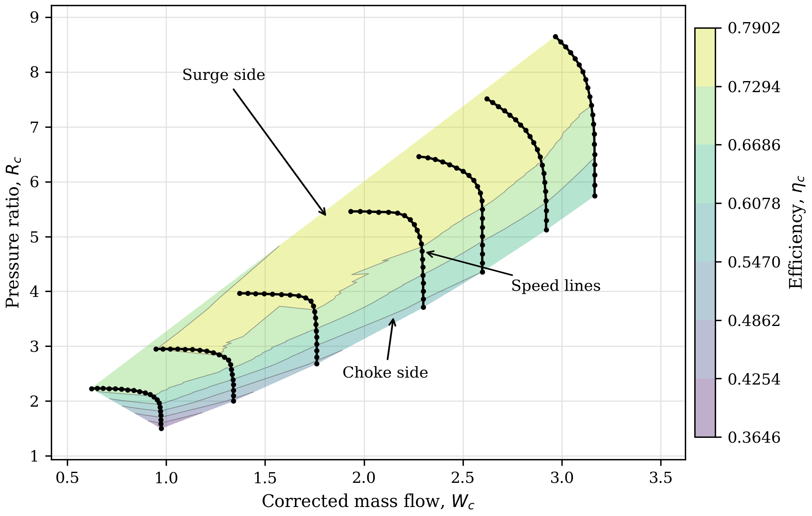
Compressor maps are key for performance modelling
Needed for
Off-design performance
Transient simulation
Control development
But are rarely complete
Full maps are proprietary
Rig tests and CFD are costly
Sparse data near surge and choke
Notes:
• what a map is: Wc vs Rc, one line per speed, efficiency contours
• choke side = vertical end, surge side = stability limit
• needed for: off-design, transients, control
• but: proprietary, costly to test, sparse near surge/choke
• → we work with incomplete maps

Slide 4
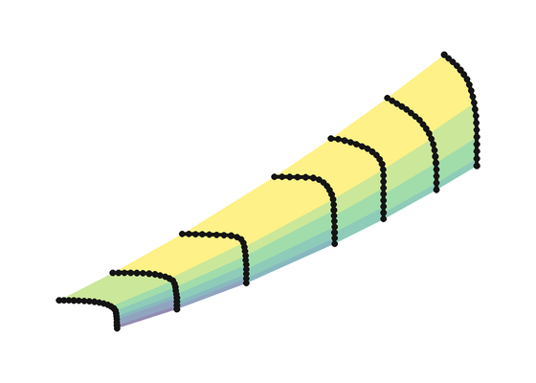
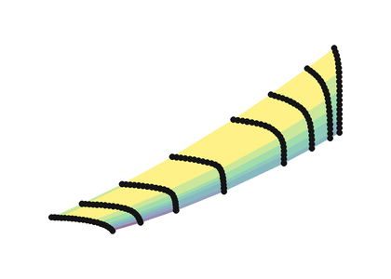
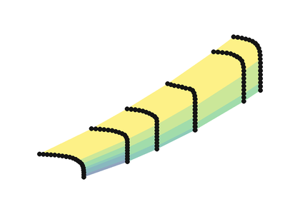
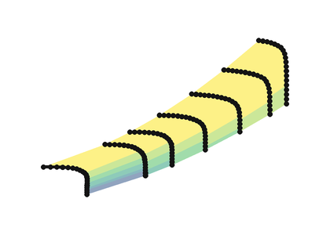
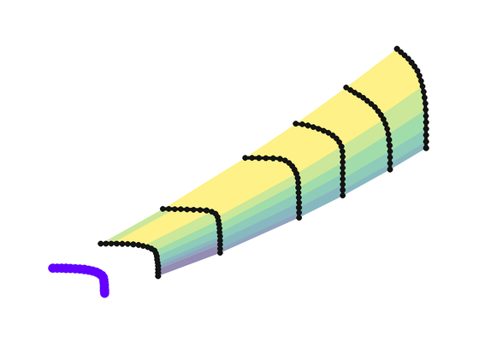
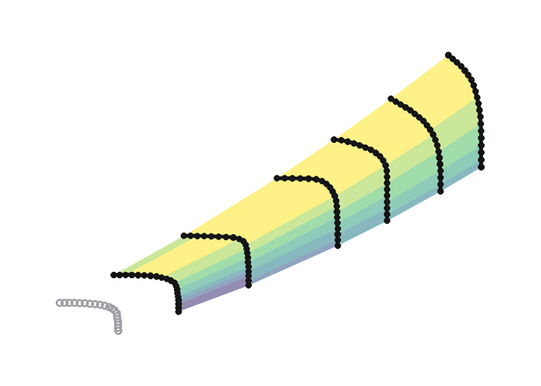
What this work adds: a configurable framework
Prediction using Machine Learning [1–5]
Single map
One fixed model
Prediction for that map only
one map · fills gaps between known points · single output R_{c}, with W_{c} assumed known → data leakage [5]
This work: configurable framework
Support maps
Support maps
β
Features
Model
multi-output: W_{c}, R_{c}, η_{c}
…
…
…
…
reconstructed target
+
3 nearest
arc length
shape
ExtraTrees
…
…
…
…
Target map
Selected options from each policy
[1] Ghorbanian & Gholamrezaei 2009 [2] Yu et al. 2007 [3] Ying et al. 2020 [4] Zhong et al. 2023 [5] Ibrahim et al. 2024 (our previous work)
Notes:
• previous ML work: one map, one fixed model, gaps between known points
• usually Rc only → Wc assumed known = leakage
• our approach: support maps + incomplete target
• pick one option per policy, per missing-data case
• output: complete missing region, Wc AND Rc, plus efficiency

Slide 5
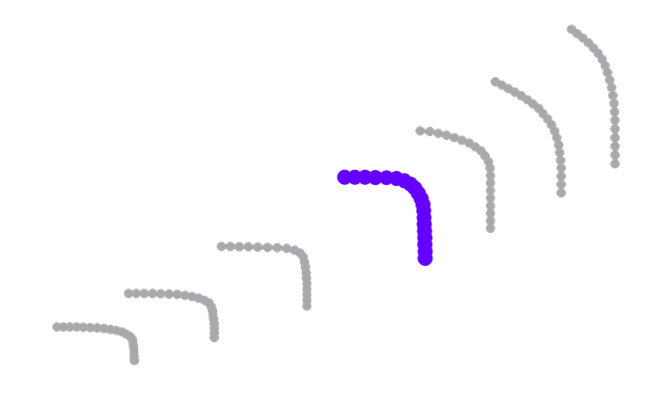
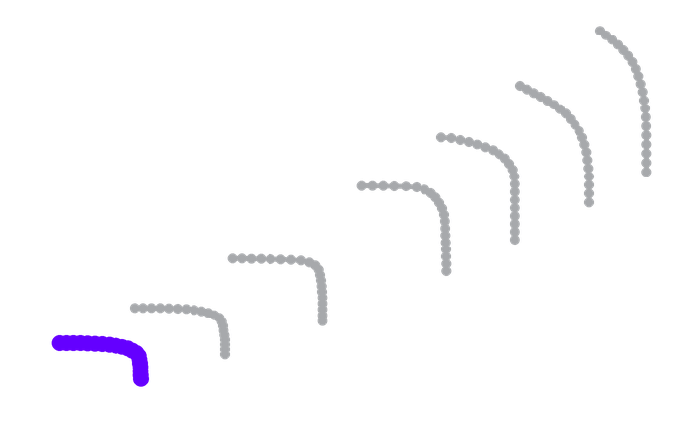

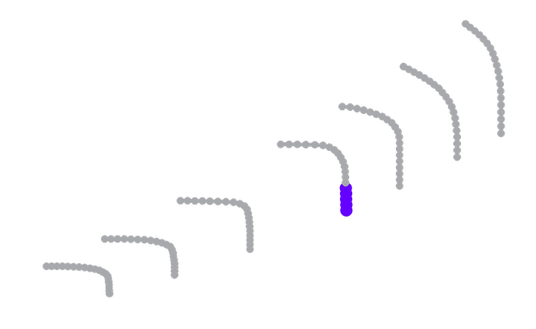
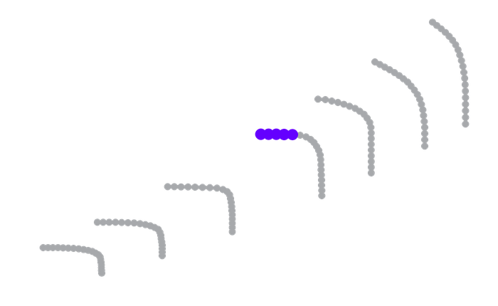
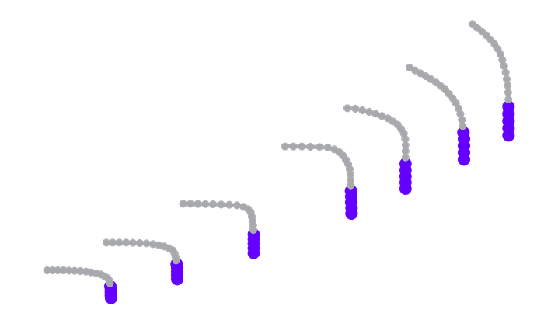
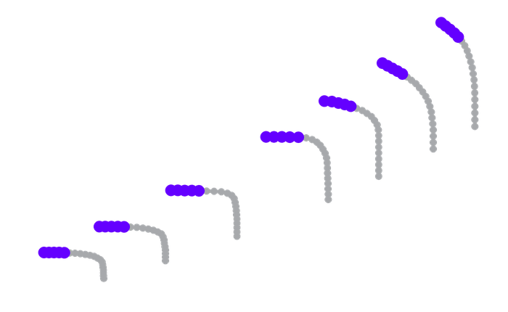
Seven missing-data cases
Missing speed line
visible
hidden: never used in training, baseline prediction, or input features creation
Intermediate
Lower exterior
Upper exterior
Missing region of one speed line
Completely missing boundary region
Choke end
Surge end
Full choke
Full surge
Notes:
• 7 controlled cases on Acp_4001; purple = hidden
• family 1: whole speed line (intermediate / lower / upper)
• family 2: choke or surge end of ONE line
• family 3: whole boundary, all lines
• hidden points never used anywhere

Slide 6
A configurable framework: one option from each policy
Selected for each missing-data case and prediction target (W_{c}–R_{c} geometry or η_{c} surface)
Support maps
β definition
Feature set
Model
Target only
Uniform
Shape
Linear
1 map
Arc length
Direction
Ridge
3 nearest
Mass-flow progress
Full
ExtraTrees
5 nearest
Bend anchored
Random Forest
All
Endpoint step
Gradient Boosting
GPR
+ hyperparameter selection per model
Notes:
• for each case + target quantity, pick one option per policy
• support maps: none → all
• β definition: 5 options
• feature set: shape / direction / full
• model + hyperparameters
• → not one universal model

Slide 7
Prediction workflow
1
2
3
4
5
6
7
8
Baseline
Support maps
β coordinate
Features
Models
Geometry prediction
Efficiency prediction
Evaluation
from visible data
ranked by similarity
Map data point position
input sets
+ tuning
W_{c}, R_{c}
(speed line shape)
η_{c}
(surface contours)
configuration selection
Policy selection
customizable per missing data case
Notes:
• roadmap for the rest of the talk
• 1 baseline → 2-5 policy selection (customisable)
• 6 geometry = speed-line shape (Wc, Rc)
• 7 efficiency = surface / contours
• 8 evaluation + configuration choice

Slide 8
Predict baseline first, then learn only the correction
Baseline
›
Support maps
›
β coordinate
›
Features
›
Models
›
Geometry
›
Efficiency
›
Evaluation
original speed
N_{c} = 95%
missing speed
baseline: linear interpolation
residual learned by the model
N_{c} = 90%
Model target: residual learning
ΔW_{c,z} = (W_{c} − W_{c,0}) / σ_{W,vis}
N_{c} = 80%
ΔR_{c,z} = (R_{c} − R_{c,0}) / σ_{R,vis}
Prediction = baseline + residual
W_{c,0}, R_{c,0}: baseline values
σ_{vis}: standard deviations calculated from the visible points
z: standardised quantity
Notes:
• example: 90% line hidden between visible 80% and 95%
• baseline = linear interpolation in speed, point by point
• outer lines → extrapolation; surge/choke → extend local direction
• grey = hidden truth
• model learns only the residual (standardised)
• prediction = baseline + residual

Slide 9
Where the maps come from
Baseline
›
Support maps
›
β coordinate
›
Features
›
Models
›
Geometry
›
Efficiency
›
Evaluation
GasTurb
8 radial maps
20
Acp_4001
component map collection,
maps from open literature
1 target + 7 candidate
support maps
points per speed line,
1300 points in total
target map and case study
(AGARD CP 400)
Candidate support maps
ASME-94-GT-73
Pep82r15
Rad1kg
RadComp9-AIAA-79-1159
RadComp10-AIAA-79-1159
T100rad
T800_c
Different sizes and operating ranges, which is why every map is normalized separately
Notes:
• maps from GasTurb collection, open-literature sources
• 8 radial maps: 1 target + 7 support
• 20 points per line, 1300 points
• Acp_4001 = target, used throughout
• very different sizes → normalise each map

Slide 10
Per-map normalization makes maps comparable
Baseline
›
Support maps
›
β coordinate
›
Features
›
Models
›
Geometry
›
Efficiency
›
Evaluation
Raw maps
Per-map z-score
Acp_4001 (target)
x_{z} = (x − μ_{x,vis}) / σ_{x,vis}
support maps
μ, σ: mean and standard deviation of the visible points of that map
Notes:
• raw maps: ranges differ by an order of magnitude
• z-score each map on its visible points
• after scaling the shapes overlap
• model learns scale-free corrections

Slide 11
Support maps are ranked by similarity to the target
Baseline
›
Support maps
›
β coordinate
›
Features
›
Models
›
Geometry
›
Efficiency
›
Evaluation
Policies tested
Target only
1 map
3 nearest
5 nearest
All maps
Map descriptor
Number of speed lines
Speed range and spread
Normalised W_{c}, R_{c} and η_{c} spans
Mean slope and curvature of the speed lines
  Descriptors are standardized and maps are ranked by Euclidean distance to the target
Notes:
• descriptor per map: lines, speed range/spread, spans, slope, curvature
• standardise descriptors, rank by distance to target
• 3 nearest here: Rad1kg, ASME-94-GT-73, Pep82r15
• full-region cases: descriptor from visible part only
• policies tested: target only → all maps

Slide 12
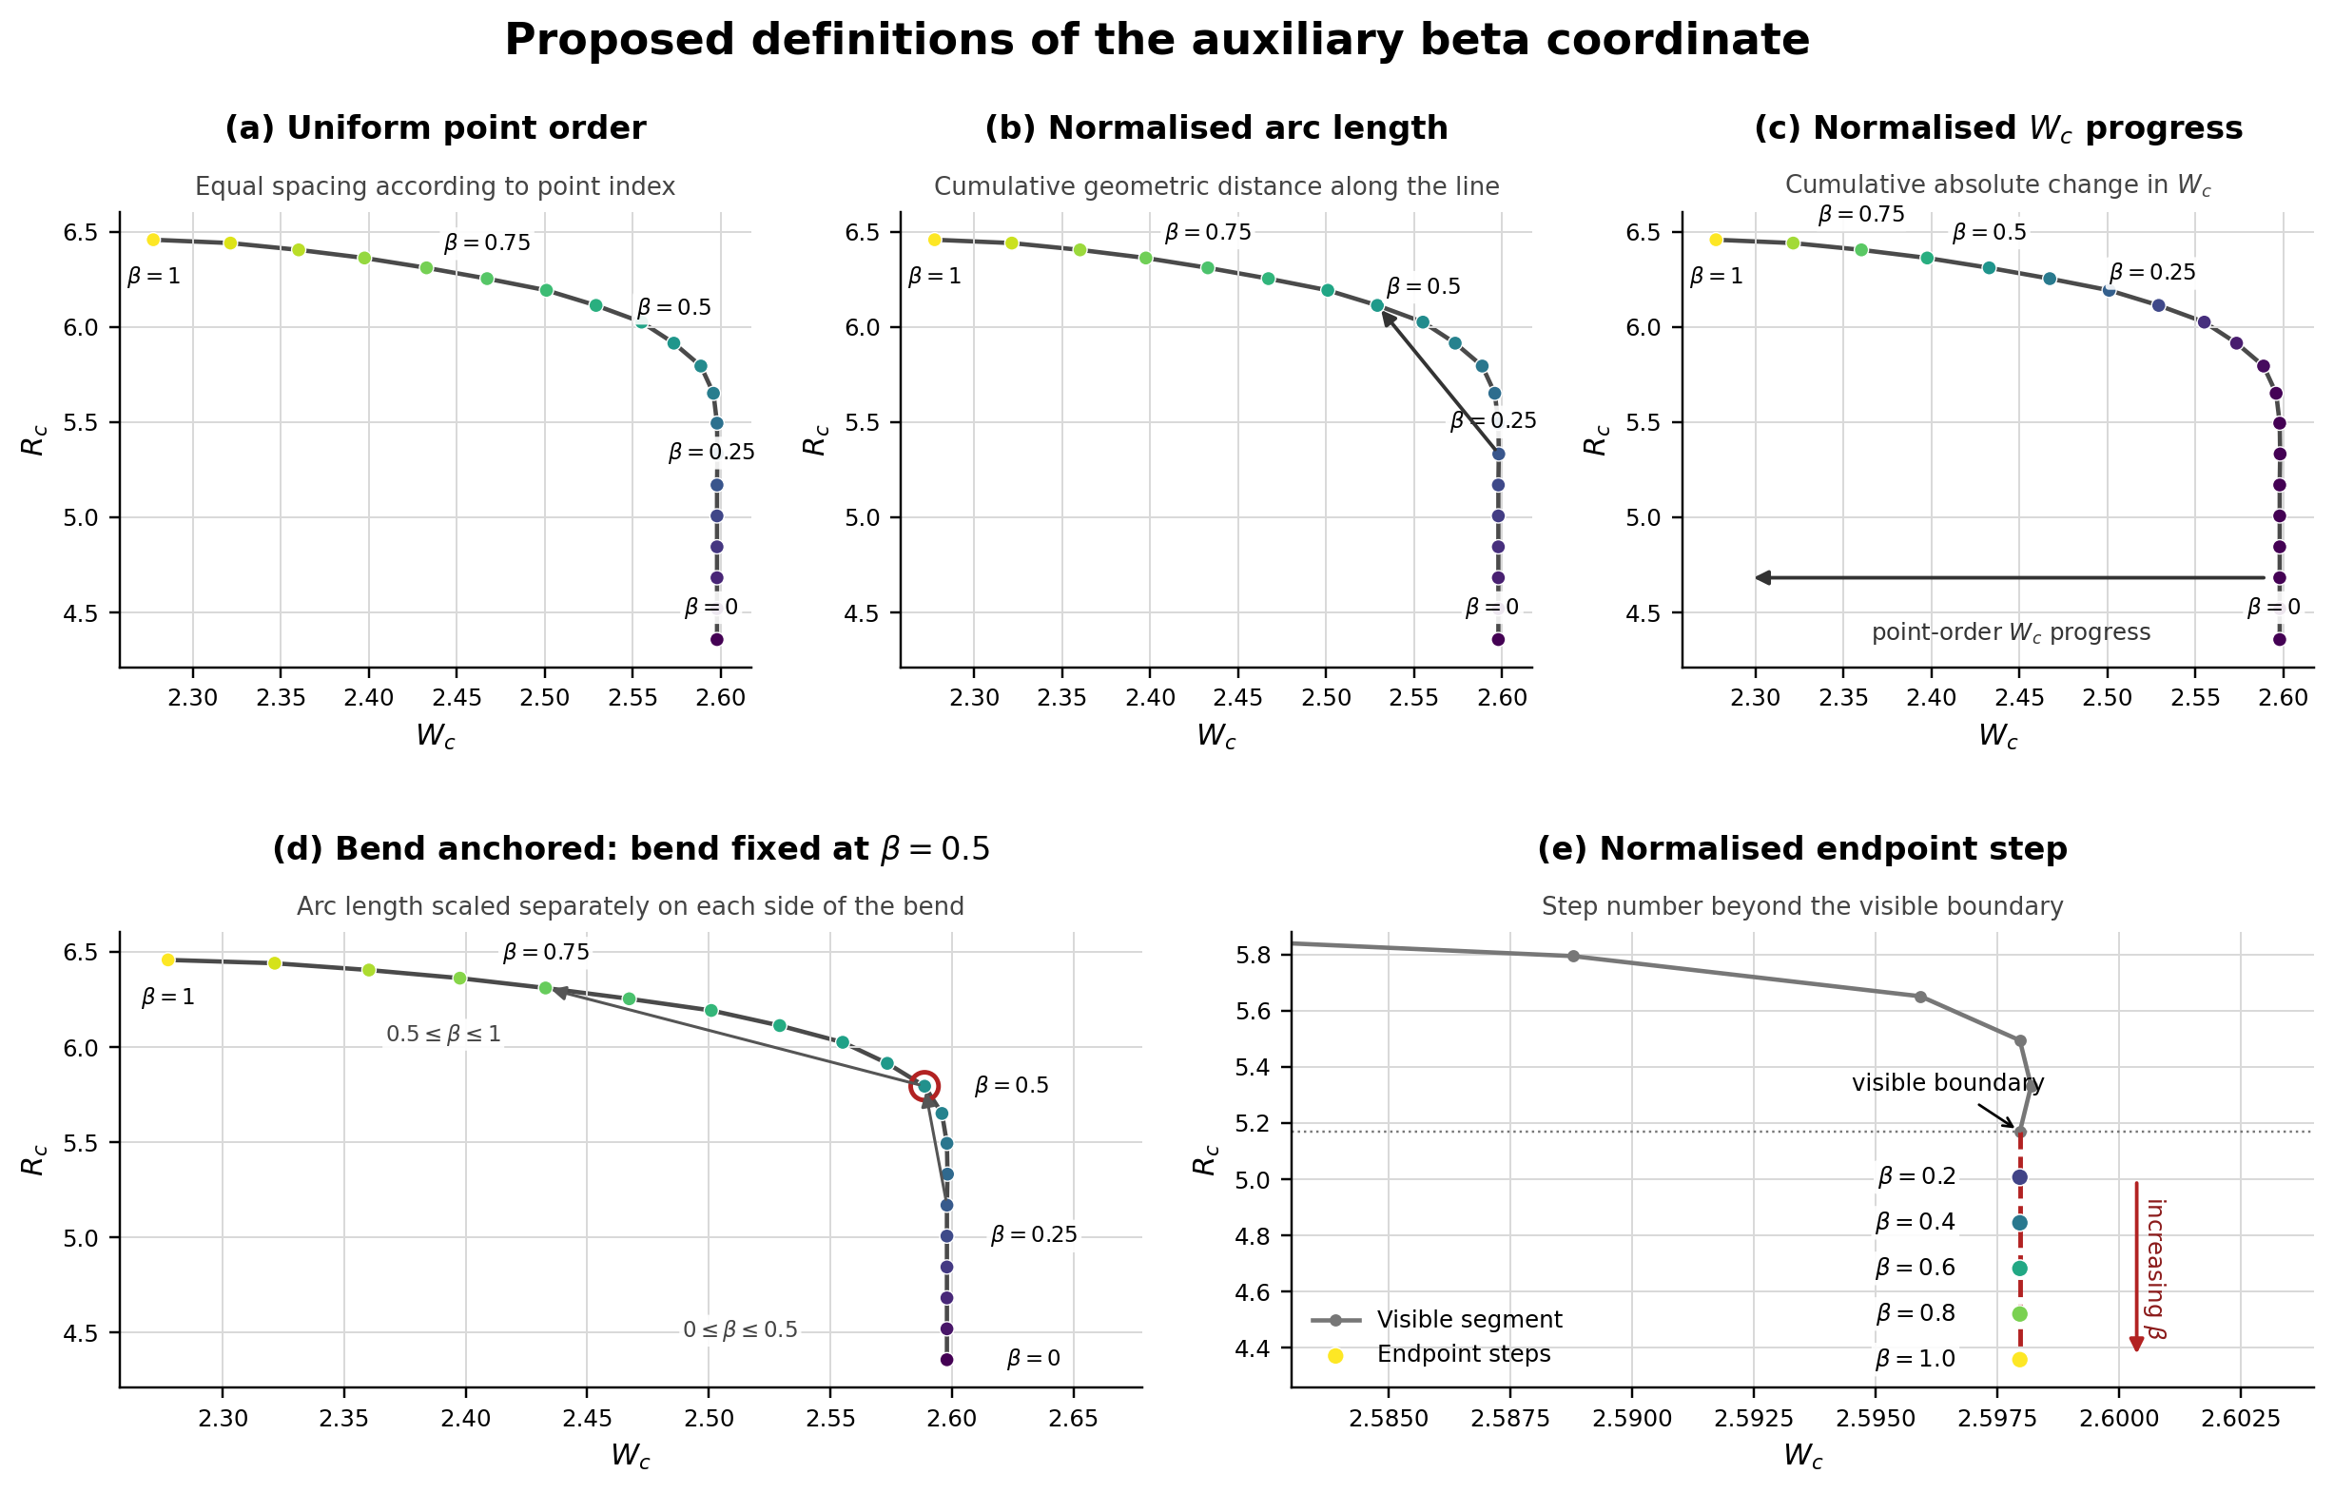
β tells the model where a point sits on the speedline
Baseline
›
Support maps
›
β coordinate
›
Features
›
Models
›
Geometry
›
Efficiency
›
Evaluation
When we look at a map, we easily notice shapes, but a model mainly sees a numeric table.
To give the model info on map shape, we introduce β values.
β = position along the line
Example (a): β=0 at choke, and β=1 at surge, indicates missing point position
From visible data only
Computed on the baseline, so it exists when target points are hidden
5 possible definitions. Best definition is selected per missing data case
Notes:
• we see shapes, the model sees numbers
• near surge/choke Rc(Wc) is multi-valued → need position along the line
• β = 0 at choke end, 1 at surge end
• computed from the visible baseline → available when points are missing
• 5 definitions, selected per case

Slide 13
Input features
Baseline
›
Support maps
›
β coordinate
›
Features
›
Models
›
Geometry
›
Efficiency
›
Evaluation
Feature | Information given to the model | Shape | Direction
N_{c,rel}, N_{c,z} | Target speed relative to the visible speeds | ● | ●
β, β² + β(1−β) in Shape | Position along the predicted line | ● | ●
W_{c,0,z}, R_{c,0,z} | Baseline point before correction | ● | ●
W′₀, R′₀ | Local change along the baseline | ●
s₀, κ₀ | Local slope and curvature of the baseline | ●
Boundary point | Last visible point next to the gap |  | ●
Direction vector | Direction in which the line is extended |  | ●
Map descriptors | Spans of W_{c}, R_{c}, and N_{c}, and number of original speeds | only in the Full variant
Missing speed lines:
Surge / choke completion:
Shape 11 inputs
or
Full = Shape + 4 descriptors 15
Direction 10 inputs
or
Full = Direction + 4 descriptors 14
Notes:
• all sets: target speed + β terms + baseline point
• shape set adds local derivatives, slope, curvature (11)
• direction set adds boundary point + extension direction (10)
• full = + 4 map descriptors (15 / 14)
• feature set is part of the per-case selection

Slide 14
Candidate models and hyperparameter tuning
Baseline
›
Support maps
›
β coordinate
›
Features
›
Models
›
Geometry
›
Efficiency
›
Evaluation
Linear
Tree ensembles
Kernel
Linear regression
ExtraTrees
Gaussian process
Ridge
Random Forest
Gradient Boosting
Hyperparameters tuned per case
no. of trees
feature subsampling
leaf size
depth
learning rate
regularisation
kernel
Notes:
• linear references vs tree ensembles vs kernel
• same model predicts both Wc and Rc residuals
• hyperparameters tuned per case
• training examples: hide known regions of training maps

Slide 15
Efficiency: surface prediction allows using simpler methods
Baseline
›
Support maps
›
β coordinate
›
Features
›
Models
›
Geometry
›
Efficiency
›
Evaluation
Approach A
Approach B
Common RBF surface
Case-wise prediction
η_{c} = f_{RBF}(N_{c}, β)
η_{c} = η_{c,0} + residual
Visible target efficiency only: no baseline, no support maps
+ Simple, same set-up for all cases
+ Accurate when interpolating
− Extrapolates poorly when a boundary is missing
Same baseline and policy selection as in geometry prediction
+ Better when extrapolating
− Needs its own configuration per case
Notes:
• efficiency is a smooth surface → simpler method can work
• A: RBF surface on visible efficiency only (no baseline, no support maps)
• A is good interpolating, poor when a boundary is missing
• B: case-wise = same baseline + policy selection as geometry
• efficiency paired with predicted geometry afterwards

Slide 16
How errors are measured
Baseline
›
Support maps
›
β coordinate
›
Features
›
Models
›
Geometry
›
Efficiency
›
Evaluation
Geometry (W_{c}, R_{c})
Efficiency (η_{c})
RMSE per withheld speed line or endpoint segment
Computed separately for R_{c} and W_{c}, then averaged per case
Ranking score:
    S_{geom} = ½ (RMSE_{Rc} + RMSE_{Wc})
RMSE per withheld speed line or endpoint segment
Only η_{c}, so nothing to combine; averaged per case
Ranking score:
    mean η_{c} RMSE
RMSE = √( mean (y − ŷ)² ) over the hidden points
Notes:
• geometry: RMSE per withheld line/segment, Rc and Wc separately, averaged
• ranking score = mean of the two (ranking only)
• efficiency: single output → mean ηc RMSE is the score
• no hidden Wc used as input
• caveat: configurations ranked with the answer key → best case (see limitations)

Slide 17
Results
Acp_4001 case study
Notes:
• results section: all on Acp_4001

Slide 18
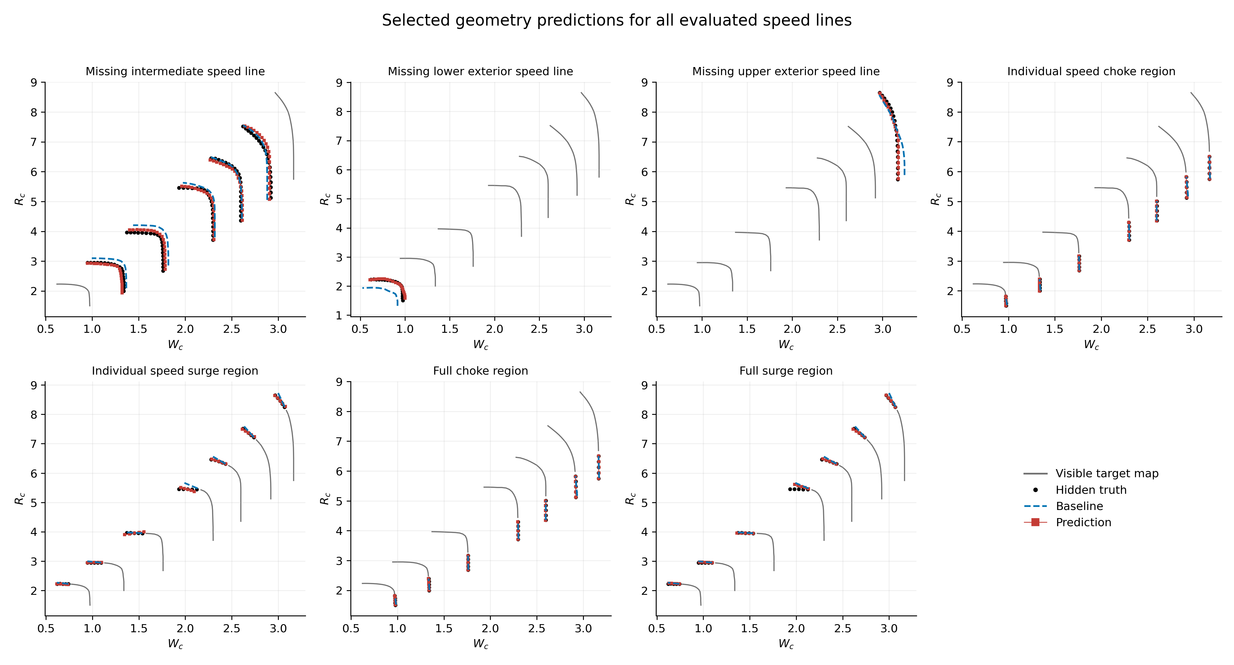
W_{c} and R_{c} prediction: all seven missing-data cases
Notes:
• selected predictions, all seven cases
• black = hidden truth, dashed = baseline, red = prediction
• line cases overlay separate masking runs; full-region = one removal

Slide 19
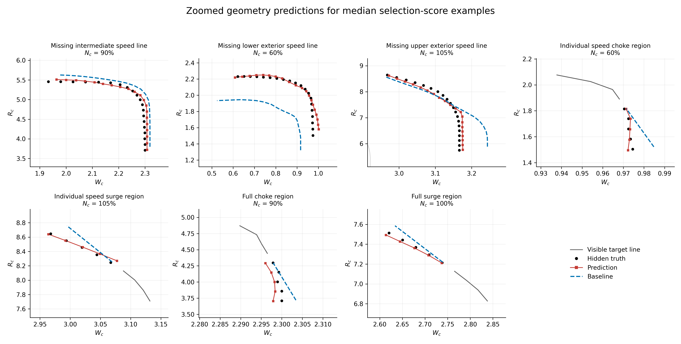
W_{c} and R_{c} prediction: one example per case
Median score is used to select the zoomed-in result for each missing-data case
Notes:
• one representative example per case (median score = typical, not best)
• biggest correction: lower exterior line
• endpoint cases: small errors, visible part anchors the baseline

Slide 20
Residual learning reduces geometry error in all cases
−46 to 90%
R_{c} RMSE vs baseline
−30 to 81%
W_{c} RMSE vs baseline
Notes:
• baseline vs selected configuration, per case
• Rc error down 46-90%, Wc down 30-81%
• largest gain lower exterior (0.30 → 0.03)
• smallest Wc gain: full surge region

Slide 21
Best configuration selection depends on missing data case
Case | Support maps | β definition | Features | Model | η_{c} method
Intermediate speed line | All | Bend anchored | Full | ExtraTrees | RBF
Lower exterior speed line | 3 nearest | Uniform | Shape | ExtraTrees | Case-wise
Upper exterior speed line | 3 nearest | Mass-flow progress | Shape | ExtraTrees | Case-wise
Choke end of one line | 3 nearest | Endpoint step | Full | ExtraTrees | Case-wise
Surge end of one line | Target only | Endpoint step | Full | Linear | RBF
Full choke region | All | Endpoint step | Direction | Linear | Case-wise
Full surge region | 1 support map | Endpoint step | Full | ExtraTrees | Case-wise
Notes:
• selected configuration differs per case
• intermediate uses all maps; exterior cases 3 nearest
• surge end of one line: target map only + linear regression
• ExtraTrees 5 cases, linear 2

Slide 22
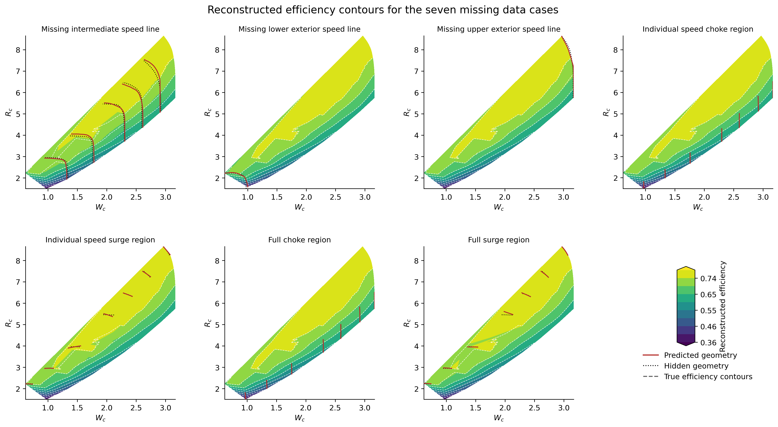
Efficiency results: reconstructed contours
Notes:
• reconstructed efficiency contours, visible data + prediction
• red = predicted geometry, grey dashed = hidden
• contours stay smooth across all cases

Slide 23
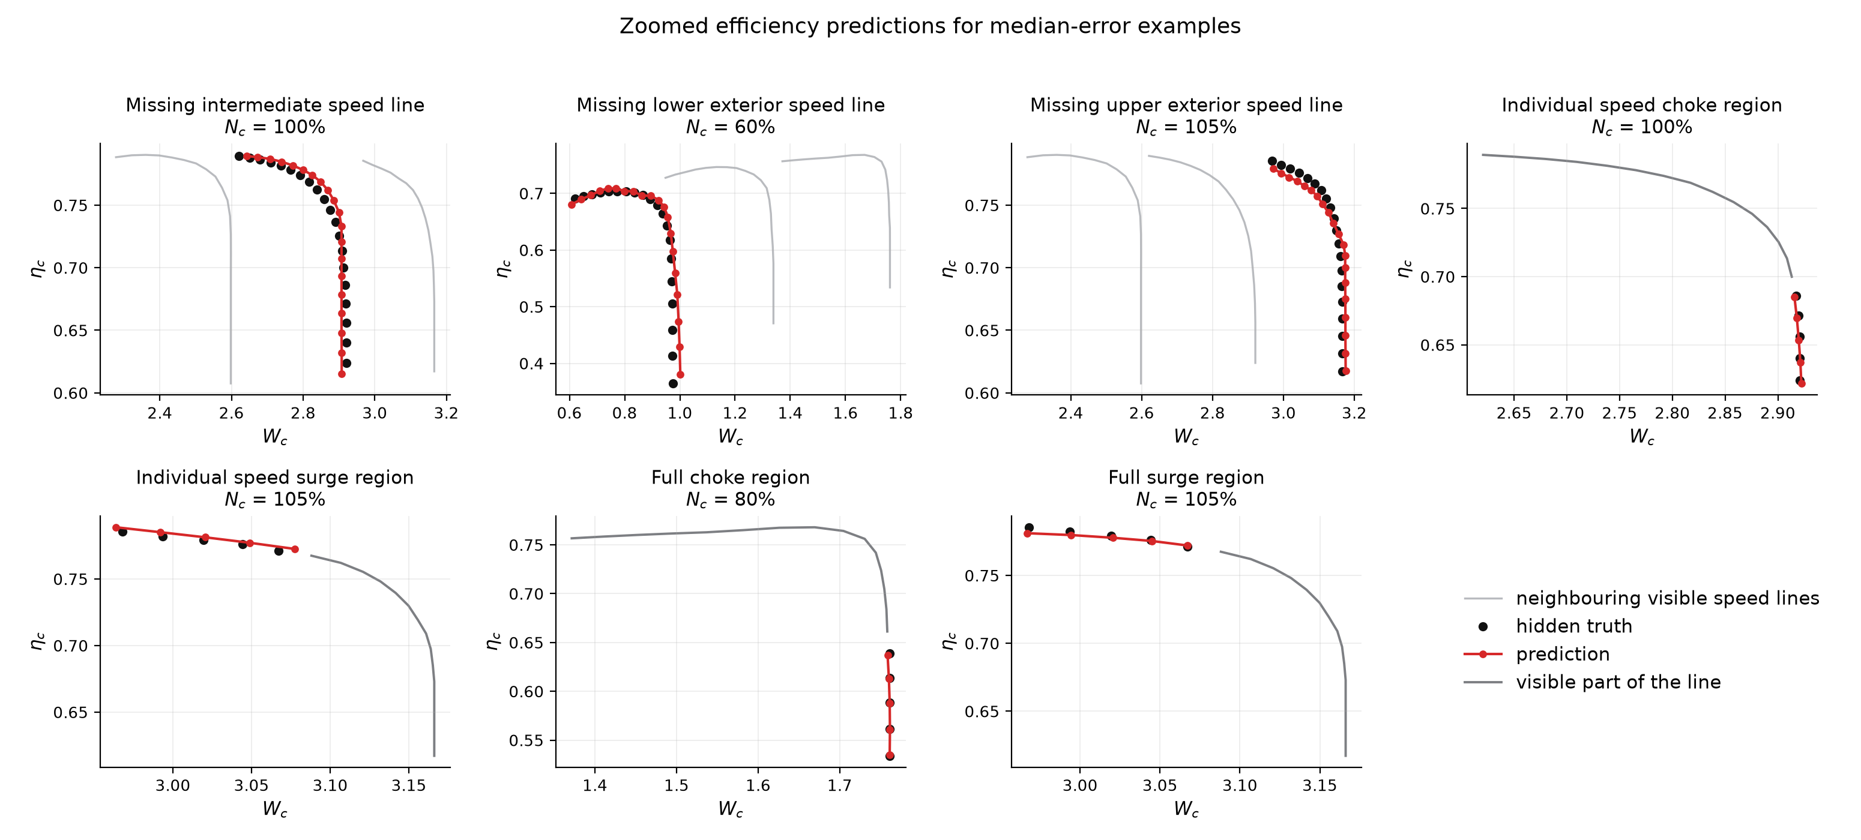
Efficiency prediction: one example per case
Median score is used to select the zoomed-in result for each missing-data case
Notes:
• same zoomed view for efficiency: ηc vs Wc
• black = truth, red = prediction at its predicted Wc
• captures the drop towards choke

Slide 24
Efficiency results: the best method depends on the case
RBF surface is best:
when the gap lies between visible data: intermediate speed line, surge end of one line
Case-wise prediction is best:
when extrapolating: exterior speed lines and whole choke/surge regions
Notes:
• RBF best where the gap sits between visible data (intermediate, surge end)
• case-wise best when extrapolating (exterior lines, whole boundaries)
• full choke: 0.021 → 0.002
• selected method below baseline in every case

Slide 25
Summary
Visible target
+ support maps
Baseline
Policy selection:
maps · β · features · model
Geometry
W_{c}, R_{c}
Efficiency
η_{c}
No leakage
No universal configuration
Residual correction works
Efficiency
hidden points are never used in training, baseline prediction, or input features creation
R_{c} RMSE −46 to 90% W_{c} RMSE −30 to 81% vs baseline
RBF surface when interpolating, Case-wise prediction when extrapolating
support maps, β, features and model depend on the case
Notes:
• framework recap: inputs → baseline → policy selection → geometry → efficiency
• no leakage
• residual correction works in every case
• no universal configuration
• efficiency: simple when interpolating, case-wise when extrapolating

Slide 26
Limitations and next steps
Limitations
Next steps
Tested on radial compressor maps only
No explicit physical constraints near surge and choke
More variations of compressor maps, including axial compressors
Physics constraints near surge and choke
Coherent geometry and efficiency reconstruction: ensuring continuity
Notes:
• radial maps only
• automatic selection = recommendation, not guarantee
• no explicit physics constraints near surge/choke
• next: more maps incl. axial, physics constraints, geometry-efficiency coherence

Slide 27

Thank you!
Happy to take your questions
Connect on LinkedIn
linkedin.com/in/heba-yy
ISABE 2026 | Youssef, Pieyre & Jhinaoui | Technology Innovation Institute
Notes:
• thank you + questions
• QR = LinkedIn

Slide 28
Appendix

Slide 29
Appendix: geometry errors per case
Case | R_{c} baseline | R_{c} selected | Reduction | W_{c} baseline | W_{c} selected | Reduction
Intermediate speed line | 0.1689 | 0.0643 | 61.9% | 0.0344 | 0.0176 | 48.9%
Lower exterior speed line | 0.2975 | 0.0300 | 89.9% | 0.0640 | 0.0120 | 81.3%
Upper exterior speed line | 0.1123 | 0.0521 | 53.6% | 0.0429 | 0.0086 | 80.0%
Choke end of one line | 0.0093 | 0.0037 | 59.5% | 0.0037 | 0.0015 | 60.0%
Surge end of one line | 0.0515 | 0.0198 | 61.5% | 0.0121 | 0.0072 | 40.5%
Full choke region | 0.0093 | 0.0050 | 45.8% | 0.0037 | 0.0017 | 54.9%
Full surge region | 0.0515 | 0.0229 | 55.5% | 0.0121 | 0.0085 | 30.0%
Notes:
• backup: per-case geometry errors and reductions

Slide 30
Appendix: efficiency errors per case
Case | Visible baseline | RBF surface | Case-wise prediction | Selected
Intermediate speed line | 0.0087 | 0.0046 | 0.0049 | RBF
Lower exterior speed line | 0.0185 | 0.0249 | 0.0105 | Case-wise
Upper exterior speed line | 0.0147 | 0.0134 | 0.0042 | Case-wise
Choke end of one line | 0.0106 | 0.0111 | 0.0023 | Case-wise
Surge end of one line | 0.0080 | 0.0025 | 0.0047 | RBF
Full choke region | 0.0106 | 0.0206 | 0.0020 | Case-wise
Full surge region | 0.0080 | 0.0141 | 0.0040 | Case-wise
Notes:
• backup: per-case efficiency errors, selected method

Slide 31
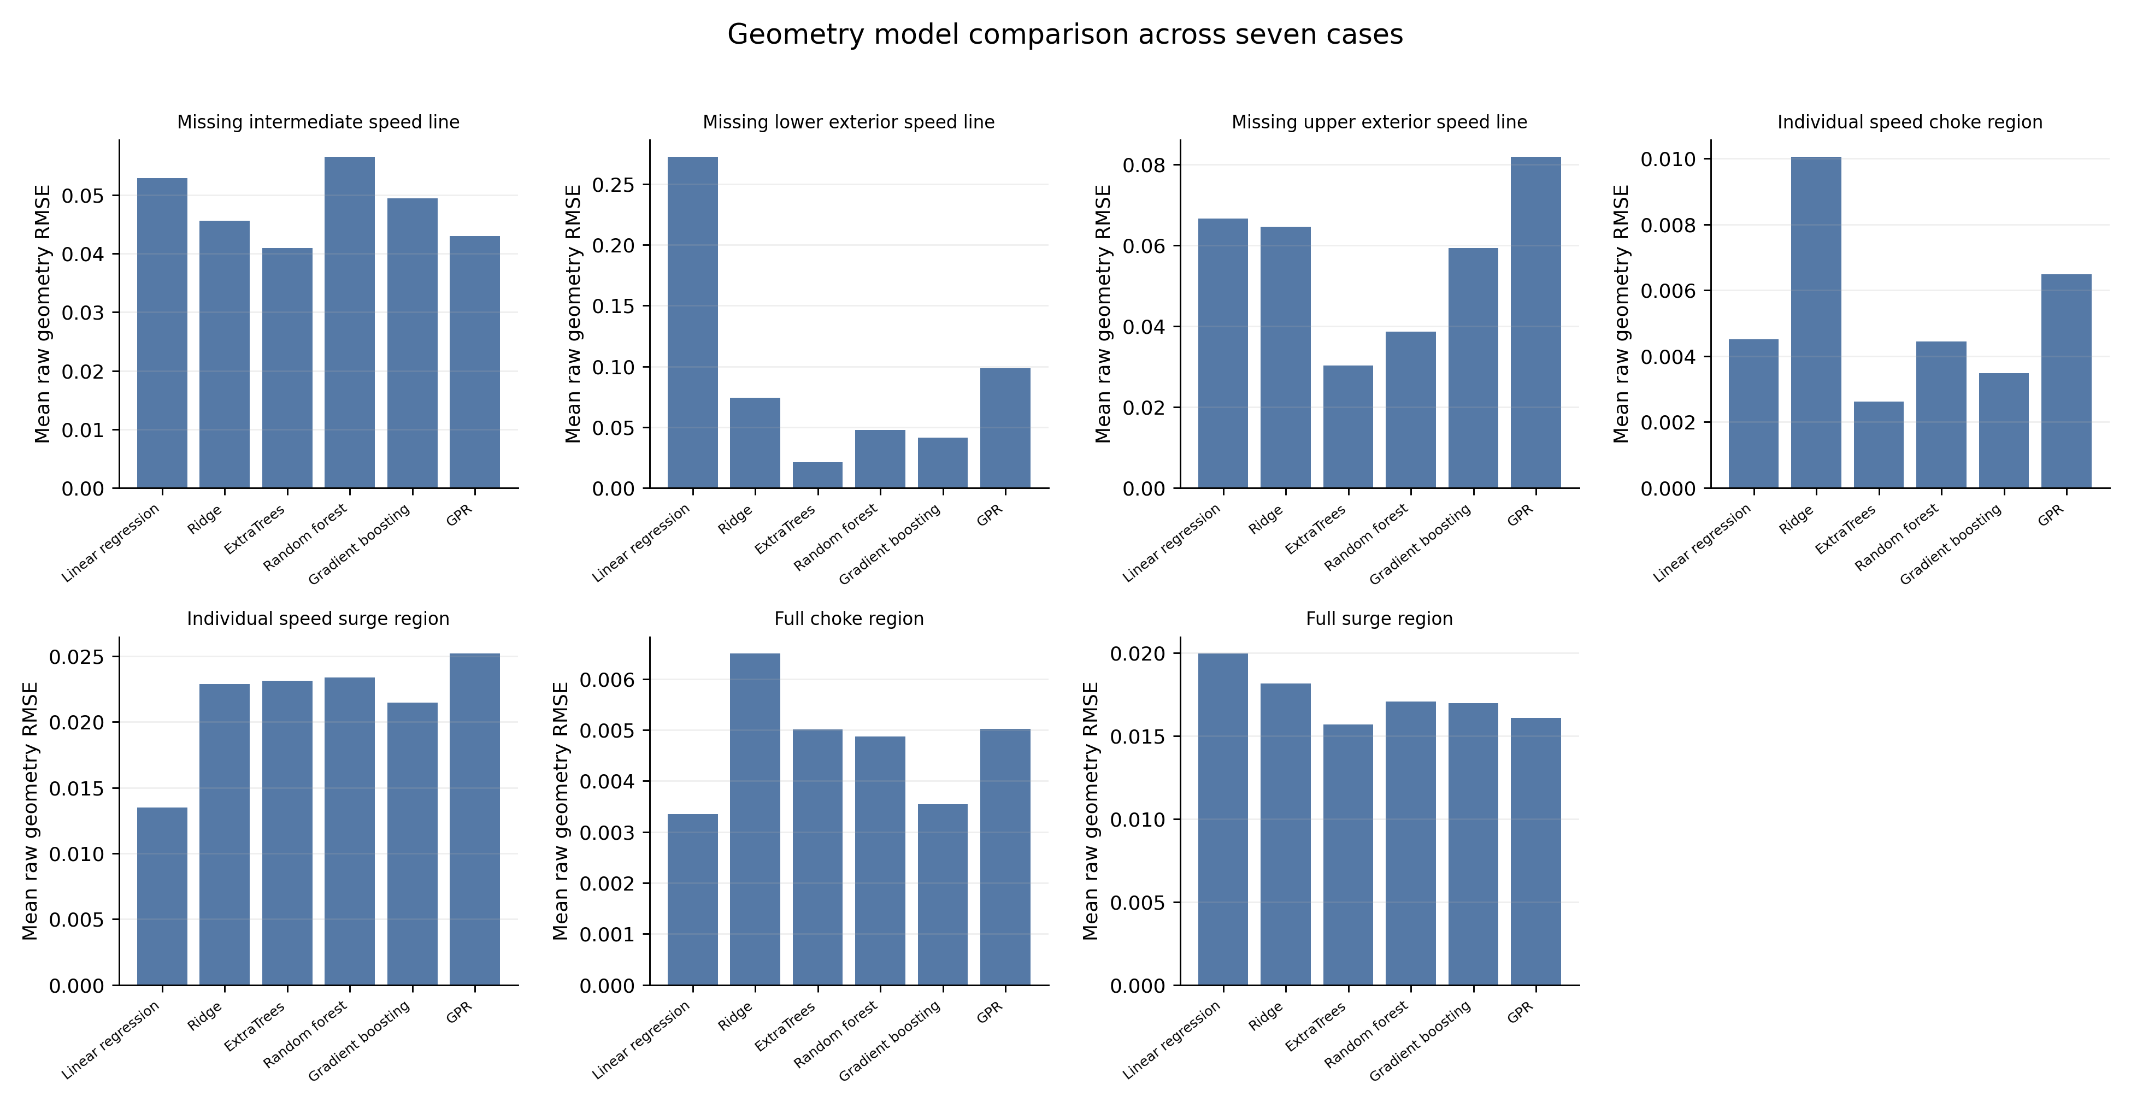
Appendix: model comparison per case
Notes:
• backup: model comparison per case

Slide 32
Appendix: automated configuration selection
Case | R_{c}, picked with target truth | R_{c}, picked with support maps only | W_{c}, picked with target truth | W_{c}, picked with support maps only
Lower exterior speed line | 0.0300 | 0.0315 | 0.0120 | 0.0133
Intermediate speed line | 0.0643 | 0.0868 | 0.0176 | 0.0193
Upper exterior speed line | 0.0521 | 0.2603 | 0.0086 | 0.0267
Picked with target truth (paper results): every configuration is scored against the true values of the removed Acp_4001 points, and the best one is kept. Not possible for a real incomplete map, so this is a ideal case.
Picked with support maps only: the same kind of region is removed from each support map, where the true values are known. Configurations are scored there, and the winner is applied to Acp_4001.
Notes:
• backup: picking the configuration with vs without the target truth

