Slide 1
New York Taxi Fare Prediction

Slide 2

<number>
Presented By:
Abd-ElRhman Sobhy Fatema Khalid Feryal Hisham
Heba Ahmed

Slide 3
<number>
Business Value
Customers
Drivers

Slide 4
<number>
Project Pipeline
Data Cleaning And Exploration
Models Trials
Model Selection
Feature Engineering
Model Tuning
Final Results

Slide 5
<number>
Data Cleaning and Exploration

Slide 6
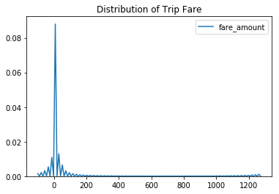
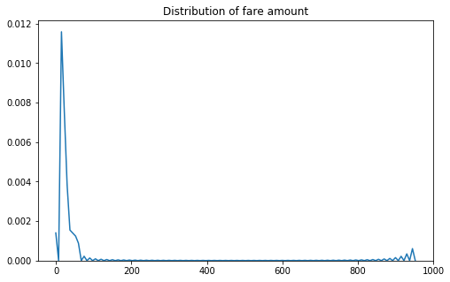
<number>
Fare Amount Negative Values

Slide 7
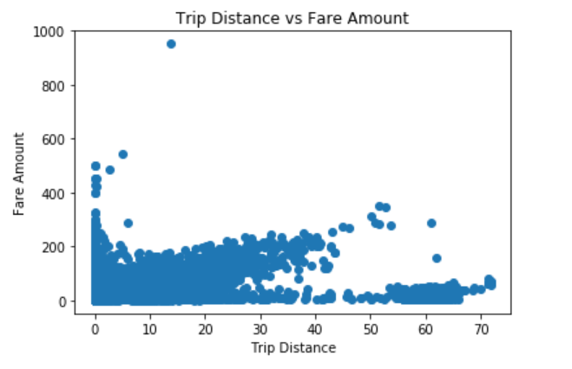
<number>
Distribution of Trip Distance

Slide 8
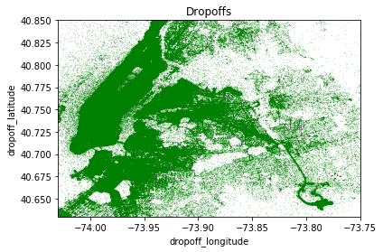
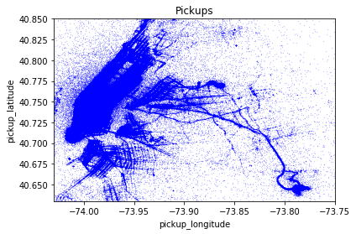
<number>
Geographical Trips Distribution

Slide 9
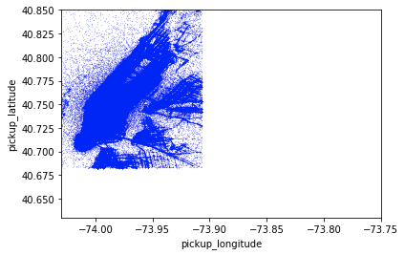
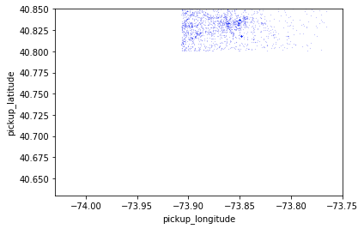
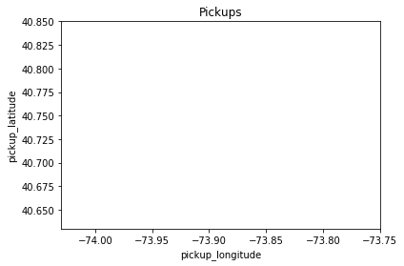
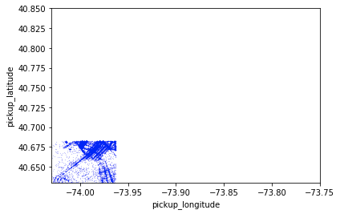
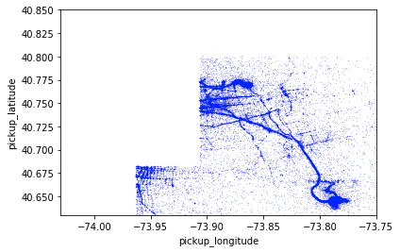
<number>
Geographical Trips Distribution(cont.)
Manhatten
Bronx
Brooklyn
Queens

Slide 10
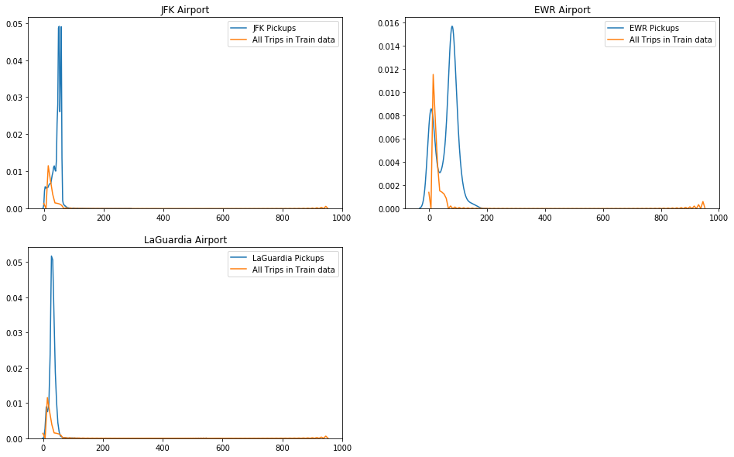
<number>
AirPorts & Pickups Relations

Slide 11
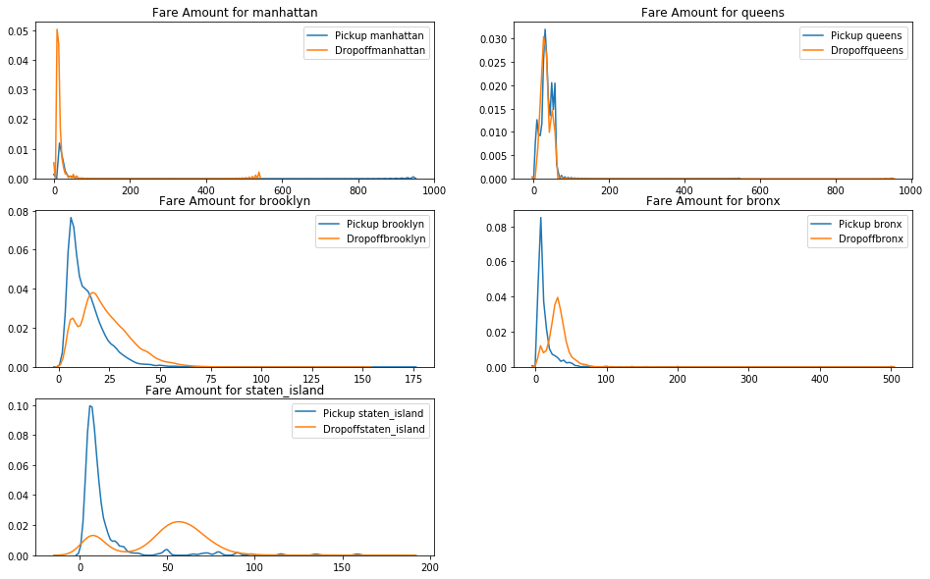
<number>
Boroughs comparison

Slide 12
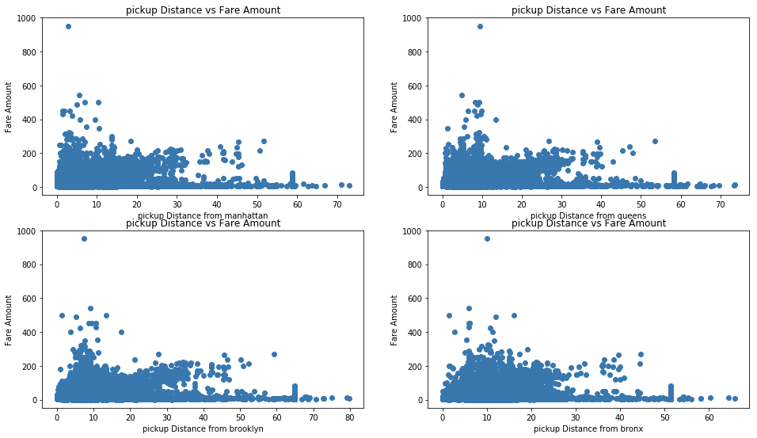
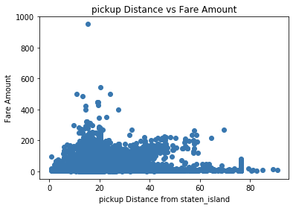
<number>
Distance to the center Vs. Fare Amount

Slide 13
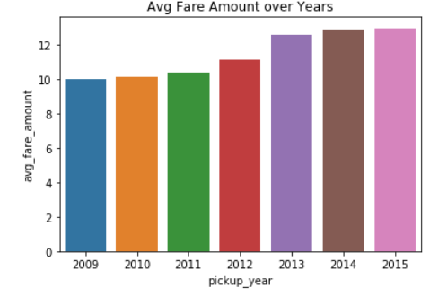
<number>
Distribution of Pickup date time

Slide 14
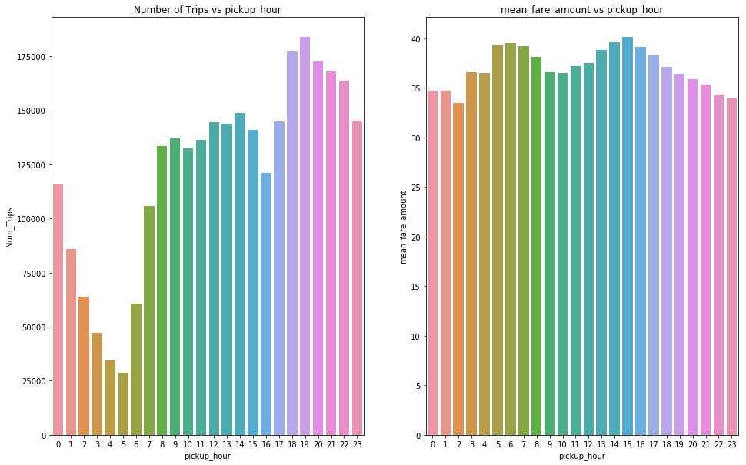
<number>
Distribution of Pickup date time

Slide 15
<number>
Models Trials
1. Baseline Model
Just calculating the average fare amounts.
Any model we build should have an RMSE lower than the baseline model’s RMSE which is 9.71.
2. Linear Regression
It identifies a line that best fits the data.
The test RMSE for Linear Regression model was 8.14, and the training RMSE was 8.20.

Slide 16
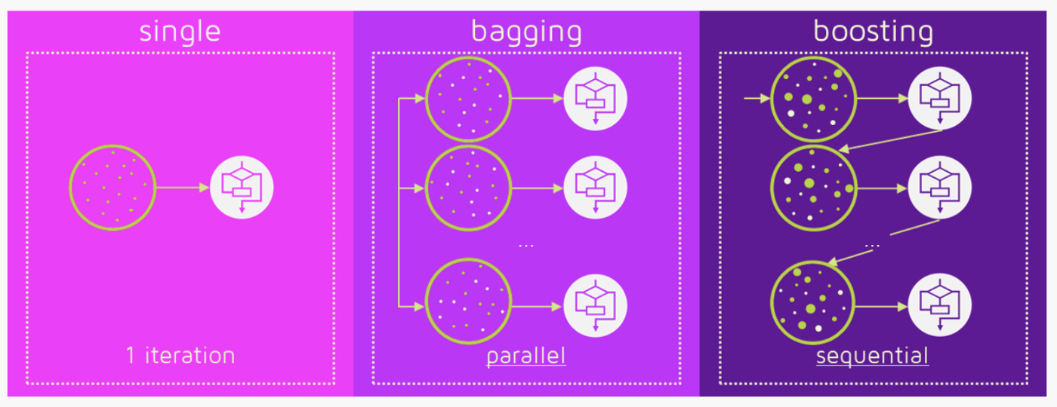
<number>
Brief Description For Ensemble
Ensemble is just a collection of predictors which come together to give a final prediction.
Ensembling techniques are further classified into Bagging and Boosting.

Slide 17
<number>
Models Trials(cont.)
3. Random Forest Model
It is an example of bagging ensemble.
In Random Forest, multiple decision trees are created, and the output is the average prediction by each of these trees.
The test RMSE was 3.83, and the training RMSE was 3.27.
4. Light GBM Model
Light GBM is based on boosting method.
It is a variation of the Gradient Boosting Decision Trees in which the decision trees are trained iteratively.
The test RMSE was 3.55, and the training RMSE was 2.75.

Slide 18
<number>
Models Comparison
Model name | Test RMSE | Train RMSE | Variance
Baseline model | 9.61 | 9.65 | 0.042
Linear Regression | 8.14 | 8.20 | 0.069
Random Forest | 3.82 | 3.27 | -0.54
LightGBM | 3.79 | 3.07 | -0.72
We choose the Light GBM

Slide 19
<number>
Feature Engineering
We added these features:
The distance of the trip.
Whether the pickup or drop was from or to the airport.
Which borough the pickup or drop was from.
The pickup and drop distance from airports.
The pickup and drop distance from each borough.
Whether the pickup or drop was from or to lower_manhattan.
Applying Light GBM model on this feature engineering data resulted in RMSE of 3.54 (drop from 3.79) and a variance of -0.83.

Slide 20
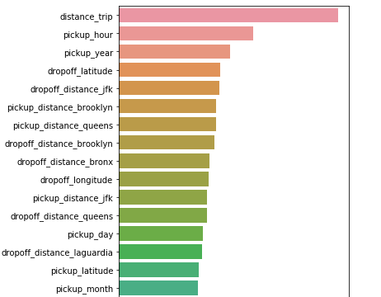
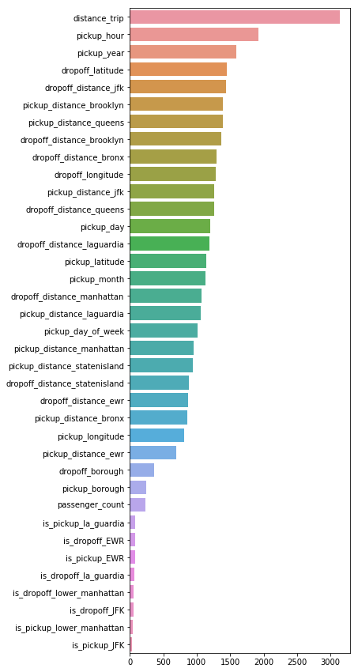
<number>

Slide 21
<number>
Model Tuning
In this phase we optimized some parameters in LightGBM to reduce overfitting:
colsample_bytree.
Subsample.
Max_depth.
num_leaves.
n_estimators.
learning_rate.

Slide 22
<number>
Model Tuning(cont.)
We use Hyperopt which is a search package that implements various search algorithms to find the best set of hyperparameters within a search space.
The objective function is to minimize the RMSE in a LightGBM Regressor
The search space defines the set of values a given parameter can take.
After defining the objective function and the search space, we run 100 trials.
After tuning paramters the LightGBM model resulted in an RMSE of 3.55 and variance of -0.25 (drop from -0.83).

Slide 23
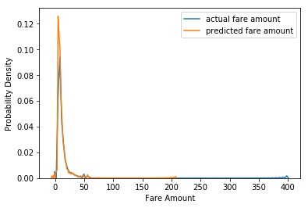
<number>
Final Result
RMSE = 3.55 , Variance = -0.25

Slide 24
<number>
THANKS!
Any questions?

