Slide 1
Modul KickWeb
Images

Slide 2
Lecture
2 hours teaching with 10 min. break in between
2x 10 min. exercises and discussions
Ask questions any time

Slide 3
HTML Tags
<img>
<map>
<area>
<figure>
<figcaption>
<picture>

Slide 4
Image Tag
<img src="url" alt="alternatetext">
<img src="Logo.jpg" alt="Company Logo">
Specifies the path
Path can be relative or absolute
provides an alternate text for an image
Notes:
«src»: It is important to keep the image in the right path, otherwise the browser will show a broken link icon and the «alt» text.
«alt»: It is important, if the user for some reason cannot view the image (because of slow connection, an error in the src attribute, or if the user uses a screen reader).
A screen reader is a software program that reads the HTML code, and allows the user to "listen" to the content. Screen readers are useful for people who are visually impaired or learning disabled.
Who knows the difference between relative and absolute paths?

Slide 5
Relative vs. Absolute File Paths
Absolute Path is the full URL/path to a file
Relative Path points to a file relative to the current page
https://www.w3schools.com/html/html_filepaths.asp
Path | Description
<img src="picture.jpg"> | The "picture.jpg" file is located in the same folder as the current page
<img src="images/picture.jpg"> | The "picture.jpg" file is located in the images folder in the current folder
<img src="/images/picture.jpg"> | The "picture.jpg" file is located in the images folder at the root of the current web
<img src="../picture.jpg"> | The "picture.jpg" file is located in the folder one level up from the current folder

Slide 6

Image Size
<img src=" Logo.jpg " alt=" Company Logo"
width="100" height="100">
<img src=" Logo.jpg " alt =" Company Logo"
style="width: 100px; height: 100px">
Notes:
Width and Height attributes always in px.
Better to use the style attribute. It prevents style sheets from changing the size of images.
Example: https://www.w3schools.com/html/tryit.asp?filename=tryhtml_images_style

Slide 7
Image as a Link
<a href="home.html">
<img src=" Logo.jpg " alt =" Company Logo"
style="width: 100px; height: 100px "> </a>
Notes:
To use an image as a link, put the <img> tag inside the <a> tag

Slide 8
Image + CSS
img{
vertical-align: bottom/middle/top; /*align*/
float: right/left/none; /*align*/
border:5px solid black; /*border*/
margin: 50px 50px 50px 50px; /*left and right margins*/
display: inline/block;
……..
}
https://www.w3schools.com/css/css3_images.asp
Notes:
Display: inline is default

Slide 9
Image Alignment
Floating
<img src="images/giphy.gif" alt="Smiley face" style="float:right; width:42px; height:42px;">
<img src="images/giphy.gif" alt="Smiley face" style="float:left; width:42px; height:42px;">
Vertical align
<img src="images/giphy.gif" alt="Smiley face"
style="vertical-align:middle; width:42px; height:42px;">
Notes:
Use the CSS float property to let the image float to the right or to the left of a text.

Slide 10
Image Attributes
Attribute | Value | Description
crossorigin | Anonymous use-credentials | Allow images from third-party sites that allow cross-origin access to be used with canvas
ismap | ismap | Specifies an image as a server-side image map
loading | eager lazy | Specifies whether a browser should load an image immediately or to defer loading of images until some conditions are met
longdesc | URL | Specifies a URL to a detailed description of an image
referrerpolicy | no-referrer no-referrer-when-downgrade origin origin-when-cross-origin unsafe-url | Specifies which referrer information to use when fetching an image
srcset | URL-list | Specifies a list of image files to use in different situations
usemap | #mapname | Specifies an image as a client-side image map
HTML Global Attributes
HTML Event Attributes

Slide 11
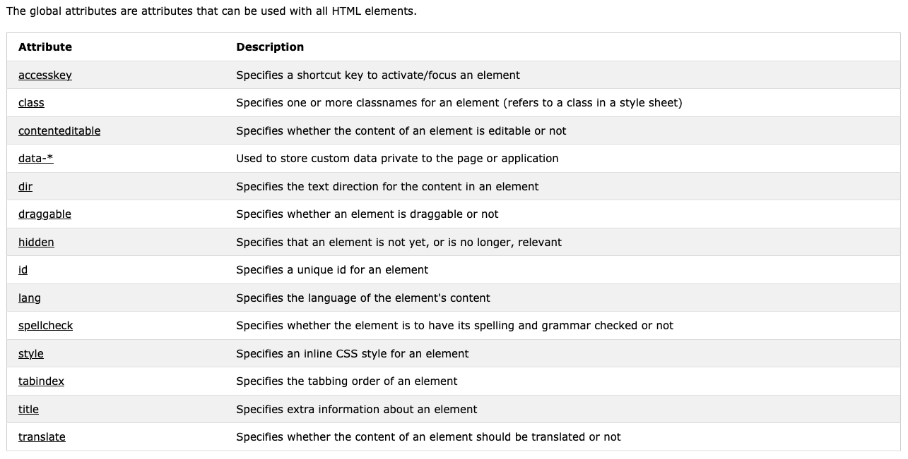
HTML Global Attributes
Are attributes that can be used with all HTML elements.

Slide 12
HTML Event Attributes
Window Event Attributes
Form Events
Keyboard Events
Mouse Events
Drag Events
Clipboard Events
Media Events
https://www.w3schools.com/tags/ref_eventattributes.asp
Notes:
Events triggered for the window object (applies to the <body> tag) ex: onload, onerror, onunload … etc
Events triggered by actions inside a HTML form (applies to almost all HTML elements, but is most used in form elements) ex: onreset, onsearch, onsubmit … etc.
Onkeydown, onkeypress, onkeyup
Onclick, onmousedown, onmousemove … etc.
Ondrag, ondragend, ondrop, onscroll … etc.
Oncopy, oncut, onpaste
Events triggered by medias like videos, images and audio (applies to all HTML elements, but is most common in media elements, like <audio>, <embed>, <img>, <object>, and <video>) ex: onplay, onabort, onpause … etc.

Slide 13
Image Formats
Joint Photographic Expert Group (.jpg, .jpeg)
Graphics Interchange Format (.gif)
Portable Network Graphics (.png)
Scalable Vector Graphics (.svg)
Microsoft Icon (.ico, .cur)
Notes:
Difference between the formats
Jpeg has 16Million colors, famous of the small size of its files because of its loosy format, it compresses by throwing away information. So it reduces file size by dropping colors from images, and averaging colors in adjacent pixels.
Gif has only 256 colors and supports transparency (all on or all off), Animated gifs
PNG images support translucency, with text
SVG is vector based graphics. Usually used for logos. The SVG files are pure XML. They can be searched, indexed, scripted, and compressed, can be printed with high quality at any resolution, zoomable, do NOT lose any quality if they are zoomed or resized.
Ico for favicon
Use JPEG for photos, but don’t overcompress. Use PNG for everything else. SVG for logos

Slide 14
Background Image
div {
background-color: red / #ff0000 / rgb(255,0,0,0.3); /* opacity = 0.3*/
background-image: url("picture.jpg");
background-position: right top / x% y% / xpos ypos / initial / inherit;
background-size: cover / 100% 100%;
background-repeat: repeat–x / repeat-y / norepeat;
background-attachment: fixed / scroll;
}
background: red url("picture.jpg") fixed;
Notes:
background image on the whole page using the body tag or in div
If you are going to use red or #ff0000 format, then you need to define the opacity using opacity tag separatly
Background-position: sets the starting position of the background image.
- If you only specify one keyword, the other value will be "center"
- The first value is the horizontal position and the second value is the vertical. The top left corner is 0% 0%. The right bottom corner is 100% 100%. If you only specify one value, the other value will be 50%. Default value is: 0% 0%
- The first value is the horizontal position and the second value is the vertical. The top left corner is 0 0. You can use any CSS Units you want, px, points, em ….etc. If you only specify one value, the other value will be 50%. You can mix % and positions. https://www.w3schools.com/cssref/css_units.asp
- Initial: Sets this property to its default value. Ex: test color black, image position left top
- Inherit: Inherits this property from its parent element. https://www.w3schools.com/cssref/tryit.asp?filename=trycss_inherit
What if you want the image to cover the entire element, so you can use background-size: cover and backgrouond-attachment: fixed. The image will cover the entire element without stretching (it will keep its original proportions). If you want to stretch it, you can set the background-size: 100% 100%
Background-repeat: by default the image will be repeated both horizontally and vertically.
Background-attachment: specifies whether the background image should scroll or be fixed.
Background (shorthand): The background property is a shorthand property for:
background-color
background-image
background-position
background-size
background-repeat
background-origin
background-clip
background-attachment

Slide 15
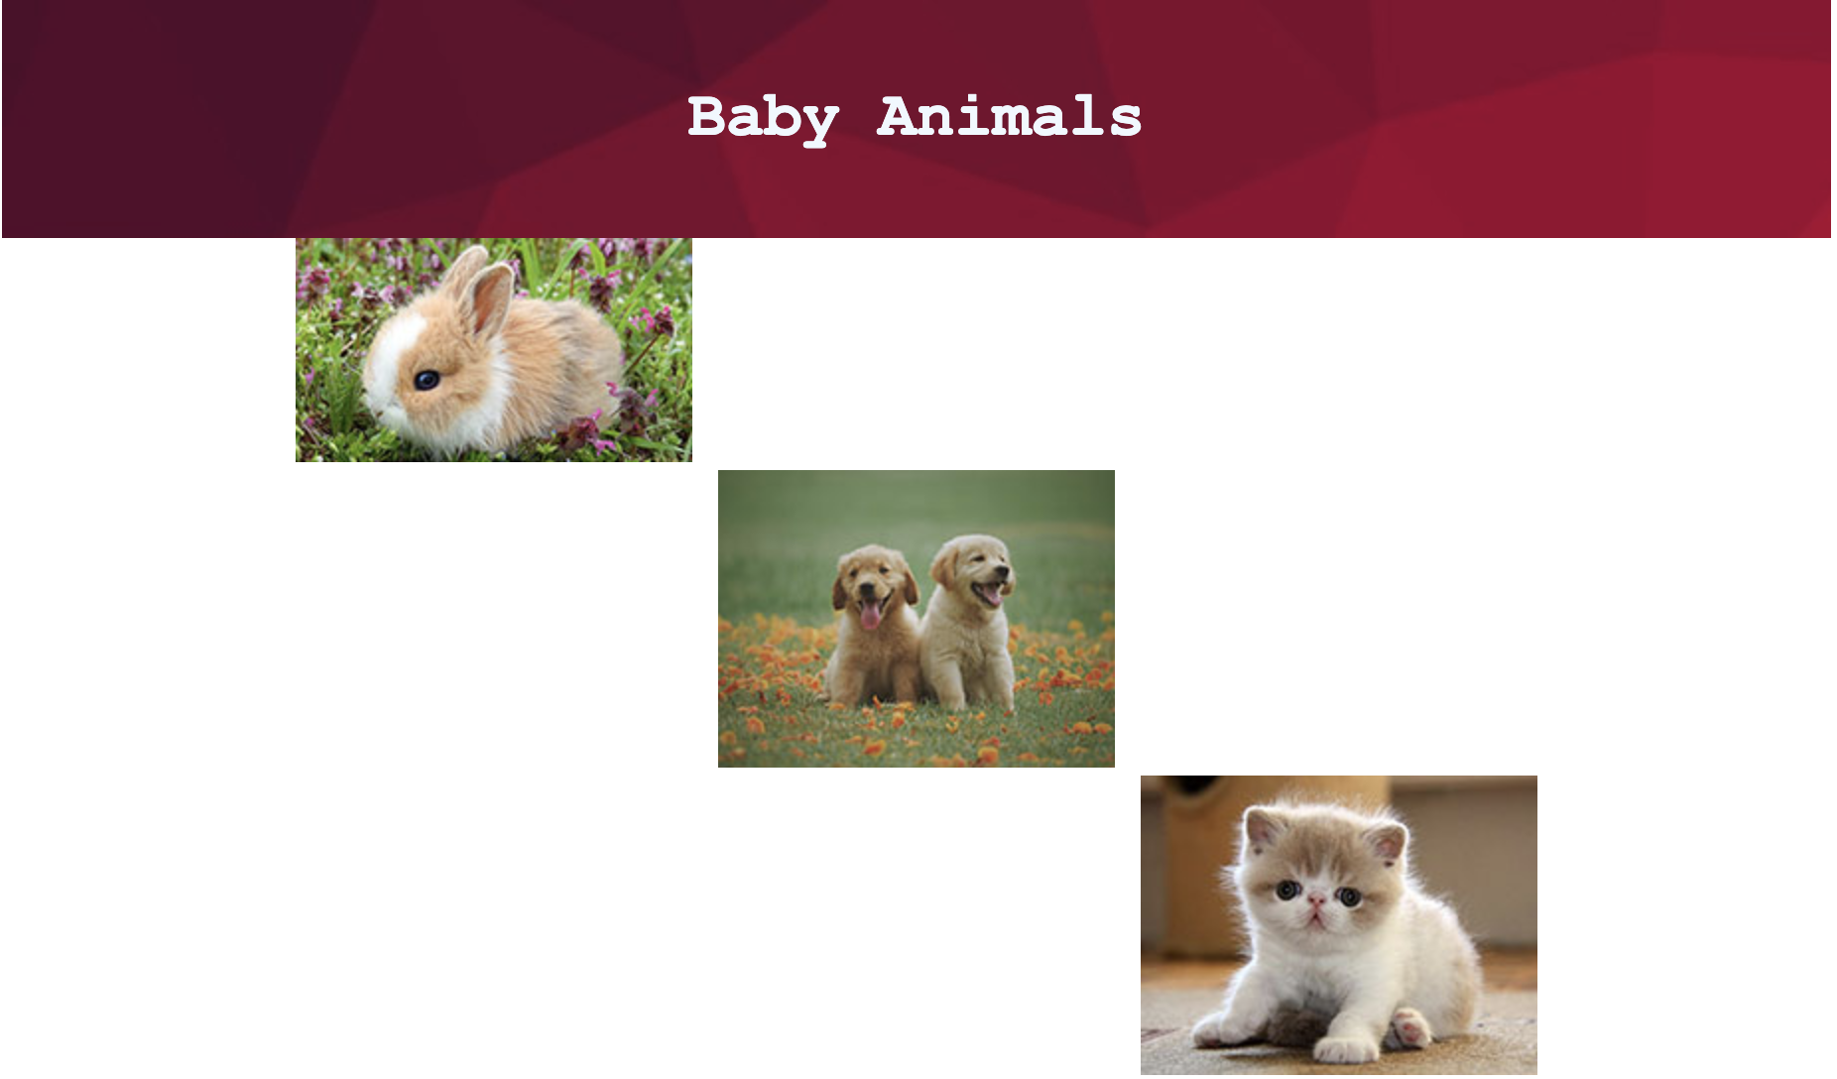
Exercise I
Arrange images on page
Notes:
Read about pseudo-elements and pseudo-classes

Slide 16
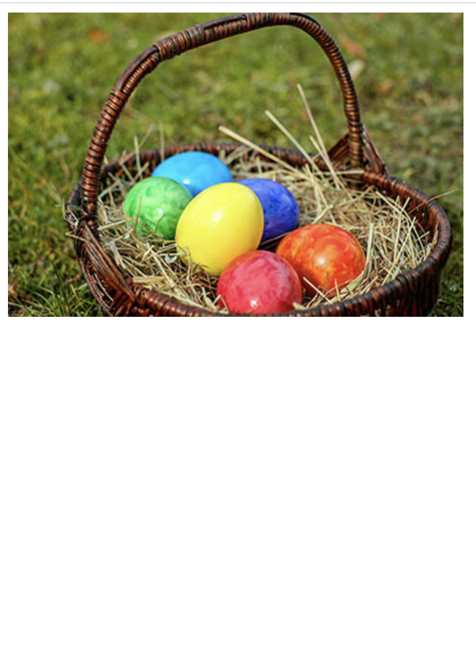

Exercise II
Show/hide image/text
Notes:
Read about pseudo-elements and pseudo-classes

Slide 17

10 min. Break

Slide 18
Image Map
is an image with clickable areas.
<img src="workplace.jpg" alt="Workplace" usemap="#workmap">
<map name="workmap"> <area shape="rect" coords="34,44,270,350" alt="Computer" href="computer.htm">
<area shape="circle" coords="337,300,44" alt="Coffee" onclick="myFunction()"> </map>
Notes:
You will need it, if you want to perform different actions depending on where in the image you click.
What do u need to create an image map?

Slide 19
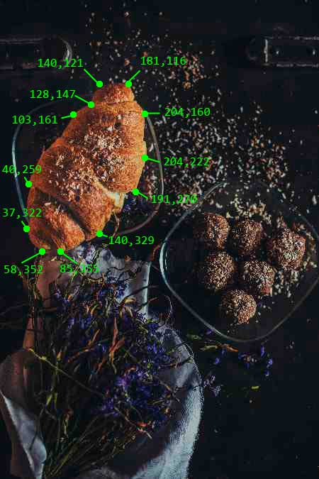
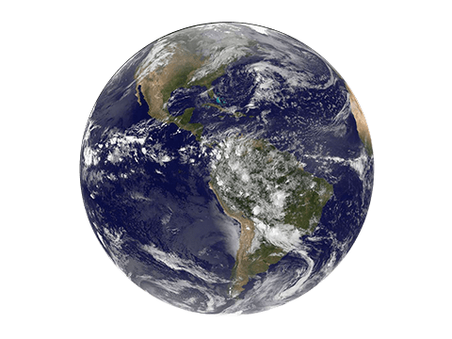

Area Tag
<area shape="shape" coords="coords" alt="text" href="link">
circle, coords = "x1,y1,radius"
rect, coords = "x1,y1,x2,y2“ (diagonal)
poly, coords = x1,y1, …,xn,yn
x1,y1
x1,y1
radius
x2,y2
Notes:
Coordinates : starts from top left corner

Slide 20
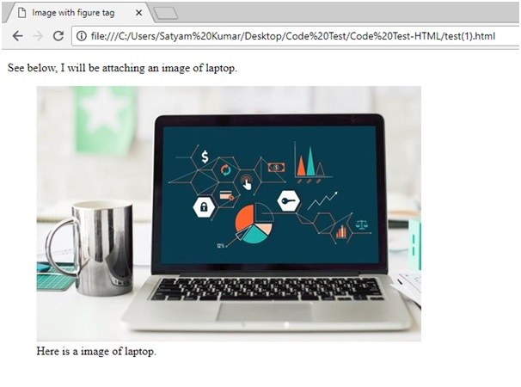
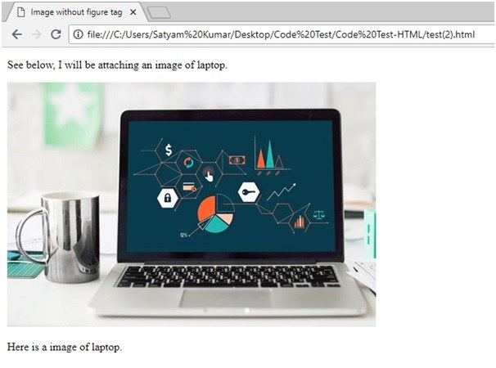
Figure Tag
<p>some text</p> <figure> <img src="url" alt="text"> <figcaption>caption text</figcaption> </figure> | <p>some text</p> <div> <img src="url" alt="text"> <p>caption text </p> </div>
Notes:
The <figure> tag usually used with illustrations, diagrams, photos, code listings, etc.
Default text-align:left
Search machines know the connection between the image and its captions

Slide 21
Figure Tag
figure { border: 1px #cccccc solid; padding: 4px; margin: auto; } Default: figure { display: block; margin-top: 1em; margin-bottom: 1em; margin-left: 40px; margin-right: 40px; } | figcaption { background-color: black; color: white; font-style: italic; padding: 2px; text-align: center; } Default: figcaption { display: block; }

Slide 22
Which image editing tool do you use?
Notes:
Go to Zoom Poll

Slide 23
Image Editing Tools
Free | Fee-based
Gimp | Adobe Photoshop
Canva | Adobe Illustrator
Paint.NET
Pixlr
Lunapic

Slide 24
Images in Responsive Designs
<meta name="viewport" content="width=device-width, initial-scale=1">
<img srcset="elva-fairy-small.jpg 480w,
elva-fairy-medium.jpg 800w,
elva-fairy-large.jpg 1200w "
sizes="(max-width: 600px) 480px,
800px"
src="elva-fairy.jpg"
alt="Elva dressed as a fairy">
Notes:
Show them the different sizes in Chrome
Initial-scale=1, keeps the same zoom.
srcset defines the set of images we will allow the browser to choose between, and what size each image is. Each set of image information is separated from the previous one by a comma. For each one, we write:
An image filename (elva-fairy-480w.jpg)
A space
The image's intrinsic width in pixels (480w) — note that this uses the w unit, not px as you might expect. This is the image's real size, which can be found by inspecting the image file on your computer (for example, on a Mac you can select the image in Finder and press Cmd + I to bring up the info screen).
sizes defines a set of media conditions (e.g. screen widths) and indicates what image size would be best to choose, when certain media conditions are true — these are the hints we talked about earlier. In this case, before each comma we write:
A media condition ((max-width:600px)) — you'll learn more about these in the CSS topic, but for now let's just say that a media condition describes a possible state that the screen can be in. In this case, we are saying "when the viewport width is 600 pixels or less".
A space
The width of the slot the image will fill when the media condition is true (480px)
So, with these attributes in place, the browser will:
Look at its device width.
Work out which media condition in the sizes list is the first one to be true.
Look at the slot size given to that media query.
Load the image referenced in the srcset list that has the same size as the slot or, if there isn't one, the first image that is bigger than the chosen slot size.

Slide 25
Images in Responsive Designs
<picture>
<source media="(max-width: 799px)"
srcset="elva-480w-close-portrait.jpg">
<source media="(min-width: 800px)"
srcset="elva-800w.jpg">
<img src="elva-800w.jpg"
alt="Chris standing up holding his daughter Elva">
</picture>
https://developer.mozilla.org/en-US/docs/Learn/HTML/Multimedia_and_embedding/Responsive_images
Notes:
The most common use of the <picture> element will be for art direction in responsive designs. Instead of having one image that is scaled up or down based on the viewport width, multiple images can be designed to more nicely fill the browser viewport.
The <picture> element contains two tags: one or more <source> tags and one <img> tag.
The browser will look for the first <source> element where the media query matches the current viewport width, and then it will display the proper image (specified in the srcset attribute). The <img> element is required as the last child of the <picture> element, as a fallback option if none of the source tags matches.

Slide 26
Responsive Designs
<meta name="viewport" content="width=device-width, initial-scale=1">
https://developer.mozilla.org/en-US/docs/Learn/CSS/CSS_layout/Flexbox
https://developer.mozilla.org/en-US/docs/Learn/CSS/CSS_layout/Grids
https://developer.mozilla.org/en-US/docs/Learn/CSS/CSS_layout/Multiple-column_Layout
CSS Flexbox .items { display: flex; justify-content: space-between; } | CSS Grid Layout .container { display: grid; grid-template-columns: 1fr 3fr; } | Multiple-column Layout .container { column-count: 3; column-gap: 20px; column-rule: 4px dotted rgb(79, 185, 227); }
Notes:
Show them the different sizes in Chrome
Flexbox is ideal when you have a set of items of different sizes and you would like them to fit comfortably in a row or rows, with smaller items taking less space and larger ones getting more space.
Grid is another way to create flexible grids. So instead of creating columns using percentages, you could use grid layout and the fr unit, which represents a portion of the available space in the container.

Slide 27
Image Best Practices
image width < 2500px
Never enlarge small images
Always crop your images using an image editor not via styling
Use different image sizes for responsive designs
Use .png files for images having text
Compression
Use non commercial images (free or licensed)
Put all images in one folder
Use "alt“ attribute
Set a background color to the image
Notes:
Images smaller than 1500 pixels may appear blurry or pixelated when they stretch to fill containers such as banners or div. Images added through Site Styles (background images and site-wide banner images) load at their original dimensions and may cause page loading issues if the image is over 2500 pixels along its longest edge. You can resize animated gifs to the size you want and then use them on the website.
Always use large scale images and scale them down to look crisp and sharp.
Browsers load the full image for images cropped by your site, such as those cropped with the cropping handle or Site Styles aspect ratio tweaks. So to reduce the size of the image use a 3rd party software.
.
Text in a .jpg file often becomes blurry when the image is compressed. A .png file typically retains its sharpness, especially if the image is displaying at its original size.
https://kinsta.com/blog/optimize-images-for-web/ https://www.foregroundweb.com/image-size/
Pixabay, unsplash, freeimages, pexels
……
…
Background-color: red; incase of a slow internet connection, the background color will show first then the image will load after.

Slide 28
Exercises
Photoshop: compression, resizing, cropping, adding text
Illustrator: export .svg

Slide 29
Related Topics
https://www.linkedin.com/learning/html-images-and-figures/welcome?u=76239226
https://www.linkedin.com/learning/css-images/working-with-images-in-css?u=76239226
https://www.linkedin.com/learning/responsive-images/when-to-use-responsive-images-with-the-lt-img-gt-tag?u=76239226

