Slide 1

Understanding Students’ Online Learning Experiences
Heba Shaheen

Slide 2
Project Motivation
Rapid shift to online learning affected students differently
Limited understanding of engagement, adaptability, and time use
Data-driven analysis helps identify key patterns and challenges
This project explores how students experienced online learning across different contexts and time periods.

Slide 3
Datasets Used
Online Education System Review
  performance before and after online learning
  engagement and technology readiness
Adaptability to Online Education
  low, moderate, high adaptability
  infrastructure and access factors
COVID-19 Student Survey
  study habits, sleep, social media
  perceived time utilization

Slide 4
Key Findings
Overall improvement in marks after online learning
Engagement levels vary by education level
Better technology access supports stronger outcomes
Social media use can reduce engagement

Slide 5
Key Findings
Most students show moderate adaptability
High adaptability linked to:
stable internet
better devices
stronger financial conditions
Gender and IT background have limited impact

Slide 6
Key Findings
Time utilization varies widely among students
Positive time use linked to:
higher self-study time
better class experiences
Low social media use
Device type plays a role

Slide 7
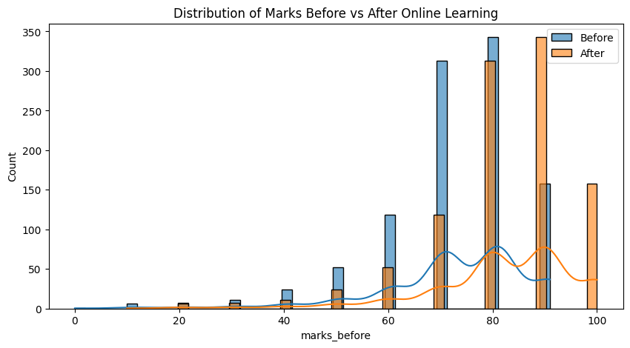
Visual Examples
Marks before vs after online learning

Slide 8
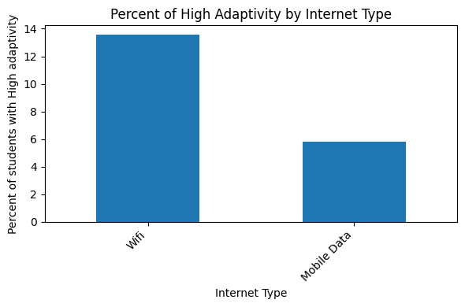
Visual Examples
Adaptivity by internet type

Slide 9
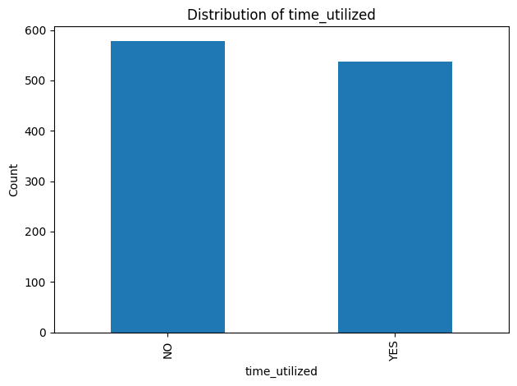
Visual Examples
Time utilized

Slide 10
Future Work
Advanced modeling and prediction
Cross-dataset comparisons
Deeper analysis of engagement factors

Slide 11

Thank You

