Slide 1
Red Light Green Light Workshop

Slide 2

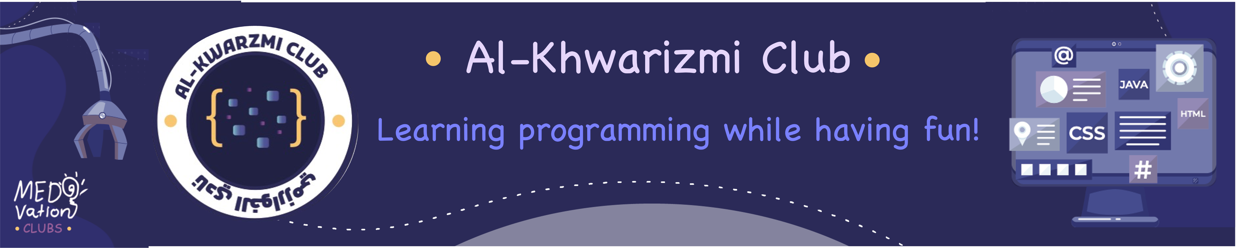
Who we are?
Learning Programming While Having Fun
At the Al-Khwarizmi Club, we’re a bunch of AI enthusiasts who love to dive deep into the rabbit hole of code and machine learning — all while staying inspired by Muhammad ibn Musa al-Khwarizmi, the original algebra maestro!

Slide 3
Workshop Overview
Brief of AI and Computer Vision
Project Description
Basics of Python programming and OpenCV.
Hands-on Practice.

Slide 4
Brief of AI and Computer Vision
- Artificial Intelligence (AI) enables machines to mimic human intelligence.
- It includes tasks like decision-making, learning, problem-solving, and understanding visual input.
- A subfield of AI Computer Vision (CV) focused on enabling computers to "see" and interpret images and videos.
- Applications include motion detection, facial recognition, object tracking, and more.

Slide 5
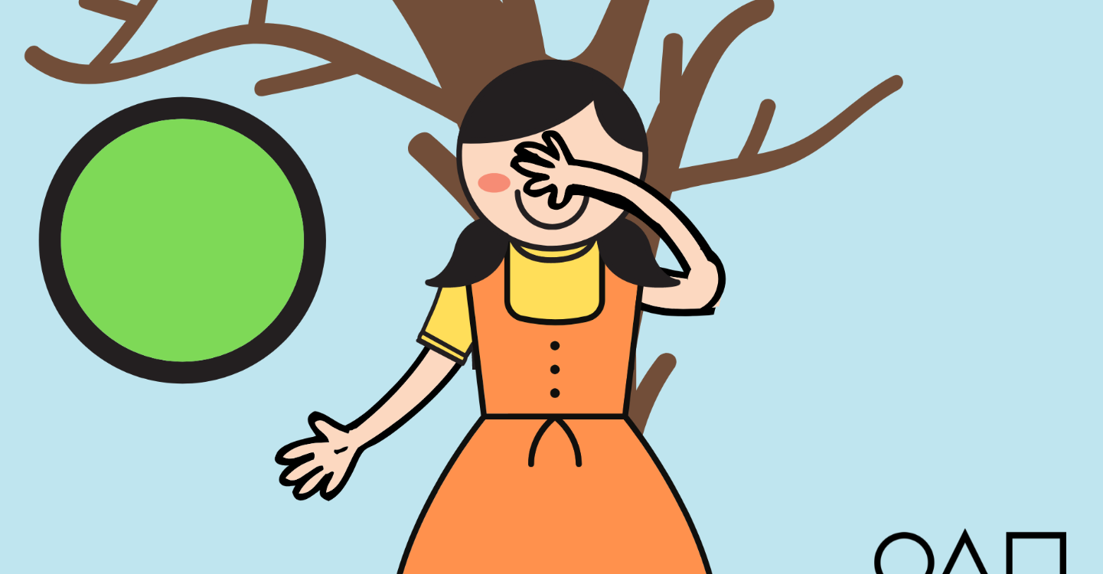
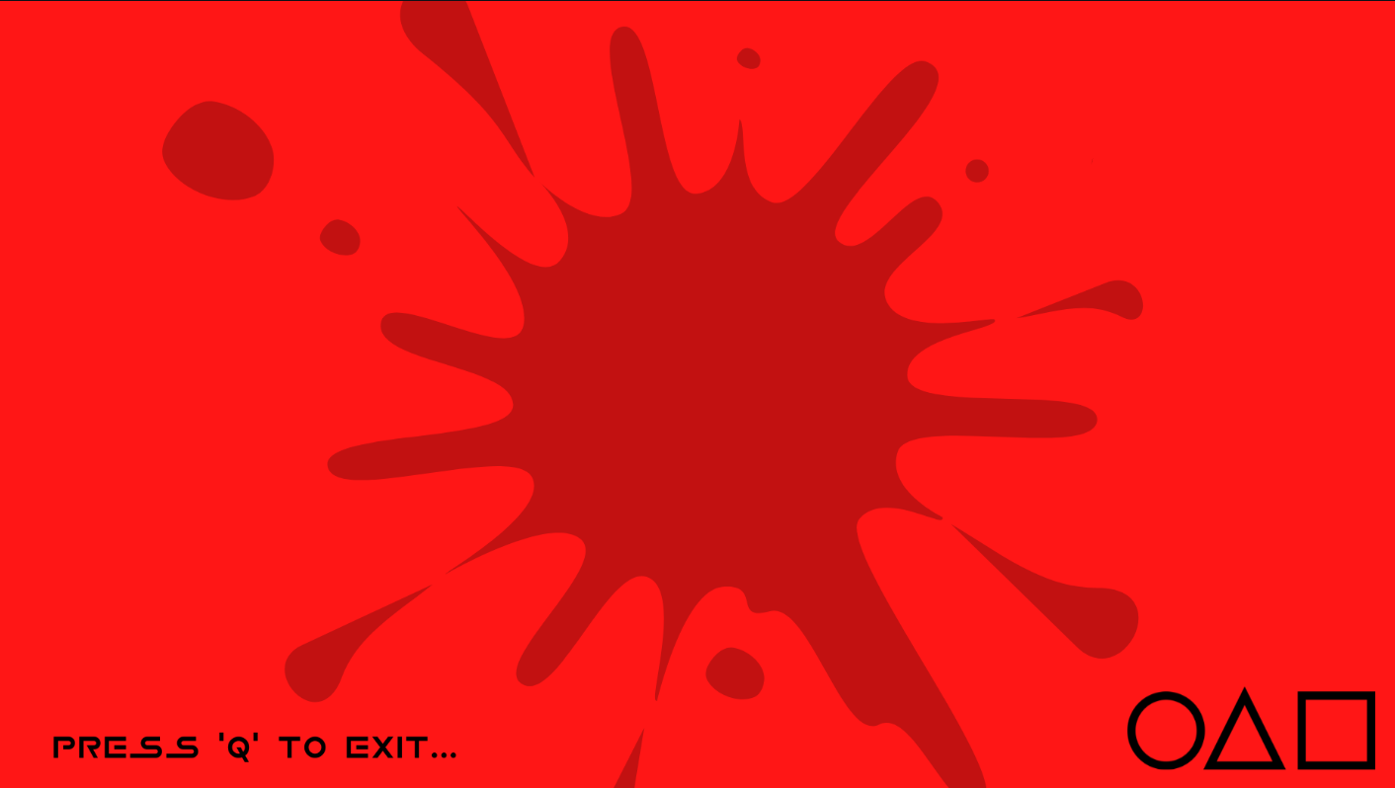
Project Description
Detecting motion using a camera and AI.
Building logic for game mechanics (e.g., freezing during red light).

Slide 6
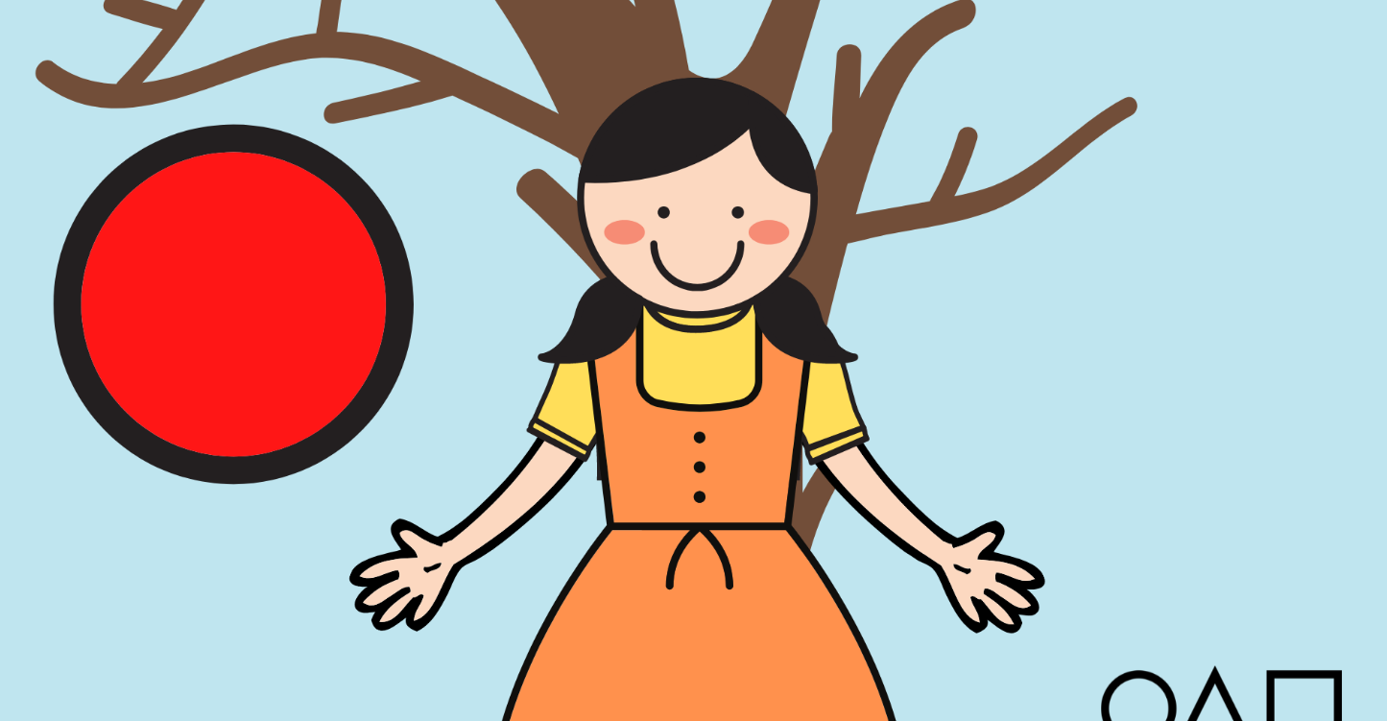
What is 'Red Light Green Light'?
Game Rules:
Green Light Phase:
Players are allowed to move freely.
The camera continues to monitor their movements but does not penalize them.
Red Light Phase:
Players must freeze in their positions.
If the AI detects any movement, that player is "out" or receives a penalty.

Slide 7
Your task now is to think how you will design this game?

Slide 8






Hands-on Practice
Tools
GitHub
Visual Studio Code
Pyhton
Numpy
OpenCV
Playsound

Slide 9
Hands-on Practice
Setup coding environment
1
2
3
4
Pyhton
Visual Studio Code
GitHub
5
Run the code

Slide 10
Now play the Game and Have Fun!

