Slide 1
PS-1 Project
Shreyas Hebbar S

Slide 2
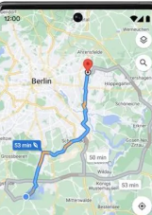
Project Idea
To create a native ios/android app which automatically displays the optimum route to the nearest hospital and to contact the hospital to send an ambulance to the users location.

Slide 3
Inputs:
The users current location.
This can be obtained directly from the users gps.

Slide 4
API/ Plugins
- Nearby search
- Directions plugin

Slide 5
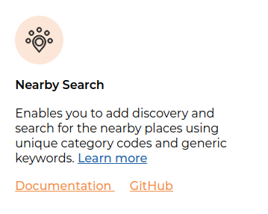
Nearby Search-
This will be used to find all hospitals which are within a 5 km radius of the user

Slide 6
Directions plugin-
To find the optimum route from the users location to the hospital and the ambulance and the user.

Slide 7

Flutter will be used for implementing the app.

Slide 8
THANKYOU

