Slide 1
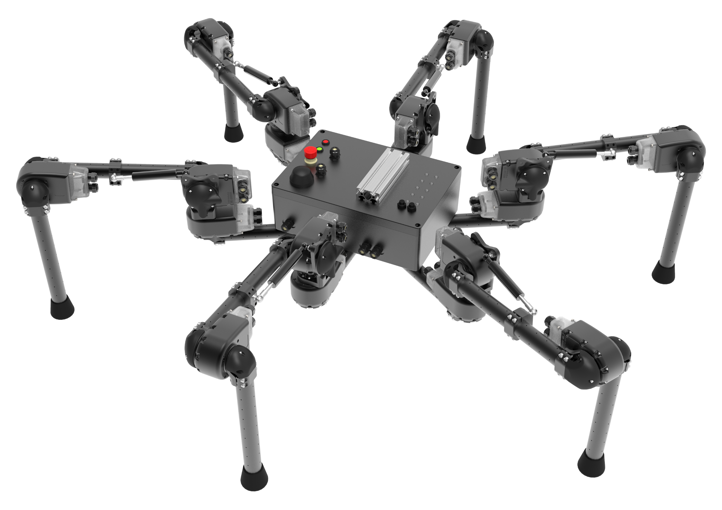
L5_J3_elbow
L3_J3_elbow
L5_J2_shoulder
L3_J2_shoulder
L5_J1_base
L3_J1_base
L1_J3_elbow
L6_J3_elbow
L6_J2_shoulder
L1_J2_shoulder
L1_J1_base
L6_J1_base
L4_J2_shoulder
L2_J2_shoulder
L4_J1_base
L2_J1_base
L4_J3_elbow
L2_J3_elbow

