Slide 1
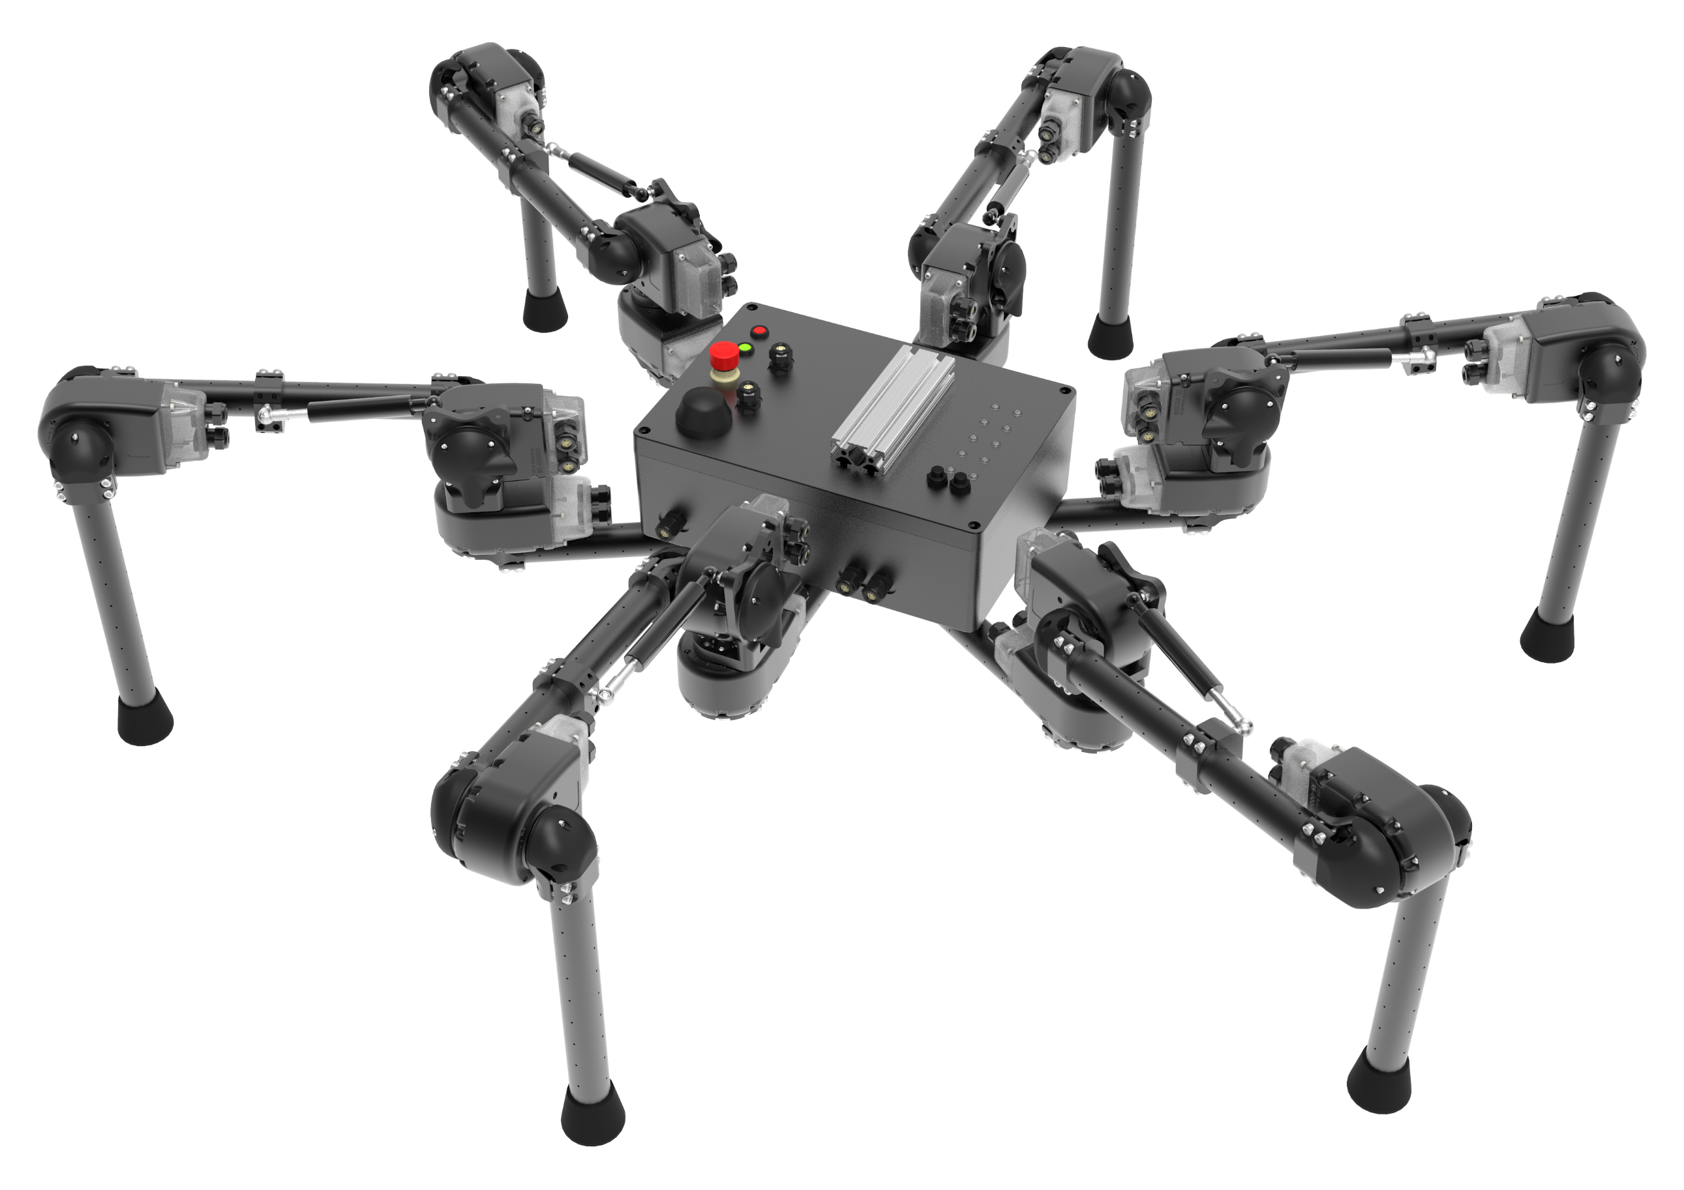
+z
+y
+x

