Slide 1

Big-O Performance Analysis
Based on a presentation by Dr. Simon Garrett, The University of Wales, Aberystwyth:
http://users.aber.ac.uk/smg/Modules/CO21120-April-2003/NOTES/15-Complexity.ppt

Slide 2
Execution Time Factors
Computer:
  CPU speed, amount of memory, etc.
Compiler:
  Efficiency of code generation.
Data:
  Number of items to be processed.
  Initial ordering (e.g., random, sorted, reversed)
Algorithm:
  E.g., linear vs. binary search.

Slide 3
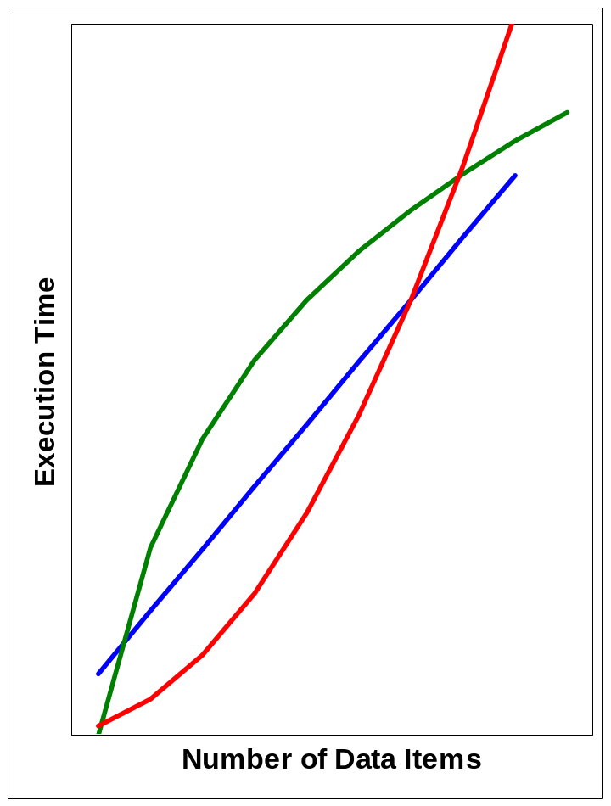
Are Algorithms Important?
The fastest algorithm for 100 items may not be the fastest for 10,000 items!
Algorithm choice is more important than any other factor!
O(log N)
O(N)
O(N²)

Slide 4
What is Big-O?
Big-O characterizes algorithm performance.
Big-O describes how execution time grows as the number of data items increase.
Big-O is a function with parameter N, where N represents the number of items.

Slide 5
Common Growth Rates
Big-O Characterization |  | Example
O(1) | constant | Adding to the front of a linked list
O(log N) | log | Binary search
O(N) | linear | Linear search
O(N log N) | n-log-n | Binary merge sort
O(N²) | quadratic | Bubble Sort
O(N³) | cubic | Simultaneous linear equations
O(2^{N}) | exponential | The Towers of Hanoi problem

Slide 6
Predicting Execution Time
If a program takes 10ms to process one item, how long will it take for 1000 items?
(time for 1 item) x (Big-O( ) time complexity of N items)
log₁₀ N | 3 x 10ms | .03 sec
N | 10³ x 10ms | 10 sec
N log₁₀ N | 10³ x 3 x 10ms | 30 sec
N² | 10⁶ x 10ms | 16 min
N³ | 10⁹ x 10ms | 12 days

Slide 7
How to Determine Big-O?
Repetition
Sequence
Selection
Logarithmic

Slide 8
Determining Big-O: Repetition
for (i = 1; i <= n; i++)
{
m = m + 2 ;
}
executed
n times
constant time
Total time = (a constant c) * n = cn = O(N)
Ignore multiplicative constants (e.g., “c”).

Slide 9
Determining Big-O: Repetition
for (i = 1; i <= n; i++)
{
for (j = 1; j <= n; j++)
{
k = k+1 ;
}
}
outer loop
executed
n times
inner loop
executed
n times
constant time
Total time = c * n * n * = cn² = O(N²)

Slide 10
Determining Big-O: Repetition
for (i = 1; i <= n; i++)
{
for (j = 1; j <= 100; j++)
{
k = k+1 ;
}
}
outer loop
executed
n times
inner loop
executed
100 times
constant time
Total time = c * 100 * n * = 100cn = O(N)

Slide 11
Determining Big-O: Sequence
constant time (c₀)
x = x +1;
for (i=1; i<=n; i++)
{
m = m + 2;
}
for (i=1; i<=n; i++)
{
for (j=1; j<=n; j++)
{
k = k+1;
}
}
executed
n times
constant time (c₁)
outer loop
executed
n times
inner loop
executed
n times
constant time (c₂)
Total time =
Total time = c₀
Total time = c₀ + c₁n
Total time = c₀ + c₁n + c₂n²
Total time = c₀ + c₁n + c₂n² = O(N²)
Only dominant term is used

Slide 12
Determining Big-O: Selection test + worst-case(then, else)
test:
constant (c₀)
if (depth( ) != otherStack.depth( ) )
{
return false;
}
else
{
for (int n = 0; n < depth( ); n++)
{
if (!list[n].equals(otherStack.list[n]))
return false;
}
}
then part:
constant (c₁)
else part:
(c₂ + c₃) * n
another if :
test (c₂)
+
then (c₃)
Total time = c₀
Total time = c₀ + Worst-Case(then, else)
Total time = c₀ + Worst-Case(c_{1,} else)
Total time = c₀ + Worst-Case(c_{1,} (c₂ + c₃) * n) = O(N)

Slide 13
Determining Big-O: Logarithmic
An algorithm is O(log N) if it takes a constant time to cut the problem size by a fraction (usually by ½)
Example: Dictionary (binary) search
Look at middle of the dictionary
Is word before or after?
Repeat with left or right half until found

Slide 14
Demonstration

