Slide 1
Lightweight Unsupervised Super-Resolution with Emphasis on Structural Similarity
Xinghao Chen Meng Zhang
ECE 6258 Course Project
School of Electrical and Computer Engineering
Georgia Institute of Technology
Shenzhen, China

Slide 2
Contents
What is super-resolution (SR)?
Landscape of State-of-the-Art (SotA) SR methods
Our Goals
Referenced Papers
Network Design
Training Procedure
Experiments & Results

Slide 3


What is super-resolution (SR)?
Interpolation!
?
?
?
4x!
?
?
?
?
?
?
?
?
774×837
?
?
?
?
Metrics: PSNR, SSIM, …
3096×3348
Super-resolution operated by https://github.com/AaronFeng753/Waifu2x-Extension-GUI with Waifu2x-NCNN-Vulkan engine
Image from https://www.pixiv.net/member_illust.php?mode=medium&illust_id=72244430
Characters from SukaMoka Series

Slide 4
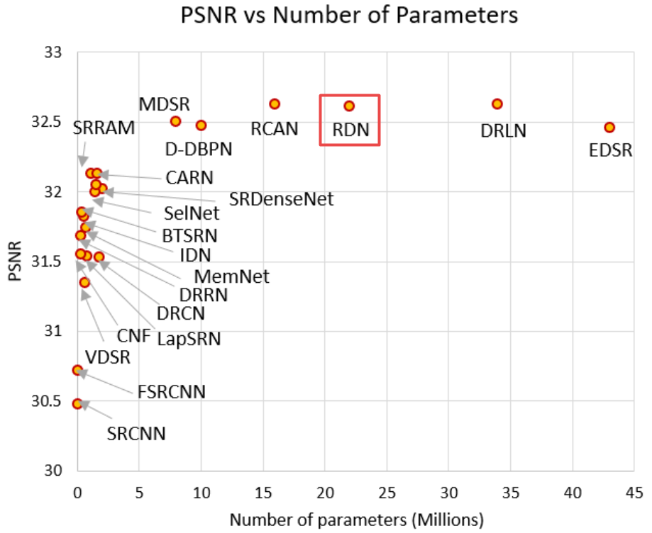
Landscape of super-resolution (SR)
Chart from
Wang, Z., Chen, J., & Hoi, S. C. (2019). Deep learning for image super-resolution: A survey. arXiv preprint arXiv:1902.06068.
Non-deep-learning methods:
Bilinear, Bicubic, … (studied in class)
ScSR | CVPR08
ANR | ICCV13
A+ | ACCV14
IA | CVPR16
SelfExSR | CVPR15
NBSRF | ICCV15
RFL | ICCV15
…
Good for real-time applications

Slide 5
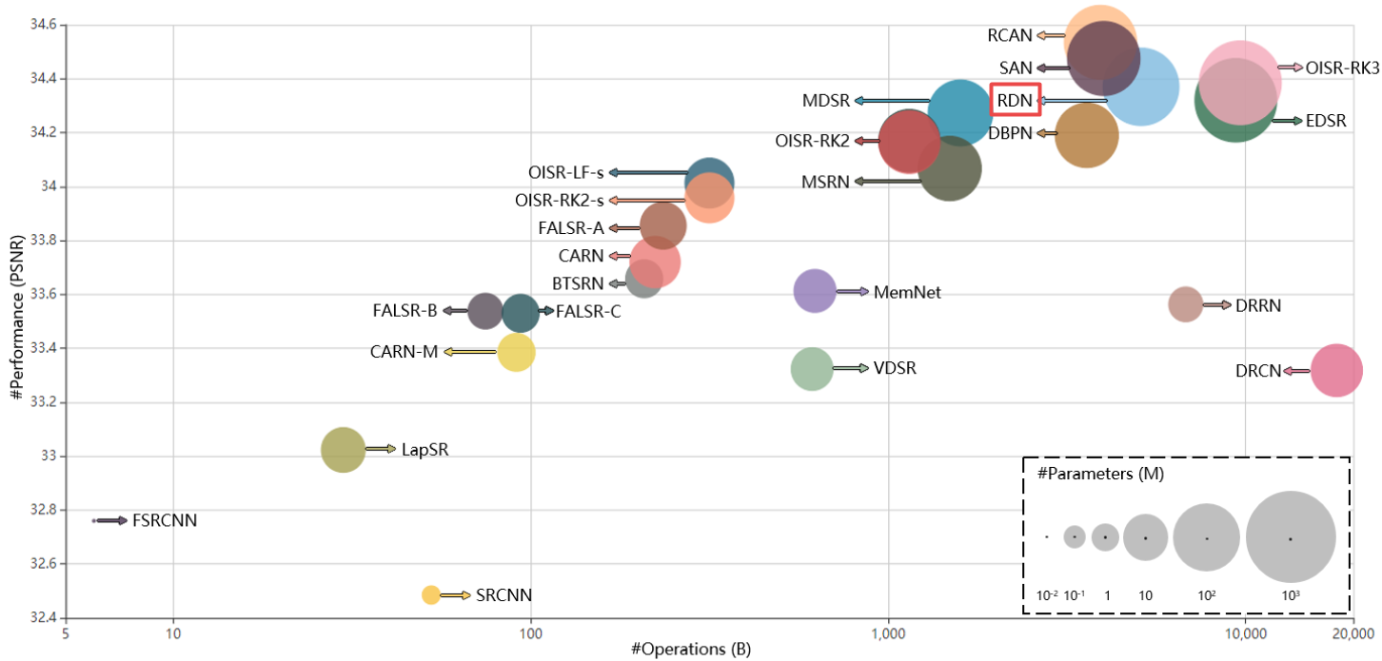
Landscape of super-resolution (SR)
Chart from
Saeed Anwar, Salman Khan, Nick Barnes. A Deep Journey into Super-resolution: A survey. arxiv, 2019.
TRILLIONs of operations!

Slide 6
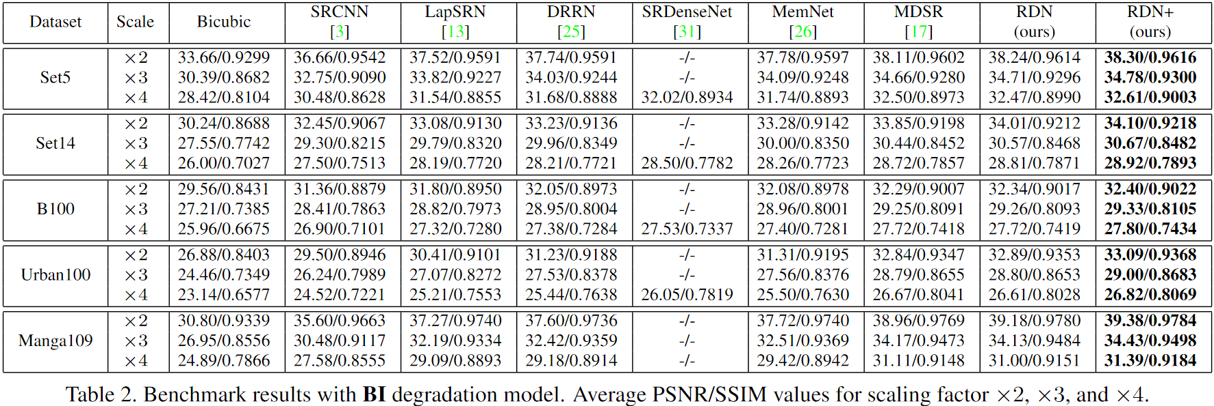
Landscape of super-resolution (SR)
Results from RDN (bicubic degradation)
\bibitem{RDN} Y. Zhang, Y. Tian, Y. Kong, B. Zhong, and Y. Fu, “Residual dense network for image super-resolution,” 2018 IEEE/CVF Conference on Computer Vision and Pattern Recognition (CVPR) IEEE, 2018.

Slide 7
Our Goal
Do better than RDN in SSIM!
without severe loss in PSNR
(We do not have powerful GPUs…)

Slide 8
Referenced Papers
\bibitem{RCAN} Zhang, Yulun , et al. "Image Super-Resolution Using Very Deep Residual Channel Attention Networks." (2018).
\bibitem{SAN} Dai, Tao , et al. "Second-order Attention Network for Single Image Super-Resolution." 2019 IEEE/CVF Conference on Computer Vision and Pattern Recognition (CVPR) IEEE, 2019.
\bibitem{RDN} Y. Zhang, Y. Tian, Y. Kong, B. Zhong, and Y. Fu, “Residual dense network for image super-resolution,” 2018 IEEE/CVF Conference on Computer Vision and Pattern Recognition (CVPR) IEEE, 2018.
\bibitem{EDSR} B. Lim, S. Son, H. Kim, S. Nah, and K. M. Lee, “Enhanced deepresidual networks for single image super-resolution,” CVPRW, 2017.
\bibitem{ZSSR} A. Shocher, N. Cohen, and M. Irani, “zero-shot super-resolution using deep internal learning,” CVPR, 2018.
\bibitem{DenseNet} G. Huang, Z. Liu, L. Van Der Maaten, and K. Q. Weinberger, “Densely connected convolutional networks,” CVPR, 2017.
\bibitem{ResNet} K. He, X. Zhang, S. Ren, and J. Sun, “Deep residual learning for image recognition,” CVPR, 2016.
\bibitem{loss} Zhao, Hang , et al. "Loss Functions for Neural Networks for Image Processing." CVPR, 2015.

Slide 9
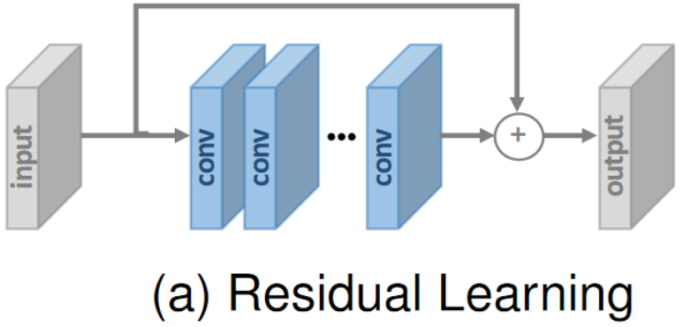
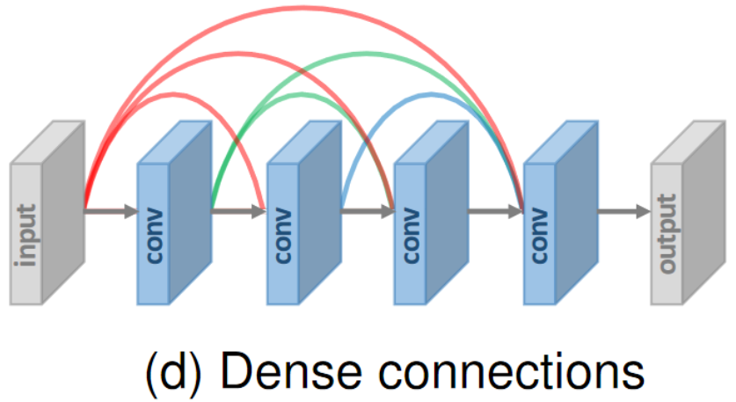
Network Design
Images from
Saeed Anwar, Salman Khan, Nick Barnes. A Deep Journey into Super-resolution: A survey. arxiv, 2019.
Residual learning
The initial input simply added to the output
The model only has to output the difference
Reduced model complexity
Dense Connection
Each layer obtains additional inputs from all preceding layers
Each layer’s output serves as input of all subsequent layers
Enhanced data propagation
Reduced model complexity
RDN: Residual Dense Network

Slide 10

Back-projection
1. Data
Augmentation
HR input
LR input
3. Bicubic
Upscale
Back-projected
HR input
2. Bicubic Downscale
1x
0.5x
1x
Our notation:
HR: the input image we are to perform super-resolution
LR: the futher-downscaled input
SR: the target image we would like to acquire
1x
0.5x
2x

Slide 11
Training Procedure
SR
Ouput
2x
0. Generate different back-projected input as training set
Back-projected
HR input
1x
3. Amend the bicubic upscaled SR image with our model
Model
8 layers of
64 3×3 conv2d filters + ReLU
residual dense connection
Paired blocks of 128×128 pixels
1. Train
lightweight!
Original
HR input
1x
SR-sized input
2x
2. Bicubic
Upscale
RDN: 64 residual dense blocks,
with 8 convolutional layers in each block
More than 64x heavier than ours

Slide 12
Unsupervised!
Estimation of upscaling kernel:
Supervised: kernel inferred from many images
each actually possessing different kernels
Unsupervised: kernel inferred from only the image that we perform SR on.
Advantages of unsupervised model:
No need for heavy dataset and pre-training
model trained for each input before using
Problem of generalization partially averted
Data Augmentation:
Affine transforms
Shifting
Various kernels for back-projection
Random noise (not implemented)
Gradual upscaling (1x→1.5x→2x)

Slide 13
Loss Metrics
We had attempted to amplify SSIM with a discrete method
But the convolutional network automatically made it for us…
Common loss functions:
L1: mean absolute error
L2: mean square error
Combination of metrics (e.g. L1+L2); proved to be more effective
Our loss function: −40SSIM − PSNR
Logarithmic element-wise loss
decreased importance of PSNR when PSNR is large enough
Combination of all levels of norms in a single package
can focus on SSIM when element-wise error is low enough
Emphasis on visual quality.

Slide 14
Experiments
Set14 2× scaling (we had no time for other datasets…)
PSNR, SSIM = 31.894, 0.9425
Without gradual-upscaling strategy applied,
PSNR, SSIM = 31.891, 0.9417
(RDN+: 34.20, 0.9218)
SSIM better than SotA methods; decent PSNR
Visually appealing output: good subjective quality
Primary features of the image preserved
Some high-frequency information can still be lost.
Without exploiting the information from heavy HR datasets, it might be difficult for our model to infer very detailed structures thoroughly.
Best
Second Best

Slide 15
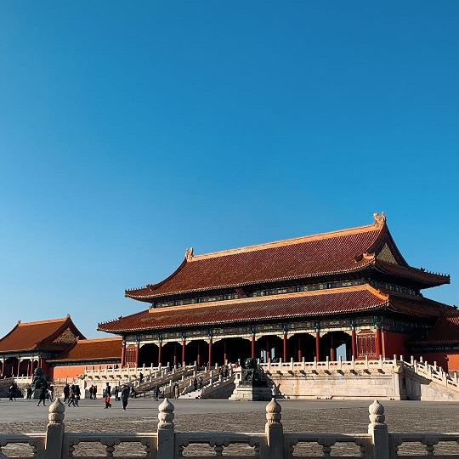

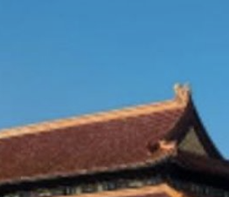
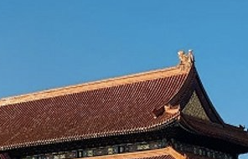
Example: The Loss of the High Frequency information

Slide 16
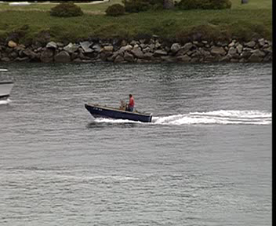



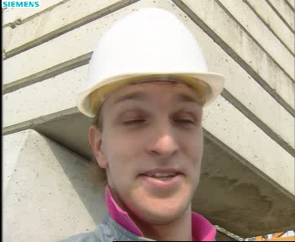


Groudtruth
Our results
PSNR / SSIM
28.94 / 0.9017
High-frequency information lost
34.42 / 0.9832

Slide 17




Groudtruth
Our results
PSNR / SSIM
27.96↓ / 0.9492↑
High-contrast images tend to have better SSIM,
but worse PSNR?
→ SSIM loss might preserve the global contrast
32.18↑ / 0.9179↓

Slide 18
Thanks for watching!
Also thank my GPU who takes all the tedious work…

