Slide 1
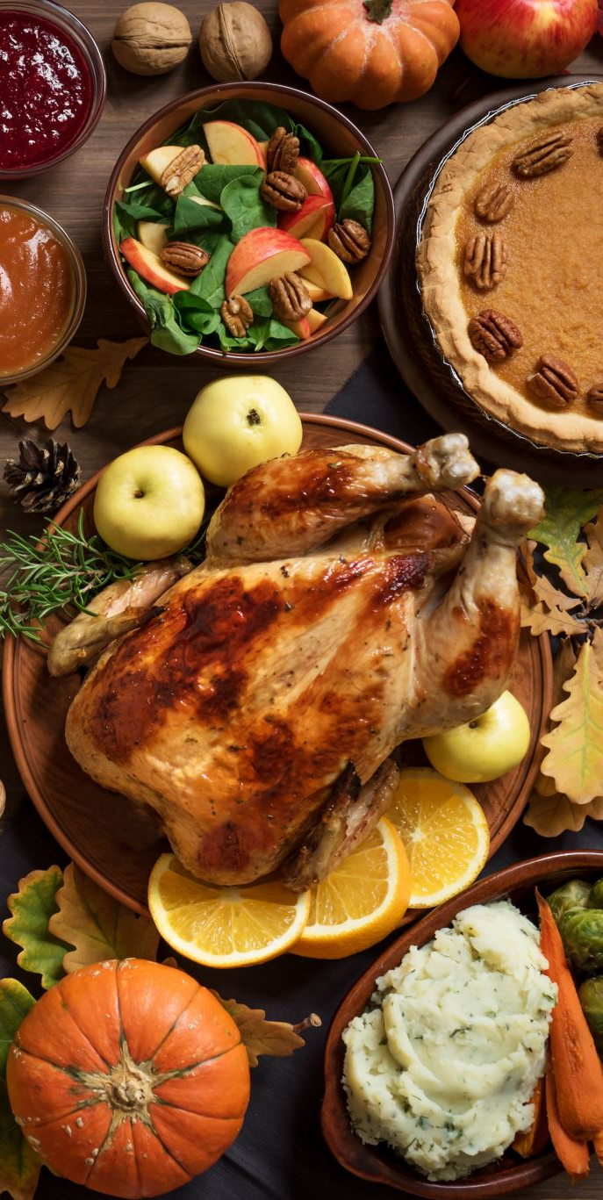

FlavorHub Application
Presented By:
Spyro Goumas
Maximus Taube
David Jorge

Slide 2
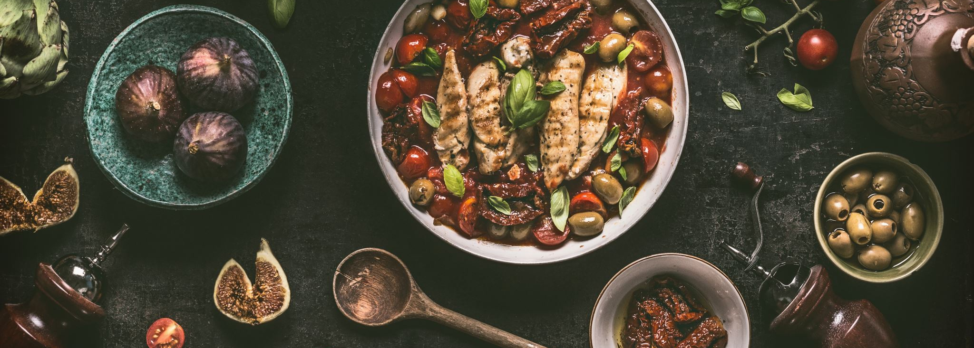
Description of Project
Our application will allow you to choose the meal you want according to the time of the day so for example: breakfast, lunch or dinner. You'll be able to browse multiple categories of foods such as pastas, steaks, seafood, organic meals...etc.
After selecting a certain meal that you are interested in, you can click on it which will bring you to the next page which will be the recipe. There you will have all the ingredients to the recipe along with the instructions on how to prepare the meal. If you are interested about the nutrition facts, there will be another page with all you would want to see.
In the nutrition facts page, we will have all the information you would need to determine how many calories for example there are in a specific meal you have selected

Slide 3
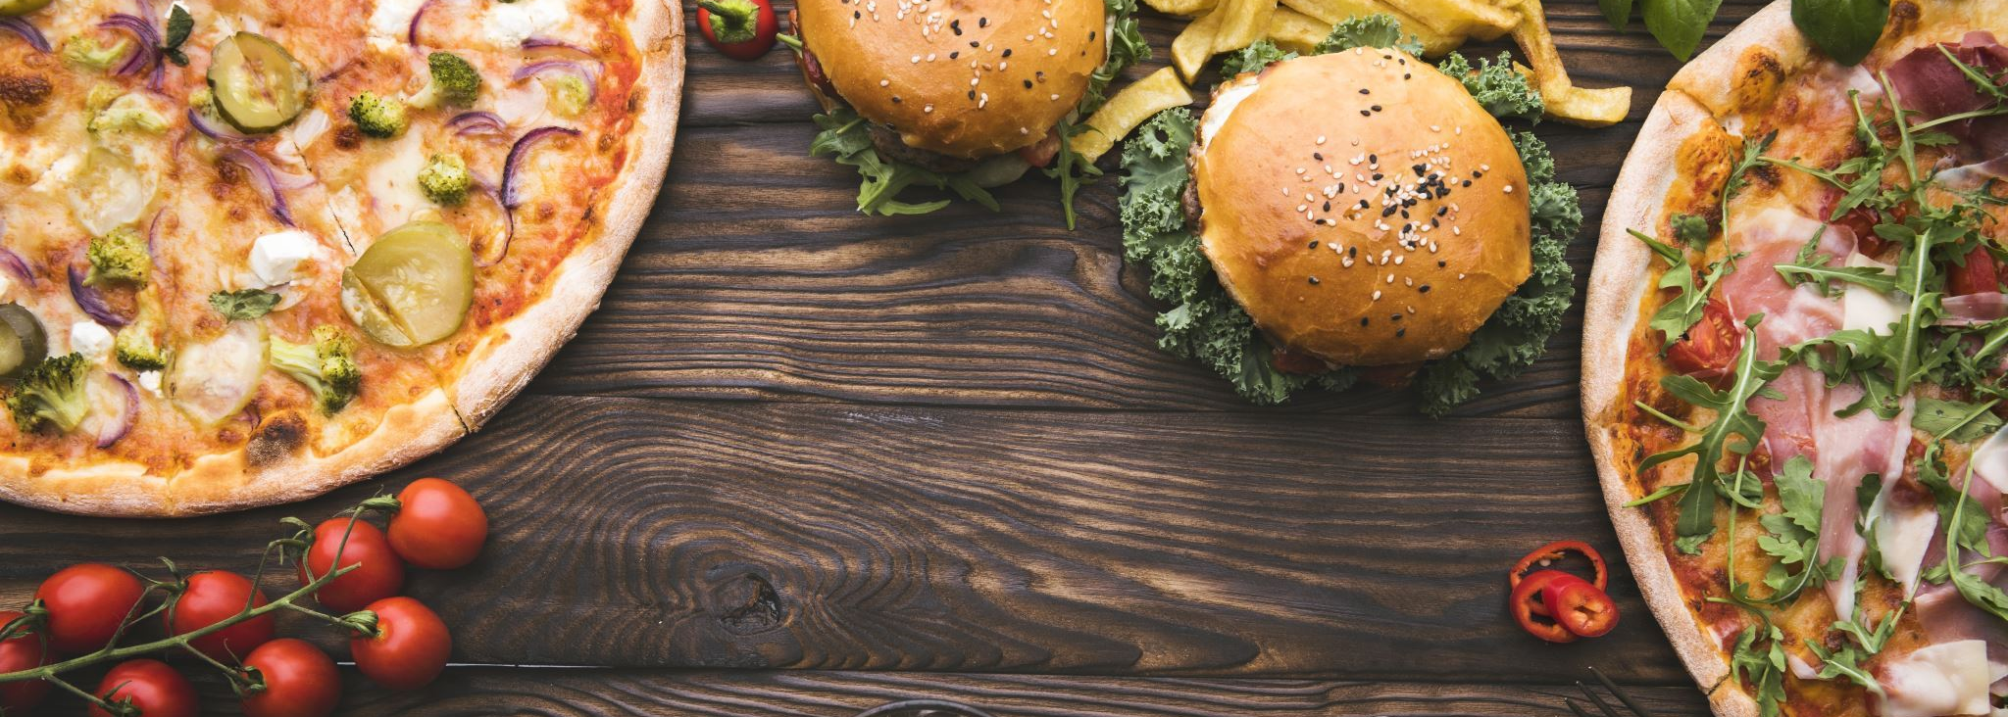
Description of Project Cont.
We will provide a Sign Up/Sign In page once you open the app so that you'll be able to keep track of your meals and save them for later if you come across one you like
There will be a rating system implemented right after you're done eating your meal. Users will be able to critique the meal once it is done and are going to be able to recommend it to others to try. A rating system followed along by a comment about their experience will be available to the user if they want to.
These comments are going to be made seen by the public whenever the meal itself is clicked on. People are going to be able to see whether the meal was pleasant according to other people's experience

Slide 4
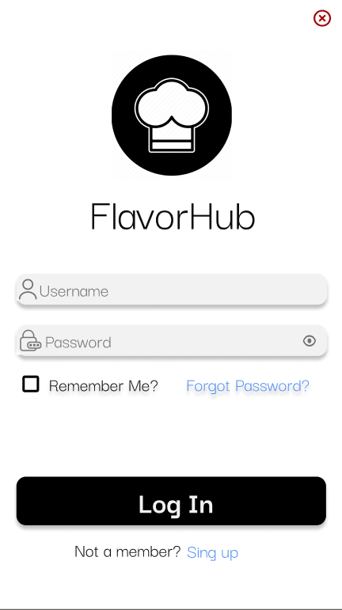
Example Of Login UI
As you normally see, we have a username/password field along with an option for remembering the user and the other is in case the user has forgotten their password
Towards the bottom of the UI, we have the Login button for when you put it in your information and you're ready to find recipes. The other one is in case you have not yet signed up with an account. Clicking that button will direct you towards the Sign-Up page where you can make your own account

Slide 5
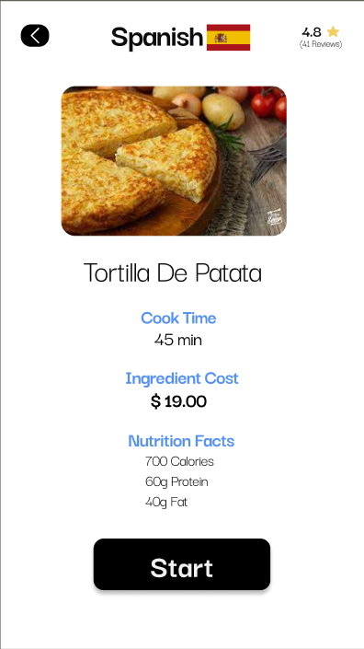
Example of Dish Page UI
At the top of the page, we have the reviews regarding this meal as well as the ethnic food type
We have a picture of the type of food as well as cook time, the ingredient cost and the nutritional facts at the bottom of the page

Slide 6
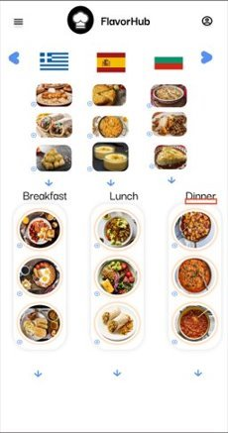
Example of Home Page UI
Starting from the top of the page on the left, we have the navigation menu which helps you move around the app. On the right side, there is the profile menu which allows you to navigate back to your profile.
Underneath this, we have the different ethnic groups of foods to choose from with the choice of either breakfast, lunch or dinner

Slide 7
Work Distribution
Database Design:
Maximus (Main Focus)
David (Light Focus)
Spyro (Light Focus)
Database Implementation:
Maximus (Main Focus)
David (Light Focus)
Spyro (Light Focus)
Program Code:
Maximus (Main Focus)
David (Main Focus)
Spyro (Main Focus)
GUI:
Maximus (Light Focus)
David (Main Focus)
Spyro (Main Focus)
Note: The database software that will be used is MySQL.

Slide 8

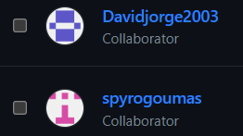

GitHub Repository
Maximus: Hecktox
David: Davidjorge2003
Spyro: spyrogoumas

