Slide 1

Software Foundations in JAVA (JSF)
Lesson 7
Monitors
Peter Boots
p.boots@fontys.nl
Erik van der Schriek
e.vanderschriek@fontys.nl

Slide 2
Overview
ReentrantLock
Condition
Monitor
Ending a thread
Notes:
Next: what is an OS

Slide 3
Drawbacks of synchronized
In week 5, we solved the Critical Section (CS) problem by using synchronized
We could wait inside a synchronized section with wait/notify/notifyAll
Problems:
  we don’t know which thread is woken up by notify
  notifyAll will wake up all threads

Slide 4
General tools
Standard synchronization tools are not always sufficient
There are tools to solve any synchronization problem
  Semaphores:
    A low level mechanism
    Difficult to get a 100% correct solution
    We will not use them
  Monitors
    High level
    Easier to get correct solution

Slide 5
ReentrantLock
Monitors in Java are made with ReentrantLock
This can be used to solve the Critical Section problem:
  Lock monLock = new ReentrantLock();
  monLock.lock();
  ...... // Critical Section
  monLock.unlock();
Alternative for synchronized

Slide 6
ReentrantLock
In order to make sure that the lock is always unlocked:
  monLock.lock();
  try {
  ...... // Critical Section
  } finally {
  monLock.unlock();
  }

Slide 7
Condition
Inside such a lock, we can wait for different ‘conditions’
For this we have class Condition
  every Condition has its own waiting queue
  can only be used inside a lock
  methods:
    void await()
      replaces the wait method
    void signal()
      replaces the notify method
    void signalAll()
      replaces the notifyAll method

Slide 8
How to use a Condition
Usually, a thread checks a certain condition
→ if not satisfied, thread calls await
  There can be a number of threads waiting, on different or the same condition
Another thread calls signal or signalAll when condition is satisfied
  signal will wake up one waiting thread
    unknown which one
  signalAll will wake up all waiting threads

Slide 9
How to use a Condition
General usage guidelines for using Conditions:
  Specify what threads are waiting for: <expression>
    Eg: if threads are waiting for x to become positive, the <expression> is: x>0
  Choose meaningful name
    Eg: xPos
  Use !<expression> in a while that contains await
    Eg: while(!(x>0)) { xPos.await(); }
  Use <expression> in an if that contains signal
    Eg: if(x>0) xPos.signal();
    if is not always necessary

Slide 10
Example
So if we want to wait until a variable x is positive:
  Lock monLock = new ReentrantLock();
  Condition xPos = monLock.newCondition();
  monLock.lock();
  try {
  ......
  while (!(x > 0)) { xPos.await(); }
  ......
  } finally {
  monLock.unlock();
  }
  monLock.lock()
  try {
  ......
  if (x > 0) xPos.signal();
  ......
  } finally {
  monLock.unlock();
  }

Slide 11
Monitor
How do we create a monitor out of this?
  There is no class with name Monitor
  A monitor is a ‘normal’ class, with some extra features
    all methods are synchronized with a Lock
    methods can contain Conditions
All synchronization issues are concentrated in a monitor:
  it contains all shared variables (private)
  it contains all synchronization code

Slide 12
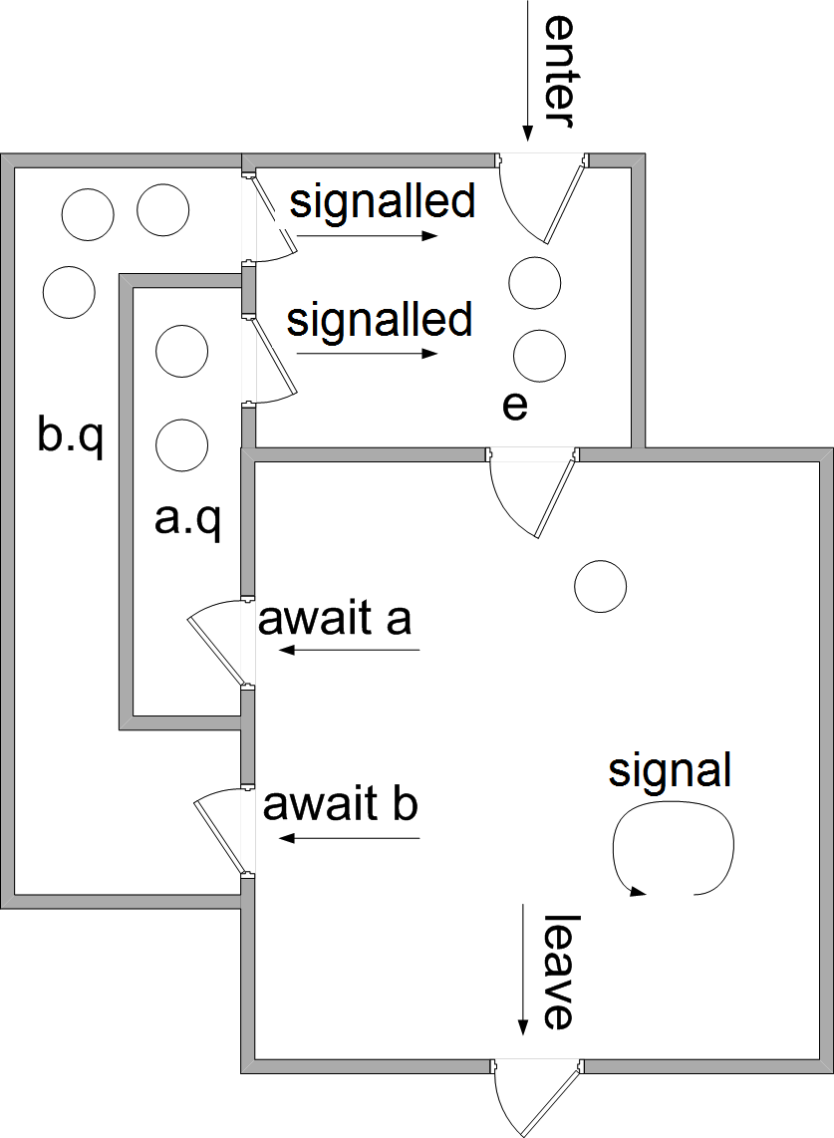
Dentist with multiple waiting rooms
  Room a:
    to wait for sedation to kick in
  Room b:
    to wait for result of a test

Slide 13
await in while
Why use while-statement for await (and not if)?
  Thread first has to wait its turn before it can continue
  running
  State can be changed in the meantime

Slide 14
Readers-Writers Problem
A data set is shared among a number of threads
Two types of threads:
  Readers
    only read the data set; do not perform any updates
  Writers
    both read and update the data set
Requirements:
  allow multiple readers at the same time
  allow only one writer at the same time
  allow no readers and writers together
Notes:
Semaphore solution: see book
Synchronized solution: see book/demo
Next: JAVA reentrantlock & conditions

Slide 15
Readers-Writers Monitor
Make a monitor class RW with 4 methods:
  enterReader
  exitReader
  enterWriter
  exitWriter

Slide 16
Structure of a reader/writer
General structure of a reader:
  while(true) {
  RW.enterReader();
  ... // Read dataset (CS)
  RW.exitReader();
  }
General structure of a writer:
  while(true) {
  RW.enterWriter();
  ... // Read/update dataset (CS)
  RW.exitWriter();
  }
More complicated if reader/writer can be interrupted in CS (see slides 23 and up : Ending a thread)

Slide 17
Inside the monitor
In this monitor, we use the following private variables:
  readersActive → Number of readers in CS
  writersActive → Number of writers in CS
We also use these Conditions:
  okToRead: readers wait here until they can read:
    writersActive==0
  okToWrite: writers wait here until they can write:
    writersActive==0 and readersActive==0

Slide 18
Reader part of monitor
public void enterReader() throws InterruptedException{
monLock.lock();
try {
while (writersActive > 0) { okToRead.await(); }
readersActive++;
}
finally {
monLock.unlock();
}
}
public void exitReader() {
monLock.lock();
try {
readersActive--;
if (readersActive == 0) okToWrite.signal();
}
finally {
monLock.unlock();
}
}

Slide 19
Writer part of monitor
public void enterWriter() throws InterruptedException {
monLock.lock();
try {
while (writersActive > 0 || readersActive > 0)
okToWrite.await();
writersActive++;
}
finally {
monLock.unlock();
}
}

Slide 20
Writer part of monitor
There is a problem when a writer leaves the CS, and there are both readers and writers waiting:
  does he wake up a reader, or
  does he wake up a writer?
Suppose we want to give the readers precedence:
  count number of waiting readers: readersWaiting

Slide 21
Replace in enterReader the while statement by:
  while (writersActive != 0) {
  readersWaiting++;
  okToRead.await();
  readersWaiting--;
  }
public void exitWriter() {
monLock.lock();
try {
writersActive--;
if(readersWaiting > 0) okToRead.signal();
else okToWrite.signal();
}
finally {
monLock.unlock();
}
}

Slide 22
Ending a thread
• 3 ways to end a thread
– We might use Thread.stop()
• Stops thread right away, no matter what it is doing
• Dangerous, therefore deprecated
• Just don’t use this
– We might use a shared boolean
– We might interrupt the thread

Slide 23
Using a shared boolean
Assume shared boolean stop, initially false
  In the thread, this variable is checked:
    while(!stop) {
    … // do some action
    }
  We can stop the thread by setting stop to true
    void StopThread() {
    stop = true;
    }
Thread will complete the action, and then stop
OK, but not when the thread is waiting or sleeping somewhere in the while statement

Slide 24
Interrupting a thread
Send interrupt signal with t.interrupt()
Every thread has an interrupt status
  initially false (cleared)
2 methods to check the interrupt status
  Static method interrupted
    returns interrupt status of current thread
    clears interrupt status
  Non-static method isInterrupted
    returns interrupt status (of any thread)
    Does not change interrupt status

Slide 25
Interrupting a thread
Effect of interrupt depends on what thread is doing:
  If thread is blocked in call to wait, join or sleep:
    interrupt status will be cleared and
    InterruptedException will be thrown
  Otherwise:
    interrupt status will be set
So wait, join and sleep can throw InterruptedException (must be caught)

Slide 26
Interrupting a thread
Suppose, thread executes this:
  while(!interrupted()) {
  ...... // do some ‘action’
  c.await(); // wait for some condition
  ...... // do some ‘action’
  sleep(500); // sleep for 500 msec
  }
2 possibilities, when we interrupt this thread:
  it might be executing the ‘action’ or
  it might be in the sleep or await

Slide 27
Interrupting a thread
If the thread was executing the ‘action’ when the interrupt occurred, then:
  interrupt status will be set,
  thread will continue normally:
    finish the ‘action’,
    do the await and/or sleep, and then
    end the while-statement
  This is what we expect

Slide 28
Interrupting a thread
If the thread was sleeping or waiting when the interrupt occurred, then :
  sleep/await ends immediately
    InterruptedException is thrown
  interrupt status will not be set
  while statement will not end
  This is unexpected!
To solve last situation:
  Handle InterruptedException correctly

Slide 29
Interrupting a thread
Solution 1: let thread interrupt itself:
  while(!interrupted()) {
  try {
  ...... // do some action
  c.await(); // wait for some condition
  ...... // do some action
  sleep(500); // wait for 500 msec
  } catch (InterruptedException) {
  Thread.currentThread().interrupt();
  }
  }
Stop thread with
  t.interrupt();

Slide 30
Interrupting a thread
Solution 2: use shared boolean
  while(!stop) {
  try {
  ...... // do some action
  c.await(); // wait for some condition
  ...... // do some action
  sleep(500); // wait for 500 msec
  } catch (InterruptedException) { }
  }
Stop thread with
  t.stop = true;
  t.interrupt();
When interrupted on the dots (......), the next wait or sleep will get InterruptedException immediately

Slide 31
Links:
  http://www.baptiste-wicht.com/2010/09/java-concurrency-part-5-monitors-locks-and-conditions/
From Java Core, Volume 1 (ed 8):
  Chapter 14 “Multithreading”, paragraphs:
    “Synchronization”, especially:
      “Lock Objects”
      “Condition Objects”

