Slide 1
cdc — Complex Desk Calculator
Test-driven development in 29 increments
Hector Giraud (261191916), Lucas Bitbol (261158667)

Slide 2
How these slides were made
Disclosure
1 Captured during development
2 Built by a deterministic program
3 Generator written with AI
While doing TDD, every RED and GREEN step ran our snap.sh script. It saved the screenshots and committed them with a structured message (incNN RED/GREEN: test id).
This deck was then generated automatically from the git history and those screenshots: 29 increments, no manual editing. The same repository always produces the same slides.
The script that builds the slides (build_slides.py) was written with the help of an AI assistant. It does not use AI when it runs: it only reads git, the test files and the images.
This was only possible because of how we organised our TDD automation: each screenshot and commit was produced in a consistent, machine-readable way at the moment the work happened.
All of the calculator code, the unit tests and their statements, and the following of the TDD process itself were written by us, WITHOUT AI-generated code. AI was used only for writing the automation script and the slide-building script.
snap.sh → git history + documentation/shots/ → build_slides.py → this deck

Slide 3
How each increment is documented
Every increment starts with a statement slide: the unit test, what it checks and the expected results.
It is followed by five screenshots, generated automatically by snap.sh and committed with the code:
1 the new unit test code (diff of tests/)
2 the new test failing before any implementation — RED commit
3 the production code changes, highlighted as a diff of src/
4 the new test passing after the change — GREEN commit
5 the whole suite (uv run pytest) still passing — no regressions
The step bar at the bottom of each slide shows where you are in the cycle.
1 Test code
2 Fails
3 Code change
4 Passes
5 All pass

Slide 4
Increments overview
1–14 of 29
Inc | Unit test | File
01 | Calculator has push | test_class.py
02 | Calculator push is safe | test_class.py
03 | Calculator has working pop | test_class.py
04 | Calculator does substract | test_class.py
05 | If stack underflow while substract number is not lost | test_class.py
06 | Calculator does divide | test_class.py
07 | If stack underflow while divide number is not lost | test_class.py
08 | If divide by zero number is not lost | test_class.py
09 | Calculator does add | test_class.py
10 | If add number is not lost | test_class.py
11 | Calculator does multiply | test_class.py
12 | If multiply number is not lost | test_class.py
13 | Calculator does delete | test_class.py
14 | Delete on empty stack raises (passed directly) | test_class.py

Slide 5
Increments overview
15–28 of 29
Inc | Unit test | File
15 | Decoder instantiates | test_ui.py
16 | Decoder handles push pop with reals | test_ui.py
17 | Decoder handles push pop with complex and weird inputs | test_ui.py
18 | Decoder handles decimal | test_ui.py
19 | Decoder rejects bad number inputs | test_ui.py
20 | Decoder handles sequence of inputs | test_ui.py
21 | Decoder handles all right inputs and wrong inputs | test_ui.py
22 | Cli quits on eof | test_ui.py
23 | Cli works for one line | test_ui.py
24 | Cli works for multiple lines and input types | test_ui.py
25 | Cli escapes errors | test_ui.py
26 | Delete works and 0 is displayed | test_ui.py
27 | No output when no pop | test_ui.py
28 | Cli is case insensitive | test_ui.py

Slide 6
Increments overview
29–29 of 29
Inc | Unit test | File
29 | Negative zero is normalized | test_ui.py

Slide 7
Increment 01 — Unit test
test_class.py · 1 / 29
Calculator has push
tests/test_class.py::test_calculator_has_push
STATEMENT
EXPECTED RESULTS
Checks that: calculator has push.
✓ assert calc.push(0)
1 Test code
2 Fails
3 Code change
4 Passes
5 All pass
red 2da1cc3 green aa94aa9

Slide 8
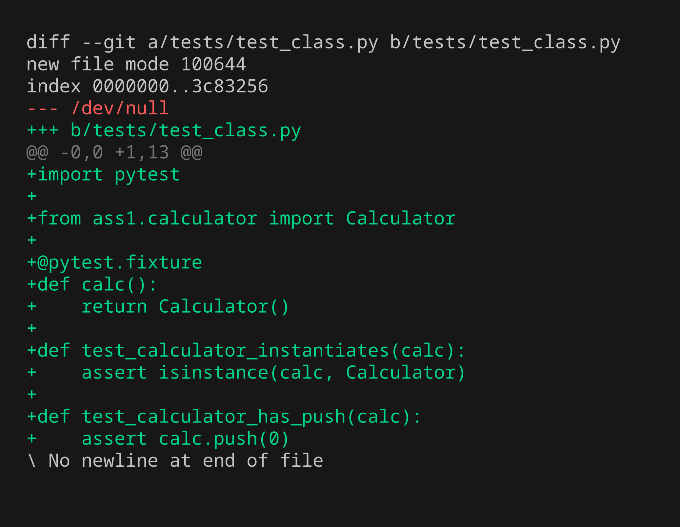
Inc 01 · Step 1/5 — Unit test code
Calculator has push
New test added — diff of tests/
1 Test code
2 Fails
3 Code change
4 Passes
5 All pass
documentation\shots\inc01\1-test-code.png · commit 2da1cc3
1 / 29

Slide 9
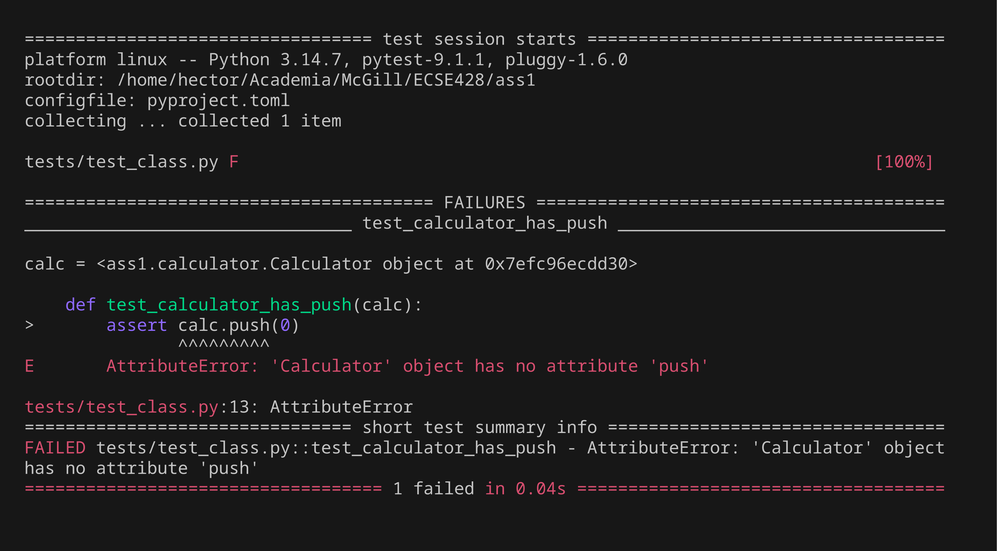
Inc 01 · Step 2/5 — Unit test fails (RED)
Calculator has push
Only the new test, run before implementing it
1 Test code
2 Fails
3 Code change
4 Passes
5 All pass
documentation\shots\inc01\2-test-fails.png · commit 2da1cc3
1 / 29

Slide 10
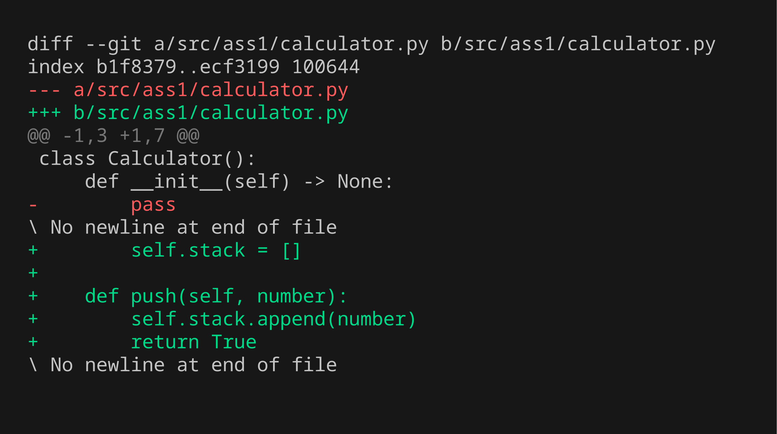
Inc 01 · Step 3/5 — Code changes
Calculator has push
Highlighted diff of src/ (green = added, red = removed)
1 Test code
2 Fails
3 Code change
4 Passes
5 All pass
documentation\shots\inc01\3-code-change.png · commit aa94aa9
1 / 29

Slide 11
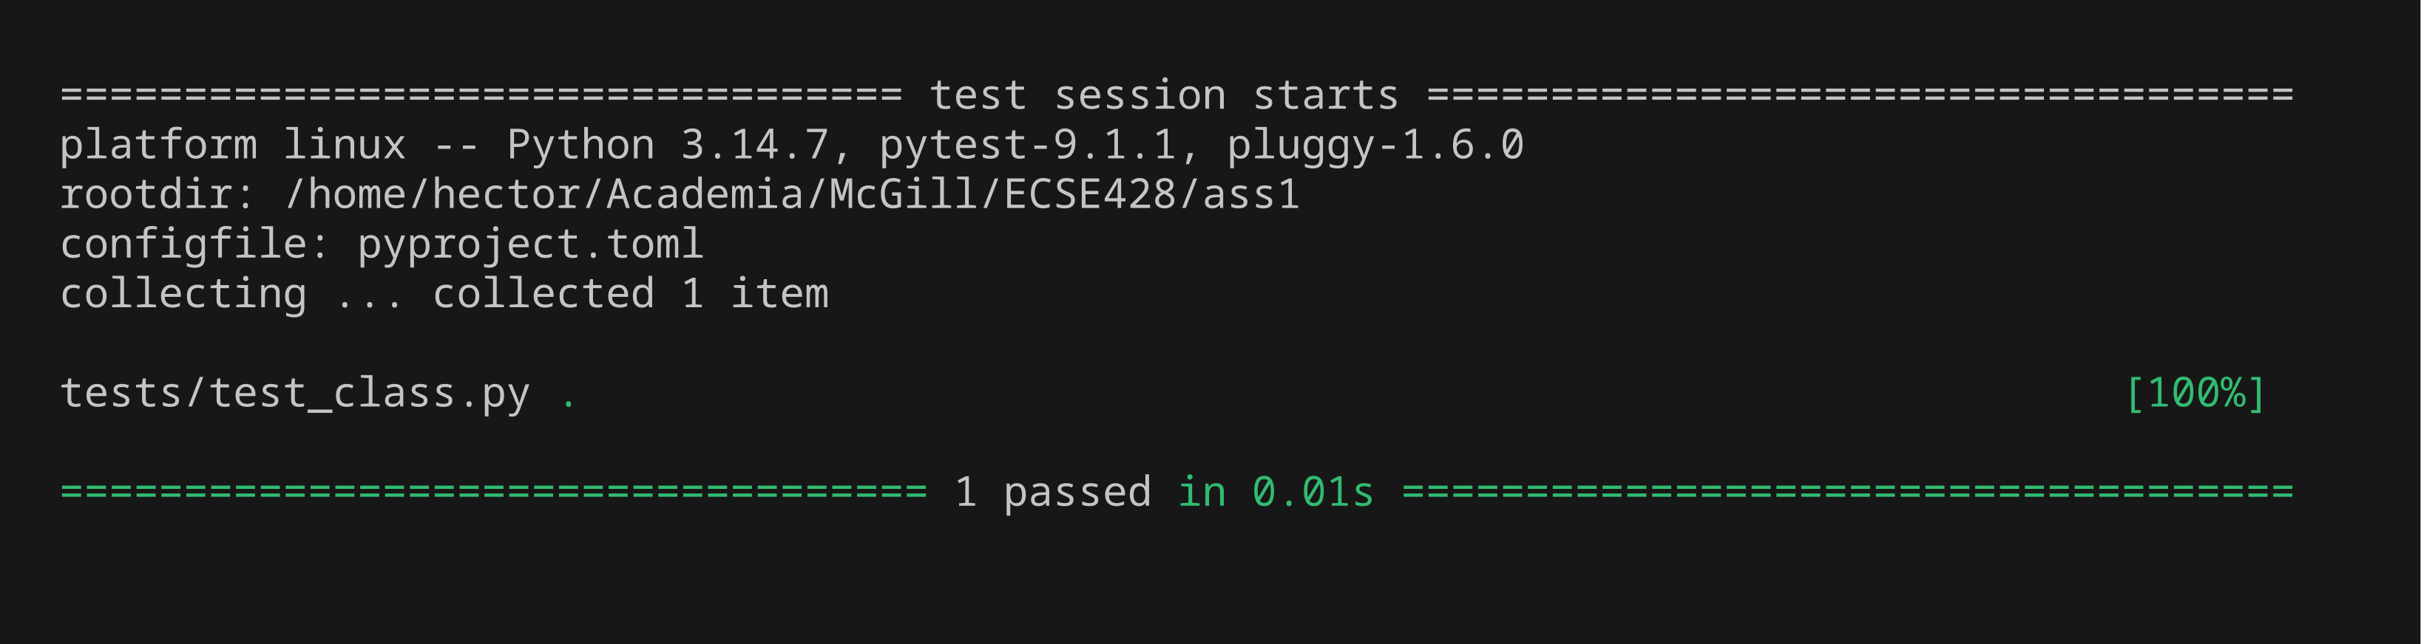
Inc 01 · Step 4/5 — Unit test passes (GREEN)
Calculator has push
Only the new test, run after the code change
1 Test code
2 Fails
3 Code change
4 Passes
5 All pass
documentation\shots\inc01\4-test-passes.png · commit aa94aa9
1 / 29

Slide 12
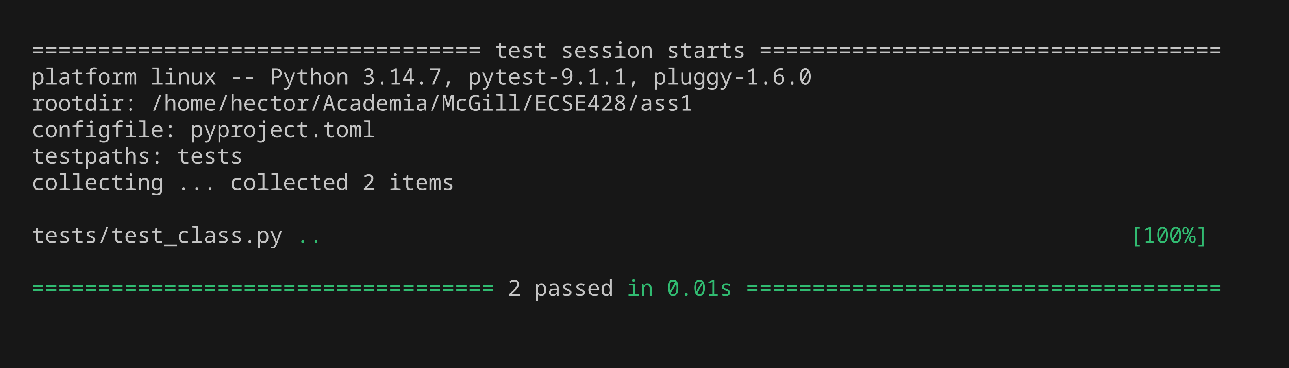
Inc 01 · Step 5/5 — All previous tests still pass
Calculator has push
Full regression run: uv run pytest
1 Test code
2 Fails
3 Code change
4 Passes
5 All pass
documentation\shots\inc01\5-all-tests-pass.png · commit aa94aa9
1 / 29

Slide 13
Increment 02 — Unit test
test_class.py · 2 / 29
Calculator push is safe
tests/test_class.py::test_calculator_push_is_safe
STATEMENT
EXPECTED RESULTS
Checks that: calculator push is safe.
✓ raises ValueError
1 Test code
2 Fails
3 Code change
4 Passes
5 All pass
red f83bfe7 green 35193f6

Slide 14
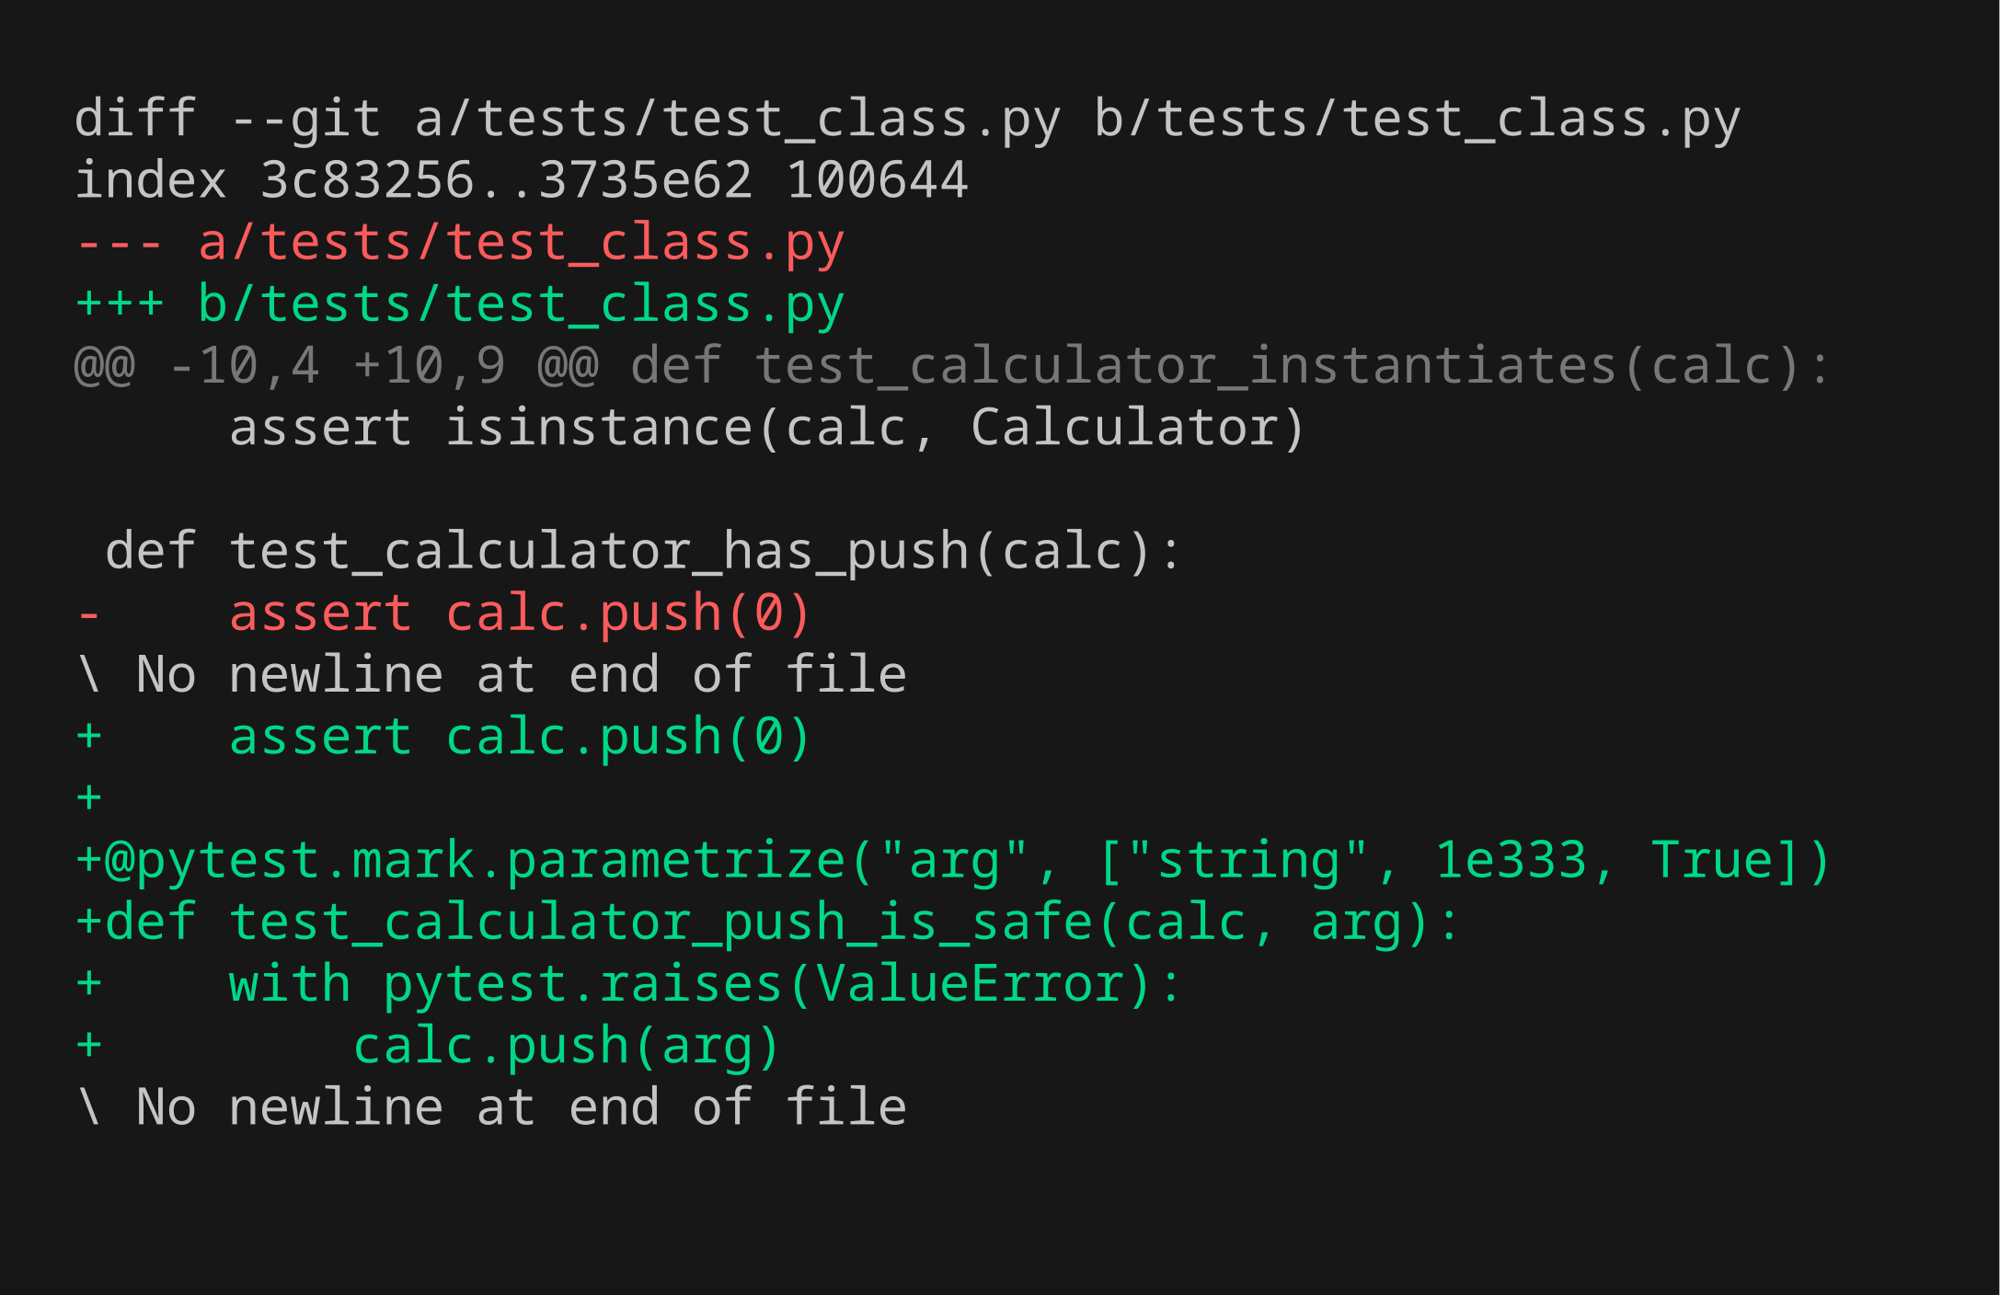
Inc 02 · Step 1/5 — Unit test code
Calculator push is safe
New test added — diff of tests/
1 Test code
2 Fails
3 Code change
4 Passes
5 All pass
documentation\shots\inc02\1-test-code.png · commit f83bfe7
2 / 29

Slide 15
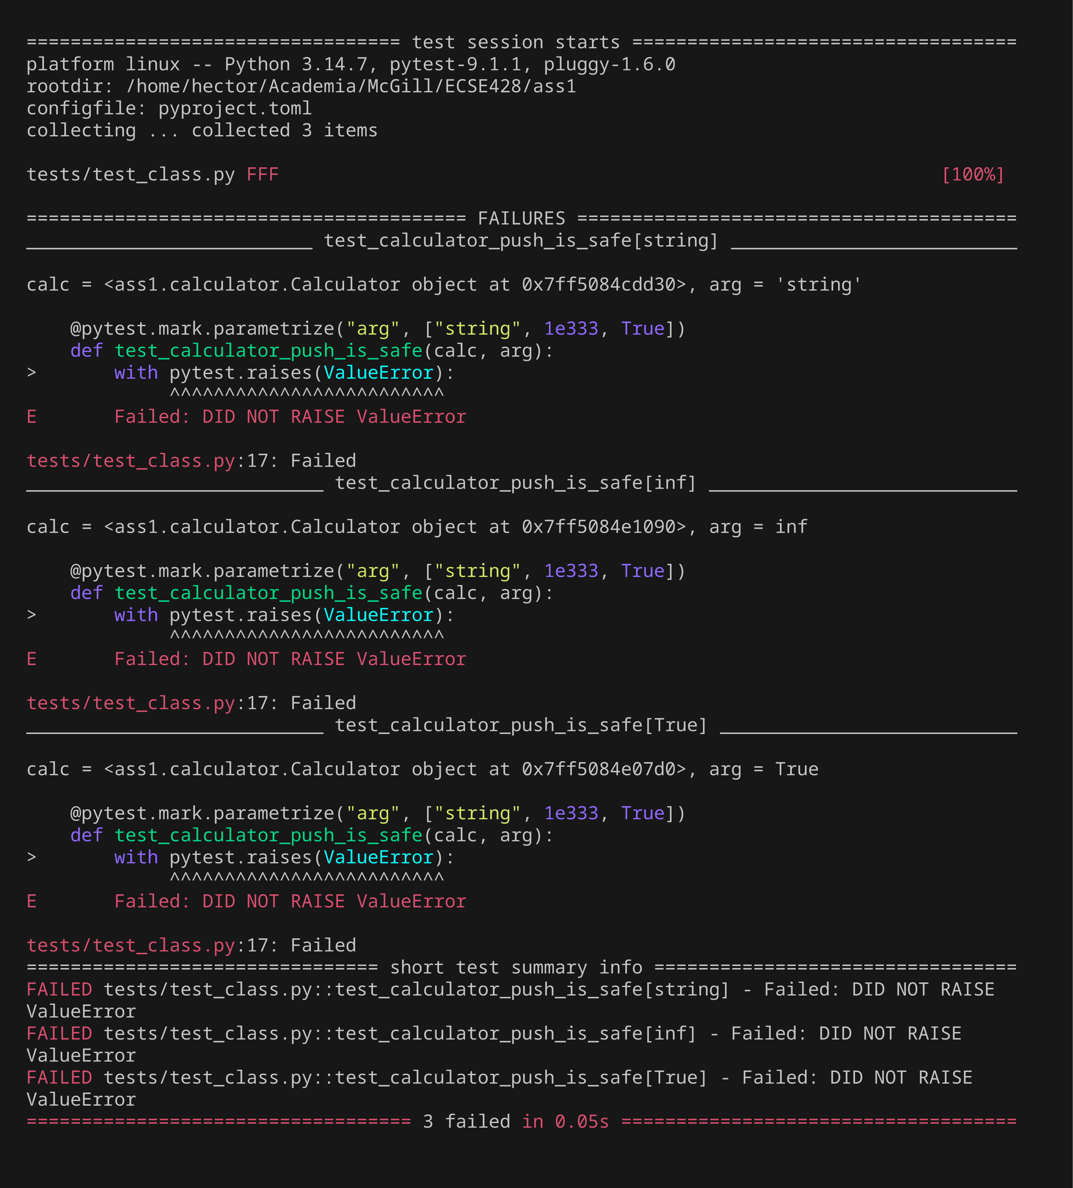
Inc 02 · Step 2/5 — Unit test fails (RED)
Calculator push is safe
Only the new test, run before implementing it
1 Test code
2 Fails
3 Code change
4 Passes
5 All pass
documentation\shots\inc02\2-test-fails.png · commit f83bfe7
2 / 29

Slide 16
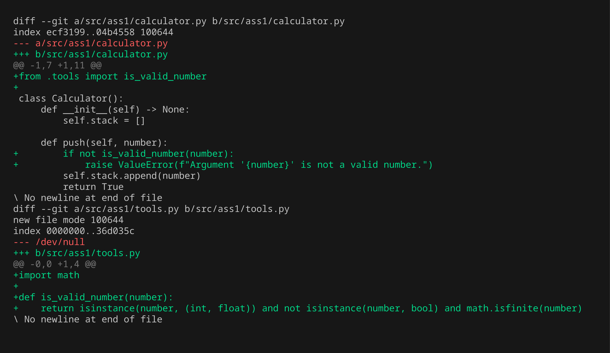
Inc 02 · Step 3/5 — Code changes
Calculator push is safe
Highlighted diff of src/ (green = added, red = removed)
1 Test code
2 Fails
3 Code change
4 Passes
5 All pass
documentation\shots\inc02\3-code-change.png · commit 35193f6
2 / 29

Slide 17
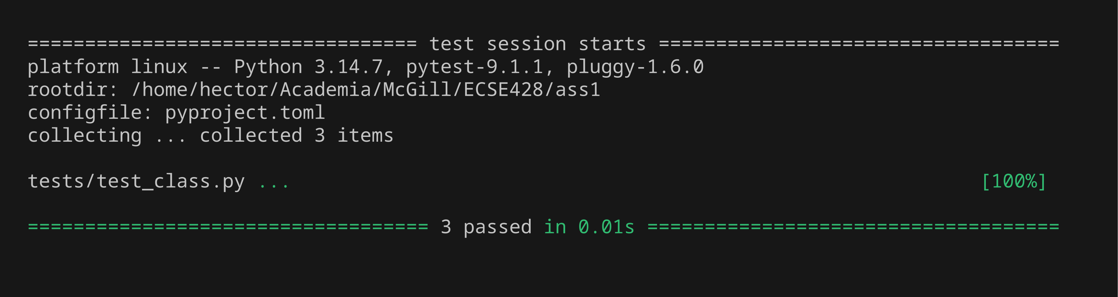
Inc 02 · Step 4/5 — Unit test passes (GREEN)
Calculator push is safe
Only the new test, run after the code change
1 Test code
2 Fails
3 Code change
4 Passes
5 All pass
documentation\shots\inc02\4-test-passes.png · commit 35193f6
2 / 29

Slide 18

Inc 02 · Step 5/5 — All previous tests still pass
Calculator push is safe
Full regression run: uv run pytest
1 Test code
2 Fails
3 Code change
4 Passes
5 All pass
documentation\shots\inc02\5-all-tests-pass.png · commit 35193f6
2 / 29

Slide 19
Increment 03 — Unit test
test_class.py · 3 / 29
Calculator has working pop
tests/test_class.py::test_calculator_has_working_pop
STATEMENT
EXPECTED RESULTS
Checks that: calculator has working pop.
✓ assert calc.pop() == n
1 Test code
2 Fails
3 Code change
4 Passes
5 All pass
red 6690114 green 095aa68

Slide 20
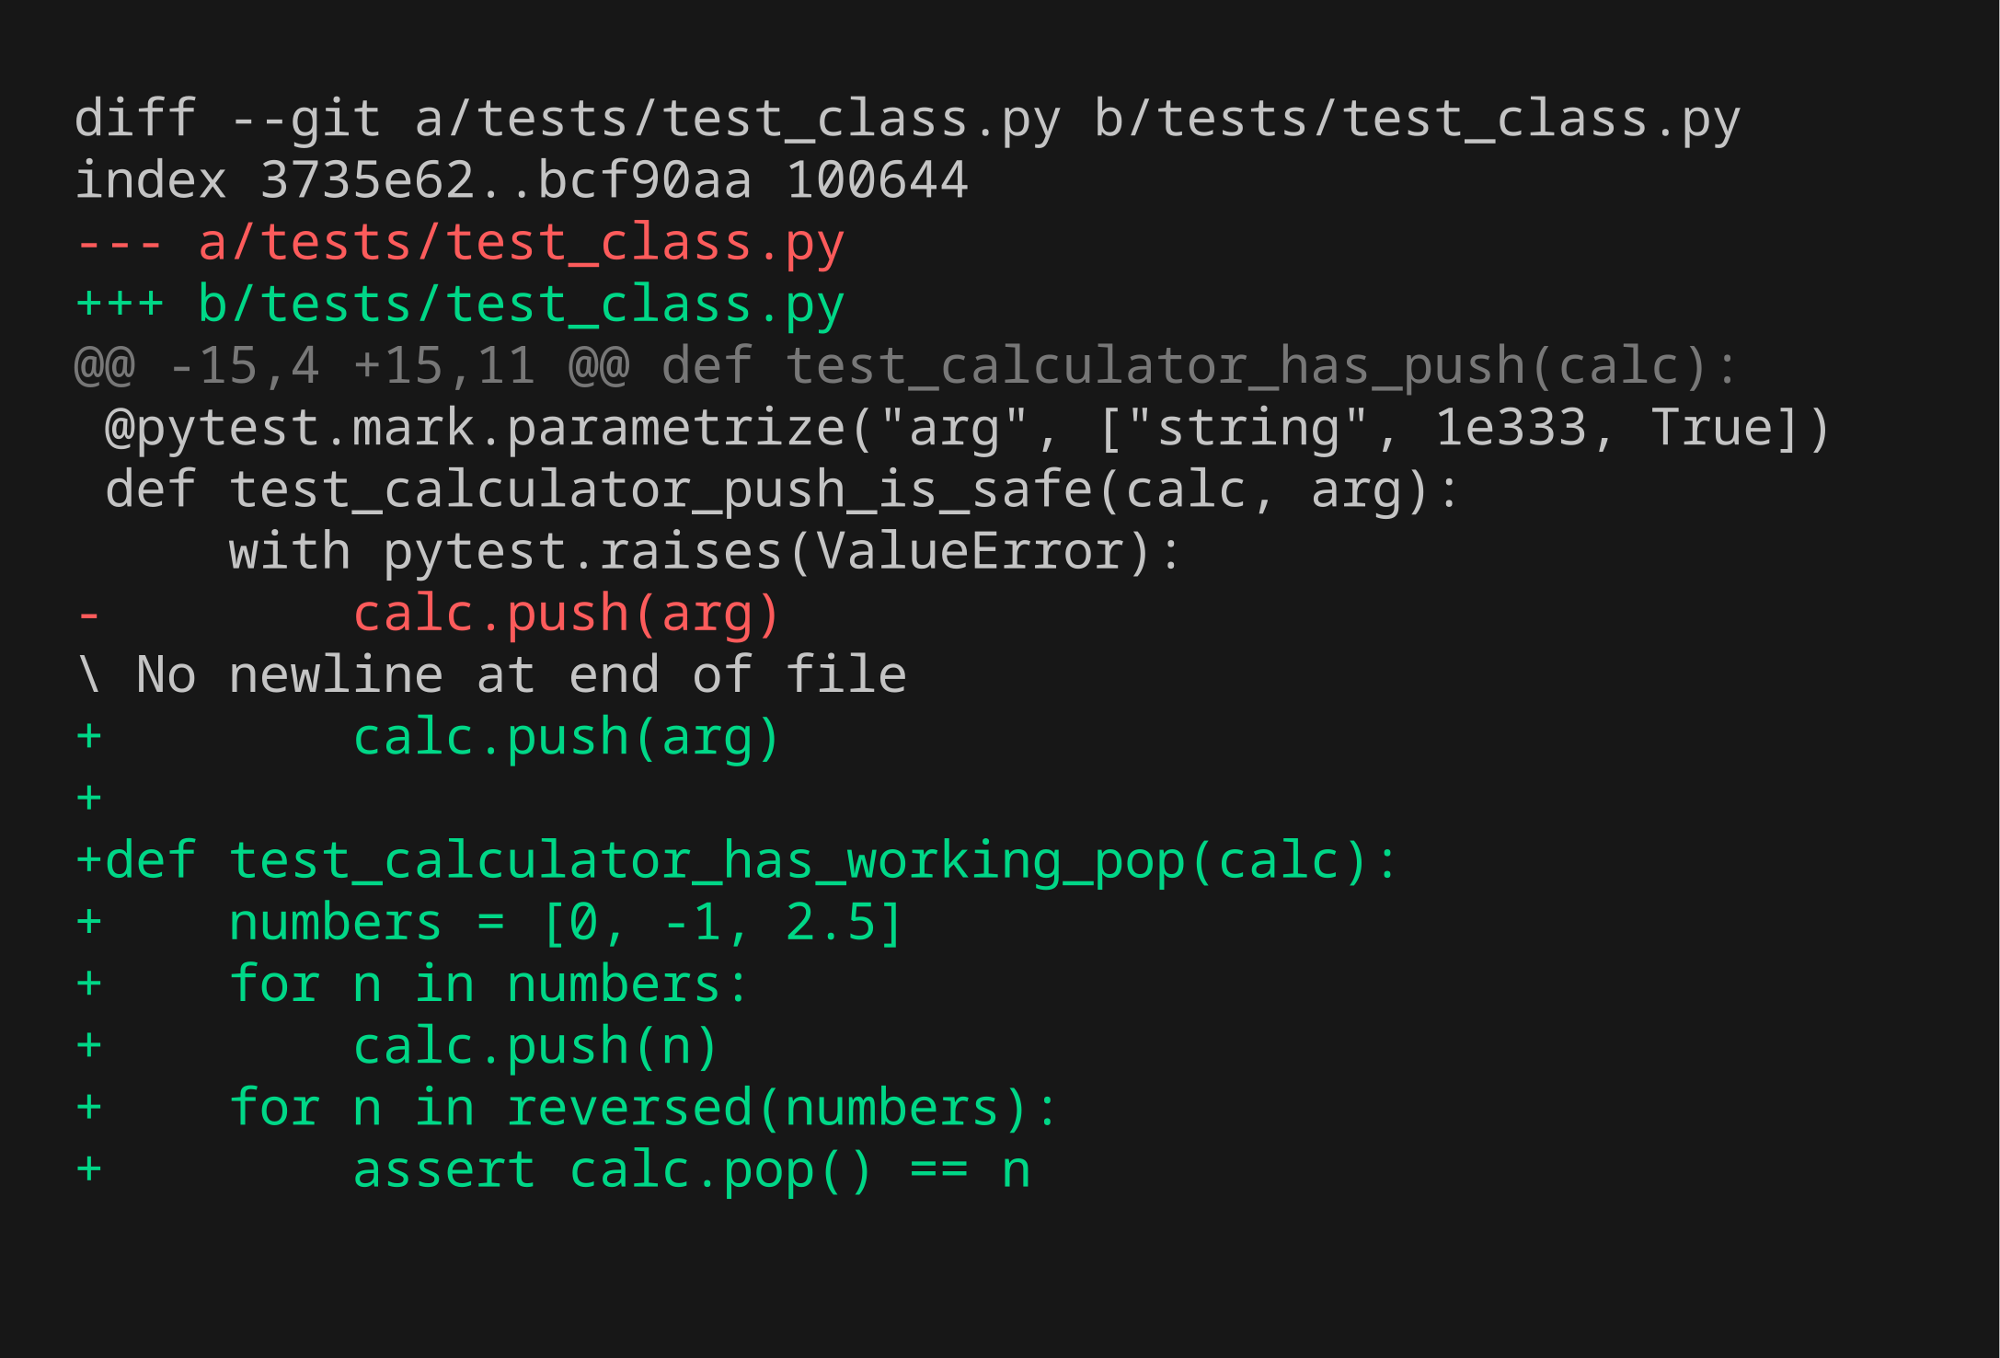
Inc 03 · Step 1/5 — Unit test code
Calculator has working pop
New test added — diff of tests/
1 Test code
2 Fails
3 Code change
4 Passes
5 All pass
documentation\shots\inc03\1-test-code.png · commit 6690114
3 / 29

Slide 21
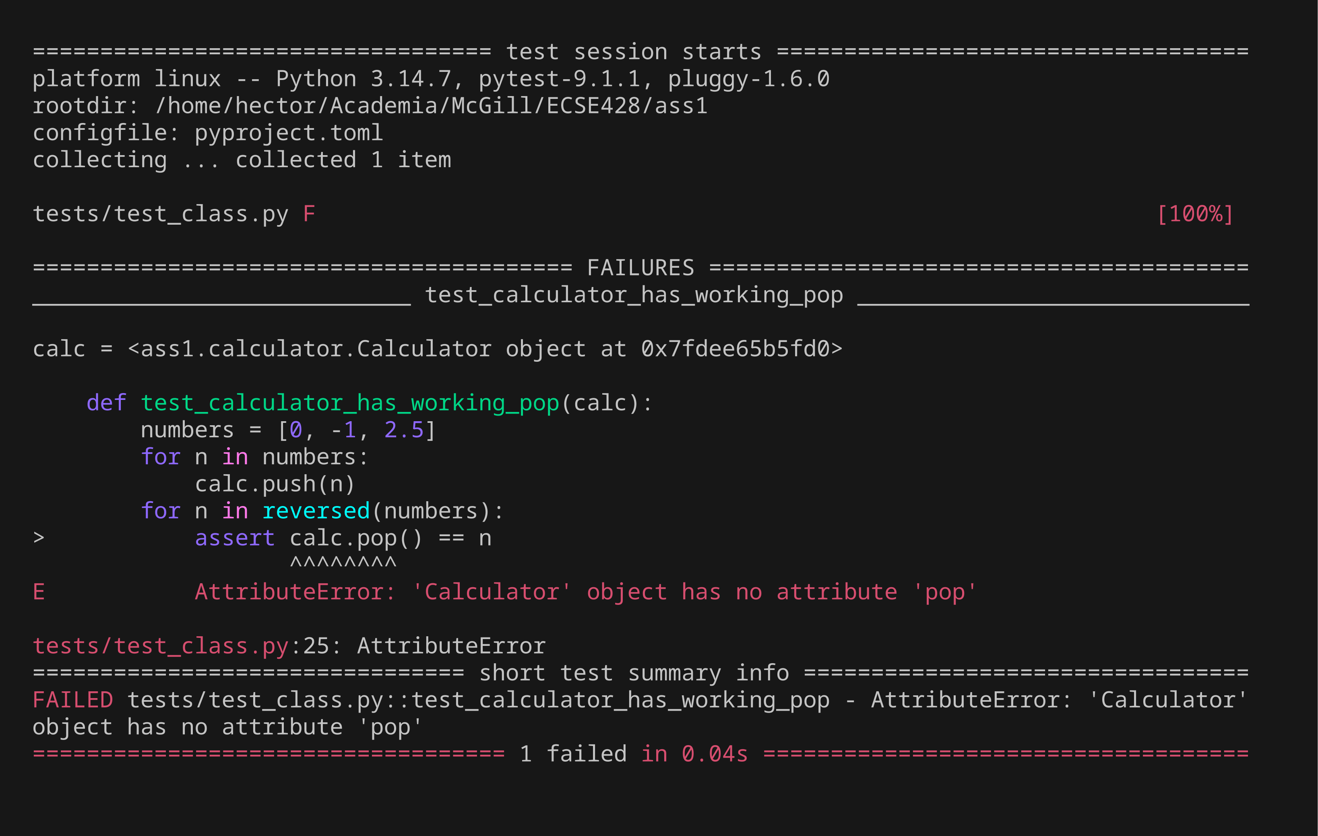
Inc 03 · Step 2/5 — Unit test fails (RED)
Calculator has working pop
Only the new test, run before implementing it
1 Test code
2 Fails
3 Code change
4 Passes
5 All pass
documentation\shots\inc03\2-test-fails.png · commit 6690114
3 / 29

Slide 22
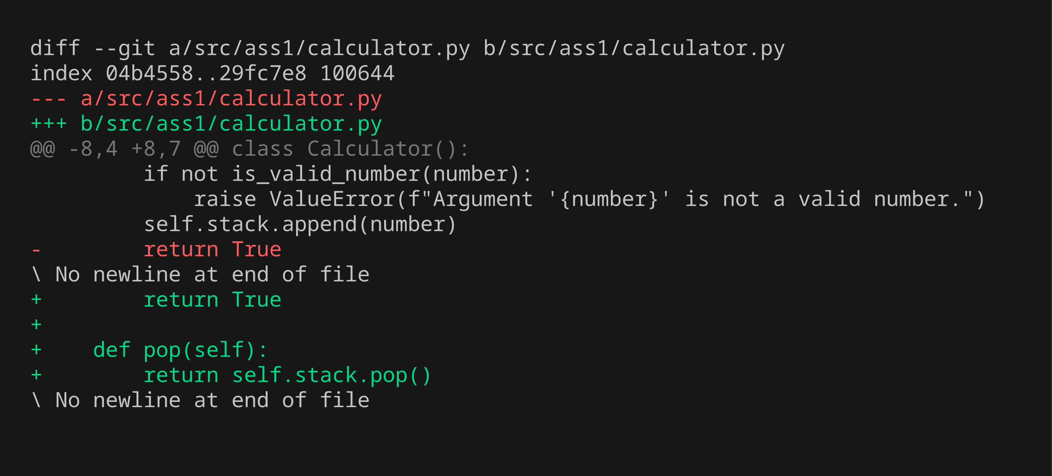
Inc 03 · Step 3/5 — Code changes
Calculator has working pop
Highlighted diff of src/ (green = added, red = removed)
1 Test code
2 Fails
3 Code change
4 Passes
5 All pass
documentation\shots\inc03\3-code-change.png · commit 095aa68
3 / 29

Slide 23
Inc 03 · Step 4/5 — Unit test passes (GREEN)
Calculator has working pop
Only the new test, run after the code change
1 Test code
2 Fails
3 Code change
4 Passes
5 All pass
documentation\shots\inc03\4-test-passes.png · commit 095aa68
3 / 29

Slide 24

Inc 03 · Step 5/5 — All previous tests still pass
Calculator has working pop
Full regression run: uv run pytest
1 Test code
2 Fails
3 Code change
4 Passes
5 All pass
documentation\shots\inc03\5-all-tests-pass.png · commit 095aa68
3 / 29

Slide 25
Increment 04 — Unit test
test_class.py · 4 / 29
Calculator does substract
tests/test_class.py::test_calculator_does_substract
STATEMENT
EXPECTED RESULTS
Checks that: calculator does substract.
✓ assert calc.pop() == result
1 Test code
2 Fails
3 Code change
4 Passes
5 All pass
red 2dd9338 green 581f619

Slide 26
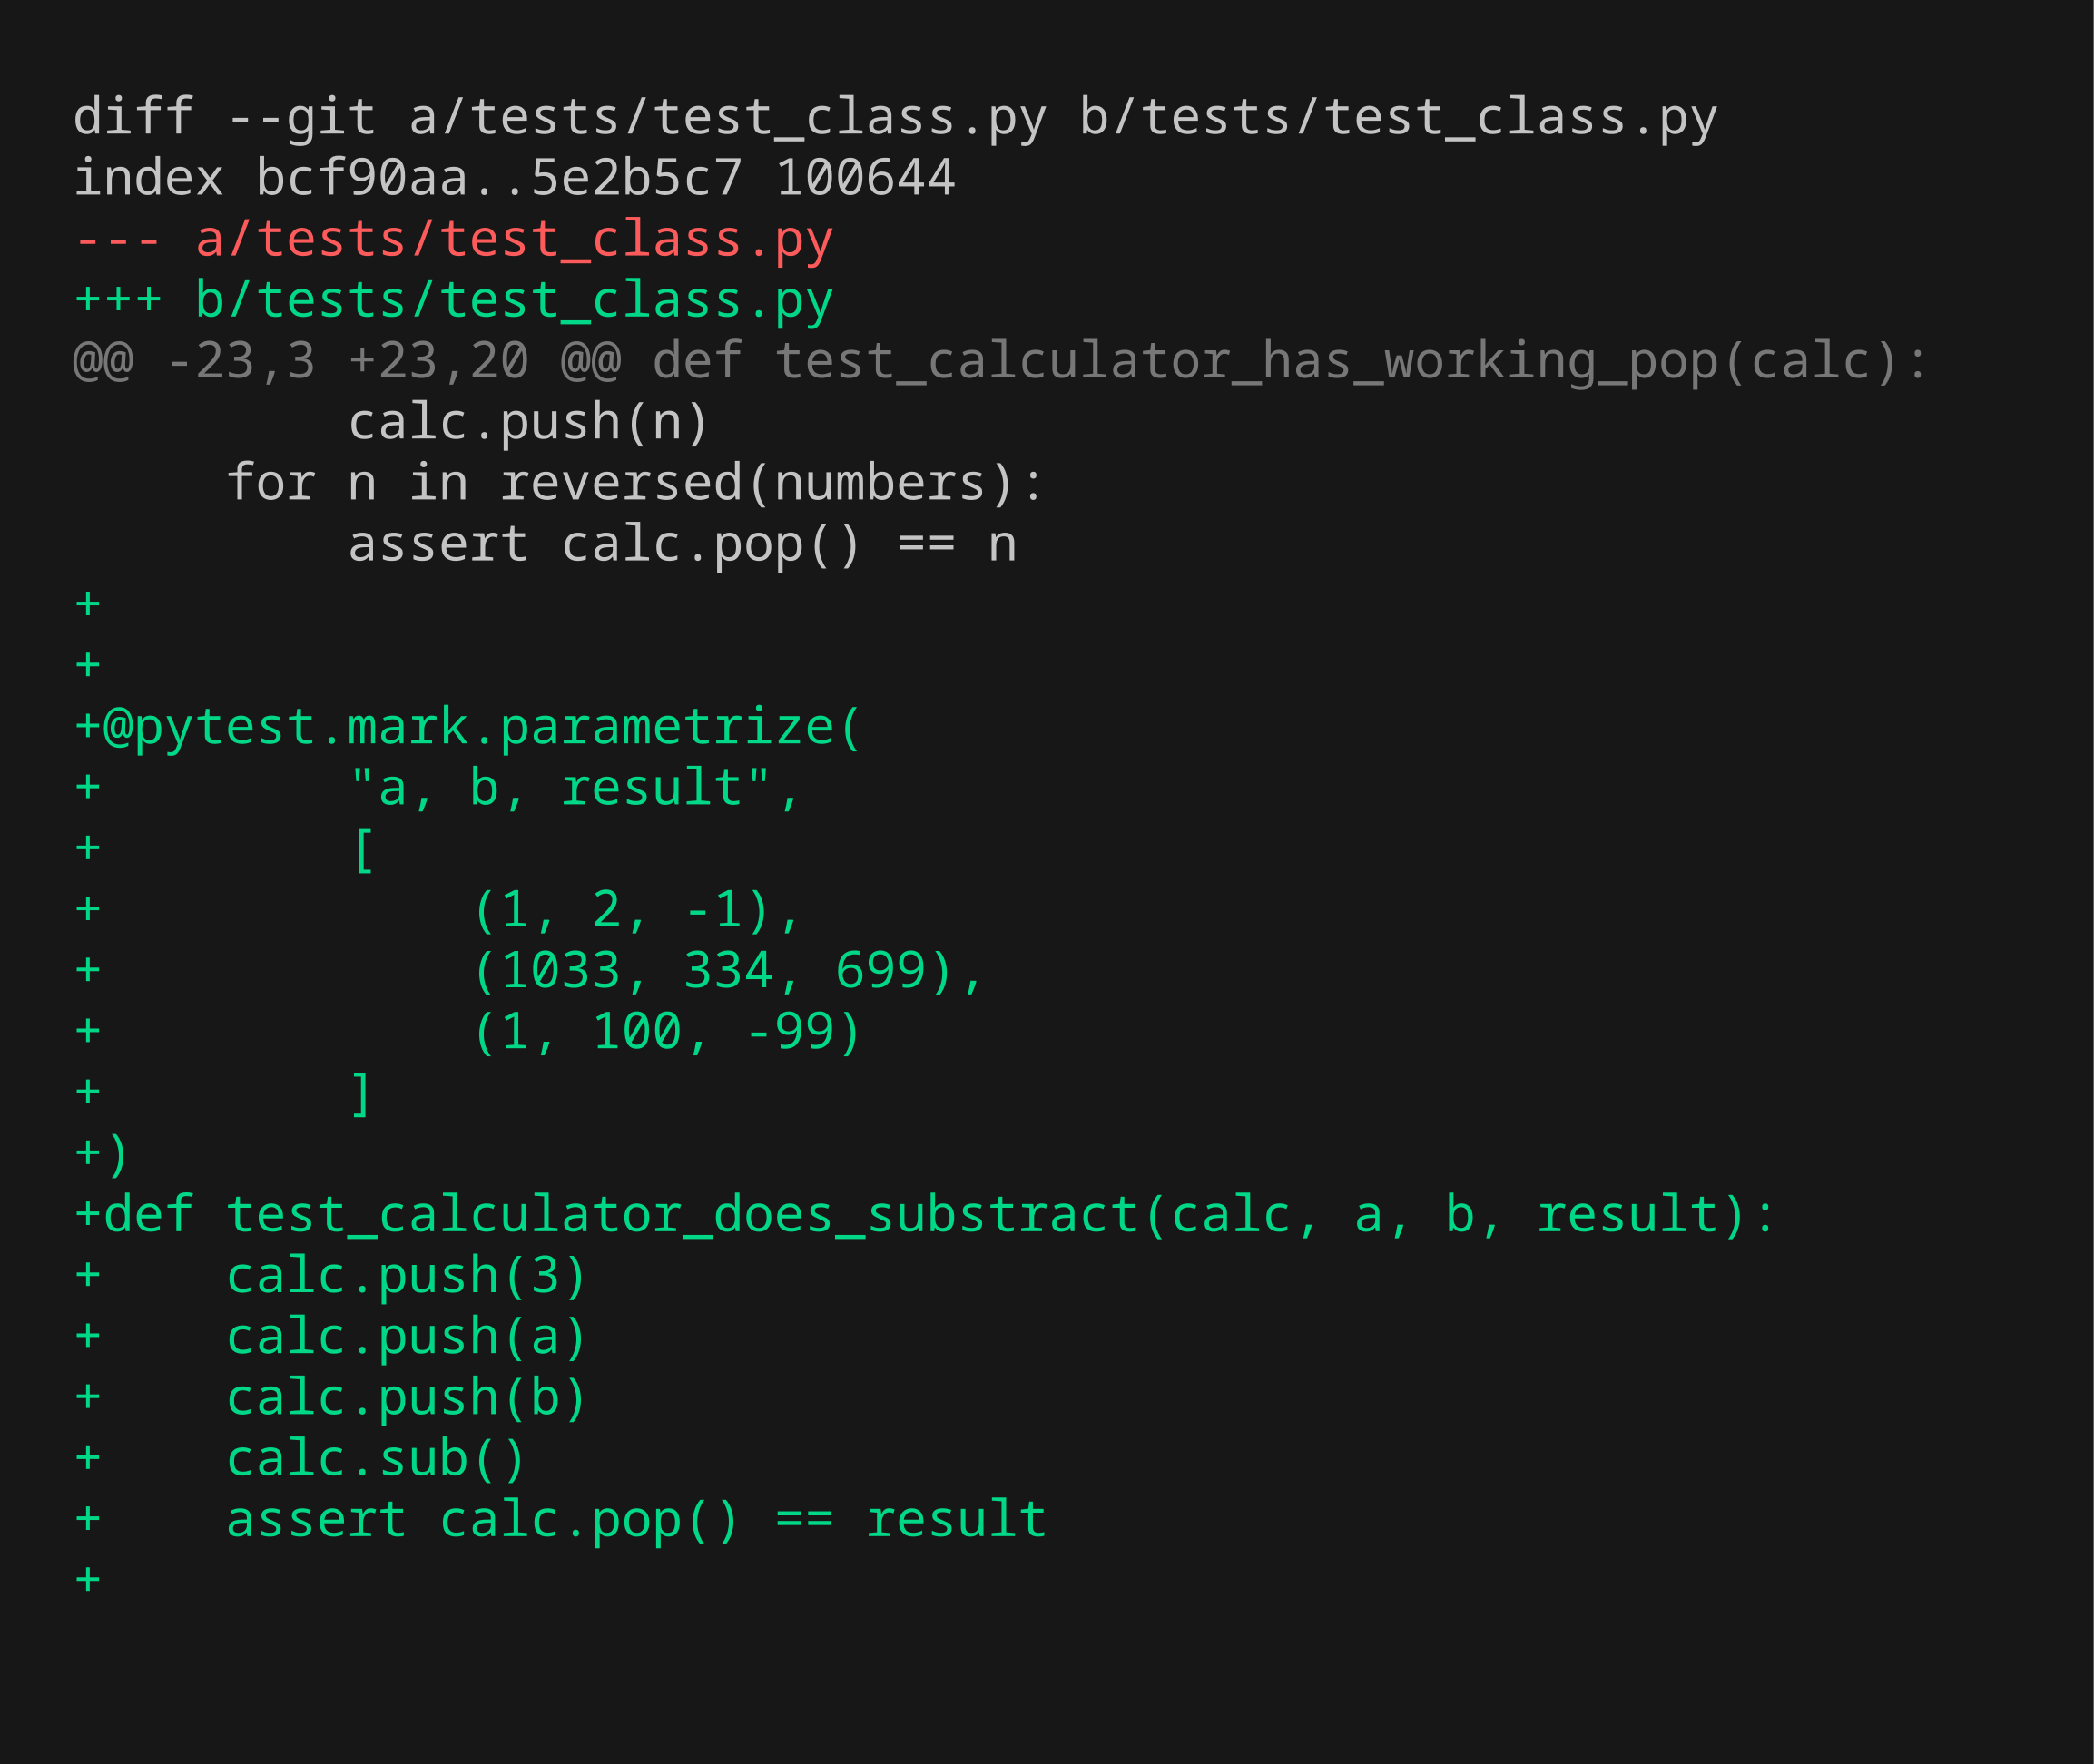
Inc 04 · Step 1/5 — Unit test code
Calculator does substract
New test added — diff of tests/
1 Test code
2 Fails
3 Code change
4 Passes
5 All pass
documentation\shots\inc04\1-test-code.png · commit 2dd9338
4 / 29

Slide 27
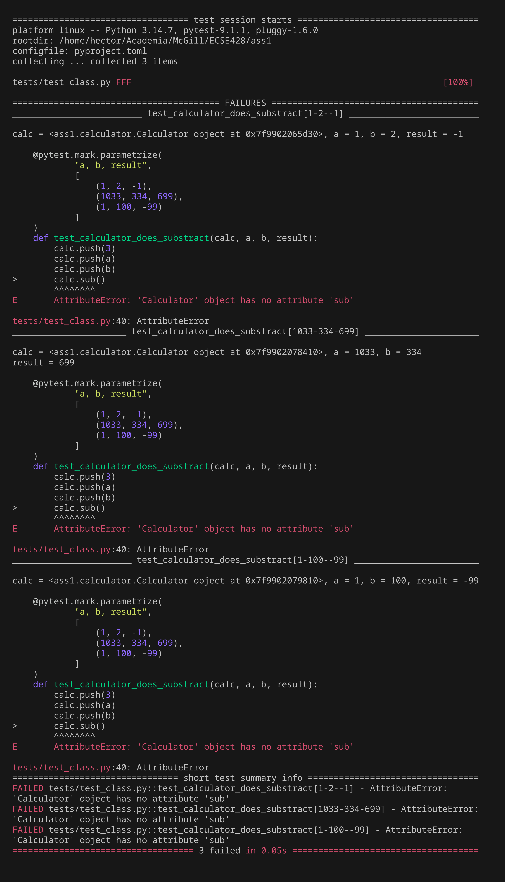
Inc 04 · Step 2/5 — Unit test fails (RED)
Calculator does substract
Only the new test, run before implementing it
1 Test code
2 Fails
3 Code change
4 Passes
5 All pass
documentation\shots\inc04\2-test-fails.png · commit 2dd9338
4 / 29

Slide 28
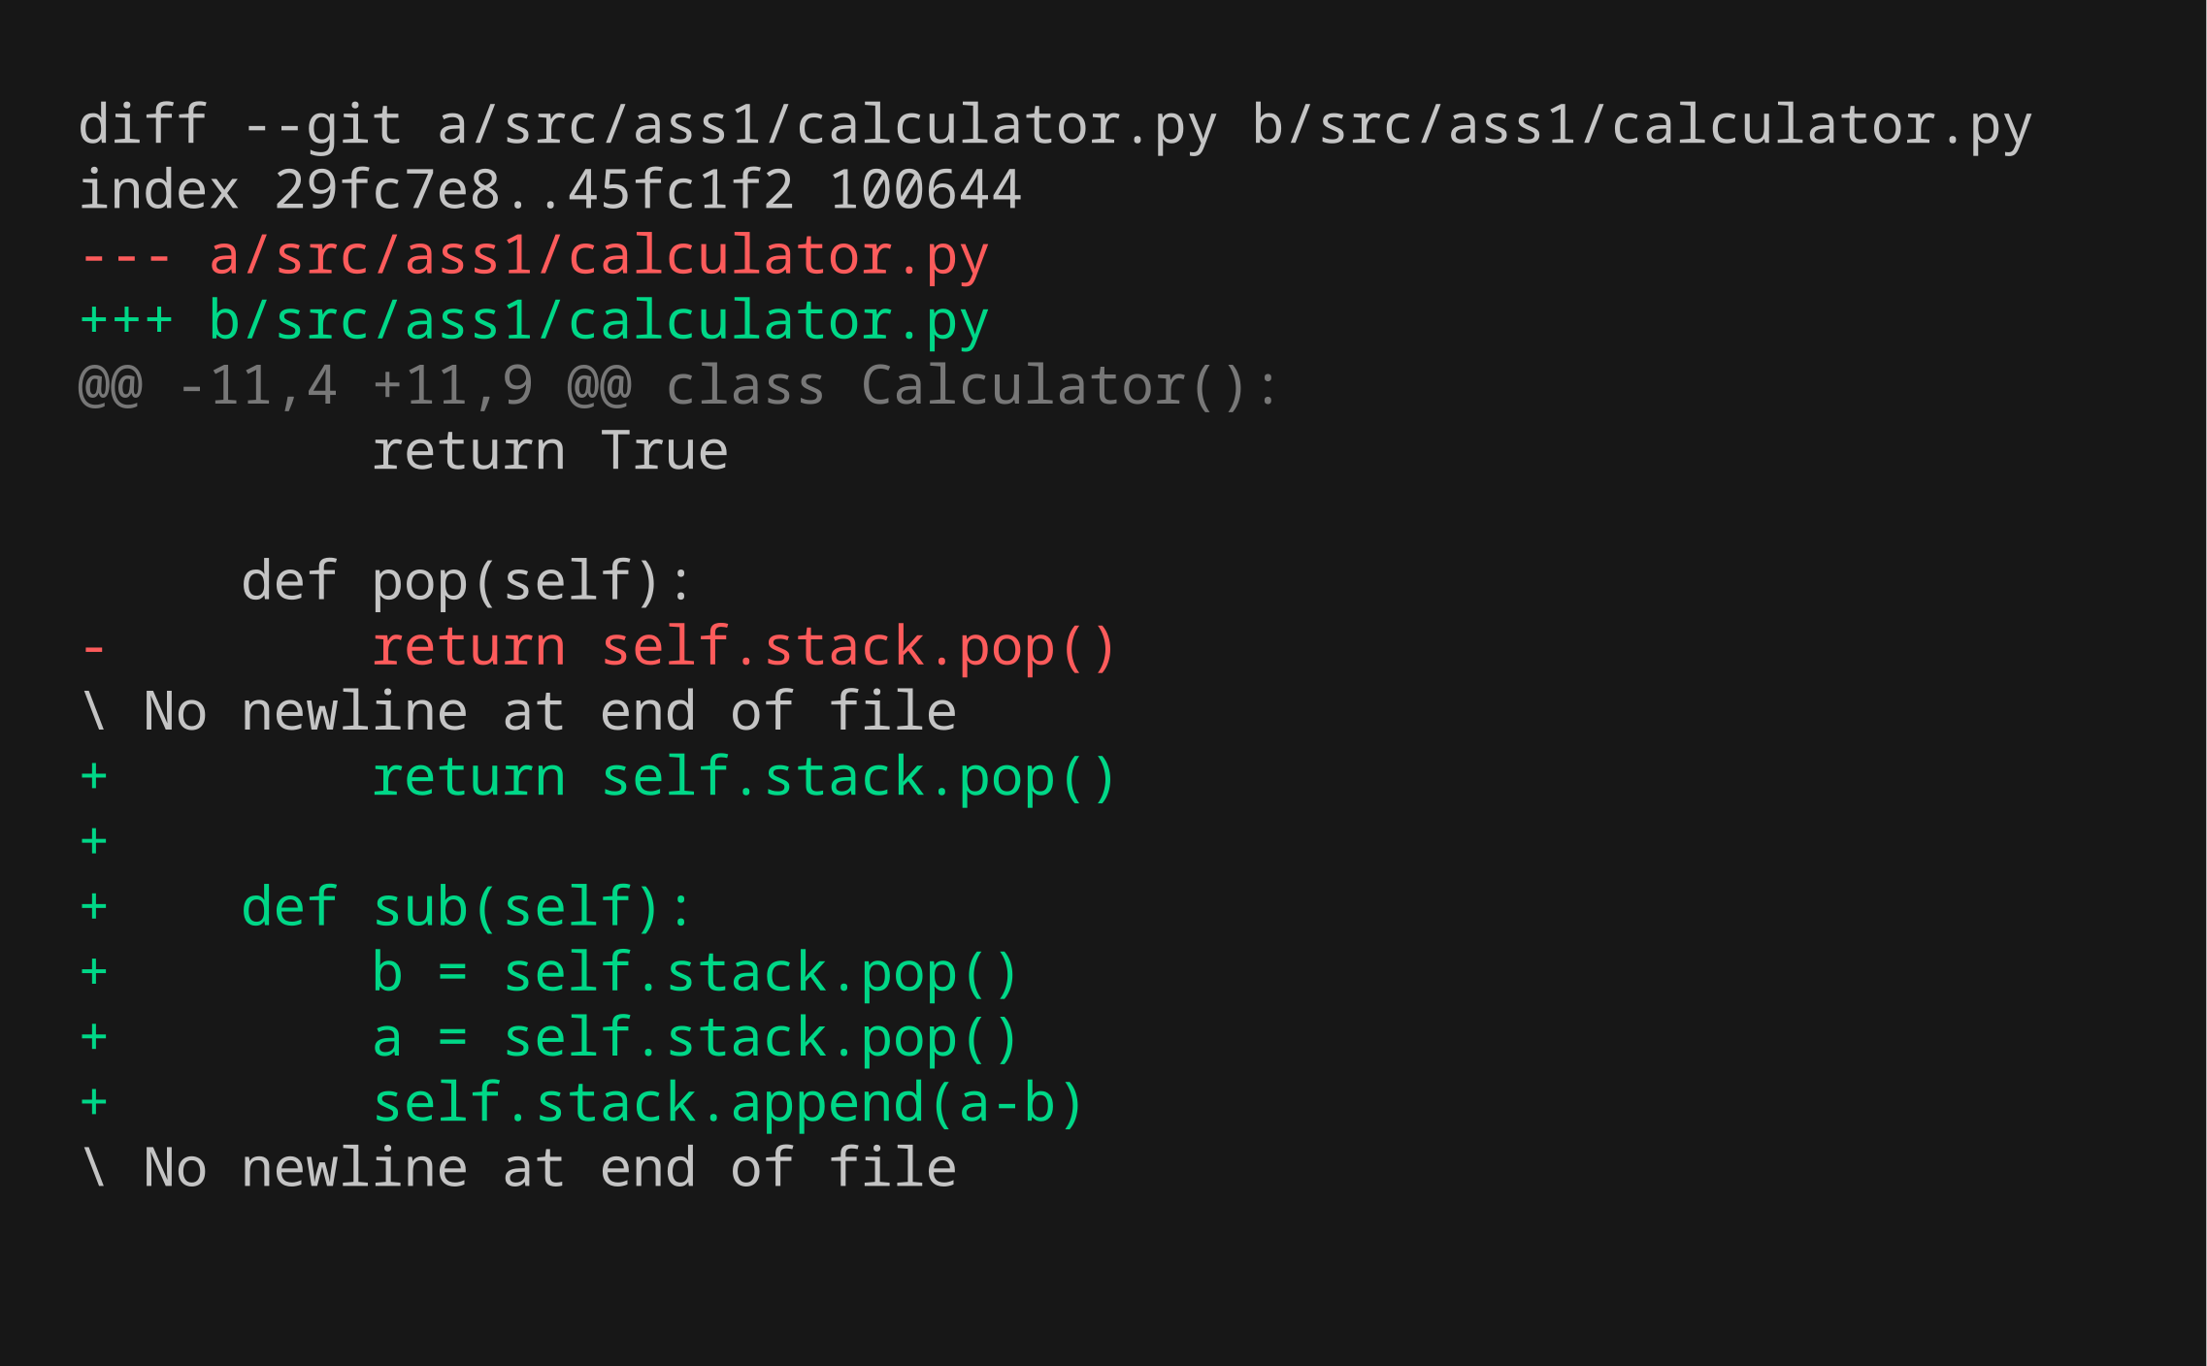
Inc 04 · Step 3/5 — Code changes
Calculator does substract
Highlighted diff of src/ (green = added, red = removed)
1 Test code
2 Fails
3 Code change
4 Passes
5 All pass
documentation\shots\inc04\3-code-change.png · commit 581f619
4 / 29

Slide 29
Inc 04 · Step 4/5 — Unit test passes (GREEN)
Calculator does substract
Only the new test, run after the code change
1 Test code
2 Fails
3 Code change
4 Passes
5 All pass
documentation\shots\inc04\4-test-passes.png · commit 581f619
4 / 29

Slide 30

Inc 04 · Step 5/5 — All previous tests still pass
Calculator does substract
Full regression run: uv run pytest
1 Test code
2 Fails
3 Code change
4 Passes
5 All pass
documentation\shots\inc04\5-all-tests-pass.png · commit 581f619
4 / 29

Slide 31
Increment 05 — Unit test
test_class.py · 5 / 29
If stack underflow while substract number is not lost
tests/test_class.py::test_if_stack_underflow_while_substract_number_is_not_lost
STATEMENT
EXPECTED RESULTS
Checks that: if stack underflow while substract number is not lost.
✓ assert calc.pop() == 3
1 Test code
2 Fails
3 Code change
4 Passes
5 All pass
red 9a75cf5 green 60e860a

Slide 32
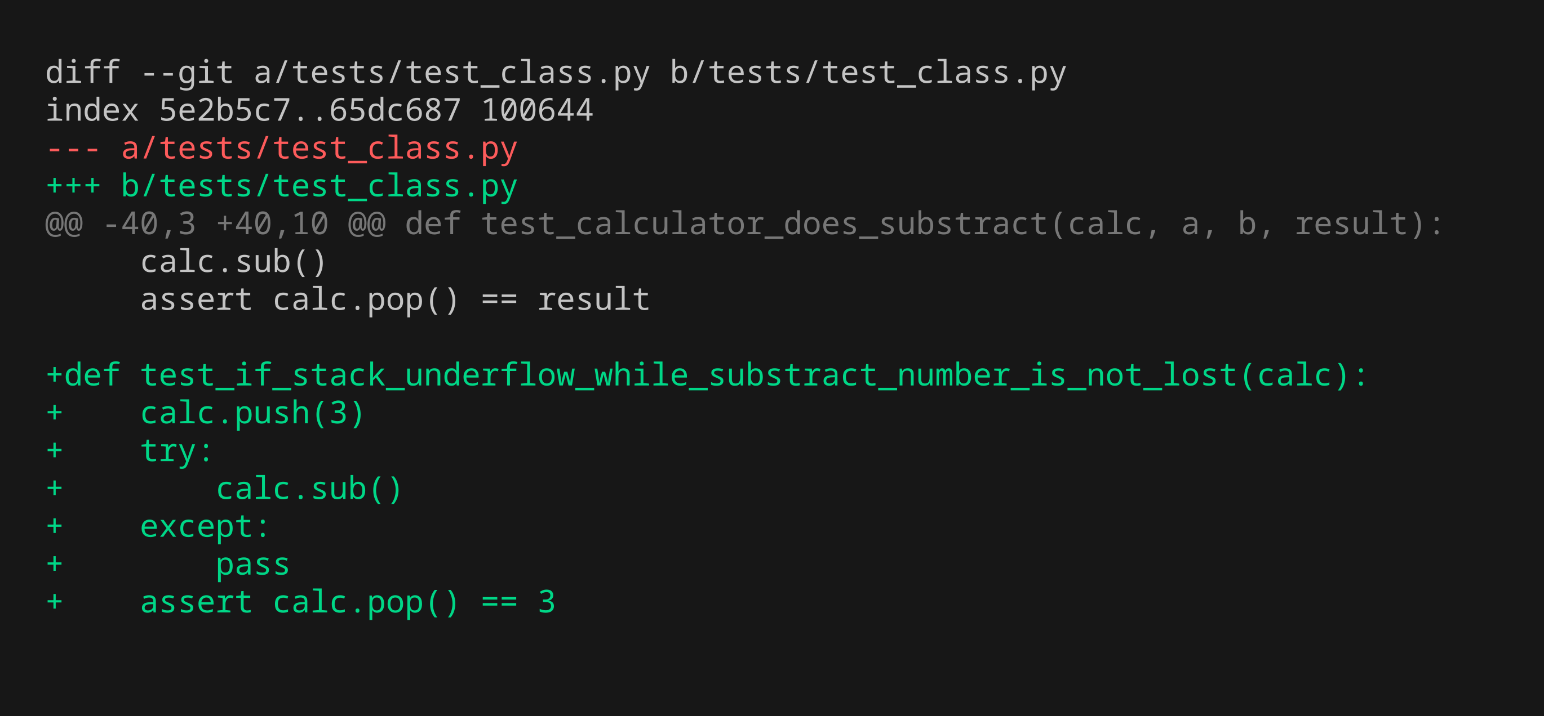
Inc 05 · Step 1/5 — Unit test code
If stack underflow while substract number is not lost
New test added — diff of tests/
1 Test code
2 Fails
3 Code change
4 Passes
5 All pass
documentation\shots\inc05\1-test-code.png · commit 9a75cf5
5 / 29

Slide 33
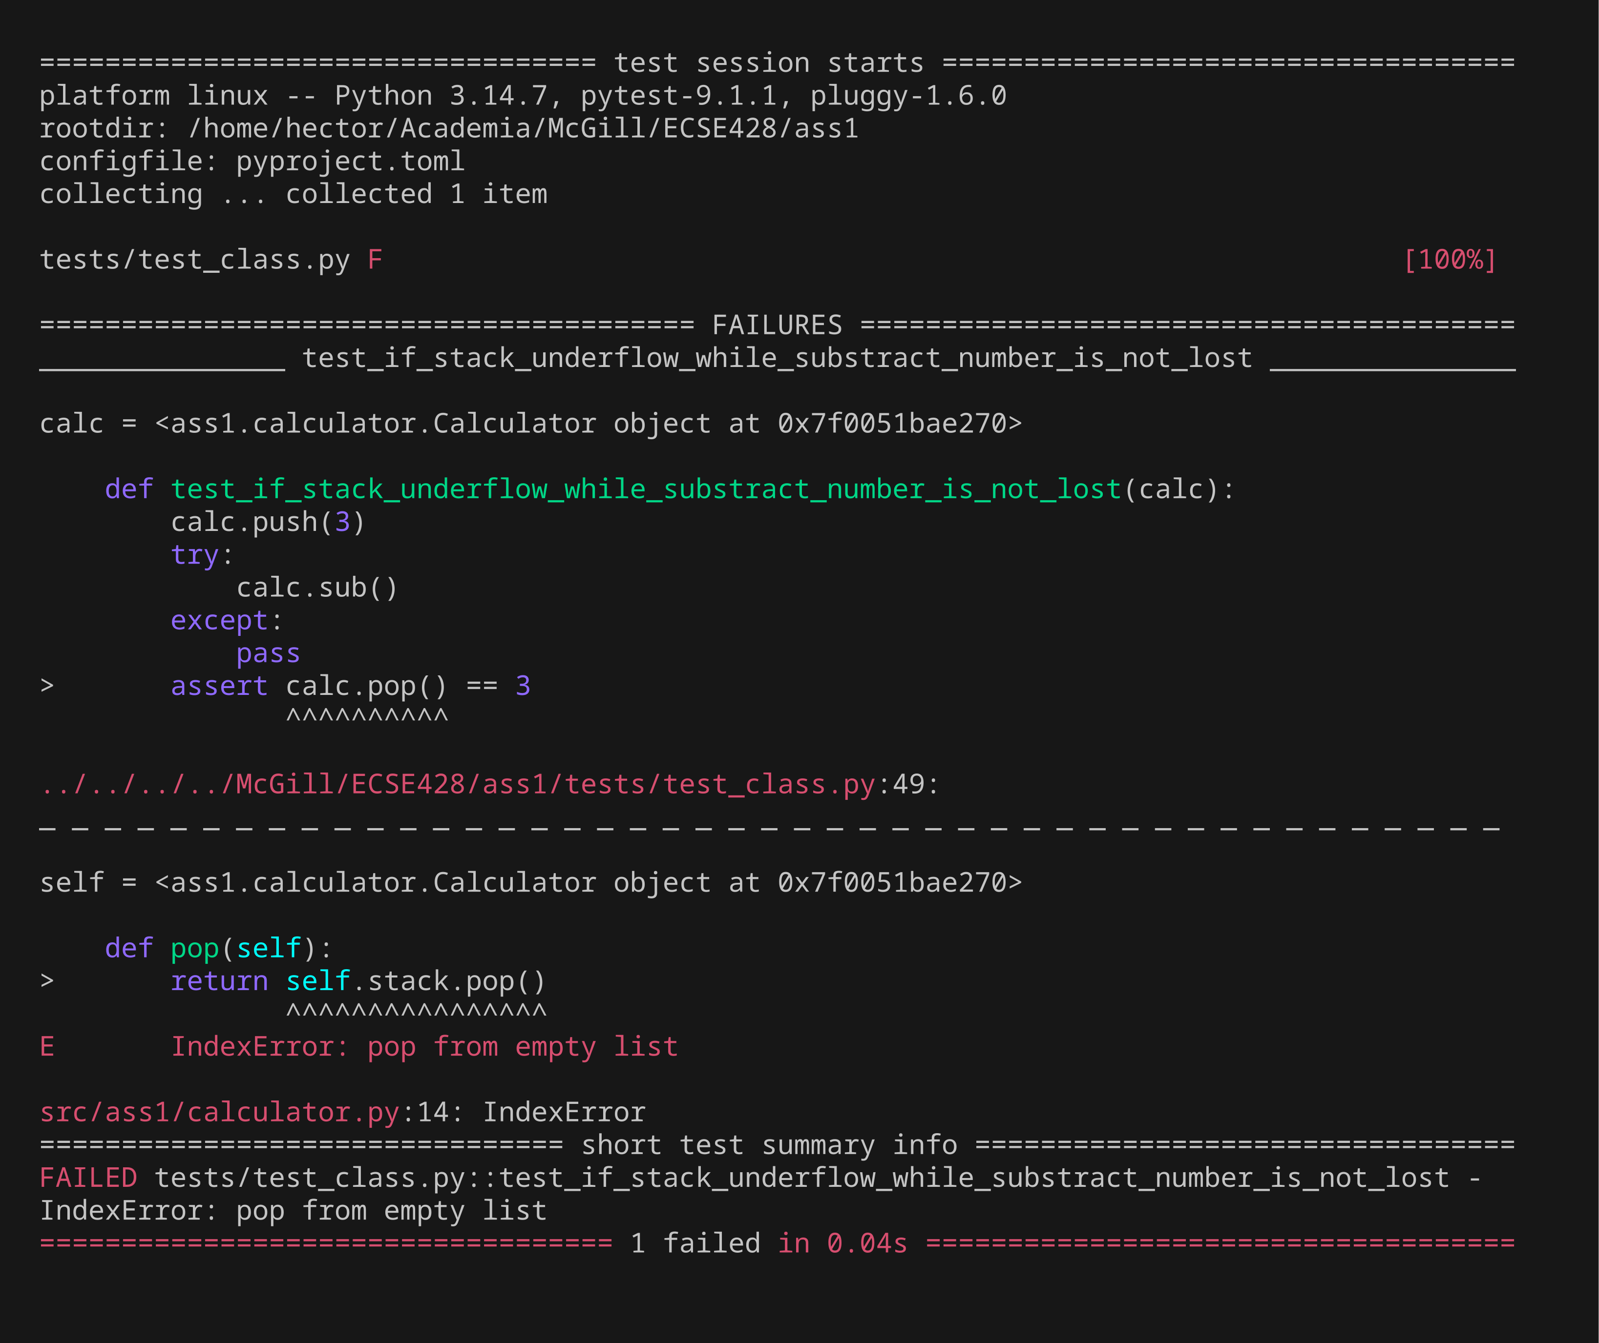
Inc 05 · Step 2/5 — Unit test fails (RED)
If stack underflow while substract number is not lost
Only the new test, run before implementing it
1 Test code
2 Fails
3 Code change
4 Passes
5 All pass
documentation\shots\inc05\2-test-fails.png · commit 9a75cf5
5 / 29

Slide 34
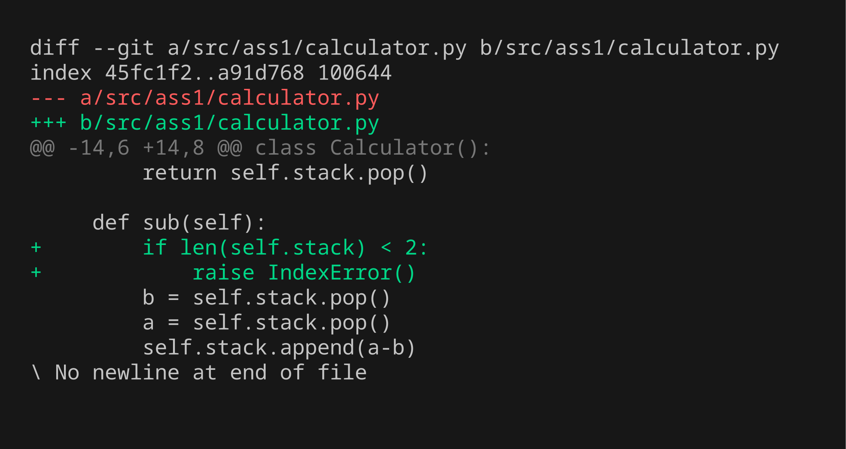
Inc 05 · Step 3/5 — Code changes
If stack underflow while substract number is not lost
Highlighted diff of src/ (green = added, red = removed)
1 Test code
2 Fails
3 Code change
4 Passes
5 All pass
documentation\shots\inc05\3-code-change.png · commit 60e860a
5 / 29

Slide 35
Inc 05 · Step 4/5 — Unit test passes (GREEN)
If stack underflow while substract number is not lost
Only the new test, run after the code change
1 Test code
2 Fails
3 Code change
4 Passes
5 All pass
documentation\shots\inc05\4-test-passes.png · commit 60e860a
5 / 29

Slide 36

Inc 05 · Step 5/5 — All previous tests still pass
If stack underflow while substract number is not lost
Full regression run: uv run pytest
1 Test code
2 Fails
3 Code change
4 Passes
5 All pass
documentation\shots\inc05\5-all-tests-pass.png · commit 60e860a
5 / 29

Slide 37
Increment 06 — Unit test
test_class.py · 6 / 29
Calculator does divide
tests/test_class.py::test_calculator_does_divide
STATEMENT
EXPECTED RESULTS
Checks that: calculator does divide.
✓ assert calc.pop() == pytest.approx(result)
1 Test code
2 Fails
3 Code change
4 Passes
5 All pass
red 30a08e4 green 3a8c154

Slide 38
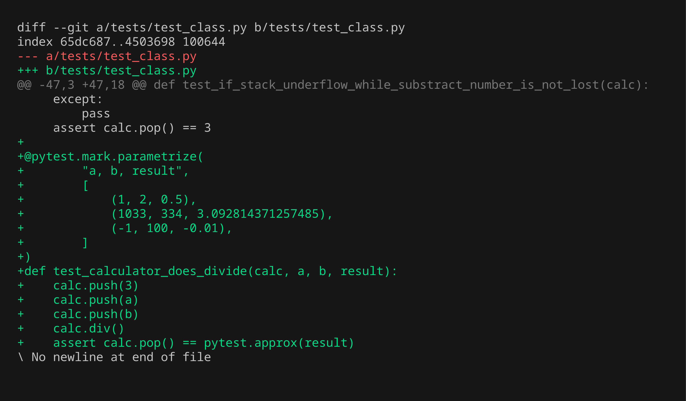
Inc 06 · Step 1/5 — Unit test code
Calculator does divide
New test added — diff of tests/
1 Test code
2 Fails
3 Code change
4 Passes
5 All pass
documentation\shots\inc06\1-test-code.png · commit 30a08e4
6 / 29

Slide 39
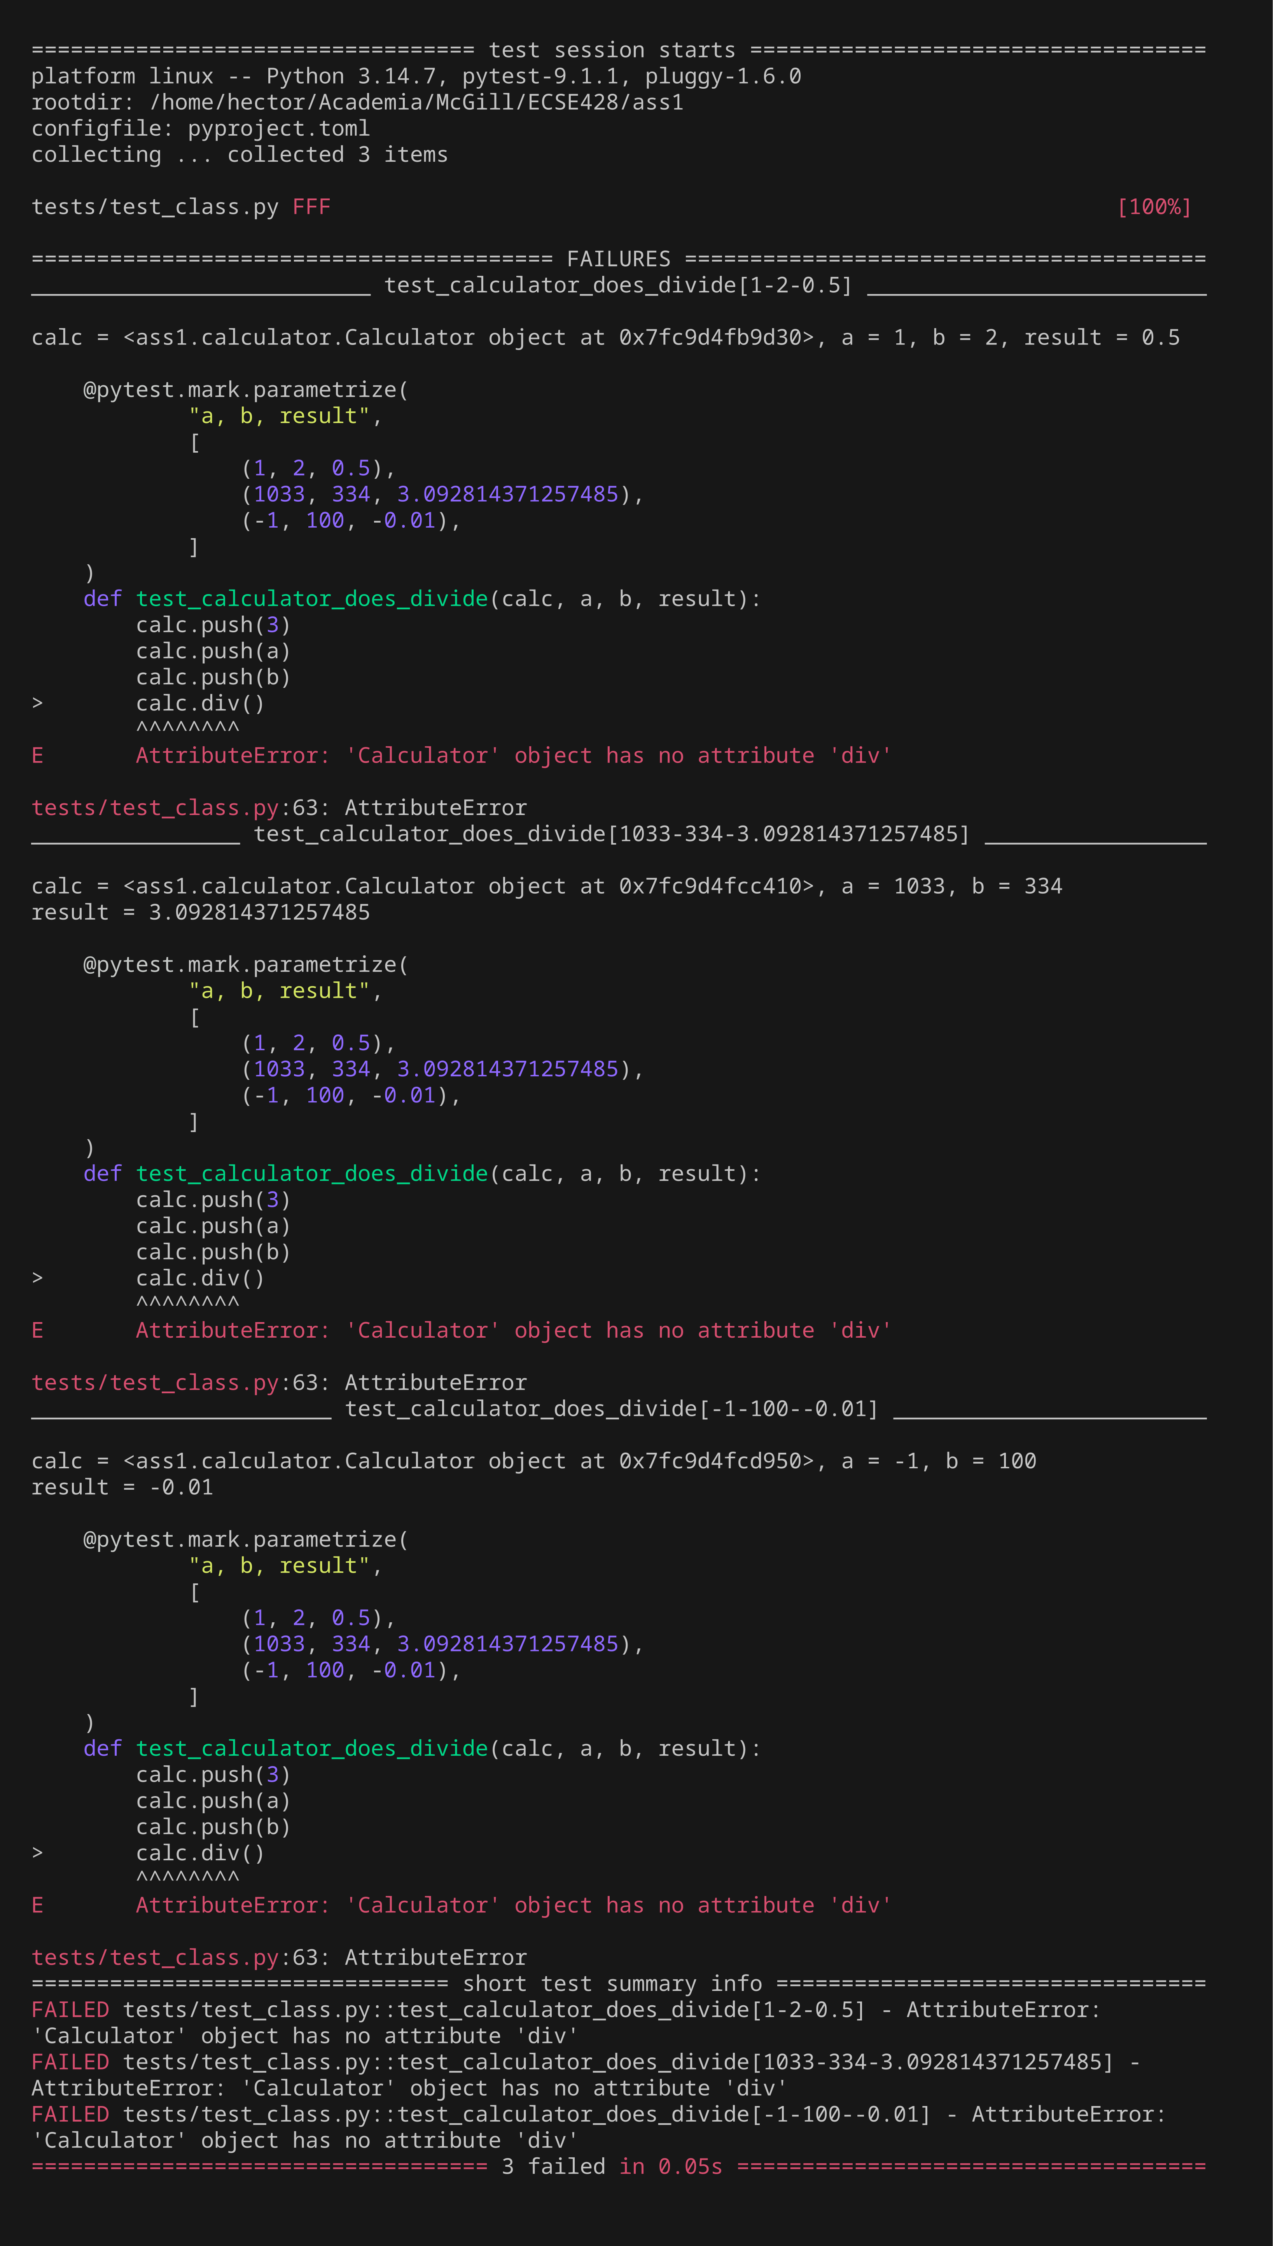
Inc 06 · Step 2/5 — Unit test fails (RED)
Calculator does divide
Only the new test, run before implementing it
1 Test code
2 Fails
3 Code change
4 Passes
5 All pass
documentation\shots\inc06\2-test-fails.png · commit 30a08e4
6 / 29

Slide 40
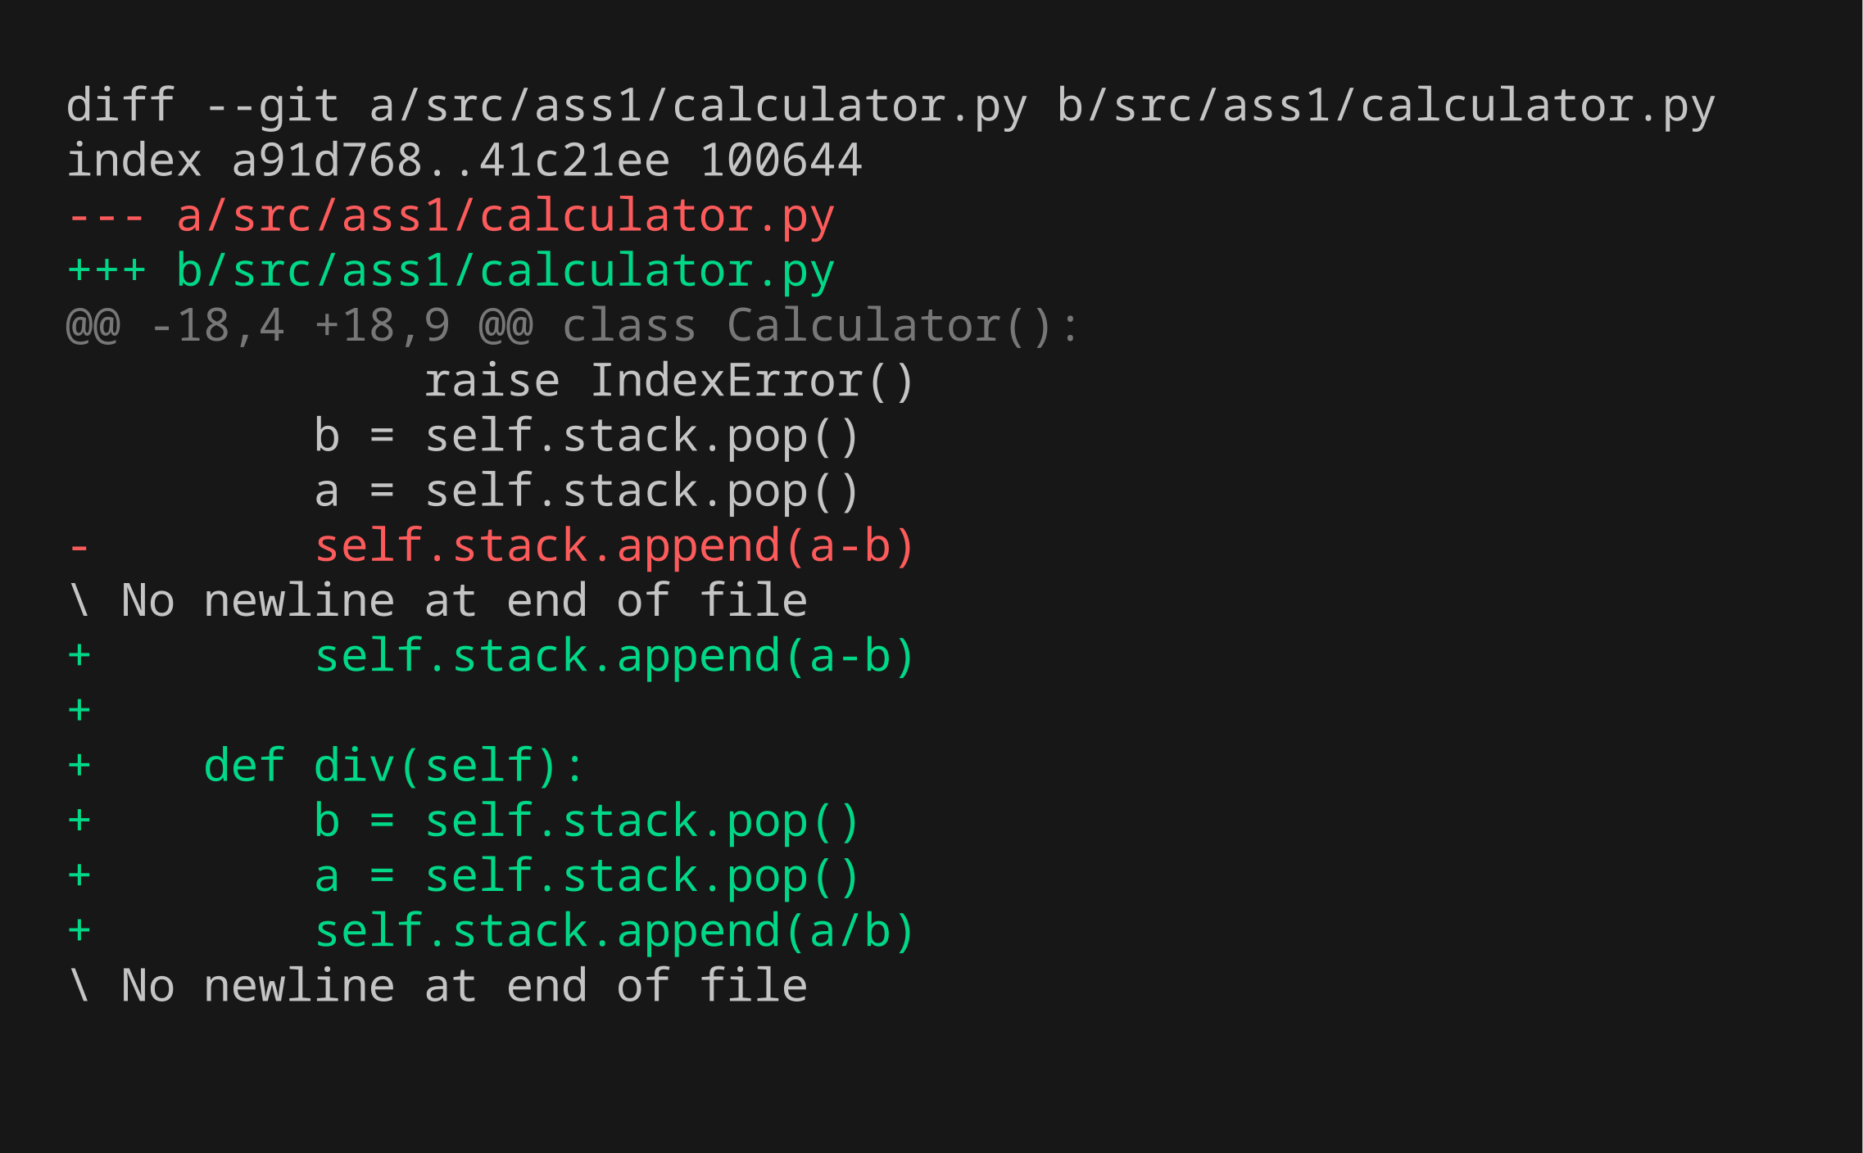
Inc 06 · Step 3/5 — Code changes
Calculator does divide
Highlighted diff of src/ (green = added, red = removed)
1 Test code
2 Fails
3 Code change
4 Passes
5 All pass
documentation\shots\inc06\3-code-change.png · commit 3a8c154
6 / 29

Slide 41
Inc 06 · Step 4/5 — Unit test passes (GREEN)
Calculator does divide
Only the new test, run after the code change
1 Test code
2 Fails
3 Code change
4 Passes
5 All pass
documentation\shots\inc06\4-test-passes.png · commit 3a8c154
6 / 29

Slide 42

Inc 06 · Step 5/5 — All previous tests still pass
Calculator does divide
Full regression run: uv run pytest
1 Test code
2 Fails
3 Code change
4 Passes
5 All pass
documentation\shots\inc06\5-all-tests-pass.png · commit 3a8c154
6 / 29

Slide 43
Increment 07 — Unit test
test_class.py · 7 / 29
If stack underflow while divide number is not lost
tests/test_class.py::test_if_stack_underflow_while_divide_number_is_not_lost
STATEMENT
EXPECTED RESULTS
Checks that: if stack underflow while divide number is not lost.
✓ assert calc.pop() == 3
1 Test code
2 Fails
3 Code change
4 Passes
5 All pass
red 848ed1a green 22811f0

Slide 44
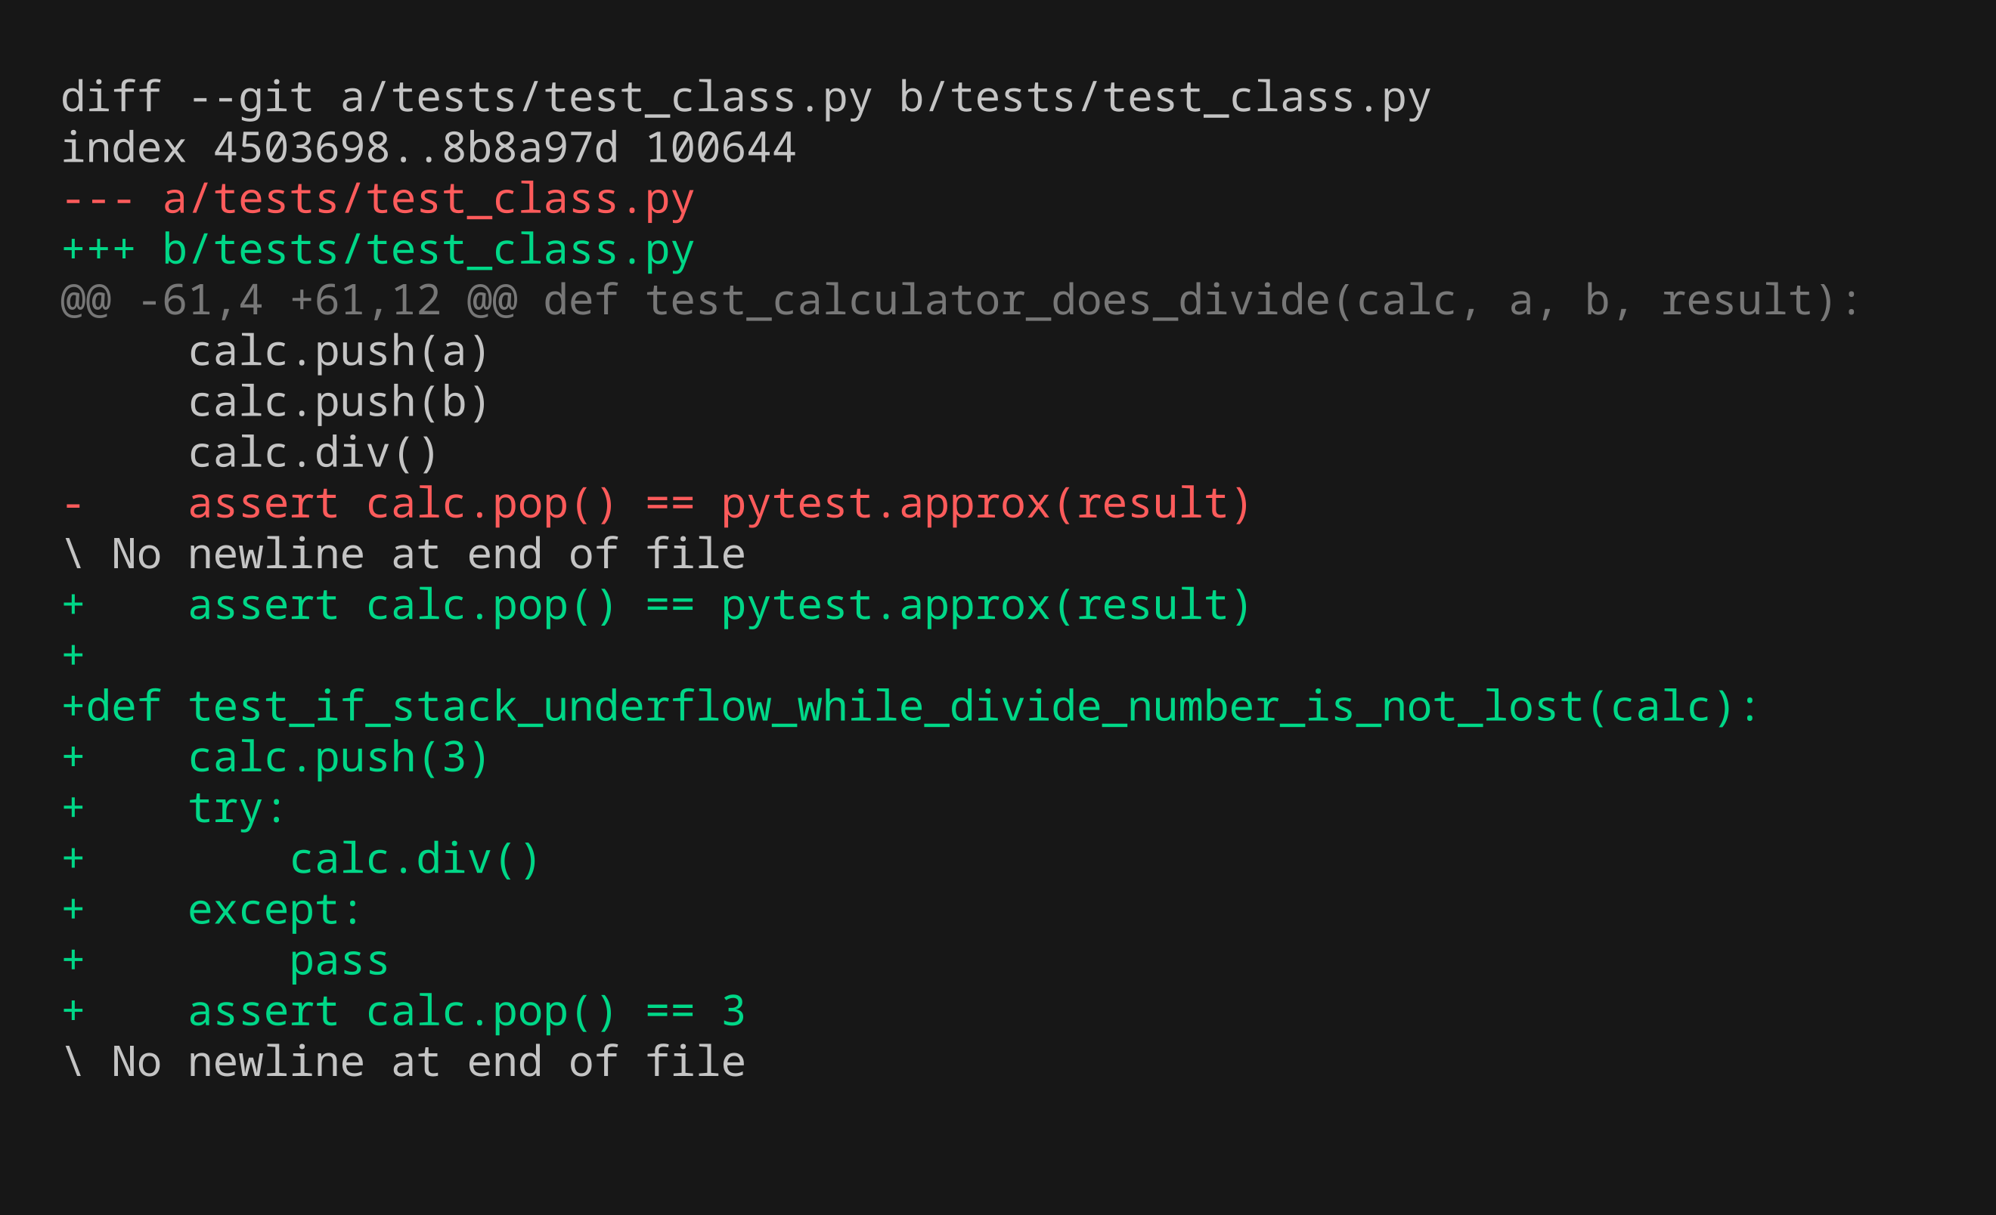
Inc 07 · Step 1/5 — Unit test code
If stack underflow while divide number is not lost
New test added — diff of tests/
1 Test code
2 Fails
3 Code change
4 Passes
5 All pass
documentation\shots\inc07\1-test-code.png · commit 848ed1a
7 / 29

Slide 45
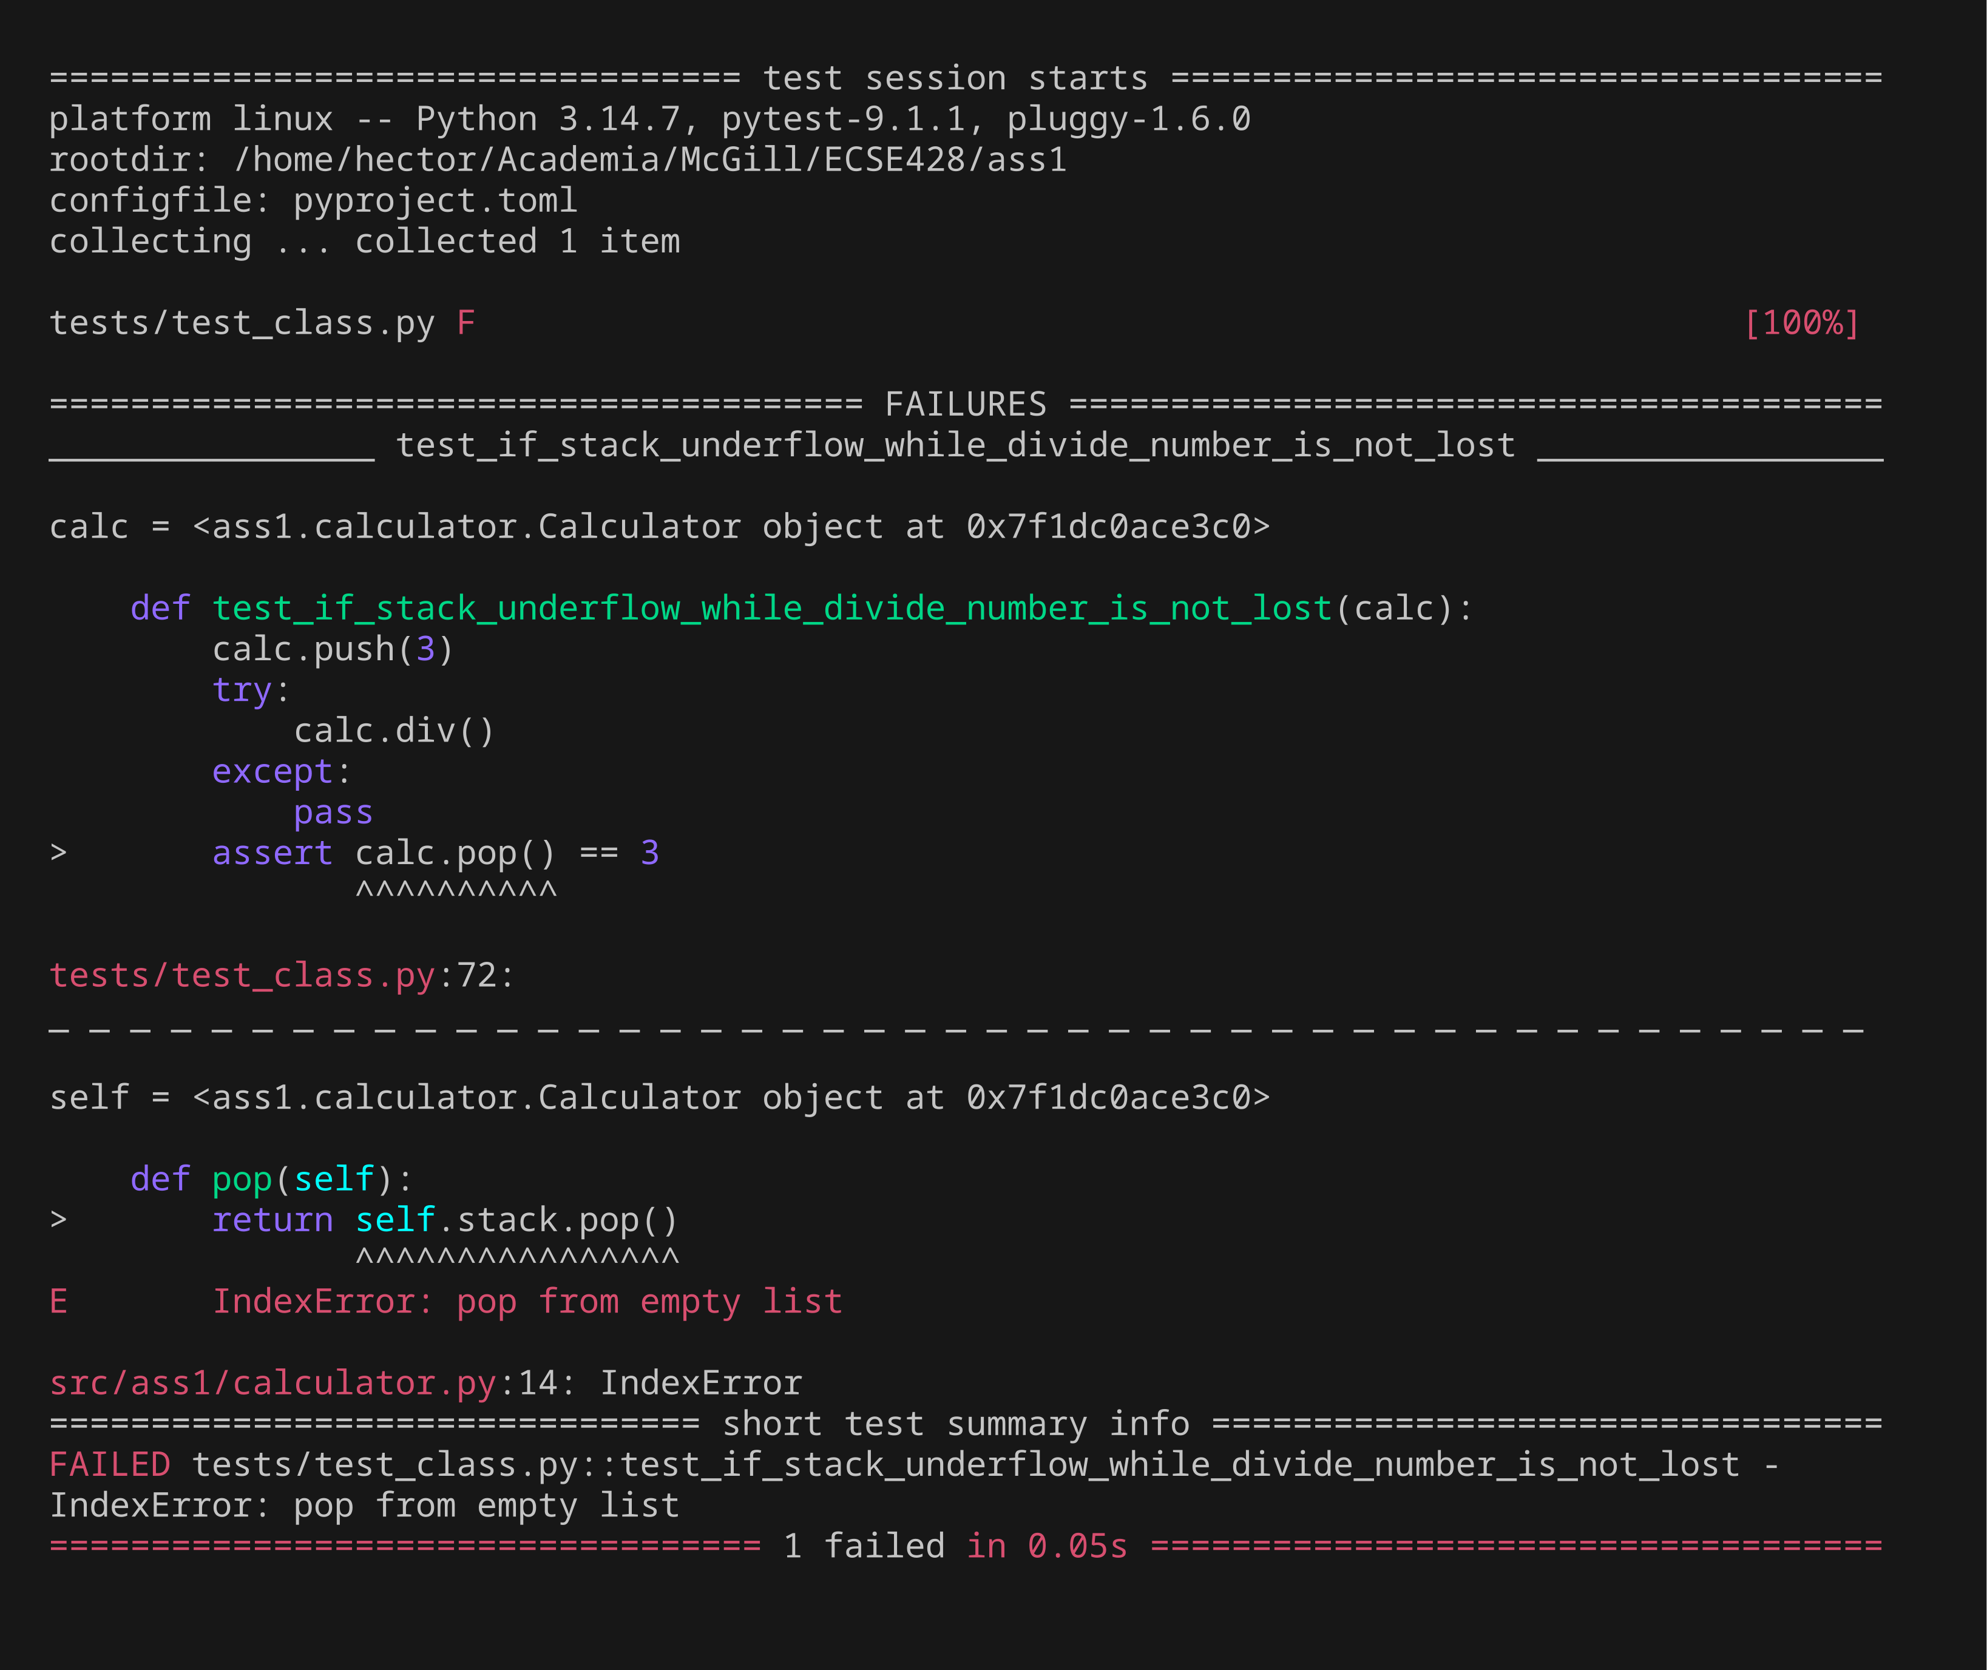
Inc 07 · Step 2/5 — Unit test fails (RED)
If stack underflow while divide number is not lost
Only the new test, run before implementing it
1 Test code
2 Fails
3 Code change
4 Passes
5 All pass
documentation\shots\inc07\2-test-fails.png · commit 848ed1a
7 / 29

Slide 46

Inc 07 · Step 3/5 — Code changes
If stack underflow while divide number is not lost
Highlighted diff of src/ (green = added, red = removed)
1 Test code
2 Fails
3 Code change
4 Passes
5 All pass
documentation\shots\inc07\3-code-change.png · commit 22811f0
7 / 29

Slide 47
Inc 07 · Step 4/5 — Unit test passes (GREEN)
If stack underflow while divide number is not lost
Only the new test, run after the code change
1 Test code
2 Fails
3 Code change
4 Passes
5 All pass
documentation\shots\inc07\4-test-passes.png · commit 22811f0
7 / 29

Slide 48

Inc 07 · Step 5/5 — All previous tests still pass
If stack underflow while divide number is not lost
Full regression run: uv run pytest
1 Test code
2 Fails
3 Code change
4 Passes
5 All pass
documentation\shots\inc07\5-all-tests-pass.png · commit 22811f0
7 / 29

Slide 49
Increment 08 — Unit test
test_class.py · 8 / 29
If divide by zero number is not lost
tests/test_class.py::test_if_divide_by_zero_number_is_not_lost
STATEMENT
EXPECTED RESULTS
Checks that: if divide by zero number is not lost.
✓ assert calc.pop() == 0
1 Test code
2 Fails
3 Code change
4 Passes
5 All pass
red a17cc75 green 038d187

Slide 50
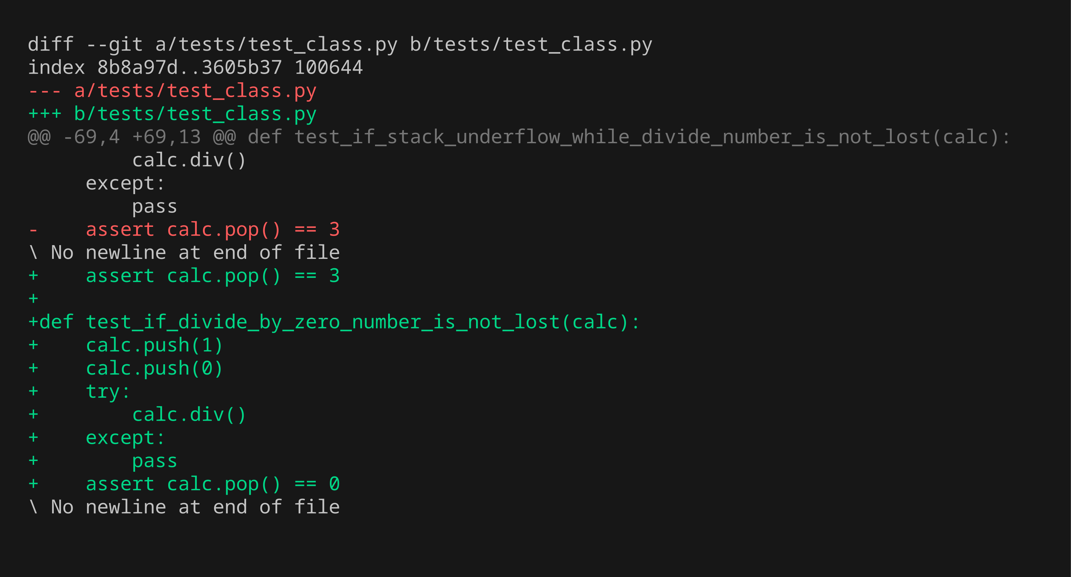
Inc 08 · Step 1/5 — Unit test code
If divide by zero number is not lost
New test added — diff of tests/
1 Test code
2 Fails
3 Code change
4 Passes
5 All pass
documentation\shots\inc08\1-test-code.png · commit a17cc75
8 / 29

Slide 51
Inc 08 · Step 2/5 — Unit test fails (RED)
If divide by zero number is not lost
Only the new test, run before implementing it
1 Test code
2 Fails
3 Code change
4 Passes
5 All pass
documentation\shots\inc08\2-test-fails.png · commit a17cc75
8 / 29

Slide 52
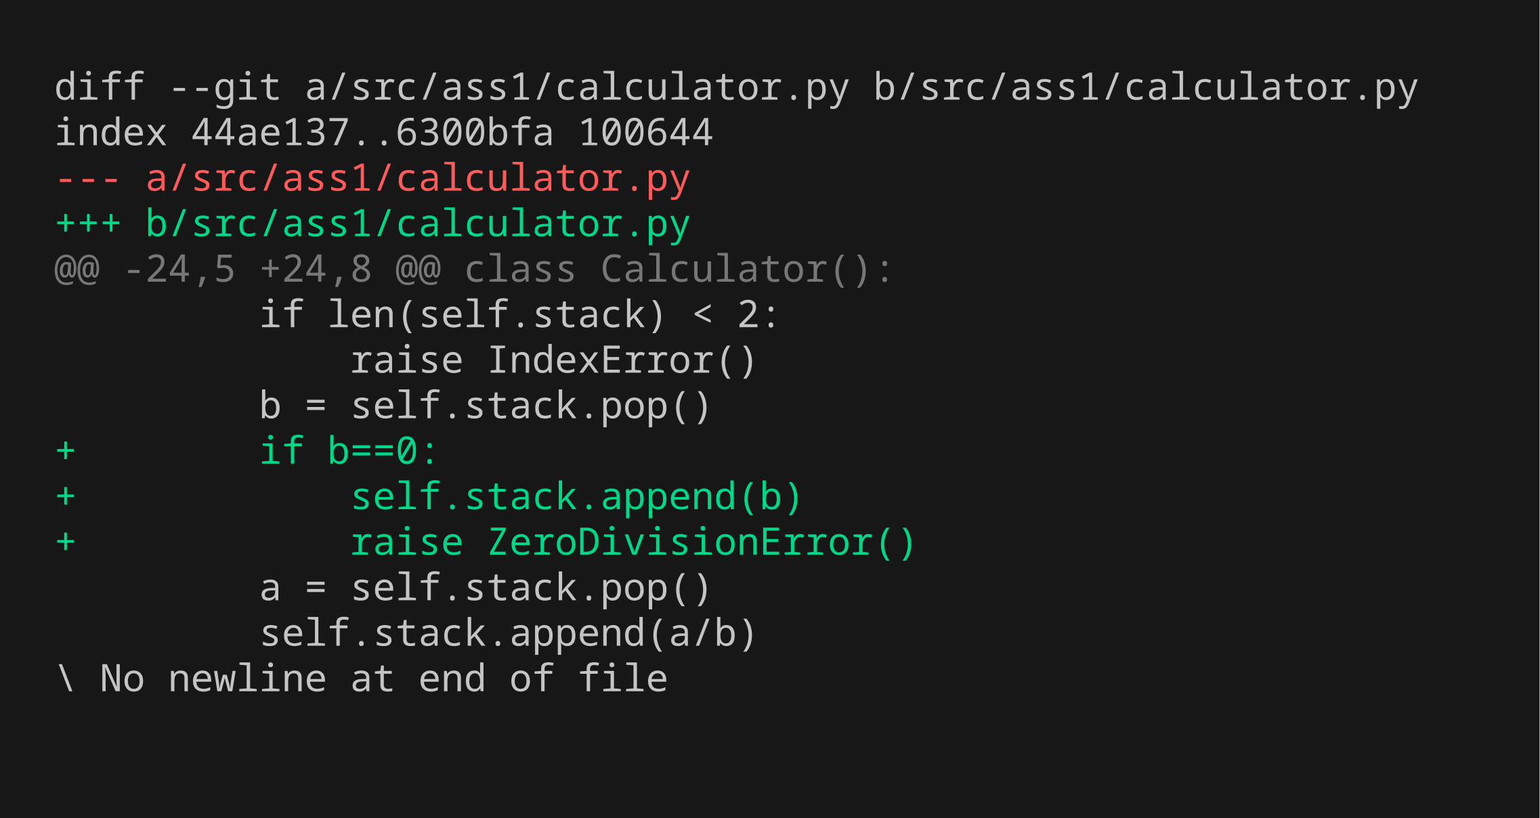
Inc 08 · Step 3/5 — Code changes
If divide by zero number is not lost
Highlighted diff of src/ (green = added, red = removed)
1 Test code
2 Fails
3 Code change
4 Passes
5 All pass
documentation\shots\inc08\3-code-change.png · commit 038d187
8 / 29

Slide 53
Inc 08 · Step 4/5 — Unit test passes (GREEN)
If divide by zero number is not lost
Only the new test, run after the code change
1 Test code
2 Fails
3 Code change
4 Passes
5 All pass
documentation\shots\inc08\4-test-passes.png · commit 038d187
8 / 29

Slide 54
Inc 08 · Step 5/5 — All previous tests still pass
If divide by zero number is not lost
Full regression run: uv run pytest
1 Test code
2 Fails
3 Code change
4 Passes
5 All pass
documentation\shots\inc08\5-all-tests-pass.png · commit 038d187
8 / 29

Slide 55
Increment 09 — Unit test
test_class.py · 9 / 29
Calculator does add
tests/test_class.py::test_calculator_does_add
STATEMENT
EXPECTED RESULTS
Checks that: calculator does add.
✓ assert calc.pop() == 8
1 Test code
2 Fails
3 Code change
4 Passes
5 All pass
commit 242614c

Slide 56
Inc 09 · Step 1/5 — Unit test code
Calculator does add
New test added — diff of tests/
1 Test code
2 Fails
3 Code change
4 Passes
5 All pass
documentation\shots\inc09\1-test-code.png · commit 242614c
9 / 29

Slide 57
Inc 09 · Step 2/5 — Unit test fails (RED)
Calculator does add
Only the new test, run before implementing it
1 Test code
2 Fails
3 Code change
4 Passes
5 All pass
documentation\shots\inc09\2-test-fails.png · commit 242614c
9 / 29

Slide 58
Inc 09 · Step 3/5 — Code changes
Calculator does add
Highlighted diff of src/ (green = added, red = removed)
1 Test code
2 Fails
3 Code change
4 Passes
5 All pass
documentation\shots\inc09\3-code-change.png · commit 242614c
9 / 29

Slide 59
Inc 09 · Step 4/5 — Unit test passes (GREEN)
Calculator does add
Only the new test, run after the code change
1 Test code
2 Fails
3 Code change
4 Passes
5 All pass
documentation\shots\inc09\4-test-passes.png · commit 242614c
9 / 29

Slide 60
Inc 09 · Step 5/5 — All previous tests still pass
Calculator does add
Full regression run: uv run pytest
1 Test code
2 Fails
3 Code change
4 Passes
5 All pass
documentation\shots\inc09\5-all-tests-pass.png · commit 242614c
9 / 29

Slide 61
Increment 10 — Unit test
test_class.py · 10 / 29
If add number is not lost
tests/test_class.py::test_if_add_number_is_not_lost
STATEMENT
EXPECTED RESULTS
Checks that: if add number is not lost.
✓ assert calc.pop() == 3
1 Test code
2 Fails
3 Code change
4 Passes
5 All pass
commit f456f94

Slide 62
Inc 10 · Step 1/5 — Unit test code
If add number is not lost
New test added — diff of tests/
1 Test code
2 Fails
3 Code change
4 Passes
5 All pass
documentation\shots\inc10\1-test-code.png · commit f456f94
10 / 29

Slide 63
Inc 10 · Step 2/5 — Unit test fails (RED)
If add number is not lost
Only the new test, run before implementing it
1 Test code
2 Fails
3 Code change
4 Passes
5 All pass
documentation\shots\inc10\2-test-fails.png · commit f456f94
10 / 29

Slide 64
Inc 10 · Step 3/5 — Code changes
If add number is not lost
Highlighted diff of src/ (green = added, red = removed)
1 Test code
2 Fails
3 Code change
4 Passes
5 All pass
documentation\shots\inc10\3-code-change.png · commit f456f94
10 / 29

Slide 65
Inc 10 · Step 4/5 — Unit test passes (GREEN)
If add number is not lost
Only the new test, run after the code change
1 Test code
2 Fails
3 Code change
4 Passes
5 All pass
documentation\shots\inc10\4-test-passes.png · commit f456f94
10 / 29

Slide 66
Inc 10 · Step 5/5 — All previous tests still pass
If add number is not lost
Full regression run: uv run pytest
1 Test code
2 Fails
3 Code change
4 Passes
5 All pass
documentation\shots\inc10\5-all-tests-pass.png · commit f456f94
10 / 29

Slide 67
Increment 11 — Unit test
test_class.py · 11 / 29
Calculator does multiply
tests/test_class.py::test_calculator_does_multiply
STATEMENT
EXPECTED RESULTS
Checks that: calculator does multiply.
✓ assert calc.pop() == 15
1 Test code
2 Fails
3 Code change
4 Passes
5 All pass
commit d93fba5

Slide 68
Inc 11 · Step 1/5 — Unit test code
Calculator does multiply
New test added — diff of tests/
1 Test code
2 Fails
3 Code change
4 Passes
5 All pass
documentation\shots\inc11\1-test-code.png · commit d93fba5
11 / 29

Slide 69
Inc 11 · Step 2/5 — Unit test fails (RED)
Calculator does multiply
Only the new test, run before implementing it
1 Test code
2 Fails
3 Code change
4 Passes
5 All pass
documentation\shots\inc11\2-test-fails.png · commit d93fba5
11 / 29

Slide 70
Inc 11 · Step 3/5 — Code changes
Calculator does multiply
Highlighted diff of src/ (green = added, red = removed)
1 Test code
2 Fails
3 Code change
4 Passes
5 All pass
documentation\shots\inc11\3-code-change.png · commit d93fba5
11 / 29

Slide 71
Inc 11 · Step 4/5 — Unit test passes (GREEN)
Calculator does multiply
Only the new test, run after the code change
1 Test code
2 Fails
3 Code change
4 Passes
5 All pass
documentation\shots\inc11\4-test-passes.png · commit d93fba5
11 / 29

Slide 72
Inc 11 · Step 5/5 — All previous tests still pass
Calculator does multiply
Full regression run: uv run pytest
1 Test code
2 Fails
3 Code change
4 Passes
5 All pass
documentation\shots\inc11\5-all-tests-pass.png · commit d93fba5
11 / 29

Slide 73
Increment 12 — Unit test
test_class.py · 12 / 29
If multiply number is not lost
tests/test_class.py::test_if_multiply_number_is_not_lost
STATEMENT
EXPECTED RESULTS
Checks that: if multiply number is not lost.
✓ assert calc.pop() == 3
1 Test code
2 Fails
3 Code change
4 Passes
5 All pass
commit 2729801

Slide 74
Inc 12 · Step 1/5 — Unit test code
If multiply number is not lost
New test added — diff of tests/
1 Test code
2 Fails
3 Code change
4 Passes
5 All pass
documentation\shots\inc12\1-test-code.png · commit 2729801
12 / 29

Slide 75
Inc 12 · Step 2/5 — Unit test fails (RED)
If multiply number is not lost
Only the new test, run before implementing it
1 Test code
2 Fails
3 Code change
4 Passes
5 All pass
documentation\shots\inc12\2-test-fails.png · commit 2729801
12 / 29

Slide 76
Inc 12 · Step 3/5 — Code changes
If multiply number is not lost
Highlighted diff of src/ (green = added, red = removed)
1 Test code
2 Fails
3 Code change
4 Passes
5 All pass
documentation\shots\inc12\3-code-change.png · commit 2729801
12 / 29

Slide 77
Inc 12 · Step 4/5 — Unit test passes (GREEN)
If multiply number is not lost
Only the new test, run after the code change
1 Test code
2 Fails
3 Code change
4 Passes
5 All pass
documentation\shots\inc12\4-test-passes.png · commit 2729801
12 / 29

Slide 78
Inc 12 · Step 5/5 — All previous tests still pass
If multiply number is not lost
Full regression run: uv run pytest
1 Test code
2 Fails
3 Code change
4 Passes
5 All pass
documentation\shots\inc12\5-all-tests-pass.png · commit 2729801
12 / 29

Slide 79
Increment 13 — Unit test
test_class.py · 13 / 29
Calculator does delete
tests/test_class.py::test_calculator_does_delete
STATEMENT
EXPECTED RESULTS
Checks that: calculator does delete.
✓ assert calc.pop() == 3
1 Test code
2 Fails
3 Code change
4 Passes
5 All pass
commit 7d379f5

Slide 80
Inc 13 · Step 1/5 — Unit test code
Calculator does delete
New test added — diff of tests/
1 Test code
2 Fails
3 Code change
4 Passes
5 All pass
documentation\shots\inc13\1-test-code.png · commit 7d379f5
13 / 29

Slide 81
Inc 13 · Step 2/5 — Unit test fails (RED)
Calculator does delete
Only the new test, run before implementing it
1 Test code
2 Fails
3 Code change
4 Passes
5 All pass
documentation\shots\inc13\2-test-fails.png · commit 7d379f5
13 / 29

Slide 82
Inc 13 · Step 3/5 — Code changes
Calculator does delete
Highlighted diff of src/ (green = added, red = removed)
1 Test code
2 Fails
3 Code change
4 Passes
5 All pass
documentation\shots\inc13\3-code-change.png · commit 7d379f5
13 / 29

Slide 83
Inc 13 · Step 4/5 — Unit test passes (GREEN)
Calculator does delete
Only the new test, run after the code change
1 Test code
2 Fails
3 Code change
4 Passes
5 All pass
documentation\shots\inc13\4-test-passes.png · commit 7d379f5
13 / 29

Slide 84
Inc 13 · Step 5/5 — All previous tests still pass
Calculator does delete
Full regression run: uv run pytest
1 Test code
2 Fails
3 Code change
4 Passes
5 All pass
documentation\shots\inc13\5-all-tests-pass.png · commit 7d379f5
13 / 29

Slide 85
Increment 14 — Unit test
test_class.py · 14 / 29
Delete on empty stack raises
tests/test_class.py::test_delete_on_empty_stack_raises
STATEMENT
EXPECTED RESULTS
Checks that: delete on empty stack raises.
✓ raises IndexError
ℹ This test passed directly: existing code already covered it, so no production change was needed.
1 Test code
2 Fails
3 Code change
4 Passes
5 All pass
commit 4f0578a

Slide 86
Inc 14 · Step 1/5 — Unit test code
Delete on empty stack raises
New test added — diff of tests/
1 Test code
2 Fails
3 Code change
4 Passes
5 All pass
documentation\shots\inc14\1-test-code.png · commit 4f0578a
14 / 29

Slide 87
Inc 14 · Step 2/5 — Unit test run before code change
Delete on empty stack raises
Passed directly — existing code already satisfied it
No screenshot for this step (2-test-fails.png not found).
1 Test code
2 Fails
3 Code change
4 Passes
5 All pass
documentation\shots\inc14\2-test-fails.png · commit 4f0578a
14 / 29

Slide 88
Inc 14 · Step 3/5 — Code changes
Delete on empty stack raises
Highlighted diff of src/ (green = added, red = removed)
No production code change was needed for this increment.
1 Test code
2 Fails
3 Code change
4 Passes
5 All pass
documentation\shots\inc14\3-code-change.png · commit 4f0578a
14 / 29

Slide 89
Inc 14 · Step 4/5 — Unit test passes (GREEN)
Delete on empty stack raises
Only the new test, run after the code change
No screenshot for this step (4-test-passes.png not found).
1 Test code
2 Fails
3 Code change
4 Passes
5 All pass
documentation\shots\inc14\4-test-passes.png · commit 4f0578a
14 / 29

Slide 90
Inc 14 · Step 5/5 — All previous tests still pass
Delete on empty stack raises
Full regression run: uv run pytest
No screenshot for this step (5-all-tests-pass.png not found).
1 Test code
2 Fails
3 Code change
4 Passes
5 All pass
documentation\shots\inc14\5-all-tests-pass.png · commit 4f0578a
14 / 29

Slide 91
Increment 15 — Unit test
test_ui.py · 15 / 29
Decoder instantiates
tests/test_ui.py::test_decoder_instantiates
STATEMENT
EXPECTED RESULTS
Checks that: decoder instantiates.
✓ assert isinstance(decoder, Decoder)
1 Test code
2 Fails
3 Code change
4 Passes
5 All pass
red 33363d9 green 3257490

Slide 92
Inc 15 · Step 1/5 — Unit test code
Decoder instantiates
New test added — diff of tests/
1 Test code
2 Fails
3 Code change
4 Passes
5 All pass
documentation\shots\inc15\1-test-code.png · commit 33363d9
15 / 29

Slide 93
Inc 15 · Step 2/5 — Unit test fails (RED)
Decoder instantiates
Only the new test, run before implementing it
1 Test code
2 Fails
3 Code change
4 Passes
5 All pass
documentation\shots\inc15\2-test-fails.png · commit 33363d9
15 / 29

Slide 94
Inc 15 · Step 3/5 — Code changes
Decoder instantiates
Highlighted diff of src/ (green = added, red = removed)
1 Test code
2 Fails
3 Code change
4 Passes
5 All pass
documentation\shots\inc15\3-code-change.png · commit 3257490
15 / 29

Slide 95
Inc 15 · Step 4/5 — Unit test passes (GREEN)
Decoder instantiates
Only the new test, run after the code change
1 Test code
2 Fails
3 Code change
4 Passes
5 All pass
documentation\shots\inc15\4-test-passes.png · commit 3257490
15 / 29

Slide 96
Inc 15 · Step 5/5 — All previous tests still pass
Decoder instantiates
Full regression run: uv run pytest
1 Test code
2 Fails
3 Code change
4 Passes
5 All pass
documentation\shots\inc15\5-all-tests-pass.png · commit 3257490
15 / 29

Slide 97
Increment 16 — Unit test
test_ui.py · 16 / 29
Decoder handles push pop with reals
tests/test_ui.py::test_decoder_handles_push_pop_with_reals
STATEMENT
EXPECTED RESULTS
Checks that: decoder handles push pop with reals.
✓ assert n == 1
✓ assert n == -1
✓ assert n == -1
1 Test code
2 Fails
3 Code change
4 Passes
5 All pass
red f090884 green 2c07019

Slide 98
Inc 16 · Step 1/5 — Unit test code
Decoder handles push pop with reals
New test added — diff of tests/
1 Test code
2 Fails
3 Code change
4 Passes
5 All pass
documentation\shots\inc16\1-test-code.png · commit f090884
16 / 29

Slide 99
Inc 16 · Step 2/5 — Unit test fails (RED)
Decoder handles push pop with reals
Only the new test, run before implementing it
1 Test code
2 Fails
3 Code change
4 Passes
5 All pass
documentation\shots\inc16\2-test-fails.png · commit f090884
16 / 29

Slide 100
Inc 16 · Step 3/5 — Code changes
Decoder handles push pop with reals
Highlighted diff of src/ (green = added, red = removed)
1 Test code
2 Fails
3 Code change
4 Passes
5 All pass
documentation\shots\inc16\3-code-change.png · commit 2c07019
16 / 29

Slide 101
Inc 16 · Step 4/5 — Unit test passes (GREEN)
Decoder handles push pop with reals
Only the new test, run after the code change
1 Test code
2 Fails
3 Code change
4 Passes
5 All pass
documentation\shots\inc16\4-test-passes.png · commit 2c07019
16 / 29

Slide 102
Inc 16 · Step 5/5 — All previous tests still pass
Decoder handles push pop with reals
Full regression run: uv run pytest
1 Test code
2 Fails
3 Code change
4 Passes
5 All pass
documentation\shots\inc16\5-all-tests-pass.png · commit 2c07019
16 / 29

Slide 103
Increment 17 — Unit test
test_ui.py · 17 / 29
Decoder handles push pop with complex and weird inputs
tests/test_ui.py::test_decoder_handles_push_pop_with_complex_and_weird_inputs
STATEMENT
EXPECTED RESULTS
Checks that: decoder handles push pop with complex and weird inputs.
✓ assert n == 2 + 3j
✓ assert n == 2 + 3j
✓ assert n == 2 + 3j
✓ assert n == 2 + 3j
✓ assert n == 2 - 3j
✓ assert n == 2 + 3j
✓ assert n == 2 + 3j
✓ assert n == -3j
✓ … and 17 more assertions
1 Test code
2 Fails
3 Code change
4 Passes
5 All pass
red 69dd06c green cb34666

Slide 104
Inc 17 · Step 1/5 — Unit test code
Decoder handles push pop with complex and weird inputs
New test added — diff of tests/
1 Test code
2 Fails
3 Code change
4 Passes
5 All pass
documentation\shots\inc17\1-test-code.png · commit 69dd06c
17 / 29

Slide 105
Inc 17 · Step 2/5 — Unit test fails (RED)
Decoder handles push pop with complex and weird inputs
Only the new test, run before implementing it
1 Test code
2 Fails
3 Code change
4 Passes
5 All pass
documentation\shots\inc17\2-test-fails.png · commit 69dd06c
17 / 29

Slide 106
Inc 17 · Step 3/5 — Code changes
Decoder handles push pop with complex and weird inputs
Highlighted diff of src/ (green = added, red = removed)
1 Test code
2 Fails
3 Code change
4 Passes
5 All pass
documentation\shots\inc17\3-code-change.png · commit cb34666
17 / 29

Slide 107
Inc 17 · Step 4/5 — Unit test passes (GREEN)
Decoder handles push pop with complex and weird inputs
Only the new test, run after the code change
1 Test code
2 Fails
3 Code change
4 Passes
5 All pass
documentation\shots\inc17\4-test-passes.png · commit cb34666
17 / 29

Slide 108
Inc 17 · Step 5/5 — All previous tests still pass
Decoder handles push pop with complex and weird inputs
Full regression run: uv run pytest
1 Test code
2 Fails
3 Code change
4 Passes
5 All pass
documentation\shots\inc17\5-all-tests-pass.png · commit cb34666
17 / 29

Slide 109
Increment 18 — Unit test
test_ui.py · 18 / 29
Decoder handles decimal
tests/test_ui.py::test_decoder_handles_decimal
STATEMENT
EXPECTED RESULTS
Checks that: decoder handles decimal.
✓ assert n == pytest.approx(1.4)
✓ assert n == pytest.approx(-1.4)
✓ assert n == pytest.approx(-1.0)
✓ assert n == pytest.approx(3.2 - 1.4j)
1 Test code
2 Fails
3 Code change
4 Passes
5 All pass
red f7d913e green cc4fd92

Slide 110
Inc 18 · Step 1/5 — Unit test code
Decoder handles decimal
New test added — diff of tests/
1 Test code
2 Fails
3 Code change
4 Passes
5 All pass
documentation\shots\inc18\1-test-code.png · commit f7d913e
18 / 29

Slide 111
Inc 18 · Step 2/5 — Unit test fails (RED)
Decoder handles decimal
Only the new test, run before implementing it
1 Test code
2 Fails
3 Code change
4 Passes
5 All pass
documentation\shots\inc18\2-test-fails.png · commit f7d913e
18 / 29

Slide 112
Inc 18 · Step 3/5 — Code changes
Decoder handles decimal
Highlighted diff of src/ (green = added, red = removed)
1 Test code
2 Fails
3 Code change
4 Passes
5 All pass
documentation\shots\inc18\3-code-change.png · commit cc4fd92
18 / 29

Slide 113
Inc 18 · Step 4/5 — Unit test passes (GREEN)
Decoder handles decimal
Only the new test, run after the code change
1 Test code
2 Fails
3 Code change
4 Passes
5 All pass
documentation\shots\inc18\4-test-passes.png · commit cc4fd92
18 / 29

Slide 114
Inc 18 · Step 5/5 — All previous tests still pass
Decoder handles decimal
Full regression run: uv run pytest
1 Test code
2 Fails
3 Code change
4 Passes
5 All pass
documentation\shots\inc18\5-all-tests-pass.png · commit cc4fd92
18 / 29

Slide 115
Increment 19 — Unit test
test_ui.py · 19 / 29
Decoder rejects bad number inputs
tests/test_ui.py::test_decoder_rejects_bad_number_inputs
STATEMENT
EXPECTED RESULTS
Checks that: decoder rejects bad number inputs.
✓ raises SyntaxError
✓ raises SyntaxError
✓ raises SyntaxError
✓ raises SyntaxError
✓ raises SyntaxError
✓ raises SyntaxError
✓ raises SyntaxError
✓ raises SyntaxError
✓ … and 4 more assertions
1 Test code
2 Fails
3 Code change
4 Passes
5 All pass
red 34a141e green b45cfac

Slide 116
Inc 19 · Step 1/5 — Unit test code
Decoder rejects bad number inputs
New test added — diff of tests/
1 Test code
2 Fails
3 Code change
4 Passes
5 All pass
documentation\shots\inc19\1-test-code.png · commit 34a141e
19 / 29

Slide 117
Inc 19 · Step 2/5 — Unit test fails (RED)
Decoder rejects bad number inputs
Only the new test, run before implementing it
1 Test code
2 Fails
3 Code change
4 Passes
5 All pass
documentation\shots\inc19\2-test-fails.png · commit 34a141e
19 / 29

Slide 118
Inc 19 · Step 3/5 — Code changes
Decoder rejects bad number inputs
Highlighted diff of src/ (green = added, red = removed)
1 Test code
2 Fails
3 Code change
4 Passes
5 All pass
documentation\shots\inc19\3-code-change.png · commit b45cfac
19 / 29

Slide 119
Inc 19 · Step 4/5 — Unit test passes (GREEN)
Decoder rejects bad number inputs
Only the new test, run after the code change
1 Test code
2 Fails
3 Code change
4 Passes
5 All pass
documentation\shots\inc19\4-test-passes.png · commit b45cfac
19 / 29

Slide 120
Inc 19 · Step 5/5 — All previous tests still pass
Decoder rejects bad number inputs
Full regression run: uv run pytest
1 Test code
2 Fails
3 Code change
4 Passes
5 All pass
documentation\shots\inc19\5-all-tests-pass.png · commit b45cfac
19 / 29

Slide 121
Increment 20 — Unit test
test_ui.py · 20 / 29
Decoder handles sequence of inputs
tests/test_ui.py::test_decoder_handles_sequence_of_inputs
STATEMENT
EXPECTED RESULTS
Checks that: decoder handles sequence of inputs.
✓ assert n == pytest.approx(1.3)
✓ assert n == pytest.approx(1.4)
✓ assert n == 5
✓ assert n == pytest.approx(3.4)
✓ assert n == 2
✓ assert n == 3j
✓ assert n == 4
✓ assert n == 1
✓ … and 3 more assertions
1 Test code
2 Fails
3 Code change
4 Passes
5 All pass
red b7d85f9 green c50425b

Slide 122
Inc 20 · Step 1/5 — Unit test code
Decoder handles sequence of inputs
New test added — diff of tests/
1 Test code
2 Fails
3 Code change
4 Passes
5 All pass
documentation\shots\inc20\1-test-code.png · commit b7d85f9
20 / 29

Slide 123
Inc 20 · Step 2/5 — Unit test fails (RED)
Decoder handles sequence of inputs
Only the new test, run before implementing it
1 Test code
2 Fails
3 Code change
4 Passes
5 All pass
documentation\shots\inc20\2-test-fails.png · commit b7d85f9
20 / 29

Slide 124
Inc 20 · Step 3/5 — Code changes
Decoder handles sequence of inputs
Highlighted diff of src/ (green = added, red = removed)
1 Test code
2 Fails
3 Code change
4 Passes
5 All pass
documentation\shots\inc20\3-code-change.png · commit c50425b
20 / 29

Slide 125
Inc 20 · Step 4/5 — Unit test passes (GREEN)
Decoder handles sequence of inputs
Only the new test, run after the code change
1 Test code
2 Fails
3 Code change
4 Passes
5 All pass
documentation\shots\inc20\4-test-passes.png · commit c50425b
20 / 29

Slide 126
Inc 20 · Step 5/5 — All previous tests still pass
Decoder handles sequence of inputs
Full regression run: uv run pytest
1 Test code
2 Fails
3 Code change
4 Passes
5 All pass
documentation\shots\inc20\5-all-tests-pass.png · commit c50425b
20 / 29

Slide 127
Increment 21 — Unit test
test_ui.py · 21 / 29
Decoder handles all right inputs and wrong inputs
tests/test_ui.py::test_decoder_handles_all_right_inputs_and_wrong_inputs
STATEMENT
EXPECTED RESULTS
Checks that: decoder handles all right inputs and wrong inputs.
✓ assert n == pytest.approx(7.6)
✓ assert n == pytest.approx(1 - 5j)
✓ raises IndexError
✓ raises IndexError
✓ raises IndexError
✓ raises IndexError
✓ raises IndexError
✓ raises IndexError
✓ … and 9 more assertions
1 Test code
2 Fails
3 Code change
4 Passes
5 All pass
red d36cb4f green 9d25d42

Slide 128
Inc 21 · Step 1/5 — Unit test code
Decoder handles all right inputs and wrong inputs
New test added — diff of tests/
1 Test code
2 Fails
3 Code change
4 Passes
5 All pass
documentation\shots\inc21\1-test-code.png · commit d36cb4f
21 / 29

Slide 129
Inc 21 · Step 2/5 — Unit test fails (RED)
Decoder handles all right inputs and wrong inputs
Only the new test, run before implementing it
1 Test code
2 Fails
3 Code change
4 Passes
5 All pass
documentation\shots\inc21\2-test-fails.png · commit d36cb4f
21 / 29

Slide 130
Inc 21 · Step 3/5 — Code changes
Decoder handles all right inputs and wrong inputs
Highlighted diff of src/ (green = added, red = removed)
1 Test code
2 Fails
3 Code change
4 Passes
5 All pass
documentation\shots\inc21\3-code-change.png · commit 9d25d42
21 / 29

Slide 131
Inc 21 · Step 4/5 — Unit test passes (GREEN)
Decoder handles all right inputs and wrong inputs
Only the new test, run after the code change
1 Test code
2 Fails
3 Code change
4 Passes
5 All pass
documentation\shots\inc21\4-test-passes.png · commit 9d25d42
21 / 29

Slide 132
Inc 21 · Step 5/5 — All previous tests still pass
Decoder handles all right inputs and wrong inputs
Full regression run: uv run pytest
1 Test code
2 Fails
3 Code change
4 Passes
5 All pass
documentation\shots\inc21\5-all-tests-pass.png · commit 9d25d42
21 / 29

Slide 133
Increment 22 — Unit test
test_ui.py · 22 / 29
Cli quits on eof
tests/test_ui.py::test_cli_quits_on_eof
STATEMENT
EXPECTED RESULTS
Checks that: cli quits on eof.
✓ assert True
1 Test code
2 Fails
3 Code change
4 Passes
5 All pass
red a98446f green 5ea44ee

Slide 134
Inc 22 · Step 1/5 — Unit test code
Cli quits on eof
New test added — diff of tests/
1 Test code
2 Fails
3 Code change
4 Passes
5 All pass
documentation\shots\inc22\1-test-code.png · commit a98446f
22 / 29

Slide 135
Inc 22 · Step 2/5 — Unit test fails (RED)
Cli quits on eof
Only the new test, run before implementing it
1 Test code
2 Fails
3 Code change
4 Passes
5 All pass
documentation\shots\inc22\2-test-fails.png · commit a98446f
22 / 29

Slide 136
Inc 22 · Step 3/5 — Code changes
Cli quits on eof
Highlighted diff of src/ (green = added, red = removed)
1 Test code
2 Fails
3 Code change
4 Passes
5 All pass
documentation\shots\inc22\3-code-change.png · commit 5ea44ee
22 / 29

Slide 137
Inc 22 · Step 4/5 — Unit test passes (GREEN)
Cli quits on eof
Only the new test, run after the code change
1 Test code
2 Fails
3 Code change
4 Passes
5 All pass
documentation\shots\inc22\4-test-passes.png · commit 5ea44ee
22 / 29

Slide 138
Inc 22 · Step 5/5 — All previous tests still pass
Cli quits on eof
Full regression run: uv run pytest
1 Test code
2 Fails
3 Code change
4 Passes
5 All pass
documentation\shots\inc22\5-all-tests-pass.png · commit 5ea44ee
22 / 29

Slide 139
Increment 23 — Unit test
test_ui.py · 23 / 29
Cli works for one line
tests/test_ui.py::test_cli_works_for_one_line
STATEMENT
EXPECTED RESULTS
Checks that: cli works for one line.
✓ assert run_session('push 3+4---5j push 6 sub push 2 mul push 2 div …
1 Test code
2 Fails
3 Code change
4 Passes
5 All pass
red 90f1ee8 green 88b807f

Slide 140
Inc 23 · Step 1/5 — Unit test code
Cli works for one line
New test added — diff of tests/
1 Test code
2 Fails
3 Code change
4 Passes
5 All pass
documentation\shots\inc23\1-test-code.png · commit 90f1ee8
23 / 29

Slide 141
Inc 23 · Step 2/5 — Unit test fails (RED)
Cli works for one line
Only the new test, run before implementing it
1 Test code
2 Fails
3 Code change
4 Passes
5 All pass
documentation\shots\inc23\2-test-fails.png · commit 90f1ee8
23 / 29

Slide 142
Inc 23 · Step 3/5 — Code changes
Cli works for one line
Highlighted diff of src/ (green = added, red = removed)
1 Test code
2 Fails
3 Code change
4 Passes
5 All pass
documentation\shots\inc23\3-code-change.png · commit 88b807f
23 / 29

Slide 143
Inc 23 · Step 4/5 — Unit test passes (GREEN)
Cli works for one line
Only the new test, run after the code change
1 Test code
2 Fails
3 Code change
4 Passes
5 All pass
documentation\shots\inc23\4-test-passes.png · commit 88b807f
23 / 29

Slide 144
Inc 23 · Step 5/5 — All previous tests still pass
Cli works for one line
Full regression run: uv run pytest
1 Test code
2 Fails
3 Code change
4 Passes
5 All pass
documentation\shots\inc23\5-all-tests-pass.png · commit 88b807f
23 / 29

Slide 145
Increment 24 — Unit test
test_ui.py · 24 / 29
Cli works for multiple lines and input types
tests/test_ui.py::test_cli_works_for_multiple_lines_and_input_types
STATEMENT
EXPECTED RESULTS
Checks that: cli works for multiple lines and input types.
✓ assert run_session('push 3+4---5j push 6 sub push 2 mul push 2 div …
1 Test code
2 Fails
3 Code change
4 Passes
5 All pass
red a6656d4 green 580e0d7

Slide 146
Inc 24 · Step 1/5 — Unit test code
Cli works for multiple lines and input types
New test added — diff of tests/
1 Test code
2 Fails
3 Code change
4 Passes
5 All pass
documentation\shots\inc24\1-test-code.png · commit a6656d4
24 / 29

Slide 147
Inc 24 · Step 2/5 — Unit test fails (RED)
Cli works for multiple lines and input types
Only the new test, run before implementing it
1 Test code
2 Fails
3 Code change
4 Passes
5 All pass
documentation\shots\inc24\2-test-fails.png · commit a6656d4
24 / 29

Slide 148
Inc 24 · Step 3/5 — Code changes
Cli works for multiple lines and input types
Highlighted diff of src/ (green = added, red = removed)
1 Test code
2 Fails
3 Code change
4 Passes
5 All pass
documentation\shots\inc24\3-code-change.png · commit 580e0d7
24 / 29

Slide 149
Inc 24 · Step 4/5 — Unit test passes (GREEN)
Cli works for multiple lines and input types
Only the new test, run after the code change
1 Test code
2 Fails
3 Code change
4 Passes
5 All pass
documentation\shots\inc24\4-test-passes.png · commit 580e0d7
24 / 29

Slide 150
Inc 24 · Step 5/5 — All previous tests still pass
Cli works for multiple lines and input types
Full regression run: uv run pytest
1 Test code
2 Fails
3 Code change
4 Passes
5 All pass
documentation\shots\inc24\5-all-tests-pass.png · commit 580e0d7
24 / 29

Slide 151
Increment 25 — Unit test
test_ui.py · 25 / 29
Cli escapes errors
tests/test_ui.py::test_cli_escapes_errors
STATEMENT
EXPECTED RESULTS
Checks that: cli escapes errors.
✓ assert run_session('add') == '$>Error: stack underflow\n$>\n'
✓ assert run_session('push 1 push 0 div') == '$>Error: division by ze…
✓ assert run_session('push pop pop') == '$>Error: wrong syntax\n$>\n'
1 Test code
2 Fails
3 Code change
4 Passes
5 All pass
red 2c9e48d green ce5d719

Slide 152
Inc 25 · Step 1/5 — Unit test code
Cli escapes errors
New test added — diff of tests/
1 Test code
2 Fails
3 Code change
4 Passes
5 All pass
documentation\shots\inc25\1-test-code.png · commit 2c9e48d
25 / 29

Slide 153
Inc 25 · Step 2/5 — Unit test fails (RED)
Cli escapes errors
Only the new test, run before implementing it
1 Test code
2 Fails
3 Code change
4 Passes
5 All pass
documentation\shots\inc25\2-test-fails.png · commit 2c9e48d
25 / 29

Slide 154
Inc 25 · Step 3/5 — Code changes
Cli escapes errors
Highlighted diff of src/ (green = added, red = removed)
1 Test code
2 Fails
3 Code change
4 Passes
5 All pass
documentation\shots\inc25\3-code-change.png · commit ce5d719
25 / 29

Slide 155
Inc 25 · Step 4/5 — Unit test passes (GREEN)
Cli escapes errors
Only the new test, run after the code change
1 Test code
2 Fails
3 Code change
4 Passes
5 All pass
documentation\shots\inc25\4-test-passes.png · commit ce5d719
25 / 29

Slide 156
Inc 25 · Step 5/5 — All previous tests still pass
Cli escapes errors
Full regression run: uv run pytest
1 Test code
2 Fails
3 Code change
4 Passes
5 All pass
documentation\shots\inc25\5-all-tests-pass.png · commit ce5d719
25 / 29

Slide 157
Increment 26 — Unit test
test_ui.py · 26 / 29
Delete works and 0 is displayed
tests/test_ui.py::test_delete_works_and_0_is_displayed
STATEMENT
EXPECTED RESULTS
Checks that: delete works and 0 is displayed.
✓ assert run_session('push 0 pop\n') == '$>0 + j0\n$>\n'
✓ assert run_session('push 1 push 0 +j00.00 mul pop\n') == '$>0 + j0\…
✓ assert run_session('push 1.0 push 2 delete pop\n') == '$>1 + j0\n$>\n'
✓ assert run_session('delete') == '$>Error: stack underflow\n$>\n'
1 Test code
2 Fails
3 Code change
4 Passes
5 All pass
red 4745f6d green 2d519a4

Slide 158
Inc 26 · Step 1/5 — Unit test code
Delete works and 0 is displayed
New test added — diff of tests/
1 Test code
2 Fails
3 Code change
4 Passes
5 All pass
documentation\shots\inc26\1-test-code.png · commit 4745f6d
26 / 29

Slide 159
Inc 26 · Step 2/5 — Unit test fails (RED)
Delete works and 0 is displayed
Only the new test, run before implementing it
1 Test code
2 Fails
3 Code change
4 Passes
5 All pass
documentation\shots\inc26\2-test-fails.png · commit 4745f6d
26 / 29

Slide 160
Inc 26 · Step 3/5 — Code changes
Delete works and 0 is displayed
Highlighted diff of src/ (green = added, red = removed)
1 Test code
2 Fails
3 Code change
4 Passes
5 All pass
documentation\shots\inc26\3-code-change.png · commit 2d519a4
26 / 29

Slide 161
Inc 26 · Step 4/5 — Unit test passes (GREEN)
Delete works and 0 is displayed
Only the new test, run after the code change
1 Test code
2 Fails
3 Code change
4 Passes
5 All pass
documentation\shots\inc26\4-test-passes.png · commit 2d519a4
26 / 29

Slide 162
Inc 26 · Step 5/5 — All previous tests still pass
Delete works and 0 is displayed
Full regression run: uv run pytest
1 Test code
2 Fails
3 Code change
4 Passes
5 All pass
documentation\shots\inc26\5-all-tests-pass.png · commit 2d519a4
26 / 29

Slide 163
Increment 27 — Unit test
test_ui.py · 27 / 29
No output when no pop
tests/test_ui.py::test_no_output_when_no_pop
STATEMENT
EXPECTED RESULTS
Checks that: no output when no pop.
✓ assert run_session('push 1\n') == '$>$>\n'
✓ assert run_session('push 3 push 4 push 6') == '$>$>\n'
1 Test code
2 Fails
3 Code change
4 Passes
5 All pass
red 7cc3a6a green 9548558

Slide 164
Inc 27 · Step 1/5 — Unit test code
No output when no pop
New test added — diff of tests/
1 Test code
2 Fails
3 Code change
4 Passes
5 All pass
documentation\shots\inc27\1-test-code.png · commit 7cc3a6a
27 / 29

Slide 165
Inc 27 · Step 2/5 — Unit test fails (RED)
No output when no pop
Only the new test, run before implementing it
1 Test code
2 Fails
3 Code change
4 Passes
5 All pass
documentation\shots\inc27\2-test-fails.png · commit 7cc3a6a
27 / 29

Slide 166
Inc 27 · Step 3/5 — Code changes
No output when no pop
Highlighted diff of src/ (green = added, red = removed)
1 Test code
2 Fails
3 Code change
4 Passes
5 All pass
documentation\shots\inc27\3-code-change.png · commit 9548558
27 / 29

Slide 167
Inc 27 · Step 4/5 — Unit test passes (GREEN)
No output when no pop
Only the new test, run after the code change
1 Test code
2 Fails
3 Code change
4 Passes
5 All pass
documentation\shots\inc27\4-test-passes.png · commit 9548558
27 / 29

Slide 168
Inc 27 · Step 5/5 — All previous tests still pass
No output when no pop
Full regression run: uv run pytest
1 Test code
2 Fails
3 Code change
4 Passes
5 All pass
documentation\shots\inc27\5-all-tests-pass.png · commit 9548558
27 / 29

Slide 169
Increment 28 — Unit test
test_ui.py · 28 / 29
Cli is case insensitive
tests/test_ui.py::test_cli_is_case_insensitive
STATEMENT
EXPECTED RESULTS
Checks that: cli is case insensitive.
✓ assert run_session('PuSh 3+4---5j PuSh 6 SuB PuSh 2 MuL PuSh 2 DiV …
✓ assert run_session('pUsH 1 pUsH 2 aDd pOp\n') == '$>3 + j0\n$>\n'
1 Test code
2 Fails
3 Code change
4 Passes
5 All pass
red 7b58c6a green ffb7719

Slide 170
Inc 28 · Step 1/5 — Unit test code
Cli is case insensitive
New test added — diff of tests/
1 Test code
2 Fails
3 Code change
4 Passes
5 All pass
documentation\shots\inc28\1-test-code.png · commit 7b58c6a
28 / 29

Slide 171
Inc 28 · Step 2/5 — Unit test fails (RED)
Cli is case insensitive
Only the new test, run before implementing it
1 Test code
2 Fails
3 Code change
4 Passes
5 All pass
documentation\shots\inc28\2-test-fails.png · commit 7b58c6a
28 / 29

Slide 172
Inc 28 · Step 3/5 — Code changes
Cli is case insensitive
Highlighted diff of src/ (green = added, red = removed)
1 Test code
2 Fails
3 Code change
4 Passes
5 All pass
documentation\shots\inc28\3-code-change.png · commit ffb7719
28 / 29

Slide 173
Inc 28 · Step 4/5 — Unit test passes (GREEN)
Cli is case insensitive
Only the new test, run after the code change
1 Test code
2 Fails
3 Code change
4 Passes
5 All pass
documentation\shots\inc28\4-test-passes.png · commit ffb7719
28 / 29

Slide 174
Inc 28 · Step 5/5 — All previous tests still pass
Cli is case insensitive
Full regression run: uv run pytest
1 Test code
2 Fails
3 Code change
4 Passes
5 All pass
documentation\shots\inc28\5-all-tests-pass.png · commit ffb7719
28 / 29

Slide 175
Increment 29 — Unit test
test_ui.py · 29 / 29
Negative zero is normalized
tests/test_ui.py::test_negative_zero_is_normalized
STATEMENT
EXPECTED RESULTS
Checks that: negative zero is normalized.
✓ assert run_session('push -0.0 pop\n') == '$>0 + j0\n$>\n'
✓ assert run_session('push 1 push -0.0 mul pop\n') == '$>0 + j0\n$>\n'
1 Test code
2 Fails
3 Code change
4 Passes
5 All pass
red 7320c35 green e5c7f62

Slide 176
Inc 29 · Step 1/5 — Unit test code
Negative zero is normalized
New test added — diff of tests/
1 Test code
2 Fails
3 Code change
4 Passes
5 All pass
documentation\shots\inc29\1-test-code.png · commit 7320c35
29 / 29

Slide 177
Inc 29 · Step 2/5 — Unit test fails (RED)
Negative zero is normalized
Only the new test, run before implementing it
1 Test code
2 Fails
3 Code change
4 Passes
5 All pass
documentation\shots\inc29\2-test-fails.png · commit 7320c35
29 / 29

Slide 178
Inc 29 · Step 3/5 — Code changes
Negative zero is normalized
Highlighted diff of src/ (green = added, red = removed)
1 Test code
2 Fails
3 Code change
4 Passes
5 All pass
documentation\shots\inc29\3-code-change.png · commit e5c7f62
29 / 29

Slide 179
Inc 29 · Step 4/5 — Unit test passes (GREEN)
Negative zero is normalized
Only the new test, run after the code change
1 Test code
2 Fails
3 Code change
4 Passes
5 All pass
documentation\shots\inc29\4-test-passes.png · commit e5c7f62
29 / 29

Slide 180
Inc 29 · Step 5/5 — All previous tests still pass
Negative zero is normalized
Full regression run: uv run pytest
1 Test code
2 Fails
3 Code change
4 Passes
5 All pass
documentation\shots\inc29\5-all-tests-pass.png · commit e5c7f62
29 / 29

