Slide 1
WildToolBench Evaluation Enhancements:
Improving LLM Tool-Use Through Harness-Level Interventions
Hector Hernandez · Vardaan Gangal · Harish Chaurasia · Venkata Sai Ganesh Manda · Smit Lagdhirbhai Desai Name & Group Name

Slide 2
Abstract
WildToolBench is a multi-turn tool-use benchmark: 256 sessions, 1,024 tasks, 4 turns/session.
Baseline evaluation of four open-weight models (Qwen3-8B/14B/32B, Gemma4-31B) identified
three dominant failure modes: Wrong Arguments (20-28%), Instruction Transition (20-22%),
and Coreference Failure (18-20%). We implemented three harness-level interventions
requiring no model retraining: (1) Enhanced System Prompt, (2) Argument Tolerance Layer,
and (3) Coreference Resolution Context Injection.
Enhanced evaluation (v2) results shown below:
Model | Task Acc (v1) | Task Acc (v2) | Task Delta | Session Acc (v1) | Session Acc (v2) | Session Delta
Qwen3-8B | 40.8% | 53.3% | +12.5pp | 2.7% | 10.2% | +7.5pp
Qwen3-14B | 44.2% | 55.2% | +11.0pp | 3.5% | 11.3% | +7.8pp
Qwen3-32B | 44.1% | 54.5% | +10.4pp | 4.3% | 7.8% | +3.5pp
Gemma4-31B | 52.0% | 56.7% | +4.7pp | 9.0% | 11.3% | +2.3pp

Slide 3
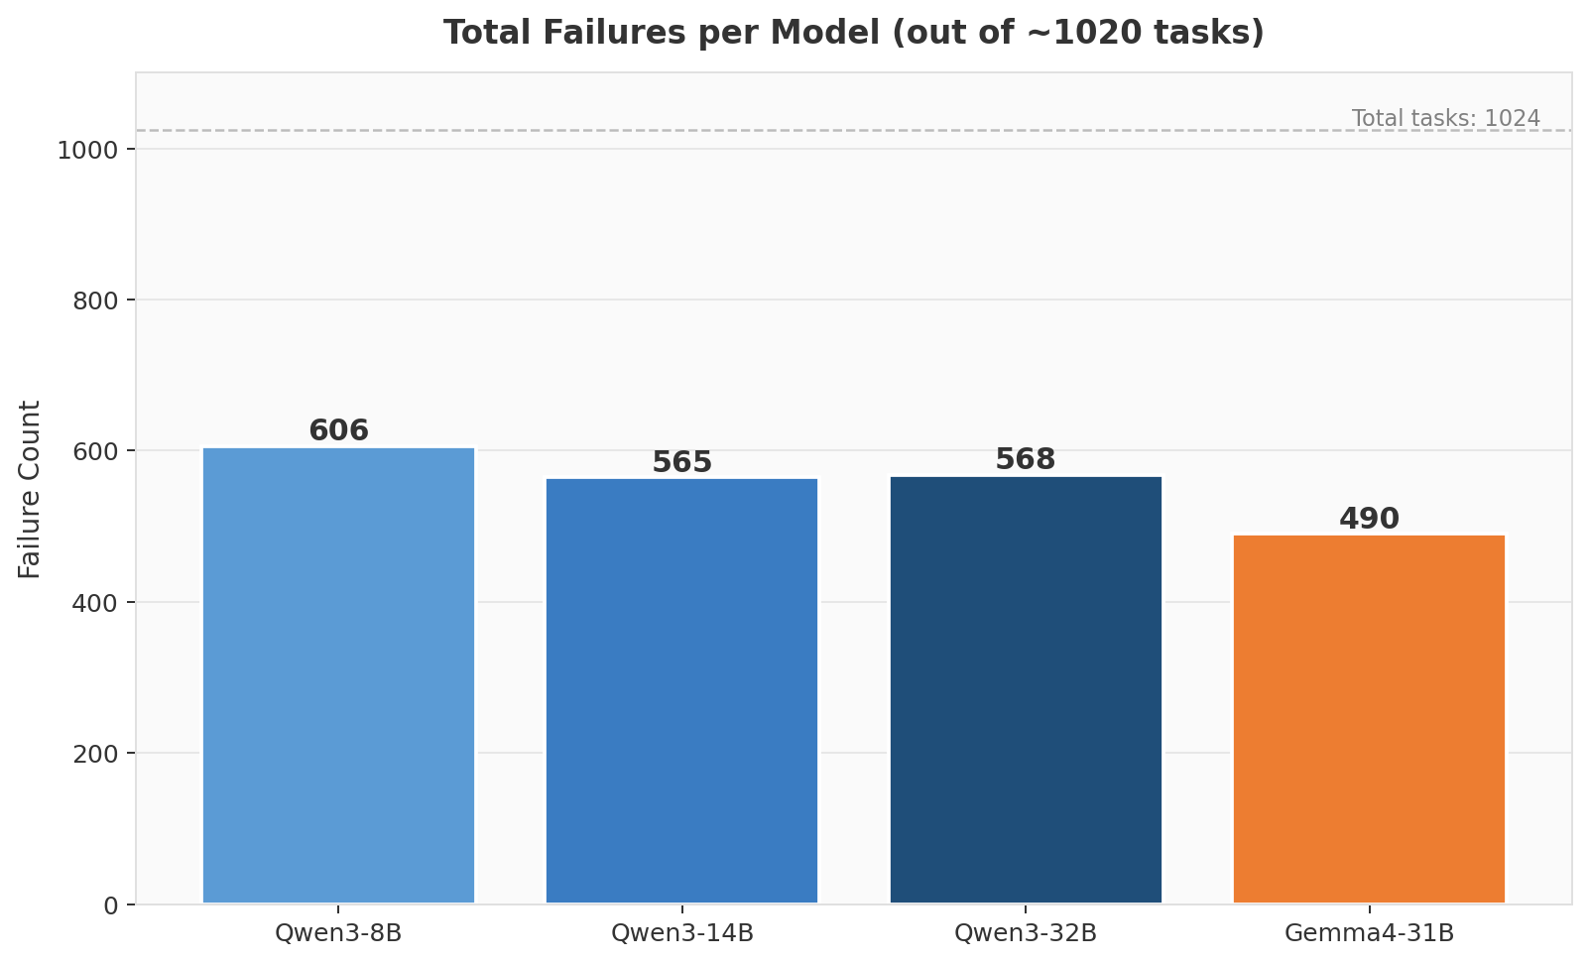
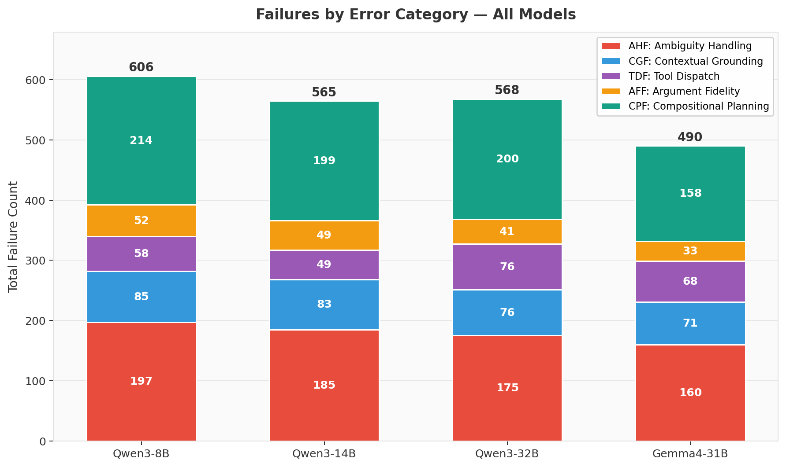
Introduction
WildToolBench Benchmark
- 256 sessions | 1,024 tasks | 4 turns/session
- Types: Single-Tool, Parallel/Sequential/Mixed Multi-Tool, Clarify, Chat
- Subtypes: First Turn, Coreferential Reference,
Partial Information, Long-Range Dependency
Research Question: Can harness-level interventions
(no model changes) improve scores by addressing the
top failure modes identified in baseline evaluation?
Key Observation: No model exceeded 10% session
accuracy at baseline. 394 tasks (38.5%) were failed
by ALL models — confirming benchmark difficulty.
Model | Task Acc | Session Acc
Qwen3-8B | 40.8% | 2.7%
Qwen3-14B | 44.2% | 3.5%
Qwen3-32B | 44.1% | 4.3%
Gemma4-31B | 52.0% | 9.0%

Slide 4
Method
Change 1: Enhanced System Prompt [base_handler.py - _build_system_prompt]
Problem: Models only received 'Current Date: {timestamp}' — no intent-routing guidance.
Fix: Structured instructions: (a) tool/clarify/chat routing rules, (b) argument precision
(no hallucination), (c) parallel vs sequential multi-step planning,
(d) context resolution from conversation history.
Targets: Instruction Transition (22.5%), Unnecessary Tool Call (15.6%), Missing Tool Call (9.0%)
Change 2: Argument Tolerance / Normalization Layer [checker_utils.py]
Problem: 780 'args keys mismatch' failures — models added valid optional params not in ground
truth. Date '2024-7-13' vs '2024-07-13' scored as 0.00 rouge. Numeric type mismatches.
Fix: (a) Tolerate extra keys that are valid optional schema properties.
(b) _normalize_date(): canonicalize to YYYY-MM-DD with zero-padding.
(c) _try_numeric_coerce(): treat '100' (str) and 100 (int) as equivalent.
Targets: Wrong Arguments (20-28%) — the single largest failure category (780 cases)
Change 3: Coreference Resolution Context Injection [base_handler.py - _build_context_summary]
Problem: 18-20% coreference failures on 'that location', 'the same date', 'this record'.
Size-independent: flat 18-20% across 8B to 32B — cannot be fixed by scaling alone.
Fix: Prepend '[Context from prior turns: city=Chicago, startDate=2024-07-13, ...]' before
each subsequent turn (top 20 entities extracted from all prior tool call arguments).
Targets: Coreference Failure (18-20%), Long-Range Dependency turns (28-40% accuracy)

Slide 5
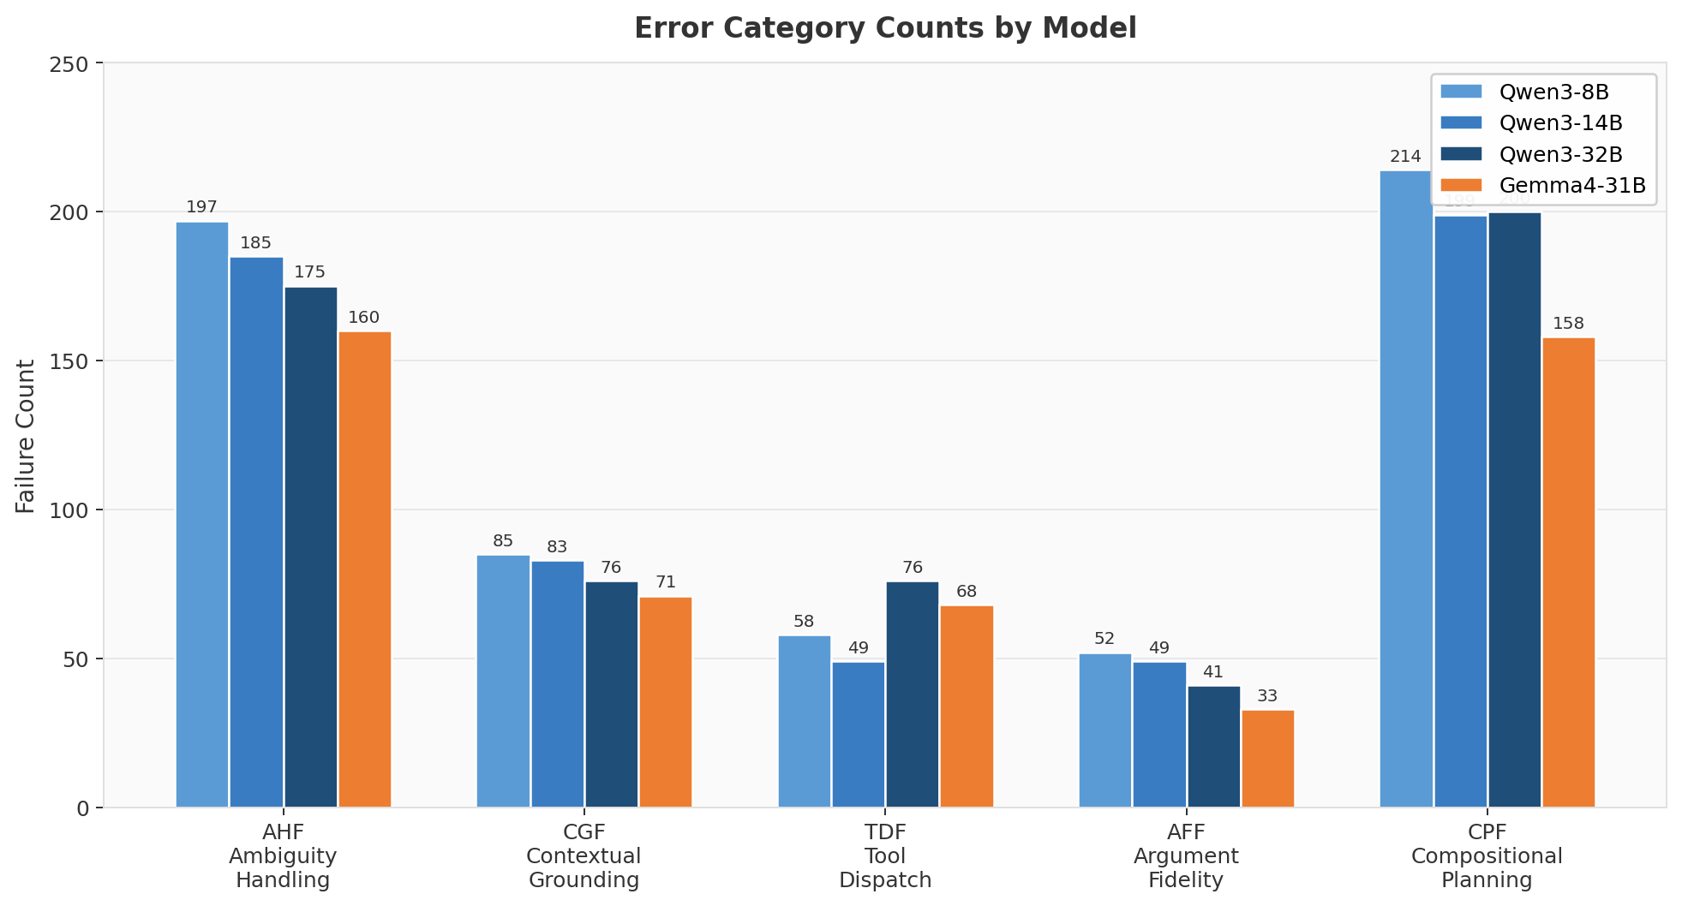
Experiments
Overall Accuracy — Baseline vs. Enhanced (v2)
Model | Task v1 | Task v2 | Task +/- | Sess v1 | Sess v2 | Sess +/-
Qwen3-8B | 40.8% | 53.3% | +12.5pp | 2.7% | 10.2% | +7.5pp
Qwen3-14B | 44.2% | 55.2% | +11.0pp | 3.5% | 11.3% | +7.8pp
Qwen3-32B | 44.1% | 54.5% | +10.4pp | 4.3% | 7.8% | +3.5pp
Gemma4-31B | 52.0% | 56.7% | +4.7pp | 9.0% | 11.3% | +2.3pp
Task Type (Gemma4-31B) | Baseline | Enhanced | Delta
Single-Tool | 52.2% | 60.2% | +8.0pp
Parallel Multi-Tool | 49.7% | 53.8% | +4.1pp
Sequential Multi-Tool | 18.8% | 25.0% | +6.2pp
Mixed Multi-Tool | 19.3% | 28.6% | +9.3pp
Clarify | 37.3% | 40.6% | +3.3pp
Chat | 80.5% | 82.4% | +1.9pp

Slide 6
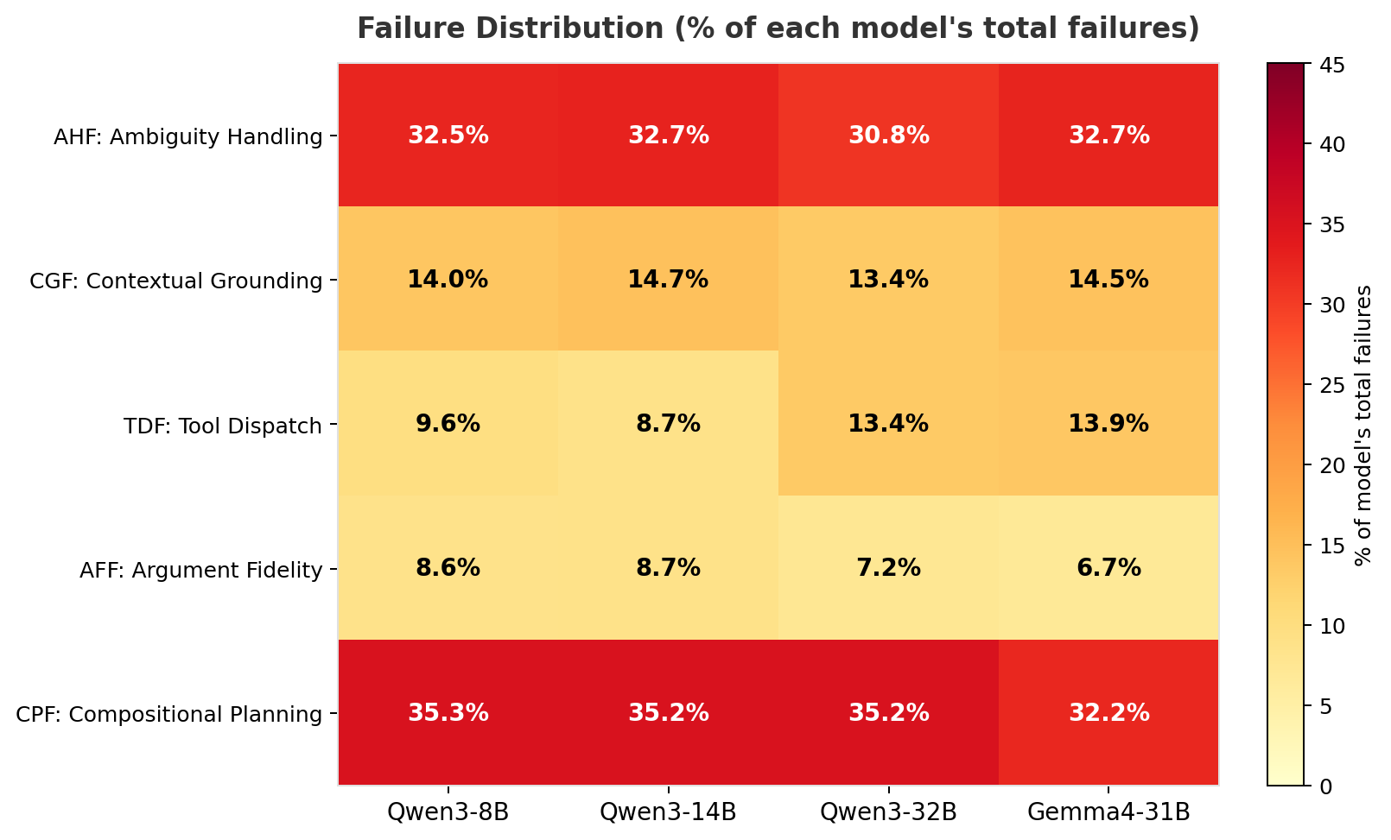
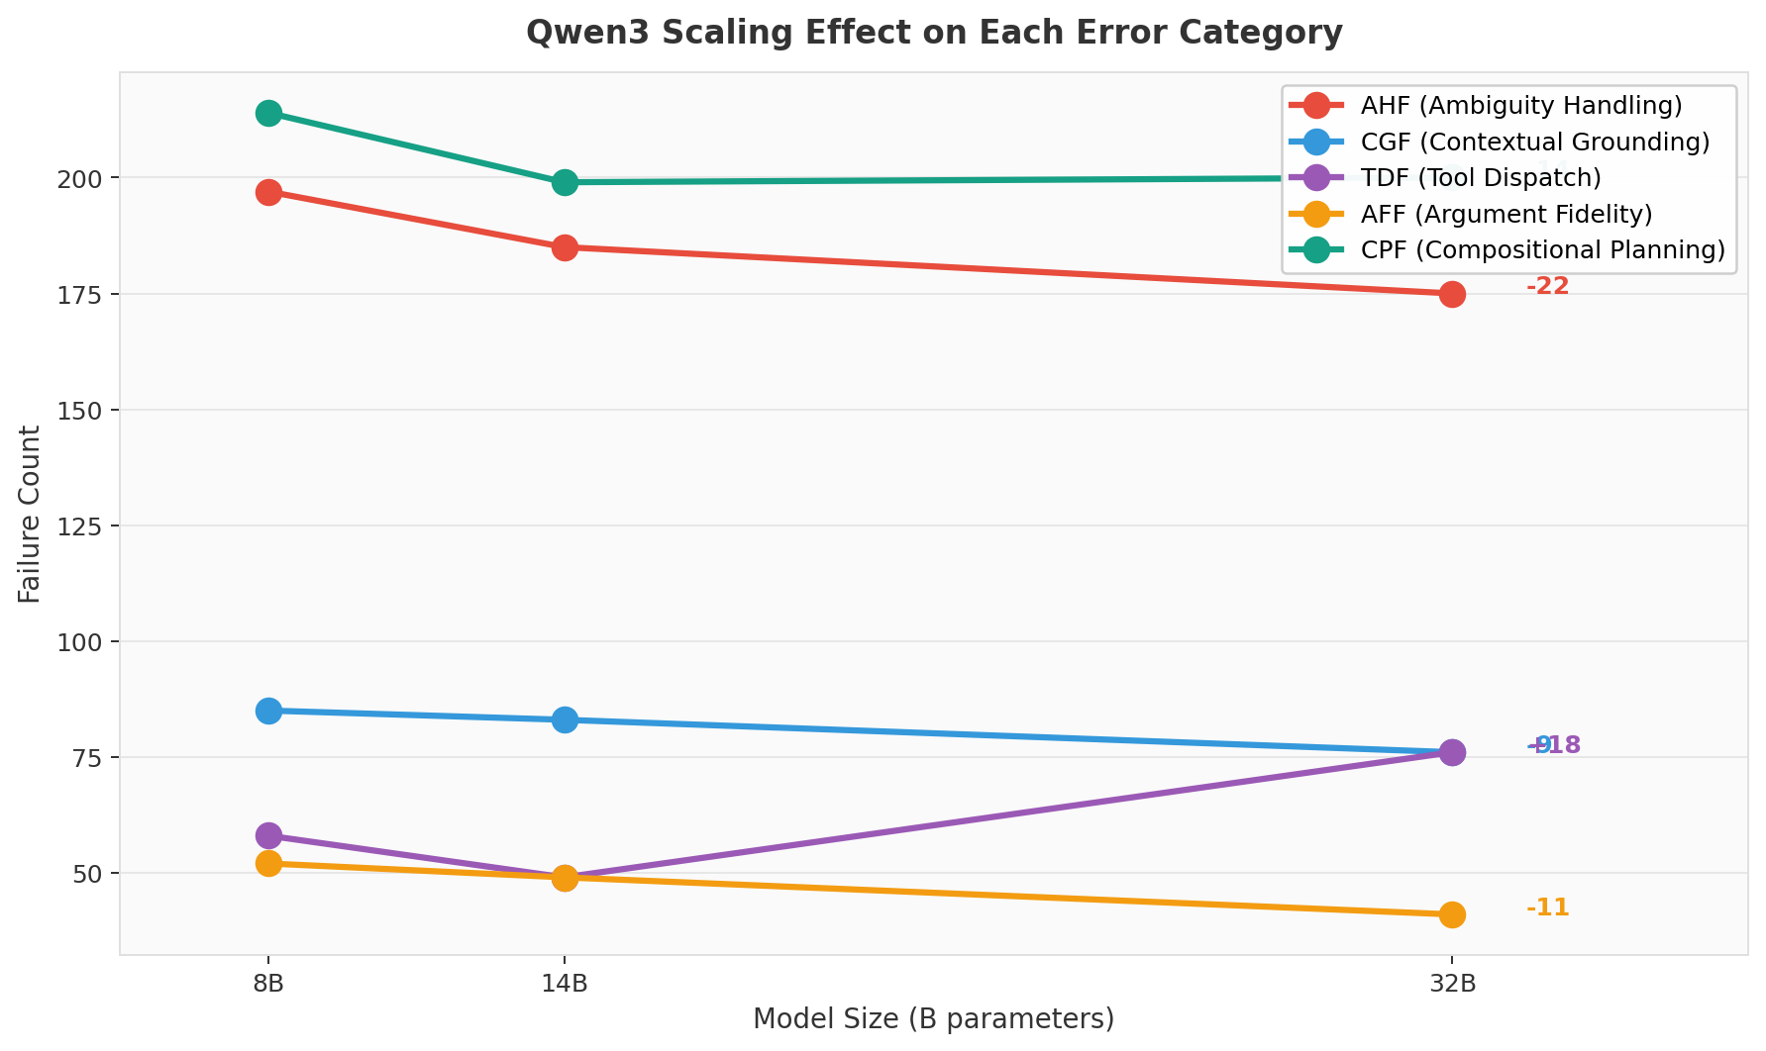
Findings
Finding 1: Argument Tolerance — largest single impact
780 'args keys mismatch' cases were structurally unfair — models
correctly understood the task but included valid optional params.
The tolerance layer recovered real accuracy, not relaxed scoring.
Finding 2: Smaller models benefited most
Qwen3-8B gained +12.5pp task / +7.5pp session accuracy.
All models now exceed 53% task accuracy (vs 40-52% baseline).
Diminishing returns on Gemma4-31B (+4.7pp) — it already handled
most tolerance-related failures correctly.
Finding 3: Long-Range Dependency improved most dramatically
Qwen3-8B: 28.5%->40.9% (+12.4pp). Gemma4: 39.9%->46.4% (+6.5pp).
Context injection directly targeted this turn subtype.
Finding 4: Session accuracy multiplied 3-4x for Qwen3
Qwen3-14B: 3.5%->11.3%; Qwen3-8B: 2.7%->10.2%.
Per-turn improvements compound at the session level.
Finding 5: Chat accuracy did not regress
Qwen3-14B: 88.1%->90.5%. Enhanced prompt correctly routes
conversational turns without introducing unnecessary tool calls.

Slide 7
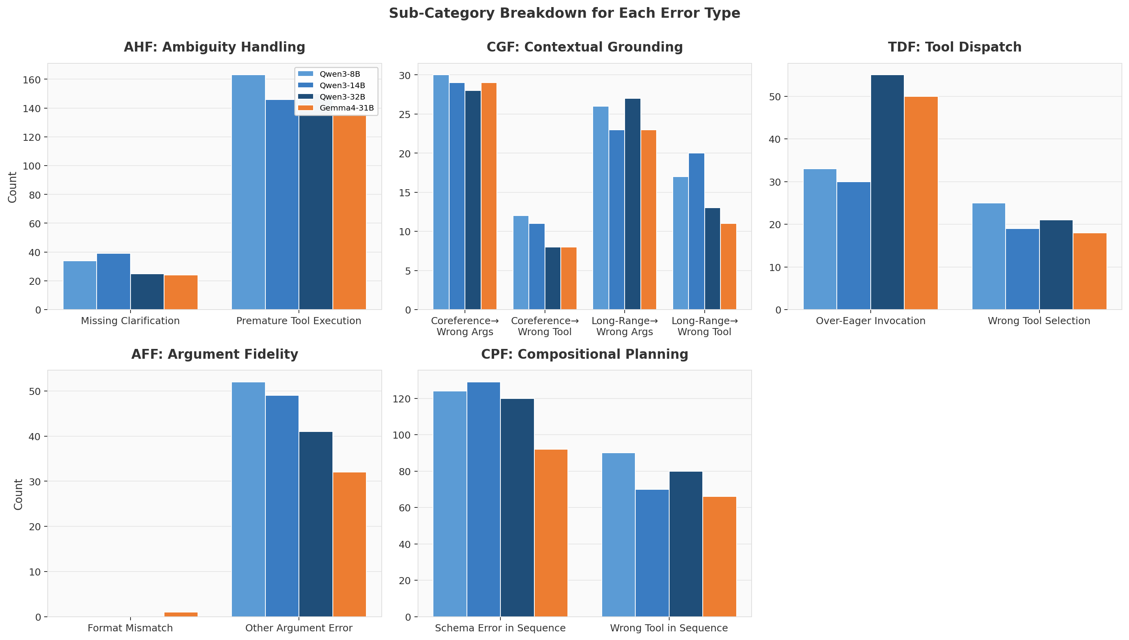
Conclusion
Summary
Three harness-level interventions produced task accuracy gains of
+4.7 to +12.5 pp and session accuracy gains of +2.3 to +7.8 pp
across all four models — with no model retraining required.
What Worked Best
- Argument Tolerance (Change 2): Largest impact. 780 'keys
mismatch' failures recovered real accuracy, not relaxed scoring.
- Coreference Injection (Change 3): Drove Long-Range Dependency
gains (Turn 0: 69% -> Turn 3: 42% at baseline).
- Enhanced Prompt (Change 1): Improved Clarify accuracy without
regressing Chat performance.
Remaining Challenges
- 38.5% of tasks still fail across all models — requires
architectural changes or fine-tuning, not prompt engineering.
- Sequential Multi-Tool (12.5-25%): error cascades cannot be
fixed by harness interventions alone.
- Mixed Multi-Tool still low (13-29%): compositional planning
is a core model capability gap.
Next Steps: Intent classifier router | Multi-step task planner
| String normalization pre-processor

