Slide 1






$$v_{1}$$
$$v_{2}$$
$$ℐ\left(v_{1}\right)=\{1:8\}$$
$$ℐ\left(v_{2}\right)=\{3:9\}$$
$$v_{3}$$
$$ℐ\left(v_{3}\right)=\{3:8,12\}$$

Slide 2
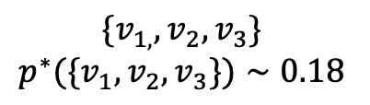
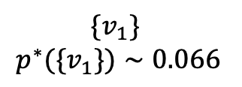
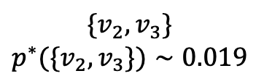
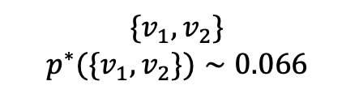
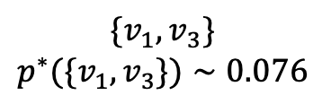
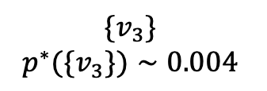

$${\{v}_{1,}, v_{2}, v_{3}\}$$
$$p^{∗}({\{v}_{1}, v_{2}, v_{3}\})∼0.18$$
$${\{v}_{1}, v_{2}\}$$
$$p^{∗}({\{v}_{1}, v_{2}\})∼0.066$$
$$\{{v_{1}, v}_{3}\}$$
$$p^{∗}({\{v}_{1}, v_{3}\})∼0.076$$
$${\{v_{2}, v}_{3}\}$$
$$p^{∗}({\{v}_{2}, v_{3}\})∼0.019$$
$${\{v}_{1}\}$$
$$p^{∗}({\{v}_{1}\})∼0.066$$
$$\{v_{2}\}$$
$$p^{∗}({\{v}_{2}\})∼0.004$$
$${\{v}_{3}\}$$
$$p^{∗}({\{v}_{3}\})∼0.004$$

Slide 3
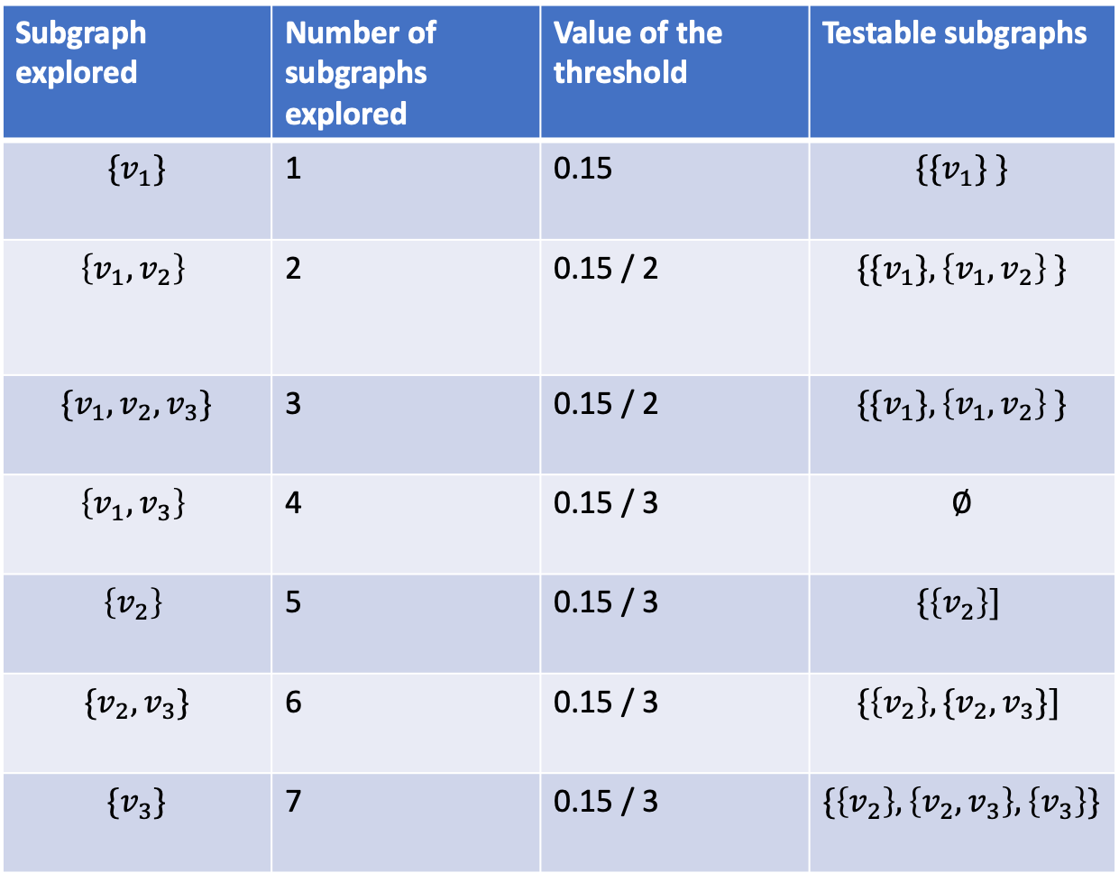
Subgraph explored | Number of subgraphs explored | Value of the threshold | Testable subgraphs
$${\{v}_{1}\}$$ | 1 | 0.15 | $${\{\{v}_{1}\} \}$$
$$\left\{v_{1}, v_{2}\right\}$$ | 2 | 0.15 / 2 | $${\{\{v}_{1}\}, \left\{v_{1}, v_{2}\right\} \}$$
$${\{v}_{1}, v_{2}, v_{3}\}$$ | 3 | 0.15 / 2 | $${\{\{v}_{1}\}, \left\{v_{1}, v_{2}\right\} \}$$
$$\left\{v_{1}, v_{3}\right\}$$ | 4 | 0.15 / 3 | $$∅$$
$$\left\{v_{2}\right\}$$ | 5 | 0.15 / 3 | $$\{\left\{v_{2}\right\}]$$
$$\{v_{2},v_{3}\}$$ | 6 | 0.15 / 3 | $$\{\left\{v_{2}\right\}, \{v_{2},v_{3}\}]$$
$$\{v_{3}\}$$ | 7 | 0.15 / 3 | $$\{\left\{v_{2}\right\}, \left\{v_{2},v_{3}\right\}, \left\{v_{3}\right\}\}$$

Slide 4
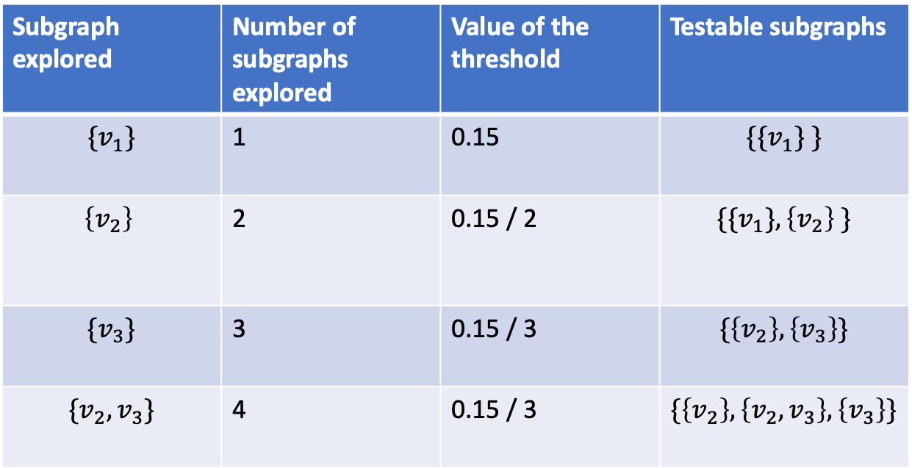
Subgraph explored | Number of subgraphs explored | Value of the threshold | Testable subgraphs
$${\{v}_{1}\}$$ | 1 | 0.15 | $${\{\{v}_{1}\} \}$$
$$\left\{v_{2}\right\}$$ | 2 | 0.15 / 2 | $${\{\{v}_{1}\}, \left\{v_{2}\right\} \}$$
$${\{v}_{3}\}$$ | 3 | 0.15 / 3 | $$\{\left\{v_{2}\right\}, \left\{v_{3}\right\}\}$$
$$\{v_{2},v_{3}\}$$ | 4 | 0.15 / 3 | $$\{\left\{v_{2}\right\}, \left\{v_{2},v_{3}\right\}, \left\{v_{3}\right\}\}$$

