Slide 1
Movie Rental System
App is focused on functionality, the UI looks rough

Slide 2
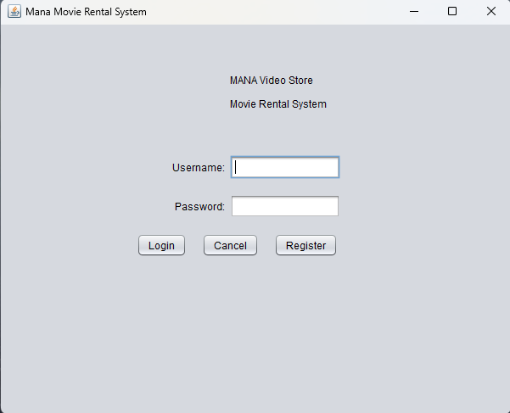
Register Account
Open Mana Movie Rental System
Click on the Register button

Slide 3
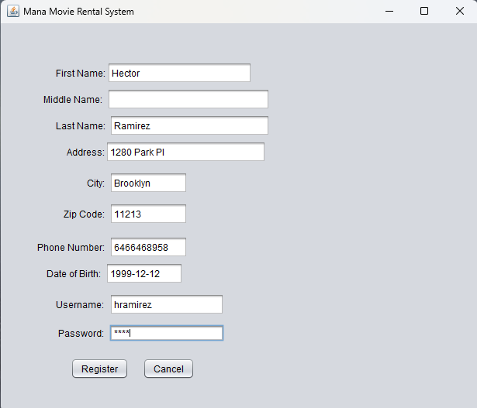
Fill out the requested information:
First name
Middle name
Last name
Address
City
Zip code
Phone number
Date of birth (YYYY-MM-DD)
Username
Password

Slide 4
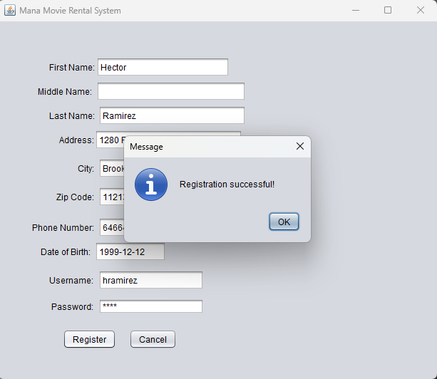
Click on the Register button

Slide 5
Login to Account
Open Mana Movie Rental System

Slide 6
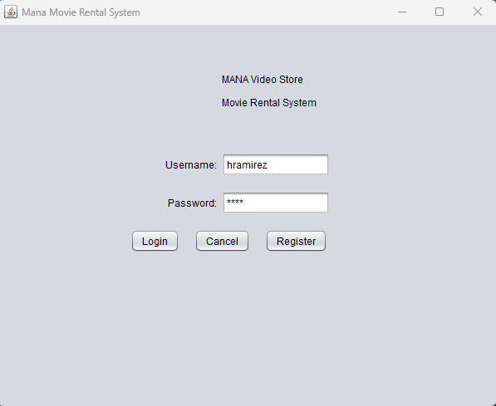
Login to Account
Fill out information:
Username
Password
Click Log in

Slide 7
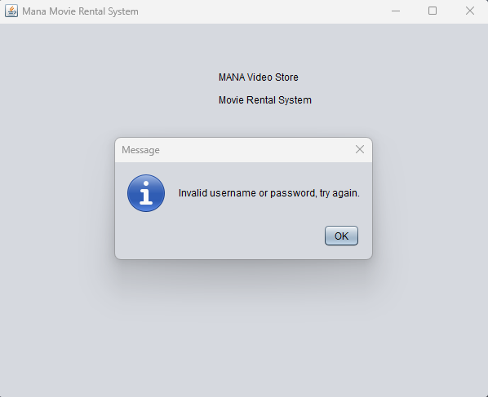
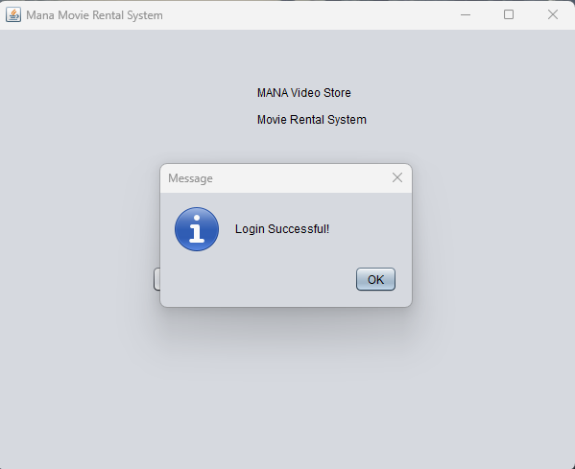
System will notify if log in was successful or not
If unsuccessful the user is prompted that there was an error and they will need to fix the information entered for Username and Password
If successful the user is taken to the client Dashboard screen based on their account type.

Slide 8
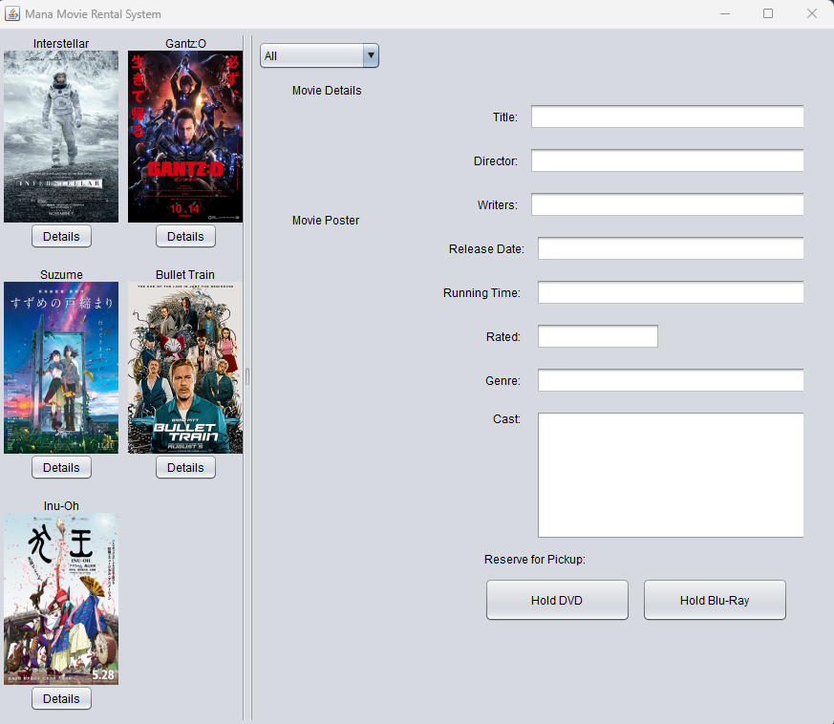
Client Dashboard
From the client dashboard users can:
View movies available to rent
View movie details
Title
Director
Writers
Release date
Running time
Rating
Genre
Cast
Reserve/hold movies for rental pick-up if it’s in stock
Two formats available:
DVD
Blu-Ray

Slide 9
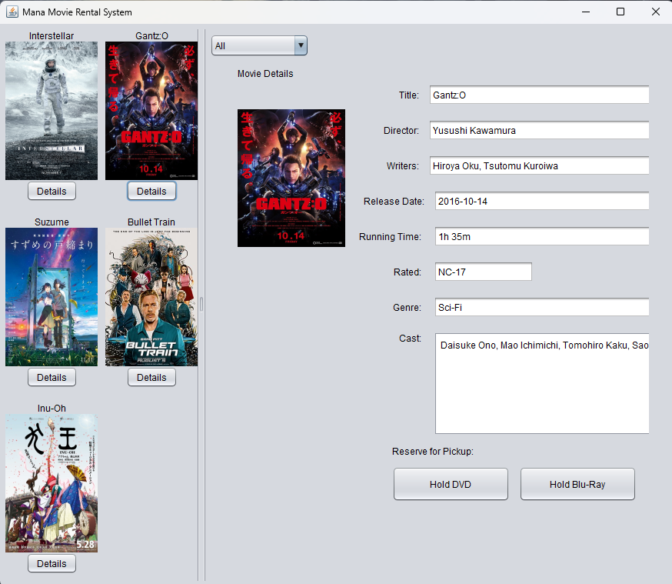
On the left panel, click on the Details button below the movie to be reserved/held for rental pick-up.
Details for the movie will appear on the right-side panel
Movies can be filtered by genre from the dropdown menu at the top of the screen

Slide 10
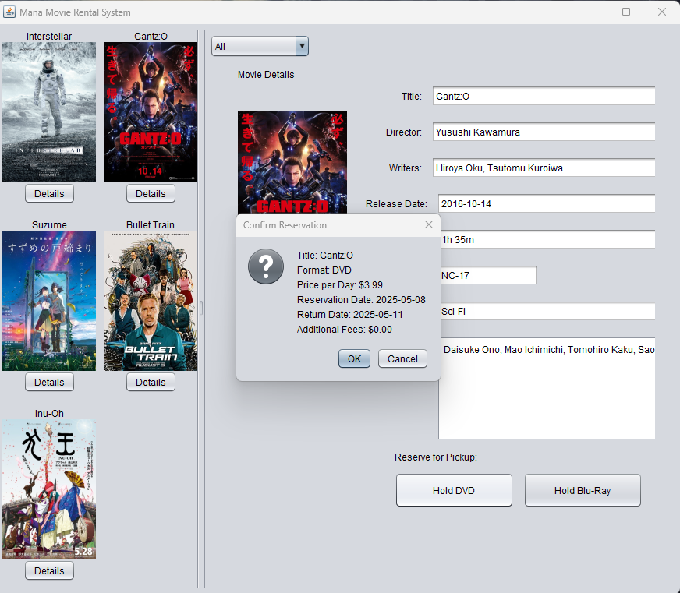
Click on the Hold button for the desired format:
Hold for DVD
Hold for Blu-Ray
If no copies of the desired format are available to rent, the user will not be able to make the reservation.
If units are available, the system will prompt the user to confirm reservation and display the details of the reservation:
Title
Format
Price per day
Reservation date
Return date
Additional fees

Slide 11
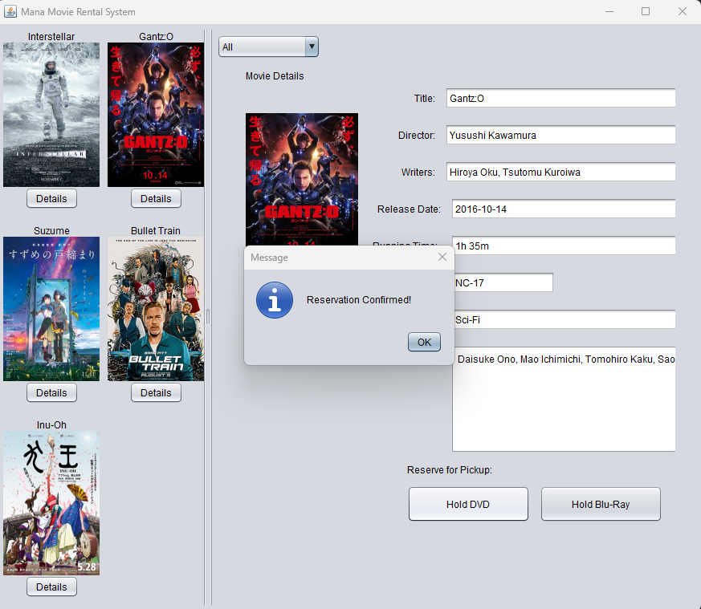
Click the Ok button
The system will notify the user that a rental pick-up reservation was made for the selected movie.
The user can then visit the store to pick-up the movie.

Slide 12
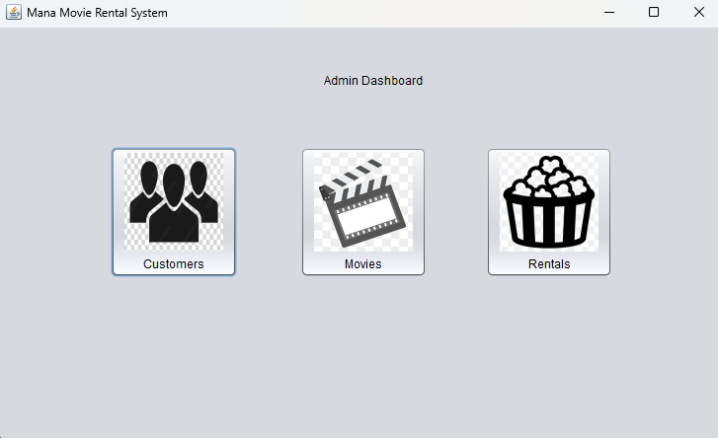
From the Admin dashboard, a user can:
Manage customer accounts
Add accounts
Edit accounts
Delete accounts
Manage movie inventory
Add movies
Edit movies
Delete movies
Manage movie rentals
Add movie rental
Process reservations for rental pick-up
Convert into movie rentals
Cancel reservations
Process movie rental returns

Slide 13
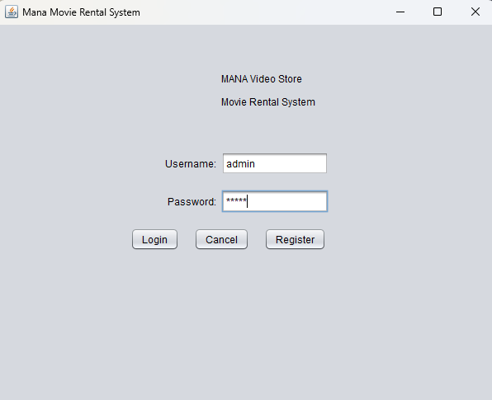
IMPORTANT NOTE
Admin accounts cannot be created from the registration screen. Client accounts generated through the registration screen need to be upgraded to Admin accounts.
Temporary Admin account for transition:
Username: admin
Password: admin

Slide 14
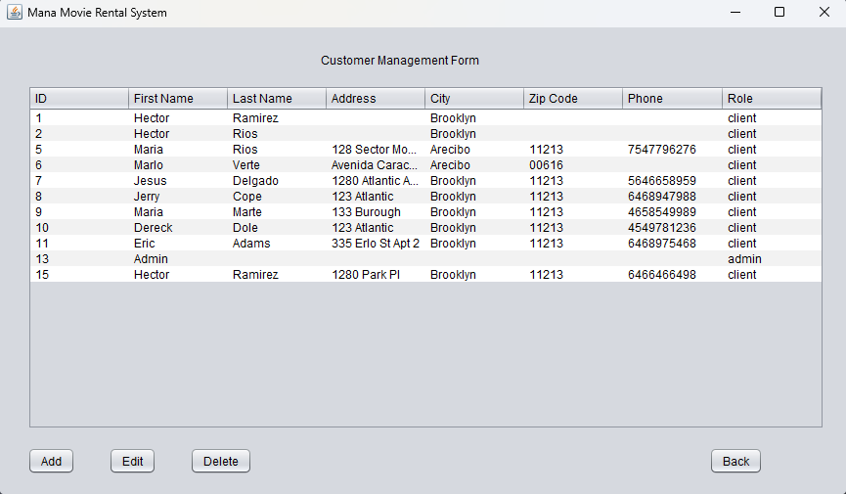
Add Customer Accounts
An admin can add a client account by following these steps:
Click on Customers button
System will display Customer Management Form
Click on the Add button

Slide 15
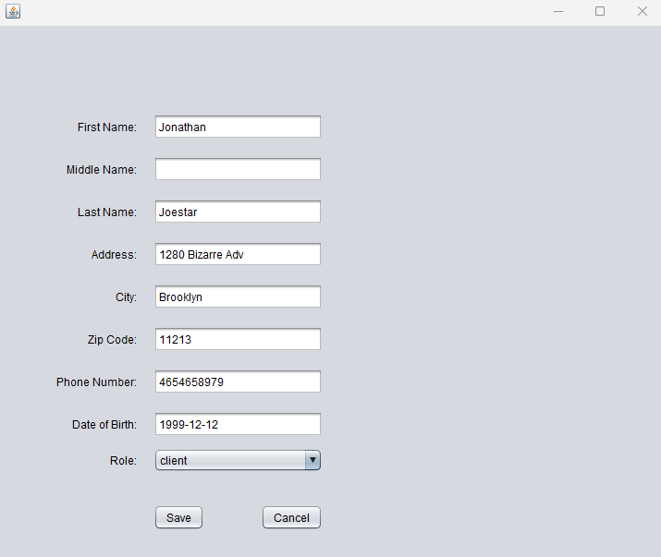
Fill out the requested information:
First name
Middle name
Last name
Address
City
Zip code
Phone number
Date of birth (YYYY-MM-DD)
Role
Accounts are defaulted to client accounts unless the admin selects a different role

Slide 16
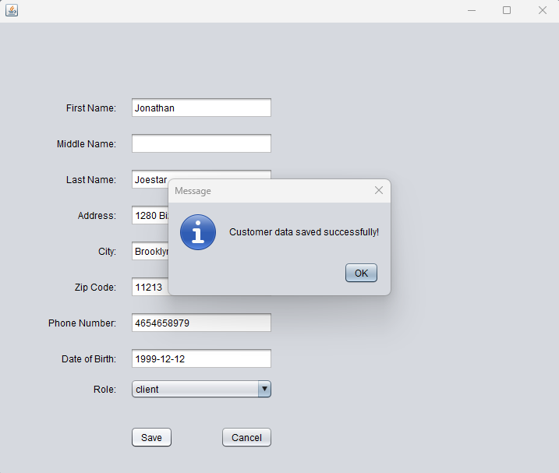
If the Save button is clicked
System will notify that a customer account was created

Slide 17
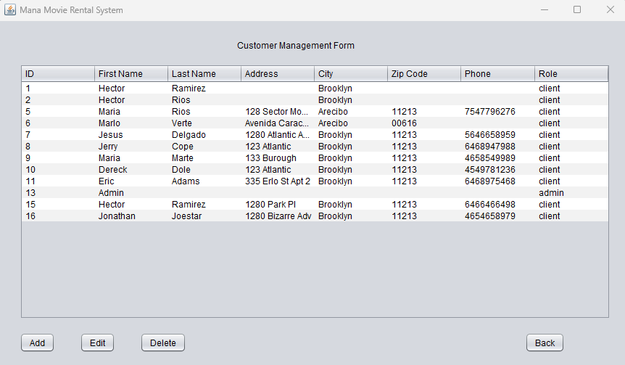
New customer account will be displayed in the Customer Management Form

Slide 18
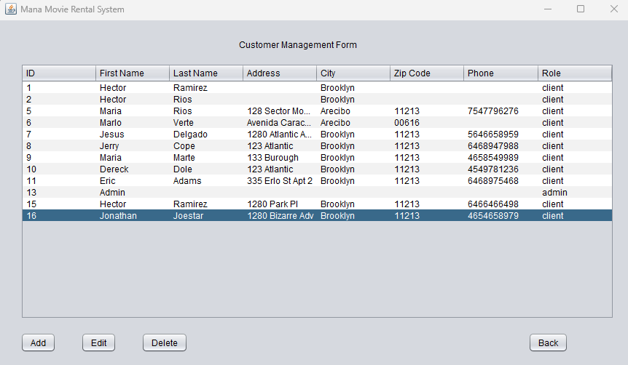
Editing Customer Accounts
An admin can edit a client account by following these steps:
Click on Customers button
System will display Customer Management Form
Click on the account that needs to be edited
Click on the Edit button

Slide 19
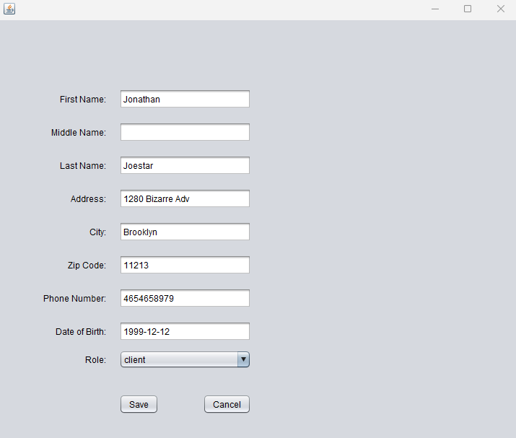
Fill out the requested information:
First name
Middle name
Last name
Address
City
Zip code
Phone number
Date of birth (YYYY-MM-DD)
Role
Accounts are defaulted to client accounts unless the admin selects a different role
Click on the Save button

Slide 20

System will notify that a customer account data was updated

Slide 21
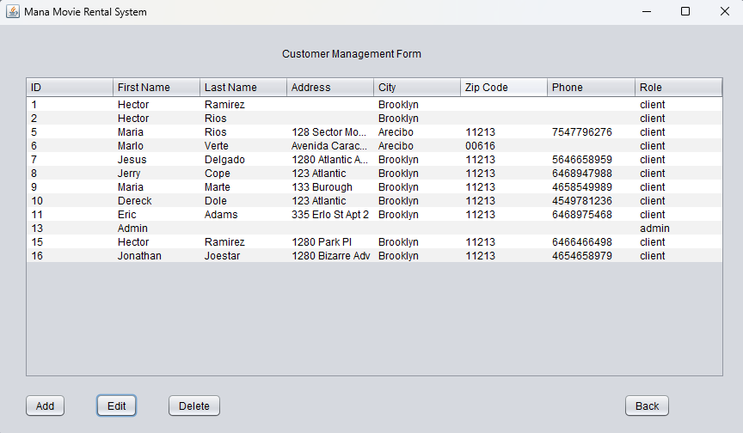
Updated customer account will be displayed in the Customer Management Form

Slide 22
Deleting Customer Accounts
An admin can delete a client account by following these steps:
Click on Customers button
System will display Customer Management Form
Click on the account that needs to be deleted
Click on the Delete button

Slide 23
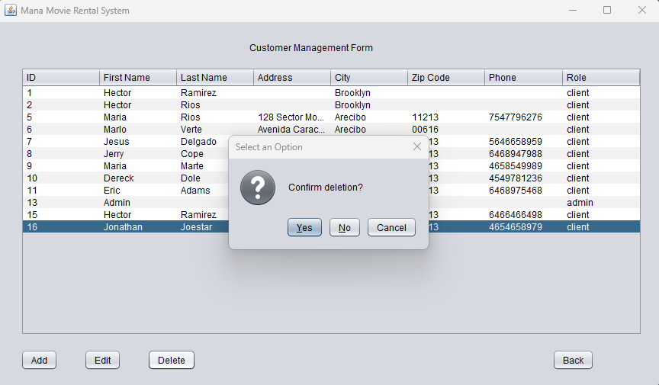
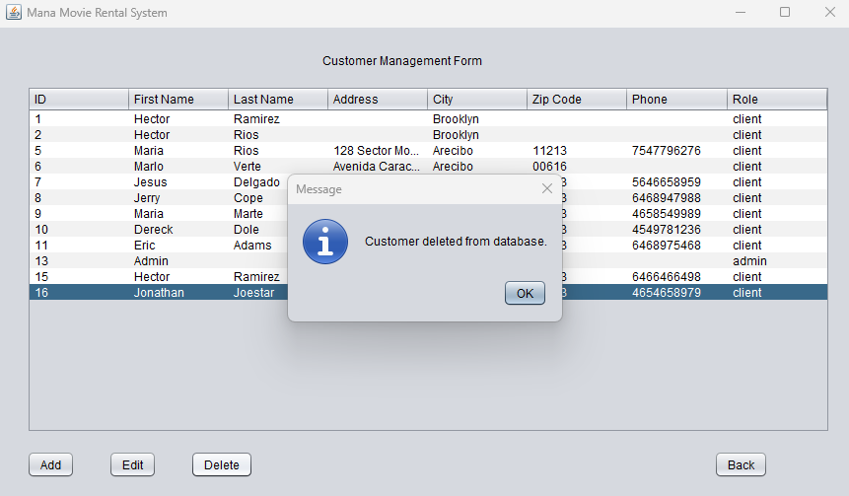
System will prompt the user to confirm deletion
Click on the Yes button to confirm
System will notify that the selected account will be deleted from the system

Slide 24
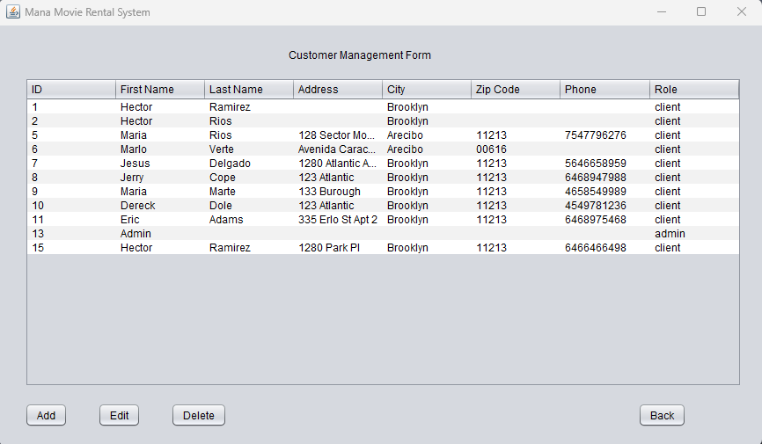
Deleted user will no longer be displayed in the Customer Management Form

Slide 25
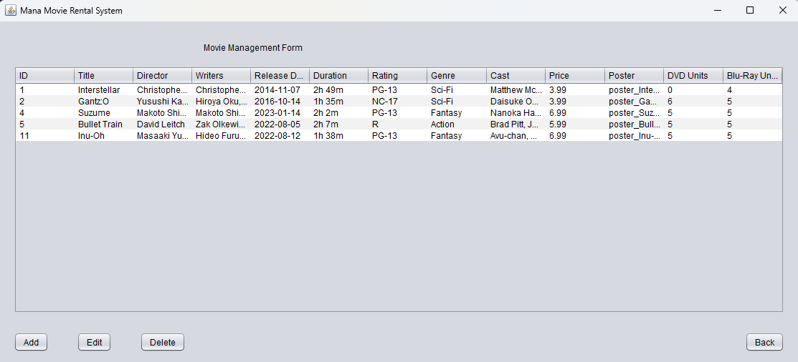
Adding a Movie to Inventory
An admin can add movies to the store inventory by following these steps:
Click on the Movies button
System will display Movie Management Form
Click on the Add button

Slide 26
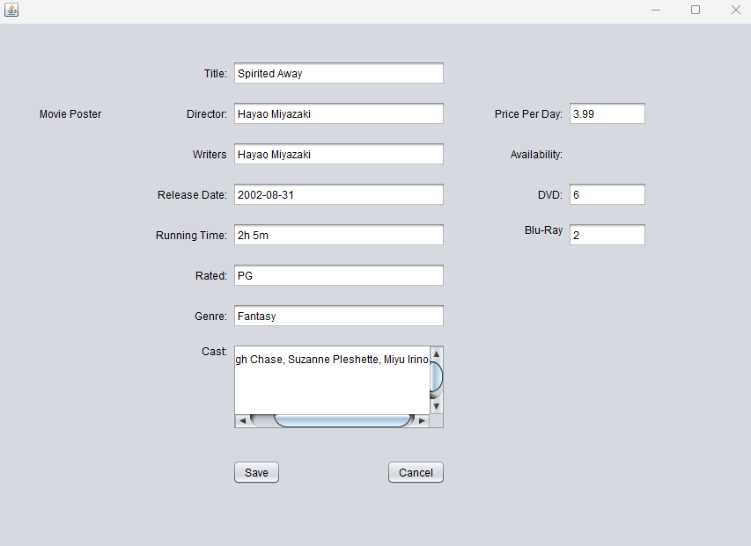
Fill out the requested information
Title
Director
Writers
Release Date
Running time
Rating
Genre
Cast
Price per day
Units available for rental:
DVD units
Blu-Ray units
Click on the Save button

Slide 27
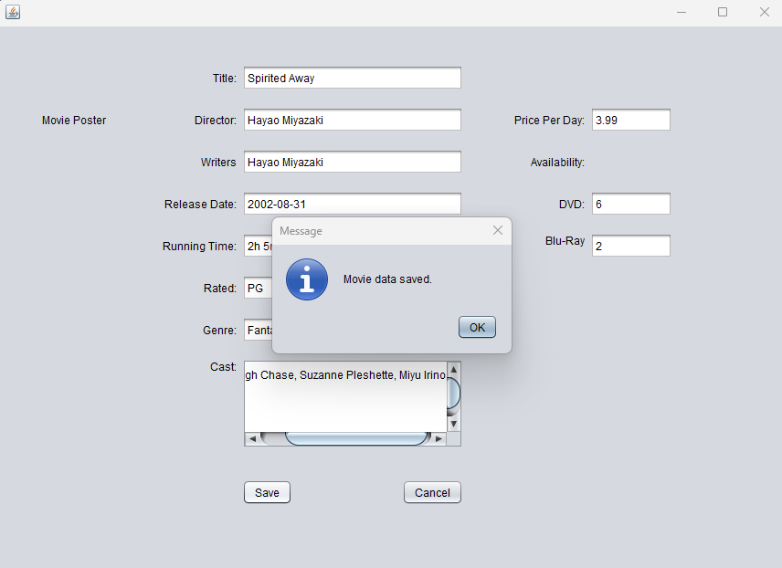
System will notify that a new movie has been added to the store inventory

Slide 28
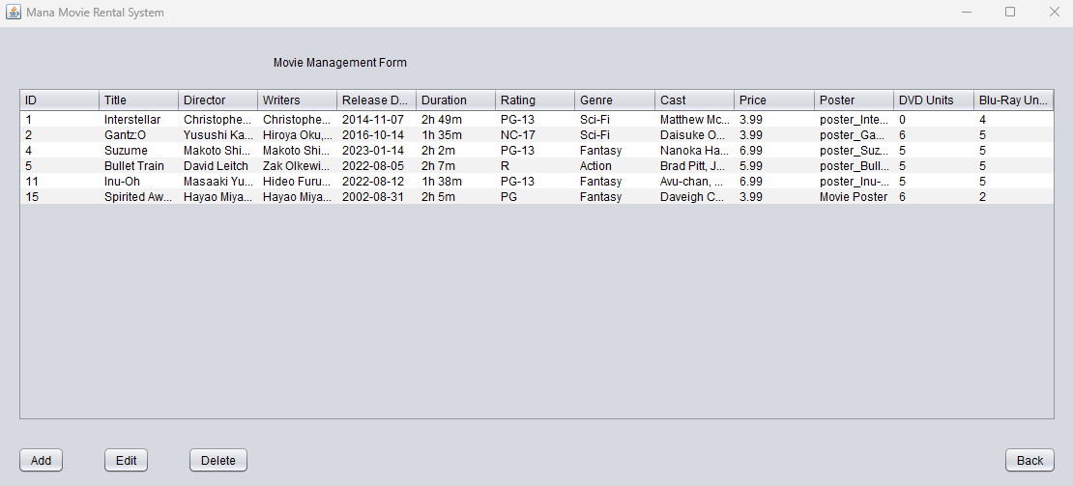
New movie will be displayed in the Movie Management Form

Slide 29
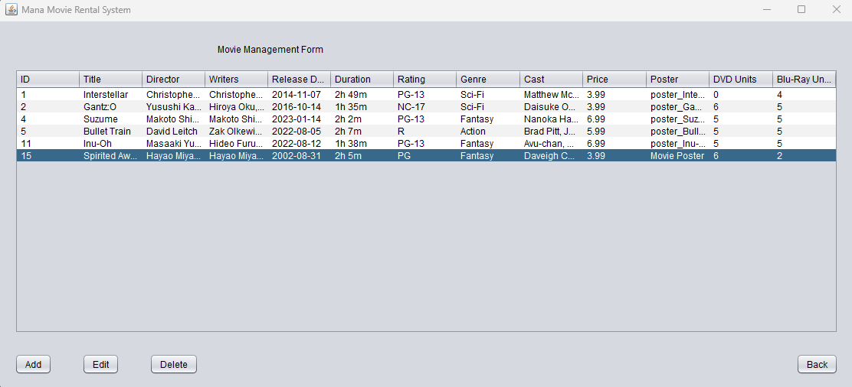
Edit a Movie in Inventory
An admin can edit the movies in the store inventory by following these steps:
Click on the Movies button
System will display Movie Management Form
Click on the movie that needs to be edited
Click on the Edit button

Slide 30
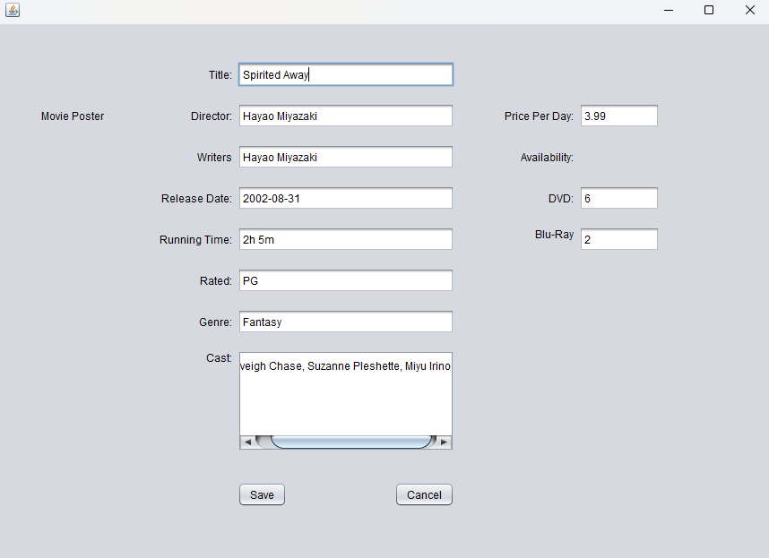
Fill out the requested information
Title
Director
Writers
Release Date
Running time
Rating
Genre
Cast
Price per day
Units available for rental:
DVD units
Blu-Ray units
Click on the Save Button

Slide 31
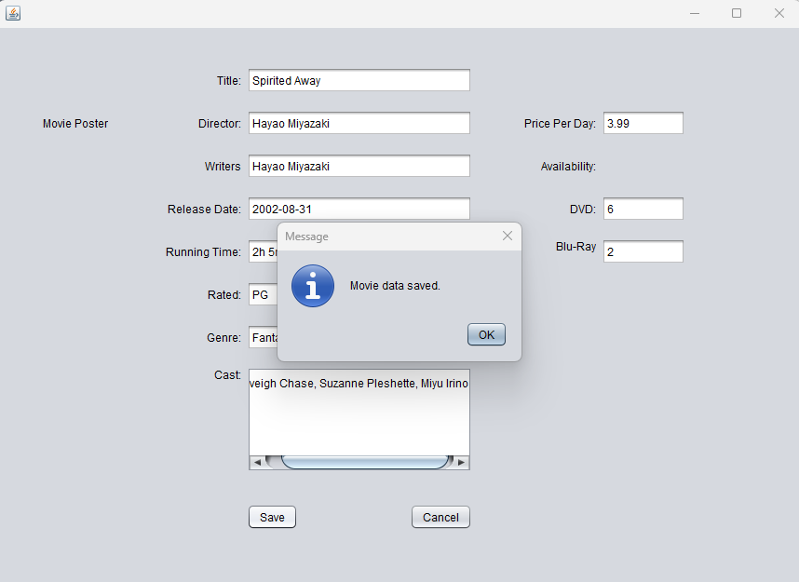
System will notify that a the movie has been updated in the store inventory

Slide 32
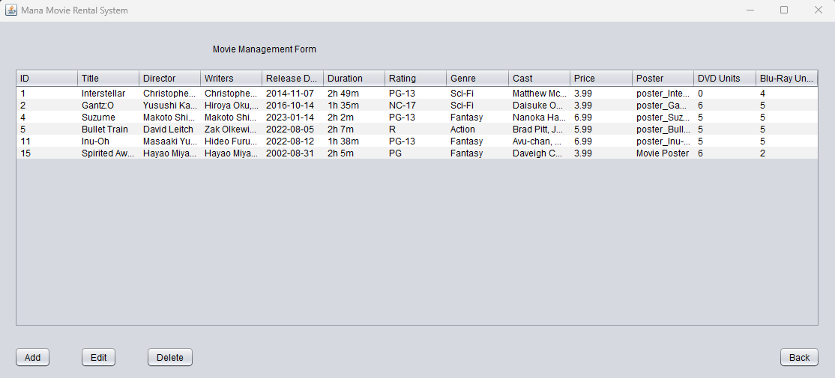
Updated movie will be displayed in the Movie Management Form

Slide 33
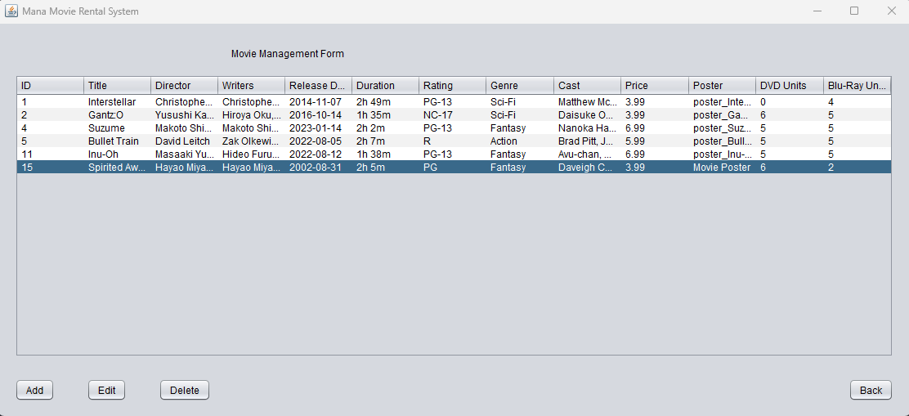
Delete a Movie in Inventory
An admin can delete a movie from the inventory by following these steps:
Click on Movies button
System will display Movie Management Form
Click on the movie that needs to be deleted
Click on the Delete button

Slide 34
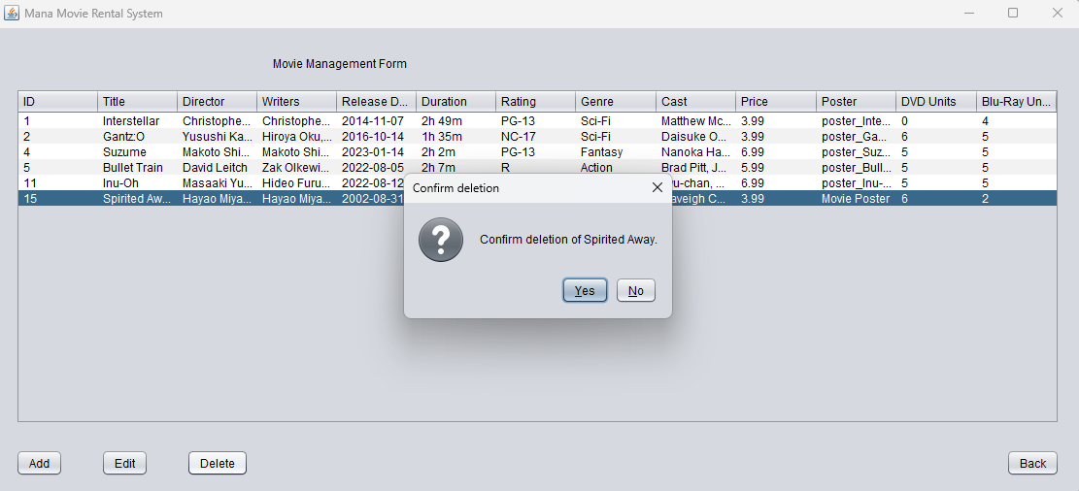
System will prompt the user to confirm deletion
Click on the Yes button to confirm
System will notify that the selected movie will be deleted from the system

Slide 35
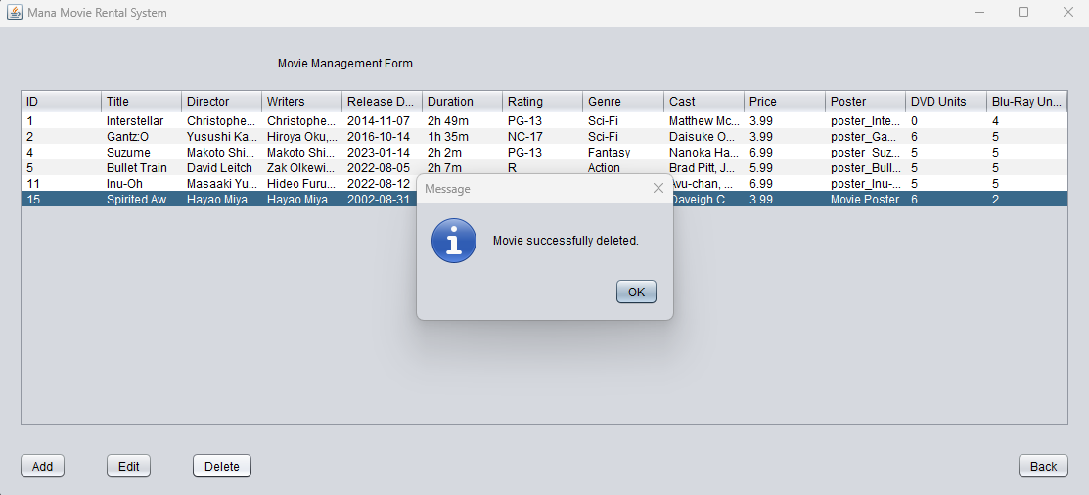
System will notify that the selected movie will be deleted from the system

Slide 36
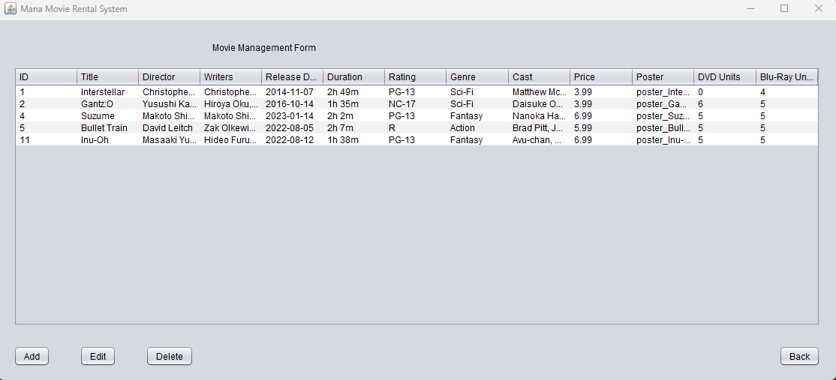
Deleted movie will no longer be displayed in the Movie Management Form

Slide 37
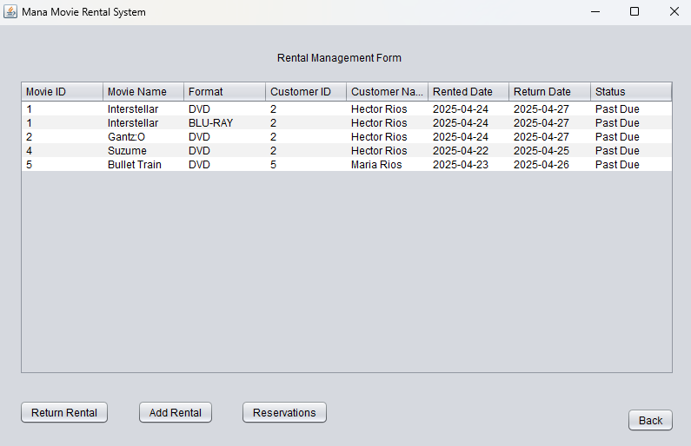
Adding a Rental
An Admin can process a movie rental for a customer by following these steps:
Click on the Rentals button
System will display Rental Management Form
Click on the Add Rental button

Slide 38
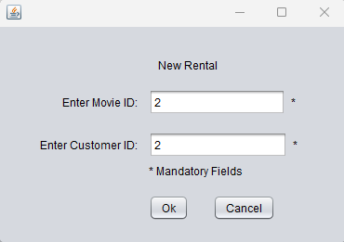
Fill out the requested information
Movie ID
Customer ID

Slide 39
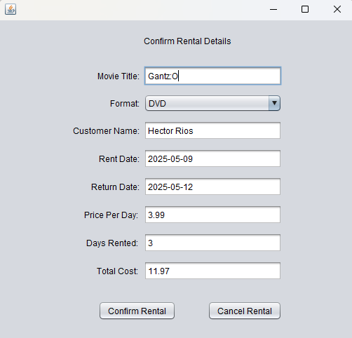
If the information entered is correct and matches data in the system
System will display the rental confirmation screen with rental details
Click on the Confirm Rental button

Slide 40
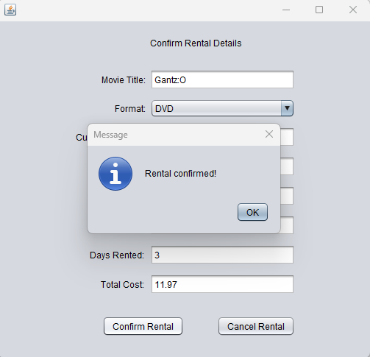
System will notify that a new movie rental has been processed for the movie and customer selected

Slide 41
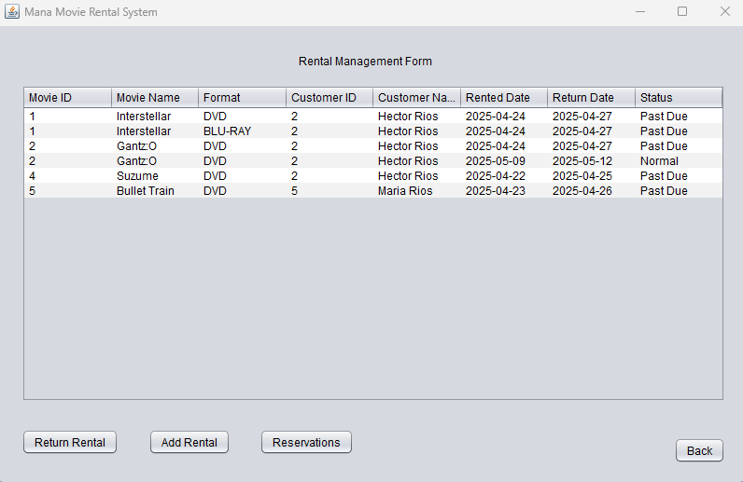
New rental will now display on the Rental Management Form

Slide 42
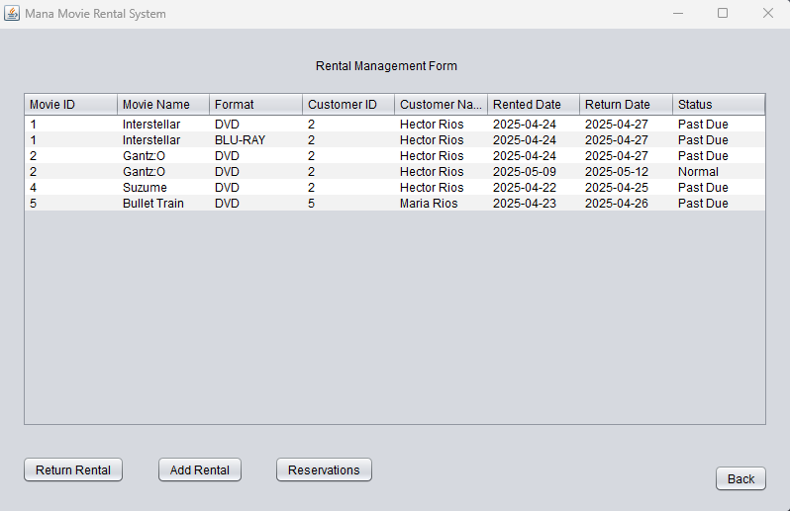
Processing Customer Rental Pick-Up Reservation
An Admin can manage rental reservations by following these steps:
Click on the Rentals button
System will display the Rental Management Form
Click on the Reservations button

Slide 43
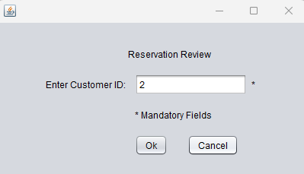
Fill out the requested information
Customer ID

Slide 44
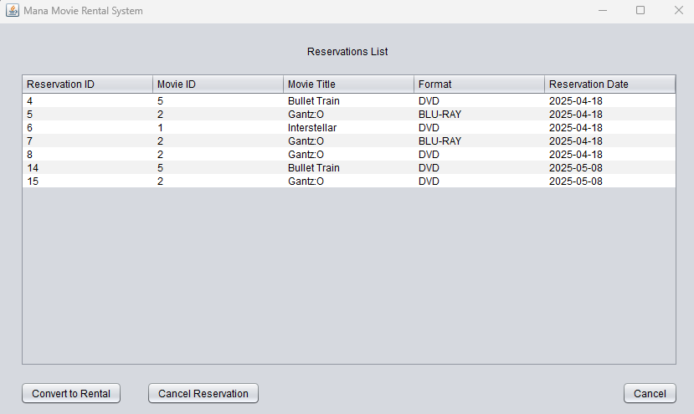
If the information entered is correct and matches data in the system
System will display the Reservation list screen

Slide 45
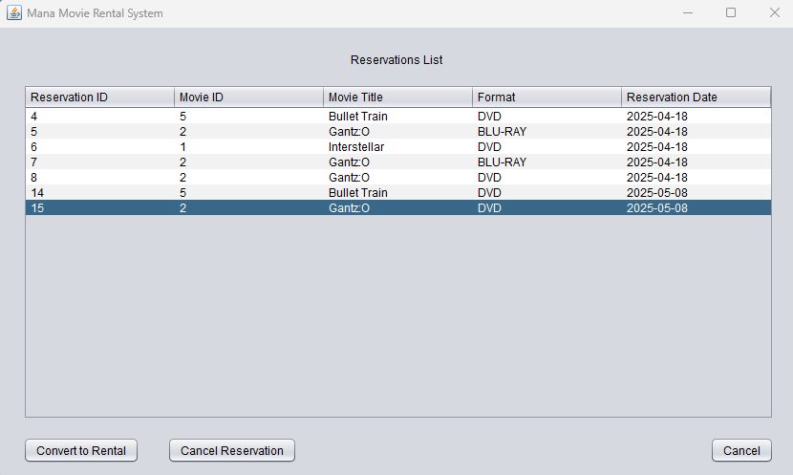
Converting a Reservation to a Rental
An Admin can convert a movie rental pick-up reservation into a rental for a customer by following these steps:
Click on a reservation from the list
Click on the Convert to Rental Button

Slide 46
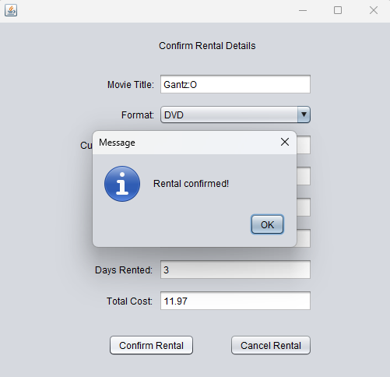
System will notify that a new movie rental has been processed for the movie and customer selected

Slide 47
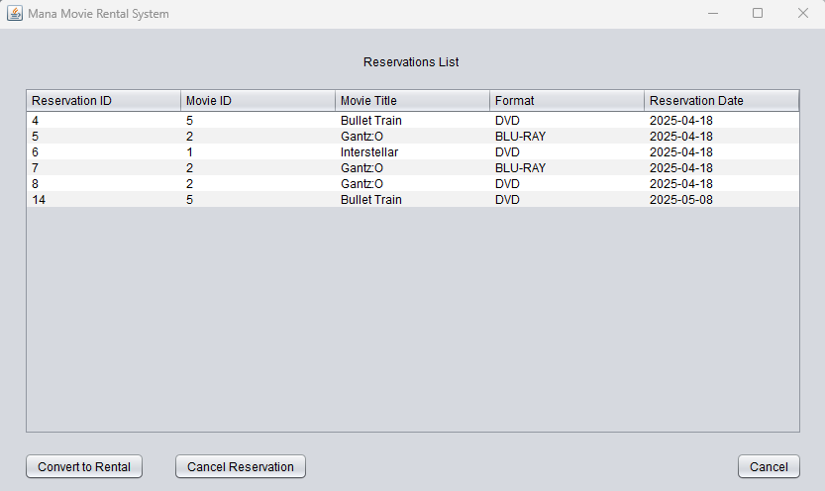
New rental will now display on the Rental Management Form

Slide 48
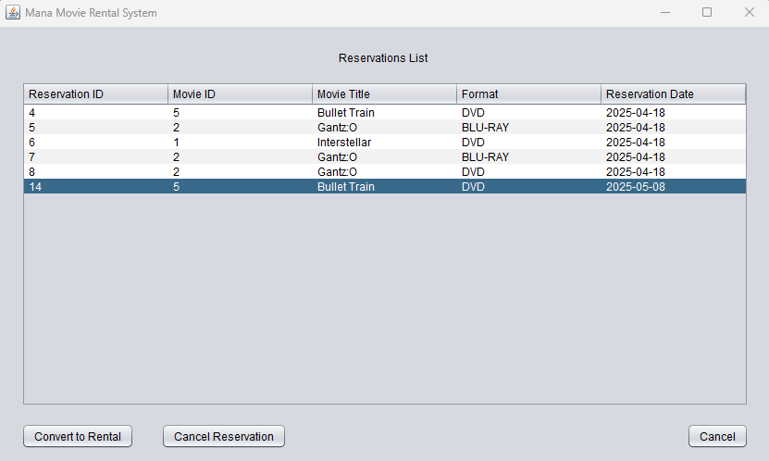
Canceling a Rental Reservation
An Admin can cancel a movie rental pick-up reservation for a customer by following these steps:
Click on a reservation from the list
Click on the Cancel Reservation button

Slide 49
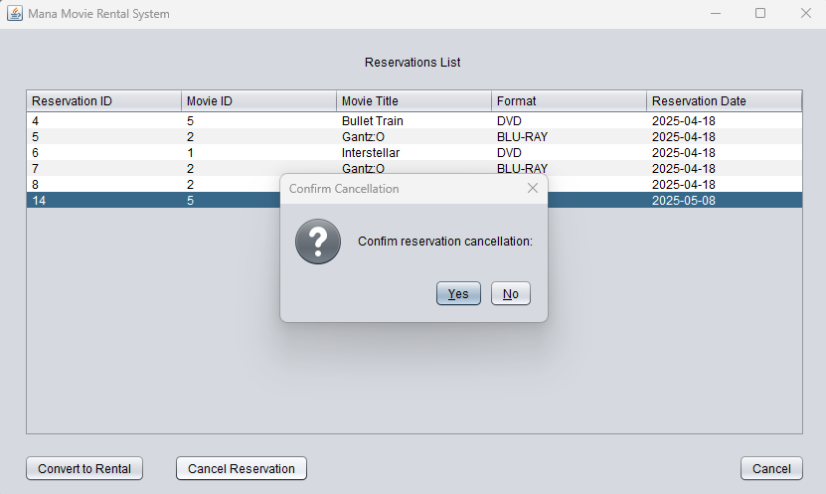
System will will prompt the user to confirm cancellation
If the Yes button is clicked

Slide 50
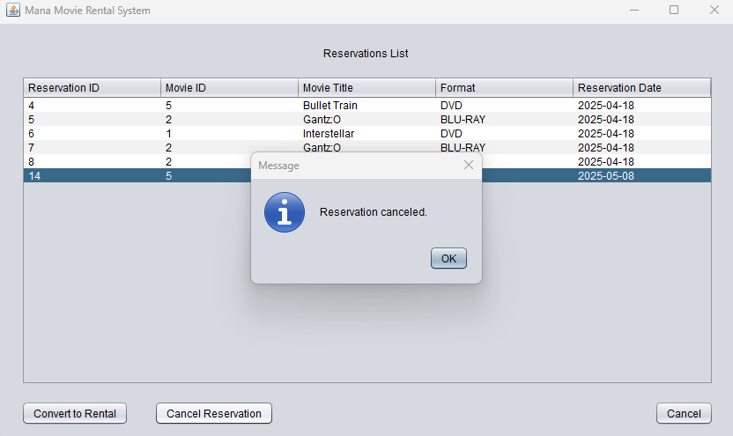
System will notify that the selected reservation will be cancelled

Slide 51
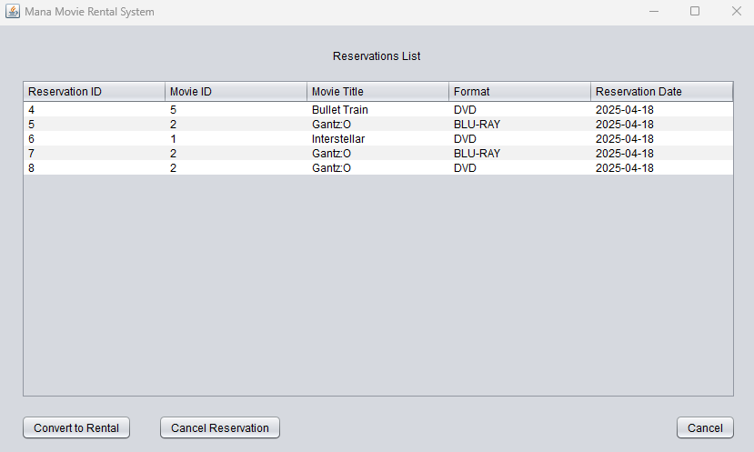
Canceled reservation will no longer be displayed in the Reservations List

Slide 52
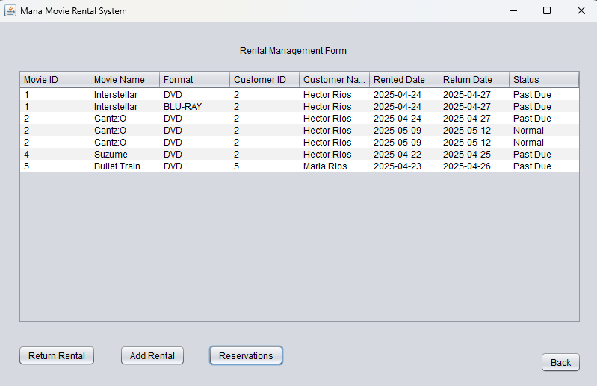
Returning a Rental
An Admin can process a movie rental return for a customer by following these steps:
Click on the Rentals button
System will display Rental Management Form

Slide 53

Fill out the requested information
Movie ID
Customer ID

Slide 54

If the information entered is correct and matches data in the system
System will display the rental return confirmation screen with rental details
Click on the Confirm Return button

Slide 55

System will notify that the movie rental return has been processed for the movie and customer selected

Slide 56

Returned rental will no longer be displayed on the Rental Management Form

